Slide 1
Optimal Food Truck Location
Michael Brewer

Slide 2
Introduction
Whitefish is one of the most active tourist towns in Montana
Food truck businesses are undoubtedly popular
Which location will attract the maximum amount of hungry tourists and consumers, thus resulting in maximum profit?
For obvious reasons, this is valuable information to any food truck owner

Slide 3
Data
We utilize Foursquare location data to determine the coordinates of the highest rated food services in Whitefish MT
Logic: the ideal location for a food truck is near other food venues that customers typically like to go when they are hungry
Venue name, category, and coordinate data obtained from Foursquare in JSON format
Removed any venues categories unrelated to food

Slide 4
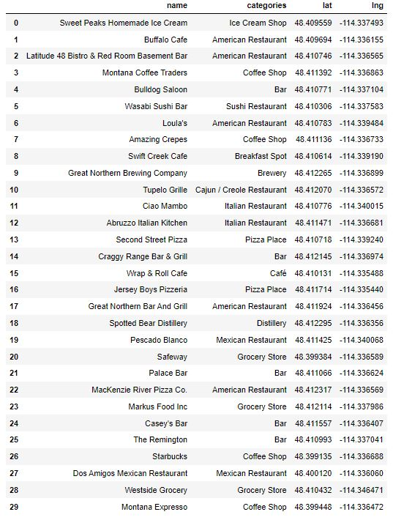

Slide 5
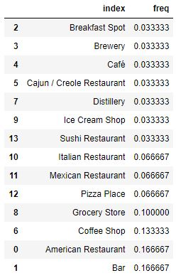
Analysis
One-hot encoding utilized to determine frequency of each venue category in descending order
Average point among collection of coordinates calculated

Slide 6
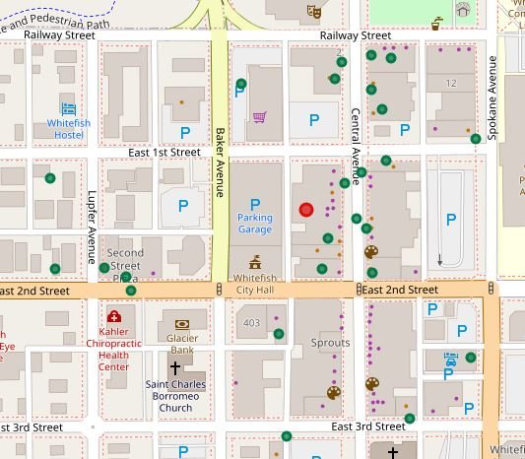
Modeling
The venue coordinates (green) and optimal point (red) were mapped accordingly using Folium

Slide 7
Conclusion
Thus, we have determined our optimal food truck location to be around the coordinate (48.41119933, -114.33727951)
More generally, somewhere on the block bounded by East 1st Street, East 2nd Street, Central Avenue, and Baker Avenue
This analysis carries too many assumptions and limitations to be used to make this type of business decision
Nonetheless, this exercise was useful in practicing and demonstrating the concepts taught in this course

