Slide 1

“ revamp expectations ”
brewnok@gmail.com

Slide 2

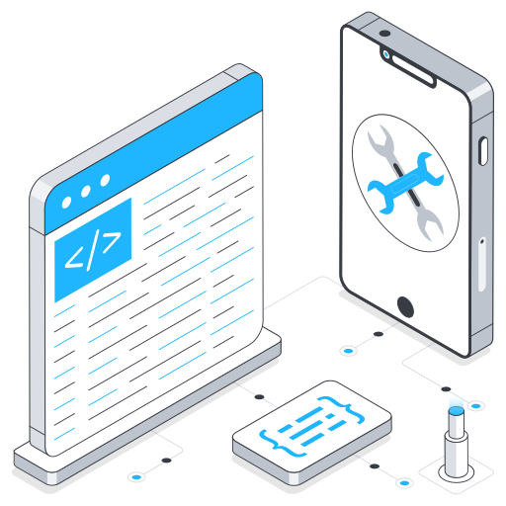
Our Services
Technical Services
Software Development: Custom software solutions tailored to your business needs.
Automation Tool Development: Creation of automated tools to streamline processes and increase efficiency.
Consultation for Software Development: Expert advice and strategy for software development projects.
QA Engineering / Load Testing / Performance Testing: Ensuring the quality, scalability, and performance of your applications.
Performance Engineering Consultation: Optimizing software and infrastructure for better performance and reliability.
Observability / Monitoring Solution Development: Building monitoring systems to track and improve application and system performance.
Observability / Monitoring Consultation: Expert guidance on implementing monitoring and observability frameworks for better insights and system health.
Tech Maintenance: Ongoing support and maintenance to ensure your systems run smoothly and securely.

Slide 3


Our Services
Non-Technical Services
Marketing / Branding Solutions: Comprehensive strategies for building your brand presence through design / marketing consultation and reaching your target audience.
Business Campaign Consultation: Tailored consultation for running impactful and results-driven business campaigns.

Slide 4
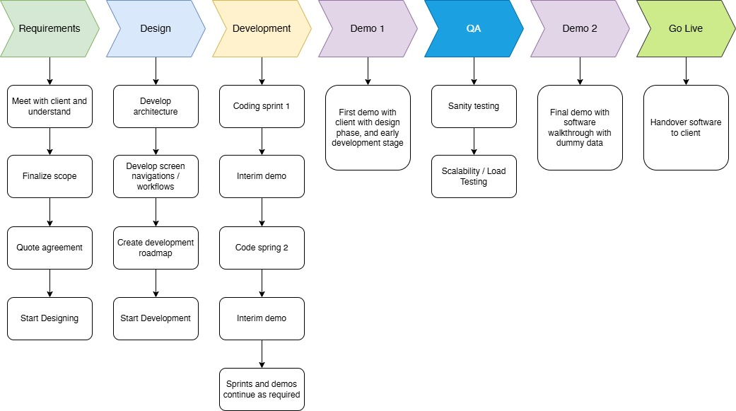
Technical Services Roadmap

Slide 5
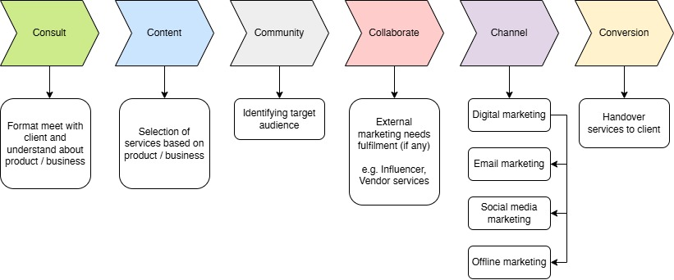
Non-Technical Services Roadmap

Slide 6
Thank you!

