Slide 1
12:00
bre:zi
Brewed for your biology.
Venture Capital Pitch Deck · Confidential · 2026
brezicoffee.com · jackson@brezi.com

Slide 2
01
THE VISION
We Are Not Building a Coffee Machine.
We are building the operating system for the human morning — starting with the one ritual no one has optimized yet.
Cold brew is the entry point. The protocol is the product. The data is the moat.

Slide 3
THE PROBLEM
Everything Is Optimized. Except the First Thing They Consume.
📱 Sleep tracked by Oura. Recovery scored by WHOOP. Training logged by Garmin.
🧊 Cold plunges adopted. Morning light protocols running. Zone 2 scheduled.
☕ Yet coffee — the most repeated morning ritual — is made with tools designed for convenience, not protocol.
❌ No product connects cold exposure + morning consumption + biometric feedback in a single loop.
📊 Cold plunge market: $330M → $660M by 2033 (8.1% CAGR). 538M wearables shipped in 2024. Nobody owns the intersection.

Slide 4
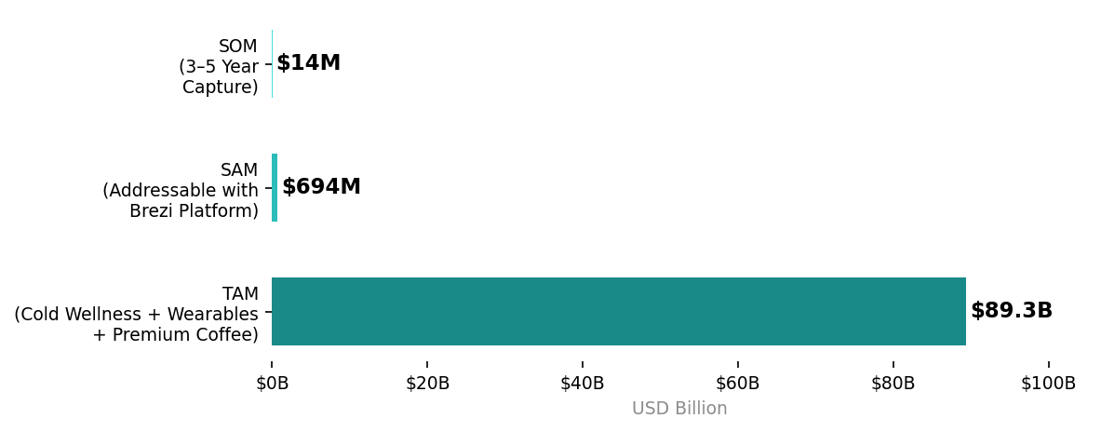
MARKET OPPORTUNITY
Three $B+ Markets Converging. Brezi Owns the Intersection.
KEY SIGNALS
$87B
Wearables market 2025
$660M
Cold wellness hardware 2033
$40.5B
Coffee pod/consumables 2024
32%
Wearable owners have an attached subscription
92%
Would pay more for health features

Slide 5
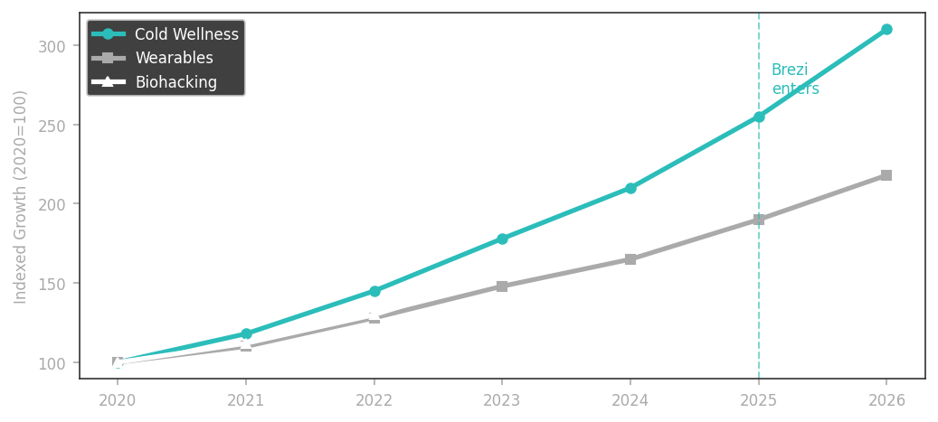
02
WHY NOW
Three Trends. One Convergence Point.
INFLECTION SIGNALS
Cold wellness crossing from sport into daily home practice
Wearable subscriptions normalized — 32% attach rate (Parks Assoc.)
Biohacking cultural mainstream: Huberman Lab 1M+ newsletter subs
"The Ice Bath Club" (SG/HK) already bundles coffee + cold therapy
API access to Oura, WHOOP, Apple Health now mature and open

Slide 6
THE SOLUTION
Introducing bre:zi
The Cold Protocol Platform
READS
BREWS
LEARNS
Your biometric state. HRV, sleep score, recovery index — before every brew.
PrecisionBrew™. 12 minutes. Cold. Formula-matched to your biology today.
Every session logged. Every outcome tracked. The longer you use it, the smarter it gets.

Slide 7
THE PRODUCT
PrecisionBrew™ — The 12-Minute Protocol
🧊 Thermoelectric cold extraction — no ice, no heat. Brews at controlled cold temperature.
⏱ 12 minutes from cold water to perfect cold brew concentrate. The ritual window.
12:00
💧 67% less acidic than hot coffee — medically relevant, not just a feature.
📡 NFC cartridge system: every Protocol Pack is formula-validated and data-encoded ($0.08/unit COGS).
THE BREW WINDOW
📱 Companion app: morning state check-in → brew profile recommendation → 2h outcome log.
One slow revolution. One cold-blue indicator light. Your 12 minutes.
💰 Hardware $388–$399 | Protocol Packs $20–35/month subscription

Slide 8
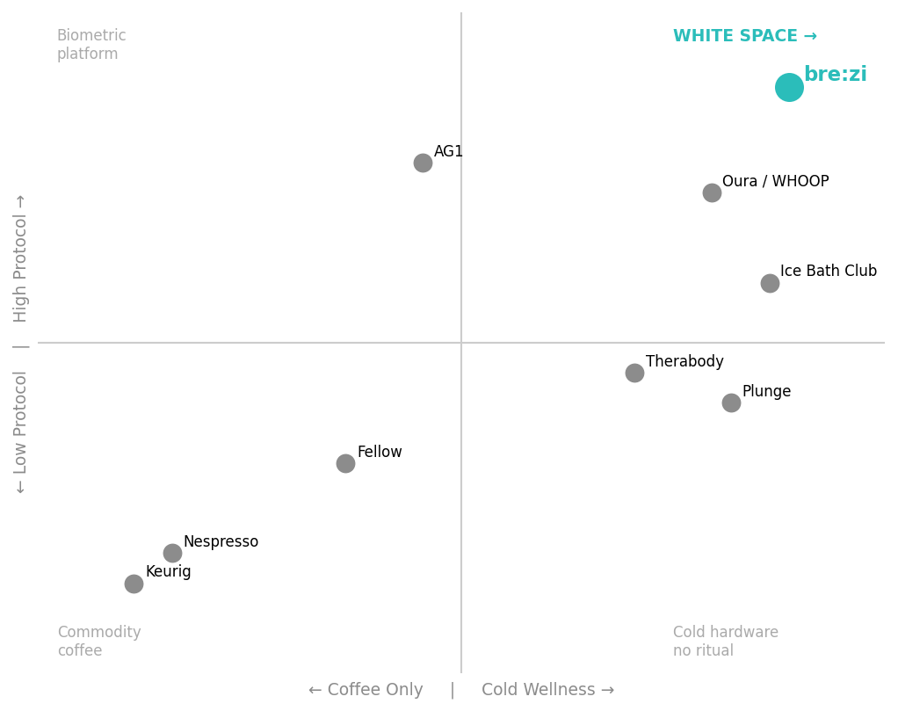
COMPETITIVE LANDSCAPE
Everyone Is a Tool OR a Brand. Nobody Is Both.
WHY BREZI WINS
• Cold plunges: own the cold exposure — no daily consumption ritual, no data loop
• Nespresso: owns the pod system — zero protocol/wellness framing
• Oura / WHOOP: own the biometric data — no ingestible system
• AG1: owns functional nutrition — consumable only, no hardware anchor
• bre:zi: ✓ Closes all three loops in one morning ritual object

Slide 9
03
BUSINESS MODEL
Hardware Opens the Door. Protocol Packs Own the Room.
HARDWARE
PROTOCOL PACKS
B2B / SPACES
PLATFORM
$388–$399
$20–35/mo
Custom
TBD
PrecisionBrew™ unit sale. Target GM: 35–45%
Cartridge subscription. Target GM: 60%+ (Peloton benchmark: 69.1%)
Hotels, gyms, corporate wellness. Revenue from Month 18+
Data insights tier, research partnerships, BreziIntel premium

Slide 10
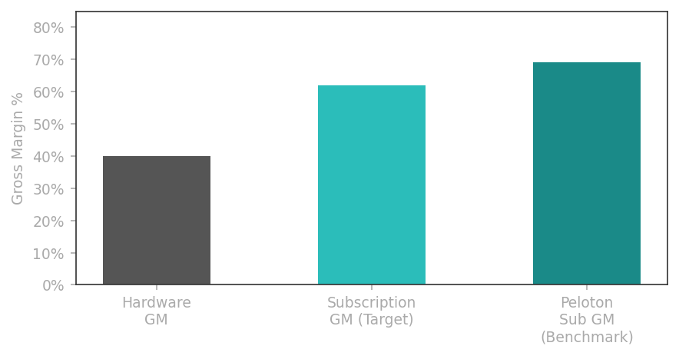
UNIT ECONOMICS
The Subscription Is the Business.
BENCHMARKS
Keurig pods
80.5% of US Coffee net sales ($3.2B of $4B)
Peloton sub GM
69.1% — hardware GM only ~13%
Eight Sleep
100% attach — subscription required yr 1
Peloton churn
1.6%/mo → 82% 12-month retention
Target attach
40% conservative | 60% strong case
Protocol Pack
$25/month → $100K MRR at 4,000 subs

Slide 11
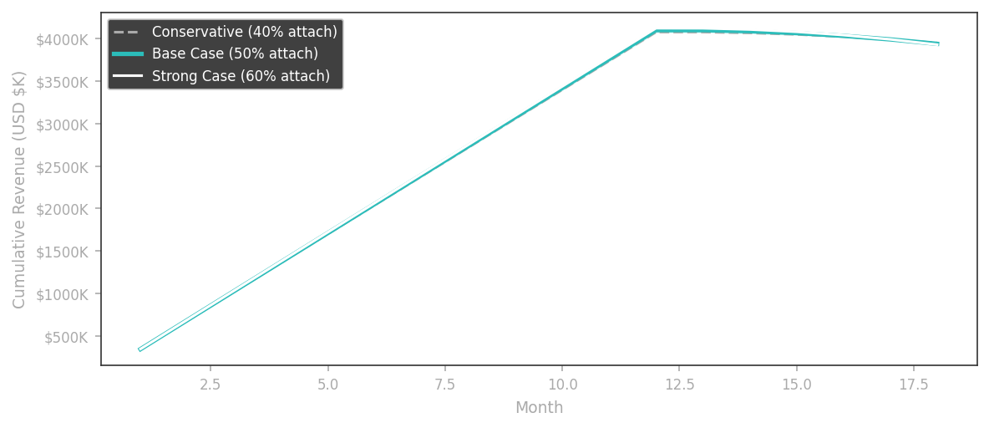
REVENUE PROJECTIONS
18-Month Model — 10,000 Units
BASE CASE (50% attach)
$388–399
Hardware ASP
$25/mo
Protocol Pack price
50%
Subscription attach rate
$5.4M
Total 18-month revenue
$99K
MRR at Month 18
1.6%/mo
Target monthly churn
$399
LTV per sub @ 3yr tenure

Slide 12
GO-TO-MARKET
03
Seed 500 Right People. Let Them Pull the Brand Forward.
PHASE 1 Days 1–30 ~$40K HKD
PHASE 2 Days 31–60 ~$120K HKD
PHASE 3 Days 61–90 ~$80K HKD
• University research partnership announced • 15–20 Protocol Practitioners seeded (coaches, sports med, Hyrox) • "The Cold Protocol" newsletter launched • Waitlist page + 90-sec hero film
• Invite-only pop-up, Sai Ying Pun HK (200 spots) • Cold exposure station + live PrecisionBrew demo • Hero film "Start Cold" debut • Podcast ad buy — Huberman-adjacent APAC shows
• 30-day Baseline Protocol — structured cold+brew program • First 500 units at $388 USD • Protocol Pack subscription as post-purchase upsell • Referral mechanic → turn 500 into distribution network
Total budget: ~$240K HKD (~$30K USD) | KPIs: 2,000 waitlist · 500 paying customers · 40% Protocol Pack attach

Slide 13
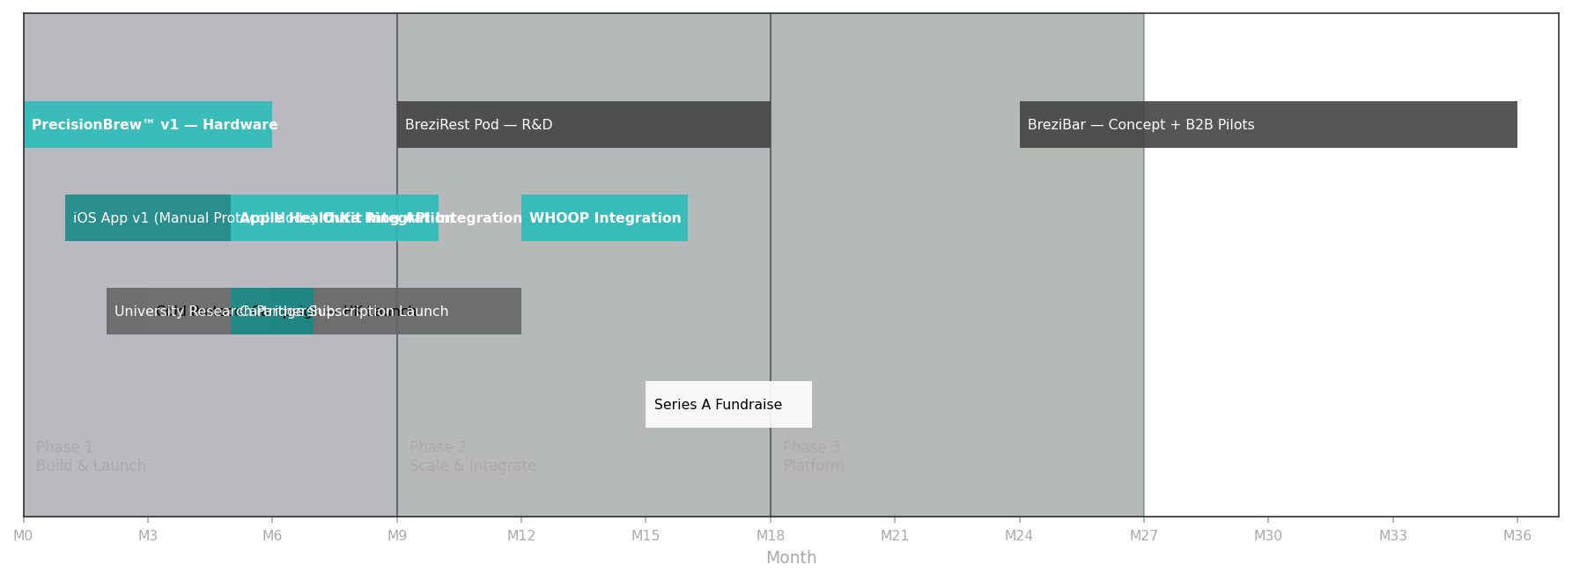
03
PRODUCT ROADMAP
0 → 36 Months: Device → Platform → OS

Slide 14
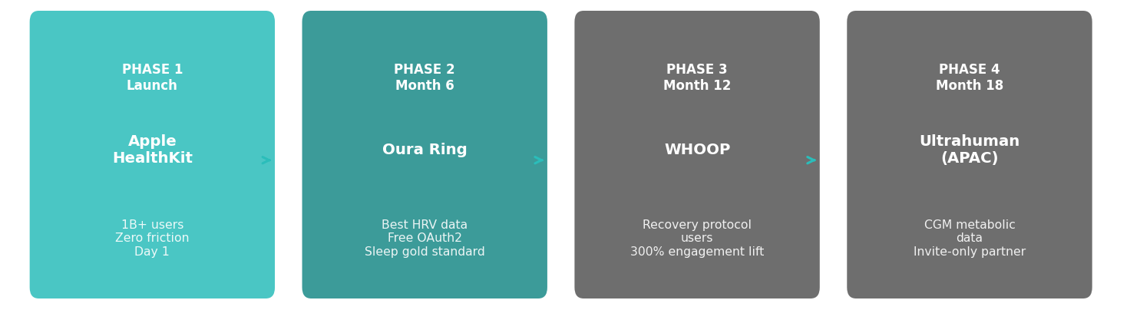
WEARABLE INTEGRATIONS
Every Device You Already Trust. Now Connected to Your Morning.
Cronometer × WHOOP integration drove 300% increase in user engagement Strava × Apple Watch integration drove 20% YoY upload increase

Slide 15
THE DATA MOAT
The Dataset That Cannot Be Reverse-Engineered.
Unique triple
Biometric state × brew parameters × 2h performance outcome — nobody else has all three
3.65M
NFC cartridge lock
Clones can copy the machine. They cannot copy the data layer.
On-device ML
labeled biometric-brew-outcome events per year at 10,000 users
Your health data never leaves your device without consent. Privacy-first by architecture.
University research
HKUST/HKU partnership → peer-reviewed publications → scientific credibility moat
Patent portfolio
Two filings: thermal profiling algorithm + biometric-to-thermal mapping method

Slide 16
WHY US
04
We Are the Customer. That Is the Unfair Advantage.
🎓 Jackson (Founder) — UC Berkeley. Product-first thinking. The original Protocol Optimizer.
📍 Hong Kong base: Asia's most concentrated high-performance urban cohort. Our test market is our backyard.
🏭 Engineering team from semiconductor + consumer electronics (DJI/Sony tier) — precision hardware is our DNA.
🤝 Graves Ho (Co-Founder): deep HK market relationships, manufacturing network, operations.
🏃 Every team member is an active sports and wellness practitioner. We test on ourselves before shipping to anyone.
💡 Semiconductor background = advantage in miniaturized thermoelectric design most consumer brands can't match.
🔬 University research partnership (HKUST/HKU Medicine) in active discussions — credibility from day one.
📊 Phase 1 research done: 7 interviews + 181 backer surveys. We know our customer. We have their data.

Slide 17
TRACTION & VALIDATION
Not a Concept. A Validated Product with Early Signal.
✅ Kickstarter campaign successfully funded — proof of market demand
✅ Live Shopify store (brezicoffee.com) + Taobao presence in China market
✅ Phase 1 customer research complete: 7 in-depth interviews + 181 backer surveys
✅ iOS technical spec complete. UX copy brief complete. App in development.
✅ Roaster partnerships live: Regent Coffee + Stitch Coffee on brezicoffee.com
✅ Hardware: Thermoelectric cooling IP validated. PrecisionBrew™ tech proven.
✅ Team assembled: founder + semiconductor engineers + operations
🔄 University research partnership: in active discussions (HKUST / HKU Medicine)

Slide 18
04
THE ASK
Join the Protocol.
CAPITAL
TALENT
[RAISE AMOUNT]
Roles Open Now
· Senior thermal systems hardware engineer
at [VALUATION] pre-money
· iOS engineer (React Native + HealthKit)
· Complete precision production batch (10,000 units)
· iOS app + platform dev (3-month sprint)
· Product designer — industrial + UX
· Cold Protocol Campaign — HK/SG launch
· Head of community (HK/SG Protocol network)
· University research partnership + IP filings
· Research coordinator — university partnership
· BreziRest Pod R&D initiation

Slide 19
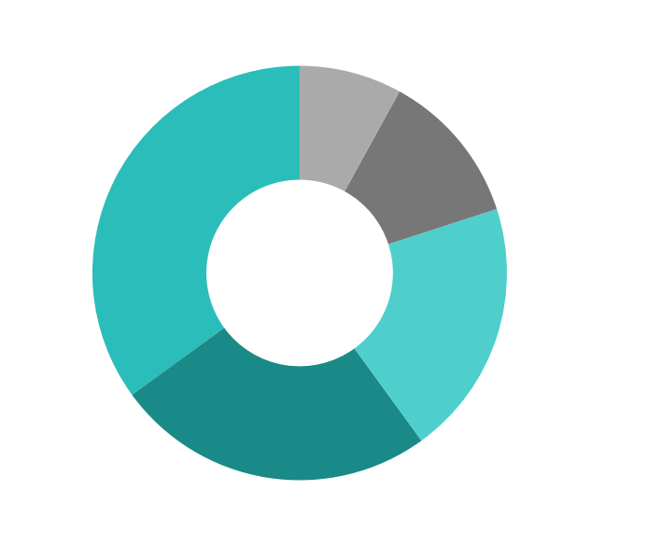
USE OF FUNDS
Every Dollar Has a Job.
ALLOCATION RATIONALE
35% Hardware Production
First 10,000-unit precision batch. NFC cartridge tooling.
25% App & Platform Dev
3-month iOS sprint + backend data infrastructure + Apple Health integration.
20% GTM & Brand
90-day Cold Protocol Campaign. Pop-up. Hero film. Podcast media.
12% R&D & Patents
Two patent filings. BreziRest Pod early R&D. University research seed funding.
8% Operations & Team
Hiring critical roles. Legal. Corporate structure in HK.

Slide 20
bre:zi
Brewed for your biology.
brezicoffee.com
jackson@brezi.com · Hong Kong

