Slide 1
12:00 · SAI YING PUN · HONG KONG · 2026
bre:zi
Brewed for your biology.
Venture Capital Pitch Deck · Confidential · 2026
brezicoffee.com · jackson@brezi.com · Hong Kong

Slide 2
01
THE VISION
We Are Not Building a Coffee Machine.
We are building the operating system for the human morning — starting with the one ritual that no one has ever optimized.
"Think Apple HomeKit for wellness — but instead of controlling your lights, it controls your biology."
Cold brew is the entry point. The protocol is the product. The data is the moat.

Slide 3
THE PROBLEM
Everything Is Optimized. Except the First Thing You Consume.
📱 Sleep tracked by Oura. Recovery scored by WHOOP. Zone 2 logged by Garmin.
🧊 Cold plunges adopted. Morning light protocols set. Supplements sorted.
☕ Yet coffee — the most-repeated morning ritual — is made with tools designed for convenience, not protocol.
❌ No product closes the loop: cold exposure + morning consumption + biometric feedback in one system.
💡 Cold wellness is a $330M → $660M hardware market. 538M wearables shipped in 2024. The intersection is empty.

Slide 4
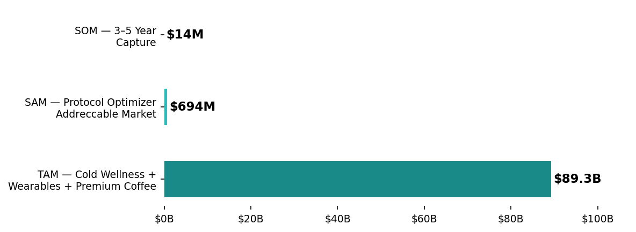
MARKET OPPORTUNITY
Three $B+ Markets Converging. Brezi Owns the Intersection.
KEY SIGNALS
$87B
Wearables market 2025
$660M
Cold wellness hardware 2033
$40.5B
Coffee consumables 2024
32%
Wearable owners with attached subscription
92%
Would pay more for health-related features

Slide 5
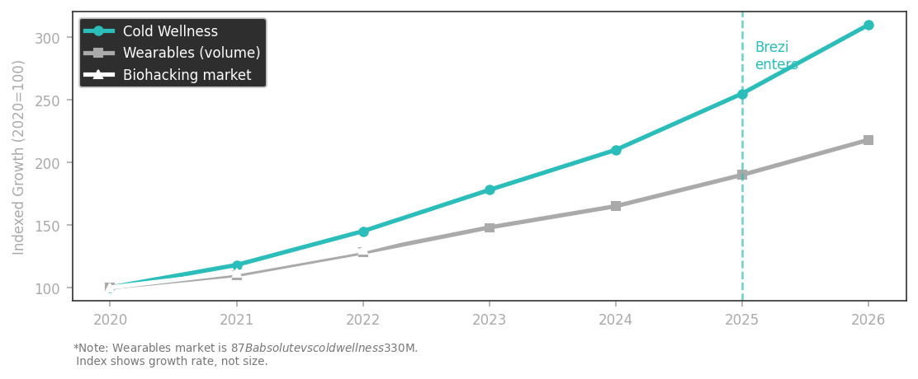
01
WHY NOW
Three Trends. One Convergence Point.
CONVERGENCE SIGNALS
Cold wellness crossing from sport → daily home practice (81% commercial, 19% residential → flipping)
Wearable subscriptions normalized — 32% attach rate, 92% pay more for health features
Biohacking mainstream: Huberman Lab 1M+ newsletter · Attia 100M+ podcast downloads
"The Ice Bath Club" (SG/HK) already bundles coffee + cold therapy — the pairing is emergent
Matter protocol + Thread mesh = platform-ready IoT infrastructure available today

Slide 6
THE SOLUTION
Introducing Brezi OS
The Connected Wellness Platform for the Protocol Optimizer
SENSE
ANALYZE
ACTUATE
LEARN
Wearables feed biometric state into Brezi OS via OAuth — HRV, sleep, recovery, glucose.
BreziIntel determines what your body needs today and when. Zero guesswork.
The right Brezi device triggers at the right time. Cold brew at 9am. Smoothie at 1pm. Recovery at 7pm.
Every behavior is logged. Day-over-day comparison. The system compounds over time.

Slide 7
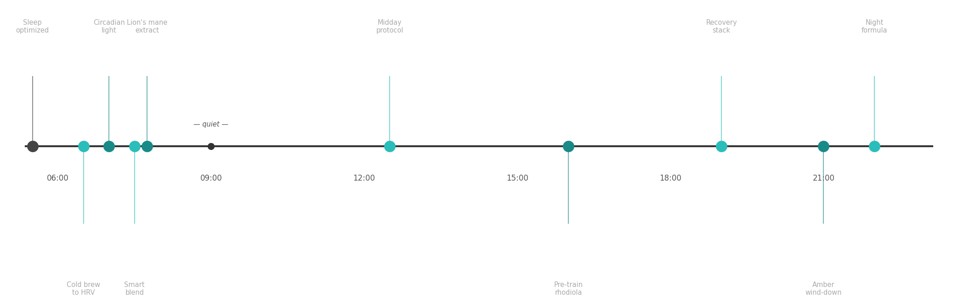
THE PLATFORM VISION
One Platform. Every Moment That Matters.
"Brezi doesn't interrupt your day. It runs underneath it."

Slide 8
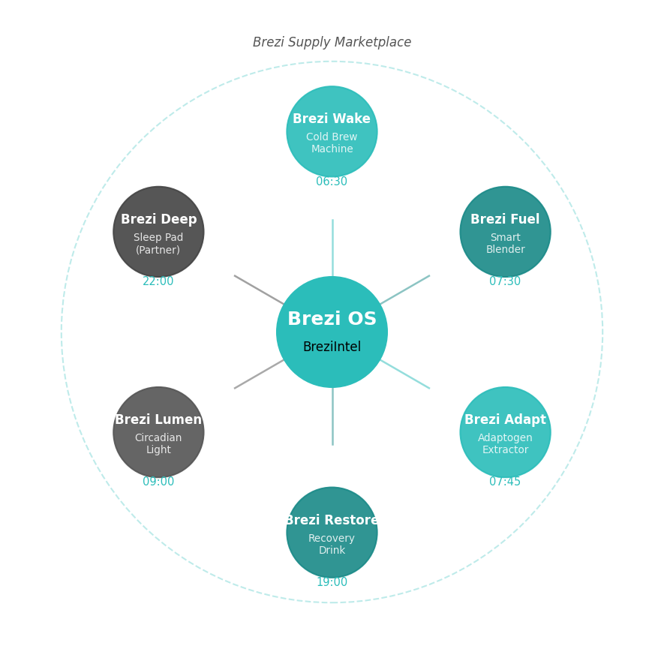
02
THE PRODUCT ECOSYSTEM
Six Products. One Platform. One Data Loop.
PRODUCT LINE
Brezi Wake
NOW
Cold brew machine — the daily ritual anchor
Brezi Adapt
18MO
Adaptogen/nootropic cold extractor
Brezi Restore
18MO
Recovery drink dispenser
Brezi Fuel
18MO
Smart cold nutrition blender
Brezi Lumen
6MO
Circadian light (software-first, Philips Hue API)
Brezi Deep
36MO
Sleep pad (partner Eight Sleep; own hardware later)
Brezi Supply
NOW
Marketplace — Brezi Certified ingredients & supplements

Slide 9
HERO PRODUCT
Brezi Wake — The 12-Minute Protocol
🧊 Thermoelectric cold extraction — no ice, no heat, no compromise. Brews at precisely controlled cold temperature.
12:00
⏱ 12 minutes from cold water to concentrate. Long enough to build habit. Short enough to fit any morning.
💧 67% less acidic than hot coffee — measurably better for your gut, cortisol response, and HRV stability.
📡 NFC cartridge system: every Brezi Certified Protocol Pack is formula-validated and data-encoded ($0.08/unit).
THE BREW WINDOW
One revolution. One cold-blue light. Your 12 minutes.
🔵 One cold-blue indicator light makes one slow revolution. No notifications. Just the light. Moving.
💰 Hardware $388–$399 | Protocol Packs $20–35/month | Brezi Supply auto-reorder

Slide 10
TECHNOLOGY — BREZI OS
Every Brew Is a Data Event. Every Event Makes the Next Brew Smarter.
LAYER 1 DEVICE
Brezi Wake, Adapt, Restore, Fuel — all on Matter/Thread mesh. Each device captures: formula NFC, extraction curve, timestamp.
LAYER 2 HEALTH GRAPH
Brezi ingests biometric context from wearables (HRV, sleep, recovery, glucose). Links each device event to your biological state.
LAYER 3 BREZINTEL
On-device + cloud ML surfaces adaptive actuation. "HRV down 18% — trigger Brezi Wake Recovery Protocol at 07:15."
LAYER 4 BREZI SUPPLY
Marketplace auto-replenishment. Brezi Certified partners. 15–30% take rate. 70%+ GM on consumables.

Slide 11
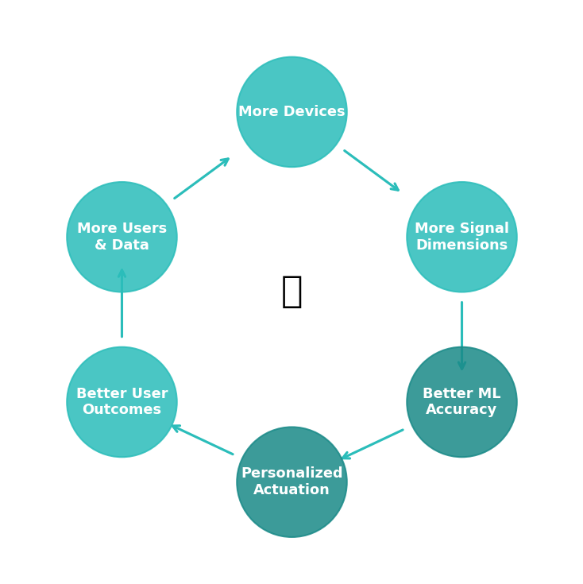
THE DATA MOAT
The Dataset That Cannot Be Reverse-Engineered.
THE TRIPLE LOCK
Unique dataset
Biometric state × brew params × 2h outcomes. No wearable, no coffee brand, no pharma has all three.
NFC cartridge auth
Clones copy the machine. They cannot copy the data layer.
On-device ML
Your health data never leaves your device without consent. Privacy-first architecture.
University research
HKUST/HKU partnership → peer-reviewed publications. Scientific credibility no competitor can buy.
Patent portfolio
Two filings: thermal profiling + biometric-to-thermal mapping.

Slide 12
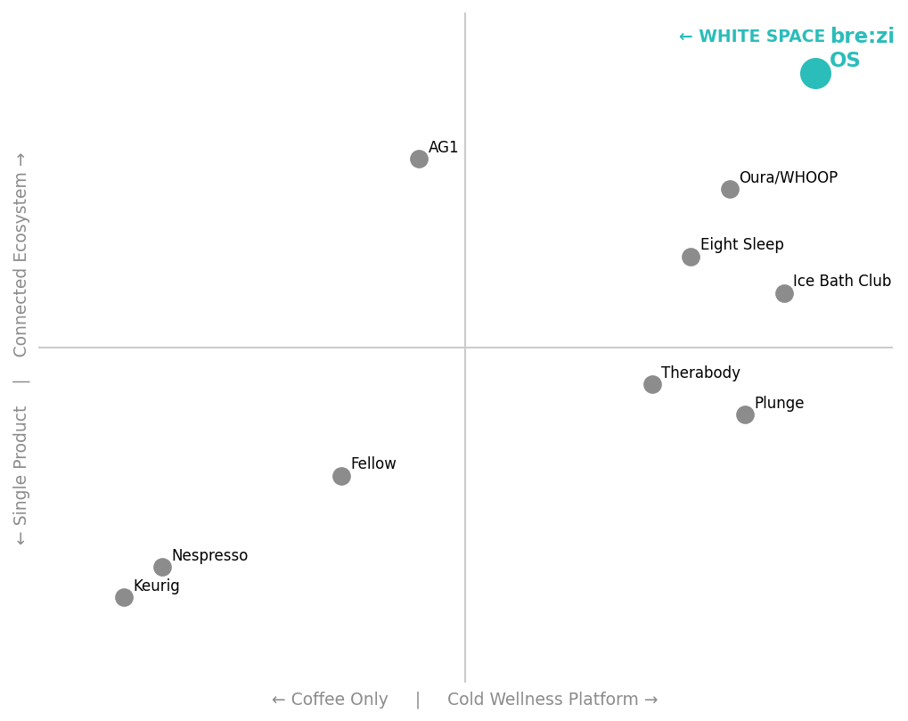
COMPETITIVE LANDSCAPE
Everyone Is a Tool OR a Brand. Nobody Is Both.
THE BREZI ADVANTAGE
• Plunge / Ice Barrel: Cold hardware. No daily consumption. No data loop.
• Oura / WHOOP: Track your biology. Don't act on it.
• Nespresso / Fellow: Premium coffee. Zero wellness framing.
• AG1 / Momentous: Protocol nutrition. No hardware anchor.
• Eight Sleep: Sleep temperature. One device, one use case.
• bre:zi ✓: Closes all loops. Hardware + platform + data + marketplace.

Slide 13
03
BUSINESS MODEL
Four Revenue Streams. All Compounding.
HARDWARE
PROTOCOL PACKS
BREZI SUPPLY
B2B + SPACES
$388–$399
$20–35/mo
15–30% take rate
Custom
Device sales. Target GM: 40–45%
Cartridge subscription. Nespresso model. Target GM: 63%+
Certified marketplace. Momentous, LMNT, Thesis Nootropics
Hotels, gyms, corporate wellness. From Month 18

Slide 14
BREZI SUPPLY — MARKETPLACE
Brezi Certified: The Nespresso Model for Premium Wellness.
Partners formulate for the Brezi platform. Cold-extraction optimized. Biometric protocol matched. "Brezi Certified" = the MFi for wellness consumables.
Momentous
LMNT
Thesis Nootropics
Day 1
Day 1
Day 1
Leading performance supps. Protocol Optimizer's brand.
Electrolytes. Massive following in exact target demographic.
Personalized stacks map to Brezi OS learning loop.
Beam Dream
Brezi Daily
Brezi Night
6MO
Own SKU
Own SKU
Sleep supplement brand. Evening protocol slot.
Morning blend. The AG1 moment.
Magnesium + L-theanine. Night formula anchor.

Slide 15
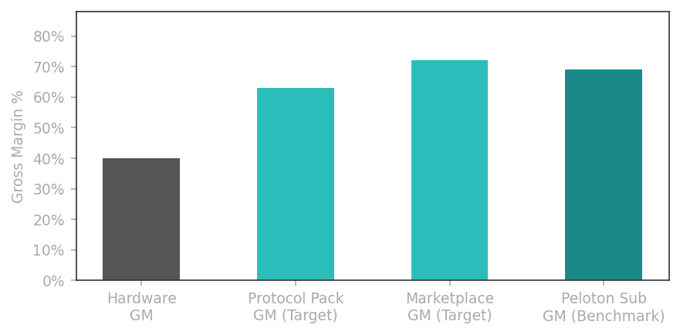
UNIT ECONOMICS
Hardware Opens the Door. Protocol Packs Own the Room.
BENCHMARKS
Keurig pods
80.5% of US Coffee net sales ($3.2B of $4B) — consumables ARE the business
Peloton sub GM
69.1% vs hardware GM ~13% — the margin wedge that changes the P&L
Eight Sleep
100% subscription attach year 1 — forced attach, high expectations
Target attach
40% conservative · 60% strong case at launch
Brezi target GM
Protocol Packs: 63%+ · Marketplace: 72%+
18-month MRR
$99K base case (10K units, 50% attach, $25/mo)

Slide 16
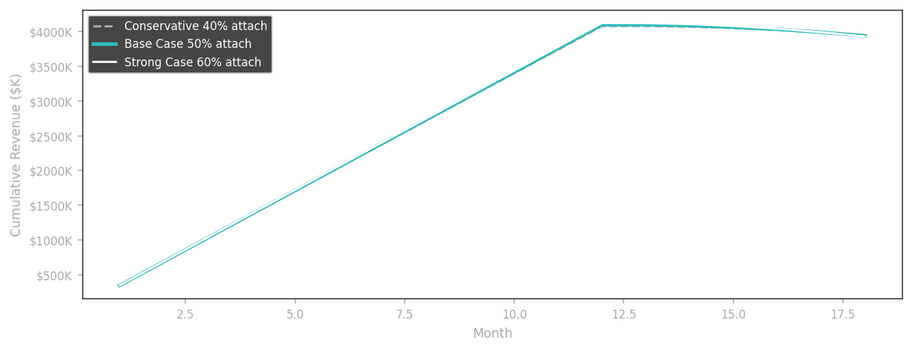
REVENUE PROJECTIONS
18-Month Model — 10,000 Units
BASE CASE (50% attach)
$388–$399
Hardware ASP
$25/mo
Protocol Pack price
50%
Subscription attach
$5.4M
Total 18-mo revenue
$99K
MRR at Month 18
1.6%/mo
Target monthly churn
82%
12-month retention (Peloton benchmark)

Slide 17
GO-TO-MARKET
03
Seed 500 Right People in Sai Ying Pun. Let Them Pull the Brand Forward.
PHASE 1 Days 1–30 ~$40K HKD
PHASE 2 Days 31–60 ~$120K HKD
PHASE 3 Days 61–90 ~$80K HKD
• Announce university research partnership • 15–20 Protocol Practitioners seeded (coaches, sports med, Hyrox, CrossFit) • "The Cold Protocol" newsletter — Day 1 • Waitlist page + 90-sec hero film
• Invite-only pop-up, Sai Ying Pun HK (200 spots — stone floors, no florals) • Live Brezi Wake demo + cold plunge station • Hero film "Start Cold" debut • Huberman-adjacent podcast ad buy
• 30-day Baseline Protocol (not a "challenge") • First 500 units at $388 USD • Protocol Packs as post-purchase upsell • Referral network → 500 becomes 2,000
Total: ~$240K HKD (~$30K USD) · KPIs: 2,000 waitlist · 500 paying · 40% Protocol Pack attach

Slide 18
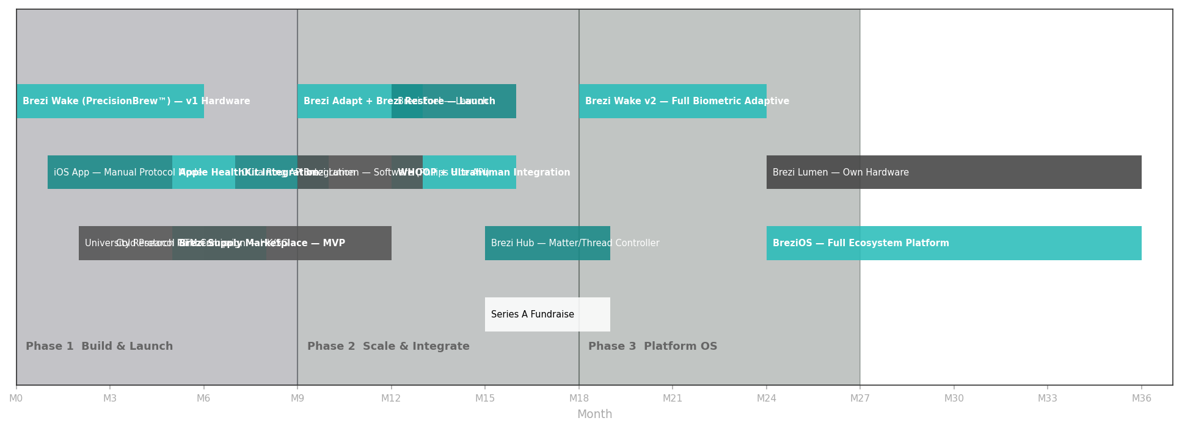
03
PRODUCT ROADMAP
0 → 36 Months: Device → Platform → OS

Slide 19
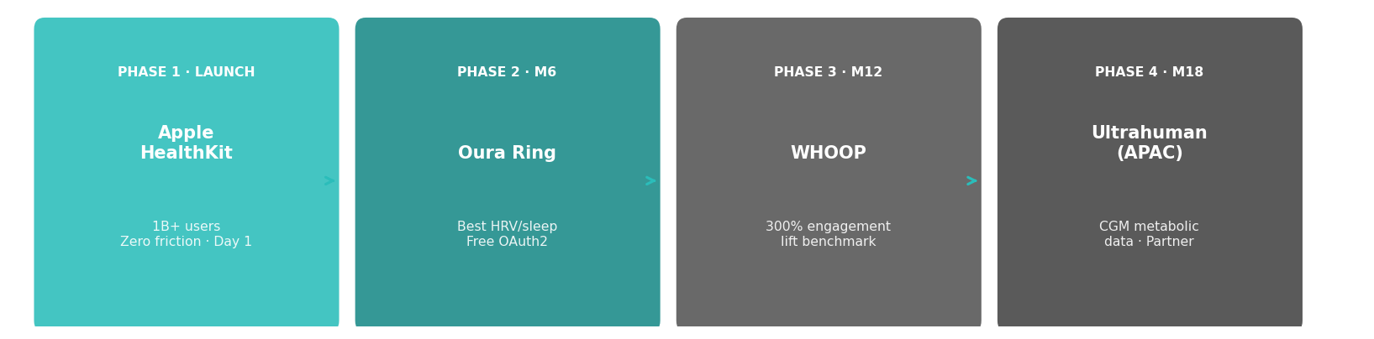
WEARABLE INTEGRATIONS
Every Device You Already Trust. Now Connected to Your Morning.
Cronometer × WHOOP: 300% engagement lift · Strava × Apple Watch: 20% YoY upload increase

Slide 20
WHY US
04
We Are the Customer. That Is the Unfair Advantage.
🎓 Jackson (Founder) — UC Berkeley. First Protocol Optimizer on the cap table.
📍 Hong Kong base: Asia's densest high-performance urban cohort. Our test market is our backyard.
🏭 Engineering team from semiconductor + consumer electronics (DJI/Sony tier). Thermal precision hardware is our DNA.
🤝 Graves Ho (Co-Founder): HK market depth, manufacturing network, operations.
🏃 Every team member is an active sports and wellness practitioner. We ship what we test on ourselves.
💡 Semiconductor background = miniaturized thermoelectric design advantage that consumer brands cannot easily replicate.
🔬 University research partnership — HKUST/HKU Medicine — in active discussions.
📊 Phase 1 research complete: 7 interviews + 181 backer surveys. We know our customer. We have their data.

Slide 21
TRACTION & VALIDATION
Not a Concept. A Validated Product with Early Signal.
✅ Kickstarter campaign successfully funded — proof of market demand for cold brew hardware
✅ Live Shopify store (brezicoffee.com) + Taobao presence — two-market distribution already live
✅ Phase 1 customer research complete: 7 in-depth interviews + 181 backer surveys
✅ iOS technical spec complete · UX copy brief complete · App in active development
✅ Roaster partnerships live: Regent Coffee + Stitch Coffee on platform
✅ Hardware: Thermoelectric cooling IP validated. PrecisionBrew™ technology proven.
✅ Full team assembled: founder + semiconductor engineers + operations
🔄 University research partnership: HKUST / HKU Medicine — in active discussions

Slide 22
04
THE ASK
Join the Protocol.
CAPITAL
TALENT — OPEN ROLES
[RAISE AMOUNT]
Building the Core Team Now
· Senior thermal systems hardware engineer
at [VALUATION] pre-money
· iOS engineer — React Native + HealthKit APIs
· Complete precision batch — 10,000 units
· iOS app + platform build (3-month sprint)
· Product designer — industrial + UX
· Cold Protocol GTM Campaign — HK + SG
· Head of Protocol Community — HK/SG
· University research partnership + 2 patent filings
· Research coordinator — university partnership
· BreziRest/Adapt R&D initiation
· Brezi Supply — marketplace partnerships lead
· Brezi Supply marketplace MVP

Slide 23
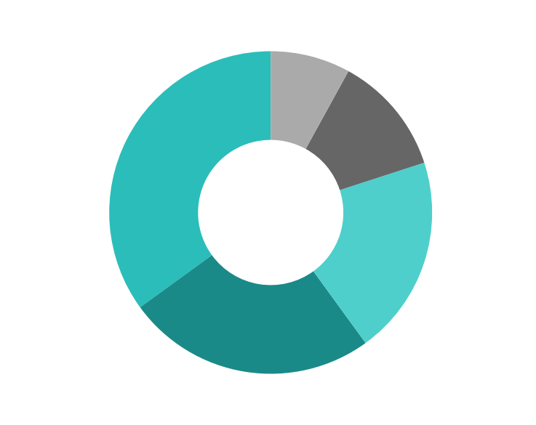
USE OF FUNDS
Every Dollar Has a Job.
ALLOCATION RATIONALE
35% Hardware Production
First 10,000-unit precision batch. NFC cartridge tooling. Quality assurance.
25% App & Platform Dev
3-month iOS sprint + backend data infrastructure + Apple HealthKit integration.
20% GTM & Brand
90-day Cold Protocol Campaign. SYP pop-up. Hero film. Podcast media buy.
12% R&D & Patents
Two patent filings. BreziRest/Adapt R&D. University research seed funding.
8% Operations & Team
Critical hires. Legal. Corporate structure. HK incorporation.

Slide 24
bre:zi
Brewed for your biology.
"The compound interest of your wellness routine."
brezicoffee.com · jackson@brezi.com · Hong Kong

