Slide 1
Expected Directory Structure
If SL.design.mumford=1;
D:\data\analysis\[SubjID]]\betas\*.img
SL.design.mumford_dir indicates the sub-directory to examine (e.g. betas)
SL.design.mumford_str indicates the type of files to look for (e.g. img)
If SL.design.mumford=0;
D:\data\analysis\[SubjID]\SPM.mat

Slide 2
RSA_find_betas.m
Master_RSA.m
RSA_output_maps.m
load_st_betas.m
RSA_shell_v2.m
SL_report.m
RSA_design_matrix.m
RSA_bootstrap.m
vect_sl_locations.m
RSA_model_Identity1_v2.m
searchlight.m
Other multivariate functions

Slide 3
Master_GT.m
GT_compute_measures_v2.m
GT_FSR_v2.m
GT_shell_v3.m
ROI_constructor.m
GT_compare_measures.m
GT_subnetwork.m

Slide 4
Condition
(1,1)
Condition
(1,2)
Condition
(2,1)
Condition
(2,2)

Slide 5
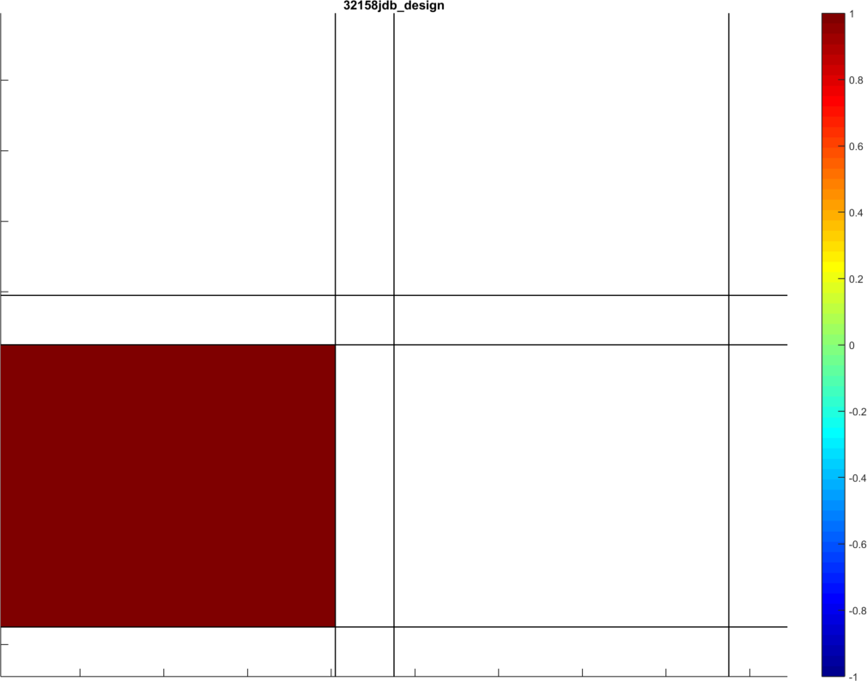
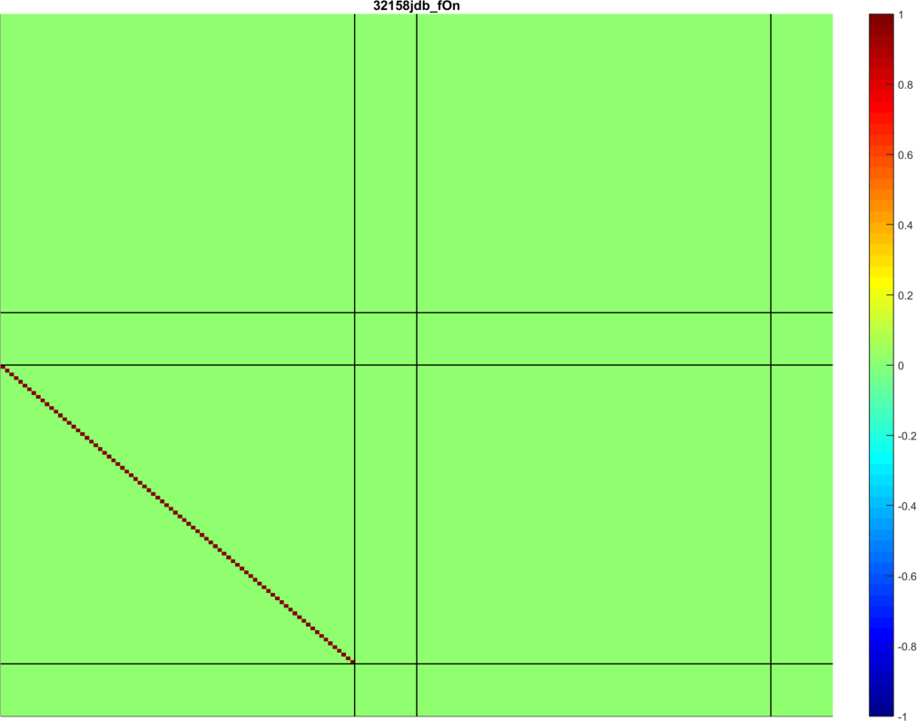
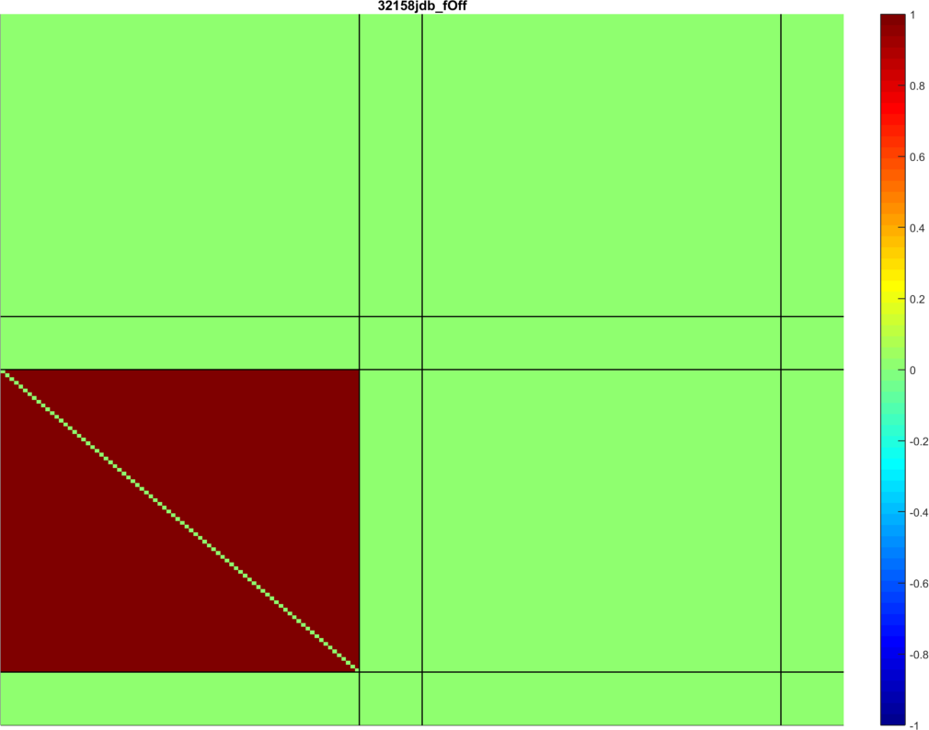

Slide 6
Master_Network_Maker_[x]
ROI_shell_v2.m

