Slide 1


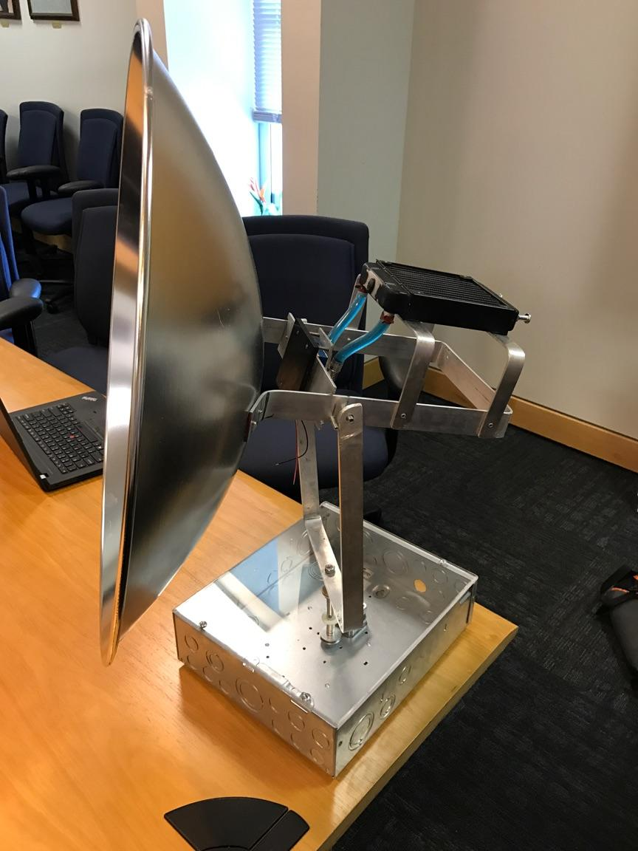
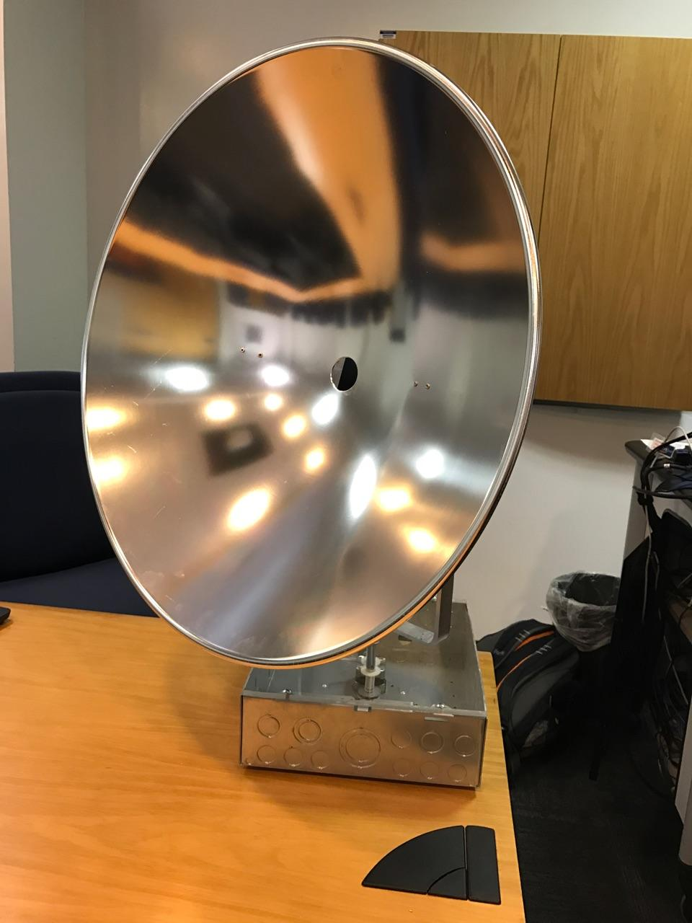
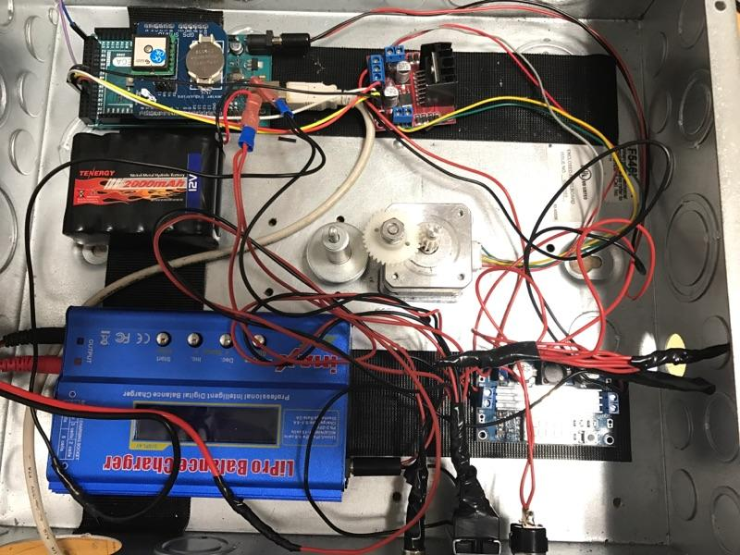
SOLAR THERMAL GENERATOR
The solar thermal generator addresses the needs of environmentally conscious persons who want a reliable , light-weight,
and green form of energy generation in remote locations.
Team Members: Ernest Crabtree, Jason Galla, Will Sidebottom, Dylan Lee, Shazeen Tariq, Benjamin Galivan.
Project Statement
Design overview
Hardware configuration
Needs Analysis:
A low cost and environmentally conscious means of power generation is required for use in remote areas.
Project Goals:
Develop a portable device that converts a wide spectrum of solar energy into useable electricity.
Design Components:
Parabolic dish.
Dish mount.
Thermo-electric generator.
Heatsink.
Radiator.
Boost converter regulates the TEG output to 12 Volts.
During charge cycle, 12 Volts is fed to the battery charger.
Battery charger limits the current to 0.5 Amps and trickle charges the NiMH battery cells.
NiMH cells feed to a 12 Volt USB output port.
Project objectives
Future improvements
Boost converter.
Arduino Mega.
Stepper motor and high torque DC motor.
Battery charger.
NiHM battery cells.
Project box and base.
Design Objectives:
Produce 20 Watts of power from the sun.
Store the generated energy in a battery pack.
Minimize the design to ensure portability.
Ensure the design is ergonomic and easy to operate.
Achieve minimal environmental impact.
Solar Collector Mount:
Current Design: Mount was handmade. Precision in solar tracking is somewhat affected by imperfections in the fittings and shaft.
Future Design: It would be beneficial to have a mechanical engineer implement the design in a modeling software such as Creo Parametric. This would allow the mount to be crafted from machined aluminum and the components fit together precisely.
Stepper Motor:
Current Design: No feedback from the stepper motor. Dish must be manually reset to the starting position when power is lost.
Future Design: Feedback from the stepper motor would allow the device to know the orientation of the dish at all times. When powered on the device would be able to automatically reset the dish to the start position.
Heat Dissipation:
Current Design: Attempted to use water cooling system and had to switch to a simple heatsink during redesign.
Future Design: Water cooling system would allow for greater heat dissipation. If a pump is used power consumption must be considered.
Design concept
Mechanical Design
Seebeck Principle:
The heart of the generator is a TEG (thermo-electric generator) that operates on the Seebeck principle of dissimilar metal junctions. In 1830 Seebeck found that a temperature gradient across the junction of two dissimilar metalloids in contact, would produce a voltage and current proportional to the thermal properties of the material (Seebeck Coefficient ‘S’) and the temperature difference in Kelvin.
For our design, the solar collector focuses heat from the sun on the “hot side” of the TEG and heat is dissipated from the “cold side” by means of a water cooling system. This process creates the temperature difference required to produce power.
Dish Mount:
For the purpose solar tracking, a mount allowing the parabolic solar collector to rotate about the horizontal and vertical axis was required. A yoke-style design, as shown in the previous section, was implemented using lightweight aluminum for portability.
Solar Tracking:
Rotation about the vertical axis is driven by a stepper motor. The motor is geared with a 3-to-1 ratio to the shaft.
Rotation about the horizontal axis is facilitated by a 5 Volt high torque DC motor and pulley system.

