Slide 1
Green Lights Forever Analyzing the Security of Traffic Infrastructure
Branden Ghena, William Beyer, Allen Hillaker, Jonathan Pevarnek, and J. Alex Halderman
8th USENIX Workshop on Offensive Technologies (WOOT’14) – August 19, 2014

Slide 2
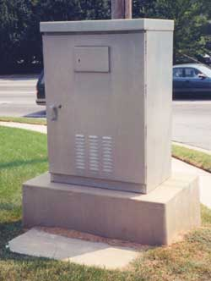
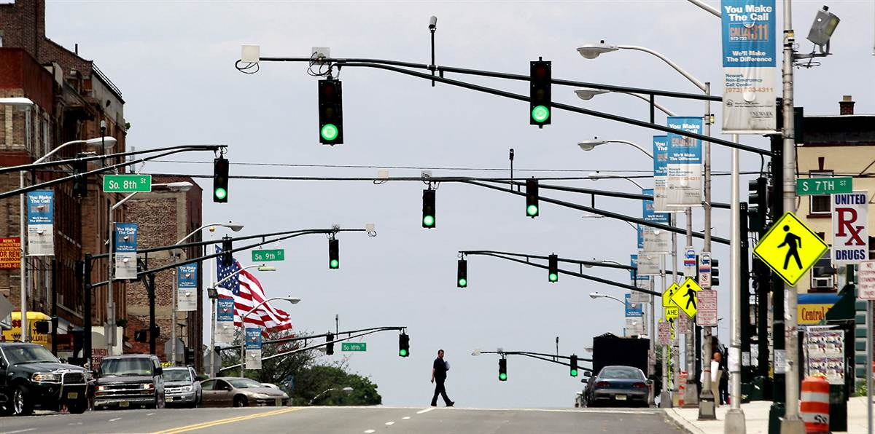
Motivating our investigation
Traffic Lights
Ubiquitous critical infrastructure
Notes:
We interact with traffic lights everyday. They are a piece of critical infrastructure that is so pervasive it’s almost invisible. Controller boxes exist at every intersection, but we never take note of them. Traffic lights have our implicit trust. A green light means that it is safe to continue. Devices that have such control over our everyday travels and safety ought to be secure from attacks. We decided to put this trust to the test.

Slide 3
High-level overview of our findings
We evaluated an existing anonymous traffic infrastructure deployment
We discovered numerous issues with the system
Both the road agency and vendors at fault
The real issue:
An absence of security consciousness in the field
Notes:
Working with an anonymous road agency, we evaluated the security of an existing deployment of traffic lights. We discovered several vulnerabilities which could allow an attacker to access the system and control the lights. The real problem isn’t any one weakness, but rather an absence of security consciousness throughout field.

Slide 4
Outline
Anatomy of a traffic intersection
Security evaluation
Recommendations
Notes:
From here, I’m going to start with a discussion of what hardware is used at traffic intersections and how it works. Then I’ll talk about our investigation, and finally I’ll give some recommendations for both traffic agencies and vendors.

Slide 5
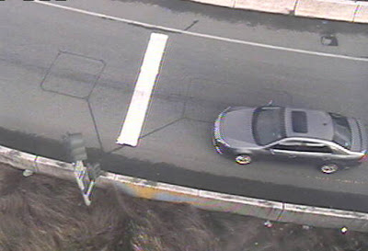
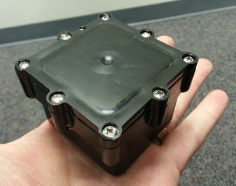
How vehicles are detected
> 80% of intersections detect vehicles
Inductive sensors
Wired and wireless
Video detection
Microwave, Radar, Ultrasonic, etc.
Notes:
The most common method of vehicles detection is inductive. These sensors are buried in the road and detect the metal bodies of vehicles as they pass above them. Wired sensors are common (as seen in the upper right), but wireless sensors (such as the bottom right) are also used. These are battery operated, designed to last for 5-10 years, and wirelessly communicate to a radio placed by the traffic lights. Earlier this year, Cerrudo gave a talk about hacking the radio communications used by these sensors in order to influence the lights.
Also commonly used to detect vehicles are video cameras, with microwave, radar, and ultrasonic also used, but less common. Frequently, it isn’t just one sensor type that is used, but rather combinations of them.

Slide 6
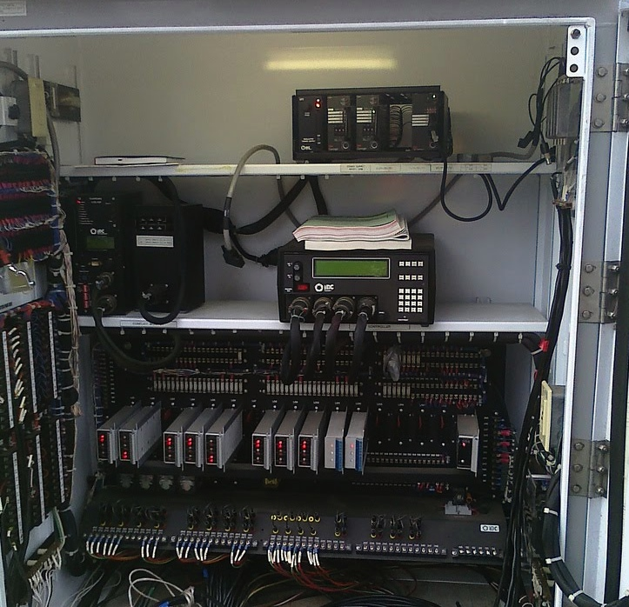
Inside the traffic cabinet
Malfunction Management Unit (MMU)
Traffic Controller
Light Relays
Notes:
Within that metal cabinet are a few key components. First is the traffic controller. It receives vehicle detection signals and uses those, along with preset timing plans, to determine when the lights should change. Every time you’ve ever been stuck at a red light, it’s the controller that’s responsible. These devices have come a long way in the last 100 years. Starting off as an electrical timing circuit, they’ve advanced to the point where today they are fully computerized.
Below it are the relays that actually control the lights. They don’t connect directly to the controller, however.
Between the two is the Malfunction Management Unit, also known as the Conflict Management Unit. The MMU is a hardware module used to prevent faults in the traffic light system. It watches the outputs of the controller for invalid control signals.

Slide 7
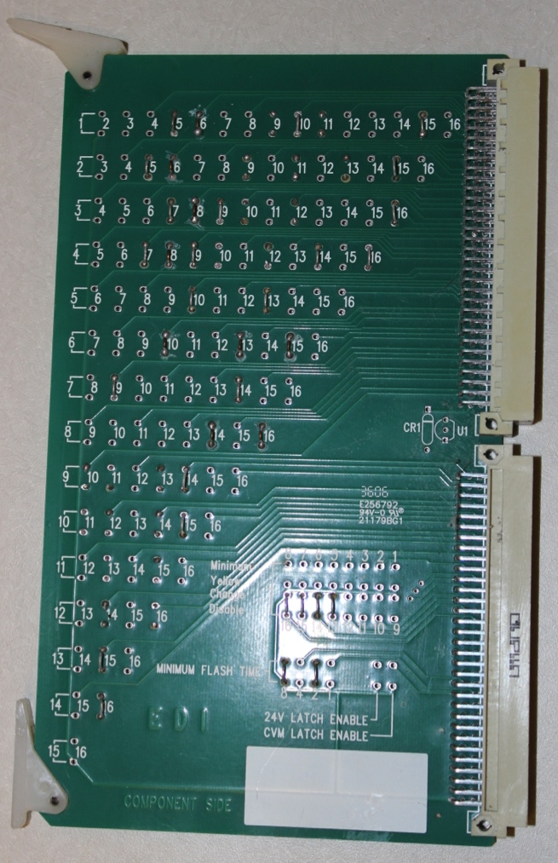
Malfunction Management Unit
Electrical failsafe
Hand-soldered configuration card
Physical connections
Whitelist of valid states
Invalid states trigger an override
Goes to blinking red lights
Requires manual reset
Stops 4-way green lights
Notes:
The MMU determines validity with a configuration circuit board. These things are hand-soldered by road agency personnel. Where each connection is a whitelisting of possible light states. So, a green light for straight through and left turn can be on simultaneously, while intersecting green lights would be invalid.
If the MMU detects an invalid state, it overrides the controller and takes the system into a failsafe state. The traffic signals go to blinking red lights. The MMU requires a technician to drive out and physically press a button in order to reset the intersection.
Unfortunately, I’m going to go ahead and ruin the fun right now, this stops 4-way green lights.
I’d also like to emphasize that this is something that the industry has done right. This kind of a failsafe system is rare to see. In so many examples, when a controller becomes computerized, hardware failsafes are removed, and trust is placed in the software instead. Continuing to require a system like this was a good idea.

Slide 8
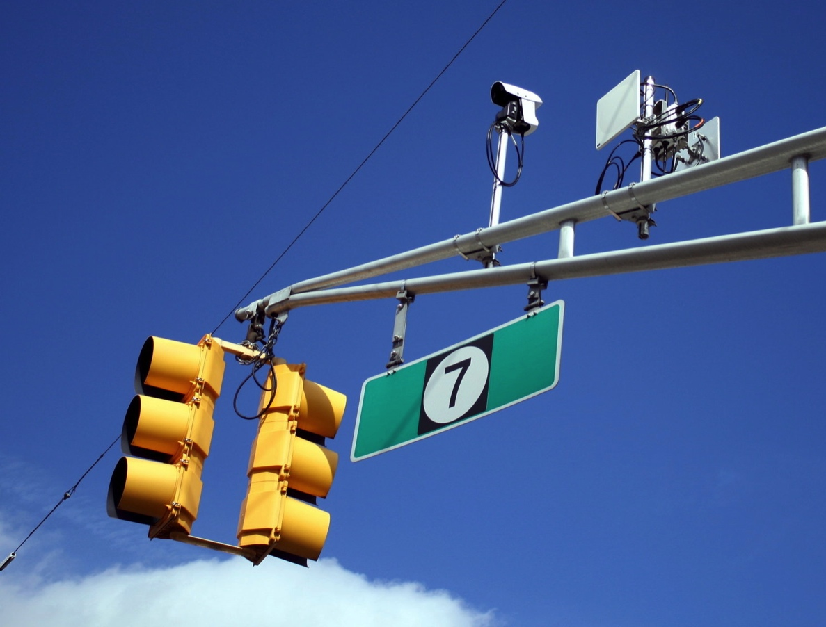
Other intersection hardware
Radio communication
Between controllers
Back to main server
Video cameras
Remote inspection
Notes:
As intersections became computer controlled, operators wanted to remotely interact with them. Radios are placed at intersections to allow data to be transmitted back to central servers and to allow traffic agency personnel to modify settings on the controller.
Once you have the capability to receive data, video cameras can be installed as well to allow for remote inspection of the intersection.

Slide 9
Overview of deployment
Collaborated with a road agency
Urban area
Approximately 100 lights total
Provided hardware for testing and access to deployment
Initial testing all performed under a laboratory setting
As a condition of their involvement:
Wish to remain anonymous and keep vendors anonymous
Notes:
Our evaluation was performed in collaboration with a road agency in an urban area with about 100 lights in their system. We feel that they are very representative of the norm. They provided us with the hardware that they use at intersections so that we could run tests in lab. They also allowed us to perform tests at an actual intersection. As a condition for this access though, they wished to remain anonymous and to keep their vendors anonymous as well.

Slide 10
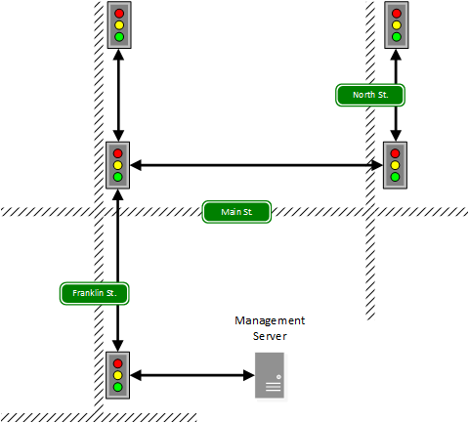
Deployment wireless network
Lights networked in a tree
Single private network
Data reporting only
Two communication bands
900 MHz
5.8 GHz
20 dBm with directional antennas
Notes:
The deployment uses a wireless network to connect the intersections back to a management server. This is only used for data reporting, not active control of the system. All the lights form a single IP network.
Two different types of radios are used throughout the deployment, 5.8 GHz whenever line-of-sight communications are possible, and 900 MHz whenever objects such as buildings, trees, or bridges are blocking the way. To give you a feel for these radios, they transmit through directional antennas at 20 dBm, sometimes hopping to other intersections over a mile down the road.

Slide 11
Findings – 900 MHz radios
No encryption enabled on connections
Relies on proprietary protocol and frequency hopping
WPA is possible
Default username and password in use
Vendor configuration software
Requires default username and password to function
Notes:
When we actually investigated the 900 MHz radios, we found:

Slide 12
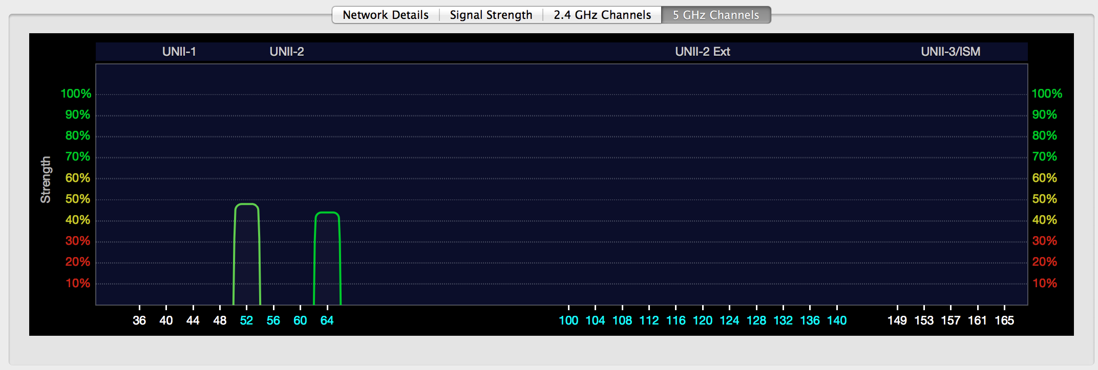
Findings - 5.8 GHz radios
Proprietary protocol
Similar to 802.11 – still broadcasts an SSID
Network name can be found on a standard laptop
Traffic Light #1
Traffic Light #2
Notes:
Next, we investigated the 5.8 GHz radios. They utilize a proprietary protocol very similar to 802.11. So much so that the network name can actually be found on a laptop or smartphone, although they can’t connect.
The picture at the bottom is a wi-fi scan taken from a macbook while we sat on a bus stop bench. Two different intersection’s wireless connections can be seen.

Slide 13
Findings - 5.8 GHz radios
No encryption enabled on connections
Relies on proprietary protocol
WPA2 is possible
Default username and password in use
Vendor configuration software
Allows password to be changed
Assumes single password in use throughout deployment
Notes:
Again, when we performed a deeper evaluation of these systems, we found:

Slide 14
Connecting to the network
How difficult is it?
Purchase 5.8 GHz radio from same vendor
Open laptop and find network SSID
Enter SSID into radio configuration as roaming slave
Network access at any point allows communication with all traffic light controllers in the deployment
Notes:
Taken these findings, we focused on the easiest route of attack to break into the network. Step 1 is to communicate using the same proprietary protocol. This could involve reverse engineering it, or simply purchasing a radio by the same vendor. Next, you need to determine the network SSID, which can be found on a laptop or smartphone. Finally, you enter the SSID into the radio, and you’re in. A laptop can be connected to the radio with an Ethernet cable, and is able to send and receive packets from any device on the network.
This is an important point. Since a single private network is in use throughout the entire deployment, accessing the wireless connections at any one point gives access to all intersections on the network. This includes physical attacks on the system.

Slide 15
Findings – Traffic controller
Usually controlled physically from the front panel
No username or password by default
Access control can be enabled, but is not simple
FTP server with database file for settings
Unchangeable default username and password
Notes:
Normally, the traffic controller is accessed through a front panel. Buttons allow you to walk through menus and configure settings. Access control is not default enabled, and in fact is more of a second class citizen. It is quite difficult to use.
There is also an FTP server where a database file with settings can be accessed. This FTP has an _unchangeable_ username and password.

Slide 16
Findings – Traffic controller
Runs VxWorks real-time operating system
Default build leaves a debug port open
Controller we tested was vulnerable
Arbitrary access to read and write memory
Actually, the vendor had already fixed this issue
The patch report didn’t mention it
Road agency hadn’t gotten around to updating controllers
Notes:
The RTOS VxWorks runs on the controller. The version of VxWorks used has a debug port left open by default. This is so commonly forgotten about in production builds that ICS-CERT has labeled it as a vulnerability of the system. This debug port allows arbitrary reading and writing of all of memory. The controller we tested was vulnerable.
Actually, the vendor had already fixed this. We didn’t find this out until we reported the issue however. Their patch reports didn’t mention it, and the road agency we worked with didn’t see the update as high priority and decided to update their controllers at a later time.

Slide 17
Findings – Traffic controller
NTCIP 1202
National Transportation Communications for ITS Protocol
Standard defining communications for traffic controllers
SNMP can be used to manage devices
Does not provide protection from unauthorized access
Vendor program for remote controller interaction
Uses NTCIP 1202 to emulate front panel interactions
Easy to sniff with Wireshark
Notes:
Joint standard by National Electrical Manufacturers Association (NEMA), American Association of State Highway and Transportation Officials (AASHTO), and Institute of Transportation Engineers (ITE)
NTCIP 1202 is a standard for traffic system communications. We get into a tiny bit of acronym hell trying to define it, but it is a protocol for Intelligent Traffic Systems. It uses SNMP for managing controllers. This standard does not provide access control.
The vendor created a program made for remotely operating controllers through this protocol. It was easy to sniff with wireshark and we were able to reverse engineer how several command mapped to button presses on the front panel of the controller.

Slide 18
Controlling the controller
We created a library of commands based on vendor program
Arrow keys, Number keys, Main Menu button
We then created a C program to act as a “traffic controller shell”
Can manually change settings on the controller
Can also run scripts to automatically perform actions
Advance lights
Freeze lights
Trigger MMU
Notes:
We created a library of commands that used NTCIP 1202. We then turned that library into a sort of a “traffic controller shell”. From here, we could modify settings on the controller manually or we could run scripts which would automatically do things like advance the lights, or halt them in place.

Slide 19
Putting it all together
We can now:
Access the network
Connect to the controller
Change light states
Next, we wanted to try it out at a real light
Notes:
So, now we have the ability to: access the network, access the traffic light controller, and change light states automatically. Next, we wanted to try it for real.

Slide 20
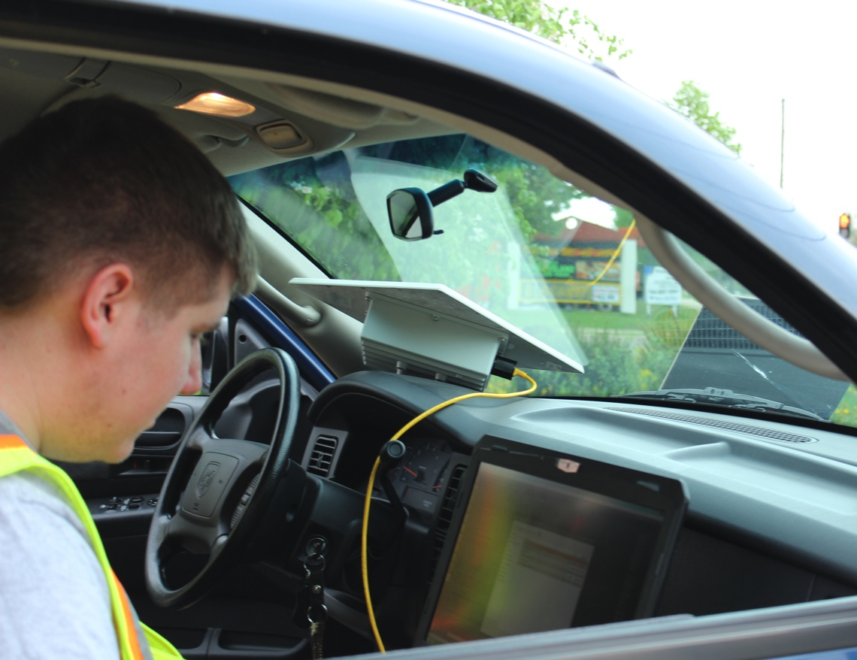
Demonstration on Deployment
T-intersection
MMU defaults to blinking yellows on main road
Required supplies
5.8 GHz radio
Laptop
AC power
Notes:
In order to test, we went out to a T-Intersection with road agency personnel. They were there monitoring during our testing to ensure that everything was safe. We only ran tests when no cars were interacting with the intersection.
In order to run our tests, we needed: a 5.8 GHz radio by the same vendor as that used at the intersection, a laptop to run our code from, and power. For our testing, we parked my car at a nearby parking lot and plugged the radio in using an AC inverter.

Slide 21
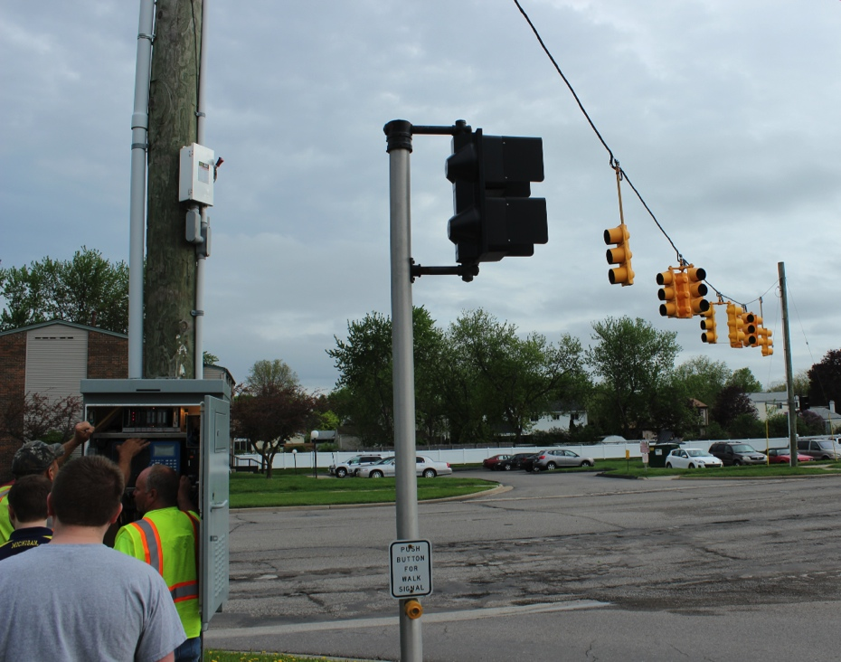
Demonstration on Deployment
Connected to network
Ran controller shell
Changed light on command
Also accidentally triggered MMU twice
Notes:
The first thing we did was connect to the network. We saw the network name of the nearby intersection on our laptop, and entered it in to the radio, but it had trouble connecting due to the directionality of the antennas. So, we just connected to the next intersection down the road (about a half mile away) instead. This allowed us to connect to every controller in the deployment, including the one we actually wanted.
Next, we started up the code and, when the light was green, commanded it to change. It immediately turned yellow, and then red. We tried this a couple of times to ensure that it was really working. Along the way, we accidentally triggered the MMU twice as well, reinforcing just how useful having this device in the system is.

Slide 22
What can an attacker really do?
Denial of service
It’s easy to trigger the MMU to take over
Requires a technician to manually reset the device
Traffic congestion
Possible to change timings such that a road becomes backed up
Individual light control
Speedy getaways just like the movies
Notes:
So, what can an attacker really do with control of the traffic light system?

Slide 23
Recommendations for road agencies
Follow basic security best practices
Need to enable encryption
Proprietary protocols do not cut it
Hiding SSIDs is a good idea
Add firewalls to block access to ports you aren’t using
Keep firmware up to date
Change default usernames and passwords
Notes:
As far as recommendations for road agencies, we have nothing more to say than to follow best practices for security. For goodness sake people, change your passwords!
The group we were working with was excited that they had even gotten a wireless network working in the first place. Enabling security which might break it was not high on their priority list.

Slide 24
Recommendations for vendors
Enforce security
Require strong wireless security options
Allow and expect usernames and passwords to be changed
Somebody needs to be thinking about security
Notes:
What we recommend for vendors is to do whatever you can to enforce security. Enable it by default, and require it whenever possible.
Moreover, someone needs to be thinking about security.

Slide 25
Vendor Response
Traffic controller vendor responded:
The company “has followed the accepted industry standard and it is that standard which does not include security”
Worrying for future Vehicle-to-Vehicle/Infrastructure technologies
Notes:
When we contacted the vendor about these issues, they responded that they had “QUOTE”
Road agencies, vendors, and the standards organizations all need to work together to provide security for these systems. Especially with an eye to the future V2V and V2I technologies. If we can’t secure even the more simple traffic light networks, how are we going to secure these more complex technologies?

Slide 26
Concluding Remarks
The real problem here is a lack of security consciousness
Traffic lights underwent a phase change
Timing electronics to computerized systems
Standalone devices to wireless networks
Security did not keep up
Ensuring security of critical infrastructure should be a top priority

Slide 27
Acknowledgements
Many thanks to the anonymous road agency personnel who allowed us access to their network and hardware

Slide 28
Questions?
Green Lights Forever: Analyzing the Security of Traffic Infrastructure
Branden Ghena | brghena@umich.edu
William Beyer | wbeyer@umich.edu
Allen Hillaker | hillaker@umich.edu
Jonathan Pevarnek | jpevarne@umich.edu
J. Alex Halderman | jhalderm@eecs.umich.edu
Notes:
Thank you very much

