Slide 1
EECS 370 Discussion
Programming Languages as cars
C
A racing car that goes incredibly fast but breaks down every fifty miles.
C++
A souped-up version of the C racing car with dozens of extra features that only breaks down every 250 miles, but when it does, nobody can figure out what went wrong.
Assembly
You are the car.

Slide 2



EECS 370 Discussion
Undergrad at Michigan Tech
Hougton, MI

Slide 3
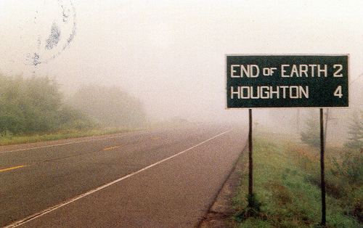
EECS 370 Discussion

Slide 4

EECS 370 Discussion
Excited By:
Embedded Systems
Space Stuff
Mandolin
Sci-Fi / Fantasy
Come say hello during Office Hours

Slide 5
EECS 370 Discussion
Two’s Complement Numbers

Slide 6
EECS 370 Discussion
Two’s Complement Numbers
Example:
-37 in 8-bit two’s complement binary

Slide 7
EECS 370 Discussion
Two’s Complement Numbers
Example:
-37 in 8-bit two’s complement binary
Answer: 11011011₂

Slide 8
EECS 370 Discussion
Two’s Complement Numbers
Example:
-37 in 8-bit two’s complement binary
Answer: 11011011₂
Question:
-37 => 11011011₂
219=> 11011011₂
How do you know the difference?

Slide 9
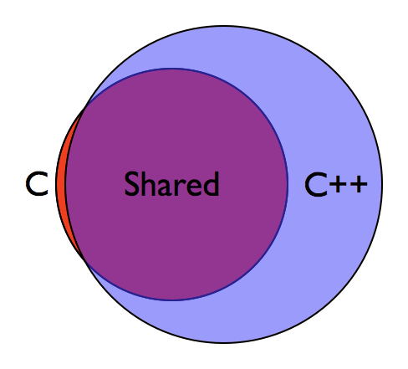
EECS 370 Discussion
C vs C++
Not in C:
Classes & Objects
Namespaces
New & Delete
Cout & Cin
Data Structures
String datatype

Slide 10
EECS 370 Discussion
printf() Examples
#include <stdio.h>
int main( ) {
printf("Hello World");
}
#include <stdio.h>
int i;
for (i = 0; i < 10; i++) {
printf(“i= %d\n", i);
}

Slide 11
EECS 370 Discussion
String Examples
char* text = “Hello”;
Equivalent to
char text[] = {‘H’, ‘e’, ‘l’, ‘l’, ‘o’, ‘\0’};

Slide 12
EECS 370 Discussion
String Examples
char* text = “Hello”;
char* copy;
copy = text;
Why is this wrong?

Slide 13
EECS 370 Discussion
String Examples
char* text = “Hello”;
if (text == “Hello”) {
...
}
Why is this wrong?

Slide 14
EECS 370 Discussion
malloc() Examples
int *foo;
foo = (int *) malloc(sizeof(int));
*foo = 5;
...
free(foo);

Slide 15
EECS 370 Discussion
Bit Twiddling Examples
char data = 87;
How would you set the 6th bit of data?

Slide 16
EECS 370 Discussion
Bit Twiddling Examples
char data = 87;
How would you set the 6th bit of data?
data |= (1<<6);
also acceptable:
data |= (0x40);

Slide 17
EECS 370 Discussion
Project 1 Overview

Slide 18
EECS 370 Discussion
Project 1 Overview
Translate to binary:
ADD 0 0 5

Slide 19
EECS 370 Discussion
Project 1 Overview
Translate to binary:
ADD 0 0 5
Opcode RegA RegB DestReg
0000000 0 00 000 000 00000000 00000 101
Equals: 0x00000005
Equals: 5₁₀

Slide 20
EECS 370 Discussion
Project 1 Overview
ADD 0 0 5 --> 5₁₀
.fill 5 -------> 5₁₀
What’s the difference?

