Slide 1
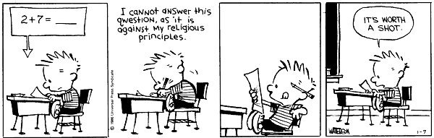
EECS 370 Discussion
Calvin and Hobbes
by Bill Watterson

Slide 2
EECS 370 Discussion
Exam
7:00 – 8:30 Tuesday (Tomorrow!)
Bring:
Pencil
Calculator
Notes Sheet
letter-sized, double sided, 1 sheet

Slide 3
EECS 370 Discussion
Exam Review
Multi-cycle Datapath
Pipeline Datapath
Hazards!
Caches

Slide 4
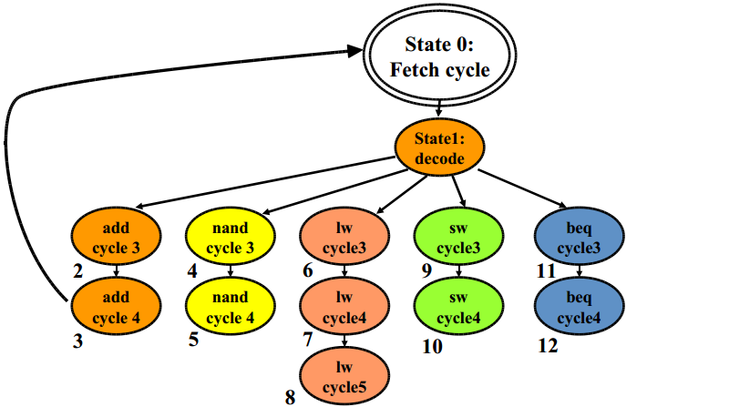
EECS 370 Discussion
Multi-Cycle Datapath

Slide 5
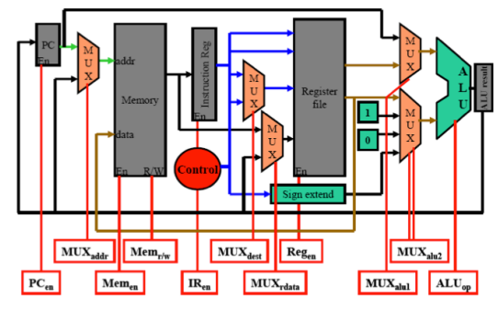
EECS 370 Discussion
Multi-Cycle Datapath

Slide 6
EECS 370 Discussion
Multi-Cycle Datapath
Frequency as compared to single-cycle?
Do all instructions take the same amount of time?
What is the CPI for a multi-cycle machine?

Slide 7
EECS 370 Discussion
Multi-Cycle Datapath
Frequency as compared to single-cycle?
Higher
Do all instructions take the same amount of time?
No! (ADD, NAND, SW, BEQ: 4 cycles, LW: 5 cycles)
What is the CPI for a multi-cycle machine?
Depends on the instructions you run through it

Slide 8
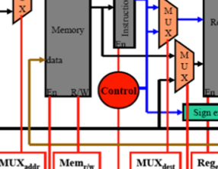
EECS 370 Discussion
Multi-Cycle Datapath
Why doesn’t multi-cycle have data hazards or control hazards?
What does the red Control circle on the diagram do?

Slide 9
EECS 370 Discussion
Multi-Cycle Datapath
Why doesn’t multi-cycle have data hazards or control hazards?
Only one instruction is running at a time
What does the red Control circle on the diagram do?
Sets the control signals for
muxes, ALU, Memory, and Reg

Slide 10
EECS 370 Discussion
Multi-Cycle Datapath
Let’s run an instruction through the datapath

Slide 11
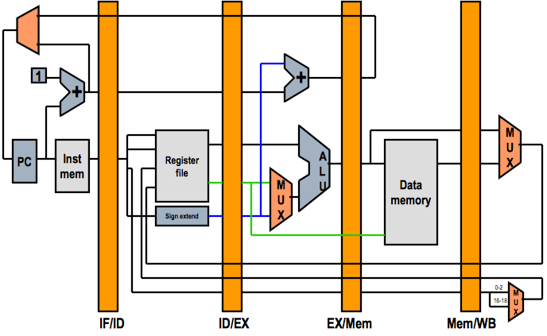
EECS 370 Discussion
Pipeline Datapath

Slide 12
EECS 370 Discussion
Pipeline Datapath
Frequency as compared to single-cycle?
Do all instructions take the same amount of time?
What is the CPI for a pipelined processor?

Slide 13
EECS 370 Discussion
Pipeline Datapath
Frequency as compared to single-cycle?
Higher
Do all instructions take the same amount of time?
Yes
What is the CPI for a pipelined processor?
1 (over many instructions)

Slide 14
EECS 370 Discussion
Pipeline Datapath
Timing Example
1000 Instructions:
What is the total execution time? (No Hazards)
25% lw
5% sw
50% add/nand
20% beq
6 ns – Register Read/Write
2 ns – ALU Operations
10 ns – Memory Access

Slide 15
EECS 370 Discussion
Pipeline Datapath
Timing Example
1000 Instructions:
What is the total execution time? (No Hazards)
10 * (4+1000) = 10040 ns
25% lw
5% sw
50% add/nand
20% beq
6 ns – Register Read/Write
2 ns – ALU Operations
10 ns – Memory Access

Slide 16
EECS 370 Discussion
Data Hazards
Avoidance
Detect and Stall
Detect and Forward

Slide 17
EECS 370 Discussion
Pipeline Datapath
Timing Example
1000 Instructions:
37% of ADD/NAND instructions followed by dependent instruction
Detect and forward
What is the total execution time?
25% lw
5% sw
50% add/nand
20% beq
6 ns – Register Read/Write
2 ns – ALU Operations
10 ns – Memory Access

Slide 18
EECS 370 Discussion
Pipeline Datapath
Timing Example
1000 Instructions:
37% of ADD/NAND instructions followed by dependent instruction
Detect and forward
What is the total execution time?
10 * (4+1000) = 10040 ns
25% lw
5% sw
50% add/nand
20% beq
6 ns – Register Read/Write
2 ns – ALU Operations
10 ns – Memory Access

Slide 19
EECS 370 Discussion
Control Hazards
No Branches
Avoid
Detect-and-stall
Speculate-and-squash

Slide 20
EECS 370 Discussion
Control Hazards
In a 27 stage pipeline, if Branches are resolved in Stage 14:
Which stages must be squashed?

Slide 21
EECS 370 Discussion
Control Hazards
In a 27 stage pipeline, if Branches are resolved in Stage 14:
Which stages must be squashed?
Stages 1 through 13

Slide 22
EECS 370 Discussion
Pipeline Datapath
Timing Example
1000 Instructions:
10% of BEQ instructions are mispredicted
Speculate-and-squash
What is the total execution time?
25% lw
5% sw
50% add/nand
20% beq
6 ns – Register Read/Write
2 ns – ALU Operations
10 ns – Memory Access

Slide 23
EECS 370 Discussion
Pipeline Datapath
Timing Example
1000 Instructions:
10% of BEQ instructions are mispredicted
Speculate-and-squash
What is the total execution time?
10 * (4+1000 + 1000*0.2*0.1*3) = 10640 ns
25% lw
5% sw
50% add/nand
20% beq
6 ns – Register Read/Write
2 ns – ALU Operations
10 ns – Memory Access

Slide 24
EECS 370 Discussion
Branch Predictors
Pattern is:
N N N T (Starting at Strongly Taken)
What is the mispredict rate?
Not Taken
Not Taken
Not Taken
Strongly
Not Taken
Weakly Not Taken
Weakly Taken
Strongly Taken
Taken
Taken
Taken

Slide 25
EECS 370 Discussion
Branch Predictors
Pattern is:
N N N T (Starting at Strongly Taken)
What is the mispredict rate? 25%
Not Taken
Not Taken
Not Taken
Strongly
Not Taken
Weakly Not Taken
Weakly Taken
Strongly Taken
Taken
Taken
Taken

Slide 26
EECS 370 Discussion
Caches
What are the types of Locality?
What’s the calculation for Block Index bits?
What’s the calculation for Set Index bits?

Slide 27
EECS 370 Discussion
Caches
What are the types of Locality?
Spatial & Temporal
What’s the calculation for Block Index bits?
log₂(block size)
What’s the calculation for Set Index bits?
log₂(number of sets)

Slide 28
EECS 370 Discussion
Types of Caches
Fully Associative
Blocks map to any cache line
Memory
0x1000 | 10
0x1004 | 20
0x1008 | 30
0x100C | 40
0x1010 | 50
0x1014 | 60
0x1018 | 70
0x101C | 80
0x1020 | 90
0x1024 | 100
0x1028 | 110
Cache
Tag | Data

Slide 29
EECS 370 Discussion
Types of Caches
Direct Mapped
Blocks map to one cache line
Memory
0x1000 | 10
0x1004 | 20
0x1008 | 30
0x100C | 40
0x1010 | 50
0x1014 | 60
0x1018 | 70
0x101C | 80
0x1020 | 90
0x1024 | 100
0x1028 | 110
Cache
Tag | Data

Slide 30
EECS 370 Discussion
Types of Caches
Set Associative
Blocks map to any line in a set
Memory
0x1000 | 10
0x1004 | 20
0x1008 | 30
0x100C | 40
0x1010 | 50
0x1014 | 60
0x1018 | 70
0x101C | 80
0x1020 | 90
0x1024 | 100
0x1028 | 110
Cache
Tag | Data

Slide 31
EECS 370 Discussion
Caches
What are the Three C’s and how do we determine them?

Slide 32
EECS 370 Discussion
Caches
What are the Three C’s and how do we determine them?
Compulsory – if we have never loaded it
Capacity – misses in same size fully associative cache
Conflict – any additional misses in actual cache

Slide 33
EECS 370 Discussion
Caches
What’s the difference between Write Allocate and
No Write Allocate?
What’s the difference between Write Through and Write Back?

Slide 34
EECS 370 Discussion
Caches
What’s the difference between Write Allocate and
No Write Allocate?
Write Allocate – add to cache on write miss
No Write Allocate – don’t add to cache
What’s the difference between Write Through and Write Back?
Write Through – always write to memory
Write Back – just write to cache

Slide 35
EECS 370 Discussion
Caches
Timing Example
1000 Instructions:
10% of BEQ instructions are mispredicted, Speculate-and-squash
20% of all memory accesses miss caches. Misses take 20 cycles
What is the total execution time?
25% lw
5% sw
50% add/nand
20% beq
6 ns – Register Read/Write
2 ns – ALU Operations
10 ns – Memory Access

Slide 36
EECS 370 Discussion
Caches
Timing Example
1000 Instructions:
10% of BEQ instructions are mispredicted, Speculate-and-squash
20% of all memory accesses miss caches. Misses take 20 cycles
What is the total execution time?
10 * (4+1000 + 1000*0.2*0.1*3)
+ 10 * (1000*.2*20 + 1000*.25*.2*20 +1000*.05*.2*20) = 62640 ns
25% lw
5% sw
50% add/nand
20% beq
6 ns – Register Read/Write
2 ns – ALU Operations
10 ns – Memory Access

