Slide 1
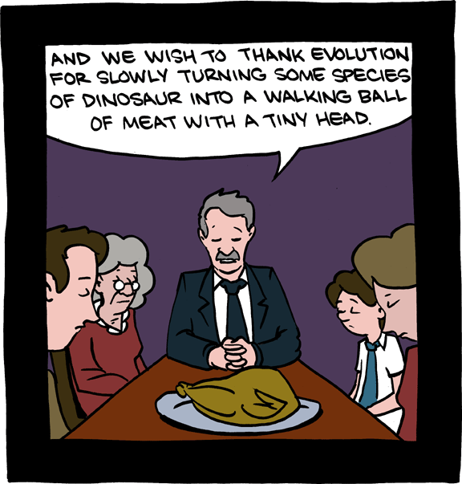
EECS 370 Discussion
SMBC

Slide 2
EECS 370 Discussion
Exam 2
Solutions posted online
Will be returned in next discussion (12/9)
Grades hopefully up on CTools earlier

Slide 3
EECS 370 Discussion
Roadmap to end of semester
Homework 7 – Thursday 12/5
Project 4 – Friday 12/6
Final Exam – Monday 12/16 10:30 am – 12:30 pm
make sure you don’t have a conflict…

Slide 4
EECS 370 Discussion
Project 4
Overview
Tips
Example
Virtual Memory
Motivation
Page Tables
Translation Lookaside Buffer
Hierarchical Page Table

Slide 5
EECS 370 Discussion
Project 4
Start from correct P1 code
- remove printstate()
- add printaction()
What are the three times you access memory?

Slide 6
EECS 370 Discussion
Project 4
Start from correct P1 code
- remove printstate()
- add printaction()
What are the three times you access memory?
LW, SW, and Fetch

Slide 7
EECS 370 Discussion
Project 4
Implement an arbitrary cache
- 2D array of structs, perhaps
Possible Function Prototypes:
int load(int address)
void store(int address, int data)

Slide 8
EECS 370 Discussion
Project 4
@@@ transferring word [0-3] from the memory to the cache
@@@ transferring word [0-0] from the cache to the processor
@@@ transferring word [4-7] from the memory to the cache
@@@ transferring word [6-6] from the processor to the cache
@@@ transferring word [1-1] from the cache to the processor
@@@ transferring word [4-7] from the cache to the memory
@@@ transferring word [20-23] from the memory to the cache
@@@ transferring word [23-23] from the cache to the processor
@@@ transferring word [2-2] from the cache to the processor
@@@ transferring word [20-23] from the cache to nowhere
@@@ transferring word [28-31] from the memory to the cache
@@@ transferring word [30-30] from the cache to the processor
@@@ transferring word [3-3] from the cache to the processor
Cache Miss
Fetch
sw 0 1 6
lw 0 1 23
lw 0 1 30
halt
Cache Miss
SW
Fetch
Eviction (dirty)
Cache Miss
LW
Fetch
Eviction (clean)
Cache Miss
LW
Fetch

Slide 9
EECS 370 Discussion
Virtual Memory
Virtual Addresses map to Physical Addresses
Software sees:
Hardware sees:

Slide 10
EECS 370 Discussion
Virtual Memory
Virtual Addresses map to Physical Addresses
Software sees:
Virtual Addresses
Hardware sees:
Physical Addresses

Slide 11
EECS 370 Discussion
Virtual Memory
Motivation - Efficiency
Address Space
0x0
0xFF
Program 1
Program 2
Program 3

Slide 12
EECS 370 Discussion
Virtual Memory
Motivation - Efficiency
Address Space
Program 1
0x0
0xFF
Program 1
Program 2
Program 3

Slide 13
EECS 370 Discussion
Virtual Memory
Motivation - Efficiency
Address Space
Program 1
0x0
0xFF
Program 1
Program 2
Program 2
Program 3

Slide 14
EECS 370 Discussion
Virtual Memory
Motivation - Efficiency
Address Space
0x0
0xFF
Program 1
Program 2
Program 2
Program 3

Slide 15
EECS 370 Discussion
Virtual Memory
Motivation - Efficiency
Address Space
Program 3
0x0
0xFF
Program 1
Program 2
Program 2
Program 3

Slide 16
EECS 370 Discussion
Virtual Memory
Motivation - Efficiency
Address Space
Program 3
0x0
0xFF
Program 1
Wasted Space
Program 2
Program 2
Program 3
Wasted Space

Slide 17
EECS 370 Discussion
Virtual Memory
Motivation - Efficiency
Address Space
Program 3
0x0
0xFF
This wouldn’t happen if we could split up programs into smaller chunks
Wasted Space
Program 2
Wasted Space

Slide 18
EECS 370 Discussion
Virtual Memory
Motivation - Size
Program 1
Address Space
0x0
0xFF

Slide 19
EECS 370 Discussion
Virtual Memory
Motivation - Size
Address Space
0x0
0xFF
Programs bigger than main memory simply can’t be run?
How do I play Civ 5 then?
(6.98 GB)

Slide 20
EECS 370 Discussion
Virtual Memory
Motivation - Security
Address Space
Program 1
0x0
0xFF
Program 1
(Operating System)
Program 2
Program 2
(Written by you)

Slide 21
EECS 370 Discussion
Virtual Memory
Motivation - Security
Address Space
Program 1
0x0
0xFF
Program 1
(Operating System)
Writes to
memory…
Program 2
Program 2
(Written by you)

Slide 22
EECS 370 Discussion
Virtual Memory
Motivation - Security
Address Space
Program 1
0x0
0xFF
Program 1
(Operating System)
Writes to
memory…
Crashes
Program 2
Program 2
(Written by you)

Slide 23
EECS 370 Discussion
Virtual Memory
Solution:
Program is split into smaller chunks (pages)
Virtual Addresses map to where page is actually stored
Could be Main Memory or Disk
Memory acts like a cache for the disk

Slide 24
EECS 370 Discussion
Virtual Memory
Motivation - Efficiency
Address Space
Program 3
0x0
0xFF
Program 1
Wasted Space
Part of Program 1
Program 2
Program 2
Program 3
Wasted Space
Part of Program 1

Slide 25
EECS 370 Discussion
Virtual Memory
Motivation - Size
Program 1 (1/4)
Address Space
Program 1 (1/4)
0x0
0xFF
Program 1
(2/4)
Program 1
(2/4)
Program 1
(3/4)
Program 1
(3/4)
Program 1
(4/4)

Slide 26
EECS 370 Discussion
Virtual Memory
Motivation - Size
Program 1 (1/4)
Address Space
Program 1 (1/4)
0x0
0xFF
Program 1
(2/4)
Program 1
(4/4)
Program 1
(3/4)
Program 1
(3/4)
Program 1
(4/4)

Slide 27
EECS 370 Discussion
Virtual Memory
We can also protect memory
Check addresses during translation
only allow writes from the correct programs
Mark entire pages as read-only

Slide 28
EECS 370 Discussion
Virtual Memory
Page Table
Data Structure for address translation
Indexed by Virtual Page Number
Each entry has
Physical Page Number
Valid Bit
Dirty Bit
LRU Policy for evictions

Slide 29
EECS 370 Discussion
Virtual Memory
Page Table is usually stored in Main Memory
What’s the problem here?

Slide 30
EECS 370 Discussion
Virtual Memory
Page Table is usually stored in Main Memory
What’s the problem here?
Two memory accesses per memory access
SUPER SLOW!

Slide 31
EECS 370 Discussion
Virtual Memory
Solution:
Translation Lookaside Buffer (TLB)
special cache for Page Table entries only

Slide 32
EECS 370 Discussion
Virtual Memory
TLB Hit
Main Memory
Page Table
Data
Virtual Page Number
Processor
Translation Lookaside Buffer
Physical Page Number
Physical Page Number
Data

Slide 33
EECS 370 Discussion
Virtual Memory
TLB Hit
Main Memory
Virtual Page Number
Page Table
Data
Translation Lookaside Buffer
Processor
Virtual Page Number
Physical Page Number
Physical Page Number
Data

Slide 34
EECS 370 Discussion
Virtual Memory
Hierarchical Page Tables:
Page Table points to locations of other Page Tables
Bottom level points to actual Physical Address
Uses much less space on average
Uses much more space at worst

Slide 35
EECS 370 Discussion
Superpage Table
Subpage Table
Physical Address
Physical Address
Subpage Table
Physical Address
Physical Address
Physical Address
Physical Address
Physical Address
Physical Address
Subpage Table
Physical Address
Physical Address
Physical Address
Physical Address
Virtual Memory

