Slide 1
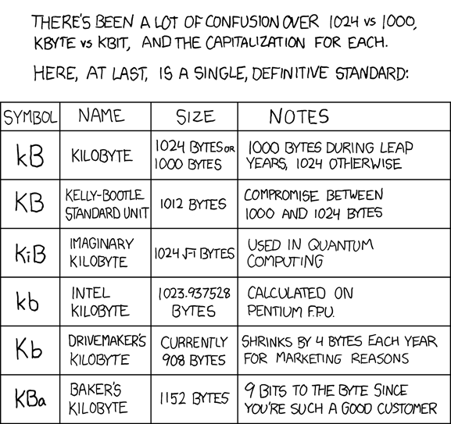
EECS 370 Discussion
xkcd

Slide 2
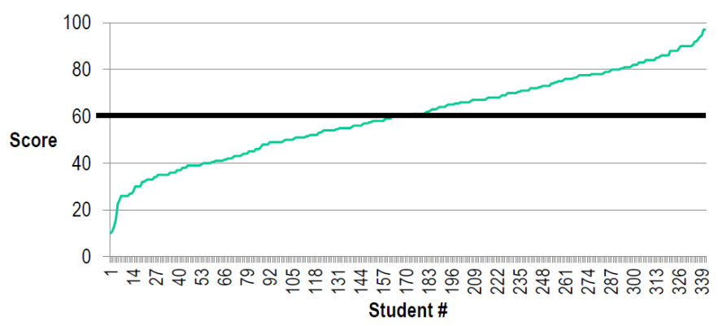
EECS 370 Discussion
Exam 2
High: 97 Low: 10 Average 60.4

Slide 3
EECS 370 Discussion
Roadmap to end of semester
Project 4 – Friday 12/6 (Due tonight at 11:59 w/ 3 slip days)
Homework 7 – Tuesday 12/7 (Tomorrow)
Final Exam – Monday 12/16 10:30 am – 12:30 pm
make sure you don’t have a conflict…

Slide 4
EECS 370 Discussion
Virtual Memory
Physically Addressed & Virtually Addressed
Hierarchical Page Tables
Hard Drives
Overview
Access Time
General Review

Slide 5
EECS 370 Discussion
Virtual Memory
Concepts
Physical Addresses are in?
Virtual Addresses are in?
What does the TLB hold?

Slide 6
EECS 370 Discussion
Virtual Memory
Concepts
Physical Addresses are in?
Hardware
Virtual Addresses are in?
Software
What does the TLB hold?
Physical Page Numbers

Slide 7
EECS 370 Discussion
Caches
Problem:
Where do we put the cache in a VM system?

Slide 8
EECS 370 Discussion
Caches
Physically Addressed
CPU
TLB
Virtual Address
Physical Address
Cache

Slide 9
EECS 370 Discussion
Caches
Virtually Addressed
CPU
Cache
TLB
Virtual Address
Physical Address
Notes:
Problem: Identical virtual spaces

Slide 10
EECS 370 Discussion
Caches
Performance Problem
Find memory latency for virtually addressed
and physically addressed systems.
 | Hit Rate | Access Time
TLB | 99% | 1 cycle
Cache | 90% | 1 cycle
Main Memory | 99.99% | 100 cycles
Disk | 100% | 1,000,000 cycles

Slide 11
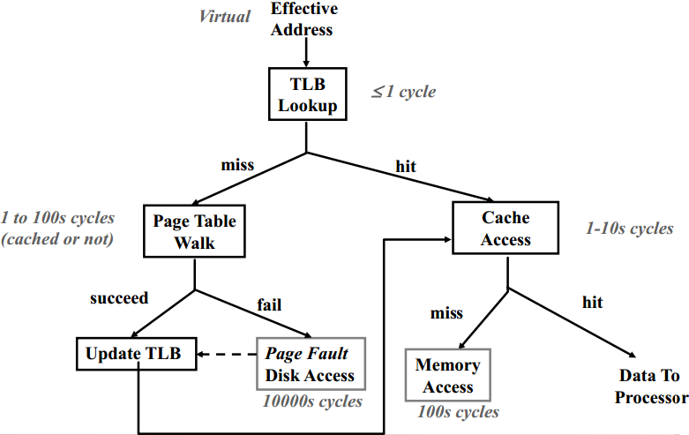
EECS 370 Discussion
Caches

Slide 12
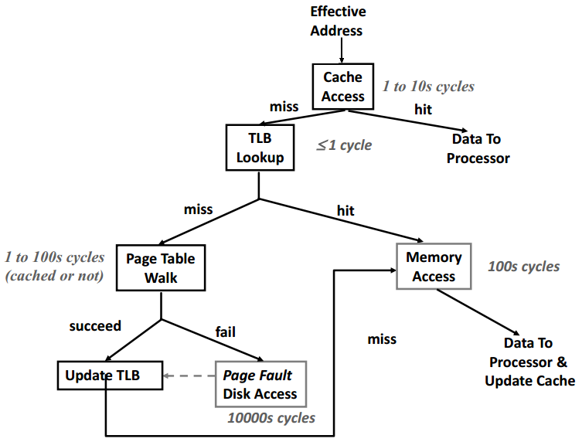
EECS 370 Discussion
Caches

Slide 13
EECS 370 Discussion
Hierarchical Page Tables
32-bit virtual addresses
Page Size: 8kB
Page Entry Size: 8B
How many levels of page tables must there be?
Where do each of the address bits go?

Slide 14
EECS 370 Discussion
Hierarchical Page Tables
32-bit virtual addresses
Page Size: 8kB
Page Entry Size: 8B
How many levels of page tables must there be?
2 levels
Where do each of the address bits go?
10-bit superpage table, 9-bit subpage table, 13-bit page offset

Slide 15
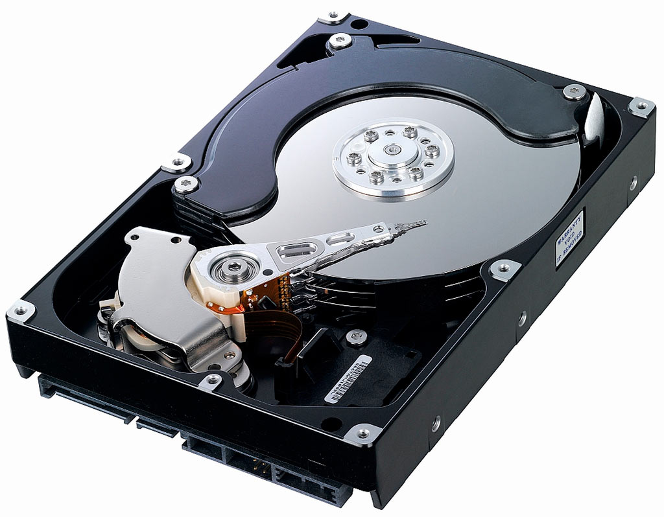
EECS 370 Discussion
Hard Drive Disk

Slide 16
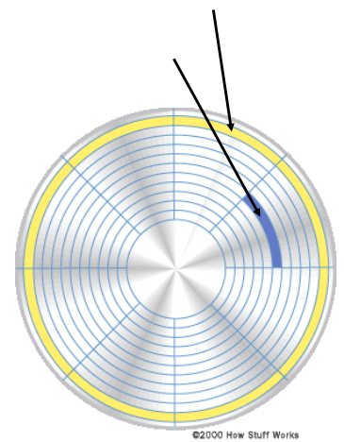
EECS 370 Discussion
Hard Drive Disk
Picture of one side of a platter
A - Sector
B - Track
B
A
Notes:
Storage Calculation

Slide 17
EECS 370 Discussion
Hard Drive Disk
Access Time
Seek Time – Moving to correct track
Rotational Delay – Waiting for correct sector
Transfer Time – Reading data from disk
Wait Time & Controller Overhead – Additional delays
Is Random Access or Sequential Access better?
B
A

Slide 18
EECS 370 Discussion
Hard Drive Disk
Access Time
5400 RPM
2 kB Sectors
512 Sectors per Track
8 ms Seek Time
No overhead
What is the time to access one sector?
B
A

Slide 19
EECS 370 Discussion
Exam Review
There will be two exam review sessions
Thursday, 4-6 pm, Chrysler 220
Sunday , 1-3 pm, Chrysler 220
B
A

Slide 20
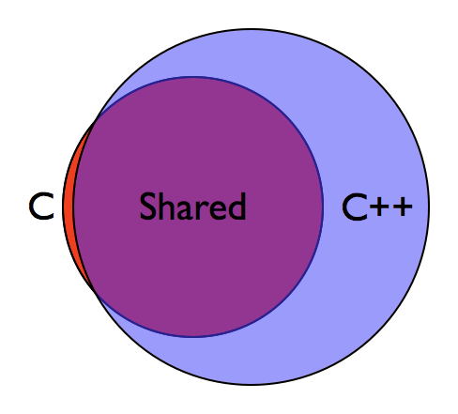
EECS 370 Discussion
Exam Review
Discussion 1
How does C work?
LC2K Instructions
B
A

Slide 21
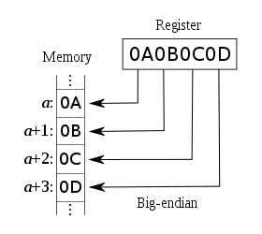
EECS 370 Discussion
Exam Review
Discussion 2
ARM Addressing
Struct Data Layout
Conditional Assembly
B
A

Slide 22
EECS 370 Discussion
Exam Review
Discussion 3
Caller / Callee Saved Registers
Memory Layout
Linking & Object Files
B
A
Return Address
Previous Frame Pointer
Callee Saved Registers
Local Variables
Spilled Registers
Caller Saved Registers
Outgoing Parameters
FP
SP
Notes:
What goes in the Symbol Table? What goes in the Relocation Table?

Slide 23
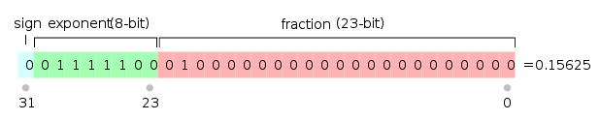

EECS 370 Discussion
Exam Review
Discussion 4
Floating Point
Finite State Machines
Combinational Logic
Sequential Logic
B
A
Notes:
What goes in the Symbol Table? What goes in the Relocation Table?

Slide 24
EECS 370 Discussion
Exam Review
Discussion 5
Single Cycle Datapath
B
A
Notes:
What goes in the Symbol Table? What goes in the Relocation Table?

Slide 25
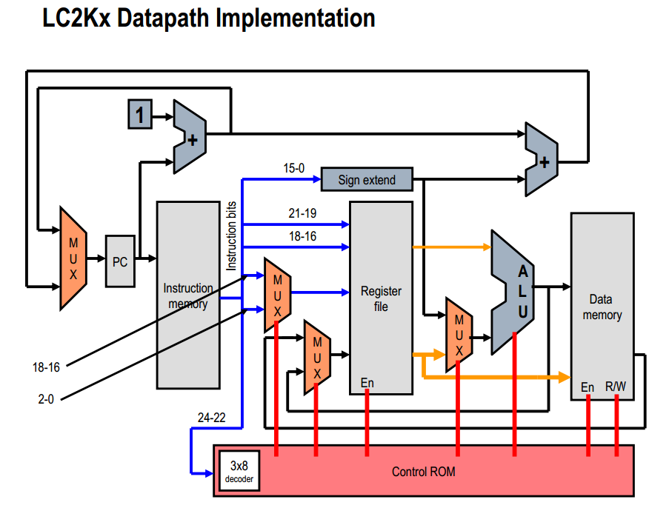
EECS 370 Discussion
Exam Review
Discussion 5
Single Cycle Datapath
B
A
Notes:
What goes in the Symbol Table? What goes in the Relocation Table?

Slide 26
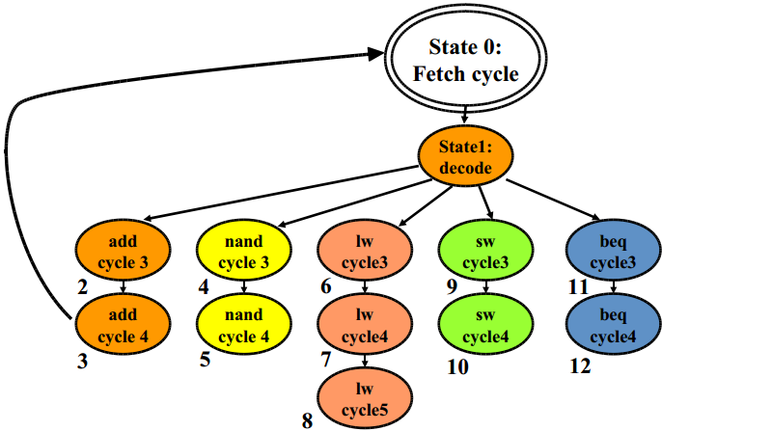
EECS 370 Discussion
Exam Review
Discussion 6
Multi Cycle Datapath
B
A
Notes:
What goes in the Symbol Table? What goes in the Relocation Table?

Slide 27
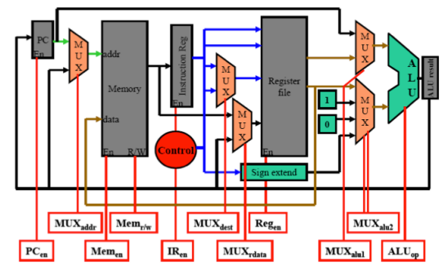
EECS 370 Discussion
Exam Review
Discussion 6
Multi Cycle Datapath
B
A
Notes:
What goes in the Symbol Table? What goes in the Relocation Table?

Slide 28
EECS 370 Discussion
Exam Review
Discussion 7
Pipelined Processor
Data Hazards
B
A
Notes:
What goes in the Symbol Table? What goes in the Relocation Table?

Slide 29
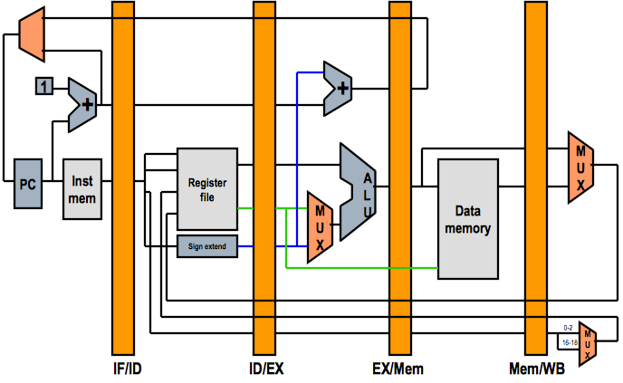
EECS 370 Discussion
Exam Review
Discussion 7
Pipelined Datapath
B
A
Notes:
What goes in the Symbol Table? What goes in the Relocation Table?

Slide 30
EECS 370 Discussion
Exam Review
Discussion 8
Control Hazards
Branch Prediction
B
A
Not Taken
Not Taken
Taken
Taken
Notes:
What goes in the Symbol Table? What goes in the Relocation Table?

Slide 31
EECS 370 Discussion
Exam Review
Discussion 9
Caches
B
A
Cache
Main Memory (RAM)
Disk (Hard Drive)
Notes:
What goes in the Symbol Table? What goes in the Relocation Table?

Slide 32
EECS 370 Discussion
Exam Review
Discussion 10
Exam Review
Discussion 11
Virtual Memory
Discussion 12
Virtual Memory
Disks
B
A
Notes:
What goes in the Symbol Table? What goes in the Relocation Table?

