Slide 1
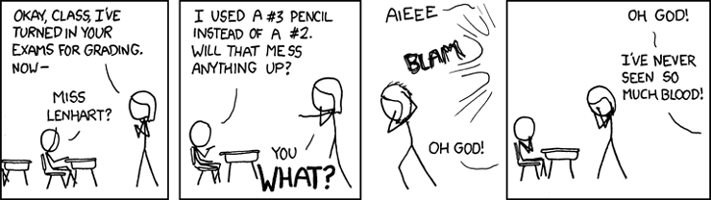
EECS 370 Discussion
xkcd.com

Slide 2
EECS 370 Discussion
Topics Today:
ARM Addressing
Endianness, Loading, and Storing Data
Data Layout
Struct Packing
Control Flow
Branches and PSR (Program Status Register)
Conditional Assembly
Predicated Assembly Instructions
C to ARM Translation

Slide 3
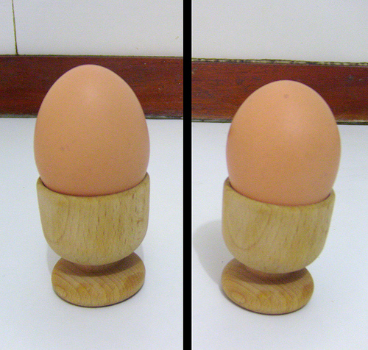
EECS 370 Discussion
ARM Addressing

Slide 4
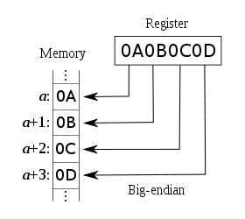
EECS 370 Discussion
ARM Addressing
Big-Endian means Big End First
Most Significant Byte (MSB) at first address in memory
In EECS370 we use Big-Endian
Applies to Bytes only!

Slide 5
EECS 370 Discussion
ARM Addressing
Example:
sub r1, r1, #0x2
strh r1, [r2, #0x0]
ldrsb r2, [r2, #0x1]
ldrh r1, [r0, #0x1002]

Slide 6
EECS 370 Discussion
Data Layout
Golden Rule
Start address of a variable is aligned based on the variable’s type
char – byte aligned
short – halfword aligned
int – word aligned
pointer – word aligned
double – two-word aligned
Structs
- start aligned based on alignment of largest member
- end padded to make overall size a multiple of largest member

Slide 7
EECS 370 Discussion
Data Layout
Example:
char a;
char* b;
short c;
double* d;
struct {
int e;
char f[10];
} g;

Slide 8
EECS 370 Discussion
Control Flow
ARM Registers:
16 total registers
R0 – R12: General Purpose
R13: Stack Pointer
R14: Link Register
R15: Program Counter ← Dangerous!

Slide 9
EECS 370 Discussion
Control Flow
Program Status Register (PSR):
Flags set by various assembly instructions
N – result is negative
Z – result is zero
C – result had a carry out of bit 31
V – result had an overflow

Slide 10
EECS 370 Discussion
Control Flow
Branch Condition Codes based on PSR
eq EQual Z == 1
ne Not Equal Z == 0
ge Greater than/Equal N == V
lt Less Than N != V
gt Greater Than Z == 0 && N == V
le Less than/Equal Z == 1 || N != V
cs unsigned higher/Same C == 1
cc unsigned lower C == 0
mi negative N == 1
pl positive/Zero N == 0
vs oVerflow Set V == 1
vc no oVerflow Clear V == 0
hi unsigned HIgher C == 1 && Z == 0
ls unsigned Lower/Same C == 0 || Z == 1
al any/Always

Slide 11
EECS 370 Discussion
Conditional Assembly
Condition Codes can also be applied to other instructions
Example: Translate the following code
while (r0 != 0) {
if (r0 > 0) {
r0 = r0 – 1;
} else {
r0 = r0 + 1;
}
}

Slide 12
EECS 370 Discussion
C to ARM Translation
Do some examples.
How to move 32-bit values into registers.

