Slide 1
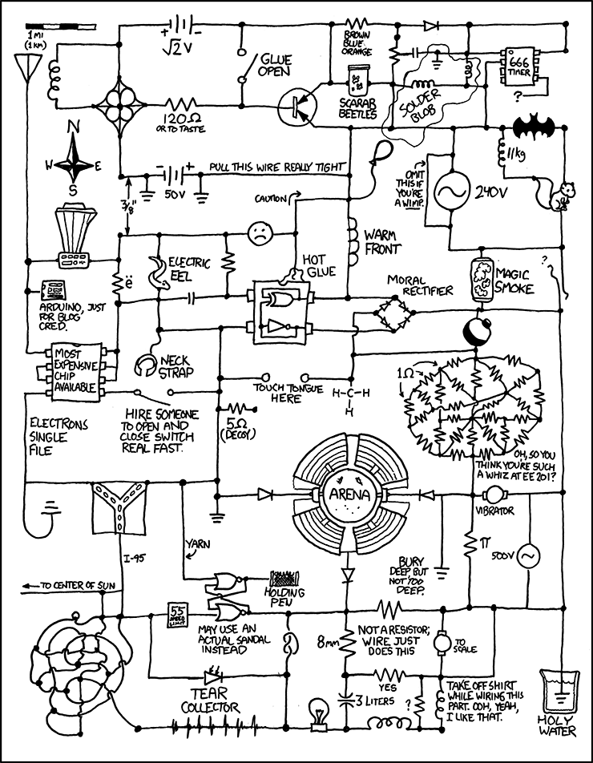
EECS 370 Discussion
xkcd.com

Slide 2
EECS 370 Discussion
Topics Today:
Floating Point
Finite State Machines
Combinational Logic
Sequential Logic

Slide 3
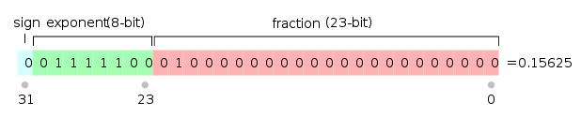
EECS 370 Discussion
Floating Point
Exponent
Biased by 127
Significand
Additional 1 before the decimal sign

Slide 4
EECS 370 Discussion
Floating Point
Don’t forget about zero!

Slide 5
EECS 370 Discussion
Floating Point
Addition
-1.1011*(2²) + 1.01*(2⁰)

Slide 6
EECS 370 Discussion
Floating Point
Addition
-1.1011*(2²) + 1.01*(2⁰)
= -1.0110*(2²)

Slide 7
EECS 370 Discussion
Floating Point
Addition
-1.1011*(2²) + 1.01*(2⁰)
[-6.75] [1.25]
= -1.0110*(2²)
[-5.5]

Slide 8
EECS 370 Discussion
Floating Point
Multiplication
-1.1011*(2²) * 1.01*(2⁰)
[-6.75] [1.25]

Slide 9
EECS 370 Discussion
Floating Point
Multiplication
-1.1011*(2²) * 1.01*(2⁰)
[-6.75] [1.25]
= -1.0000111*(2³)

Slide 10
EECS 370 Discussion
Floating Point
Multiplication
-1.1011*(2²) * 1.01*(2⁰)
[-6.75] [1.25]
= -1.0000111*(2³)
[-8.4375]

Slide 11

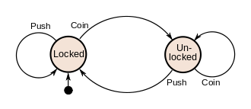
EECS 370 Discussion
Finite State Machines
Diagram of State, Conditions to change state, and Outputs
Conditions to change are based on inputs

Slide 12
EECS 370 Discussion
Finite State Machines
Example: Output a 1 on the pattern 001
States:
Pattern ‘1’
Pattern ‘0’
Pattern ‘00’
Pattern ‘001’ => Output = 1

Slide 13
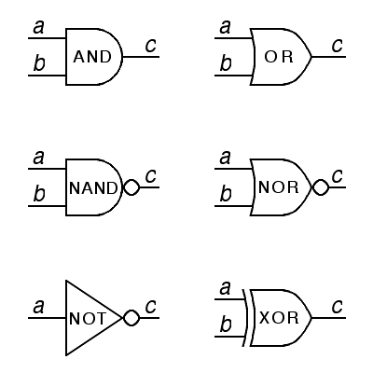
EECS 370 Discussion
Combinational Logic
Digital circuit representing a Boolean equation
Truth tables!!

Slide 14
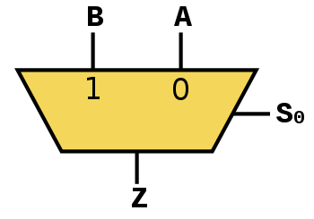
EECS 370 Discussion
Combinational Logic
More Complex Circuits:
Mux Decoder
A
A₀
Out₀
A₁
S
C
Out₁
B
Out₂
Out₃

Slide 15
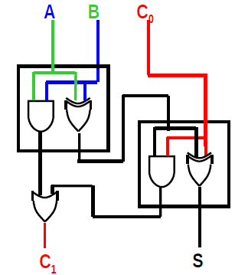
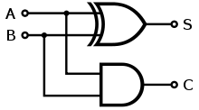
EECS 370 Discussion
Combinational Logic
More Complex Circuits: Full Adder
Half Adder

Slide 16
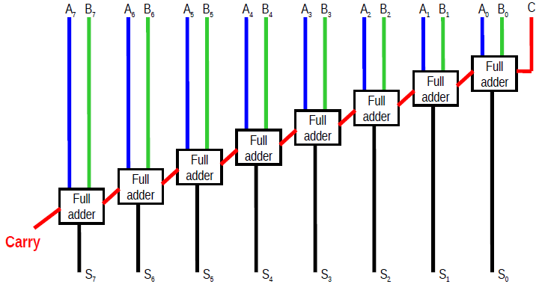
EECS 370 Discussion
Combinational Logic
More Complex Circuits:
Ripple Carry Adder

Slide 17
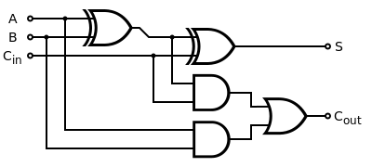
EECS 370 Discussion
Combinational Logic
Propagation Delay

Slide 18
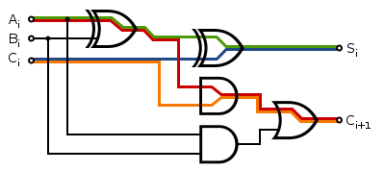
EECS 370 Discussion
Combinational Logic
Propagation Delay
Slows down the speed of your circuit!

Slide 19
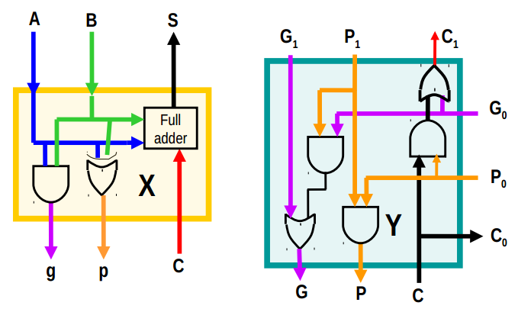
EECS 370 Discussion
Combinational Logic
Most Complex Circuits:
Carry Look-ahead Adder

Slide 20
EECS 370 Discussion
Sequential Logic
Combinational Logic
Stateless
Output is direct function of current input
Sequential Logic
Stateful
Output is function of current input and past input
Clocked!

Slide 21
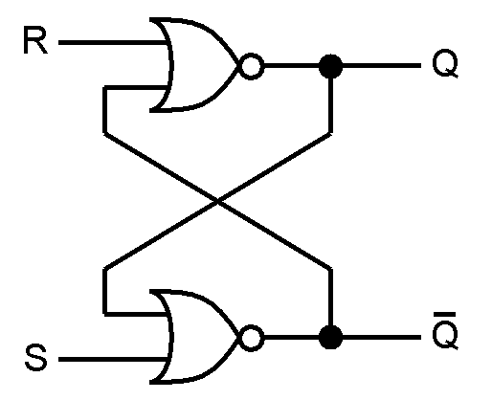
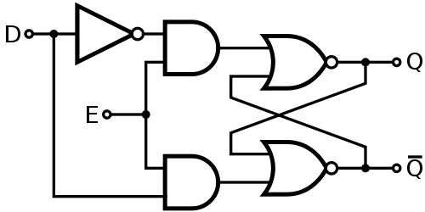
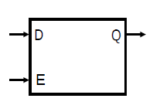
EECS 370 Discussion
Sequential Logic
Latches
SR Latch D Latch

Slide 22
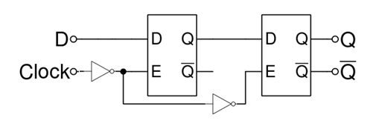

EECS 370 Discussion
Sequential Logic
Flip Flops
Positive Edge Triggered

Slide 23
EECS 370 Discussion
Sequential Logic
Why do we want clocked logic?
Specifies a time by which all operations are “done”
Results before that time do not matter

Slide 24
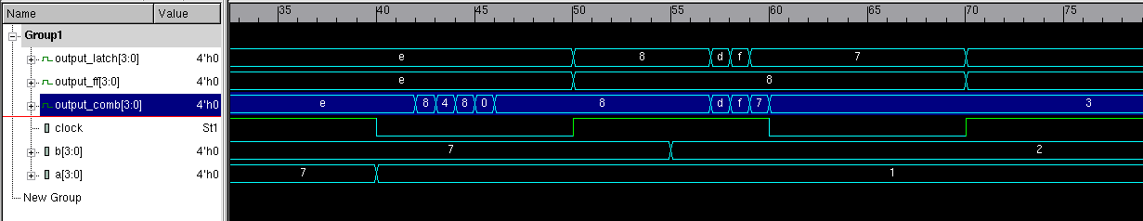
An Example of why this matters
Delays in combinational circuits are very real.
Here’s an example with a ripple carry adder.

Slide 25
An Example of why this matters
Let’s zoom in on the interesting part.
The value of a goes from 7 to 1 here

Slide 26
An Example of why this matters
Let’s zoom in on the interesting part.
There’s propagation delay before the adder even starts to change values.

Slide 27
An Example of why this matters
Let’s zoom in on the interesting part.
The value stabilizes

Slide 28
An Example of why this matters
Let’s zoom in on the interesting part.
The next clock edge comes along

Slide 29
An Example of why this matters
Let’s zoom in on the interesting part.
The latch opens up
(and shows new value)
The flip-flop grabs new value.

Slide 30
An Example of why this matters
Let’s zoom in on the interesting part.
B changes now,
while the clock is still high.

Slide 31
An Example of why this matters
Let’s zoom in on the interesting part.
Again, there’s propagation delay before the adder starts to change.

Slide 32
An Example of why this matters
Let’s zoom in on the interesting part.
The value in the latch changes too!

Slide 33
An Example of why this matters
Let’s zoom in on the interesting part.
The next falling edge comes along

Slide 34
An Example of why this matters
Let’s zoom in on the interesting part.
The adder stabilizes.

Slide 35
An Example of why this matters
Let’s zoom in on the interesting part.
The latch locked with the wrong value!

