Slide 1
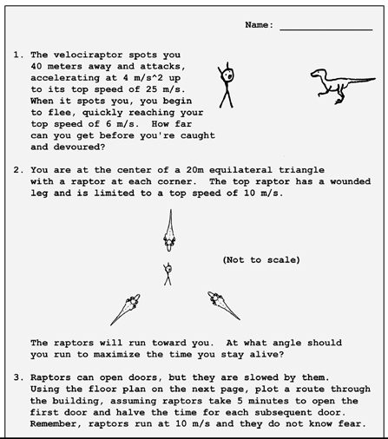
EECS 370 Discussion
Sample Exam Questions

Slide 2
EECS 370 Discussion
Not Really…
xkcd.com

Slide 3
EECS 370 Discussion
Topics Today:
Processor Components
Single-Cycle Datapath
Project 2
Time for Questions

Slide 4
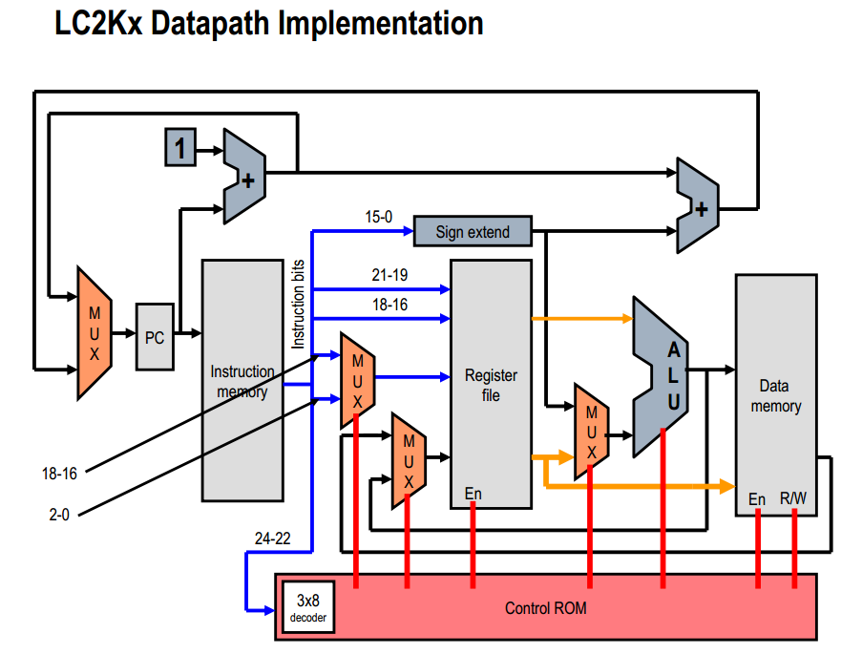
EECS 370 Discussion

Slide 5
EECS 370 Discussion
Processor Components
Control Blocks

Slide 6
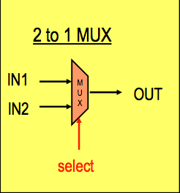
EECS 370 Discussion
Processor Components - Mux
Used to choose options
if (select == 0) {
OUT = IN1;
} else {
OUT = IN2;
}

Slide 7
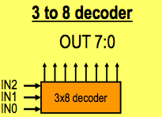
EECS 370 Discussion
Processor Components - Decoder
Allows an N-bit binary number to select one of 2^{N} output lines
IN | OUT
000 | 00000001
001 | 00000010
010 | 00000100
011 | 00001000
100 | 00010000
101 | 00100000
110 | 01000000
111 | 10000000

Slide 8
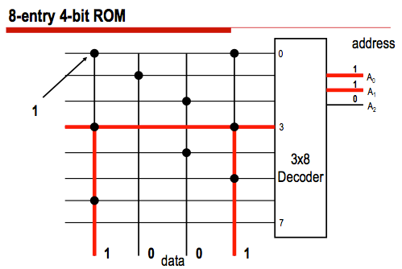
EECS 370 Discussion
Processor Components – ROM
Just a memory!
Address | Data
000 | 1001
001 | 0100
010 | 0010
011 | 1001
100 | 0010
101 | 0001
110 | 1000
111 | 0000

Slide 9
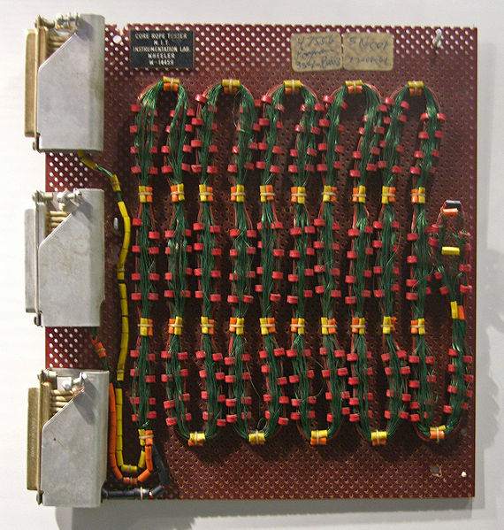
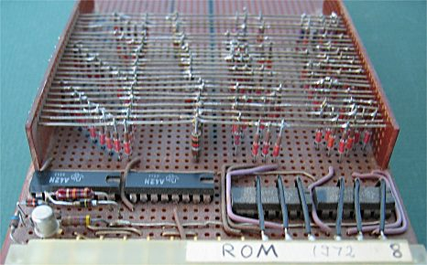
EECS 370 Discussion
Processor Components – ROM

Slide 10
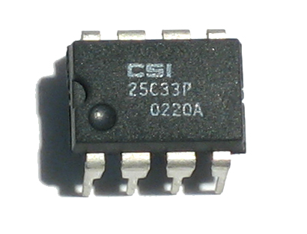
EECS 370 Discussion
Processor Components – ROM

Slide 11
EECS 370 Discussion
Processor Components
Mathematic Blocks

Slide 12
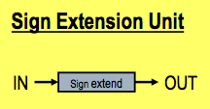
EECS 370 Discussion
Processor Components – Sign Extension Unit
Increases the number of bits in a value
Adds 1s or 0s as appropriate

Slide 13

EECS 370 Discussion
Processor Components – Adder
OUT = IN1 + IN2;
Is this a Half-Adder or Full-Adder?

Slide 14
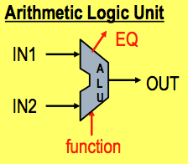
EECS 370 Discussion
Processor Components – ALU
Performs math operations
if (f == 0) {
OUT = IN1 + IN2;
} else {
OUT = IN1 ~& IN2;
}
EQ = (IN1 == IN2);

Slide 15
EECS 370 Discussion
Processor Components
State Blocks

Slide 16
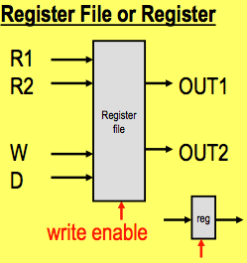
EECS 370 Discussion
Processor Components – Registers
R_ADDR1
R_ADDR2
W_ADDR
W_DATA

Slide 17
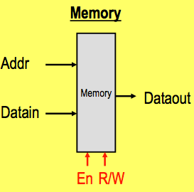
EECS 370 Discussion
Processor Components – Memory

Slide 18
EECS 370 Discussion
Single Cycle Datapath

Slide 19
EECS 370 Discussion

Slide 20
EECS 370 Discussion
Single Cycle Datapath
Key Concept: Entire path executes in a single clock cycle
Fetch Instruction
Decode Instruction
Execute Instruction
Memory Access
Writeback Data
This limits the clock speed to slowest instruction

Slide 21
EECS 370 Discussion
Single Cycle Datapath
Example: 5ns Reg Access, 10ns ALU Op, 20ns Mem Access
Inst | I-Mem Access | Read Register | ALU Operation | D-Mem Access | Write Register
add | ✔ | ✔ | ✔ |  | ✔
nand | ✔ | ✔ | ✔ |  | ✔
lw | ✔ | ✔ | ✔ | ✔ | ✔
sw | ✔ | ✔ | ✔ | ✔
beq | ✔ | ✔ | ✔
jalr | ✔ | ✔
noop | ✔
halt | ✔

Slide 22
EECS 370 Discussion
Project 2

Slide 23
EECS 370 Discussion
Project 2
Suggested Register Convention
HIGHLY recommended you follow this
Register | Use
R0 | Value 0
R1 | Input N
R2 | Input R
R3 | Return Value
R4 | Local Variable
R5 | Stack Pointer
R6 | Temporary Value
R7 | Return Address

Slide 24
EECS 370 Discussion
?
Exam Review Questions

