Slide 1
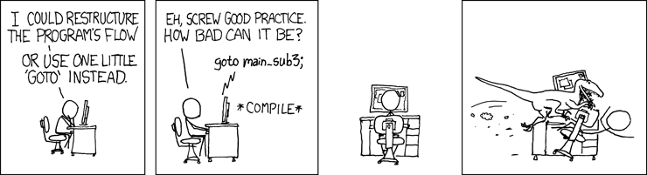
EECS 370 Discussion
xkcd.com

Slide 2
EECS 370 Discussion
Mid-semester Feedback
Thanks!

Slide 3
EECS 370 Discussion
Topics Today:
Multi-cycle Datapath
Project 2
Exams

Slide 4
EECS 370 Discussion
Exam Results
Answer Keys are posted online
Exams will be returned now next week

Slide 5
EECS 370 Discussion
Multi-Cycle Datapath
Key Concepts
Is the frequency of the processor Higher or Lower than Single Cycle?
Will any individual instruction take the same amount of time to complete?

Slide 6
EECS 370 Discussion
Multi-Cycle Datapath
Key Concepts
Is the frequency of the processor Higher or Lower than Single Cycle?
HIGHER (each stage is simpler)
Will any individual instruction take the same amount of time to complete?
NO (some have more states than others)

Slide 7
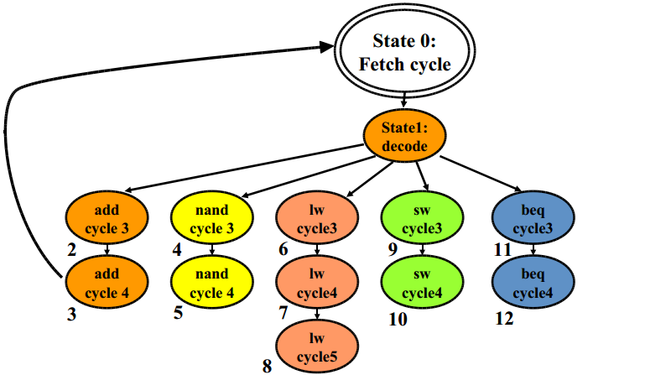
EECS 370 Discussion
Multi-Cycle Datapath

Slide 8
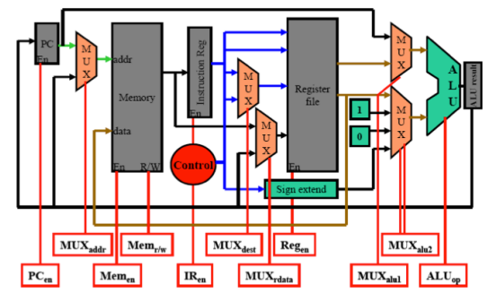
EECS 370 Discussion
Multi-Cycle Datapath

Slide 9
EECS 370 Discussion
Multi-Cycle Datapath
Timing Example
Single Cycle Processor
5 ns – Register Read/Write
10 ns – ALU Operations
20 ns – Memory Access
Inst | I-Mem Access | Read Register | ALU Operation | D-Mem Access | Write Register | Cycle Time
add | ✔ | ✔ | ✔ |  | ✔
nand | ✔ | ✔ | ✔ |  | ✔
lw | ✔ | ✔ | ✔ | ✔ | ✔
sw | ✔ | ✔ | ✔ | ✔
beq | ✔ | ✔ | ✔

Slide 10
EECS 370 Discussion
Multi-Cycle Datapath
Timing Example
Single Cycle Processor
5 ns – Register Read/Write
10 ns – ALU Operations
20 ns – Memory Access
Inst | I-Mem Access | Read Register | ALU Operation | D-Mem Access | Write Register | Cycle Time
add | ✔ | ✔ | ✔ |  | ✔ | 40 ns
nand | ✔ | ✔ | ✔ |  | ✔ | 40 ns
lw | ✔ | ✔ | ✔ | ✔ | ✔ | 60 ns
sw | ✔ | ✔ | ✔ | ✔ |  | 55 ns
beq | ✔ | ✔ | ✔ |  |  | 35 ns

Slide 11
EECS 370 Discussion
Multi-Cycle Datapath
Timing Example
Multi Cycle Processor
5 ns – Register Read/Write
10 ns – ALU Operations
20 ns – Memory Access
Inst | Number of Cycles
add
nand
lw
sw
beq

Slide 12
EECS 370 Discussion
Multi-Cycle Datapath
Timing Example
Multi Cycle Processor
5 ns – Register Read/Write
10 ns – ALU Operations
20 ns – Memory Access
Inst | Number of Cycles
add | 4
nand | 4
lw | 5
sw | 4
beq | 4

Slide 13
EECS 370 Discussion
Multi-Cycle Datapath
Timing Example
Multi Cycle Processor
What is our cycle time?
5 ns – Register Read/Write
10 ns – ALU Operations
20 ns – Memory Access
Inst | Number of Cycles
add | 4
nand | 4
lw | 5
sw | 4
beq | 4

Slide 14
EECS 370 Discussion
Multi-Cycle Datapath
Timing Example
Multi Cycle Processor
What is our cycle time?
20 ns
5 ns – Register Read/Write
10 ns – ALU Operations
20 ns – Memory Access
Inst | Number of Cycles
add | 4
nand | 4
lw | 5
sw | 4
beq | 4

Slide 15
EECS 370 Discussion
Multi-Cycle Datapath
Timing Example
100 Instructions:
What is the total execution time?
Single Cycle:
Multi-Cycle:
35% lw
15% sw
40% add/nand
20% beq

Slide 16
EECS 370 Discussion
Multi-Cycle Datapath
Timing Example
100 Instructions:
What is the total execution time?
Single Cycle: 100 * 60 = 6000 ns
Multi-Cycle: 20 * (35*5 + 15*4 + 30*4 + 20*4) = 8700 ns
35% lw
15% sw
30% add/nand
20% beq

Slide 17
EECS 370 Discussion
Project 2
Key Concepts
How many of you have read the project specification?
Is it the same multi-cycle processor from class?

Slide 18
EECS 370 Discussion
Project 2
Key Concepts
How many of you have read the project specification?
All of you, cause you’re the best students ever!!
Is it the same multi-cycle processor from class?
NO

Slide 19
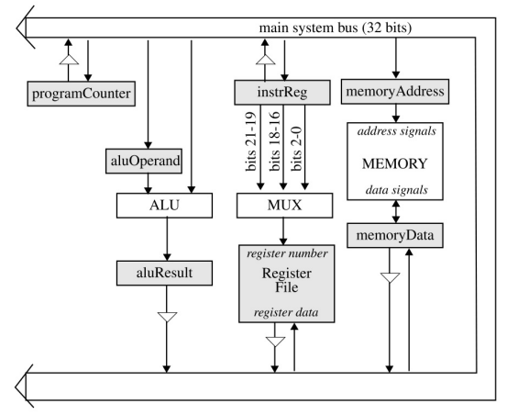
EECS 370 Discussion
Project 2 - Multicycle

Slide 20
EECS 370 Discussion
Project 2 - Multicycle
Illegal State Transitions
Write to register and read it in same cycle
Write two different values to bus in same cycle
Use value on bus from previous cycle
Use hardware twice in same cycle
Memory
ALU

Slide 21
EECS 370 Discussion
Project 2 - Multicycle
Commonly Overlooked Optimization
For PC, don’t use the ALU to increment
state.pc++

Slide 22
EECS 370 Discussion
Project 2 - Combinations
Let’s write a function in LC2K assembly
(Caller Saved Registers)
int main( ) {
int a = 2;
int b = 3;
int c = func(a, b);
return c + a;
}
int func(int n, int r) {
return n+r+1;
}
Register | Use
R0 | Value 0
R1 | Input N
R2 | Input R
R3 | Return Value
R4 | Local Variable
R5 | Stack Pointer
R6 | Temporary Value
R7 | Return Address

Slide 23
EECS 370 Discussion
lw 0 1 n_2
lw 0 2 n_3
lw 0 4 fnAdr
lw 0 6 n_1
sw 5 1 stack
add 5 6 5
jalr 4 7
lw 0 6 n_n1
add 5 6 5
lw 5 1 stack
add 3 1 3
halt
func lw 0 6 n_1
add 1 2 3
add 3 6 3
jalr 7 4
n_1 .fill 1
n_2 .fill 2
n_3 .fill 3
n_n1 .fill -1
fnAdr .fill func
stack .fill 0
Save
Load

