Slide 1
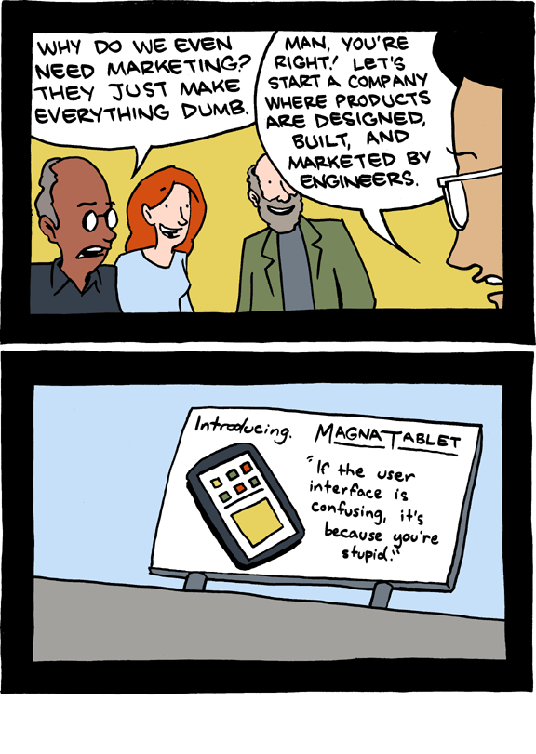
EECS 370 Discussion
smbc-comics.com

Slide 2
EECS 370 Discussion
Topics Today:
5-stage Pipeline
Basic Design
Performance
Data Hazards
Exams

Slide 3
EECS 370 Discussion
Single Cycle
CPI =
Clock Period =

Slide 4
EECS 370 Discussion
Single Cycle
CPI = 1
Clock Period = long
Multi-Cycle
CPI =
Clock Period =

Slide 5
EECS 370 Discussion
Single Cycle
CPI = 1
Clock Period = long
Multi-Cycle
CPI = >1
Clock Period = short
Pipelined
CPI =
Clock Period =

Slide 6
EECS 370 Discussion
Single Cycle
CPI = 1
Clock Period = long
Multi-Cycle
CPI = >1
Clock Period = short
Pipelined
CPI ≈ 1
Clock Period = short

Slide 7
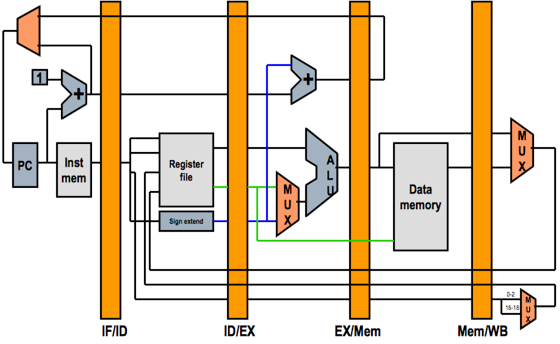
EECS 370 Discussion
5-stage Pipeline

Slide 8
EECS 370 Discussion
5-stage Pipeline
Pipeline Example
add 1 2 3
nand 4 5 6
lw 0 4 26
add 2 2 2
nand 1 1 1

Slide 9
EECS 370 Discussion
5-stage Pipeline
Key Concept
1000 instructions are run on a 5-stage pipeline (no hazards)
How many cycles are needed to complete them?

Slide 10
EECS 370 Discussion
5-stage Pipeline
Key Concept
1000 instructions are run on a 5-stage pipeline (no hazards)
How many cycles are needed to complete them?
1004 cycles

Slide 11
EECS 370 Discussion
Multi-Cycle Datapath
Timing Example
100 Instructions:
What is the total execution time? (No Hazards)
Single Cycle: 100 * 60 = 6000 ns
Multi-Cycle: 20 * (35*5 + 15*4 + 30*4 + 20*4) = 8700 ns
Pipelined:
35% lw
15% sw
30% add/nand
20% beq
5 ns – Register Read/Write
10 ns – ALU Operations
20 ns – Memory Access

Slide 12
EECS 370 Discussion
Multi-Cycle Datapath
Timing Example
100 Instructions:
What is the total execution time? (No Hazards)
Single Cycle: 100 * 60 = 6000 ns
Multi-Cycle: 20 * (35*5 + 15*4 + 30*4 + 20*4) = 8700 ns
Pipelined: 20 * (4 + 100) = 2080 ns
35% lw
15% sw
30% add/nand
20% beq
5 ns – Register Read/Write
10 ns – ALU Operations
20 ns – Memory Access

Slide 13
EECS 370 Discussion
Data Hazards
Key Concepts
In what stage is data read from registers?
In what stage is data written to registers?

Slide 14
EECS 370 Discussion
Data Hazards
Key Concepts
In what stage is data read from registers?
Decode
In what stage is data written to registers?
Writeback

Slide 15
EECS 370 Discussion
Data Hazards
The Problem:
x = 5*y+3;
LDR R1 [R0, #wherever y is]
MUL R2 R1 #5
ADD R2 R2 #3
STR R2 [R0, #wherever x is]

Slide 16
EECS 370 Discussion
Data Hazards
Solutions:
Avoidance
Detect and Stall
Detect and Forward

Slide 17
EECS 370 Discussion
Data Hazards
Pipeline Example
add 1 2 3
nand 3 5 6
lw 0 3 26
add 6 2 4
nand 4 3 1

Slide 18
EECS 370 Discussion
Exam Results
Answer Keys are posted online
Exams will be returned now next week
Regrade Requests:
Submit Scantron + written statement to IA/GSI/Professor
Before Friday

