Slide 1
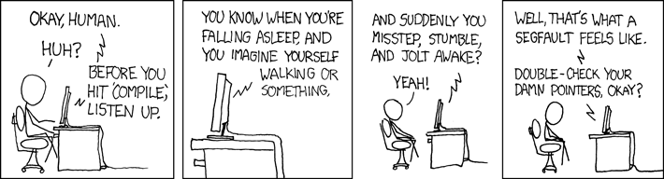
EECS 370 Discussion
xkcd.com

Slide 2
EECS 370 Discussion
Topics Today:
Control Hazards
Branch Prediction
Project 3
stackoverflow Example

Slide 3
EECS 370 Discussion
Control Hazards
Key Concept
Which LC-2K instruction(s) can cause a Control Hazard?
In which stage are branches resolved?

Slide 4
EECS 370 Discussion
Control Hazards
Key Concept
Which LC-2K instruction(s) can cause a Control Hazard?
BEQ & JALR
In which stage are branches resolved?
MEM

Slide 5
EECS 370 Discussion
Control Hazards
Problem:
If we don’t know what the next PC should be
what do we do?
Options:
No Branches
Avoid
Detect-and-stall
Speculate-and-squash

Slide 6
EECS 370 Discussion
Control Hazards
No Branches
Is this a feasible solution?
How could we eliminate this if statement?
if (r0 == r1) {
r2 = r3;
} else {
r2++;
}

Slide 7
EECS 370 Discussion
Control Hazards
No Branches
Is this a feasible solution?
How could we eliminate this if statement?
Conditional Assembly!
if (r0 == r1) {
r2 = r3;
} else {
r2++;
}
cmp r0, r1
moveq r2, r3
addne r2, r2, #1

Slide 8
EECS 370 Discussion
Control Hazards
Avoid
ADD 1 1 1
NAND 2 2 2
BEQ 3 0 jump
ADD 4 4 4
NAND 5 5 5
jump ADD 6 6 6
NAND 7 7 7

Slide 9
EECS 370 Discussion
Control Hazards
Detect-and-stall
Any better than avoid?

Slide 10
EECS 370 Discussion
Control Hazards
Speculate-and-squash
Guess!
What do you have to do if you’re correct?
What do you have to do if you’re wrong?

Slide 11
EECS 370 Discussion
Control Hazards
Speculate-and-squash
Guess!
What do you have to do if you’re correct?
Nothing at all
What do you have to do if you’re wrong?
Turn IF, ID, & EX into Noops

Slide 12
EECS 370 Discussion
Branch Prediction
Based on the PC
What did this branch do last time?
1-bit predictor
Not Taken
Not Taken
Taken
Taken

Slide 13
EECS 370 Discussion
Branch Prediction
2-bit predictor
Not Taken
Not Taken
Not Taken
Strongly
Not Taken
Weakly Not Taken
Weakly Taken
Strongly Taken
Taken
Taken
Taken

Slide 14
EECS 370 Discussion
Branch Prediction
What does the PC become if we predict Not Taken?
What does the PC become if we predict Taken?

Slide 15
EECS 370 Discussion
Branch Prediction
What does the PC become if we predict Not Taken?
PC+1
What does the PC become if we predict Taken?
???

Slide 16
EECS 370 Discussion
Branch Prediction
Branch Target Buffer
Maps PC values to Addresses
PC | Address
0x1234 | 0x00001000
0x4523 | 0x00004000
0xA342 | 0x00000004
0xFF76 | 0x0000A342

Slide 17

EECS 370 Discussion
Branch Prediction
Do we branch? Where?
PC
PC | Address
0x1234
0x4523
0xA342
0xFF76
PC | Address
0x1234 | 0x00001000
0x4523 | 0x00004000
0xA342 | 0x00000004
0xFF76 | 0x0000A342

Slide 18
EECS 370 Discussion
Project 3
Make your own pipelined processor
Need to use code for the file input from Project 1
Write non-hazard code first
Design good test code!!

Slide 19
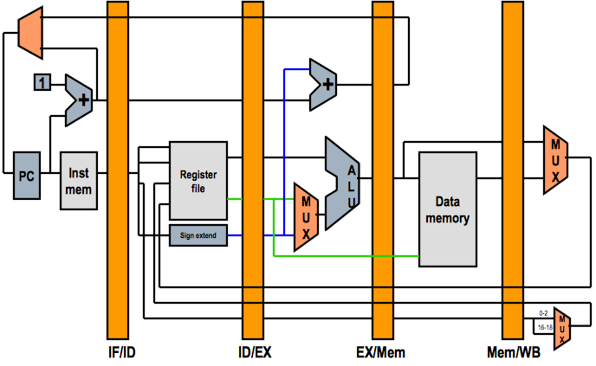
EECS 370 Discussion
WBEND Register and Forwarding
WBEND

Slide 20
EECS 370 Discussion
stackoverflow example
Real-world example. Why this stuff matters.
http://stackoverflow.com/questions/11227809/why-is-processing-a-sorted-array-faster-than-an-unsorted-array

Slide 21
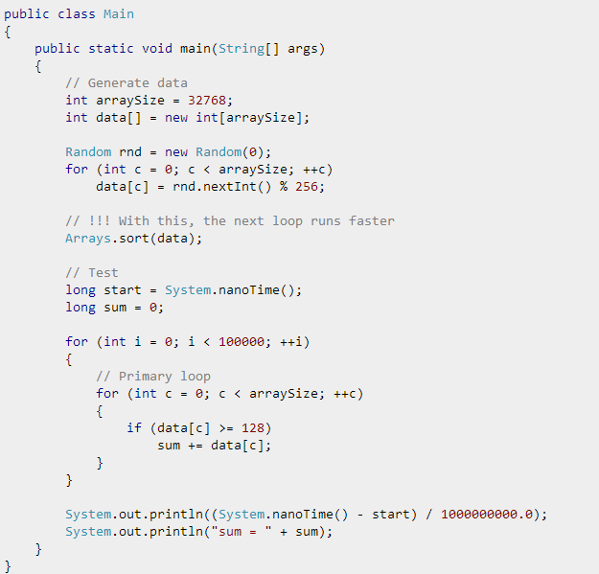
EECS 370 Discussion

Slide 22
EECS 370 Discussion
With this line: 6.54 seconds
Without: 13.84 seconds

Slide 23
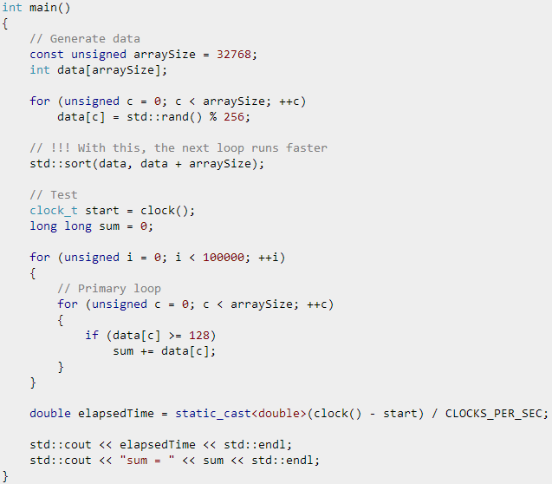
EECS 370 Discussion
With this line: 1.93 seconds
Without: 11.54 seconds

Slide 24
EECS 370 Discussion
Why is this happening? What is causing the time differences?

Slide 25
EECS 370 Discussion
Branch Prediction!

