Slide 1
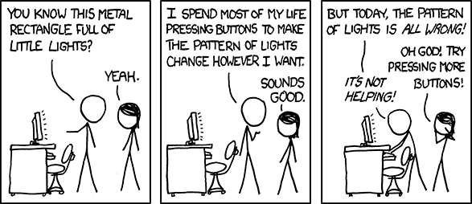
EECS 370 Discussion
xkcd.com

Slide 2
EECS 370 Discussion
Topics Today:
Function Calls
Caller / Callee Saved Registers
Call Stack
Memory Layout
Stack, Heap, Static, Text
Object Files
Symbol and Relocation Tables

Slide 3
EECS 370 Discussion
Caller / Callee Saved Registers
Goal: Call arbitrary functions
Problem: Other functions use the same registers as I do
What if they overwrite my registers?
Solution: Somebody needs to save them to memory first!

Slide 4
EECS 370 Discussion
Caller / Callee Saved Registers
Simple Solution #1
Save all registers before calling functions (Caller Saved Registers)
Only save registers you want to keep
Problem:
foo();

Slide 5
EECS 370 Discussion
Caller / Callee Saved Registers
Simple Solution #2
New functions save all registers (Callee Saved Registers)
Only save registers you want to use
Problem:
for (i=0; i<10; i++) {
foo();
}

Slide 6
EECS 370 Discussion
Caller / Callee Saved Registers
Real-world Solution ARM
Mixture of both
R0 – R3 | Caller Saved
R4 – R11 | Callee Saved
R12 | Scratch
R13 | Stack Pointer
R14 | Link Register
R15 | Program Counter

Slide 7
EECS 370 Discussion
Caller / Callee Saved Registers
Example:
int foo (void) {
int r0 = 3;
int r1 = 0;
int r2 = 0;
r2 = bar(r1);
return (r2 + r1);
}
int bar (void) { … uses r0, r1, and r2 … }
How many total stores for:
Caller Saved?
Callee Saved?

Slide 8
EECS 370 Discussion
Caller / Callee Saved Registers
Example:
int foo (void) {
int r0 = 3;
int r1 = 0;
int r2 = 0;
r2 = bar(r1);
return (r2 + r1);
}
int bar (void) { … uses r0, r1, and r2 … }
How many total stores for:
Caller Saved?
1
Callee Saved?
3

Slide 9
EECS 370 Discussion
Function Calls
Stack data associated with a function:
Return Address
Previous Frame Pointer
Callee Saved Registers
Local Variables
Spilled Registers
Caller Saved Registers
Outgoing Parameters
FP
SP

Slide 10
EECS 370 Discussion
Function Calls
Example: The Stack
Function foo() gets called
FP
SP

Slide 11
EECS 370 Discussion
Function Calls
Example: The Stack
1) Save the Return Address
FP
Return Address
SP

Slide 12
EECS 370 Discussion
Function Calls
Example: The Stack
2) Save the Frame Pointer
FP
Return Address
Previous Frame Pointer
SP

Slide 13
EECS 370 Discussion
Function Calls
Example: The Stack
3) Move the Frame Pointer
Return Address
Previous Frame Pointer
FP
SP

Slide 14
EECS 370 Discussion
Function Calls
Example: The Stack
4) Save Callee-saved Registers
Return Address
Previous Frame Pointer
Callee Saved Registers
FP
SP

Slide 15
EECS 370 Discussion
Function Calls
Example: The Stack
5) Make space for local variables
Also initialize them
Return Address
Previous Frame Pointer
Callee Saved Registers
Local Variables
FP
SP

Slide 16
EECS 370 Discussion
Function Calls
Example: The Stack
6) Allocate additional space if needed
Return Address
Previous Frame Pointer
Callee Saved Registers
Local Variables
Spilled Registers
FP
SP

Slide 17
EECS 370 Discussion
Function Calls
Example: The Stack
Function is ready to begin running
Return Address
Previous Frame Pointer
Callee Saved Registers
Local Variables
Spilled Registers
FP
SP

Slide 18
EECS 370 Discussion
Function Calls
Example: The Stack
Executes code for a while…
Return Address
Previous Frame Pointer
Callee Saved Registers
Local Variables
Spilled Registers
FP
SP

Slide 19
EECS 370 Discussion
Function Calls
Example: The Stack
Going to call function bar()
Return Address
Previous Frame Pointer
Callee Saved Registers
Local Variables
Spilled Registers
FP
SP

Slide 20
EECS 370 Discussion
Function Calls
Example: The Stack
1) Save Caller-saved Registers
Return Address
Previous Frame Pointer
Callee Saved Registers
Local Variables
Spilled Registers
Caller Saved Registers
FP
SP

Slide 21
EECS 370 Discussion
Function Calls
Example: The Stack
2) Put arguments for bar() on the stack
(if needed)
Return Address
Previous Frame Pointer
Callee Saved Registers
Local Variables
Spilled Registers
Caller Saved Registers
Outgoing Parameters
FP
SP

Slide 22
EECS 370 Discussion
Function Calls
Example: The Stack
Function bar() gets called
Return Address
Previous Frame Pointer
Callee Saved Registers
Local Variables
Spilled Registers
Caller Saved Registers
Outgoing Parameters
FP
SP

Slide 23
EECS 370 Discussion
Return Address
Previous Frame Pointer
Callee Saved Registers
Local Variables
Spilled Registers
Caller Saved Registers
Outgoing Parameters
Return Address
Previous Frame Pointer
Callee Saved Registers
Local Variables
Spilled Registers
Function Calls
Example:
The process repeats…
foo()
bar()
FP
SP

Slide 24
EECS 370 Discussion
Memory Layout
Address 0xFFFFFFFF
Stack
Heap
Static
Text
Address 0x00000000

Slide 25
EECS 370 Discussion
Memory Layout
Example:
int a;
void foo(short b) {
static int c = 3;
char* d;
d = (char*) malloc(4);
printf(“Hello EECS370\n”);
}
Stack
Heap
Static
Text

Slide 26
EECS 370 Discussion
Object Files
Header
Sizes of the other sections
Text
All code
Data
Global and Static data
Symbol Table
Connects label names to specific Data or Text locations
Relocation Table
Lists instructions that rely on absolute addresses

Slide 27
EECS 370 Discussion
Object Files
Example :
What goes in the Symbol Table?
What goes in the Relocation Table
int a;
void foo(int b) {
x = b;
printf(“%d\n”, x);
a = 15;
return;
}

Slide 28
EECS 370 Discussion
Object Files
Putting together an executable:
Add text sections together
Add data sections together
Check that all symbols are resolved
Relocate absolute references

Slide 29
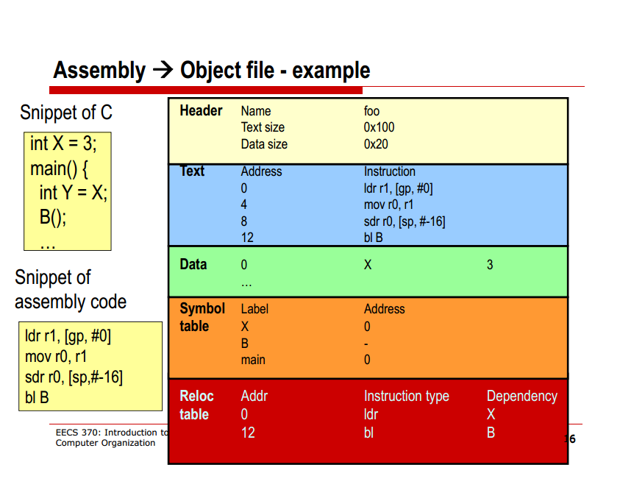
EECS 370 Discussion

Slide 30
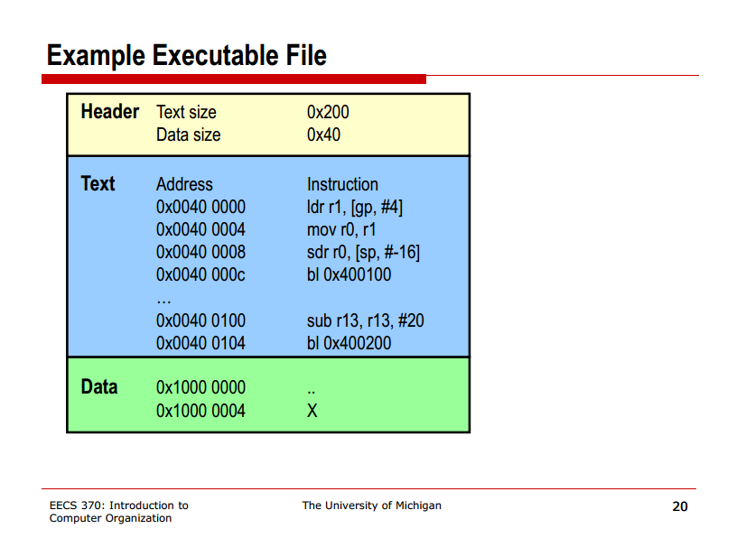
EECS 370 Discussion

