Slide 1




Challenge: Unlicensed LPWANs Are Not Yet the Path to Ubiquitous Connectivity
Branden Ghena¹, Joshua Adkins¹, Longfei Shangguan², Kyle Jamieson³, Philip Levis⁴, Prabal Dutta¹
1
2
3
4
Notes:
Hi, I’m Branden Ghena, a PhD student at UC Berkeley. I’m presenting our challenge paper on LPWANS.
We’re really excited about the potential of the low-power, wide-area network space
The idea that we could pop up a gateway or two and support communication for devices over an entire city is incredibly powerful

Slide 2
Challenge to the community
Ubiquitous connectivity needs are not yet met by unlicensed LPWANs
Significant improvements in capacity and coexistence are needed
Without these improvements
Many applications will move to cellular IoT networks
Unlicensed LPWANs will be relegated to remote deployments and controlled campuses
Notes:
However, I’m here to present our challenge to the community
Ubiquitous connectivity needs are not yet met by unlicensed LPWANs
Significant improvements to the protocols are necessary
And without improvements, we believe applications will abandon unlicensed protocols for cellular networks
In this presentation I'll show you how we came to this conclusion

Slide 3
Two major categories of low-power, wide-area network protocols
Unlicensed LPWANs
Sigfox, LoRaWAN, etc.
Unlicensed band, 915 MHz (US)
Managed or user deployable
Notes:
The Low-Power, Wide-Area Networks we’re talking about come in two major categories, Unlicensed LPWANs and Cellular IoT
Unlicensed LPWANs include networks you may have heard of like Sigfox and LoRaWAN
They operate in unlicensed spectrum, 915 MHz in the US
LoRaWAN is user-deployable as well. You can go on Digikey, purchase a gateway, and deploy it anywhere you want
These networks are particularly exciting because they operate without a license
This means research deployments can modify the protocols and test their modifications easily

Slide 4
Two major categories of low-power, wide-area network protocols
Unlicensed LPWANs
Sigfox, LoRaWAN, etc.
Unlicensed band, 915 MHz (US)
Managed or user deployable
Cellular IoT
LTE-M and NB-IoT
Licensed cellular bands
Managed networks
Rolled out US-wide
Notes:
Cellular IoT includes the new machine-to-machine focused cellular protocols, LTE-M and NarrowBand-IoT
These operate in the standard licensed cellular bands in managed networks
On the right you can see
Each of these networks have range on the order of kilometers
Throughput focuses on uplink, with rates of ten to several thousand kbps
We also have 2G plotted as an example of the kinds of networks we’re evolving from
LPWANs have lower throughput, but increased range over the 2G protocol

Slide 5
Ubiquitous applications already exist …
Ecological sensing
Zebranet, Great Duck Island, Volcano Monitoring, Macroscope, Green Orbs
City-Scale Sensing
Trash Cans, Electricity Meters, Air Quality Sensors
Human-Centric Sensing
Human disease spread monitoring
Notes:
The exciting ubiquitous applications that these networks support are already out there
Ecological sensing that has been important in our field for a long time, like Zebranet or Great Duck Island
Many applications focused on city-scale sensing, such as localized air quality sensing, are being deployed as well

Slide 6
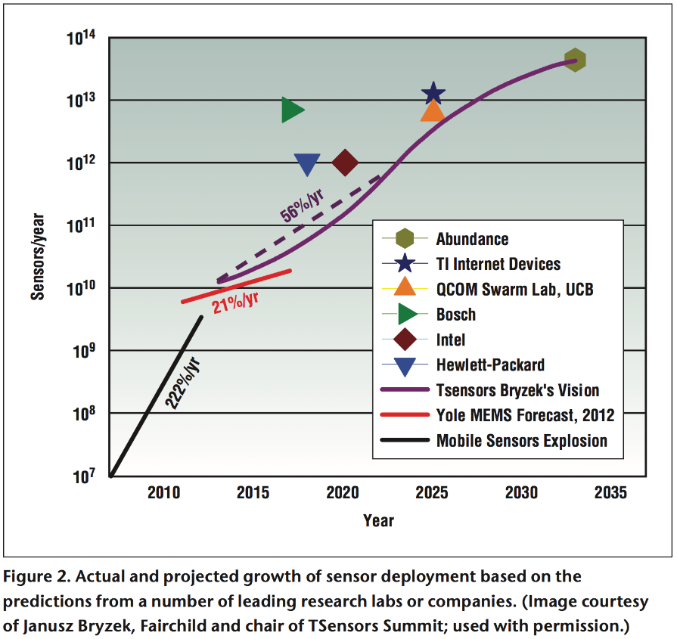
… and the deployment of devices continues to expand
Notes:
These motivating applications are only becoming more and more relevant as deployed devices increases from Billions to Trillions
And they all need to communicate

Slide 7
Do LPWANs meet ubiquitous connectivity needs?
What metric do we use to determine suitability?
Focus on throughput rather than latency or energy
Explore suitability for an example application
Notes:
The question we investigated is whether LPWANs can actually meet the needs ubiquitously deployed applications
First, we’re going to look at what metric we use to determine suitability
And here we’re focusing on throughput, but latency and especially energy use are important as well
Then, I’ll explore how well the networks can provide for an example application and what problems they face

Slide 8
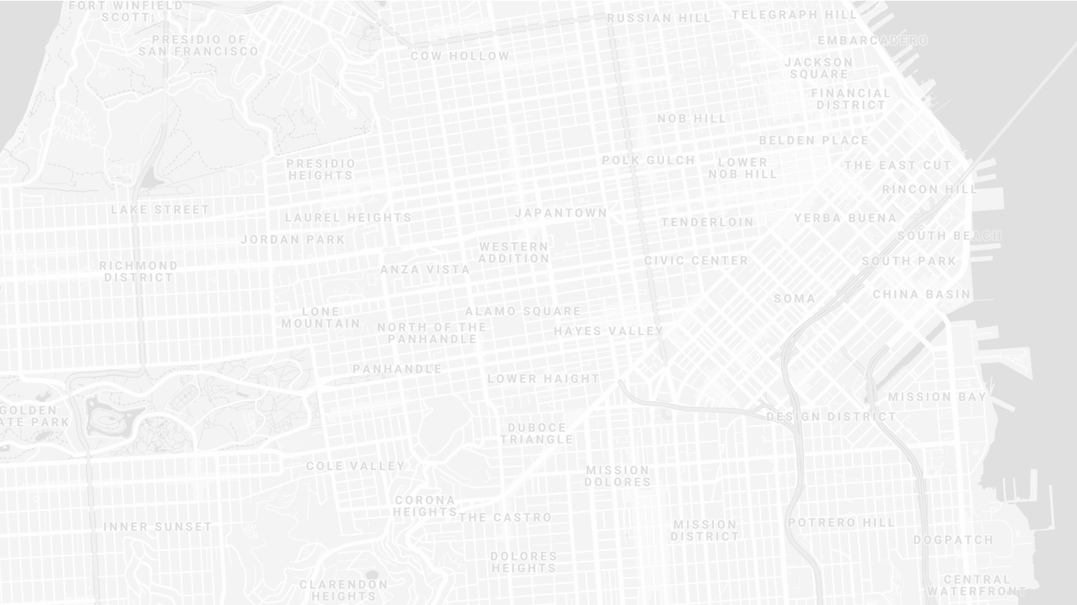
Goal: compare applications and networks
Ubiquitous applications are wider than a single gateway’s coverage
Need to account for physical space of deployment and range of gateways
Compare the density of data transmission
Notes:
Our goal is to compare applications and networks
The problem is that for ubiquitously deployed applications, we’re not talking about a single location
Deployments are wider than a single gateway, even with kilometers of range
So we need to take into account the physical space of the deployments and the range of gateways
We’re going to abstract this into a measure of data density

Slide 9
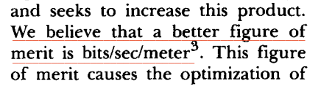
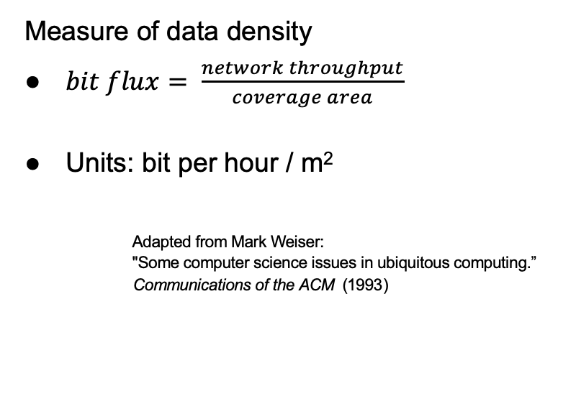
Bit flux metric of data density
Measure of data density
$bit flux= \frac{network throughput}{coverage area}$
Units: bit per hour / m²
Adapted from Mark Weiser: "Some computer science issues in ubiquitous computing.” Communications of the ACM (1993)
Notes:
bit flux is our metric for data density
throughput divided by coverage area
As with many ideas, this was first suggested by Mark Weiser

Slide 10
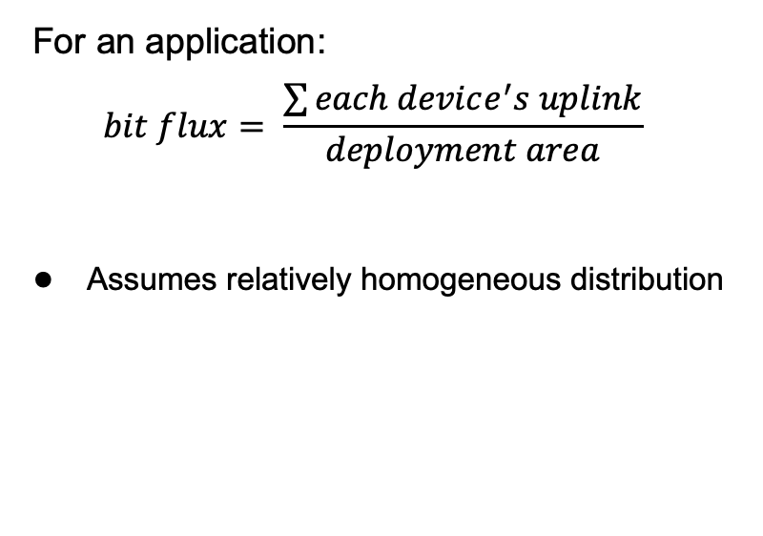
Bit flux measures applications…
For an application:
$$bit flux= \frac{\sum{each device^{′}s uplink}}{deployment area}$$
Assumes relatively homogeneous distribution
Notes:
For applications, bit flux sums the data needs for each device in the deployment
And divides by the total deployment area
To determine the application uplink density

Slide 11
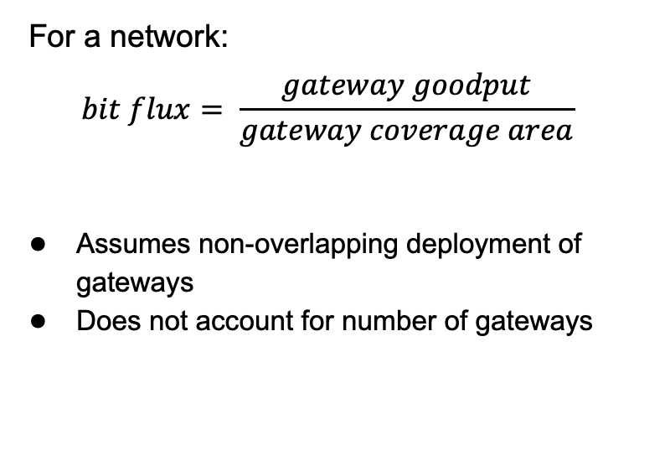
…and bit flux measures networks
For a network:
$$bit flux= \frac{gateway goodput}{gateway coverage area}$$
Assumes non-overlapping deployment of gateways
Does not account for number of gateways
Notes:
For networks, we divide the goodput of a network
By the coverage area of a single gateway
This gives us a number that represents the data density that a network can support, at any width of deployment

Slide 12

Bit flux accounts for spatial reuse
Reducing coverage area and deploying additional gateways improves capacity
$bit flux↑ = \frac{gateway goodput}{coverage area↓}$
Notes:
Bit flux also accounts for spatial reuse in networks
Reducing range (and deploying more gateways), reduces the coverage area for each gateway, increasing the network bit flux

Slide 13
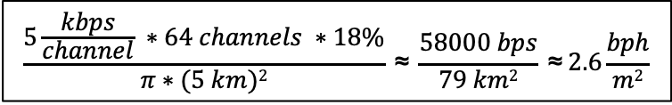
Bit flux measurement for LoRaWAN
ALOHA access control
$$\frac{5\frac{kbps}{channel} ∗64 channels ∗18\%}{π∗(5 km)2} \text{≈} \frac{58000 bps}{79 km2} \text{≈} 2.6\frac{bph}{m2}$$
Hata model
Notes:
Here is the bit flux measurement for a LoRaWAN network
In the US, LoRaWAN has 64 channels for uplink
But it relies on an ALOHA access control mechanism, so packet collisions reduce throughput significantly

Slide 14
Networks differ in capability by orders of magnitude
Notes:
We can calculate bit flux for each of the networks we’re interested in
We note that there are several orders of magnitude difference in the throughput capability of each network
Particularly between cellular communication and unlicensed LPWANs

Slide 15
Range reduction results in a bit flux curve for each network
Notes:
These points are at the maximum range for each network, but they have the ability to perform power control and reduce range
This creates a curve for each network, where we can reduce range (and install more gateways) in order to increase network capability

Slide 16
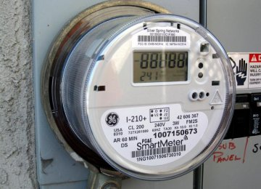
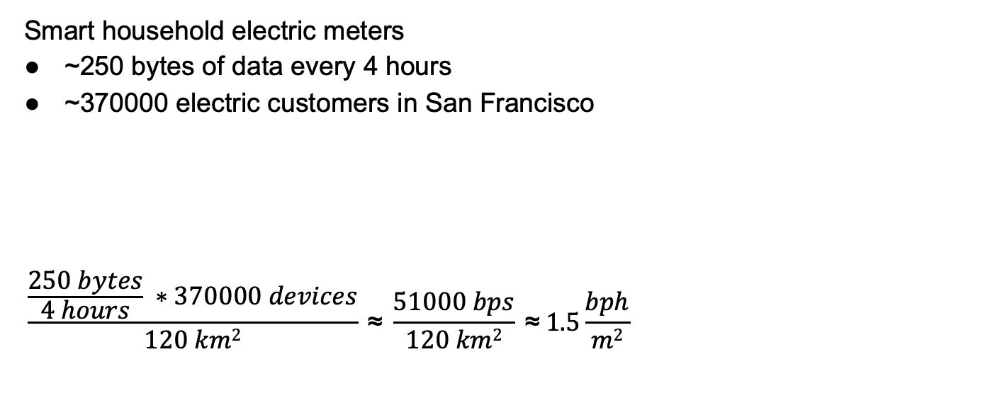
Application example
Smart household electric meters
~250 bytes of data every 4 hours
~370000 electric customers in San Francisco
$$\frac{\frac{250 bytes}{4 hours} ∗370000 devices}{120 km2} \text{≈} \frac{51000 bps}{120 km2} \text{≈} 1.5\frac{bph}{m2}$$
Notes:
Now that we can measure the capability of each network, lets compare that to the needs of an application
The example I’ll be talking through is Electricity Metering, there are about a dozen others in the paper
PG&E smart meters send about 250 bytes every 4 hours
This isn’t a lot of data, but smart meters are densely deployed, with three hundred thousand across San Francisco

Slide 17
All networks are capable of meeting data needs of electricity metering
Electricity Metering Application
Notes:
We can plot the need of the Electricity Metering application as a line on our bit flux figure
Any network above this line is capable of serving the application’s needs
Sigfox needs range reduction, but all networks are capable of serving this application’s needs
So, great! Networks can serve ubiquitous applications. Problem solved, right?

Slide 18
Unlicensed LPWANs lag behind Cellular IoT in ability to support applications
2G < 0.03% utilized
Notes:
Let’s visualize this instead as the number of gateways deployed and the proportion of network utilized.
Again, because of power control, there is a tradeoff here. We could deploy a single gateway for everything, or many gateways with reduced range to increase capacity.
Cellular networks have no problem with this application
With a single gateway, LTE-M could spend 1% of its capacity to service this app.
Unlicensed LPWANs, however, have choices to make on how many gateways they deploy and how much capacity they are willing to spend on this one application

Slide 19
Sigfox requires range reduction to meet application needs
Capacity Problem
Throughput capability of Sigfox is insufficient to support application needs
It can only support the application with reduced range and additional gateways
Notes:
There are two particular problems we can see with the unlicensed LPWANs
The first is a capacity issue:
Sigfox can’t satisfy the application at all without power control.
Range is sufficient for a single gateway to cover the city, but it wouldn’t be able to keep up with the data.

Slide 20
Capacity solutions are relatively straightforward
Better access control mechanisms
Recover simultaneous transmissions (Choir and Charm)
Increase bandwidth (TV white spaces)
Likely at the cost of increased energy usage…
Adwait Dongare, et al. "Charm: exploiting geographical diversity through coherent combining in low-power wide-area networks." IPSN’18 Rashad Eletreby, et al. "Empowering low-power wide area networks in urban settings." SIGCOMM’17
Abusayeed Saifullah, et al. "SNOW: Sensor network over white spaces." SenSys’16
Notes:
Solving these capacity problems is relatively straightforward
And a lot of research from our community has begun that path
One solution would be better access control mechanisms than the ALOHA
We could also significantly increase the available bandwidth through the use of TV white spaces

Slide 21
LoRaWAN devotes most of its network capacity to a single application
Coexistence Problem
LoRaWAN can meet application needs
But only by using 50% of the 915 MHz unlicensed-band spectrum
Notes:
But there is a second problem, that of coexistence
LoRaWAN could handle the application with only 2 or 3 gateways
Remember, that we are calculating bit flux for LoRaWAN using all available channels
As long as you are willing to commit 50% of the 915 MHz spectrum to electricity metering

Slide 22
Coexistence is inevitable in urban areas
Urban environments and long range lead to many overlapping deployed networks
Capacity problems worsen coexistence by devoting more bandwidth to one application
Notes:
You might try to say it’s fine to dedicate so much of a network to a single application. I dedicate 50% of my home WiFi to Netflix all the time…
But coexistence cannot be ignored in urban areas
There won’t just be one network, but two, or three, or more
And they all have to share the same bandwidth for all deployed applications

Slide 23
Coexistence in unlicensed bands is a more difficult problem
No methods for inter-network negotiation so far
2.4 GHz has less impact from neighboring networks due to range
Without buy-in from most deployments, all access control reduces to ALOHA
Cellular IoT does not have this problem
Notes:
Solving these coexistence problems are more difficult
We need methods for coordination and negotiation between deployed networks
And without buy-in from all networks, collisions are inevitable
It doesn’t matter that you are using a wonderful scheduling TDMA algorithm to send data without collisions if your neighbor is transmitting whenever they want
And a really important point is that cellular IoT doesn’t face this problem

Slide 24
Cellular will potentially dominate deployments
LTE-M and NB-IoT are now deployed in the US (and worldwide)
Licensed bandwidth avoids the coexistence problem
Without solutions for unlicensed LPWANs, applications will deploy with cellular
Losing out on an exciting research domain
Notes:
Occupying licensed bands means LTE-M and NB-IoT don’t have multiple overlapping networks to coordinate with
So coexistence isn’t a concern
And they already have more capacity than the unlicensed protocols
Without solutions for unlicensed LPWANs, deployments will move to cellular networks
And when the applications leave, research will leave as well
Without real solutions to the problems they face, we’re in danger of losing an exciting research domain
We pose this as a challenge to the community to develop coexistence and capacity solutions for unlicensed LPWANs

Slide 25
Challenge: Unlicensed LPWANs Are Not Yet the Path to Ubiquitous Connectivity
Branden Ghena¹, Joshua Adkins¹, Longfei Shangguan², Kyle Jamieson³, Philip Levis⁴, Prabal Dutta¹ ^{brghena@berkeley.edu}
1
2
3
4
Notes:
Thank you very much for you interest. I’m happy to take questions

Slide 26
Notes and Backup Slides

Slide 27
Network example
LoRaWAN gateway
Goodput ≈ 58000 bps
5 kbps per channel
64 channels (in the US)
18% maximum throughput (ALOHA access control)
Coverage area ≈ 79 km²
5 km range
Hata model estimation
Bit flux ≈ 2.6 bph / m²

Slide 28
NB-IoT has similar performance to LoRaWAN with wider range

Slide 29
H1N1 application is more difficult to satisfy
H1N1 Application

Slide 30
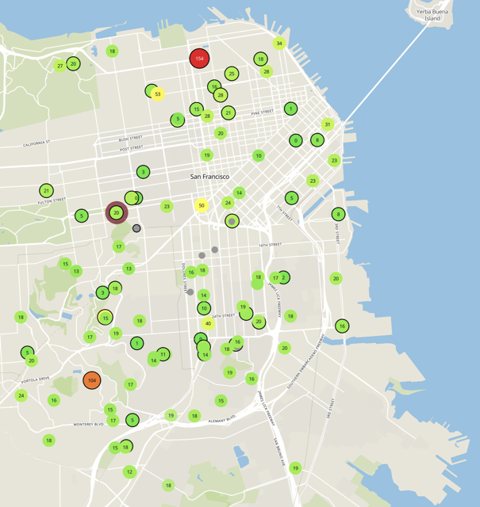
Low-Power Wide-Area Networks have been developed to meet IoT needs
LPWANs target wide-area, machine-to-machine communications
City-scale sensing e.g. air quality
Industrial monitoring e.g. electric grid
Agricultural sensing e.g. soil moisture
Traditional cellular communications fail to meet needs
Do not need high download capacity
Too high of power for battery-powered deployments
High data costs to operate

Slide 31
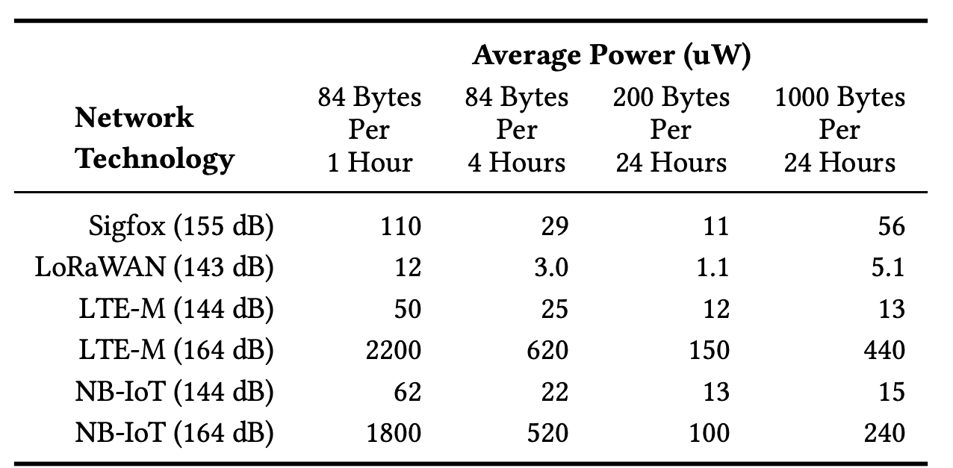
Average power is only 10x more for cellular at similar range

Slide 32
Background on LPWANs (~1 minute)
Unlicensed band
Cellular IoT
How do we measure ubiquitous connectivity? (~4 minutes, pictures for this)
Throughput insufficient
Bit flux for networks
Goodput over area
not-3D as a reasonable simplification
Ability for power control leads to curves
Bit flux for applications
Example results
Problems (~4 minutes)
Capacity
Co-existence
Made worse by capacity issues
Rallying cry to save unlicensed LPWANs

