Slide 1
Lecture 10 Analog Output
CE346 – Microprocessor System Design
Branden Ghena – Fall 2022
Some slides borrowed from: Josiah Hester (Northwestern), Prabal Dutta (UC Berkeley)

Slide 2
Administrivia
Everyone should have gotten feedback by now
If you haven’t, either check spam folder or I somehow forgot about you
Design presentations all next week!
Happy to discuss things before then either after class or on Campuswire
Drop deadline is Friday next week
I’m not worried about anyone in CE346
But if you’re worried, I’m happy to talk about it.

Slide 3
Today’s Goals
Discuss one last sensor: capacitive touch
Explore common methods for generating analog signals
Understand the role of Digital-to-Analog converters
Discuss the concepts of Pulse-Width Modulation
And the nRF52 implementation of it

Slide 4
Outline
Capacitive Touch Sensing
Digital-to-Analog Converters
Pulse-Width Modulation
nRF52 PWM

Slide 5
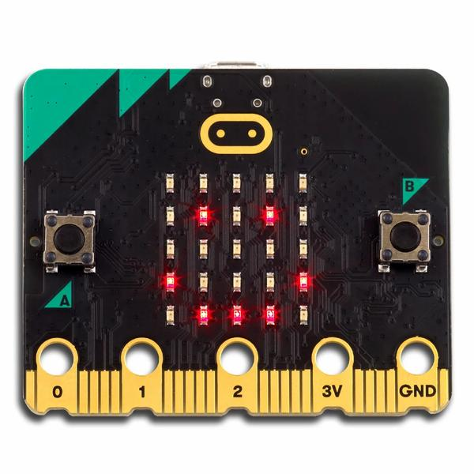
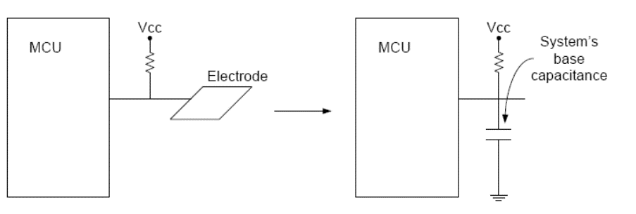
Capacitive Touch Sensor
Pull-up resistors connected to metal pads
Also connected to GPIO pin
Acts as a capacitor connected to ground

Slide 6
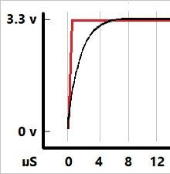
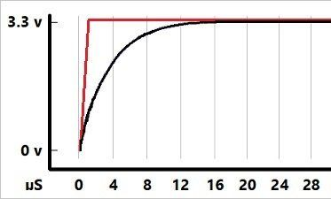
The touch pad recharges on its own
If you drive the GPIO pin attached to it low, touchpad clears low
If you make the GPIO pin an input (high impedance)
The touchpad gets pulled high, which takes some amount of time
Low Capacitance
High Capacitance
The more capacitance the longer this takes!

Slide 7
Capacitive touch sensing method
Drive GPIO pin low
Connects the pad to ground
Set GPIO pin as input and enable low-to-high interrupt
Gets an interrupt when the pad finally becomes high on its own
Use a timer to determine time until interrupt
~70 μs with no finger, <= milliseconds with finger
Needs to timeout after a few milliseconds and declare “touched”
Repeat periodically (a few times a second is probably good enough)
Sudden large increase in rise time ⇨ someone is touching!
Finger acts as a large capacitor

Slide 8
Capacitive touch works on any metal surface
Idea: Microbit door handle sensor
Connect a wire and a pull-up resistor to a metal door handle to sense when someone is touching it!
Timing will be very different from capacitive pad, but should be repeatable and distinguishable from human touch

Slide 9
Outline
Capacitive Touch Sensing
Digital-to-Analog Converters
Pulse-Width Modulation
nRF52 PWM

Slide 10
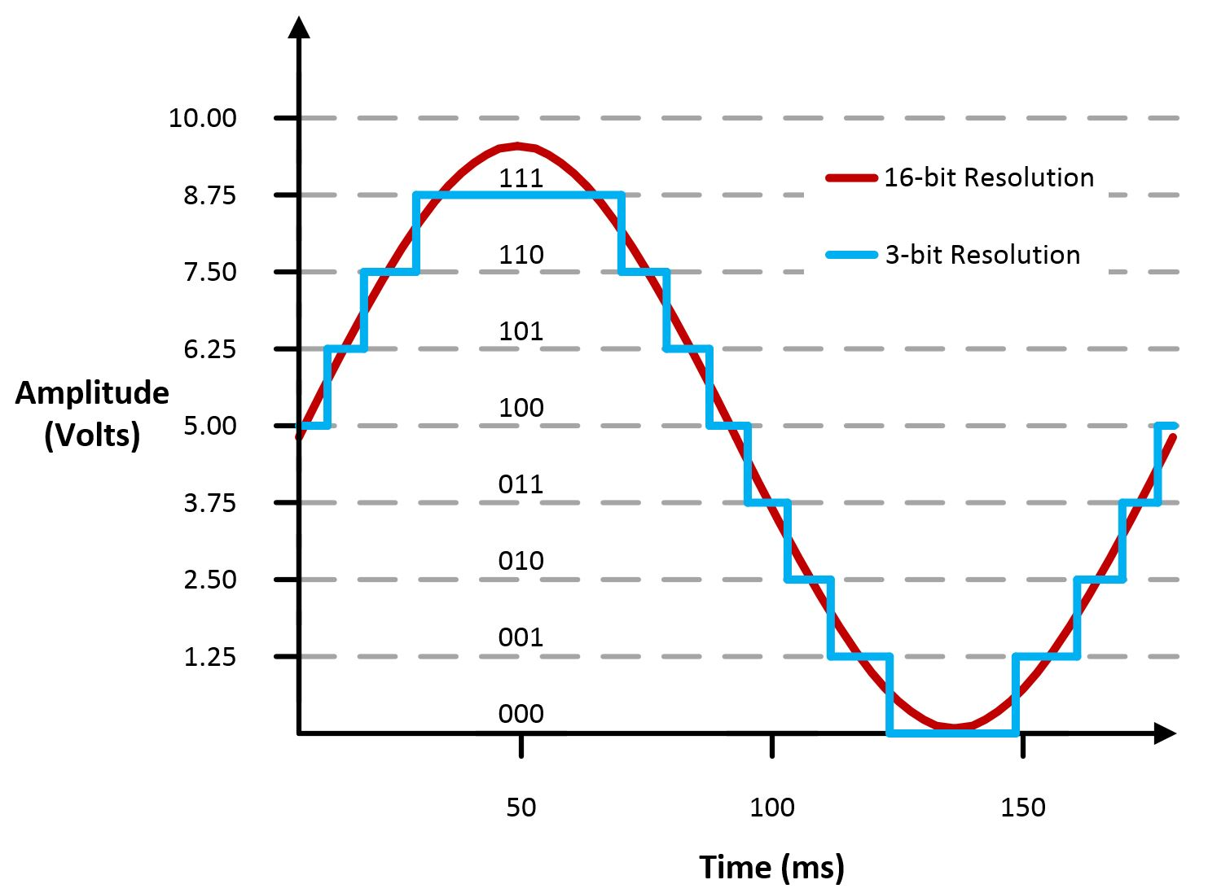
Digital-to-Analog Converters
Generates an analog voltage
DACs are conceptually the inverse of ADCs
Number of bits of resolution choose analog step size
Frequency determines step duration

Slide 11
High resolution versus high frequency
What role does each play in a DAC? Which is more important?
High resolution can accurately represent a voltage
High frequency can accurately represent a changing voltage
In practice:
Need high enough resolution, then as high of frequency as possible

Slide 12
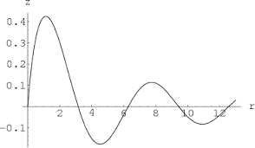
Infinite resolution is not sufficient
DAC frequency corresponds to representable signal changes
Rise and fall times
Even an infinite resolution DAC cannot represent a signal if it is not fast enough

Slide 13
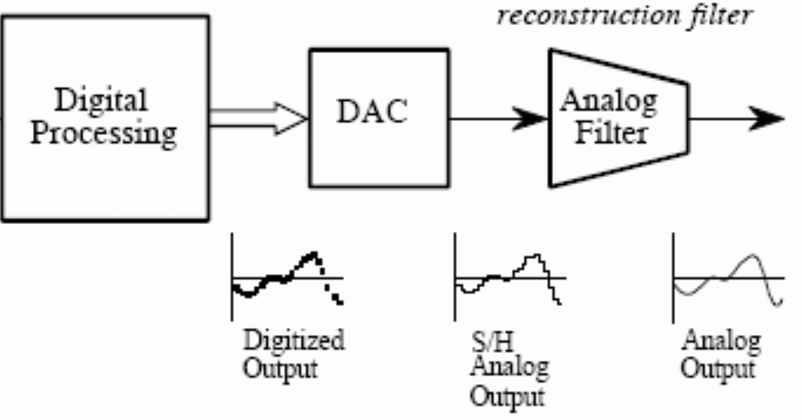
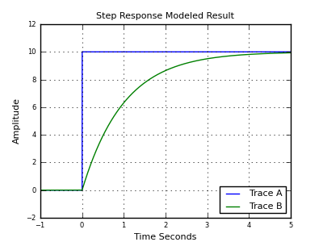
Low-pass filter smooths output
Low-pass filter delays changes in voltage and smoothly transitions between them
Low-frequency signals stay
High-frequency are smoothed
Greatly improves quality of output but must be tuned to the desired signal frequency
Usually not included in microcontroller

Slide 14
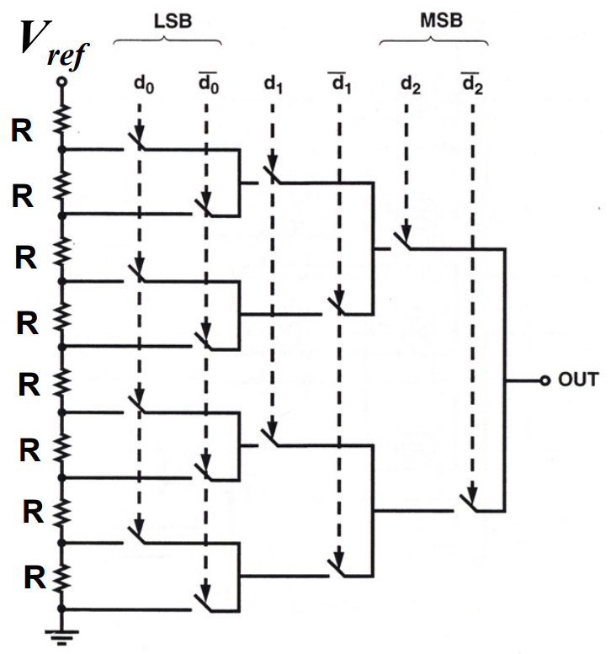
Resistor string DAC
Use series of voltage dividers and switches to set output voltage
Generates equally spaced voltages that can be selected between
Needs output buffer to provide stable current
Takes a lot of resistors
And resistors take a lot of silicon

Slide 15
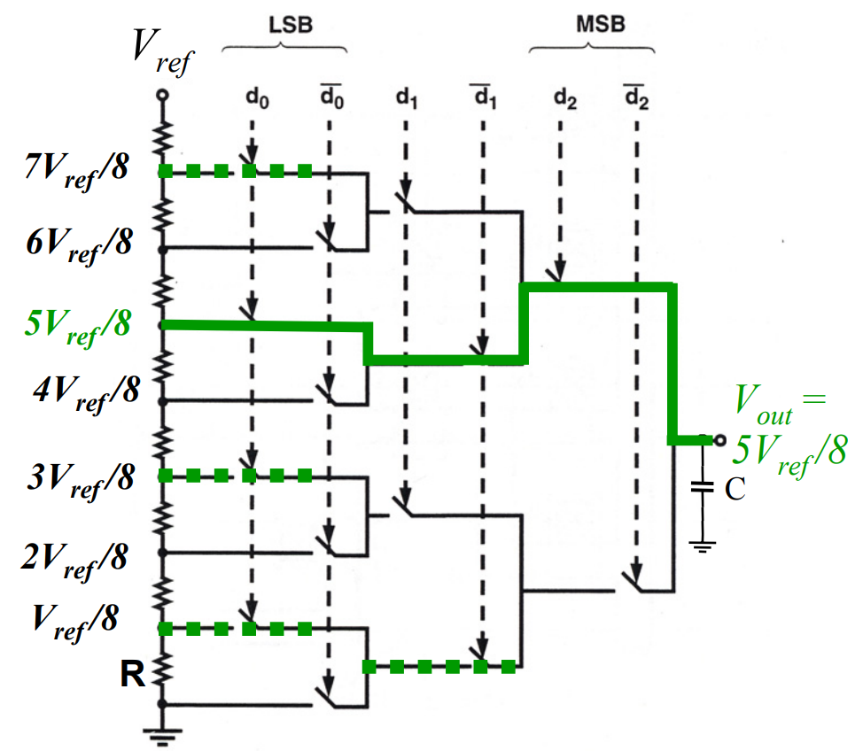
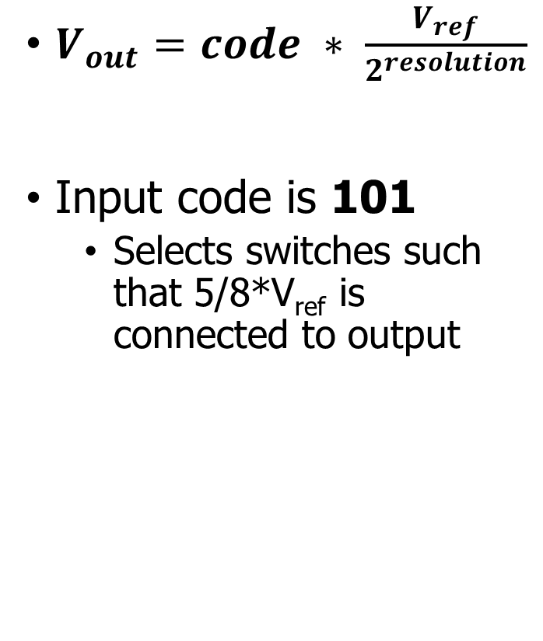
Resistor string example
$V_{out}=code ∗ \frac{V_{ref}}{2^{resolution}}$
Input code is 101
Selects switches such that 5/8*V_{ref} is connected to output

Slide 16
Break + DAC applications
What do you use an analog output for?

Slide 17
Break + DAC applications
What do you use an analog output for?
Audio output
But it needs to be high quality (resolution and speed)
Motors
But only with a controller that actually drives them with enough current
LED brightness
Not Much
And these last two can be done more easily with PWM

Slide 18
DACs are not in all microcontrollers
Not rare, but not ubiquitous either
Every microcontroller has GPIO
Just about every microcontroller has an ADC
Some microcontrollers have DACs (the nRF52833 does not!)
Reasons
Hardware is complicated (but we could fit it if we wanted)
Use cases are uncommon (and might need very high quality)
Many devices can be controller digitally
Pulse-Width Modulation (PWM) can emulate usably analog signals

Slide 19
Outline
Capacitive Touch Sensing
Digital-to-Analog Converters
Pulse-Width Modulation
nRF52 PWM

Slide 20
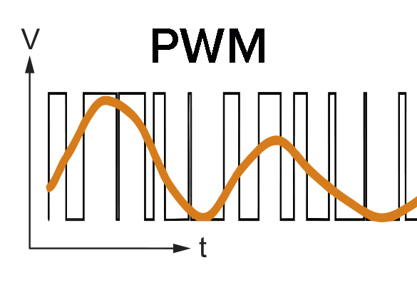
Pulse-Width Modulation
Much easier to control high or low than an analog output
Idea: modify how long a signal is high within some switching frequency, a.k.a duty cycle
On 50% of the time for half voltage
On 10% of the time for tenth voltage
Duty cycle, not frequency!

Slide 21
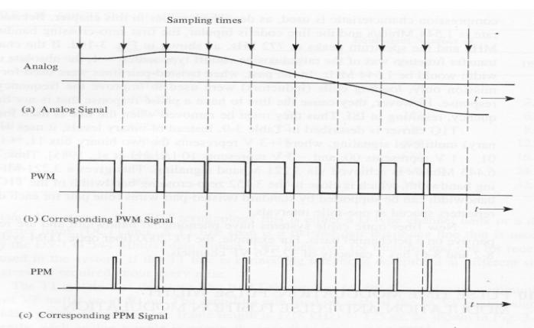
Analog to PWM example

Slide 22
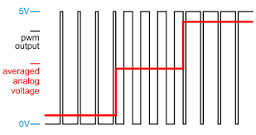
PWM to Analog Signal example
PWM period should be much faster than the desired analog signal
PWM duty cycle represents the voltage along the way
Multiple duty cycles per output point makes it more accurate

Slide 23
Low-pass approach works here too
Importantly, many devices are inherent low-pass filters
Heaters, Motors
Low-pass by physical design
I.e., they can’t start/stop quickly
LEDs are not
But our eyes are!

Slide 24
Controlling PWM
Vary duty cycle by selecting transition points
Time when set
Time when unset
Repeat every cycle
Period much faster than signal if possible
Makes analog approximation more accurate
The faster you run it, the less likely it matters that it is not actually analog
Example: LED switching frequency
Duty cycle could vary cycle-by-cycle if it must

Slide 25
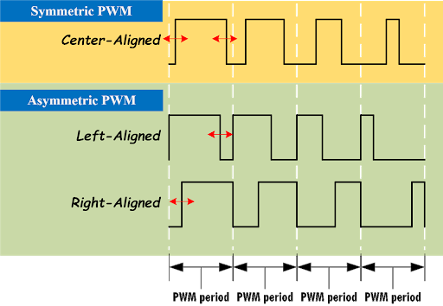
PWM alignment
Can select alignment as well
Equivalent to a phase delay
Centering produces cleaner analog output
Less harmonics
Not relevant for most devices

Slide 26
Every microcontroller can do PWM
Not every microcontroller has a PWM peripheral
But every microcontroller has timers and digital outputs
All that is needed is a GPIO and a Timer (or two)
Timer determines when to turn GPIO on and off
Often can be automated in hardware rather than use interrupt handler

Slide 27
PWM is a method of encoding data
PWM is a pulse-width modulated signal
There are many other ways to “modulate” a signal to transmit data
Amplitude, Frequency, and Phase are common
Layers data on top of an existing “carrier signal”
Used especially for high-speed communication
Wired (cable lines) or Wireless (basically everything)

Slide 28
PWM applications
Servos
Duty cycle chooses angle or rotation speed
Motor controllers
Duty cycle chooses current and therefore speed
LED brightness
And “breathing” effect
Audio
Can sound okay if frequency is high enough

Slide 29
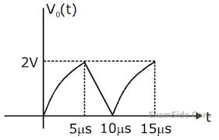
Break + Open Question
Imagine you want to represent the following signal with PWM
What should the PWM period be?
What kinds of duty cycle values would you use? (3.3v is 100%)

Slide 30
Break + Open Question
Imagine you want to represent the following signal with PWM
What should the PWM period be?
Signal period is ~10 μs
PWM period should be at least 2x that
10x faster seems like a good start
Then if we want multiple PWM outputs per sample, that’s ~20-40x faster
What kinds of duty cycle values would you use? (3.3v is 100%)
2/3.3 = 61% duty cycle max
0/3.3 = 0% duty cycle min

Slide 31
Outline
Capacitive Touch Sensing
Digital-to-Analog Converters
Pulse-Width Modulation
nRF52 PWM

Slide 32
nRF52 PWM – theory of operation
A clock continuously adds to a counter value
(just like the Timer peripheral does)
When the counter value reaches COMP[n], the GPIO value on channel n changes from high to low (or vice-versa)
When the counter value reaches COUNTERTOP, the GPIO value on channel n changes from low to high (or vice-versa)
AND the counter value resets to zero

Slide 33
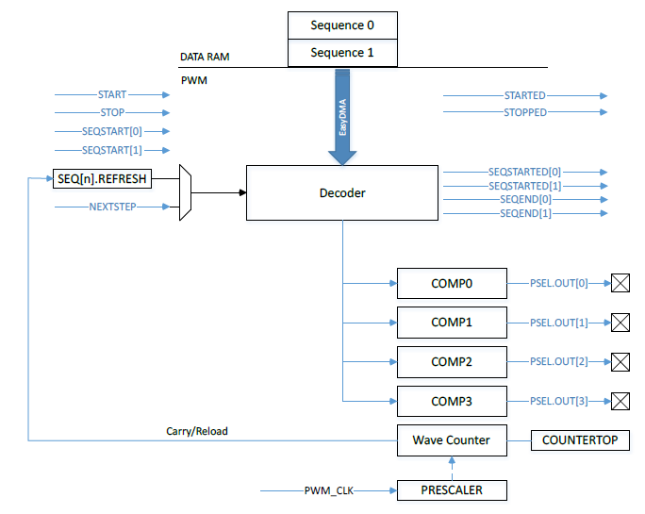
nRF52 PWM peripheral
Uses internal timer to create PWM output on up to 4 pins
4 peripherals, so up to 16 pins total
Loads compare values via DMA to rapidly vary “analog” signal

Slide 34
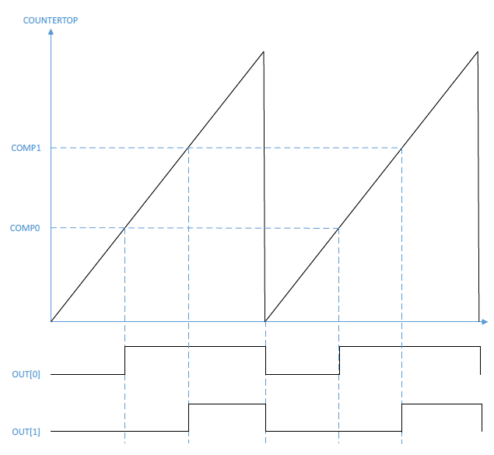
PWM example
One PWM period
Counter increments up to COUNTERTOP, resets and continues
Period/Frequency
Chosen by COUNTEROP and timer PRESCALER
Counter Value
Time

Slide 35

PWM example
One PWM period
Counter increments up to COUNTERTOP, resets and continues
Duty Cycle
COMP0 chooses first toggle point for OUT[0]
Second toggle point is when the timer resets
Counter Value
(right-aligned) $COMP=$
$$COUNTERTOP−(COUNTERTOP∗DutyCycle)$$
(left-aligned) $COMP=$
$$COUNTERTOP∗DutyCycle$$
Time

Slide 36
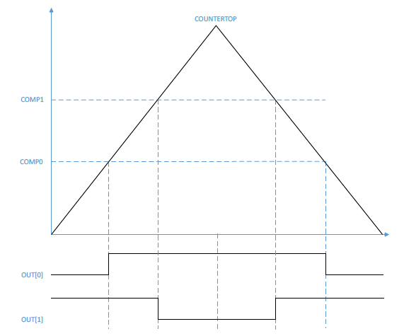
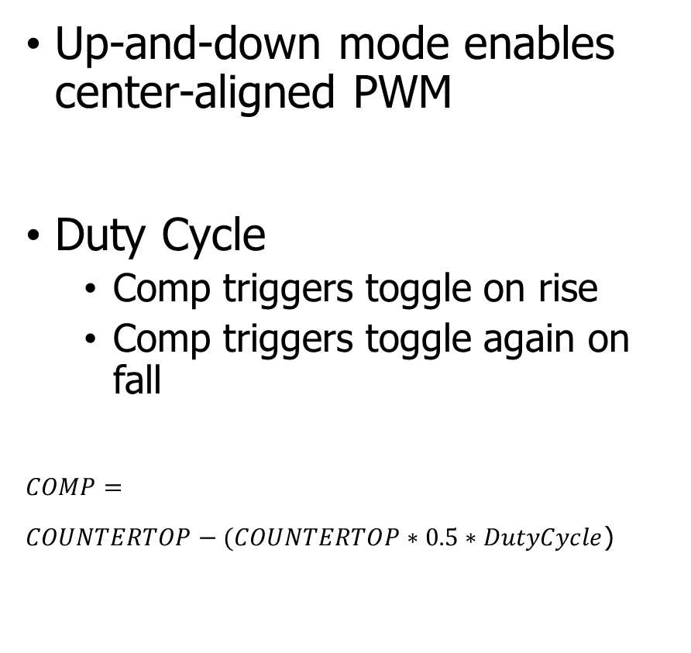
Center-aligned PWM
Up-and-down mode enables center-aligned PWM
Duty Cycle
Comp triggers toggle on rise
Comp triggers toggle again on fall
$$COMP=$$
$COUNTERTOP−(COUNTERTOP∗0.5∗DutyCycle$)

Slide 37
Trading speed and accuracy
How do you get the most accurate PWM values?
Select the largest COUNTERTOP possible
Most possible COMP values
Up to 15-bit resolution (32767 max)
How do you get the fastest PWM frequency?
Select the smallest COUNTERTOP possible
PRESCALER also affects this
16 MHz – 128 kHz (8 possible values)
Fastest PRESCALER + largest COUNTERTOP equals 488 Hz
Likely need to sacrifice resolution for speed

Slide 38
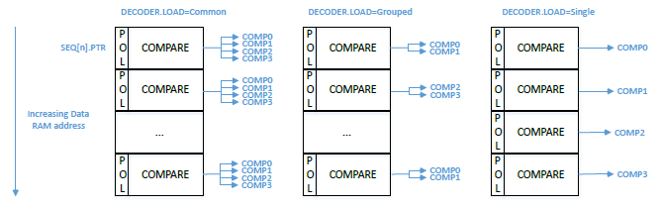
DMA with PWM
Every N periods it loads a new configuration from RAM
N combined with PRESCALER and COUNTERTOP chooses “analog signal” period
Configuration sets COMP values for each output channel
Also sets polarity (starting value: low or high)
Application of memory loads to channels is configurable

Slide 39
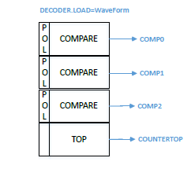
Waveform mode
Also has the option to change COUNTERTOP every N PWM periods
Allows arbitrary waveforms to be created
Frequency changes every period
Duty cycle can also change each period
We don’t normally need this, as a constant frequency with changing duty cycle should be fine

Slide 40
Other configurations
How many times the entire DMA sequence repeats
0 to large number, infinite with a configuration in SHORTS
How long to delay between repeating sequence cycles
Repeats last PWM configuration
Two DMA sequence configurations (0 and 1)
Can modify one while the other is playing
Allows continuous signal (for example, music)

Slide 41
nRF SDK PWM driver
https://infocenter.nordicsemi.com/index.jsp?topic=%2Fsdk_nrf5_v16.0.0%2Fgroup__nrfx__pwm.html
Initialize PWM with base configuration
Output pins, Clock frequency, COUNTERTOP, DMA grouping mode
Handler for events from peripheral
nrfx_pwm_simple_playback(instance, sequence, count, flags)
Instance: pointer to global variable with registers
Sequence: struct containing sequence to be played (see next slide)
Count: number of times (1 or more) to repeat sequence
Flags: stop peripheral when done, loop forever, various events

Slide 42
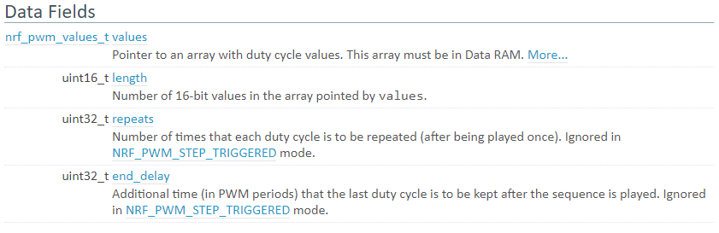
Sequence struct
values: pointer to array of uint16_t values (union of types)
length: length of array
repeats: number of times to repeat each individual value
Sets period for “analog value” changing

Slide 43
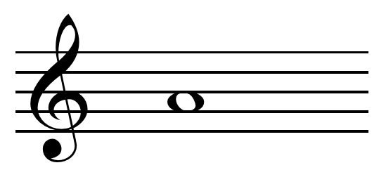
Example, playing a note
Pick PWM frequency to match note frequency
Combination of PRESCALER, COUNTERTOP, and repeats
440 Hz for the note A
PRESCALER 1 MHz, COUNTERTOP 2273 -> 440 Hz
Set duty cycle of PWM to control volume
50% duty cycle -> COMP value of 1137
Set sequence with an array of length 1, content is {1137} (polarity 0)
Repeats 0, end_delay 0
Set playback_count to 1 and flags to NRFX_PWM_FLAG_LOOP

Slide 44
Controlling LED Matrix brightness
Option 1: PWM peripheral
Need to use multiple PWM peripherals to get 5 pins
Could only allow brightness to be controlled for the entire matrix
Then use a single PWM output to control the row
When timer fires, change which row pin is used for PWM
Option 2: do it manually (for individual control)
Can’t determine duty cycle when the row is turned on
Each row already at 100 Hz, duty cycling would be slower and visible
Instead add 5 new one-shot app timers, one for each column
Fire at some time while the row is active (within that 2 ms)
Use to toggle column LED back to off

Slide 45
Outline
Capacitive Touch Sensing
Digital-to-Analog Converters
Pulse-Width Modulation
nRF52 PWM

