Slide 1
Lecture 03 Embedded Software
CE346 – Microprocessor System Design
Branden Ghena – Fall 2023
Some slides borrowed from: Josiah Hester (Northwestern), Prabal Dutta (UC Berkeley)

Slide 2
Administrivia
Office hours start today!
Four 1.5-hour slots per week to get help or lab checkoffs
Tried for a variety of times to meet everyone’s needs
Make sure you have your personal lab setup working
Ask in office hours or on Piazza if you run into issues
Labs will start this Friday!!!
You MUST come to your scheduled lab session
Not really enough room for students to swap sections
If there’s some known obligation and you give me a heads up, I could approve a few per week

Slide 3
Changes to schedule
Unfortunately, I’m out-of-town on Wednesday and Thursday
In-class portion on Thursday is canceled
Lecture for Thursday will be recorded and uploaded to Canvas
Necessary information for lab on Friday
Make sure you look through it
Ask questions on Piazza!
Lecture will be posted either late tonight or early tomorrow
I will be back on Friday for labs!

Slide 4
Today’s Goals
Discuss challenges of embedded software
Describe compilation and linking of embedded code
Actually applies to all code, but you probably never learned much about linking before
Introduce new software pattern: interrupts
Explore the microcontroller boot process

Slide 5
Outline
Embedded Software
Embedded Toolchain
Lab Software Environment
Interrupts
Boot Process

Slide 6
Review: C memory layout
Address 0xFFFFFFFFFFFFFFFF
Stack Section
Local variables
Function arguments
Heap Section
Memory granted through malloc()
Static Section (a.k.a. Data Section)
Global variables
Static function variables
Text Section (a.k.a Code Section)
Program code
Stack
Heap
Static
Text
Address 0x0000000000000000

Slide 7
Assumptions of embedded programs
Expect limitations
Very little memory
Very little computational power
Very little energy
Don’t expect a lot of support
Likely no operating system
Might not even have error reporting capabilities
Moral: think differently about your programs

Slide 8
Ramifications of limited memory
Stack and Data sections are limited
Be careful about too much recursion
Be careful about large local variables
Large data structures defined globally are preferred
Fail at compile time
In embedded, we often encourage global variables for large things
Heap section is likely non-existent
Why?

Slide 9
Ramifications of limited memory
Stack and Data sections are limited
Be careful about too much recursion
Be careful about large local variables
Large data structures defined globally are preferred
Fail at compile time
In embedded, we often encourage global variables for large things
Heap section is likely non-existent
Why?
Malloc could run out of memory at runtime

Slide 10
Avoiding dynamic memory
Malloc is scary in an embedded context
What if there’s no more memory available?
Traditional computer
Swap memory to disk
Worst case: wait for a process to end (or kill one)
Embedded computer
There’s likely only a single application
And it’s the one asking for more memory
So it’s not giving anything back anytime soon
This is unlikely to happen at boot
Instead it’ll happen hours or days into running as memory is slowly exhausted…

Slide 11
Limitations on processing power
Typically not all that important
Code still runs pretty fast
10 MHz -> 100 ns per cycle (i.e. ~100 ns per instruction)
Controlling hardware usually doesn’t have a lot of code complexity
Quickly gets to the “waiting on hardware” part (apps are I/O bound)
Problems
Machine learning
Learning on the device is neigh impossible
Memory limitations make it hard to fit weights anyways
Cryptography
Public key encryption takes seconds to minutes

Slide 12
Common programming languages for embedded
C
For all the reasons that you assume
Easy to map variables to memory usage and code to instructions
Assembly
Not entirely uncommon, but rarer than you might guess
C code optimized by a modern compiler is likely faster
Notable uses:
Cryptography to create deterministic algorithms
Operating Systems to handle process swaps
C++
Similar to C but with better library support
Libraries take up a lot of code space though ~100 KB

Slide 13
Rarer programming languages for embedded
Rust
Modern language with safety and reliability guarantees
Becoming relevant in the embedded space
But with a high learning curve
Python, Javascript, etc.
Mostly toy languages
Fine for simple things but incapable of complex operations
Especially low-level things like managing memory

Slide 14
What’s missing from programming languages?
The embedded domain has several requirements that other domains do not
What is missing from programming languages that it wants?
Sense of time
Sense of energy

Slide 15
Programming languages have no sense of time
Imagine a system that needs to send messages to a motor every 10 milliseconds
Write a function that definitely completes within 10 milliseconds
Accounting for timing when programming is very challenging
We can profile code and determine timing at runtime
If we know many details of hardware, instructions can give timing
Unless the code interacts with external devices

Slide 16
Determining energy use is rather complicated
Software might
Start executing a loop
Turn on/off an LED
Send messages over a wired bus to another device
Determining energy these operations take is really difficult
Even with many details of the hardware
Different choices of processor clocks can have a large impact
Often profiled at runtime after writing the code
Iterative write-test-modify cycle

Slide 17
Break + Say hi to your neighbors
Things to share
Name
Major
One of the following
Favorite Candy
Favorite Pokemon
Favorite Emoji

Slide 18
Break + Say hi to your neighbors
Things to share
Name -Branden
Major -Electrical and Computer Engineering, and Computer Science
One of the following
Favorite Candy - Twix
Favorite Pokemon - Eevee
Favorite Emoji - 🍢

Slide 19
Outline
Embedded Software
Embedded Toolchain
Lab Software Environment
Interrupts
Boot Process

Slide 20
Embedded compilation steps
Same first steps as any system
Compiler
Turn C code into assembly
Optimize code (often for code size instead of speed)

Slide 21
Cross compilers compile for different architectures
The compiler we’ll be using is a cross compiler
Run on one architecture but compile code for another
Example: runs on x86-64 but compiles armv7e-m
GCC naming scheme: ARCH-VENDOR-(OS-)-ABI-gcc
arm-none-eabi-gcc
ARM architecture
No vendor
No OS
Embedded Application Binary Interface
Others: arm-none-linux-gnueabi-gcc, i686-pc-windows-msvc-gcc

Slide 22
Embedded compilation steps
Same first steps as any system
Compiler
Turn C code into assembly
Optimize code (often for size instead of speed)
Linker
Combine multiple C files together
Resolve dependencies
Point function calls at correct place
Connect creation and uses of global variables

Slide 23
Informing linker of system memory
Linker actually places code and variables in memory
It needs to know where to place things
How do x86-64 compilers know which addresses to use?

Slide 24
Informing linker of system memory
Linker actually places code and variables in memory
It needs to know where to place things
How do x86-64 compilers know which addresses to use?
Virtual memory allows all applications to use the same memory addresses
Embedded solution
Only run a single application
Provide an LD file
Specifies memory layout for a certain system
Places sections of code in different places in memory

Slide 25
Anatomy of an LD file
nRF52833: 512 KB Flash, 128 KB SRAM
First, LD file defines memory regions
MEMORY {
FLASH (rx) : ORIGIN = 0x00000000, LENGTH = 0x80000
RAM (rwx) : ORIGIN = 0x20000000, LENGTH = 0x20000
}
A neat thing about microcontrollers: pointers have meaning
Just printing the value of a pointer can tell you if it’s in Flash or RAM

Slide 26
Anatomy of an LD file
It then places sections of code into those memory regions
.text : {
KEEP(*(.Vectors))
*(.text*)
*(.rodata*)
. = ALIGN(4);
} > FLASH __etext = .;
.data : AT (__etext) {
__data_start__ = .;
*(.data*)
__data_end__ = .;
} > RAM
.bss : {
. = ALIGN(4);
__bss_start__ = .;
*(.bss*)
. = ALIGN(4);
__bss_end__ = .;
} > RAM

Slide 27
Sections of code
Where do these sections come from?
Most are generated by the compiler
.text, .rodata, .data, .bss
You need to be deep in the docs to figure out how the esoteric ones work
Some are generated by the programmer
Allows you to place certain data items in a specific way
__attribute__((section(".foo")))
int test[10] = {0,0,0,0,0,0,0,0,0,0};

Slide 28
Embedded compilation steps
Same first steps as any system
Compiler
Turn C code into assembly
Optimize code (often for size instead of speed)
Linker
Combine multiple C files together
Resolve dependencies
Point function calls at correct place
Connect creation and uses of global variables
Output: a binary (or hex) file

Slide 29
Loading the hex file onto a board
This is a use case for JTAG
You provide it a hex file which specifies addresses and values
It writes those into Flash on the microcontroller
The LD file already specified addresses
So passing around hex files is enough to load an application
But a hex file for one microcontroller won’t work on another with a different memory layout

Slide 30
Example
Demonstrated in the blink application in lab repo
https://github.com/nu-ce346/nu-microbit-base/tree/main/software/apps/blink

Slide 31
Outline
Embedded Software
Embedded Toolchain
Lab Software Environment
Interrupts
Boot Process

Slide 32
Embedded environments
There are a multitude of embedded software systems
Every microcontroller vendor has their own
Popular platforms like Arduino
We’re using the Nordic software development libraries plus some extensions made by my research group
It’ll be a week until that matters for the most part
We’ll start off by writing low-level drivers ourselves without libraries

Slide 33
Software Development Kit (SDK)
Libraries provided by Nordic for using their microcontrollers
Actually incredibly well documented! (relatively)
Various peripherals and library tools
SDK documentation
https://infocenter.nordicsemi.com/topic/sdk_nrf5_v16.0.0/index.html
Warning: search doesn’t really work
Possibly more useful: the list of data structures
Search that page for whatever “thing” you’re working with
https://infocenter.nordicsemi.com/topic/sdk_nrf5_v16.0.0/annotated.html

Slide 34

nRF52x-base
Wrapper built around the SDK by Lab11
Branden Ghena, Brad Campbell (UVA), Neal Jackson, a few others
Allows everything to be used with Makefiles and command line
https://github.com/lab11/nrf52x-base
We include it as a submodule
It has a copy of the SDK code and softdevice binaries
It has a whole Makefile system to include to proper C and H files
We include a Board file that specifies our specific board’s needs and capabilities
Go to repo to explain

Slide 35
Break

Slide 36
Outline
Embedded Software
Embedded Toolchain
Lab Software Environment
Interrupts
Boot Process

Slide 37
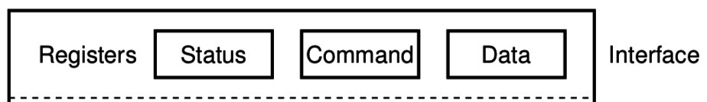
What do interactions with devices look like?
while STATUS==BUSY; Wait
(Need to make sure device is ready for a command)
Write value(s) to DATA
Write command(s) to COMMAND
while STATUS==BUSY; Wait
(Need to make sure device has completed the request)
Read value(s) from Data
This is the “polling” model of I/O.
“Poll” the peripheral in software repeatedly to see if it’s ready yet.

Slide 38
Waiting can be a waste of CPU time
while STATUS==BUSY; Wait
(Need to make sure device is ready for a command)
Write value(s) to DATA
Write command(s) to COMMAND
while STATUS==BUSY; Wait
(Need to make sure device has completed the request)
Read value(s) from Data
Problem: imagine a keyboard device
CPU could be waiting for minutes before data arrives
Need a way to notify CPU when an event occurs
Interrupts!

Slide 39
Interrupts
What is an interrupt?
Some event which causes the processor to stop normal execution
The processor instead jumps to a software “handler” for that event
Then returns back to what it was doing afterwards
What causes interrupts?
Hardware exceptions
Divide by zero, Undefined Instruction, Memory bus error
Software
Syscall, Software Interrupt (SWI)
External hardware
Input pin, Timer, various “Data Ready”

Slide 40
Interrupts, visually
Some code that’s executing

Slide 41
Interrupts, visually
Some code that’s executing
Interrupt triggers!
Interrupt handler code

Slide 42
Interrupts, visually
Some code that’s executing
Interrupt triggers!
Interrupt handler code
Continue original code

Slide 43
ARM Nested Vectored Interrupt Controller (NVIC)
Handles interrupt entry and exit
Stacking
Unstacking
Priorities
Interrupts can preempt other interrupts!
Jump directly to the interrupt handler
Manages interrupt requests (IRQ)
Stores all caller-saved registers on the stack
So the handler code doesn’t overwrite them
Moves execution to proper handler, a.k.a. Interrupt Service Routine (ISR)
Restores registers after handler returns and moves execution back

Slide 44
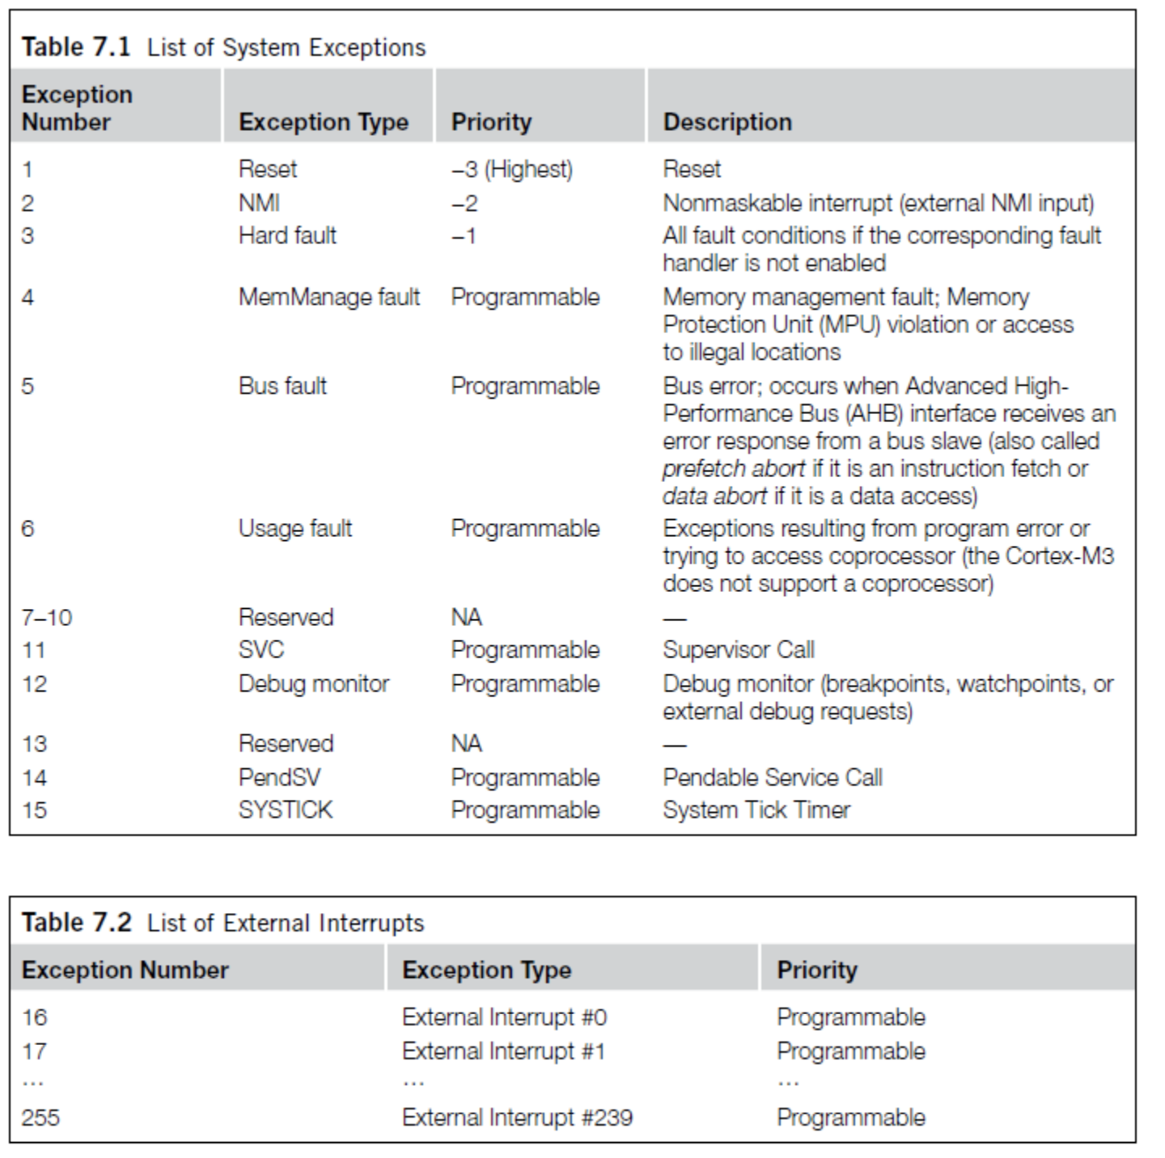
ARM Vector table
List of function pointers to handler for each interrupt/exception
First 15 are architecture-specific exceptions
After that are microcontroller interrupt signals

Slide 45
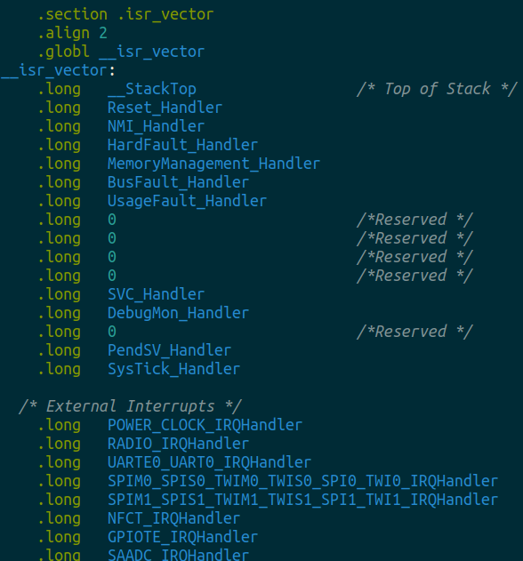
Vector table in software
Placed in its own section
LD file puts it first in Flash
Reset_Handler determines where software starts executing
After that are all exception and interrupt handlers
All function pointers to some C code somewhere

Slide 46
NVIC functionality
NVIC functions
NVIC_EnableIRQ(number)
NVIC_DisableIRQ(number)
NVIC_SetPriority(number, priority)
Technically 256 priorities
Only 8 are implemented
Must enable interrupts in two places!
Enabling interrupt in the peripheral will generate the signal
Enabling interrupt in the NVIC will cause signal to jump to handler
Priority determines which interrupt goes first
And determines how interrupts are nested

Slide 47
Nested interrupts, visually
Some code that’s executing
Interrupt triggers!
Interrupt handler
Higher priority Interrupt triggers!
Interrupt handler
continues
Continue original code

Slide 48
Break + Open Question
When should a system use polling versus interrupts?

Slide 49
Break + Open Question
When should a system use polling versus interrupts?
Polling
Great if the device is going to respond immediately (like 1 cycle)
Important if we need to respond very quick (less than a microsecond)
Interrupts
Great if we’ll need to wait a long time for status to change
Still responds pretty quickly, but not immediately
Needs to context switch from running code to interrupt handler

Slide 50
Outline
Embedded Software
Embedded Toolchain
Lab Software Environment
Interrupts
Boot Process

Slide 51
How does a microcontroller start running code?
Power comes on
Microcontroller needs to start executing assembly code
You expect your main() function to run
But a few things need to happen first

Slide 52
Step 0: set a stack pointer
Assembly code might need to write data to the stack
Might call functions that need to stack registers
ARM: Valid address for the stack pointer is at address 0 in Flash
Needs to point to somewhere in RAM
Hardware loads it into the Stack Pointer when it powers on

Slide 53
Step 1: set the program counter (PC)
a.k.a. the Instruction Pointer (IP) in x86 land
32-bit ARM: valid instruction pointer is at address 4 in Flash
Could point to RAM, usually to Flash though
In interrupt terms: this is the “Reset Handler”!
Automatically loaded into the PC after the SP is loaded
Again, hardware does this

Slide 54
Step 2: “reset handler” prepares memory
Code that handles system resets
Either reset button or power-on reset
Address was loaded into PC in Step 1
Reset handler code:
Loads initial values of .data section from Flash into RAM
Loads zeros as values of .bss section in RAM
Calls SystemInit
Starts correct clocks for the system
Handles various hardware configurations/errata
Calls _start
nu-microbit-base/software/nrf52x-base/sdk/nrf5_sdk_16.0.0/modules/nrfx/mdk/gcc_startup_nrf52833.S nu-microbit-base/software/nrf52x-base/sdk/nrf5_sdk_16.0.0/modules/nrfx/mdk/system_nrf52.c

Slide 55
Step 3: set up C runtime
_start is provided by newlib
An implementation of libc – the C standard library
Startup is a file usually named crt0
Does more setup, almost none of which is relevant for our system
Probably is this code that actually zeros out .bss
Sets argc and argv to 0
Calls main() !!!
https://sourceware.org/git/gitweb.cgi?p=newlib-cygwin.git;a=blob_plain;f=libgloss/arm/crt0.S;hb=HEAD

Slide 56
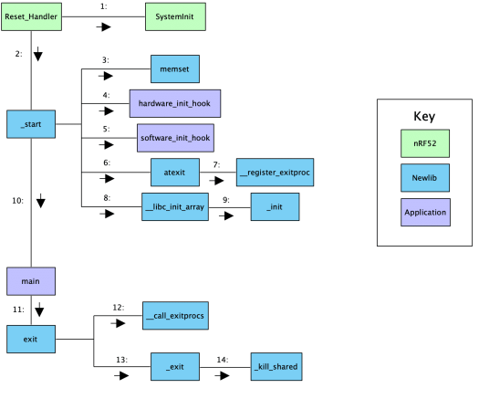
Online writeup with way more details and a diagram
Relevant guide!!
https://embeddedartistry.com/blog/2019/04/17/exploring-startup-implementations-newlib-arm/
Covers the nRF52!

Slide 57
Outline
Embedded Software
Embedded Toolchain
Lab Software Environment
Interrupts
Boot Process

