Slide 1
Lecture 07 Driver Design
CE346 – Microprocessor System Design
Branden Ghena – Fall 2023
Some slides borrowed from: Josiah Hester (Northwestern), Prabal Dutta (UC Berkeley)

Slide 2
Administriva
Postlab 1 questions due today. Don’t forget!
Project Proposals due Thursday!
A few are in so far and they look great and I’m super excited!!!!!
My goal is get you feedback by early next week
If you still need a partner, let me know TODAY after class.
Otherwise, class keeps going as usual
Still have four more lab sessions
Still have three more quizzes
Lots more content to cover

Slide 3
Today’s Goals
Deep-dive into driver design options
Explore another aspect of device driver design
Non-blocking vs Blocking interfaces
Discuss how interrupts interact with these
Event-loop as a partial alternative
Consider how an LED matrix driver could be constructed

Slide 4
Outline
Driver Interfaces (Blocking and Non-Blocking)
Event-driven Model
Continuous Operation

Slide 5
How should we write driver software?
There are various knobs available to us from hardware
Polling, Interrupts, DMA
There are also various software interface design
Synchronous
Asynchronous
Callback
Event-driven model

Slide 6
Synchronous device drivers
Synchronous functions
Function call issues a command
Does not return until action is complete and result is ready
Example: most functions we’re used to
sqrt() for example
printf() also usually works this way (with some exceptions)
Arduino interfaces are usually like this!
Easy to get started with and understand

Slide 7
Downside of synchronous code: the waiting
How long will it take until the function returns?
Immediately, seconds, minutes?
What if there’s an error and the device never responds?
More advanced interface could include a timeout option
Synchronous designs require other synchronous designs
We can build synchronous interfaces from asynchronous ones
But we can’t go the other way

Slide 8
Asynchronous drivers
Goal: let the hardware run on its own and have the code get back to it later
Challenge: programmers don’t think that way
Other challenge: how do we “get back to it later”?
Callbacks
Event-driven model

Slide 9
Callbacks
Callbacks reuse a similar idea to interrupts
When the event occurs, call this function
General pattern
Call driver function with one argument being a function pointer
Driver sets up interaction and returns immediately
Later the event happens and the driver calls the function pointer

Slide 10
Function pointers in C
Harder than in Javascript or C++. Can’t define anonymous function inline
Instead create a pointer to an existing function in your code
void myfun(int a) {
// do something here
}
void main() {
void (*fun_ptr)(int) = &myfun;
fun_ptr(10); // dereference happens automatically
}
& is actually unnecessary. With or without are identical.

Slide 11
Callback functions
uint32_t timer_start( uint32_t microseconds, void (*callback_fn)(void*), void* context );
timer_start(duration, my_timer_handler, context);
“Context” is often provided as well (void*)
Ability for caller to pass an argument for the callback function
Often a pointer to a position in a structure or a shared variable to modify

Slide 12
Callbacks usually run in an interrupt mode
If the interrupt handler calls the callback, the callback will be within that same interrupt mode
Be careful which variables you modify!!
Could lead to concurrency issues if you modify a public structure
Starts to get pretty annoying
Embedded systems deal with concurrency issues just like OS

Slide 13
Building synchronous code out of callbacks
Callback handlers can be used to build synchronous code
void myfun(void* context) {
*(boolean*)context = true; // context is the flag pointer
}
void timer_start_blocking(duration) {
volatile boolean flag = false;
timer_start(duration, &myfun, &flag);
while (!flag) { // spin-loop }
}

Slide 14
Live Coding: Temp driver example
nu-microbit-base/software/apps/temp_driver/
Some necessary functions
NVIC_EnableIRQ(irq); // TEMP_IRQn is for the Temperature Sensor
NVIC_SetPriority(irq, priority)

Slide 15
Outline
Driver Interfaces (Blocking and Non-Blocking)
Event-driven Model
Continuous Operation

Slide 16
Interrupts are frustrating
We do not always want to block on every call
We also do not want to deal with concurrency issues
An alternative: one main event loop
Polls necessary sensors
Iterates through state machine and determine actions
Runs at a certain frequency

Slide 17
Event loop
Rather than polling a single driver, poll all of them
Each time through the loop check all relevant inputs
Respond to events that are necessary
Sleep until ready to start again
while (1) {
time start = get_time();
boolean result = check_timer();
if (result) { check_gps(); }
adjust_throttle();
delay_ms(1000 – (get_time() – start));
}

Slide 18
Downsides of event loop design
Timeliness can be a problem
How long between the timer being ready and the GPS being checked in this example?
Maximum of 1 second plus the time spent checking other stuff
while (1) {
time start = get_time();
boolean result = check_timer();
if (result) { check_gps(); }
adjust_throttle();
delay_ms(1000 – (get_time() – start));
}

Slide 19
Top-half / Bottom-half handler design
Top half
Interrupt handler
Immediately continues next transaction
Or signals for top half to continue (often with shared variable)
Bottom half
Performs logic to actually process and respond to the event
Run in a non-interrupt context when the scheduler is ready for it
Usually safe to run it even while interrupts could be occurring

Slide 20
Live Codeing: Temperature event-loop example
nu-microbit-base/software/apps/temp_event_loop/
Some necessary functions
NVIC_EnableIRQ(irq); // TEMP_IRQn is for the Temperature Sensor
NVIC_SetPriority(irq, priority)

Slide 21
Outline
Driver Interfaces (Blocking and Non-Blocking)
Event-driven Model
Continuous Operation

Slide 22
Continuous operation
For some sensors/actuators they might be continuously updating in the background
For those, we only need one init_and_start() function and a read or write function
Continuous sensors are always ready with the most recent sample
Continuous actuators will always update to the new command as soon as possible
They might skip a command if you give it multiple very quickly

Slide 23
Continuously updating temperature
Temperature driver design
In the interrupt handler, copy over the value
Start the next event, which will automatically re-trigger the interrupt
No more is_ready() function, data is always ready with the most up-to-date value
Might be a little behind real-time, but only by one sample
This particular implementation would mean a TON of interrupts
Probably want to combine with a timer to run it more slowly

Slide 24
LED Matrix design
This is a good example of a continuous operation actuator
General driver design
Split operation between a Model and a View (Model-View-Controller design)
Model contains what you want the state of the LEDs to be
Only updates when the user calls a function
Updates immediately (non-blocking)
View contains the code to take the model and display it on the LEDs
Continuously updates the LED states with a timer

Slide 25
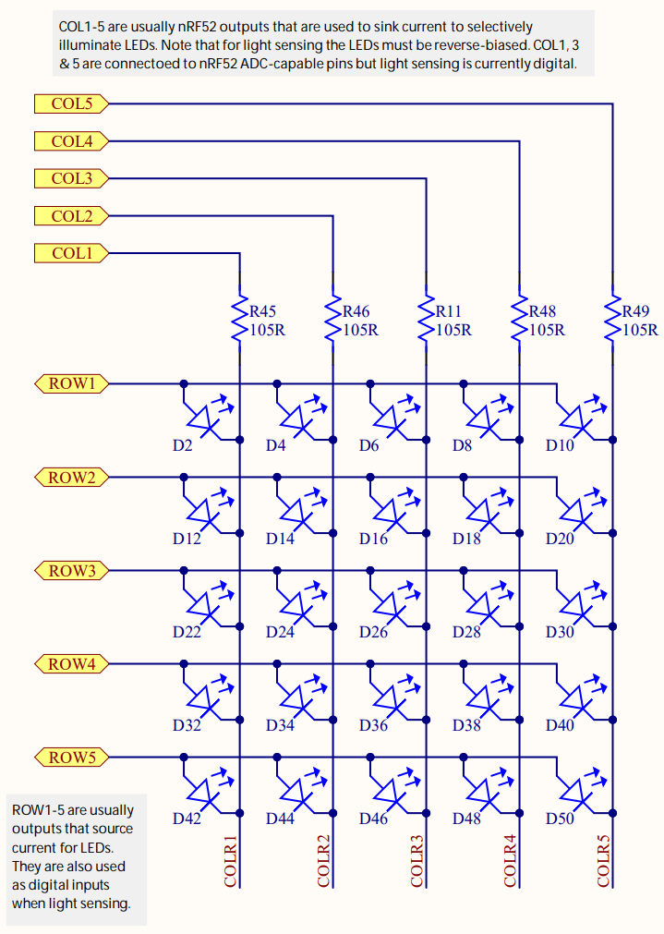
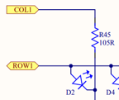
LEDs on the Microbit
Use two GPIO pins to control each LED
Row high as VDD
Column low as Ground
Remember, connections only exist where there are dots

Slide 26
Controlling the LED matrix
LOW
We can light up all the LEDs at once:
Set all rows to High
Clear all columns to Low
LOW
LOW
LOW
LOW
HIGH
HIGH
HIGH
HIGH
HIGH

Slide 27
Controlling the LED matrix
LOW
But now how do we turn off the right middle LED?
LOW
LOW
LOW
LOW
HIGH
HIGH
HIGH
HIGH
HIGH

Slide 28
Can we control by row?
LOW
But now how do we turn off the right middle LED?
What if we clear the row to Low?
Messes up the entire row
LOW
LOW
LOW
LOW
HIGH
HIGH
LOW
HIGH
HIGH

Slide 29
Can we control by column?
HIGH
But now how do we turn off the right middle LED?
What if we set the column to High?
Messes up the entire column
We don’t actually have arbitrary control over the whole thing at once
LOW
LOW
LOW
LOW
HIGH
HIGH
HIGH
HIGH
HIGH

Slide 30
Persistence of vision
The solution here is to abuse how human eyes work
Eyes can’t detect changes in light that are going faster than a certain speed
Or if they do at all, it’s interpreted as slightly dimmer light
Any given LED should be above ~100 Hz to keep humans from noticing the flicker

Slide 31
Persistance of vision on an LED matrix

Slide 32
One column at a time
HIGH
What if we instead control a single column at a time?
First column, all LEDs on
HIGH
HIGH
HIGH
LOW
HIGH
HIGH
HIGH
HIGH
HIGH

Slide 33
One column at a time
HIGH
What if we instead control a single column at a time?
Same for second column through fourth column
HIGH
HIGH
LOW
HIGH
HIGH
HIGH
HIGH
HIGH
HIGH

Slide 34
One column at a time
HIGH
What if we instead control a single column at a time?
Same for second column through fourth column
HIGH
LOW
HIGH
HIGH
HIGH
HIGH
HIGH
HIGH
HIGH

Slide 35
One column at a time
HIGH
What if we instead control a single column at a time?
Same for second column through fourth column
LOW
HIGH
HIGH
HIGH
HIGH
HIGH
HIGH
HIGH
HIGH

Slide 36
One column at a time
LOW
What if we instead control a single column at a time?
Last column we only turn on some of the LEDs
As long as we keep cycling through columns fast enough, the whole thing becomes a display
HIGH
HIGH
HIGH
HIGH
HIGH
HIGH
LOW
HIGH
HIGH

Slide 37
LED matrix full design
Requires GPIO pins and a Timer
When the Timer fires
Change which column you are displaying
Update the row pins based on this new column
Read row data from a 5x5 array that models what the screen should show
When the user wants to change the display
Update that 5x5 array in memory
It’ll start getting drawn on the screen the next time the Timer fires

Slide 38
Outline
Driver Interfaces (Blocking and Non-Blocking)
Event-driven Model
Continuous Operation

Slide 39
Outline
Embedded Software
Embedded Toolchain
Lab Software Environment
Interrupts
Boot Process

Slide 40
How does a microcontroller start running code?
Power comes on
Microcontroller needs to start executing assembly code
You expect your main() function to run
But a few things need to happen first

Slide 41
Step 0: set a stack pointer
Assembly code might need to write data to the stack
Might call functions that need to stack registers
ARM: Valid address for the stack pointer is at address 0 in Flash
Needs to point to somewhere in RAM
Hardware loads it into the Stack Pointer when it powers on

Slide 42
Step 1: set the program counter (PC)
a.k.a. the Instruction Pointer (IP) in x86 land
32-bit ARM: valid instruction pointer is at address 4 in Flash
Could point to RAM, usually to Flash though
In interrupt terms: this is the “Reset Handler”!
Automatically loaded into the PC after the SP is loaded
Again, hardware does this

Slide 43
Step 2: “reset handler” prepares memory
Code that handles system resets
Either reset button or power-on reset
Address was loaded into PC in Step 1
Reset handler code:
Loads initial values of .data section from Flash into RAM
Loads zeros as values of .bss section in RAM
Calls SystemInit
Starts correct clocks for the system
Handles various hardware configurations/errata
Calls _start
nu-microbit-base/software/nrf52x-base/sdk/nrf5_sdk_16.0.0/modules/nrfx/mdk/gcc_startup_nrf52833.S nu-microbit-base/software/nrf52x-base/sdk/nrf5_sdk_16.0.0/modules/nrfx/mdk/system_nrf52.c

Slide 44
Step 3: set up C runtime
_start is provided by newlib
An implementation of libc – the C standard library
Startup is a file usually named crt0
Does more setup, almost none of which is relevant for our system
Probably is this code that actually zeros out .bss
Sets argc and argv to 0
Calls main() !!!
https://sourceware.org/git/gitweb.cgi?p=newlib-cygwin.git;a=blob_plain;f=libgloss/arm/crt0.S;hb=HEAD

Slide 45
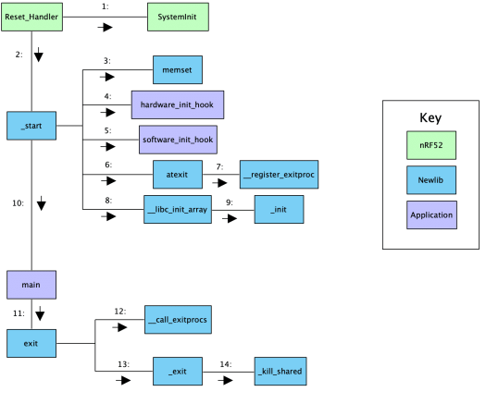
Online writeup with way more details and a diagram
Relevant guide!!
https://embeddedartistry.com/blog/2019/04/17/exploring-startup-implementations-newlib-arm/
Covers the nRF52!

