Slide 1
Lecture 09 Sensors
CE346 – Microprocessor System Design
Branden Ghena – Fall 2023
Some slides borrowed from: Josiah Hester (Northwestern), Prabal Dutta (UC Berkeley)

Slide 2
Administrivia
Proposal feedback has been greatly delayed
Feedback will start tomorrow and will continue through Saturday
Design presentations will be next week Tuesday & Thursday
Details are on Piazza: 5 minute presentation
What are you doing
What sensors/actuators are you using
What’s the first step you’re going to take
I’ll make a presentation schedule Wednesday or Thursday

Slide 3
Today’s Goals
Think about sensing and sensors
Explore a variety of sensor types, how they are made, and what their capabilities are
Discuss an example research platform with a custom sensor

Slide 4
Outline
Sensing Overview
Types of Sensors
Temperature
Light
Inertial
Others
Capacitive Touch Sensing

Slide 5
Definitions
A sensor is a device that measures a physical quantity
Temperature sensor
Light sensor
Microphone
An actuator is a device that modifies a physical quantity
Heater
Motor
Speaker

Slide 6
Sensors transform quantity into an electric signal
Microcontrollers can interact with analog signals
Generating an analog signal proportional to physical quantity makes the quantity able to be sensed
How do we generate an electrical signal?
Ohm’s Law: V = I * R (Voltage = Current * Resistance)
Vary any one of these three and an analog signal is created
Resistive sensors are common
As are sensors that produce a voltage/current

Slide 7
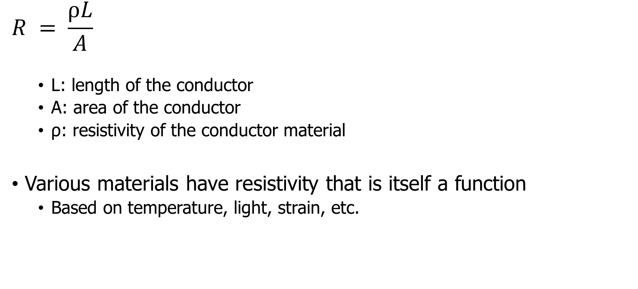
Resistive sensors
$$R = \frac{ρL}{A}$$
L: length of the conductor
A: area of the conductor
ρ: resistivity of the conductor material
Various materials have resistivity that is itself a function
Based on temperature, light, strain, etc.

Slide 8
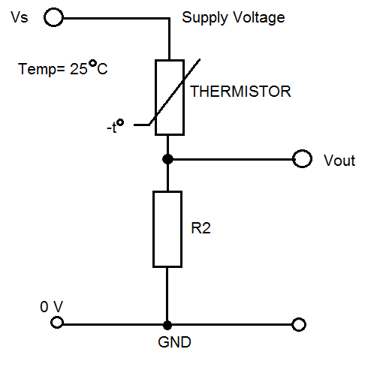
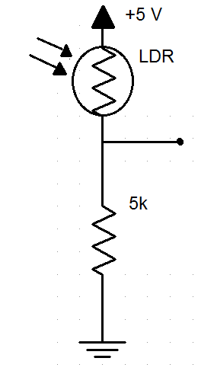
Using a resistive sensor
Place in series with another resistor
Between VCC and ground
Measure voltage between the two relative to ground
Forms a “voltage divider”

Slide 9
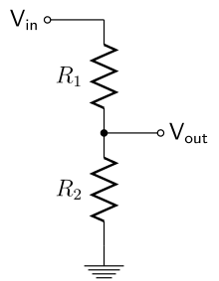
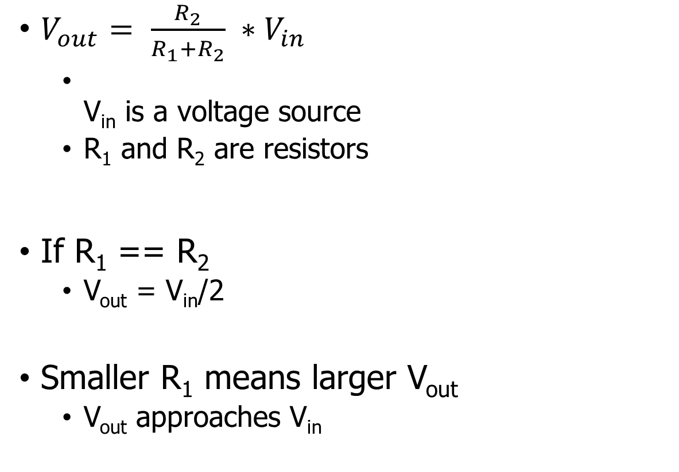
Voltage divider
Important! Learn this
$V_{out}= \frac{R_{2}}{R_{1}+R_{2}} ∗V_{in}$
V_{in} is a voltage source
R₁ and R₂ are resistors
If R₁ == R₂
V_{out} = V_{in}/2
Smaller R₁ means larger V_{out}
V_{out} approaches V_{in}

Slide 10
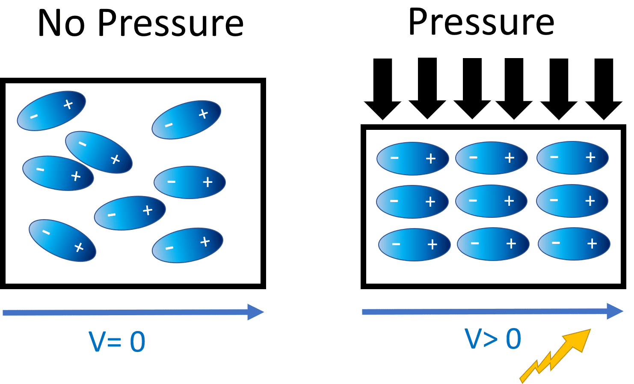
Generating voltage via piezoelectric effect
Compression of the material generates a voltage
Various sources of compression:
Air Pressure
Acceleration
Strain
Alternative to resistive sensors. But, a voltage is still the output

Slide 11
Understanding sensor voltage
Once you get a voltage, what do you do with it?
Need to understand the transfer function between voltage and the sensed quantity
Examples for an accelerometer: senses acceleration
Hopefully, function is linear
Frequently, function is NOT

Slide 12
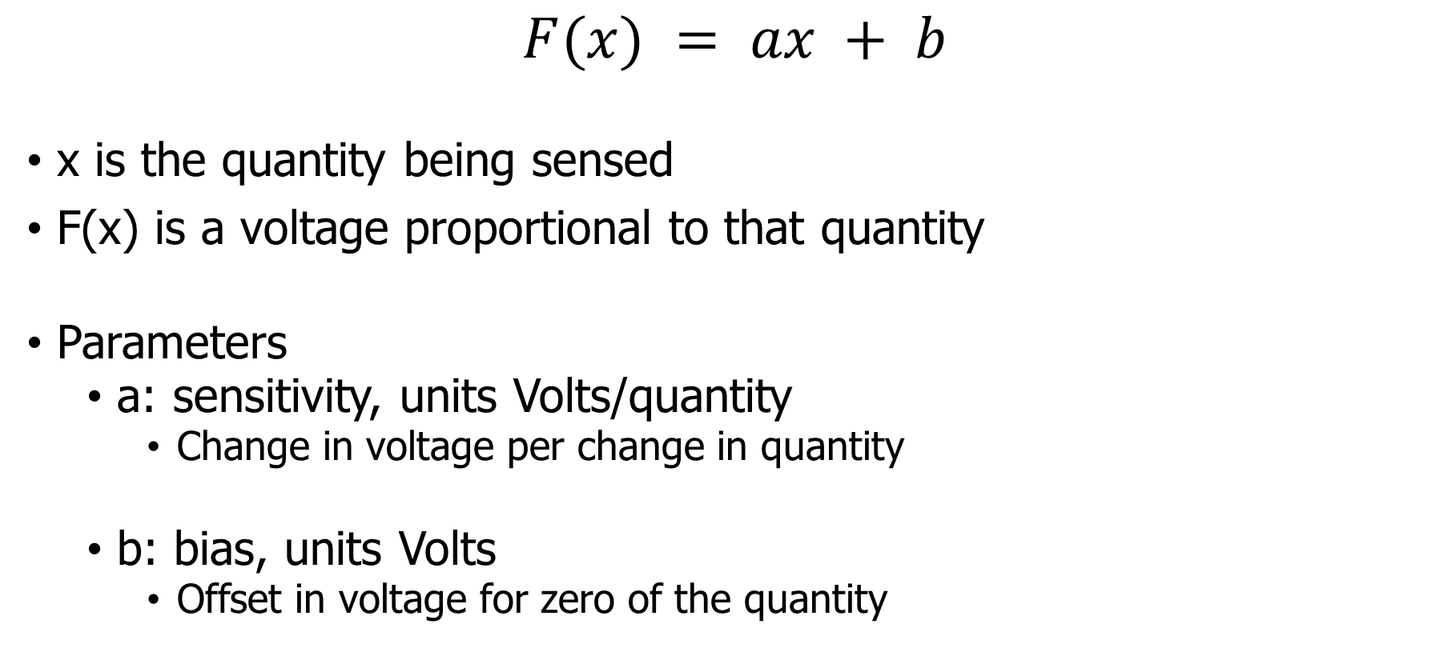
Affine sensor model (for linear sensors)
$$F(x) = ax + b$$
x is the quantity being sensed
F(x) is a voltage proportional to that quantity
Parameters
a: sensitivity, units Volts/quantity
Change in voltage per change in quantity
b: bias, units Volts
Offset in voltage for zero of the quantity

Slide 13
Bias and sensitivity example
Accel
x(g)
-3.6
0
3.6
0
1.5
3.0
V_{readout} (V)
F(x)
F(x) = ax+b
b = 1.5
a = 1.5/3.6 = 0.417 V/g
ADC (16-bit)
[0,3 V] → [0, 2¹⁶-1]
0
32768
65535

Slide 14
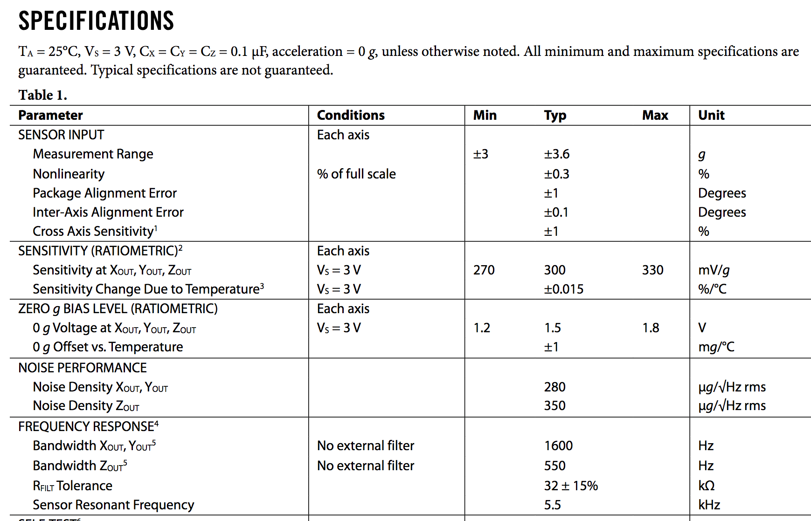
Understanding transfer function: ADXL330 datasheet
Ratiometric
Relative to sensor voltage
Bandwidth
≈Data update speed of the sensor
Data changes above 1600 Hz are less detectable

Slide 15

Break + Question
$$F(x) = ax + b$$
x is the quantity being sensed
F(x) is a voltage proportional to that quantity
a: sensitivity, units Volts/quantity
Change in voltage per change in quantity
b: bias, units Volts
Offset in voltage for zero of the quantity
Accelerometer
Measures 0-5 g
Over a 0-5v range
What is sensitivity?
What is bias?
What acceleration is the voltage reading 3.5 volts?

Slide 16

Break + Question
$$F(x) = ax + b$$
x is the quantity being sensed
F(x) is a voltage proportional to that quantity
a: sensitivity, units Volts/quantity
Change in voltage per change in quantity
b: bias, units Volts
Offset in voltage for zero of the quantity
Accelerometer
Measures 0-5 g
Over a 0-5v range
What is sensitivity? 1 v/g
What is bias? 0 v
What acceleration is the voltage reading 3.5 volts?
3.5 v = 1v/g * x + 0v -> 3.5 g

Slide 17
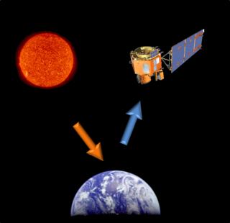
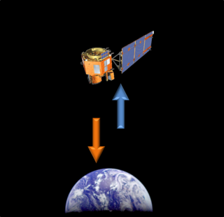
Active and passive sensing
Passive Sensing
Active Sensing

Slide 18
Active and passive sensing
We usually focus on passive sensing
Cheaper and lower energy costs!
Active sensing examples
Flash photography
Ultrasonic distance sensing
Lidar and Radar

Slide 19
Intelligent sensors
Many embedded sensors are more intelligent than simple analog
Combine it with a built-in ADC
Can be more finely tuned and calibrated for accuracy
Now gives digital output over some wired communication mechanism
Combine it with additional circuitry / computation
Automatically filter data
Detect specific signal patterns and interrupt
I point most groups at intelligent sensors for projects
More expensive but easier to use

Slide 20
Outline
Sensing Overview
Types of Sensors
Temperature
Light
Inertial
Others
Capacitive Touch Sensing

Slide 21
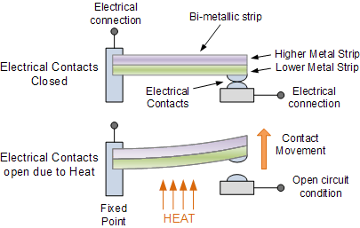
Digital temperature sensor
Thermostat
Original meaning of the word
Heat bends a strip of two different metals
Switches circuit on/off based on the temperature

Slide 22
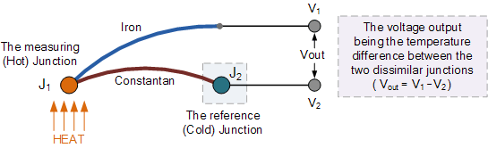
Thermo-electric temperature sensing
Thermocouple generates a voltage based on temperature
Can be used to harvest energy to run system
Part of RTG design

Slide 23
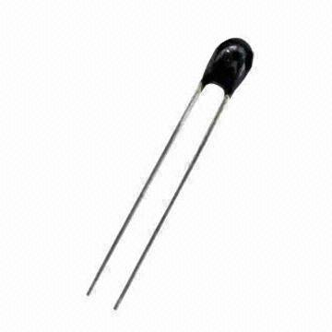
Resistive temperature sensing
Thermistor varies resistance based on temperature
Set up as a voltage divider to measure
Advantages: extremely cheap and easy to use
Disadvantages: non-linear transfer function

Slide 24
Outline
Sensing Overview
Types of Sensors
Temperature
Light
Inertial
Others
Capacitive Touch Sensing

Slide 25
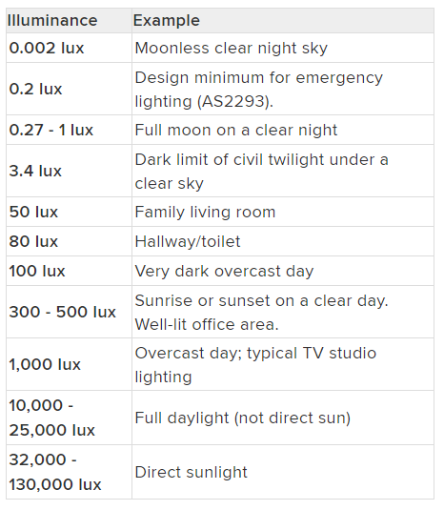
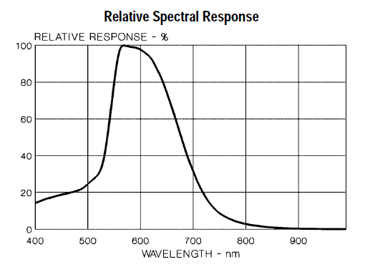
Measuring light
Lux: unit of illuminance
Beware spectrum sensitivity

Slide 26
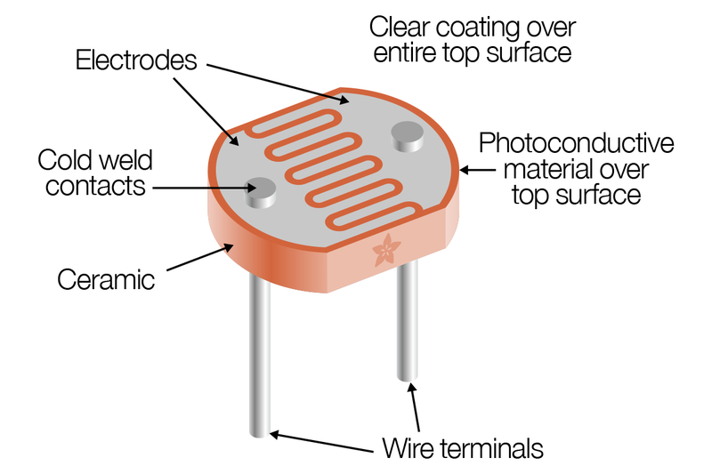
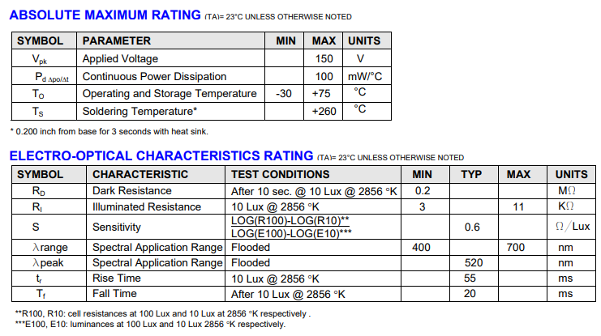
Resistive light sensing
Photocell changes resistance with light (non-linear)
Kit version:
10 kΩ when dark
1 kΩ when light

Slide 27
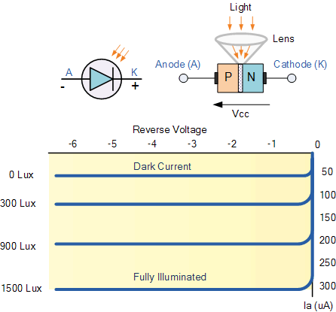
Photodiodes leak current based on light levels
When voltage is applied in reverse to an ideal diode, no current flows
But some small amount of current leaks for real-world diodes
Proportional to light levels!
LEDs can be used as (crappy) photodiodes as well!
Apply reverse voltage
Read in leak current as voltage across a resistor using ADC
https://wiki.analog.com/university/courses/electronics/electronics-lab-led-sensor

Slide 28
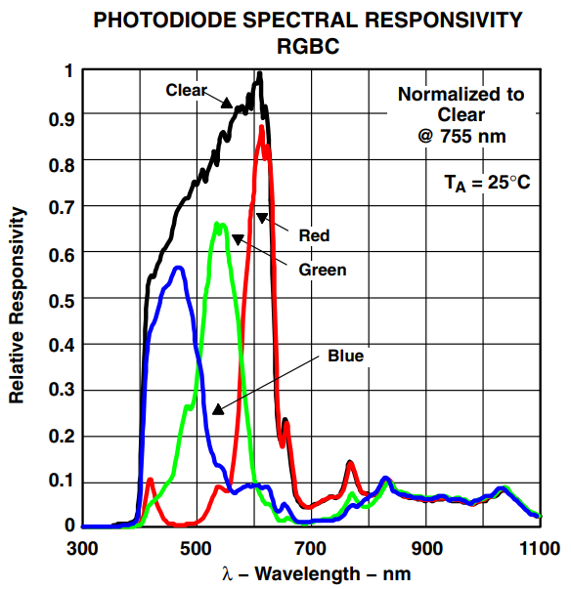
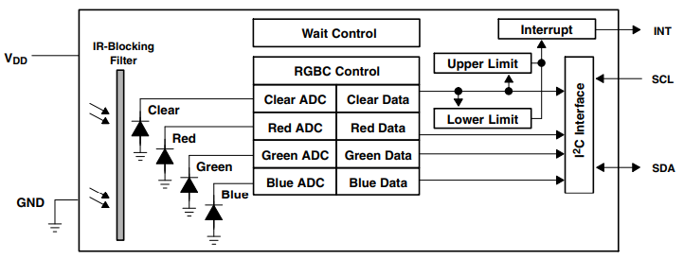
Light color sensing
Respond to specific light colors separately
Intelligent sensor: photodiodes combined with ADCs and a wired interface (I2C)
Allows interrupting based on comparator too

Slide 29
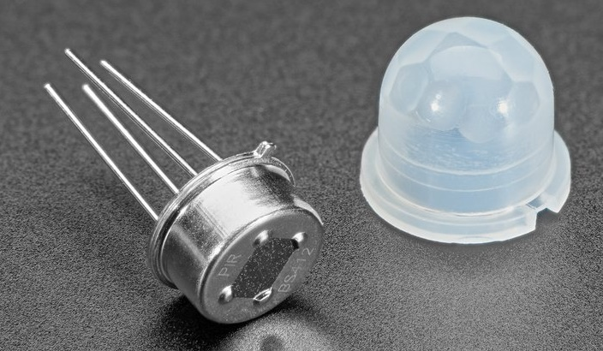
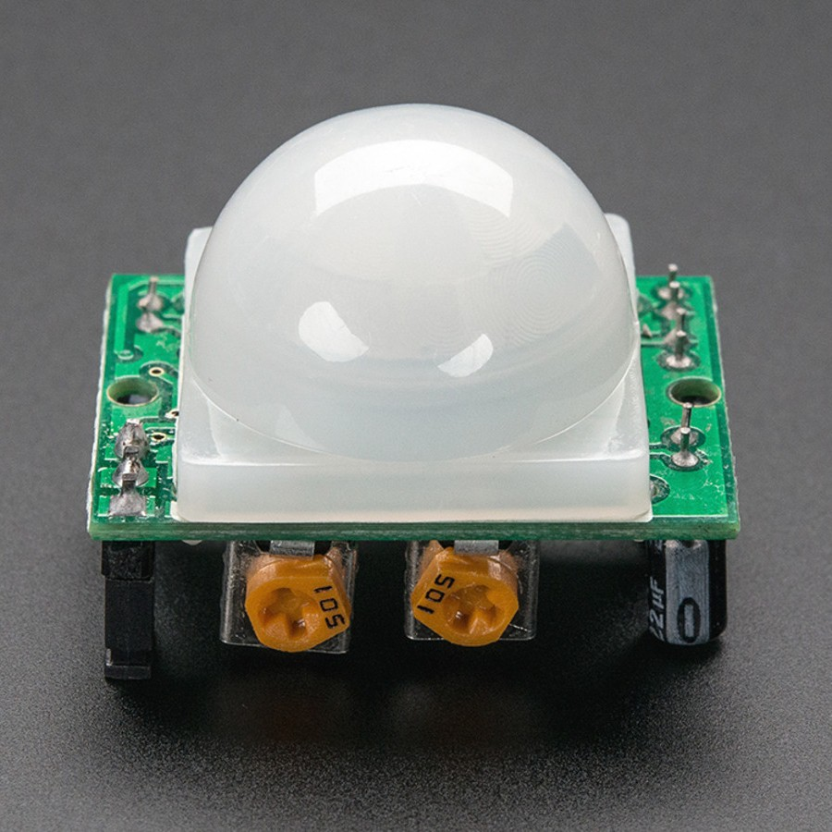
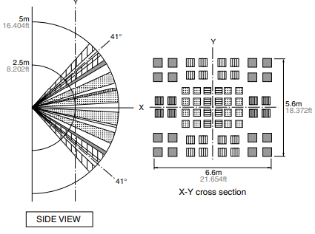
Passive Infrared (PIR) sensor
Detect movement in the environment
By detecting change in IR levels
Often come with plastic lens cover to improve field of view and range

Slide 30
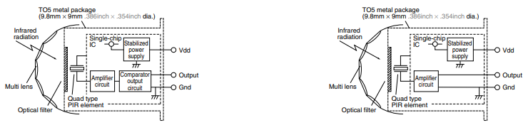
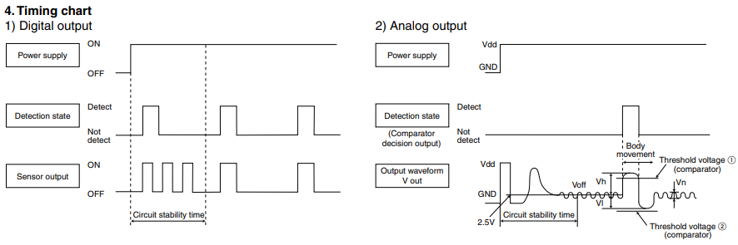
PIR sensors come in digital and analog forms
Digital includes a preconfigured comparator

Slide 31
Outline
Sensing Overview
Types of Sensors
Temperature
Light
Inertial
Others
Capacitive Touch Sensing

Slide 32
Inertial Measurement Unit (IMU)
IMUs (a.k.a 9 degree-of-freedom, 9DOF) are used for tracking motion of a device
Acceleration (X, Y, Z axes)
Rotation (X, Y, Z axes)
Magnetism (X, Y, Z axes)
Sometimes 6DOF with Acceleration + one of the others
Intelligent sensing: combines multiple sensors, ADCs, and computation with a wired interface
9 analog inputs would otherwise be too many
Can be used to track motion, determine transportation method
Smartphones, Robotics, etc.

Slide 33
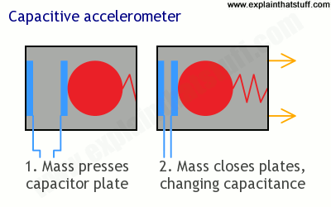
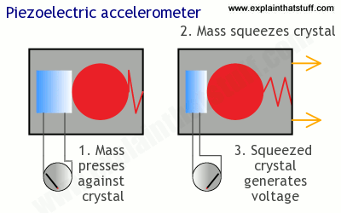
Sensing acceleration
Goal: create a voltage that changes based on force

Slide 34
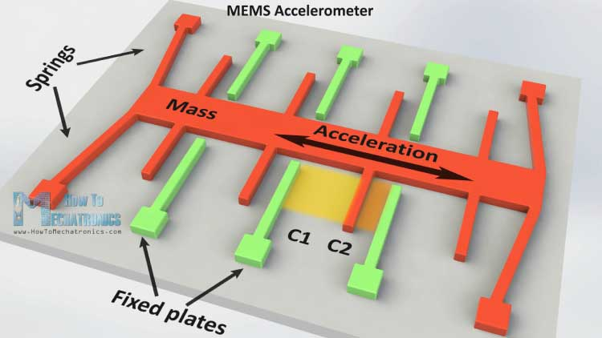
Microelectromechanical Systems (MEMS)
Same concept, but within an IC and 1 to 100 micrometers in size

Slide 35
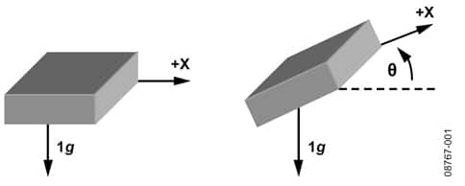
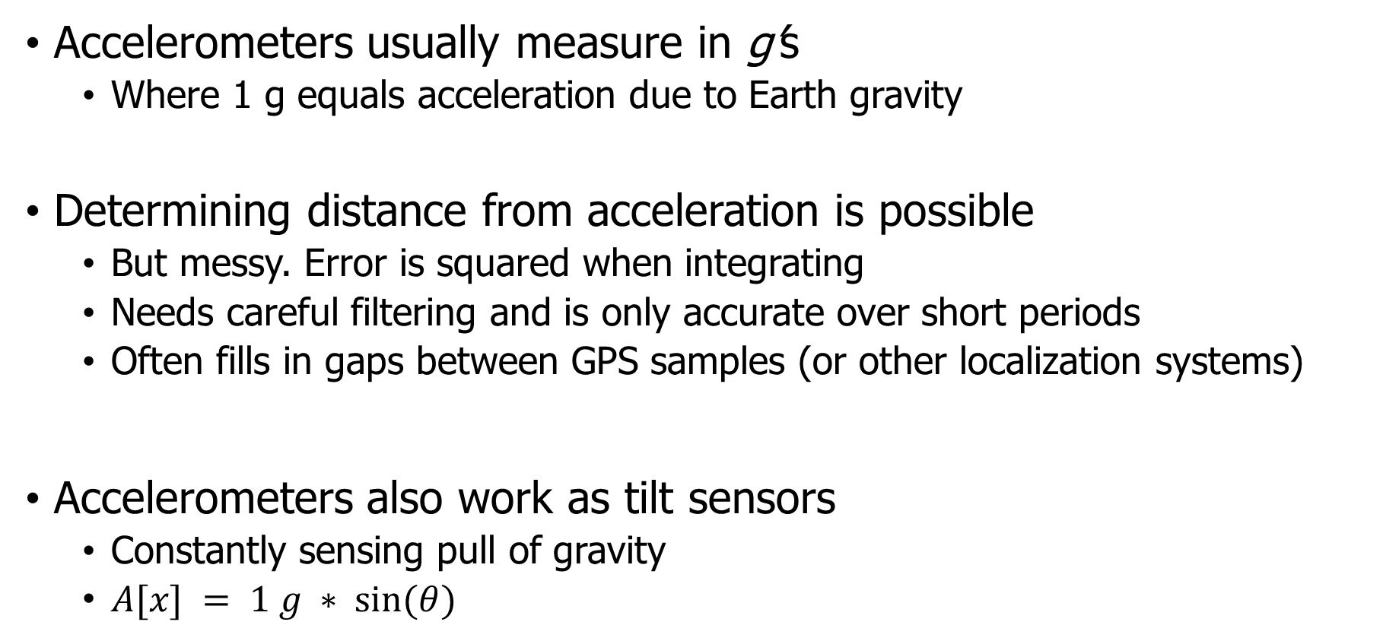
Using accelerometers
Accelerometers usually measure in g’s
Where 1 g equals acceleration due to Earth gravity
Determining distance from acceleration is possible
But messy. Error is squared when integrating
Needs careful filtering and is only accurate over short periods
Often fills in gaps between GPS samples (or other localization systems)
Accelerometers also work as tilt sensors
Constantly sensing pull of gravity
$A[x] = 1 g ∗ sin⁡(θ)$

Slide 36
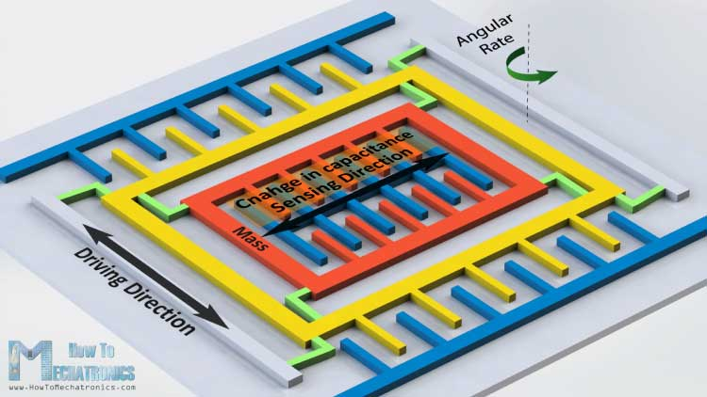
Gyroscopes
Measures angular velocity
Usually lower limit than you might hope
<10 rotations per second
Usually, we want angle instead of rotation speed
Integrate signal to determine current angle
Combine noise and DC bias with integration and you get a continuously accumulating error: drift

Slide 37
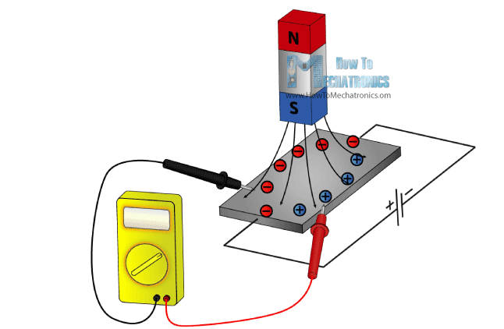
Magnetometer
Measures the magnetic field
Usually used in devices as a compass
Detect Earth’s magnetic field orientation
Problem: Earth’s magnetic field often overwhelmed by local magnetism when indoors
Large chunks of metal in walls, for example
Or other metal parts nearby on the circuit board!!
Satellites can use magnetometers for localization

Slide 38
Outline
Sensing Overview
Types of Sensors
Temperature
Light
Inertial
Others
Capacitive Touch Sensing

Slide 39
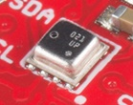
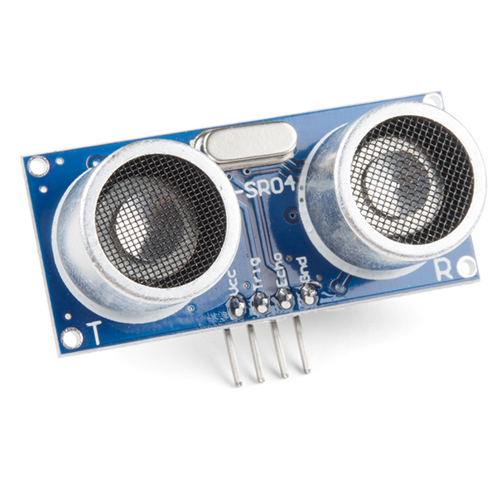
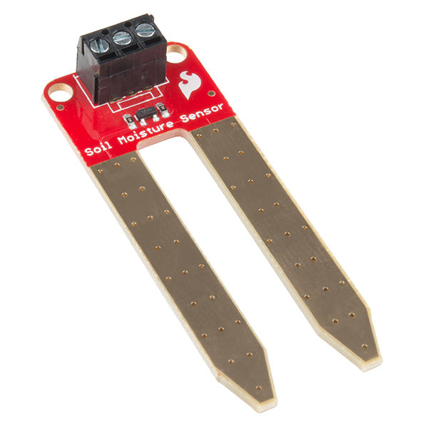
Other sensors
Environment: Pressure, Humidity, Air Velocity, Air Quality
Distance: Ultrasonic, Lidar, or Radar
Biometric: Pulse Oximeter, Heart Rate
Agricultural: Soil moisture

Slide 40
Break + Open Question
How are new sensors discovered/created?

Slide 41
Outline
Sensing Overview
Types of Sensors
Temperature
Light
Inertial
Others
Capacitive Touch Sensing

Slide 42
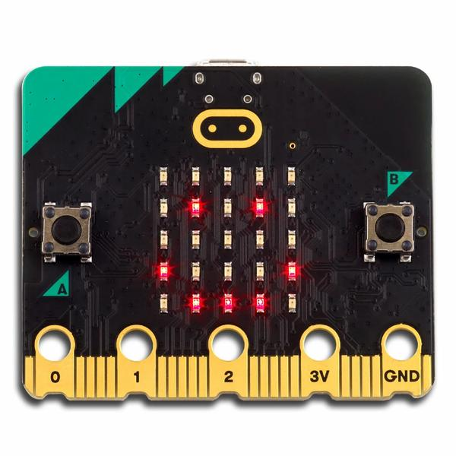
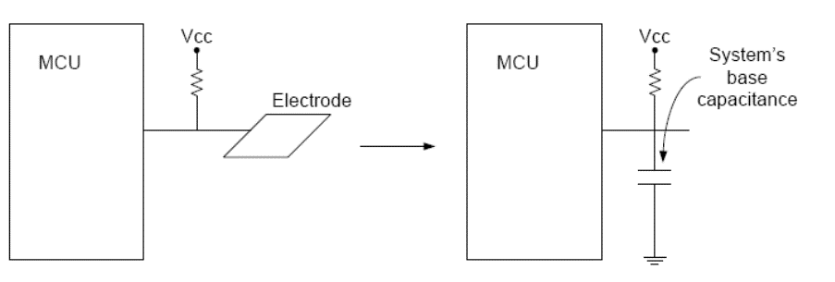
Capacitive Touch Sensor
Pull-up resistors connected to metal pads
Also connected to GPIO pin
Acts as a capacitor connected to ground

Slide 43
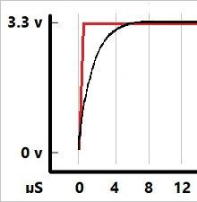
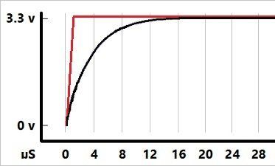
The touch pad recharges on its own
If you drive the GPIO pin attached to it low, touchpad clears low
If you make the GPIO pin an input (high impedance)
The touchpad gets pulled high, which takes some amount of time
Low Capacitance
High Capacitance
The more capacitance the longer this takes!
And fingers are GIANT capacitors

Slide 44
Capacitive touch sensing method
Drive GPIO pin low
Connects the pad to ground
Set GPIO pin as input and enable low-to-high interrupt
Gets an interrupt when the pad finally becomes high on its own
Use a timer to determine time until interrupt
~70 μs with no finger, <= milliseconds with finger
Needs to timeout after a few milliseconds to declare “touched” as there might be enough capacitance to never go fully high
Repeat periodically (a few times a second is probably good enough)
Sudden large increase in rise time ⇨ someone is touching!
Finger acts as a large capacitor

Slide 45
Capacitive touch works on any metal surface
Idea: Microbit door handle sensor
Connect a wire and a pull-up resistor to a metal door handle to sense when someone is touching it!
Timing will be very different from capacitive pad, but should be repeatable and capable of distinguishing human touch

Slide 46
Outline
Sensing Overview
Types of Sensors
Temperature
Light
Inertial
Others
Capacitive Touch Sensing

Slide 47
Bonus
Research case study

Slide 48
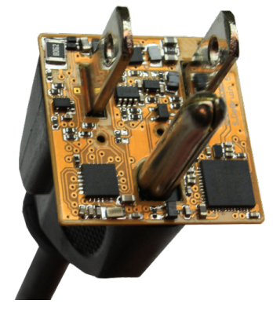
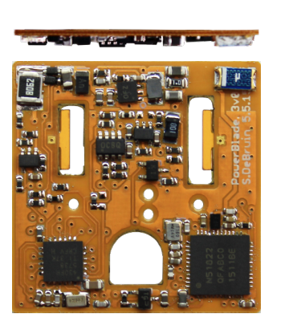
PowerBlade current sensing
Example of creating a custom sensor
PowerBlade goals
Sense current and voltage in real-time
Be small enough to be deployable
Problem
To measure current, you usually have to break the circuit
But PowerBlade attaches in parallel

Slide 49
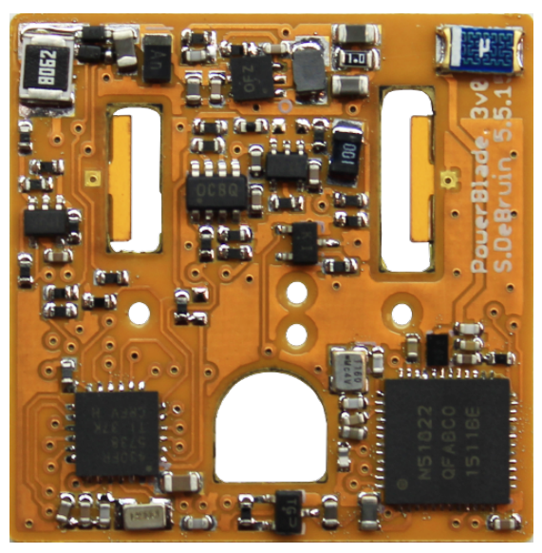
Measuring current
Coil of wire in a changing electric/magnetic field produces a voltage
One way to make inductors is as a coil of wire wrapped horizontally around a magnetic core
Re-purpose horizontally wire-wound inductor as current sensor!

Slide 50
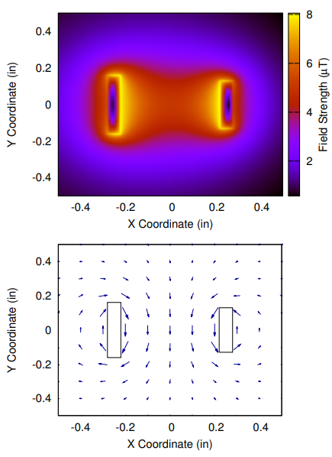
Sensor placement
Is in the middle or close to a prong the best choice?
Turns out it’s closer to a prong
Decreases with distance squared
Angled like the magnetic field is

Slide 51
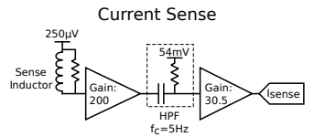
Measuring sensor values
Sensor output is very small
Amplify to make output large enough to accurately measure with ADC
Need to pick sampling rate
AC: 60 cycles per second in US
Need N * 60 measurements per second
N=42 (as fast as we can measure)
2520 measurements per second

Slide 52
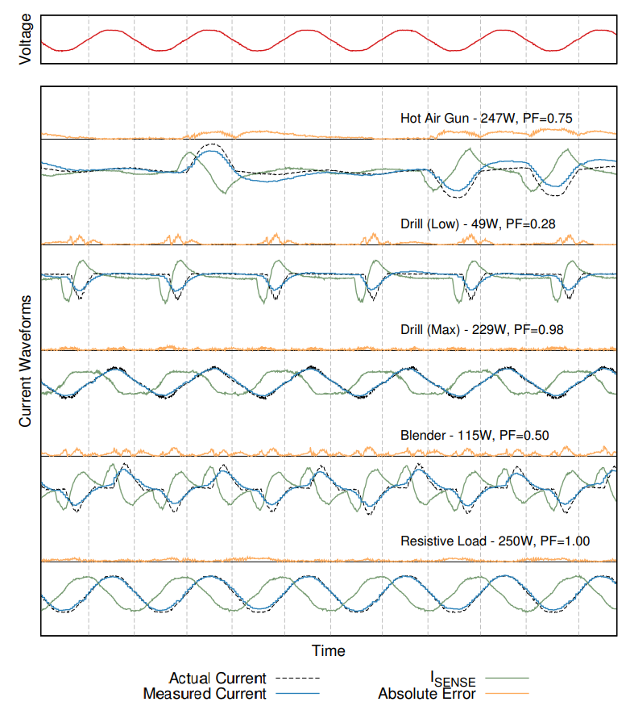
At first, our output signal was this green line

Slide 53

Measurement into current
Search coil measures the derivative of current!!
Need to integrate to get signal and apply sensitivity and bias

