Slide 1
Lecture 01 Introduction & C
CS211 – Fundamentals of Computer Programming II
Branden Ghena – Spring 2023
Slides adapted from: Jesse Tov, Sruti Bhagavatula, Joe Hummel

Slide 2
Welcome to CS211
Course Goal: become a better and broader programmer
First half
C programming
Unix shell
Second half
C++ programming
Introduces students to industry-standard languages and tools
Builds foundational software design skills at a medium scale

Slide 3
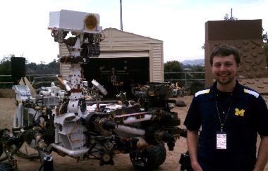
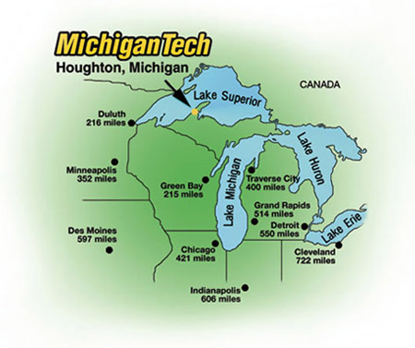
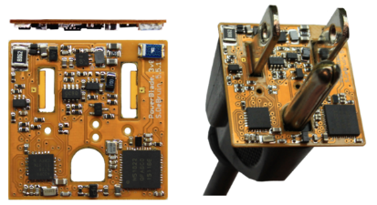
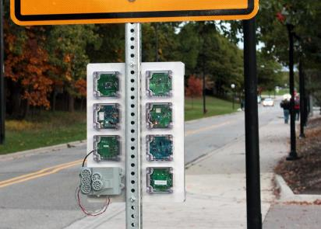





Branden Ghena (he/him)
Assistant Faculty of Instruction
Education
Undergrad: Michigan Tech
Master’s: University of Michigan
PhD: University of California, Berkeley
Research
Resource-constrained sensing systems
Low-energy wireless networks
Embedded operating systems
Teaching
Computer Systems
CS211: Fundamentals of Programming II
CS213: Intro to Computer Systems
CS343: Operating Systems
CE346: Microprocessor System Design
CS397: Wireless Protocols for the IoT
Things I love

Slide 4
Questions in class
Please ask questions!!!
It’s not just you who doesn’t understand something.
You can always ask questions verbally during class
Raise hand whenever
I’ll stop for questions too
Other options
Ask me after class
Ask on Piazza

Slide 5
Today’s Goals
Discuss why we teach (and require) this class
Describe how this class is going to function
Introduction to C programming

Slide 6
Outline
Why?
Course Overview
Intro to C
Hello World
Variables
Computing Fibonacci

Slide 7
What does CS211 teach?
C and C++ Programming
Unix Shell

Slide 8
C - the most important programming language
Old (1972), but nowhere near the first programming language
FORTRAN, LISP, ALGOL, COBOL, Basic, B, and many others came first
Right time, right place, right capability
Enables both low-level control and (relatively) high level thinking
Fast, efficient, and highly portable
Inspired everything that has come since
C syntax is copied partially or completely in MANY other languages
Lessons learned from using C inspired improvements to make programming easier

Slide 9
C++ - an evolutionary addition to C
Additional features on top of C
Most important: classes to support Object Oriented Programming
Also includes a significant amount of libraries that C does not
Enables more complicated software design
Manages which part of code can access which things at which times
Manages how things are named and referred to
Manages errors to help software respond to them

Slide 10
Things written in C/C++
All major modern operating systems are partially or entirely C
Windows, Linux, MacOS, Android, iOS
Scientific computing (mix of C and C++)
Mathematica, MATLAB, various scientific libraries
Video game engines (often C++)
Unreal Engine, Unity, CryEngine
Embedded control systems (usually C, occasionally C++)
Cars, Airplanes, Satellites and Rovers, Thermostats, Webcams, …

Slide 11
Upsides to C and C++
You are in charge of everything
You can do anything you want without constraints
Capable of directly interacting with hardware (“systems language”)
Grab exactly as much memory as you need and manage it yourself
Makes it incredibly fast (~100x faster than Python)
Makes it incredibly efficient (no memory is wasted)
These lead to the languages being very widely used
Top five programming languages for decades include C and C++

Slide 12
Downsides to C and C++
You are in charge of everything
And nothing is taken care of for you
Things you “can’t” do are often UNDEFINED BEHAVIOR
To enable portability, the languages just straight-up don’t say what happens if you violate the rules
The computer could do anything
Backwards compatibility means features are only ever added
You’ll see this especially in C++, C just has less features total
C++ feels like a bunch of things stapled together
And there’s an amazing programming language hiding in there

Slide 13
Analogies for programming languages
Racket
Generic beginner’s car that gets you places
Python
Great car you can drive without a license
Unless you want to go really fast or on bad terrain, might be good enough
C
A racing car that goes incredibly fast but breaks down every fifty miles
C++
A souped-up version of the C racing car with dozens of extra features that only breaks down every 250 miles
But when it breaks down, nobody can figure out what went wrong
http://users.cms.caltech.edu/~mvanier/hacking/rants/cars.html

Slide 14
So why teach C and C++?
You’ll learn a lot more about programming
Syntax and ideas from C inspired a lot of other languages
Feels very different from Racket or Python
You’ll become a better programmer
You’re going to run into a lot of errors and problems in this class
Hopefully they teach you to better design and plan your code
Prepare you to dig deeper into computer systems
A “systems language” is needed to interact directly with hardware
Major options: Pascal, C, C++, Ada, Rust

Slide 15
What does CS211 teach?
C and C++ Programming
Unix Shell

Slide 16
Unix
A wildly popular operating system in the 1970s and 80s
Today refers to the family of operating systems inspired or grown from Unix
Particular design style for “everything is a file”
Various tools the OS is expected to provide
Command line interface, also known as a “shell”
Unix
Linux
Android
BSD
MacOS
iOS

Slide 17
C and Unix were born together
Operating systems used to be written in assembly
Basic instructions specific to a certain processor family (see CS213)
So supporting a new computer type meant rewriting all of your software
Unix development (1969) by Ken Thompson and Dennis Ritchie
Developed at Bell Labs, which was a computing research powerhouse
C language (1972) by Dennis Ritchie to write Unix programs
And they quickly rewrote the whole OS in C as well
This made the OS simpler to modify and easier to port to new systems
Unix became enormously popular due in part to its portability

Slide 18
Unix shell
Text-based interface to a computer
Compare to graphical interfaces that need a mouse
Necessary for remote interactions with many computers
Cloud servers
Specialized “headless” hardware
Can be incredibly efficient and powerful
Find all JPEG files in this folder and convert into PNGs mogrify –format png *.jpg
Replace all instances of CS150 with CS211 across all Markdown files sed –i ‘s/CS150/CS211/g’ *.md

Slide 19

So why teach Unix shell?
Many future classes are going to require you to work on a specialized computer that is shared by the class
More resources, specific capabilities, etc.
Add another basic computing tool to your skillset
You might not use shell every day
But maybe you might
You get to feel like a “hacker”
Using shell isn’t the only way to be a programmer, but is a stereotypical way

Slide 20
So, why CS211?
It’s going to make you a much better programmer
It’s going to teach you a bunch of new skills
It’s going to enable you to succeed in future classes

Slide 21
Architecture of a lecture
Full
Administrivia
+ stretch break
Open Question
Summary
+ Bonus
Attention
0
20
25
50
53
78
80
Time (minutes)

Slide 22
Break + Question
Why might some software use C instead of Python?

Slide 23
Break + Question
Why might some software use C instead of Python?
Performance!!
C is MUCH faster than Python
Tricky low-level “systems” behavior
Directly manipulating memory and hardware devices
E.g., an Operating System or a Game Engine
Legacy code
C is older than Python is, and is supported on more systems
An old Palm Pilot from the 90s: Python won’t work on it but C will

Slide 24
Outline
Why?
Course Overview
Intro to C
Hello World
Variables
Computing Fibonacci

Slide 25
Course Staff
TA (1)
Sherwin Shen - PhD student in Computer Science
PMs (14)
Sofia Melendez Ethan McAlpin
Natalie Hill John Sanchez
Chisara Ojiako Matt Saperstein
Mercy Omwoyo Jackie Lin
Eli Barlow Ben Geduld
Antonio Rocha Liz Yumbla
Inessa Verbitsky Emily Wei
Their role: support student questions via office hours and Piazza

Slide 26
How to learn stuff
Lectures: here in class on Tuesdays and Thursdays
Please attend and ask questions!
Panopto tab on Canvas will have recordings (a few hours later)
Textbook
Zybooks “Programming in C” and “Programming in C++”
Interactive materials covering the basics of C and C++
Office hours (starting next week)
Planning a mix of in-person and online
More info will be posted to Piazza when the schedule is ready

Slide 27
Asking questions
Class and office hours are always an option!
I’ve got time to hang out after lectures and answer questions
Piazza: (similar to Campuswire)
Post questions
Answer each other’s questions
Find posts from the course staff
Post private info just to course staff
Please do not email me! Post to Piazza instead!
I’m terrible at email and won’t respond when I get busy
Exception: email me if you can’t access Piazza. I’ll be updating roster again a few times

Slide 28
Exercises
Practice labs in the zyBooks textbook
Small snippets of code you’ll need to write to match some expected output
Usually, 1-20 lines of code
Immediate feedback, infinite retries, graded on completion
Can work with others on them if that’s helpful
Provides practice programming in C/C++
If you’re already comfortable, should be easy
If you’re uncomfortable, these should help!

Slide 29
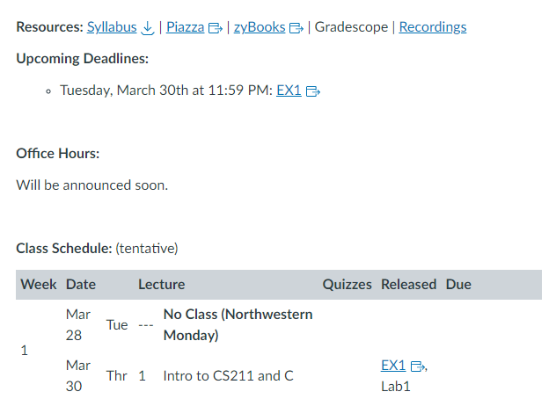
Bad news: first assignment is already out
The first set of exercises (“EX1”) is due next week Tuesday
Posted on Canvas homepage
Lecture slides are also posted to Canvas right before class

Slide 30
Labs
Small, guided practice sessions to set up a new environment
Setup for SSH access to lab machines (C programming)
CLion IDE setup with game engine (C++)
These are super important, because without them you won’t be able to work on your homework!
First lab will be out tonight or tomorrow
These are not formal assignments or quizzes
You may work with others on them
Goal is to make sure your setup works before the homework starts

Slide 31
Homeworks
Medium-sized individual programming assignments
Around 200-1000 lines of code (50-200 is your solution)
About a week to complete them
First three are C, last two are C++
These are serious work, but also where the most learning will happen
Individual, may NOT work with other students on them

Slide 32
Final Project
A bigger homework, where you get to choose what you want to do
Done with a partner of your choosing
Make an “interactive program” (usually a game)
Examples: Pacman, Tetris, Two-dots, MS Paint, Checkers, Desert Bus
This is your chance to do something interesting and fun!
Can be a significant amount of work though

Slide 33
Quizzes
Multiple quizzes instead of a big exam
Should be four total
Each is roughly 15-20 minutes
Quizzes cover mainly material from the last two weeks
But build upon knowledge from the entire course
Only 10% of your grade total (2.5% each)
Focus is really on making sure you’re caught up on class material
Hopefully shouldn’t be too stressful
First quiz isn’t until Tuesday of Week 3

Slide 34
Grade composition
Category | Count | Total Value
Exercises | 6 | 5%
Labs | 2 | 5%
Homework | 5 | 55%
Final project | 1 | 25%
Quizzes | 4 | 10%
Standard letter grade scale
93%+ A
90%+ A-
87%+ B+
etc.

Slide 35
Relative homework difficulties
Homework | Difficulty
HW1 | 5
HW2 | 7
HW3 | 11
HW4 | 6
HW5 | 9
Final Project | 10ish*
HW3 is the last in C
It’s a two-part assignment spread over two weeks
* But really it’s up to you

Slide 36
Late Policy
You can submit homeworks late
Quizzes, exercises, and labs cannot be submitted late
10% penalty to maximum grade per day late
Example: three days late means maximum grade is 70%
Final project has a sliding scale
90% for up to 24-hours late
60% and 30% for the two days after that

Slide 37
We will support you if possible and equitable
We can be flexible with deadlines for problems outside of your control
Sick, family emergency, broken computer
Contact me (via Piazza) and I’ll provide additional extensions
Also, we support expected accessibility needs
Make sure to submit ANU requests if you have any
Let me know about anything else you need and we can discuss it

Slide 38
Slip Days
Slip days let you turn in a homework late and receive no penalty
Each student gets 4 slip days
Apply to homeworks only (not final project, exercises, or labs)
You don’t need to tell us you’re using them, we’ll just automatically apply them at the end of the year
Examples:
Turn in HW1 three days late
Turn in HW4 two days late and HW5 one day late
Turn in HW2 four days late with only a one-day penalty

Slide 39
Getting Help – Office Hours
Office hours are mostly hosted by the PMs and TA
I will have some too! Especially for higher-level questions
Schedule
We’re going to host a TON of office hours
With some in-person and some online
Details to follow, schedule on Canvas homepage
Reminder: office hours are meant to augment the class
Attend them when you need to!

Slide 40
Getting Help – Request a Meeting
Lecture is my side gig
My main job is helping students succeed
If you are struggling, reach out and I will meet with you
Course material
Homework
Other stuff going on in your life

Slide 41
Advice
Submit assignments early and often!
If you find this course difficult, that’s because it is difficult.
However, nobody fails unless they give up.
You belong here and can succeed here.
Be kind to each other.

Slide 42
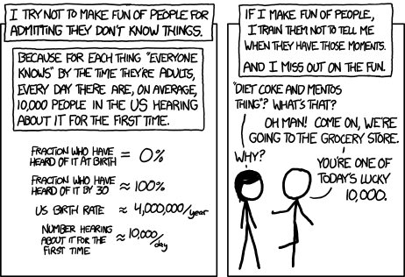
Break + relevant xkcd
https://xkcd.com/1053/

Slide 43
Collaboration in CS211, three levels:
Partner Collaboration
Your code and the other student’s code are identical because you share it and work on it together
ONLY for registered partners on final project
Close Collaboration
You communicate about code however you see fit
ONLY acceptable for labs and exercises
Arms-Length Collaboration
You discuss problems and solutions at a high level
MAY NOT read, write, look at, record, or transcribe code
MAY NOT have the code up on screen during collaboration
MUST cite your sources, both arms-length collaborators and other resources
Refer to syllabus for the official version of this policy

Slide 44
Academic Honesty
In CS211, we take cheating very seriously
Cheating is when you:
Engage in an inappropriate level of collaboration
Such as look at another student’s code
Enable another student, present or future, to cheat
Such as letting a CS211 student read your code next year
Fail to cite your sources (friend, Stack Overflow, etc.)
Such as you get a big hint and don’t acknowledge where it came from in a code comment

Slide 45
Academic Honesty
Please do not cheat in CS211
If you don’t write code, you won’t learn!
Cheating on code is super easy to catch!!
No, like really really easy
All suspected cheating is reported to the relevant dean for investigation
Last time I taught CS211, eight different students were reported
If you are unsure about a situation, ask the staff on Piazza

Slide 46
Outline
Why?
Course Overview
Intro to C
Hello World
Variables
Computing Fibonacci

Slide 47
Hello world C program
hello.c
#include <stdio.h>
int main(void) {
printf("Hello, CS 211!\n");
return 0;
}

Slide 48
Hello world C program
hello.c
#include <stdio.h>
int main(void) {
printf("Hello, CS 211!\n");
return 0;
}
This is the code file where you can find this code!
Usually, I’ll provide students source code for any in-class examples

Slide 49
Hello world C program
hello.c
#include <stdio.h>
int main(void) {
printf("Hello, CS 211!\n");
return 0;
}
A function named main()

Slide 50
Hello world C program
hello.c
#include <stdio.h>
int main(void) {
printf("Hello, CS 211!\n");
return 0;
}
A function named main()
No Arguments (void)
Returns an integer

Slide 51
Hello world C program
hello.c
#include <stdio.h>
int main(void) {
printf("Hello, CS 211!\n");
return 0;
}
Call to the printf() function
One argument to the function, the string “Hello, CS211\n”

Slide 52
Hello world C program
hello.c
The printf() function is a part of the standard input/output library, included here
#include <stdio.h>
int main(void) {
printf("Hello, CS 211!\n");
return 0;
}
Call to the printf() function
One argument to the function, the string “Hello, CS211\n”

Slide 53
Hello world C program
hello.c
#include <stdio.h>
int main(void) {
printf("Hello, CS 211!\n");
return 0;
}
Returns a value, 0 (which is of type int)

Slide 54
Hello world C program
hello.c
Two special things going on here:
main() is a special function name that is called when the program runs
#include <stdio.h>
int main(void) {
printf("Hello, CS 211!\n");
return 0;
}

Slide 55
Hello world C program
hello.c
Two special things going on here:
main() is a special function name that is called when the program runs
main() returns a number that specifies whether the program succeeded or failed and how
0 means success
non-zero means failure
specific numbers mean different things to different programs
#include <stdio.h>
int main(void) {
printf("Hello, CS 211!\n");
return 0;
}

Slide 56
Outline
Why?
Course Overview
Intro to C
Hello World
Variables
Computing Fibonacci

Slide 57
Program state is preserved in variables
C is an Imperative programming language
List of step-by-step statements that modify the program’s state
State is information from prior steps that influences future steps
Example: TV volume Up/Down apply to prior setting
In programs, we explicitly keep state in variables
int z = 5;

Slide 58
Values, objects, and variables
Values are the actual information we want to work with
Numbers, Strings, Images, etc.
Example: 5 is an int value while ‘a’ is a char value
An object is a chunk of memory that can hold a value of a particular type.
Example: function f takes an argument int x
Each time f is called, a “fresh” object that can hold an int is “created”
A variable is the name of an object
Assigning to a variable changes the value stored in the object named by the variable

Slide 59
Example of definition and assignment
int z = 5;
z = 7;
z = z + 4;
What happens?

Slide 60
Example of definition and assignment
int z = 5;
z = 7;
z = z + 4;
What happens?
The first statement is a definition. It creates an int object, names it z, and initializes it to the value 5
z: | 5

Slide 61
Example of definition and assignment
int z = 5;
z = 7;
z = z + 4;
What happens?
The second statement is an assignment. It replaces the value 5 stored in the object named by z with the value 7.
z: | 7

Slide 62
Example of definition and assignment
int z = 5;
z = 7;
z = z + 4;
What happens?
The third statement is also an assignment. It retrieves the current value of z (which is 7), then adds 4 to it, and then stores the result back in the object named by z.
z: | 11

Slide 63
C: Typed imperative programming
Imperative programming
Each line is a statement that changes the program’s state
Usually, the values within a variable
Type System
Variables have a type associated with them
The type determines qualities of the object
Example: how much memory it takes up
The type specifies what kind of value the variable holds
Example: integers, decimal numbers, strings, etc.

Slide 64
Some types in C
Hold an integer number (like 5 or 0 or -3)
char, short, int, long, size_t, int8_t, int16_t, int32_t, etc.
These can also specify signedness
unsigned: only 0 and greater
signed: negative, 0, or positive
Hold a decimal number (like 6.238 or 0.00001 or -32566.5)
float, double
These are always negative, 0, or positive
Difference between types: how big of a value they can hold
short: 0 to 65536 OR signed short: -32768 to 32767
int: 0 to 4294967296 OR signed int: -2147483648 to 2147483647
We’ll have a whole future lecture on why the types are like this

Slide 65
Signed vs unsigned variables
All “integer” types in C can be signed or unsigned
char, short, int, long, etc.
Unsigned: only zero or positive
Signed: negative, zero, or positive
Signed is the default! If it doesn’t say, it’s usually signed
An exception is size_t which is unsigned
Comparing signed and unsigned numbers generates a warning
Should make sure they’re the same before comparing

Slide 66
Temporarily changing types while comparing
You can cast a variable to another type during an expression
To cast, put a type in parentheses before the variable name
Example
int i = 0; //int is signed by default
size_t length = 5; //size_t is unsigned
if (i > length) { // warning here!
printf(“Too big!\n”);
}

Slide 67
Temporarily changing types while comparing
You can cast a variable to another type during an expression
To cast, put a type in parentheses before the variable name
Example
int i = 0; //int is signed by default
size_t length = 5; //size_t is unsigned
if (i > (int)length) { // no warning anymore!
printf(“Too big!\n”);
}

Slide 68
typedef can be used to make new C type names
Typedef creates a new type name that is a copy of an existing type
Typedef keyword is followed by two types
First type: the original type name
Second type: the new type name
Example:
typedef int x_coordinate_t;
x_coordinate_t my_variable = 5;

Slide 69
More complicated example
int prev;
int curr = 5;
int next = 8;
prev = curr;
curr = next;
next = prev + curr;
prev = curr;
curr = next;
next = prev + curr;
prev = curr;
curr = next;
next = prev + curr;

Slide 70
More complicated example
prev: | 🐝
int prev;
int curr = 5;
int next = 8;
prev = curr;
curr = next;
next = prev + curr;
prev = curr;
curr = next;
next = prev + curr;
prev = curr;
curr = next;
next = prev + curr;

Slide 71
More complicated example
prev: | 🐝
curr: | 5
int prev;
int curr = 5;
int next = 8;
prev = curr;
curr = next;
next = prev + curr;
prev = curr;
curr = next;
next = prev + curr;
prev = curr;
curr = next;
next = prev + curr;

Slide 72
More complicated example
prev: | 🐝
curr: | 5
next: | 8
int prev;
int curr = 5;
int next = 8;
prev = curr;
curr = next;
next = prev + curr;
prev = curr;
curr = next;
next = prev + curr;
prev = curr;
curr = next;
next = prev + curr;

Slide 73
More complicated example
prev: | 5
curr: | 5
next: | 8
int prev;
int curr = 5;
int next = 8;
prev = curr;
curr = next;
next = prev + curr;
prev = curr;
curr = next;
next = prev + curr;
prev = curr;
curr = next;
next = prev + curr;

Slide 74
More complicated example
prev: | 5
curr: | 8
next: | 8
int prev;
int curr = 5;
int next = 8;
prev = curr;
curr = next;
next = prev + curr;
prev = curr;
curr = next;
next = prev + curr;
prev = curr;
curr = next;
next = prev + curr;

Slide 75
More complicated example
prev: | 5
curr: | 8
next: | 13
int prev;
int curr = 5;
int next = 8;
prev = curr;
curr = next;
next = prev + curr;
prev = curr;
curr = next;
next = prev + curr;
prev = curr;
curr = next;
next = prev + curr;

Slide 76
More complicated example
prev: | 8
curr: | 8
next: | 13
int prev;
int curr = 5;
int next = 8;
prev = curr;
curr = next;
next = prev + curr;
prev = curr;
curr = next;
next = prev + curr;
prev = curr;
curr = next;
next = prev + curr;

Slide 77
More complicated example
prev: | 8
curr: | 13
next: | 13
int prev;
int curr = 5;
int next = 8;
prev = curr;
curr = next;
next = prev + curr;
prev = curr;
curr = next;
next = prev + curr;
prev = curr;
curr = next;
next = prev + curr;

Slide 78
More complicated example
prev: | 8
curr: | 13
next: | 21
int prev;
int curr = 5;
int next = 8;
prev = curr;
curr = next;
next = prev + curr;
prev = curr;
curr = next;
next = prev + curr;
prev = curr;
curr = next;
next = prev + curr;

Slide 79
More complicated example
prev: | 13
curr: | 13
next: | 21
int prev;
int curr = 5;
int next = 8;
prev = curr;
curr = next;
next = prev + curr;
prev = curr;
curr = next;
next = prev + curr;
prev = curr;
curr = next;
next = prev + curr;

Slide 80
More complicated example
prev: | 13
curr: | 21
next: | 21
int prev;
int curr = 5;
int next = 8;
prev = curr;
curr = next;
next = prev + curr;
prev = curr;
curr = next;
next = prev + curr;
prev = curr;
curr = next;
next = prev + curr;

Slide 81
More complicated example
prev: | 13
curr: | 21
next: | 34
int prev;
int curr = 5;
int next = 8;
prev = curr;
curr = next;
next = prev + curr;
prev = curr;
curr = next;
next = prev + curr;
prev = curr;
curr = next;
next = prev + curr;

Slide 82
Outline
Why?
Course Overview
Intro to C
Hello World
Variables
Computing Fibonacci

Slide 83
Definition of Fibonacci Function
$fib\left(n\right)= \left\{\begin{aligned}n, if n<2; \\ fib\left(n−2\right)+fib\left(n−1\right), otherwise\end{aligned}\right.$
n | fib(n)
0 | 0
1 | 1
2 | 1
3 | 2
4 | 3
5 | 5
6 | 8
7 | 13
8 | 21

Slide 84
Implementing Fibonacci in C
fib.c
long fib(int n){
if (n < 2) {
return n;
} else {
return fib(n ‑ 2) + fib(n ‑ 1);
}
}
$$fib\left(n\right)= \left\{\begin{aligned}n, if n<2; \\ fib\left(n−2\right)+fib\left(n−1\right), otherwise\end{aligned}\right.$$
Recursion works in C!

Slide 85
Implementing Fibonacci in C
fib.c
long fib(int n){
if (n < 2) {
return n;
} else {
return fib(n ‑ 2) + fib(n ‑ 1);
}
}
$$fib\left(n\right)= \left\{\begin{aligned}n, if n<2; \\ fib\left(n−2\right)+fib\left(n−1\right), otherwise\end{aligned}\right.$$
if (⟨test-expr⟩) { // evaluate ⟨test-expr⟩; then… ⟨then-stms⟩ // do these if ⟨test-expr⟩ was true
} else {
⟨else-stms⟩ // do these if ⟨test-expr⟩ was false
}

Slide 86
Any statements can be nested in C
if (⟨first-test-expr⟩) {
if (⟨second-test-expr⟩) {
⟨A-stms⟩
} else {
⟨B-stms⟩
}
} else {
if (⟨third-test-expr⟩) {
⟨C-stms⟩
} else {
⟨D-stms⟩
}
}

Slide 87
C ignores most whitespace
$$fib\left(n\right)= \left\{\begin{aligned}n, if n<2; \\ fib\left(n−2\right)+fib\left(n−1\right), otherwise\end{aligned}\right.$$
long fib(int n){
if (n < 2) {
return n;
} else {
return fib(n ‑ 2) + fib(n ‑ 1);
}
}

Slide 88
C ignores most whitespace
$$fib\left(n\right)= \left\{\begin{aligned}n, if n<2; \\ fib\left(n−2\right)+fib\left(n−1\right), otherwise\end{aligned}\right.$$
long fib(int n){
if (n < 2) {
return n;
} else {
return fib(n ‑ 2) +
fib(n ‑ 1);
}
}
C doesn’t care about whitespace

Slide 89
C ignores most whitespace
$$fib\left(n\right)= \left\{\begin{aligned}n, if n<2; \\ fib\left(n−2\right)+fib\left(n−1\right), otherwise\end{aligned}\right.$$
long fib(int n){if(n<2){return n;}else{return fib(n‑2)+fib(n‑1);}}
C really doesn’t care about whitespace

Slide 90
C ignores most whitespace
$$fib\left(n\right)= \left\{\begin{aligned}n, if n<2; \\ fib\left(n−2\right)+fib\left(n−1\right), otherwise\end{aligned}\right.$$
long fib(int n){if(n<2){return n;}else{return fib(n‑2)+fib(n‑1);}}
C really doesn’t care about whitespace
But humans do! So don’t write your code this way!!!!!!!!!!

Slide 91
A note on style
A lot of things are possible in C, but bad ideas
They can make things hard to read
They can be a source of bugs in code
We try to provide you with what we think of as “good” C code
We have a guide to how you should write your C code
This is a (small) portion of your grade on each homework!
https://nu-cs211.github.io/cs211-files/cstyle.html

Slide 92
Outline
Why?
Course Overview
Intro to C
Hello World
Variables
Computing Fibonacci

