Slide 1
Lecture 02 Unix Shell & C Compilation
CS211 – Fundamentals of Computer Programming II
Branden Ghena – Spring 2023
Slides adapted from: Jesse Tov

Slide 2
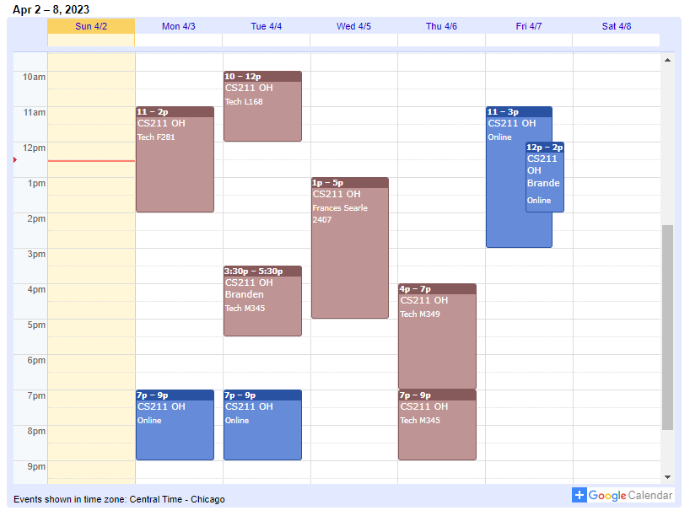
Administrivia
Office hours have started!
Check Canvas homepage for calendar
I have office hours right after class today!
Everyone should have Piazza access
Email me ASAP if you don’t

Slide 3
Assignments
EX1 due today (88%+ of you are done)
Need to buy the textbook unfortunately
Remember: no late submission for exercises
EX2 due Thursday (32%+ completed)
A little deeper into C programming: Branches and Loops
Lab1 due Thursday (31%+ completed)
SSH access to lab servers for C programming
Using Linux command line
Submitted to Gradescope

Slide 4
Today’s Goals
Introduction to working in Unix shell (command line)
Understand the C compilation process
Continue exploring C programming
Iteration
Input and Output

Slide 5
Getting the examples from lecture
First, make your own cs211 directory to store class stuff in
cd ~/
mkdir cs211
The files for this class are in a zipped tarball (just like a zip file)
We can extract them right into your cs211/ directory
cd ~/cs211/
tar -xvkf ~cs211/lec/02_shell_compilation.tgz
cd 02_shell_compilation
What does that command do?: https://explainshell.com/explain?cmd=tar+-xvkf+%7Ecs211%2Flec%2F02_shell_compilation.tgz

Slide 6
Outline
Unix Shell
Navigation
Working with files
Compilation
Separate Compilation
Makefiles
Pre-processor
More C syntax
Computing Fibonacci Numbers
Iteration
Input and Output
Other C Syntax

Slide 7
How do you get a Unix shell?
Have a MacOS or Linux computer
Or set up Windows Subsystem for Linux (WSL) on Windows
Install Virtualbox and Linux
Installing Ubuntu is free and only takes twenty minutes
Log in to a class server remotely!
This is what we’ll do for CS211
Lab01 teaches you how to do this

Slide 8
Command line interfaces
Text-based commands
Positives
It’s easy to be precisely clear about what you want and how things are configured
Negatives
How do you remember everything?
Reality
There will be a few dozen commands you’ll memorize (after practice)
And you’ll learn how to look up everything else

Slide 9
Commands for moving between directories
Directory structure and moving through it
ls
Lists files in the current directory
cd
Change directory
pwd
Prints the path of the current directory
Mis-typing something
“Command not found” means you tried to run something invalid
fish: somecommandyoumistyped: command not found...

Slide 10
Live command-line demo!!!
To do:
Log in
Move around with commands
Fail at some command
Tab completion
Get files from lecture!

Slide 11
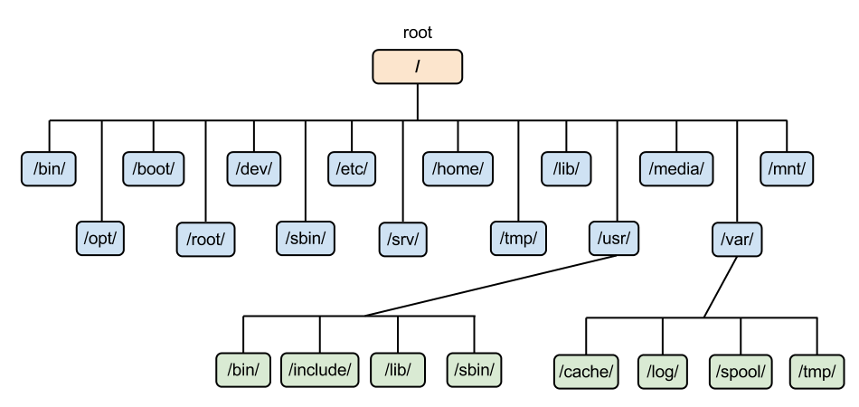
Directory structure in Linux
Example: /usr/bin/ is the path to user-installed programs

Slide 12
Special paths
. the current directory
.. the parent of the current directory
../../ the parent of the parent of the current directory
../../../ and so on…
- the previous directory you were in before the current one
~/ the home directory of the current user (your home)
~cs211 the home directory of the user cs211
(works for any user, but you’ll probably won’t interact with other users)
/ the root directory (analogous to C:\ on windows)

Slide 13
Relative vs absolute paths
Relative paths are relative to the current directory
../
src/
../../code/src/../build/
Absolute paths have the full path name to the location
/home/branden/
/home/branden/cs213/code/
/home/branden/cs213/code/src/../build/

Slide 14
Wildcard in path names
Sometimes you’re not sure exactly what the name is
Or there might be multiple files that you want to interact with simultaneously
The wildcard symbol, *, replaces any number of characters in a path name
Examples
ls /home/*/ List all files in all user’s home directories
ls ~/cs21*/ List all files in any directory starting with cs21
ls code/src/*.c List all files that end with “.c” in code/src/

Slide 15
Tab Completion
Typing takes toooooooo looooooonnnnggg
Solution, let the computer guess what you’re trying to type
Pressing tab while part-way through typing just about anything in terminal will tab-complete it for you
As long as you have typed enough characters so that only one option remains, it will complete it
If multiple options remain, it will stop trying
Also, up-arrow gets you the previously typed command
And you can edit that, if that’s faster

Slide 16
Outline
Unix Shell
Navigation
Working with files
Compilation
Separate Compilation
Makefiles
Pre-processor
More C syntax
Computing Fibonacci Numbers
Iteration
Input and Output
Other C Syntax

Slide 17
Working with files
cat path
Prints out the contents of the file
mv path1 path2
Moves a file from path1 to path2
cp path1 path2
Copies a file from path1 to path2
rm path
Deletes (removes) a file

Slide 18
Editing files
There are many different terminal text editors
And there are holy wars about why one is best
There is no best. Just use whatever you like
Example editors
Vim, Emacs, Nano
In CS211, I’ll be teaching you using the Micro text editor
Occasionally I’ll open vim by accident. Someone yell at me when I do
https://micro-editor.github.io/

Slide 19
Editing with Micro
micro filename
Opens micro, editing filename
Works just like any text editor you’ve used
Mouse moves the cursor around, as do the arrow keys
Typing makes text appear
(This isn’t true in some shell editors, looking at you vim)
Ctrl-s save the file
Ctrl-o open a file
Ctrl-q quit

Slide 20
Live command-line demo 2!!
To do:
Make directories
Edit a file
Move a file
Use a command with flags

Slide 21
Cancelling a command
Ctrl-C stops most things from running
Ctrl key and C key both at once
If you have C code that’s stuck in an infinite loop, Ctrl-C will stop it
Note: this means Ctrl-C isn’t usually copy
Except it does work as copy in Micro! (but that means it won’t stop Micro from running)

Slide 22
Command flags
man
Opens the manual pages for a program
Example: man ls
Flags are configurations for a command that change what it does
ls –l lists files in the current directory in a vertical list with details
ls –t sorts the ls output by most recently modified
ls –l –t does both
You can type multiple flags after a single dash
ls –lt is equivalent to ls –l –t is equivalent to ls -tl

Slide 23
Searching for things
grep –r “text” *
Explanation
Grep prints lines matching a pattern
The pattern in this case is “text”
-r means search recursively, i.e. in this directory and all subdirectories
* means to search in any file in the current directory
Summary
Search all the files here and below for the word “text”

Slide 24
Don’t be overwhelmed!!!!
You have plenty of time to learn this
Lab01 guides you through the same kinds of commands I did today, step by step
Practice is the only thing that will really help
And CS211 will give you plenty of practice

Slide 25
Helpful guides
Great lecture notes on using the shell
https://swcarpentry.github.io/shell-novice/
Tool to explain various shell command syntax
https://explainshell.com/
Tool to explain how to use various shell commands
Just type the command into the box at the top
https://tldr.ostera.io/

Slide 26
Shell command: sudo
Superuser do
Executes a command with special administrator privilege (superuser)
Necessary for installing new programs and modifying the OS
Run it before a command to execute that command as a superuser
Example: sudo whoami
You can only use sudo on computers where you are an admin
Only use with caution and care. It can destroy your computer
You’ll never need it for class stuff
You are NOT an admin on the class servers! (neither am I)
You might see it in stack overflow answers (won’t solve 211 problems though)
IT MAKES WORK FOR IT TOO DON”T DO IT

Slide 27
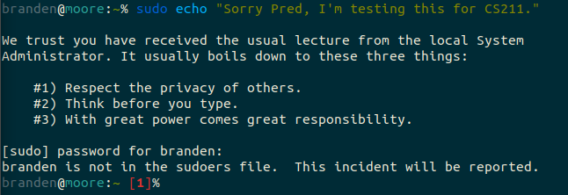
sudo example

Slide 28
sudo example

Slide 29
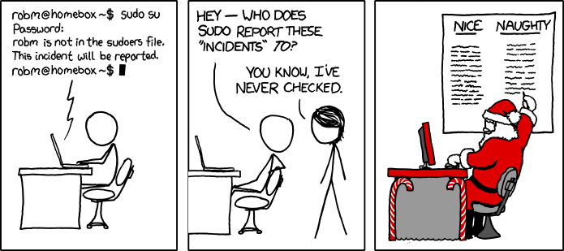
Break + relevant xkcd
https://xkcd.com/838/

Slide 30
Outline
Unix Shell
Navigation
Working with files
Compilation
Separate Compilation
Makefiles
Pre-processor
More C syntax
Computing Fibonacci Numbers
Iteration
Input and Output
Other C Syntax

Slide 31
How do you “run” C code?
First, the C code needs to be translated
From human-readable source code
To machine code capable of being executed on a particular machine (definitely not human readable)
This translation process is called “compiling”
The tool that does it is a “compiler”
Source Code
compilation
Machine Code

Slide 32
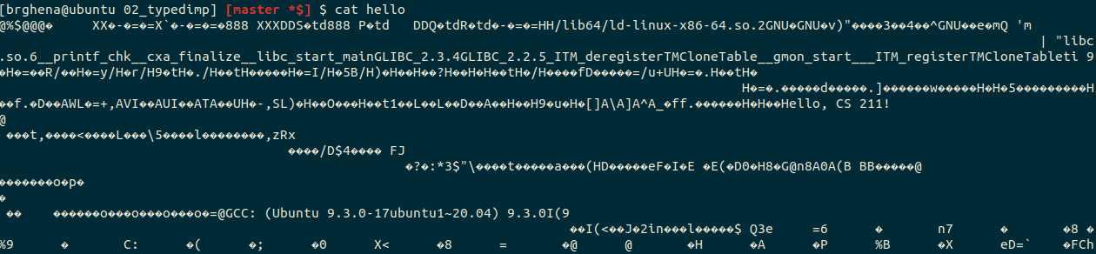
What does machine code look like?
Just a bunch of numbers
Your text editor would interpret those numbers as random characters
The computer processor reads the numbers to figure out which instruction to run
This is a version of assembly code
See CS213 for way more details

Slide 33
Compiling a C program
The compiler we’ll use is referred to as cc
Short for C Compiler
It takes in C source code and outputs executable machine code
cc hello.c
ls a.out hello.c
./a.out Hello, CS 211!
Don’t memorize this. You won’t be running cc manually.

Slide 34
Compiling a C program
a.out is the default name, but we probably want to use something more memorable
The -o flag specifies the output filename for the compiler
cc -o hello hello.c
ls hello hello.c
./hello Hello, CS 211!
Don’t memorize this. You won’t be running cc manually.

Slide 35
Remember to compile!
You need to re-compile code every time the source code changes
You WILL forget to do this at some point
And you’ll run the program but it’ll do the old behavior rather than the new things you’ve written
Compile often!
Keep multiple windows open to make this easier
I write a handful of lines of C code, then compile again
Way easier to find one or two mistakes now than deal with MANY later

Slide 36
IMPORTANT: compile often!
Important enough that I’ll repeat it
Keep multiple terminals open
One for editing and one for compiling
Compile every few lines of C code you write
Maybe every time you finish a function
Compilation points out errors in your code for you!
But it can get overwhelming if you don’t run it until the end

Slide 37
Outline
Unix Shell
Navigation
Working with files
Compilation
Separate Compilation
Makefiles
Pre-processor
More C syntax
Computing Fibonacci Numbers
Iteration
Input and Output
Other C Syntax

Slide 38
Real-world projects have multiple files
You can write code in any number of different C files
And combine them together while compiling
But we need some way to tell C code in one file about the existence of C code in another file
Solution: header files (.h)
Header files list all the publicly available functions and variables from a C file
Usually, there is a .c and .h file for various libraries
Header files are #include-ed at the top of your C file

Slide 39
Compiling multiple C files
Each C file is compiled separately
Then combine multiple together into a single program
Compilers have a middle step: object files (.o)
Still not human readable
Meant to be joined together into a single executable
Object files don’t have to be recompiled if their source file hasn’t changed
This speeds up compilation for large projects!

Slide 40
General C project layout
src/
Various code that actually runs your project
test/
Various code that tests your files in src/
We separate code in src/ into two categories
The executable, which has a main() function and not much else
Named whatever your executable is, but with a .c
Example: interact.c
Libraries which have both .c and .h files
Example: posn.c and posn.h

Slide 41
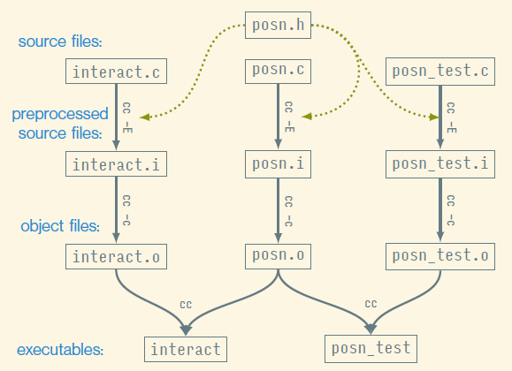
Example of multiple compilation
example_project/

Slide 42
Outline
Unix Shell
Navigation
Working with files
Compilation
Separate Compilation
Makefiles
Pre-processor
More C syntax
Computing Fibonacci Numbers
Iteration
Input and Output
Other C Syntax

Slide 43
New problem, how do you remember all these steps?
And this doesn’t even include various flags we give to the compiler, such as the location of the 211.h library

Slide 44
Simplifying multiple compilation with Make
Make is a tool for building programs out of multiple source files
Allows you to specify goals and requirements as “rules”
And then runs the compiler to fulfill those
To build a file named ⟨goal⟩ using make, you run:
make ⟨goal⟩
Make looks around the current directory for a file named Makefile which specifies the various rules
We’ll provide the Makefile for you in this class
But you’ll have to use make to compile your programs

Slide 45
What does a make rule look like?
A rule has a goal and pre-requisites for the goal
And then specifies commands to create the goal given the pre-requisites
⟨goal⟩: ⟨prereqs⟩. . .
⟨commands⟩
...
Example:
hello: hello.c
cc ‑o hello hello.c

Slide 46
Always use Make, rather than calling the compiler yourself
Make is our tool for compiling programs
It has rules for how to build the programs using the compiler
You could compile your programs manually
But you would need to know the proper flags for the compiler to do so
Some programs rely on class-specific libraries for testing and memory management
This is a big pain, so just you make instead
And if you’re curious, you can look at the Makefile to see what the flags we’re providing are

Slide 47
Outline
Unix Shell
Navigation
Working with files
Compilation
Separate Compilation
Makefiles
Pre-processor
More C syntax
Computing Fibonacci Numbers
Iteration
Input and Output
Other C Syntax

Slide 48
C pre-processor
Reads in the text of your source code
Does some initial text-based manipulations to the code
Prepares everything for the compiler

Slide 49
C reads files from the top down
First important thing to know about the pre-processor/compiler
They read from the top of the file down
Functions that don’t exist when you try to call them are an error
How would we write this code then?
void a(void) {
b(); }
void b(void) {
a(); }

Slide 50
Function declaration
You can inform the compiler about functions that will later be defined
You are telling the C compiler: “here’s what this other function looks like, you’ll get details about how it works later”
Very useful for libraries that you are using
A function declaration in C includes the return type, name, and argument types
Examples:
void a(int, float);
struct posn read_posn(void);
A function definition in C also includes the body of the function

Slide 51
Header files are collections of declarations
You could manually type out the declaration for each function you want to use at the top of your C file
Instead, we create “Header files” (.h) that hold all the function declarations for functions in the associated .c file
#include-ing a header file tells the pre-processor to paste its contents
The same as if you had typed them in the top of the file yourself
Leads to weird errors sometimes if you mess up a header file
Be sure to only include header files!

Slide 52
Examples
example_project/
preprocessor_example/
The –E flag tells the compiler to only run the pre-processor
In example_project/
cc –E src/interact.c –o interact.i
Note that header files are included
Note that some functions are only definitions right now
Simpler example can be found in preprocessor_example/
Run make to create client.i and library.i

Slide 53
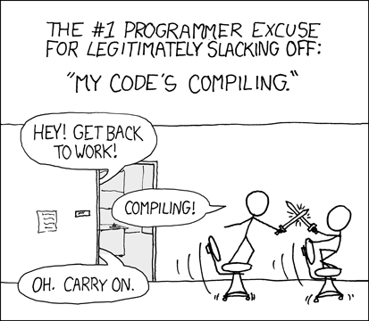
Break + relevant xkcd
https://xkcd.com/303/

Slide 54
Outline
Unix Shell
Navigation
Working with files
Compilation
Separate Compilation
Makefiles
Pre-processor
More C syntax
Computing Fibonacci Numbers
Iteration
Input and Output
Other C Syntax

Slide 55

Definition of Fibonacci Function
$fib\left(n\right)= \left\{\begin{aligned}n, if n<2; \\ fib\left(n−2\right)+fib\left(n−1\right), otherwise\end{aligned}\right.$
n | fib(n)
0 | 0
1 | 1
2 | 1
3 | 2
4 | 3
5 | 5
6 | 8
7 | 13
8 | 21

Slide 56
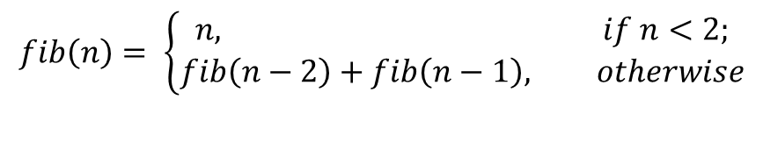
Implementing Fibonacci in C
fib.c
long fib(int n){
if (n < 2) {
return n;
} else {
return fib(n ‑ 2) + fib(n ‑ 1);
}
}
$$fib\left(n\right)= \left\{\begin{aligned}n, if n<2; \\ fib\left(n−2\right)+fib\left(n−1\right), otherwise\end{aligned}\right.$$

Slide 57
Outline
Unix Shell
Navigation
Working with files
Compilation
Separate Compilation
Makefiles
Pre-processor
More C syntax
Computing Fibonacci Numbers
Iteration
Input and Output
Other C Syntax

Slide 58
Statements and Conditions aren’t enough
Not all problems are easily solved with recursion
C, like many programming languages, also has loops
Repeats the statements inside it until some condition is met

Slide 59
Iteration with the While Statement
Syntax
while (⟨test-expression⟩) {
⟨body-statements⟩
}
Semantics
Evaluate ⟨test-expression⟩ to a bool
If the bool is false then skip to the statement after the while loop
Execute ⟨body-statements⟩ (if the bool was true)
Go back to step 1

Slide 60
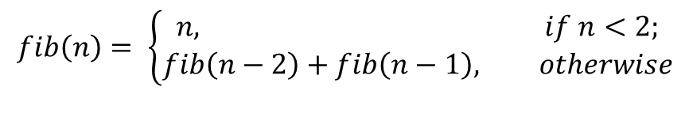
Implementing Fibonacci in C
fib.c
long fib_iterative(int n){
long curr = 0;
long next = 1;
while (n > 0) {
long prev = curr;
curr = next;
next = prev + curr;
n = n ‑ 1;
}
return curr;
}
$$fib\left(n\right)= \left\{\begin{aligned}n, if n<2; \\ fib\left(n−2\right)+fib\left(n−1\right), otherwise\end{aligned}\right.$$

Slide 61
For loops
For loops allow you to combine iteration and incrementing
When you write a for statement like this:
for (⟨start-decl⟩; ⟨test-expr⟩; ⟨step-expr⟩) {
⟨body-stms⟩
}
It’s as if you’d written this while statement:
{
⟨start-decl⟩;
while (⟨test-expr⟩) {
⟨body-stms⟩
⟨step-expr⟩;
}
}

Slide 62
Modify fib to use a for loop
fib.c
long fib_iterative(int n){
long curr = 0;
long next = 1;
while (n > 0) {
long prev = curr;
curr = next;
next = prev + curr;
n = n ‑ 1;
}
return curr;
}
$$fib\left(n\right)= \left\{\begin{aligned}n, if n<2; \\ fib\left(n−2\right)+fib\left(n−1\right), otherwise\end{aligned}\right.$$

Slide 63
Modify fib to use a for loop
fib.c
long fib_iterative(int n){
long curr = 0;
long next = 1;
int i = 0;
while (i < n) {
long prev = curr;
curr = next;
next = prev + curr;
i = i + 1;
}
return curr;
}
$$fib\left(n\right)= \left\{\begin{aligned}n, if n<2; \\ fib\left(n−2\right)+fib\left(n−1\right), otherwise\end{aligned}\right.$$

Slide 64
Modify fib to use a for loop
fib.c
long fib_iterative(int n){
long curr = 0;
long next = 1;
int i = 0;
for ( ; i < n; ) {
long prev = curr;
curr = next;
next = prev + curr;
i = i + 1;
}
return curr;
}
$$fib\left(n\right)= \left\{\begin{aligned}n, if n<2; \\ fib\left(n−2\right)+fib\left(n−1\right), otherwise\end{aligned}\right.$$

Slide 65
Modify fib to use a for loop
fib.c
long fib_iterative(int n){
long curr = 0;
long next = 1;
// int i = 0;
for (int i = 0; i < n; ) {
long prev = curr;
curr = next;
next = prev + curr;
i = i + 1;
}
return curr;
}
$$fib\left(n\right)= \left\{\begin{aligned}n, if n<2; \\ fib\left(n−2\right)+fib\left(n−1\right), otherwise\end{aligned}\right.$$

Slide 66
Modify fib to use a for loop
fib.c
long fib_iterative(int n){
long curr = 0;
long next = 1;
for (int i = 0; i < n; i = i + 1) {
long prev = curr;
curr = next;
next = prev + curr; //i = i + 1;
}
return curr;
}
$$fib\left(n\right)= \left\{\begin{aligned}n, if n<2; \\ fib\left(n−2\right)+fib\left(n−1\right), otherwise\end{aligned}\right.$$

Slide 67
Complete: modify fib to use a for loop
fib.c
long fib_iterative(int n){
long curr = 0;
long next = 1;
for (int i = 0; i < n; i = i + 1) {
long prev = curr;
curr = next;
next = prev + curr; }
return curr;
}
$$fib\left(n\right)= \left\{\begin{aligned}n, if n<2; \\ fib\left(n−2\right)+fib\left(n−1\right), otherwise\end{aligned}\right.$$

Slide 68
Break + Question
What value will this code return when called as:
loop_function(6)
loop_function(5)
loop_function(3)
int loop_function(int test) {
int retval = 0;
while (test < 5) {
retval = retval + 1;
test = test + 1;
}
return retval;
}

Slide 69
Break + Question
What value will this code return when called as:
loop_function(6) returns 0
loop_function(5)
loop_function(3)
int loop_function(int test) {
int retval = 0;
while (test < 5) {
retval = retval + 1;
test = test + 1;
}
return retval;
}

Slide 70
Break + Question
What value will this code return when called as:
loop_function(6) returns 0
loop_function(5) returns 0
loop_function(3)
int loop_function(int test) {
int retval = 0;
while (test < 5) {
retval = retval + 1;
test = test + 1;
}
return retval;
}

Slide 71
Break + Question
What value will this code return when called as:
loop_function(6) returns 0
loop_function(5) returns 0
loop_function(3) returns 2
int loop_function(int test) {
int retval = 0;
while (test < 5) {
retval = retval + 1;
test = test + 1;
}
return retval;
}

Slide 72
Outline
Unix Shell
Navigation
Working with files
Compilation
Separate Compilation
Makefiles
Pre-processor
More C syntax
Computing Fibonacci Numbers
Iteration
Input and Output
Other C Syntax

Slide 73
printf() function
The usual way to print in C is the printf() function
Takes a format string followed by arguments to interpolate in place of the string’s format specifiers
printf("(%d, %d)\n", x, y);
%d format specifier means the argument is an int
Prints “(“ + the value of x + “, “ + the value of y + “)\n”
printf() is in the stdio.h library, which needs to be #include-ed

Slide 74
Example: formatted output
output.c
#include <stdio.h>
int main(void){
int x = 5;
double f = 5.1;
printf("sizeof x: %zu bytes\n", sizeof(x));
printf("sizeof f: %zu bytes\n", sizeof(f));
printf("x: %d\nf: %.60e\n", x, f);
}
A format specifier gives the argument’s type and maybe some options
%zu type: size_t (the return result of sizeof)
%d type: int
%.60e type: double, include 60 digits of precision

Slide 75
How do you learn format specifiers?
You look them up in a guide!
Even I don’t have them memorized…
man 3 printf
Runs in the terminal
Shows details about printf
google “printf format specifiers” (this is what I do)
cplusplus.com is a good resource
https://www.cplusplus.com/reference/cstdio/printf/

Slide 76
Reading user input
To input numbers in C, use the scanf() function
scanf reads keyboard input, converts it to the require type, and stores it in an existing variable:
int x = 0;
scanf("%d", &x);
Like printf(), scanf() uses a format string to determine what type to convert the input into
&x means to pass x’s location, not its value (more on this next week)
Careful: scanf() directives aren’t exactly the same as printf()

Slide 77
Example: reading input
input.c
#include <stdio.h>
double sqr_dbl(double n){
return n * n;
}
int main(void){
double d = 0.0;
scanf("%lf", &d);
printf("%lf squared is %lf\n", d, sqr_dbl(d));
}

Slide 78
Example: reading multiple items
multi_input.c
#include <stdio.h>
int main(void){
int x;
int y;
printf("Enter two integers: ");
scanf("%d%d", &x, &y);
printf("%d * %d = %d\n", x, y, x * y);
}

Slide 79
What if scanf() has an error?
check_input.c
scanf() returns the number of successful conversions
#include <stdio.h>
int main(void){
int x int y;
printf("Enter two integers: ");
if (scanf("%d%d", &x, &y) != 2) {
printf("Input error\n");
return 1;
}
printf("%d * %d == %d\n", x, y, x * y);
}

Slide 80
Outline
Unix Shell
Navigation
Working with files
Compilation
Separate Compilation
Makefiles
Pre-processor
More C syntax
Computing Fibonacci Numbers
Iteration
Input and Output
Other C Syntax

Slide 81
C comments
// means a single-line comment
/* starts a multiline comment, which continues until */
How to use comments effectively
Comment “blocks” of code with their purpose
Every line is too much
Often helpful to write the comments before the code as planning
Comment tricky bits of code so you know what it means
You + several weeks = “what does that code mean?!”

Slide 82
Logical operators
|| &&
Logical OR, and Logical AND
a < 5 && b > 12
!
Logical NOT
!(a < 5) equivalent to (a >= 5)
==
Equality test
5 == 5 -> TRUE
16 == -3 -> FALSE
Don’t mix it up with assignment (single equals sign)
Really common new C programmer mistake

Slide 83
Other operators you’ll see around
+= *= -= /=
Perform the action of VAR = VAR operator ARG
a += 5 -> a = a + 5
a *= b -> a = a * b
%
Modulus operator
Returns the remainder of division
12 % 10 -> 2
~ | & ^
Bitwise NOT, OR, AND, and XOR (you’ll learn these in CS213)
Importantly, ^ is not exponentiation!!!

Slide 84
Adding and Subtracting one
++ --
Shorthand for plus 1 or minus 1
++a -> a += 1 -> a = a + 1
The auto-increment/decrement operators can go before or after the variable
(--x) subtracts one and returns the new value of x from the expression
(x--) subtracts one but returns the old value of x from the expression
Usually, this doesn’t matter, unless you write complicated statements that combine assignment and conditions
if (--x > 0) … (please just never do this)

Slide 85
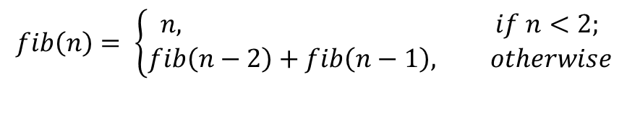
Implementing Fibonacci in C
fib.c
long fib_iterative(int n){
long curr = 0;
long next = 1;
for (int i = 0; i < n; ++i) { // i++ also works
long prev = curr;
curr = next;
next = prev + curr; }
return curr;
}
$$fib\left(n\right)= \left\{\begin{aligned}n, if n<2; \\ fib\left(n−2\right)+fib\left(n−1\right), otherwise\end{aligned}\right.$$

Slide 86
typedef can be used to make new C type names
Typedef creates a new type name that is a copy of an existing type
Typedef keyword is followed by two types
First type: the original type name
Second type: the new type name
Example:
typedef int x_coordinate_t;
x_coordinate_t my_variable = 5;

Slide 87
Ternary Operator
? :
Shorthand version of an if statement, determining result of expression
Example:
return (a < 5) ? a : b;
equivalent to
if (a < 5) { return a; } else { return b; }
You won’t need to use this. Usually, it just makes code harder to read.

Slide 88
Outline
Unix Shell
Navigation
Working with files
Compilation
Separate Compilation
Makefiles
Pre-processor
More C syntax
Computing Fibonacci Numbers
Iteration
Input and Output
Other C Syntax

Slide 89
Outline
Bonus: these are optional extra things that you might be interested in
They won’t be on a quiz, but may come up in real code
More Pre-processor
Makefile Syntax

Slide 90
What else can the pre-processor do?
Macros
Text substitutions made by the pre-processor
Compile-time code inclusion
Determine which code is actually compiled based on flags
Pragma
Special commands to the compiler

Slide 91
C macros
#define NAME_OF_MACRO value_of_macro
Examples:
#define LENGTH 20
#define FAIL_MESSAGE “There was an error!\n”
The pre-processor pastes the text of the “value” wherever it finds the macro “name” in the source code
Useful for defining values that will be used in code
Again, be careful about weird bugs here!

Slide 92
Macro functions
Macros can be used as functions as well
#define DEBUG(msg) printf(msg)
#define MIN(a, b) ((a < b) ? a : b)
Generally, avoid this
You could just write a C function to do the operation instead
And the compiler will check this for errors better
It can be tricky to get right

Slide 93
Example of macro function trickiness
#define ADD(a, b) a+b
int x = ADD(3,4)*5; // Expects 7*5=35
The pre-processor will expand this to:
int x = 3+4*5; // Expects 7*5=35
Extra parentheses around the macro value prevent this issue #define ADD(a, b) (a+b)

Slide 94
Ifdef in C
The pre-processor evaluates the statement before compilation and either includes or removes the text
Useful because the code literally does not exist if removed
#ifdef DEBUG
printf(“Debug message here\n”);
#endif
Ifdef hell: when you can’t figure out which C code is actually being compiled due to too many #ifdefs

Slide 95
Pragma examples
Pragmas tell the C compiler to do something
Turn on/off warnings
Various compiler tricks that are important for low-level OS code
Most common example: #pragma once at the top of each header
Tells the compiler to track this file and only paste it in a given C file once
Otherwise could end up with a bunch of different copies
Old C code uses #ifdef at the top of header files for the same task
Paired with an #endif at the very bottom of the file

Slide 96
Outline
Bonus: these are optional extra things that you might be interested in
They won’t be on a quiz, but may come up in real code
More Pre-processor
Makefile Syntax

Slide 97
Bonus: Makefile for example_project/
example_project/
Take a look at these if you want to understand the Makefile for the interact and posn_test programs from today’s lecture files
In the example_project/ directory

Slide 98
Bonus: Makefile for building interact and posn_test
These rules encode the dependency diagram from a few slides back (but with preprocessing and translation combined)
interact: interact.o posn.o
cc ‑o interact interact.o posn.o
posn_test: posn_test.o posn.o
cc ‑o posn_test posn_test.o posn.o
interact.o: interact.c posn.h
cc ‑c ‑o interact.o interact.c
posn_test.o: posn_test.c posn.h
cc ‑c ‑o posn_test.o posn_test.c
posn.o: posn.c posn.h
cc ‑c ‑o posn.o posn.c

Slide 99
Bonus: Makefile for building interact and posn_test
Good programmers are lazy and hate repetition. So much repetition here!
interact: interact.o posn.o
cc ‑o interact interact.o posn.o
posn_test: posn_test.o posn.o
cc ‑o posn_test posn_test.o posn.o
interact.o: interact.c posn.h
cc ‑c ‑o interact.o interact.c
posn_test.o: posn_test.c posn.h
cc ‑c ‑o posn_test.o posn_test.c
posn.o: posn.c posn.h
cc ‑c ‑o posn.o posn.c

Slide 100
Bonus: Makefile for building interact and posn_test
You don’t have to repeat the goal in each recipe
It’s better to use the special variable $@ instead
interact: interact.o posn.o
cc ‑o $@ interact.o posn.o
posn_test: posn_test.o posn.o
cc ‑o $@ posn_test.o posn.o
interact.o: interact.c posn.h
cc ‑c ‑o $@ interact.c
posn_test.o: posn_test.c posn.h
cc ‑c ‑o $@ posn_test.c
posn.o: posn.c posn.h
cc ‑c ‑o $@ posn.c

Slide 101
Bonus: Makefile for building interact and posn_test
Similarly, $^ is a variable that stands for the prerequisites
Or $< when you only want the first prerequisite
interact: interact.o posn.o
cc ‑o $@ $^
posn_test: posn_test.o posn.o
cc ‑o $@ $^
interact.o: interact.c posn.h
cc ‑c ‑o $@ $<
posn_test.o: posn_test.c posn.h
cc ‑c ‑o $@ $<
posn.o: posn.c posn.h
cc ‑c ‑o $@ $<

Slide 102
Bonus: Makefile for building interact and posn_test
Now note that the bottom three compilation rules are the same except for the filename. We can replace them with a pattern rule
interact: interact.o posn.o
cc ‑o $@ $^
posn_test: posn_test.o posn.o
cc ‑o $@ $^
interact.o: interact.c posn.h
cc ‑c ‑o $@ $<
posn_test.o: posn_test.c posn.h
cc ‑c ‑o $@ $<
posn.o: posn.c posn.h
cc ‑c ‑o $@ $<

Slide 103
Bonus: Makefile for building interact and posn_test
This pattern says we can build any .o file from a matching .c file
interact: interact.o posn.o
cc ‑o $@ $^
posn_test: posn_test.o posn.o
cc ‑o $@ $^
%.o: %.c posn.h
cc ‑c ‑o $@ $<

Slide 104
Bonus: Makefile for building interact and posn_test
That pattern is pretty generic except for the reliance on posn.h
Let’s break that out into a separate rule
interact: interact.o posn.o
cc ‑o $@ $^
posn_test: posn_test.o posn.o
cc ‑o $@ $^
%.o: %.c
cc ‑c ‑o $@ $<
interact.o posn_test.o posn.o: posn.h

Slide 105
Bonus: Makefile for building interact and posn_test
And we really ought to make the compiler used a variable
Then others could change it out if desired
interact: interact.o posn.o
$(CC) ‑o $@ $^
posn_test: posn_test.o posn.o
$(CC) ‑o $@ $^
%.o: %.c
$(CC) ‑c ‑o $@ $<
interact.o posn_test.o posn.o: posn.h

Slide 106
Bonus: Makefile for building interact and posn_test
Finally, there are often compiler options we want to pass in
Here are the standard variables for holding those
interact: interact.o posn.o
$(CC) ‑o $@ $^ $(CFLAGS) $(LDFLAGS)
posn_test: posn_test.o posn.o
$(CC) ‑o $@ $^ $(CFLAGS) $(LDFLAGS)
%.o: %.c
$(CC) ‑c ‑o $@ $< $(CPPFLAGS) $(CFLAGS)
interact.o posn_test.o posn.o: posn.h

