Slide 1
Lecture 07 File Input & Output
CS211 – Fundamentals of Computer Programming II
Branden Ghena – Winter 2023
Slides adapted from: Jesse Tov

Slide 2
Administrivia
Homework 2 due tonight
Remember that slip days exist
Beware: office hours are overloaded
Prepare for long delays until you can get help, and only high-level help
Feel free to ask questions on Piazza too
I’ll be checking it frequently
No more exercises for two weeks!
Get started on Homework 3 early instead
Homework 3 has two parts
Part 1 due next week
Part 2 due in two weeks

Slide 3
Homework 2 hint: comparing strings
char* a = “abc”
char b[4] = {‘a’, ‘b’, ‘c’, ‘\0’}
if (a == b) {
print(“They match!\n”);
} else {
print(“They do not match\n”);
}
This code prints: “They do not match\n”. Why?
What does a == b compare?
Two pointers!

Slide 4
Strings must be compared with strcmp()
https://www.cplusplus.com/reference/cstring/strcmp/
int strcmp(const char* str1, const char* str2)
Compares two strings character-by-character until reaching a ‘\0’
Returns an integer value of the following:
<0 str1 comes before str2 alphabetically
0 str1 is equal to str2
>0 str1 comes after str2 alphabetically

Slide 5
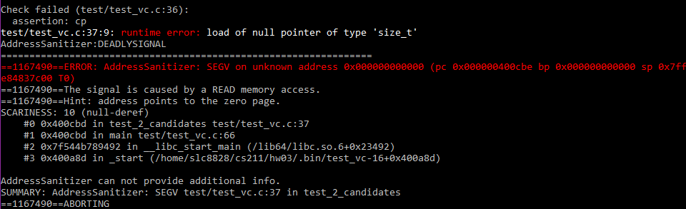
SEGV is a null pointer dereference
This AddressSanitizer error is due to dereferencing a NULL pointer
Often in Homework 3, it’s because you tried to read a NULL candidate name
Possibly with `strcmp()`

Slide 6
Today’s Goals
Practice dynamic memory allocation with arrays
How do we make an array the dynamically changes size?
Introduce and explore concept of linked lists
What are they and what are their advantages?
How do we write code that uses them?
Discuss concept of pointers to pointers

Slide 7
Getting the code for today
cd ~/cs211/lec/ (or wherever you put stuff)
tar -xkvf ~cs211/lec/07_fileio.tgz
cd 07_fileio/

Slide 8
Outline
Ownership Review
File Input & Output (I/O)
Standard I/O
Dynamic Arrays

Slide 9
Review: ownership idea
malloc() creates memory objects (chunks of heap memory)
MUST later be freed
The “owner” of a memory object is responsible for it
Must either free() it
Or transfer ownership to something else
Pass into another function
Store it in some data structure for later

Slide 10
The full ownership protocol
The owner of a heap-allocated object is responsible for deallocating it
No one else may do so
Borrowers of an object may access or modify it
But they may not hold on to a reference to it or deallocate it
Passing or returning a pointer may or may not transfer ownership
Transfer: caller must have owned it previously and now give up ownership
No transfer: caller could also be borrowing. New function is borrowing

Slide 11
Borrowing example
Function A
- borrows memory object
Can use and modify memory
Cannot free() memory Cannot store memory for later
Calls Function B and passes the memory
After return
Can still use and modify memory
Function B
- MUST also be borrowing
Can use and modify memory
Cannot free() or store memory

Slide 12
Ownership example, return transferring ownership
Function A
- has no memory object
Calls Function B
After return
Can use and modify memory
Must free(), store, or transfer memory
Function B
- creates memory object (malloc)
Can use and modify memory
Must free(), store, or transfer memory
Returns object, transferring ownership

Slide 13
Ownership example, calling a borrowing function
Function A
- owns memory object
Can use and modify memory
Must free(), store, or transfer memory
Calls Function B and passes the memory
After return
Can still use and modify memory
Must free(), store, or transfer memory
Function B
- borrows memory object
Can use and modify memory
Cannot free() or store memory

Slide 14
Ownership example, transferring ownership
Function A
- owns memory object
Can use and modify memory
Must free(), store, or transfer memory
Calls Function B and passes the memory
After return
Cannot access memory
Function B
- takes ownership of memory object
Can use and modify memory
Must free(), store, or transfer memory

Slide 15
Break + Practice
Example from Homework 3
void ballot_insert(ballot_t ballot, char* name)
Borrows ballot transiently
Takes ownership of name
What is ballot_insert() allowed to do to ballot?
What is ballot_insert() allowed to do to name?

Slide 16
Break + Practice
Example from Homework 3
void ballot_insert(ballot_t ballot, char* name)
Borrows ballot transiently
Takes ownership of name
What is ballot_insert() allowed to do to ballot?
Can modify and use. Cannot free() or store.
What is ballot_insert() allowed to do to name?
Can modify and use. MUST free() or store.

Slide 17
Outline
Ownership Review
File Input & Output (I/O)
Standard I/O
Dynamic Arrays

Slide 18
Files
Collections of data
Usually in permanent storage on your computer
Types of files
Regular files
Arbitrary data
Think of each file as a big array of bytes (just like memory)
Directories
Collections of regular files
Special files
Links, pipes, devices (see CS343)

Slide 19
How do we interact with files?
Analogy: think of a file as a book
Big array of characters (bytes)
Open the book, starting at the first page
Read from the book
Write to the book
Change pages (without reading everything in between)
Close the book when finished

Slide 20
System calls for interacting with files
Open the book, starting at the first page
fopen()
Read from the book
fread()
Write to the book
fwrite()
Change pages (without reading everything in between)
fseek()
Close the book when finished
fclose()

Slide 21
References
https://www.cplusplus.com/reference/cstdio/
Explanation of and links for everything in <stdio.h>

Slide 22
Opening files
FILE* fopen(const char* filename, const char* mode);
filename is the string path for the file
“/home/branden/cs211/s23/hw/hw1/src/tr.c”
“./arguments.c”
“arguments.c”
mode specifies what you intend to do with the file
“r” - read only (must exist)
“w” - write (overwrites if exists)
“a” - append (starts writing at end of file if exists)

Slide 23
Open returns a FILE object
FILE* fopen(const char* filename, const char* mode);
Pointer type for an object used to interact with the file
A “handle” to the file
Other file interaction functions will take in a FILE* as an argument
Don’t need to remember the file path and look it up every time
NULL instead specifies an error attempting to open the file

Slide 24
Reading files
size_t fread(void* ptr, size_t size, size_t count, FILE* stream);
ptr is a pointer to an array to read into
At least size×count bytes in length
size is the number of bytes for each element in the array
count is the number of elements to read
stream is the file pointer returned from a previous call to fopen()
Note: nowhere do we specify where to start reading
Library keeps track of a file offset with the file
Updated on each read
First read of 100 bytes starts at zero, next starts 100 bytes in

Slide 25
How do we know when we finished the file?
size_t fread(void* ptr, size_t size, size_t count, FILE* stream);
Return from read is the count of elements actually read
Less than count means there was either an error or end-of-file was reached
feof() lets you check if end-of-file was reached
ferror() lets you check for particular errors

Slide 26
Writing files looks a lot like reading
size_t fwrite(const void* ptr, size_t size, size_t count, FILE* stream);
Array to write from, size of elements in the array, number of elements to write, and a file pointer
Returns number of elements actually written
Write occurs at the current file offset

Slide 27
Moving the file offset
int fseek(FILE* stream, long int offset, int origin);
Moves to offset for this file descriptor based on origin:
SEEK_SET – set to offset (essentially start of file plus offset)
SEEK_CUR – current location plus the offset
SEEK_END – end of file plus the offset (which should be negative)
Returns zero if successful
Anything else means an error occurred
ftell() gets the current location in a file
So you can seek back there later

Slide 28
Closing a file
int fclose(FILE* stream);
Closes the file
Returns zero on success
It is an error to keep using the file descriptor after it is closed
Just like with dynamic memory management

Slide 29
Buffered I/O
C standard library buffers your interactions to make them more efficient
One big write to a file is MUCH faster than many small writes
Sometimes you want to write to output right now
fflush() guarantees that the buffer is written now
Otherwise no write is guaranteed until fclose() is called
Example: printf() buffers until a newline is reached
So a print right before a fault might not appear unless it includes a ‘\n’ 😱

Slide 30
Example: kitten tool
Command line tool: cat – prints out the contents of files
Does so very efficiently
Our program: kitten – prints out the contents of one file
No efficiency promises
Implementing kitten only requires file I/O calls we’ve discussed!

Slide 31
Live coding: implement kitten
kitten-starter.c
kitten-complete.c
Requirements
Parse argv[] to find file to open
Open the file
Read in lines from the file repeatedly
If end-of-file is reached, break (feof())
Print contents of file
Handle errors

Slide 32
Outline
Ownership Review
File Input & Output (I/O)
Standard I/O
Dynamic Arrays

Slide 33
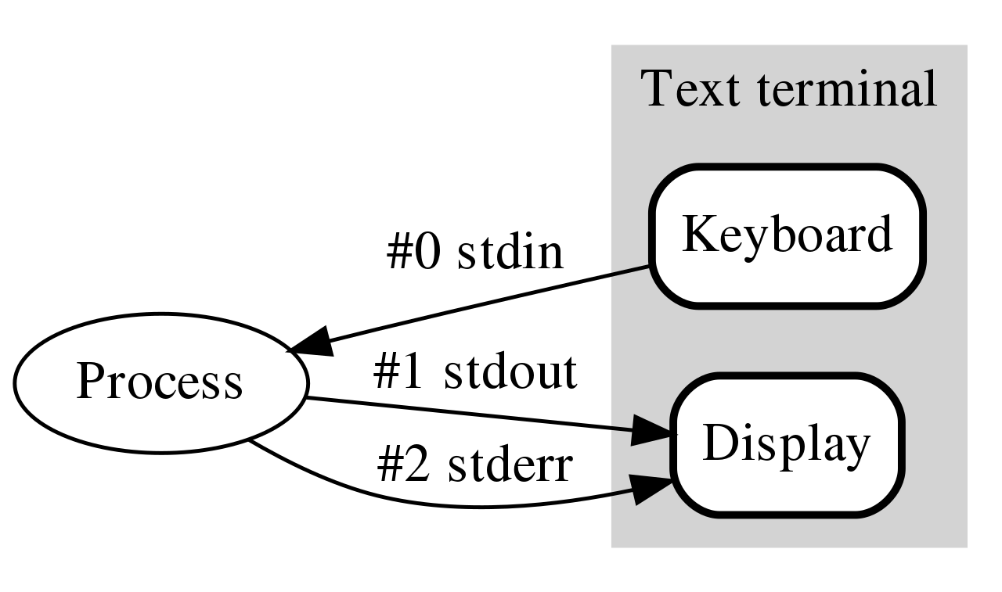
How do programs talk to users?
We glossed over this before
printf()
scanf()
Work through the same file mechanism
Three special files created for each program
stdin – standard input
stdout – standard output
stderr – standard error
printf() -> fprintf(stdout) -> handle arguments & fwrite(stdout)

Slide 34
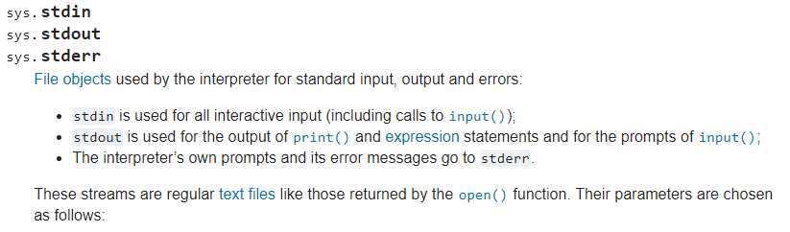
Standard I/O is a process thing, not a C thing
You can access them in Python, for instance
https://docs.python.org/3/library/sys.html#sys.stdin

Slide 35
Standard I/O is configured by the shell
When you run a program in command line, the shell attaches a standard input, standard output, and standard error to it
Defaults
stdin - read from terminal
stdout - write to terminal
stderr - write to terminal

Slide 36
Live coding: kitten upgrades
kitten-starter.c
kitten-complete.c
Errors should be written to stderr
Output can be written to stdout directly using fwrite()
Instead of using printf() in a loop to do it for us

Slide 37
Redirecting standard I/O
Shells by default setup standard I/O to connect to the keyboard and the screen
But any file will also work
Shell I/O redirection commands
COMMAND < filename
Connect standard input to filename
COMMAND > filename
Connect standard output to filename (overwrite)
COMMAND >> filename
Connect standard output to filename (append)

Slide 38
Piping commands
A command shell desire is to run multiple commands where the output of the first feeds into the second
COMMAND1 | COMMAND2
Connects stdout of COMMAND1 to stdin of COMMAND2
Example: print out files and sort by size
ls –lah | sort –h

Slide 39
Sidebar: super useful command for testing
tee [OPTION]... [FILE]...
Reads from stdin and write to both stdout and file
Example: prints out a list of files and saves results
ls –lah | tee results.txt
I run this with various programs I’m testing, so I can record the results, but also seem them in real-time.

Slide 40
Example: redirection with kitten
Standard I/O redirection is handled when the process is created
So it does not need to be aware of it at all
Our kitten tool works with redirection automatically!
./kitten arguments.c > OUTPUT_FILE

Slide 41
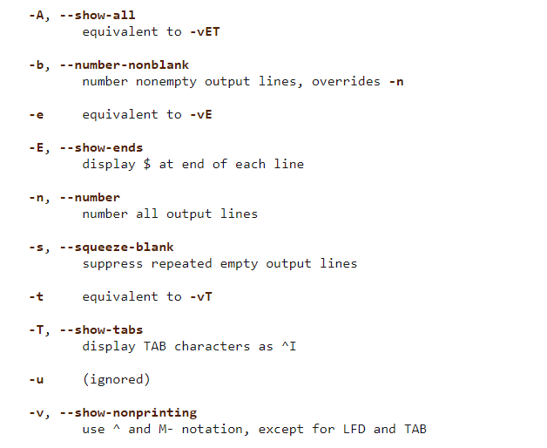
Break + Thinking Excercise
Take a look at the cat command to see the other flags it supports
How hard would these be to implement in kitten?

Slide 42
Outline
Ownership Review
File Input & Output (I/O)
Standard I/O
Dynamic Arrays

Slide 43
Dealing with dynamic input
What if you want to read in data, but you don’t know how much data there might be?
Arrays in C are a fixed size
But you can malloc() as many times as needed
Request some memory
Use until you run out
Request more memory and copy existing values over
realloc() makes this simple

Slide 44
Example of dynamic memory: read_line()
char* read_line(void)
Reads an entire line at a time from stdin
Can’t know in advance how many bytes there will be to read
Keeps reading in bytes until ‘\n’ character or end-of-file
Needs to request more memory until it holds the entire line
Note: part of the 211 library, not standard C

Slide 45
Live coding: implement read_line()
readline-starter.c
readline-complete.c
char* read_line(void)
Requirements
Read from stdin until ‘\n’ or end-of-file (EOF)
Allocate an array to hold the read characters
Make sure to end it with a ‘\0’
Returns
NULL pointer if EOF was reached immediately
Pointer to string otherwise (not including the newline character)

Slide 46
Realloc versus malloc
We could just malloc() and copy ourselves, what does realloc() add?
realloc() can be far more efficient
Doesn’t have to copy data at all if there is room in the heap to expand
Also simpler for programmers
Can’t forget to free the old memory if realloc() does it for you

Slide 47
Default string size will change efficiency
Memory efficiency
Pointer returned could have way more memory than characters
User might hold on to memory for a while before freeing
The less wasted memory, the less memory the program needs
Runtime speed
malloc() and realloc() are slow
The fewer times we call them, the faster the program will run
Need to pick a sweet spot to balance the two of these
Real program: starts at 80 characters, doubles size when reallocating

Slide 48
Does efficiency really matter though?
If you’re writing a CS211 homework: no
If you’re writing a Javascript interpreter for Firefox,
Which has millions of users
times hundreds of websites per day for each user
times hundreds of lines of code per website
and each line of code is read with read_line()
YES

Slide 49

Break + relevant xkcd
https://xkcd.com/2347/

Slide 50
Outline
Ownership Review
File Input & Output (I/O)
Standard I/O
Dynamic Arrays

