Slide 1
Lecture 09 Memory and Binary
CS211 – Fundamentals of Computer Programming II
Branden Ghena – Spring 2023
Slides adapted from: Jesse Tov

Slide 2
Administrivia
Homework 3 part 1 due today
Only need to submit code in ballot.c and test_ballot.c
(Unless you made any Resources/ files. Submit those!)
Homework 3 part 2 due next week Thursday
Can start submitting to Gradescope later today
Continuation of Part 1, so it shouldn’t be too hard to get started

Slide 3
End of C!!
Today is the last lecture on C
Next week we’ll be starting C++!
That means it’s time for another Lab
Will release sometime on Friday
Setup for CLion IDE and the SDL2 game engine
Reach out to me for help with this!

Slide 4
Today’s Goals
Discuss concept of pointers to pointers
Practice dynamic memory allocation with arrays
How do we make an array the dynamically changes size?
Go below the level of C and understand how the computer thinks about data with bits and bytes
Understand how this leads to the boundaries of common C types

Slide 5
Getting the code for today
Same files as last lecture!
cd ~/cs211/lec/ (or wherever you put stuff)
tar -xkvf ~cs211/lec/08_linked_lists.tgz
cd 08_linked_lists/

Slide 6
Outline
Linked Lists
Pointers to Pointers
Dynamic Arrays
Bits and Bytes
Integer Encodings

Slide 7
An alternative: linked allocations
array_pointer:
 | 3 | 4 | 2 | 3
linked_list_pointer:
 | 3 |  |  | 4 |  |  | 2 |  |  | 3 | NULL

Slide 8
C code for a linked list structure
Array version:
int myarray[];
Linked List version:
struct node {
int value;
struct node* next;
};
typedef struct node node_t;
node_t* head;

Slide 9
Items can be added at any point in the list
linked_list-starter.c
linked_list-complete.c
We can add/remove the middle item of the list
Just make sure you get the next pointer right
Arrays can’t support that kind of thing
You would have to copy over all the later elements in the array
Let’s write list_append_front() and list_remove_front() functions

Slide 10
Outline
Linked Lists
Pointers to Pointers
Dynamic Arrays
Bits and Bytes
Integer Encodings

Slide 11
Reminder: Pointers are another type of value
Values could be a number, like 5 or 6.27
Or they could be a “pointer” to an object
Points at the object, not the variable or value
It points at the “chunk of memory”
Technically, in C it holds the address of that memory
z: | 5
z_pointer:

Slide 12
We can make a pointer to another pointer
Pointers are values stored in an object
That object has a memory address
We could make a pointer to a pointer
z: | 5
z_pointer:
z_pointer_pointer:

Slide 13
Double pointers in C
To make a pointer to something, add a * to the type
z: | 5
z_pointer:
int z = 5;
int* z_pointer = &z;
int** z_pointer_pointer = &z_pointer;
z_pointer_pointer:

Slide 14
When is this useful?
linked_list.c
(from last lecture)
Various functions in the linked list code need to return the new head of the linked list
Instead, they could update the linked list variable
struct node* list_append_front(struct node* list, int value);
could become
void list_append_front(struct node** list, int value);

Slide 15
Also occurs in arguments to main
argv is an array of strings
Strings are char*
So argv is char**
char* argv[] is equivalent to char** argv

Slide 16
Outline
Linked Lists
Pointers to Pointers
Dynamic Arrays
Bits and Bytes
Integer Encodings

Slide 17
Dealing with dynamic input
What if you want to read in data, but you don’t know how much data there might be?
Arrays in C are a fixed size
But you can malloc() as many times as needed
Request some memory
Use until you run out
Request more memory and copy existing values over
realloc() makes this simple, but it’s still slow

Slide 18
Example of dynamic memory: read_line()
char* read_line(void)
Reads an entire line at a time from stdin
Can’t know in advance how many bytes there will be to read
Keeps reading in bytes until ‘\n’ character or end-of-file
Needs to request more memory until it holds the entire line
Note: part of the 211 library, not standard C

Slide 19
Live coding: implement read_line()
readline-starter.c
readline-complete.c
char* read_line(void)
Requirements
Read from stdin until ‘\n’ or end-of-file (EOF)
Allocate an array to hold the read characters
Make sure to end it with a ‘\0’
Returns
NULL pointer if EOF was reached immediately
Pointer to string otherwise (not including the newline character)

Slide 20
Realloc versus malloc
We could just malloc() and copy ourselves, what does realloc() add?
realloc() can be far more efficient
Doesn’t have to copy data at all if there is room in the heap to expand
Also simpler for programmers
Can’t forget to free the old memory if realloc() does it for you

Slide 21
Default string size will change efficiency
Memory efficiency
Pointer returned could have way more memory than characters
User might hold on to memory for a while before freeing
The less wasted memory, the less memory the program needs
Runtime speed
malloc() and realloc() are slow
The fewer times we call them, the faster the program will run
Need to pick a sweet spot to balance the two of these
Real program: starts at 80 characters, doubles size when reallocating

Slide 22
Does efficiency really matter though?
If you’re writing a CS211 homework: no
If you’re writing a Javascript interpreter for Firefox,
Which has millions of users
times hundreds of websites per day for each user
times hundreds of lines of code per website
and each line of code is read with read_line()
YES

Slide 23
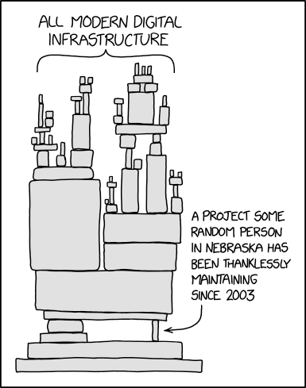
Break + relevant xkcd
https://xkcd.com/2347/

Slide 24
Outline
Linked Lists
Pointers to Pointers
Dynamic Arrays
Bits and Bytes
Integer Encodings

Slide 25
Learning binary
To understand how a computer really works we need to understand that data it operates on
Computers hold data in memory as individual ones and zeros
These ones and zeros make up binary values
So, we’re going to need to understand binary
Binary will definitely come up again in this and other classes

Slide 26
Positional Numbering Systems
The position of a numeral (e.g., digit) determines its contribution to the overall number
Makes arithmetic simple (compared to, say, roman numerals)
Any number has one canonical representation
Example: base 10
10456₁₀ = 1*10⁴ + 0*10³ + 4*10² + 5*10¹ + 6*10⁰
Usually, we leave out the zeros:
1*10⁴ + 4*10² + 5*10¹ + 6*10⁰

Slide 27
Other bases are also possible
Base 60, used by the Babylonians
The source of 60 seconds in a minute, 60 minutes in an hour
And 360 degrees in a circle
Base 20, used by the Maya and Gauls
Parts of this remain in French today
Base 2, used by computers
Example: 10010010₂
Same idea as before: 1*2⁷ + 1*2⁴ + 1*2¹ = 128₁₀ + 16₁₀ + 2₁₀ = 146₁₀

Slide 28
Base 2 Example
Computer Scientists use base 2 a LOT (especially in computer systems)
Let’s convert 138₁₀ to base 2
We need to decompose 138₁₀ into a sum of powers of 2
Start with the largest power of 2 that is smaller or equal to 138₁₀
Subtract it, then repeat the process
138₁₀ – 128₁₀ = 10₁₀
10₁₀ – 8₁₀ = 2₁₀
2₁₀ – 2₁₀ = 0₁₀
138₁₀ = 1×128 + 0×64 + 0×32 + 0×16 + 1×8 + 0×4 + 1×2 + 0×1
138₁₀ = 1×2⁷ + 0×2⁶ + 0×2⁵ + 0×2⁴ + 1×2³ + 0×2² + 1×2¹ + 0×2⁰
138₁₀ = 10001010₂

Slide 29
Binary practice
Convert 101₂ to decimal
= 1×2² + 0×2¹ + 1×2⁰
= 4 + 0 + 1
= 5₁₀
Convert 4₁₀ to binary: 100₂ (one less than 5)
Convert 6₁₀ to binary: 110₂ (one more than 5)

Slide 30
Why computers use Base 2
Simple electronic implementation
Easy to store with bi-stable elements
Reliably transmitted on noisy and inaccurate wires
Straightforward implementation of arithmetic functions
(Pretty much) all computers use base 2
0
1
0
3.3V
2.8V
Voltage
0.5V
0.0V
Time

Slide 31
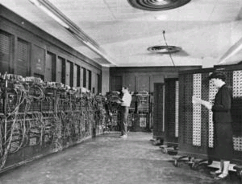
Why don’t computers use Base 10?
Because implementing it electronically is a pain
Hard to store
ENIAC (first general-purpose electronic computer) used 10 vacuum tubes / digit
Hard to transmit
Need high precision to encode 10 signal levels on single wire
Messy to implement digital logic functions
Addition, multiplication, etc.
(See CE203 for details)

Slide 32
Base 16: Hexadecimal
Hex | Decimal | Binary
0 | 0 | 0000
1 | 1 | 0001
2 | 2 | 0010
3 | 3 | 0011
4 | 4 | 0100
5 | 5 | 0101
6 | 6 | 0110
7 | 7 | 0111
8 | 8 | 1000
9 | 9 | 1001
A | 10 | 1010
B | 11 | 1011
C | 12 | 1100
D | 13 | 1101
E | 14 | 1110
F | 15 | 1111
Writing long sequences of 0s and 1s is tedious and error-prone
And takes up a lot of space on a page!
So we’ll often use base 16 (also called hexadecimal)
Base 2 = 2 symbols (0, 1) Base 10 = 10 symbols (0-9) Base 16, need 16 symbols
Use letters A-F once we run out of decimal digits

Slide 33
Base 16: Hexadecimal
Hex | Decimal | Binary
0 | 0 | 0000
1 | 1 | 0001
2 | 2 | 0010
3 | 3 | 0011
4 | 4 | 0100
5 | 5 | 0101
6 | 6 | 0110
7 | 7 | 0111
8 | 8 | 1000
9 | 9 | 1001
A | 10 | 1010
B | 11 | 1011
C | 12 | 1100
D | 13 | 1101
E | 14 | 1110
F | 15 | 1111
16 = 2⁴, so every group of 4 bits becomes a hexadecimal digit (or hexit)
If we have a number of bits not divisible by 4, add 0s on the left (always ok, just like base 10)
1 0 1 0 0 1 0 1 1 1 1 0 1 1
0 0
0x297B
“0x” prefix = it’s in hex

Slide 34
Bytes
A single bit doesn’t hold much information
Only two possible values: 0 and 1
So we’ll typically work with larger groups of bits
For convenience, we’ll refer to groups of 8 bits as bytes
And usually work with multiples of 8 bits at a time
Conveniently, 8 bits = 2 hexits
Some examples
1 byte: 0b01100111 = 0x67
2 bytes: 11000100 00101111₂ = 0xC42F
“0b” prefix = it’s in binary

Slide 35
Practice problem
Hex | Decimal | Binary
0 | 0 | 0000
1 | 1 | 0001
2 | 2 | 0010
3 | 3 | 0011
4 | 4 | 0100
5 | 5 | 0101
6 | 6 | 0110
7 | 7 | 0111
8 | 8 | 1000
9 | 9 | 1001
A | 10 | 1010
B | 11 | 1011
C | 12 | 1100
D | 13 | 1101
E | 14 | 1110
F | 15 | 1111
Convert 0x42 to decimal
Steps
Convert 0x42 to binary:
Convert binary to decimal:

Slide 36
Practice problem
Convert 0x42 to decimal
Steps
Convert 0x42 to binary:
0x4 -> 0b0100 0x2 -> 0b0010 0x42 -> 0b 0100 0010
Convert binary to decimal:

Slide 37
Practice problem
Convert 0x42 to decimal
Steps
Convert 0x42 to binary:
0x4 -> 0b0100 0x2 -> 0b0010 0x42 -> 0b 0100 0010
Convert binary to decimal:
1*2⁶ + 1*2¹ = 64 + 2 = 66

Slide 38
Outline
Linked Lists
Pointers to Pointers
Dynamic Arrays
Bits and Bytes
Integer Encodings

Slide 39
These two lines of code are equivalent
char mychar = 97;
char mychar = ‘a’;
Per the ASCII table, the character ‘a’ has a decimal value 97
The character value and decimal value are equivalent
These two are also equivalent
char diff = ‘c’ - ‘a’;
char diff = 99 - 97;

Slide 40
Big idea: bits can be used to represent anything
Depending on the context, the bits 11000011 could mean
The number 195
The number -61
The number -1.1875
The value True
The character ‘├’
The ret x86 instruction
You have to know the context to make sense of any bits you have!
People and software they write determine what the bits actually mean

Slide 41
Integer types in C
C type provides both size and encoding rules
Integer types in C come in two flavors
Signed: short, signed short, int, long, …
Unsigned: unsigned char, unsigned short, unsigned int, ...
And in multiple different sizes
1 byte: signed char, unsigned char
2 bytes: short, unsigned short
4 bytes: int, unsigned int
Etc.

Slide 42
Sizes of C types are system dependent
C Data Type | Intel IA32 | x86-64 | C Standard* (C99)
char | 1 | 1 | ≥1
short | 2 | 2 | ≥2
int | 4 | 4 | ≥2
long | 4 | 8 | ≥4
long long | 8 | 8 | ≥8
float | 4 | 4
double | 8 | 8
pointer | 4 | 8 | Widths for data, code pointers may differ!
Notes:
Note that short int use 2-bytes, unqualified int is 4B and long int uses the full word size (4 or 8)
Also note two different floating-point formats – single and double precision
There are differences among same architectures of different width, different archs of same width, and the standard is in lala land

Slide 43
Expressing C types in bits
Two families of encodings to express integers using bits
Unsigned encoding for unsigned integers
Two’s complement encoding for signed integers
Each encoding will use a fixed size (# of bits)
For a given machine
Size + encoding family determine which C type we’re representing
Fixed size is because computers are finite!

Slide 44
Unsigned integer encoding
Just write out the number in binary
Works for 0 and all positive integers
Example: encode 104₁₀ as an unsigned 8-bit integer
104₁₀ = 0×2⁷ + 1×2⁶ + 1×2⁵ + 0×2⁴ + 1×2³ + 0×2² + 0×2¹ + 0×2⁰
⇒ 01101000
⇒ 0x68
(Binary To Unsigned)

Slide 45
Bounds of unsigned integers
For a fixed width w, a limited range of integers can be expressed
Smallest value (we will call UMin):
all 0s bit pattern: 000…0, value of 0
Largest value (we will call UMax):
all 1s bit pattern: 111...1, value of 2^{w} – 1
2^{w} – 1 = 1×2^{w-1} + 1×2^{w-2} + ... + 1×2¹ + 1×2⁰ = 11111...
Maximum 8-bit number = 2⁸-1 = 256-1 = 255

Slide 46
Encoding signed integers
What’s different about representing a signed number?
It can be negative!
So, we’re going to have to somehow represent values that are negative and positive
There are actually many different encodings capable of doing this
This is when that “nice encoding” versus “annoying encoding” matters

Slide 47
Two’s complement encoding
Plan:
Start with unsigned encoding, but make ONLY the largest power negative
Example: for 8 bits, most significant bit is worth -2⁷ not +2⁷ (other bits are still positive)
To encode a negative integer
First, set the most significant bit to 1 to start with a big negative number
Then, add positive powers of 2 (the other bits) to “get back” to number we want
Example: encode -6 as a 4-bit two’s complement integer
-6₁₀ =
1 × -2³
+ 0 × 2² + 1 × 2¹ + 0 × 2¹
⇒ 0b1010
⇒ 0xa

Slide 48
Two’s complement examples
Encode -100 as an 8-bit two’s complement number
-100₁₀ =
1 × -2⁷
-128
+ 0 × 2⁶
+ 0
+ 0 × 2⁵
+ 0
+ 1 × 2⁴
+ 16
+ 1 × 2³
+ 8
+ 1 × 2² + 0 × 2¹ + 0 × 2⁰
+4 +0 +0
Problem becomes: encode +28 as a 7-bit unsigned number
-100₁₀ = 0b10011100 = 0x9C

Slide 49
Interpreting binary signed values
Converting binary to signed:
Note: most significant bit still tells us sign!! 1-> negative
Checking if a number is negative is just checking that top bit
Zero problem is always all zeros
0b00000000 = 0 0b10000000 = -128
-1: 0b111…1 = -1 (regardless of number of bits!)
Sign bit

Slide 50
Bounds of two’s complement integers
For a fixed width w, a limited range of integers can be expressed
Smallest value, most negative (we will call TMin):
1 followed by all 0s bit pattern: 100…0 = -2^{w-1}
Largest value, most positive (we will call TMax):
0 followed by all 1s bit pattern: 01...1, value of 2^{w-1} – 1
Beware the asymmetry! Bigger negative number than positive

Slide 51
Ranges for different bit amounts
Observations
|TMin | = TMax + 1
Asymmetric range
UMax = 2 * TMax + 1
C Programming
#include <limits.h>
Declares constants, e.g.,
ULONG_MAX
LONG_MAX
LONG_MIN
Values are platform specific
Notes:
Note the asymmetry on the 2’s-complement range, a source of bugs; why the asymmetry? 0 is nonnegative which means it can represent one less positive number
Note also that UMax is just over 2 TMax (Umax = 2*Tmax+1)

Slide 52
Overflow
What happens if you exceed the bound of a variable type?

Slide 53
Overflow
What happens if you exceed the bound of a variable type?
Unsigned Variables
They wrap!
char a = 255;
a++;
// a now equals 0
char b = 2;
b = b-5;
// b now equals 253

Slide 54
Modulo behavior in binary numbers
10000
0000
1111
0001
1110
0010
1101
0011
-1
1100
0100
+1
1011
0101
1010
0110
1001
0111
1000

Slide 55
Overflow
What happens if you exceed the bound of a variable type?
Signed Variables
UNDEFINED BEHAVIOR
Usually they wrap (that’s what the hardware does)
But also the compiler can do anything it wants

Slide 56
Remember that overflow/underflow can occur in C
Warning: programmers often fail to account for wrapping!
Sometimes it leads to unexpected behavior

Slide 57
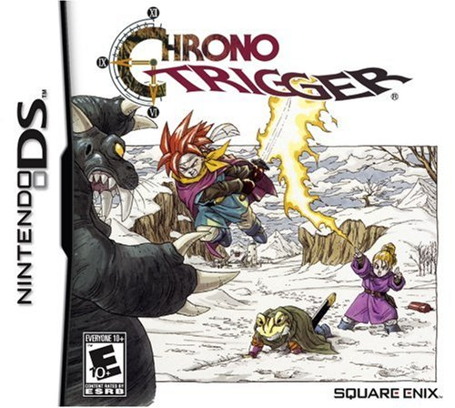

Overflow example in the real world
Dream Devourer
Special boss in the Nintendo DS edition
Wanted to make it even more challenging
32000 hit points
Takes forever to defeat
Hit points stored as a 16-bit signed integer
Range: -32768 to +32767

Slide 58
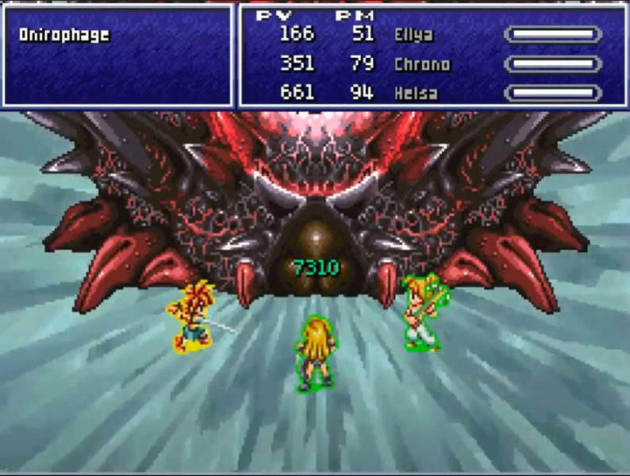
Chrono Trigger signed overflow bug
Solution: heal it
Hit points go negative and it dies

Slide 59
Outline
Linked Lists
Pointers to Pointers
Dynamic Arrays
Bits and Bytes
Integer Encodings

