Slide 1
Lecture 13 Generics and STL
CS211 – Fundamentals of Computer Programming II
Branden Ghena – Spring 2023
Slides adapted from: Jesse Tov (Northwestern), Hal Perkins (Washington)

Slide 2
Administrivia
Homework 4 due tonight
Remember you need to write tests for you code AND play your game
Both parts are important
Exercise 6 is available
Last one. Not too long
Homework 5 should be released tonight
Project details will be released in next few days
First part will be proposing a project idea

Slide 3
Today’s Goals
Explore an Access Control example
Introduce concept of generic functions/classes
How they are made
How we used them
Discuss major use case for generics
C++ Standard Template Library
Understand how iterators allow generic traversal of a container

Slide 4
Getting the code for today
Download code in a zip file from here: https://nu-cs211.github.io/cs211-files/lec/13_generics_stl.zip
Extract code wherever
Open with CLion
Make sure you open the folder with the CMakeLists.txt
Details on CLion in Lab05

Slide 5
Outline
Encapsulation Example
Generics
Standard Template Library
Homework 5 Overview
Iterators

Slide 6
Encapsulation
Goal: protect the rules of your data so it remains consistent
Policy:
Make the data private
Add public member functions to let clients do useful things
Don’t add public member functions that let clients do bad things (like break the rules of the data)

Slide 7
Live coding: update String_Holder access control
string_holder.cxx
string_holder-access.cxx
Data members should be private
Convention: private members end with “_”
Functions should be public
And functions should never allow the rules to be broken

Slide 8
Encapsulation cuts off direct access to data members
Problem: functions outside of the class can never access data members, even to just read from them
Options:
Include the function as a member function instead
Add “getters” for data variables, example: String_Holder::size()
Declare function as a friend

Slide 9
Allowing specific things access to private members
friend keyword declares another thing that can access private members from this class
Example overloaded operator! operator<<()
Needs to access the private members of String_Holder
Inside the String_Holder class definition, add:
friend std::ostream& operator<<(std::ostream&, const String_Holder&);

Slide 10
Welcome to Encapsulation
Software engineering principle:
Bundle your data and operations together
Don’t let non-bundled operations mess with your bundled data
Benefits
Correctness
Data will never become inconsistent
Flexibility
Implementation details can change without modifying the API
Warning: does NOT improve security
Data can still be accessed, just not by accident

Slide 11
Outline
Encapsulation Example
Generics
Standard Template Library
Homework 5 Overview
Iterators

Slide 12
Overloading functions to support multiple types
Suppose you want a function that can compare any two things
Implement for int and implement for float
// returns 0 if equal, 1 if value1 is bigger, -1 otherwise
int compare(const int& value1, const int& value2) {
if (value1 < value2){ return -1;}
if (value2 < value1){ return 1;}
return 0;
}
// returns 0 if equal, 1 if value1 is bigger, -1 otherwise
int compare(const float& value1, const float& value2) {
if (value1 < value2){ return -1;}
if (value2 < value1){ return 1;}
return 0;
}

Slide 13
We want to avoid duplicated code
The two implementations of compare() are nearly identical
Seems wasteful
What if we want to extend compare() for other things?
char, short, long, string, Position, String_Holder, etc.
Impossible to get everything…

Slide 14
“Generic” version of the function
// returns 0 if equal, 1 if value1 is bigger, -1 otherwise
int compare(const ???& value1, const ???& value2) {
if (value1 < value2){ return -1;}
if (value2 < value1){ return 1;}
return 0;
}
What we would prefer is one “generic” version of the function
Code will be independent of what the real type is
One implementation works for everything!
Condition here: must implement operator<()

Slide 15
C++ Generics
C++ implements generics through a concept called “templates”
A template is a function or class that accepts a type as a parameter
You write the function code once in a type-agnostic way
When you invoke the function or instantiate the class, you specify the type as an argument to it
At compile time, the compiler will generate the “specialized” code from your template that uses the type provided
The template definition is NOT runnable code
The compiler creates runnable code given a concrete type
A little like macro substitution

Slide 16
Generic functions
Template to compare() any two things
// returns 0 if equal, 1 if value1 is bigger, -1 otherwise
template <typename T> // <...> can also be written <class T>
int compare(const T& value1, const T& value2) {
if (value1 < value2) return -1;
if (value2 < value1) return 1;
return 0;
}

Slide 17
Generic functions
Template to compare() any two things
Declares the following function a template
The “generic” type is called T
// returns 0 if equal, 1 if value1 is bigger, -1 otherwise
template <typename T> // <...> can also be written <class T>
int compare(const T& value1, const T& value2) {
if (value1 < value2) return -1;
if (value2 < value1) return 1;
return 0;
}

Slide 18
Generic functions
Template to compare() any two things
Declares the following function a template
The “generic” type is called T
Code inside the template can use T like a type
// returns 0 if equal, 1 if value1 is bigger, -1 otherwise
template <typename T> // <...> can also be written <class T>
int compare(const T& value1, const T& value2) {
if (value1 < value2) return -1;
if (value2 < value1) return 1;
return 0;
}

Slide 19
Generic functions
Template to compare() any two things
We didn’t have to name the type T
Could name it anything we want
Named in all capital letters by convention
// returns 0 if equal, 1 if value1 is bigger, -1 otherwise
template <typename COMPARE_TYPE>
int compare(const COMPARE_TYPE& value1, const COMPARE_TYPE& value2) {
if (value1 < value2) return -1;
if (value2 < value1) return 1;
return 0;
}

Slide 20
Using generic functions
generic_compare.cxx
Actual type being used goes in angle brackets after function name
compare<COMPARE_TYPE>
int main() {
std::cout << compare<int>(10, 20) << “\n”;
std::cout << compare<double>(50.5, 50.6) << “\n”;
std::cout << compare<std::string>(“hello”, “world”) << “\n”;
return 0;
}

Slide 21
Using generic functions
The compiler can sometimes guess the correct type for you based on the arguments provided
This is known as “type inference”
Can occasionally lead to unexpected results though…
int main() {
std::cout << compare(10, 20) << “\n”; // OK
std::cout << compare(50.5, 50.6) << “\n”; // OK
std::cout << compare(“hello”, “world”) << “\n”; // FAILS!
return 0;
}

Slide 22
Using generic functions
The compiler can sometimes guess the correct type for you based on the arguments provided
This is known as “type inference”
Can occasionally lead to unexpected results though…
Third example below ends up calling compare<char*>()
int main() {
std::cout << compare(10, 20) << “\n”; // OK
std::cout << compare(50.5, 50.6) << “\n”; // OK
std::cout << compare(“hello”, “world”) << “\n”; // FAILS!
return 0;
}

Slide 23
Generic classes
Templates are most commonly used for classes (similarly structs)
Entire class definition is templated
Template type can be used for any data member or member functions

Slide 24
Example of generic classes
Let’s create a class called Pair that holds two “things”
The things do NOT have to be the same type
Like a tuple in python, but limited to two
Operations
Set the value of the first thing
Set the value of the second thing
Get the value of the first thing
Get the value of the second thing
Print the pair of things
Useful for the ability to return two things at once from a function!

Slide 25
Live coding: implement pair
generic_pair-starter.cxx
generic_pair-complete.cxx
Operations
Set the value of the first thing
Set the value of the second thing
Get the value of the first thing
Get the value of the second thing
Print the pair of things
Real Pair implementation available in the C++ <utility> library
https://www.cplusplus.com/reference/utility/pair/pair/

Slide 26
Dangers of templates
generic_pair_compare.cxx
Doing tricky things with compilers results in tricky errors
Compiler error when you misuse a generic function (usually unintentionally!) can get really bad
Example: try calling compare() with something invalid
Working with templates in general gets complicated and messy
Need to implement all template code inside headers
Needs to be imported into each C++ file that uses it so the generated definitions are available

Slide 27
Generics in GE211
You’ve already been using them!
Posn<int>, Posn<float>, Dims<int>, etc.
You know enough to understand the entire implementation of Posn
Take a look at it when you get a chance
https://github.com/tov/ge211/blob/2d7d3a1bd762c3b6d6fac791b0da2fc6c2013d3c/include/ge211/geometry.hxx#L264

Slide 28
Break + Question
What syntax would you use to create a Pair where both the values are a Posn object with coordinates of type int?
Pair<???> pair({0, 0}, {3, 3});

Slide 29
Break + Question
What syntax would you use to create a Pair where both the values are a Posn object with coordinates of type int?
Pair<Posn<int>, Posn<int>> pair({0, 0}, {3, 3});

Slide 30
Outline
Encapsulation Example
Generics
Standard Template Library
Homework 5 Overview
Iterators

Slide 31
C++ Standard Library
Four major pieces
The entire C standard library
C++ input/output stream library
std::cin, std::cout, etc.
C++ Standard Template Library (STL)
Containers, iterators, algorithms, etc.
Miscellaneous other stuff
Strings, exceptions, memory allocation, localization

Slide 32
STL Containers
Standard Template Library
Contains various useful functionality created as templates!
Apply for any type you want
A container is an object that stores a collection of other objects
Like arrays or linked lists
We already covered one of these: std::vector

Slide 33
STL std::list
http://www.cplusplus.com/reference/list/list/
A generic doubly-linked list
Next pointers and previous pointers allow movement in either direction
Can be more or less efficient than std::vector
See CS214

Slide 34
STL std::unordered_map
https://www.cplusplus.com/reference/unordered_map/unordered_map/
Generic map from key to value
For any type of key and type of value
Can store a value by its key
Can retrieve a value by its key
Works just like a python dict

Slide 35
Live coding: unordered_map example
unordered_map_example.cxx
int main() { std::unordered_map<std::string, int> map; map[“CS211”] = 176; map[“CE346”] = 0; std::cout << “map at CS211 = “ << map[“CS211”] << “\n”; return 0;
}

Slide 36
Other STL containers
https://www.cplusplus.com/reference/stl/
Map
Key->Value in sorted order by key
Set
Ordered list of unique elements
Unordered_set
Unique elements in no particular order
Array
Fixed size list of elements (like vector, but not resizable)
And various others
Stack, Queue, etc.

Slide 37
Outline
Encapsulation Example
Generics
Standard Template Library
Homework 5 Overview
Iterators

Slide 38
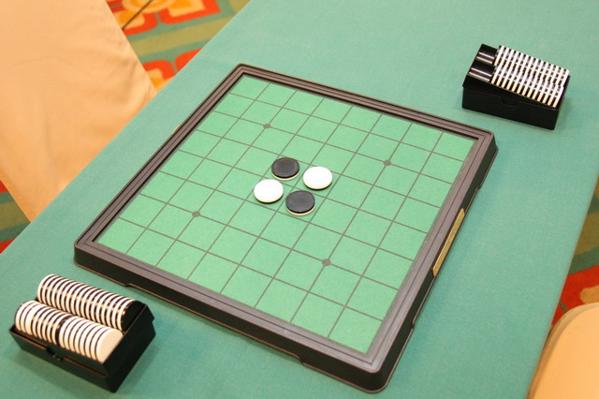
Reversi
Also known as Othello
Light player and dark player take turns placing pieces
A valid placed piece must be in a line with any number of opposing pieces followed by one piece of the current player
All opposing pieces in that bounded line are flipped to belong to the current player

Slide 39
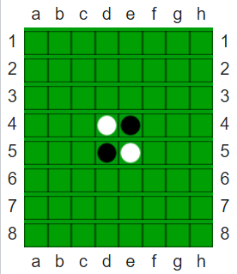
Example move in reversi
First, must place pieces in the central four squares
These don’t follow the normal rules

Slide 40
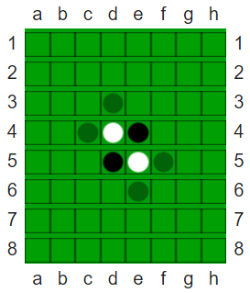
Example move in reversi
It is the dark player’s turn
They may play in any of the four locations indicated
Must form a line with a light piece in the middle

Slide 41
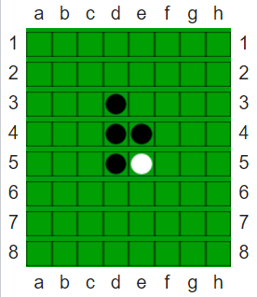
Example move in reversi
Once the dark player places a piece, all opposing pieces in that line are flipped

Slide 42
Game demo
https://www.mathsisfun.com/games/reversi.html
Warning: the game setup rules are slightly different from ours
We let players play out the first two moves, which must be in the center

Slide 43
Project layout
Model, View, Controller
Same as with prior homework
View is responsible for drawing things
Controller gets inputs from the user
Model contains the game logic
Model interacts with several other components
Board
Player
Move
Position_set
Move_map

Slide 44
Player
Represents a Player
Either in terms who owns a piece
Or whose turn it currently is
enum class Player {
dark,
light,
neither
};

Slide 45
Enums
Define a new type with a fixed list of possible values
enum class Player {
dark,
light,
neither
};
New type: Player
Possible values: Player::dark, Player::light, Player::neither
Enums are in C as well as many other languages!

Slide 46
Board
Stores state for the game
The board at each Posn<int> contains a Player
Player::light, Player::dark, or Player::neither
Valid positions are the rows/columns on the board
An 8x8 board goes from {0,0} to {7,7}
We might change the size of the board in tests though
Can ask the board which piece is in a certain position
Can tell the board to set a piece in a certain position

Slide 47
Move
A std::pair of:
A position on the board
All pieces that would flip if the current player played in that position
Stored as a Position_set
Move_map
An std::unordered_map
Holds Moves
Key is a position on the board
Value is the corresponding position set for the Move

Slide 48
What do you have to do?
Interact with a big program with lots of library files you didn’t write
Board, Move, Player, Position_set
You don’t need to understand all of the code, but you do need to understand how to use them
Look through the .hxx files for them
Fill the Move_map next_moves
Contents are each valid Move that the current player could make
Need to analyze the board to make that determination
Eventually, you’ll fill in the controller/view too
Including hints to the current player about possible places they could play

Slide 49
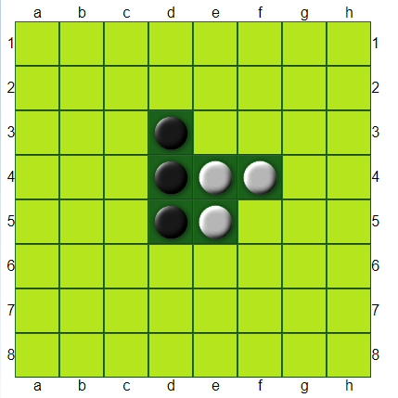
Break + Reversi
It is Dark’s turn. Where may they play?

Slide 50
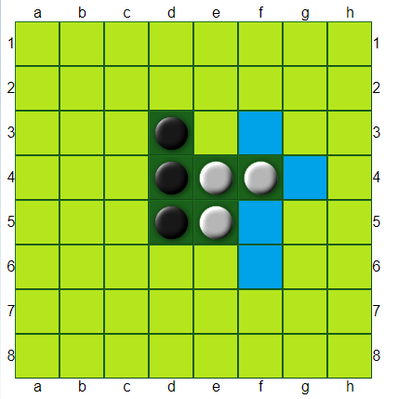
Break + Reversi
It is Dark’s turn. Where may they play?

Slide 51
Outline
Encapsulation Example
Generics
Standard Template Library
Homework 5 Overview
Iterators

Slide 52
How do we make algorithms work on generic containers?
C++ provides various algorithms in its <algorithm> library
find(), count(), sort()
How does it make those work on any container?
Algorithm needs to traverse the container. But each container is different
Vector: for(i=0; i<vector.size(); i++) { vector[i]; }
List: for(node* curr=head; curr!=NULL; curr=curr->next){ curr.value; }

Slide 53
Iterators allow generic traversing of containers
Concept:
Create an object that allows you to move through the container
Holds a reference to the original object
Understands how to move through that specific implementation
Operations an iterator must support:
Construction
Getting the value at the current location (* dereference)
Moving to the next location in the container (++)
Comparison with another iterator (== or !=)
Usually get two iterators, start and end, and traverse start until at end

Slide 54
General iterator pattern
start_iterator = object.begin();
end_iterator = object.end();
while (start_iterator != end_iterator) {
value = *start_iterator; // get value
// do something useful with value
start_iterator++; // move to next location
}

Slide 55
Iterators are modeled after pointers!
iterator_example.cxx
int array[5] = {1, 2, 3, 4, 5};
int* start_iterator = &(array[0]);
int* end_iterator = &(array[5]);
while (start_iterator != end_iterator) {
int value = *start_iterator;
std::cout << “Value: “ << value << “\n”;
start_iterator++;
}

Slide 56
Same code but for std::vector
iterator_example.cxx
std::vector<int> vec{1, 2, 3, 4, 5};
auto start_iterator = vec.begin();
auto end_iterator = vec.end();
while (start_iterator != end_iterator) {
int value = *start_iterator;
std::cout << “Value: “ << value << “\n”;
start_iterator++;
}
auto asks the compiler to figure out the type for you
This part didn’t have to change at all!

Slide 57
More complicated iterators can support more operations
Depending on the container, iterators could support many operations
Forward:
construction, equality, increment, get value
Bidirectional:
Everything Forward does, decrement
Random Access:
Everything Bidirectional does, arithmetic, comparison, get value at index

Slide 58
Live coding: use the count algorithm
iterator_example.cxx
int count(InputIterator first, InputIterator second, constT& value)
Counts occurrences of a value in a container
Actually returns an iterator::difference_type, but we’ll ignore that
It’s just a signed integer in practice
We can count the number of times a certain value occurs inside a vector or array

Slide 59
Break + Question
How would we implement the following code?
int array[5] = {1, 1, 1, 2, 2};
// count the number of twos in array
int num_twos = count(???, ???, 2);

Slide 60
Break + Question
How would we implement the following code?
Pointers!
int array[5] = {1, 1, 1, 2, 2};
// count the number of twos in array
int num_twos = count(&(array[0]), &(array[5]), 2);

Slide 61
Outline
Encapsulation Example
Generics
Standard Template Library
Homework 5 Overview
Iterators

