Slide 1
Lecture 15 C++ Inheritance
CS211 – Fundamentals of Computer Programming II
Branden Ghena – Spring 2023
Slides adapted from: Jesse Tov (Northwestern), Hal Perkins (Washington), Godmar Back (Virginia Tech)

Slide 2
Administrivia
Homework 5 is due today
We’ll do the best we can, but office hours will be busy
Remember that project proposals are due on Friday!
We’ve gotten only a few proposals so far
I’m going to start emailing approvals later today

Slide 3
Today’s Goals
Introduce concept of inheritance for classes
Describe inheritance process in C++
Understand some benefits and possible challenges
Explore how GE211 uses inheritance

Slide 4
Getting the code for today
Download code in a zip files from here: https://nu-cs211.github.io/cs211-files/lec/15_inheritance.zip
Extract code wherever
Open with CLion
Make sure you open the folder with the CMakeLists.txt

Slide 5
Outline
Concept of Inheritance
Inheritance in C++
Overriding Functions
Storing Inherited Classes
GE211 Inheritance

Slide 6
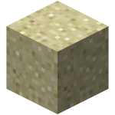
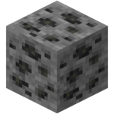
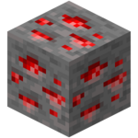
Duplicated behavior in separate classes
Example: Minecraft
World is made of destructible blocks of various types
Blocks have different qualities
Sounds when hit, number of hits to break, what it drops when broken
Sand Block
Coal Ore Block
Redstone Ore Block

Slide 7
Example Class for a Sand Block
class Sand_block {
public: Sand_block(Posn<int>);
void hit_block();
void fall();
private:
Posn<int> position_;
int hits_remaining_;
}
These functions would probably take arguments and maybe return things. We’ll ignore that for this example.

Slide 8
Example Class for a Coal Ore Block
class Coal_ore_block {
public: Coal_ore_block(Posn<int>);
void hit_block();
void drop_item();
private:
Posn<int> position_;
int hits_remaining_;
}
These functions would probably take arguments and maybe return things. We’ll ignore that for this example.

Slide 9
Example Class for a Redstone Ore Block
class Redstone_ore_block {
public: Redstone_ore_block(Posn<int>);
void hit_block();
void drop_item();
void emit_particles();
private:
Posn<int> position_;
int hits_remaining_;
}
These functions would probably take arguments and maybe return things. We’ll ignore that for this example.

Slide 10
Design without inheritance
One class per block type:
Feels pretty redundant. Lots of repeated information
Cannot use multiple blocks as the same thing
Can’t have a vector of blocks, for instance
Sand_block
hit_block() fall()
position_ hits_remaining_
Coal_ore_block
hit_block() drop_item()
position_ hits_remaining_
Redstone_ore_block
hit_block() drop_item() emit_particles()
position_ hits_remaining_

Slide 11
Concept: share common traits
Inheritance allows one class to copy all the qualities of another
i.e. it inherits member functions and data members
Allows us to form parent-child “is-a” relationship between classes
A child (derived class) extends a parent (base class)
Objects can be treated as anything they inherit from
Object can be treated as the base class to access general functionality
Or treated as the specific derived class to access specific functionality

Slide 12
Redesign of blocks with inheritance
Coal_ore_block
hit_block() drop_item()
position_ hits_remaining_
Ore_block
hit_block() drop_item()
position_ hits_remaining_
Block
hit_block()
position_ hits_remaining_
Redstone_ore_block
hit_block() drop_item() emit_particles()
position_ hits_remaining_
Sand_block
hit_block() fall()
position_ hits_remaining_

Slide 13
Derived classes can override inherited functionality
void Ore_block::hit_block() {
hits_remaining--;
if (hits_remaining == 0) { drop_item(); }
}
void Redstone_ore_block::hit_block() {
hits_remaining--;
emit_particles();
if (hits_remaining == 0) { drop_item(); }
}

Slide 14
Derived classes can be treated as the parent class
We can make a vector of generic “Block” and fill it with specific types of blocks
Although we have to do some extra work: using pointers in this example
More on this later
std::vector<Block*> blocks;
blocks.push_back(&Coal_ore_block());
blocks.push_back(&Redstone_ore_block());
blocks.push_back(&Coal_ore_block());
blocks.push_back(&Sand_block());
blocks[1]->hit_block(); // calls Redstone hit_block()

Slide 15
Benefits of inheritance
Code reuse
Children can automatically inherit code from parents
Extensibility
Children can add custom behavior by extending or overriding
Polymorphism (biggest reason)
Ability to redefine existing behavior but preserve the interface
Children can override the behavior of the parent
Other parts of the code can make calls on objects without knowing which part of the inheritance tree they are from

Slide 16
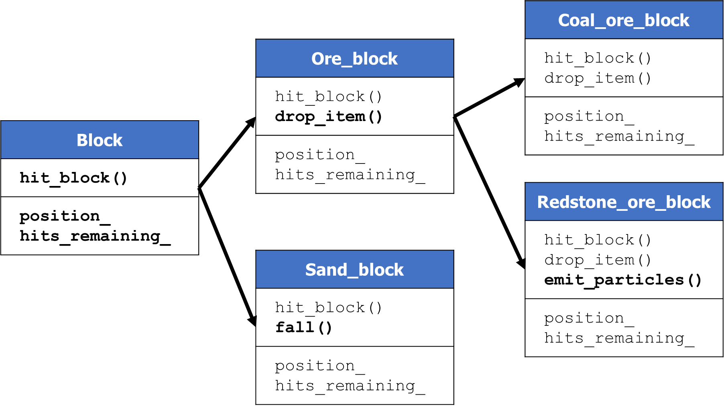
Break + Quiz: Relationships between our blocks
Determine if the following is-a relationships exist
True or False:
Redstone_ore_block is-a Ore_block?
Coal_ore_block is-a Ore_block?
Coal_ore_block is-a Block?
Coal_ore_block is-a Redstone_ore_block?
Ore_block is-a Redstone_ore_block?

Slide 17
Break + Quiz: Relationships between our blocks
Determine if the following is-a relationships exist
True or False:
Redstone_ore_block is-a Ore_block? TRUE
Coal_ore_block is-a Ore_block? TRUE
Coal_ore_block is-a Block? TRUE
Coal_ore_block is-a Redstone_ore_block? FALSE
Ore_block is-a Redstone_ore_block? FALSE

Slide 18
Outline
Concept of Inheritance
Inheritance in C++
Overriding Functions
Storing Inherited Classes
GE211 Inheritance

Slide 19
Simpler class for demonstrating inheritance
positions.hxx
positions.cxx
class Position {
public:
Position(int x, int y);
int distance_to(Position const& other) const;
void print() const;
private:
int x_;
int y_;
};

Slide 20
Create a new class that inherits from Position
positions.hxx
positions.cxx
class Position3D: public Position {
public:
Position3D(int x, int y, int z);
int distance_to(Position3D const& other) const;
void print() const;
private:
int z_;
};

Slide 21
Needs its own unique constructor
positions.hxx
positions.cxx
class Position3D: public Position {
public:
Position3D(int x, int y, int z);
int distance_to(Position3D const& other) const;
void print() const;
private:
int z_;
};
Class derivation list
Position3D inherits from Position

Slide 22
Class derivation list
class Name : public BaseClass1, public BaseClass2
{ };
It is possible to inherit from any number of classes
Can add some difficulties outside the scope of this class (Diamond problem)
public is an access specifier
Always want to use public
Private would make everything inherited private
Which would mean other things wouldn’t know you had them
Which really defeats the whole purpose

Slide 23
Derived class needs its own unique constructor
positions.hxx
positions.cxx
class Position3D: public Position {
public:
Position3D(int x, int y, int z);
int distance_to(Position3D const& other) const;
void print() const;
private:
int z_;
};
Constructor
Must be unique for each class

Slide 24
Extending base class functionality
positions.hxx
positions.cxx
class Position3D: public Position {
public:
Position3D(int x, int y, int z);
int distance_to(Position3D const& other) const;
void print() const;
private:
int z_;
};
Extended functionality
Provides features that the original class does not

Slide 25
Overriding base class functionality
positions.hxx
positions.cxx
class Position3D: public Position {
public:
Position3D(int x, int y, int z);
int distance_to(Position3D const& other) const;
void print() const;
private:
int z_;
};
Overridden functionality
Redefines existing functionality to do something different

Slide 26
Constructor for our derived class
positions.hxx
positions.cxx
Position3D::Position3D(int x, int y, int z)
: Position(x, y),
z_(z)
{ }
Base class constructors are called first in the initializer list
C++ will automatically call the default constructor if one exists and you don’t

Slide 27
Access is not allowed to the base class’s private members
int Position3D::distance_to(Position3D const& other) const {
int diffx = other.x_ - x_;
int diffy = other.y_ - y_;
int diffz = other.z_ - z_;
return std::sqrt(diffx*diffx + diffy*diffy + diffz*diffz);
}
ERROR! This won’t work because x_ and y_ are private
Need some way to make them accessible to things that inherit from the class
Additional access specifier: protected

Slide 28
Classes meant to be inherited from use protected members
class Position {
public:
Position(int x, int y);
int distance_to(Position const& other) const;
void print() const;
protected:
int x_;
int y_;
};

Slide 29
Break + Open Question
How do you decide whether a given member should be private or protected?

Slide 30
Break + Open Question
How do you decide whether a given member should be private or protected?
No always-correct answer here, but some thoughts:
If your class will never be inherited from: make it private
If your class will be inherited from: likely make it protected
Unless it’s special to this implementation and won’t be reused
Or further if inheriting classes should not modify it directly

Slide 31
Outline
Concept of Inheritance
Inheritance in C++
Overriding Functions
Storing Inherited Classes
GE211 Inheritance

Slide 32
Compiler decides which version of an overridden function to call
Position p1 {0, 0};
Position3D p2 {0, 0, 0};
p1.print();
p2.print();
How does the compiler know which version of print() to call?
Decides at compile time based on which type it is
This is known as “static dispatch”

Slide 33
Problem with static dispatch
But often we would prefer to call the extended version of the function
Even if the object is treated as the base class
void print_position(Position const& p) {
p.print();
}
Position p1 {0, 0};
Position3D p2 {0, 0, -5};
print_position(p1);
print_position(p2);// prints the 2D position version

Slide 34
Dynamic dispatch
For some functions, have code use the overridden version if it exists
Need some way of specifying which functions should work this way
This needs to be decided at runtime
Function doesn’t know in advance which specific type it is going to be called with
Language has to support this feature (C++ does!)

Slide 35
Declare functions virtual if dynamic dispatch should occur
class Position {
public:
Position(int x, int y);
int distance_to(Position const& other) const;
virtual void print() const;
protected:
int x_;
int y_;
};

Slide 36
In derived class, mark function as override
class Position3D: public Position {
public:
Position3D(int x, int y, int z);
int distance_to(Position3D const& other) const;
void print() const override;
private:
int z_;
};
Important for compile-time errors. Compiler will tell you if there isn’t a virtual function you’re overriding.

Slide 37
Repeat example but with dynamic dispatch
Now our example works because the program decides which version of print() to call at run-time
void print_position(Position const& p) {
p.print();
}
Position p1 {0, 0};
Position3D p2 {0, 0, -5};
print_position(p1);
print_position(p2);// prints the 3D position version!

Slide 38
Creating a class that MUST be overridden
Sometimes we want to include a function in a base class but only implement it in derived classes
Back to Minecraft example: hit_block() might not have a default implementation
We can make a function “pure virtual” in C++
No implementation is written for the base class
Any class that inherits is required to implement it
The base class becomes an “abstract class”
It cannot be instantiated as an object because all of its functions aren’t implemented
It is only useful as a class to inherit from

Slide 39
Making a pure virtual function
class Printable {
public: virtual void print() const = 0;
}
class Position : public Printable {
void print() const override;
}

Slide 40
Outline
Concept of Inheritance
Inheritance in C++
Overriding Functions
Storing Inherited Classes
GE211 Inheritance

Slide 41
Storing a collection of inherited objects
We can make a vector of generic “Block” and fill it with specific types of blocks
Although we have to do some extra work: using pointers in this example
More on this later
std::vector<Block*> blocks;
blocks.push_back(&Coal_ore_block());
blocks.push_back(&Redstone_ore_block());
blocks.push_back(&Coal_ore_block());
blocks.push_back(&Sand_block());
blocks[1]->hit_block(); // calls Redstone hit_block()

Slide 42
The simple thing is broken
vector_of_base.hxx
vector_of_base.cxx
Position p1 {1, 2};
Position3D p2 {-1, -2, -3};
std::vector<Printable> broken;
broken.push_back(p1);
broken.push_back(p2);
for (Printable const& p: broken) {
print_position(p); // prints the wrong thing!
}

Slide 43
Object slicing
std::vector<Printable> only allocates enough space to hold the “Printable” class, not the extra stuff for the other classes
So, you put a child class in and it “slices” off all the special parts
Only holds whatever was in the base class
In terms of memory:
If each Printable needed 10 bytes
And each Position needed 30 bytes
The vector only hangs on to the first 10 bytes of each Position

Slide 44
Fixing object slicing
To solve this problem, we just need to make sure there’s actually memory available
std::vector<Position> has enough memory for each Position
std::vector<Position3D> has enough memory for each Position3D
But we really want to mix objects of different inherited types
So the solution is to hang on to pointers instead!

Slide 45
Storing pointers fixes object slicing
vector_of_base.hxx
vector_of_base.cxx
Position p1 {1, 2};
Position3D p2 {-1, -2, -3};
std::vector<Printable*> fixed;
fixed.push_back(&p1);
fixed.push_back(&p2);
for (Printable* const& p: fixed) {
print_position(*p); // prints the right thing!
}

Slide 46
Warning: now we’re worried about scoping and liftetimes!
The new vector just hangs on to pointers, not to the objects themselves!
That means we need to make sure that the objects are actually stored somewhere too
Common solutions
Keep each object as a member of a class
We do this with sprites in GE211!
Keep an array of each individual object type (likely still as a member)
And a mixed array of pointers to all of them
Dynamic memory (we’ll talk about this next week)

Slide 47
Smart pointers example
vector_of_base.hxx
vector_of_base.cxx
std::vector<std::unique_ptr<Printable>> heap;
heap.push_back(std::make_unique<Position>(1, 2));
heap.push_back(std::make_unique<Position3D>(-7, -6, -5);
for (std::unique_ptr<Printable> const& p: heap) {
print_position(*p); // prints the right thing!
}
More on this next week

Slide 48
Break + Practice
class Rectangle: public Shape {
public:
Rectangle(float x, float y, std::string col) : Shape(col), height_(x), width_(y)
{ }
void print_color() {
std::cout << color_ << "\n";
}
private:
float height_;
float width_; };
class Shape {
public:
Shape(std::string col)
: color_(col)
{}
protected:
std::string color_ = "purple";
};
What does this print? Rectangle rect(3, 4, "red"); rect.print_color();

Slide 49
Break + Practice
class Rectangle: public Shape {
public:
Rectangle(float x, float y, std::string col) : Shape(col), height_(x), width_(y)
{ }
void print_color() {
std::cout << color_ << "\n";
}
private:
float height_;
float width_; };
class Shape {
public:
Shape(std::string col)
: color_(col)
{}
protected:
std::string color_ = "purple";
};
What does this print? Rectangle rect(3, 4, "red"); rect.print_color();
It prints:
“red”

Slide 50
Outline
Concept of Inheritance
Inheritance in C++
Overriding Functions
Storing Inherited Classes
GE211 Inheritance

Slide 51
Inheritance in GE211
https://github.com/tov/ge211/blob/main/include/ge211/base.hxx
Abstract_game is an abstract base class
draw(Sprite_set&) is a pure virtual function
Any game MUST implement draw()
Many other functions are marked virtual
Our Controller overrides them with its own implementation
on_key, on_mouse_move, etc.
Some functions are implemented and we inherit directly
run() is a good example of this

Slide 52
Break + Open Question
Do you need to use inheritance in your Final Project?
Technically yes: Controller inherits from Abstract_game
Otherwise no, you could make everything as a part of the model
Situations where inheritance could help
Multiple pieces that have some shared behaviors and some unique behaviors
Could still manage this manually, or could use classes/inheritance

Slide 53
Outline
Concept of Inheritance
Inheritance in C++
Overriding Functions
Storing Inherited Classes
GE211 Inheritance

