Slide 1
Lecture 16 RAII & Memory Management
CS211 – Fundamentals of Computer Programming II
Branden Ghena – Spring 2023
Slides adapted from: Jesse Tov (Northwestern), Hal Perkins (Washington), Godmar Back (Virginia Tech)

Slide 2
Administrivia
Project specifications due today!
Each group gets will get feedback later this week
In the meantime: get started on code now!
Start with the core functionality, which isn’t really going to change
Due at the end of next week!!!
Worth more than double any homework assignment
Late penalty is significant. No slip days
Up to 90% max points for one day late
Up to 60% max points for two days late
Up to 30% max points for three days late

Slide 3
Lecture plan from here
Thursday 5/25
C and C++ wrap-up
Tuesday 5/30
Version control and Git
Also, the final quiz!
Thursday 6/01
No lecture
Office hours in Tech Auditorium during lecture time

Slide 4
Today’s Goals
Consider the RAII programming idiom: (Resource Acquisition Is Initialization)
Understand how it is making development easier in C++
Discuss C++ memory management
What exists and how it works
How to use Smart Pointers to make it easy too

Slide 5
Outline
C++ Strings
RAII
C++ Memory Management
Smart Pointers
Example GE211 Project

Slide 6
Strings in C++
Everything you wanted from C strings and didn’t get
#include <string>
std::string s1 = “Test”;
s1 += “ String”;
s1[0] = ‘B’;
std::cout << s1 << “\n”; // prints “Best String”

Slide 7
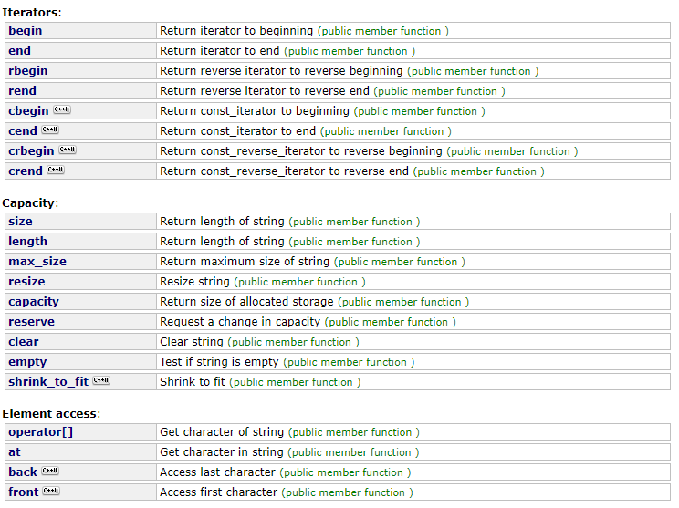
C++ string operations
Iterators
Including reverse and constant
Sizing
Characters and memory
Access to characters
https://www.cplusplus.com/reference/string/string/

Slide 8
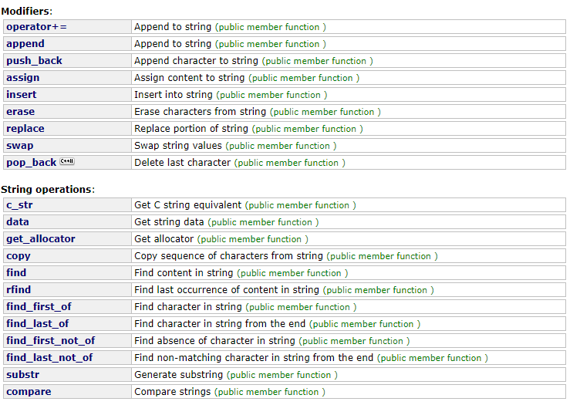
C++ string operations
Modification of strings
Add or remove from them
Operations
Get C string from std::string
Find
Substring
Compare
https://www.cplusplus.com/reference/string/string/

Slide 9
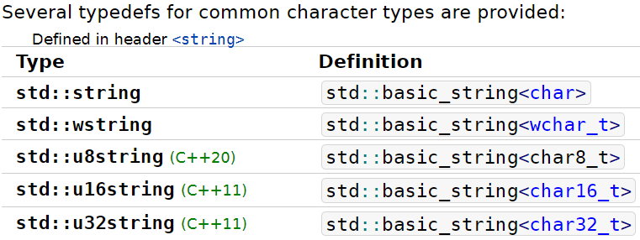
Strings with different character sizes
All are actually implementations of the generic std::basic_string
16-bit “wide” characters
Strings of 8-bit, 16-bit, or 32-bit characters
UTF-8 mostly works with std::string by default
Some helper functions won’t work properly though…
Needs additional libraries for many functions

Slide 10
Outline
C++ Strings
RAII
C++ Memory Management
Smart Pointers
Example GE211 Project

Slide 11
RAII-structured libraries enable simple dynamic memory
std::vector, std::string, and other library containers must use dynamic memory internally
But we never have to call vector.destroy() or free(string)
What makes memory management so automatic in C++?
Programming paradigm: RAII
Resource Acquisition Is Initialization
Basic idea:
Wrap resources in an object
Allocate when you initialize and deallocate when destructed

Slide 12
What is a “resource”?
Abstractly:
Something you need to get your computation done,
That you can run out of,
So you need to keep track of what you’re using and release what you aren’t
Concretely:
Memory!
File handles
Network sockets
Database sessions
Acquired locks (concurrent programming)

Slide 13
The problem: leaking resources
#include <cstdio> void handle_file(std:: string const& name) { FILE* f = fopen(name.c_str(), "r"); // various code here using the file }
Didn’t close the file! There’s a resource leak!!

Slide 14
The problem: leaking resources
#include <cstdio> void handle_file(std:: string const& name) { FILE* f = fopen(name.c_str(), "r"); // various code here using the file if (some error occurred) { return; } // various more code using the file fclose(f); }
What’s wrong here?

Slide 15
The problem: leaking resources
#include <cstdio> void handle_file(std:: string const& name) { FILE* f = fopen(name.c_str(), "r"); // various code here using the file if (some error occurred) { return; } // various more code using the file fclose(f); }
More common cause: early returns
Always beware when code returns early

Slide 16
Exceptions make early returns even worse
void helper(FILE* f) { if (some problem detected){throw std::runtime_error(“Oops”);} // various code here using the file } void handle_file(std:: string const& name) { FILE* f = fopen(name.c_str(), "r"); // various code here using the file helper(f); // might throw an exception never “return” // various more code using the file fclose(f); }
Can’t clean up here without try/catch everywhere

Slide 17
C++ solution: Resource Acquisition Is Initialization
Also known as Scope Based Resource Management (SBRM)
Never open/close or free/allocate manually
Instead make a class that owns the Resource
Allocate in the constructor
Programmer calls this when initializing the object variable
Deallocate in the destructor
Automatically occurs. Programmer doesn’t have to do anything!

Slide 18
Destructors
Same concept as constructors: used to clean up an object
Automatically called when the object goes out of scope
Note: you never call the destructor yourself!
Handles any cleanup, including freeing necessary resources
std::ifstream::~ifstream() {
// close the file here
}

Slide 19
Destructors allow resources to automatically be cleaned up
#include <fstream>
void handle_file(std:: string const& name) {
std::ifstream f(name , "r");
// do stuff with the file
} // f.~ifstream() happens automatically here

Slide 20
Destructors allow resources to automatically be cleaned up
#include <fstream>
void handle_file(std:: string const& name) {
std::ifstream f(name , "r");
// do stuff with the file.
// Possibly return or throw exceptions! } // f.~ifstream() happens here regardless
The destructor is guaranteed to run. Even if there is an exception!

Slide 21
Break + Question
In RAII (Resource Acquisition Is Initialization), when are resources allocated?
In the Constructor
By a special function, which is called on-demand
When compiling the code
Wherever new is called

Slide 22
Break + Question
In RAII (Resource Acquisition Is Initialization), when are resources allocated?
In the Constructor
By a special function, which is called on-demand
When compiling the code
Wherever new is called

Slide 23
Outline
C++ Strings
RAII
C++ Memory Management
Smart Pointers
Example GE211 Project

Slide 24
C++ memory management
In C, dynamic memory was very important for making any realistic program that responds to user input
In C++, because of RAII concepts and the Standard Template Library, we haven’t had to manually use dynamic memory at all!
But it is still there, happening
And we could harness it ourselves if we need to

Slide 25
Reminder: C memory allocation
void* malloc(size_t size)
Requests size bytes of memory from the heap
Returns a pointer to this new object
Not associated with any variable (sort of like string literals)
It has no value by default
The object persists until it is manually deallocated
Deallocated through a call to free()

Slide 26
C++ memory allocation (original, old style)
Allocate with the new keyword and a type
No need to specify number of bytes anymore
Works for primitive types and for objects
Examples:
int* value_ptr = new int;
Posn<int>* p = new Posn<int>;
Deallocate with the delete keyword and the pointer
Example: delete p;
Warning: never mix-and-match malloc()/free() with new/delete
UNDEFINED BEHAVIOR (free() doesn’t call destructor!!)

Slide 27
Dynamic arrays in C++
For new, add the size of the array after the type
int* data = new int[10];
For delete, must instead use delete[]
Important: Must remember this or UNDEFINED BEHAVIOR 😭
Reason:
delete calls the destructor and then frees the memory
delete[] iteratively calls destructors and then frees the memory
delete[] could have worked for everything, but it would be less efficient

Slide 28
Dynamic arrays in C++
For new, add the size of the array after the type
int* data = new int[10];
For delete, must instead use delete[]
Important: Must remember this or UNDEFINED BEHAVIOR 😭
Reason:
delete calls the destructor and then frees the memory
delete[] iteratively calls destructors and then frees the memory
delete[] could have worked for everything, but it would be less efficient
Just use std::array or std::vector instead!!

Slide 29
C dynamic memory vs C++ dynamic memory
 | malloc() | new
What is it? | a function | an operator or keyword
How often used (in C)? | often | never
How often used (in C++)? | rarely | sometimes (often, but by a library without the dev knowing)
Allocated memory for | anything | arrays, structs, objects, primitives
Returns | a void* (should be cast) | appropriate pointer type (doesn’t need a cast)
When out of memory | returns NULL | throws an exception
Deallocating | free() | delete or delete[]

Slide 30
Null pointers in C
While NULL still works (legacy from C), there’s a better way
nullptr is the preferred literal
Same meaning as NULL, but its type is explicitly T* for any type T
Still converts to 0 when needed
C++ example:
void print(int* value_ptr);
void print(int value);
print(NULL); // calls print for type int 😱
print(nullptr); // calls print for type int* 😎

Slide 31
Outline
C++ Strings
RAII
C++ Memory Management
Smart Pointers
Example GE211 Project

Slide 32
Using dynamic memory in a class
Constructor will call new to allocate memory for some data member
Destructor will call delete to free the memory when the object goes out of scope
Observation:
Memory is manually created and initialized to values
But deletion is almost always just calling delete
We could use RAII to do this for us

Slide 33
C++ Smart Pointers (modern C++ memory management)
A smart pointer is an object that stores a pointer to a heap-allocated object
Behaves just like a normal C++ pointer by overloading *, ->, [], etc.
Smart pointers do the memory management for you
Automatically deletes the pointed-to object if the smart pointer goes out of scope
I.e., if the memory would leak, it is instead freed
Smart pointers are the modern C++ way to do dynamic memory

Slide 34
Unique pointer (unique_ptr)
Takes ownership of a pointer
Allows access to the value pointed to
Invokes delete automatically
Either when the unique_ptr goes out of scope via the destructor
Or when the owned pointer is overwritten
#include <memory>
std::unique_ptr<char> letter_ptr(new char(‘a’));
char letter = *letter_ptr; // sets letter to ‘a’

Slide 35
Smart pointers don’t require new either
Function std::make_unique<TYPE>() calls new for you
Totally gets rid of old C++ syntax (new and delete)
Pass in arguments for the Constructor as needed
Make it harder to mess up ownership
Original way
std::unique_ptr<char> letter_ptr(new char(‘a’));
True modern way
std::unique_ptr<char> letter_ptr = std::make_unique<char>(‘a’);

Slide 36
Smart pointers are automatically freed
#include <memory>
void handle_memory() {
std::unique_ptr<double> d = std::make_unique<double>(3.7);
// do stuff with the pointer
// Possibly return or throw exceptions! } // memory is freed here regardless
The destructor is guaranteed to run. Even if there is an exception!

Slide 37
Unique_ptr ownership rules
Matches the “ownership rules” we discussed in C
There is only one single owner of a unique_ptr
Which in turn owns the memory
Cannot be copied
std::unique_ptr<int> x = std::make_unique<int>(5); // OK
std::unique_ptr<int> y(x); // Fails, no copy constructor
std::unique_ptr<int> z; // OK, holds nullptr
z = x; // Fails, no assignment operator
Ownership can be transferred if needed
release() gives up ownership of the pointer
reset() deletes the current pointer (if any) and stores a new one

Slide 38
Unique_ptr and arrays
unique_ptr can store arrays as well
Will call delete[] on destruction
int main() {
std::unique_ptr<int[]> x = std::make_unique<int[]>(5);
x[0] = 1;
x[1] = 2;
return 0; // memory will be freed automatically
}

Slide 39
Shared pointers (shared_ptr)
Similar to a unique_ptr, except that there can be multiple owners
Different ownership policy
Tracks the number of owners to decide when to free
Copy/assign operators do work and increment number of owners
Destructor decrements number of owners
Frees memory if number of owners hits zero
Technique is known as “reference counting”
Higher overhead than a unique_ptr has, means slower to use

Slide 40
Main takeaways
Smart pointers are how memory is managed in modern C++
Never need new or delete
Never have to worry about creating the right amount of memory
Never have to worry about freeing the memory correctly
unique_ptr automatically manages ownership rules for us
Ensures that there is only one owner at a time
Ensure that memory is properly freed if there would be no owner

Slide 41
Break + Question
When is manual memory management necessary at all in C++?
Assumption: we’re using modern C++ with STL and smart pointers

Slide 42
Break + Question
When is manual memory management necessary at all in C++?
Assumption: we’re using modern C++ with STL and smart pointers
Need for very efficient code
Some kind of game engine that needs to reuse large amounts of memory
Implementing a new data structure from scratch
Some kind of crazy red-black tree nonsense
When something else needs to hold the memory for objects
Object slicing example from last lecture

Slide 43
Smart pointers fix object slicing
vector_of_base.hxx
vector_of_base.cxx
std::vector<std::unique_ptr<Printable>> heap;
heap.push_back(std::make_unique<Position>(1, 2));
heap.push_back(std::make_unique<Position3D>(-7, -6, -5);
for (std::unique_ptr<Printable> const& p: heap) {
print_position(*p); // prints the right thing!
}
Each object is heap-allocated, so there’s enough memory for each
Pointers to each are inserted into the Vector
Objects are automatically freed when the Vector is destroyed

Slide 44
Outline
C++ Strings
RAII
C++ Memory Management
Smart Pointers
Example GE211 Project

Slide 45
Multi-lecture project example
Starting from https://nu-cs211.github.io/cs211-files/hw/final_project.zip
We’ll add features as we go
Probably not going to finish today
Plan to hop back into it in future lectures though
Idea: Snake Game
Too simple for a final project
Simple enough to do in class?

Slide 46
Should the snake game be a grid-based game?
Options:
Snake could be arbitrary double positions (like the ball in Brickout)
Snake could be fixed int grid positions (like the pieces in Reversi)
Considerations
Hit detection: much simpler for grid than arbitrary positions
Movement: arbitrary physics or just move one grid position forwards
Generally: much easier to make grid-based games
Pac-man, Tetris, and many others fit this same idea too!

Slide 47
Plan for game
List<Posn<int>> for each “segment” of the snake
Consider the playing field as a 2D grid of locations
Posn<int> is one location on the grid
Snake should “move” in current direction
Segment at end disappears
Segment at front gets added
Check for collisions
Occurs every N seconds?
Draw each segment in the list to see the snake
Key presses change direction of snake

Slide 48
Simplest initial design
One segment only in the list
Implement
Constructors
Model::on_frame() (most basic version)
View::draw()
Controller::on_key()

Slide 49
Start adding features
Check for collisions
With edge of screen
With body of snake
Goal object that increases snake length
Obstacles to avoid
Get added randomly, or when eating food
But not right in front of the snake
Resize draw based on screen dimensions and grid dimensions
Maybe even pick game dimensions at start

Slide 50
Outline
C++ Strings
RAII
C++ Memory Management
Smart Pointers
Example GE211 Project

