Slide 1
Lecture 17 Wrapup
CS211 – Fundamentals of Computer Programming II
Branden Ghena – Spring 2023
Slides adapted from: Jesse Tov

Slide 2
Administrivia
Projects spec feedback coming soon
~20 groups have already gotten feedback
The rest should be today or tomorrow
Submission on Gradescope is available
If it doesn’t pass tests there, it won’t compile when we go to run it
Get working on your project code!

Slide 3
Today’s Goals
Review what you’ve learned and why it is useful
Understand when to use or avoid C/C++ in future projects
Brief overview of the Rust programming language
Consider what’s next after CS211

Slide 4
Outline
Course Goals
When should you use C and C++?
Rust for C/C++ Programmers
Review of Class Topics
What’s next?

Slide 5
So, why CS211?
It’s going to make you a much better programmer
It’s going to teach you a bunch of new skills
It’s going to enable you to succeed in future classes

Slide 6
Formal goals
CS211:
Teaches software design skills at a small-to-medium scale
Some smaller programs: Overlapped, Brickout
Some larger programs: Rank-choice Voting, Reversi

Slide 7
Formal goals
CS211:
Teaches software design skills at a small-to-medium scale
Some smaller programs: Overlapped, Brickout
Some larger programs: Rank-choice Voting, Reversi
Bridges students from How to Design Programs languages to industry-standard languages and tools
Unix shell: SSH, ls, cd,
C and C++ programming languages
CLion IDE
Make and CMake

Slide 8
Upsides to C and C++
You are in charge of everything
You can do anything you want without constraints
Capable of directly interacting with hardware (“systems language”)
Grab exactly as much memory as you need and manage it yourself
Makes it incredibly fast (~100x faster than Python)
Makes it incredibly efficient (no memory is wasted)
These lead to the languages being very widely used
Top five programming languages for decades include C and C++

Slide 9
Downsides to C and C++
You are in charge of everything
And nothing is taken care of for you
Things you “can’t” do are UNDEFINED BEHAVIOR
To enable portability, the languages just straight-up don’t say what happens if you violate the rules
The computer could do anything
Backwards compatibility means features are only ever added
You’ll see this especially in C++, C just has less features total
C++ feels like a bunch of things stapled together
And there’s an amazing programming language hiding in there

Slide 10
So why teach C and C++?
You’ll learn a lot more about programming
Syntax and ideas from C inspired a lot of other languages
Feels very different from Racket or Python
You’ll become a better programmer
You’re going to run into a lot of errors and problems in this class
Hopefully they teach you to better design and plan your code
Prepare you to dig deeper into computer systems
A “systems language” is needed to interact directly with hardware
Major options: Pascal, C, C++, Ada, Rust

Slide 11
Outline
Course Goals
When should you use C and C++?
Rust for C/C++ Programmers
Review of Class Topics
What’s next?

Slide 12
When should you use C?
You probably shouldn’t

Slide 13
When should you use C?
You probably shouldn’t
Stronger: Don’t use C.

Slide 14
When should you use C?
You probably shouldn’t
Stronger: Don’t use C.
Stronger still (and what I actually believe):
Using C when you could use a safer language is engineering malpractice.
C and UNDEFINED BEHAVIOR are the root of many security vulnerabilities

Slide 15
What is C good for?
Very particular things
Need for extreme efficiency and speed
Often efficient services for other programs
Systems Programming
Low-level memory or hardware manipulation
Interact with raw memory
Computer Systems

Slide 16
Slowly we are replacing the need for C
C is used for extreme efficiency and speed
Beware premature optimization
Often algorithm and library choice are more important than language
C++ (and others) are often good for this as well
C is used for low-level memory or hardware manipulation
New languages like Rust are starting to meet the needs here

Slide 17
The value of learning C
The impact it has on every other language you might learn
Java, Objective-C, C#, Go, Javascript, Swift, PHP, Perl, Python
You’ll see lots of similar ideas
Structs
Curly braces and semicolons
if, while, for
Arrays and square bracket indexing
You may use it for future systems courses: CS213, CS343, etc.
Some experience helps you understand the danger

Slide 18
What about C++?
More ambiguous than C
Definitely don’t use old C++
We learned modern C++14
Includes many more standard libraries
Includes safer memory management (smart pointers)
C++ Core Guidelines is a good place to start
There are other languages with many of the benefits without the confusing parts
But really big, important software often eventually ends up in C++

Slide 19
Use the right programming language for the job
Remember: there is no best programming language
Every tool is situational
C and C++ are not good for simple programs and demonstrations
So use something simpler, like Python
But if we wrote all of our video game engines in Python, games would be very limited in what they could do
So use something more complex, like C++

Slide 20
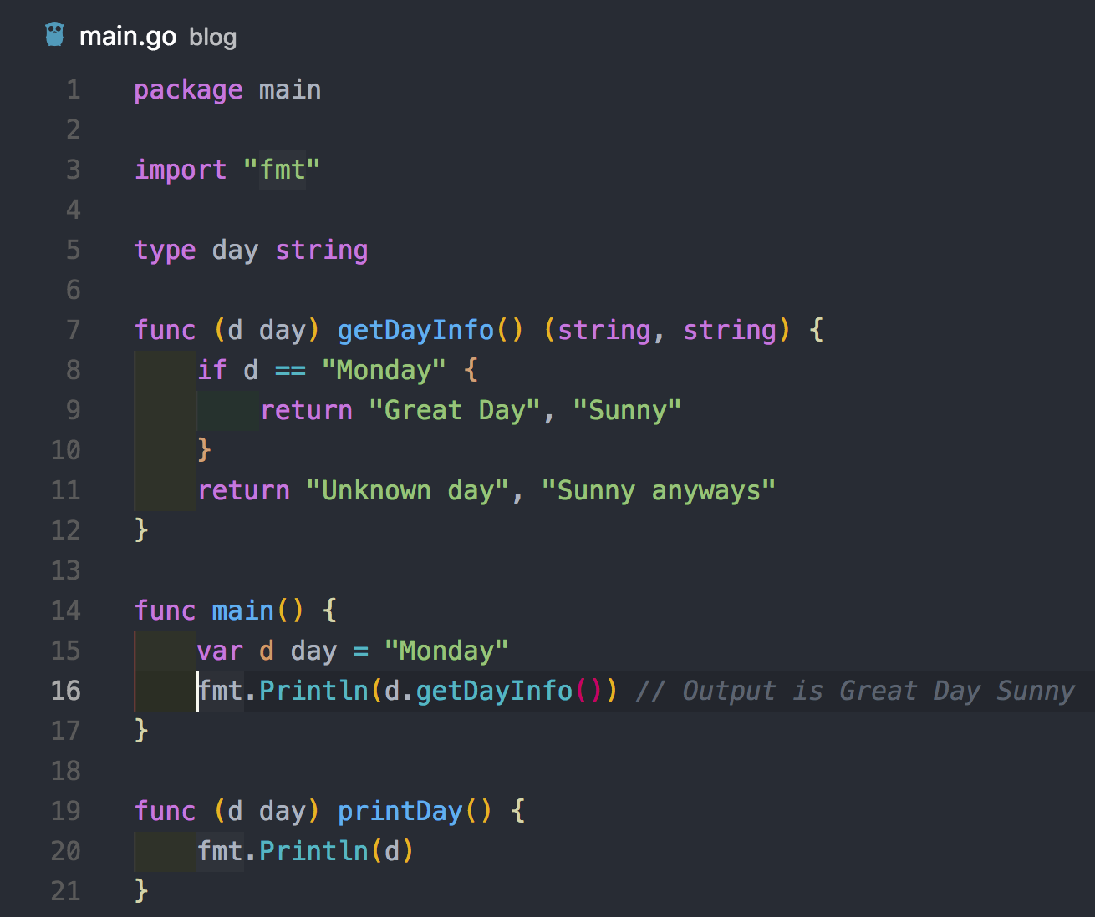
Break + example Go code
I’m guessing that few of you have used Go
But do you understand it?
Where does code start?
What is the type of d?

Slide 21
Break + example Go code
I’m guessing that few of you have used Go
But do you understand it?
Where does code start?
main()
What is the type of d?
day which is a string

Slide 22
Outline
Course Goals
When should you use C and C++?
Rust for C/C++ Programmers
Review of Class Topics
What’s next?

Slide 23
Background on Rust
Relatively new programming language (1.0 release in 2015)
Supports low-level “systems programming”
Like C, C++, Ada, Go, Pascal, and few others
Selling points of Rust
Modern language features
Zero-cost abstractions, foreign-function interfaces
Package management, built-in support for testing
Compile-time memory safety
No uninitialized variables, no use-after-free or double-free
Lack of undefined runtime behavior
Array access is bounds-checked

Slide 24
“Hello World” in Rust
fn main() {
println!("Hello 🌍!");
}

Slide 25
“Hello World” in Rust
fn main() {
println!("Hello 🌍!");
}
main() is a function, and it’s the starting point for Rust programs
Takes no arguments, returns no values
Separate ways to get input arguments or return error codes

Slide 26
“Hello World” in Rust
fn main() {
println!("Hello 🌍!");
}
main() is a function, and it’s the starting point for Rust programs
Takes no arguments, returns no values
Separate ways to get input arguments or return error codes
Strings in Rust are Unicode

Slide 27
“Hello World” in Rust
fn main() {
println!("Hello 🌍!");
}
main() is a function, and it’s the starting point for Rust programs
Takes no arguments, returns no values
Separate ways to get input arguments or return error codes
Strings in Rust are Unicode
A little weird: println!() is a macro function
Handles most argument stuff at compile time to generate better errors
Macro is code that generates code at compile-time

Slide 28
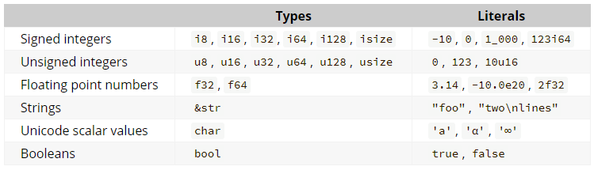
Types in Rust
Types in Rust are explicit about their size
Listed in number of bits, so i8 ≈ char and u32 ≈ unsigned int

Slide 29
Working with variables
fn main() {
let x: i32 = 10;
println!("x: {}", x);
}

Slide 30
Working with variables
fn main() {
let x: i32 = 10;
println!("x: {}", x);
}
x is a variable of type i32 with initial value 10

Slide 31
Working with variables
fn main() {
let x: i32 = 10;
println!("x: {}", x);
}
x is a variable of type i32 with initial value 10
Curly brackets denote an expression you want to print

Slide 32
Rust playground - Variables
Test out Rust code online in a browser
https://play.rust-lang.org/
Let’s try out that function and play around with some things
Variable types and initialization
Modify the variable value
https://play.rust-lang.org/?version=stable&mode=debug&edition=2021&gist=cd7cc8a19bbf719cdbc6eb4b06edbb29

Slide 33
Type inference in Rust
fn takes_u32(x: u32) {
println!("u32: {x}");
}
fn takes_i8(y: i8) {
println!("i8: {y}");
}
fn main() {
let x = 10;
let y = 20;
takes_u32(x);
takes_i8(y);
// below would fail
// takes_u32(y);
}
Rust figures out what type you meant if you leave it out
But everything does still have a type
https://play.rust-lang.org/?version=stable&mode=debug&edition=2021&gist=aae8903ef418552d0a10b731e6a11390

Slide 34
Rust has structs which can have methods
#[derive(Debug)]
struct Person {
name: String,
age: u8,
}
impl Person {
fn say_hello(&self) {
println!("Hello, my name is {}", self.name);
}
}
fn main() {
let peter = Person {
name: String::from("Peter"),
age: 27,
};
peter.say_hello();
}

Slide 35
Rust has structs which can have methods
#[derive(Debug)]
struct Person {
name: String,
age: u8,
}
impl Person {
fn say_hello(&self) {
println!("Hello, my name is {}", self.name);
}
}
fn main() {
let peter = Person {
name: String::from("Peter"),
age: 27,
};
peter.say_hello();
}
Struct with two fields

Slide 36
Rust has structs which can have methods
Tells compiler to create default code that will print the struct for debugging
#[derive(Debug)]
struct Person {
name: String,
age: u8,
}
impl Person {
fn say_hello(&self) {
println!("Hello, my name is {}", self.name);
}
}
fn main() {
let peter = Person {
name: String::from("Peter"),
age: 27,
};
peter.say_hello();
}

Slide 37
Rust has structs which can have methods
#[derive(Debug)]
struct Person {
name: String,
age: u8,
}
impl Person {
fn say_hello(&self) {
println!("Hello, my name is {}", self.name);
}
}
fn main() {
let peter = Person {
name: String::from("Peter"),
age: 27,
};
peter.say_hello();
}
All member functions of the struct

Slide 38
Rust has structs which can have methods
#[derive(Debug)]
struct Person {
name: String,
age: u8,
}
impl Person {
fn say_hello(&self) {
println!("Hello, my name is {}", self.name);
}
}
fn main() {
let peter = Person {
name: String::from("Peter"),
age: 27,
};
peter.say_hello();
}
Creating a struct

Slide 39
Rust has structs which can have methods
#[derive(Debug)]
struct Person {
name: String,
age: u8,
}
impl Person {
fn say_hello(&self) {
println!("Hello, my name is {}", self.name);
}
}
fn main() {
let peter = Person {
name: String::from("Peter"),
age: 27,
};
peter.say_hello();
}
Calling a method

Slide 40
Rust Playground - Methods
https://play.rust-lang.org/?version=stable&mode=debug&edition=2021&gist=2925da360685d3be97f2c5726499344a
Things to try
Print out the entire struct
Create a constructor with “new”
Look at some error messages
Try using a string literal as a message

Slide 41
Rust solves memory ownership issues
C++ example of an ownership issue
Reference points to a value that no longer exists
int main() {
std::vector<std::string> v;
v.push_back(“Hello”);
string& x = v[0]; // gets reference to item
v.push_back(“world”); // may reallocate memory
std::cout << x << “\n”; // UNDEFINED BEHAVIOR
}

Slide 42
Rust prevents ownership issues at compile-time
The following code errors
https://play.rust-lang.org/?version=stable&mode=debug&edition=2021&gist=e7bee1ca785182ce1c7e0c1ea3d21748
fn main() {
let mut v = vec![];
v.push("Hello");
let x = &v[0];
v.push("world");
println!("{}", x);
}

Slide 43
Way more to Rust
Don’t have time for an extensive review of the language
Course in Rust
Most of these slides are borrowed directly from here
https://google.github.io/comprehensive-rust/hello-world.html
Rust for Systems Programmers
Targets people who know C++ and care about “systems” topics
Some of this is likely not understandable yet for CS211 students
https://github.com/nrc/r4cppp

Slide 44
Break + Question
What does this code print?
fn main() { let v = vec![10, 20, 30]; for x in v { println!("x: {x}"); } for i in (0..10).step_by(2) { println!("i: {i}"); } }

Slide 45
Break + Question
What does this code print?
fn main() { let v = vec![10, 20, 30]; for x in v { println!("x: {x}"); } for i in (0..10).step_by(2) { println!("i: {i}"); } }
Output:
x: 10
x: 20
x: 30
i: 0
i: 2
i: 4
i: 6
i: 8

Slide 46
Outline
Course Goals
When should you use C and C++?
Rust for C/C++ Programmers
Review of Class Topics
What’s next?

Slide 47
What did we learn in CS211?
In reverse order:
Game Design
C++ Programming
C Programming
Unix Shell

Slide 48
Game Design
Model, View, Controller concept
Model handles the program state
View displays information based on the state
Controller modifies the state based on user input
Breaking a system up into these three parts enables more robust, testable code
Applicable to any interactive program, not just games

Slide 49
C++ Programming
Object Oriented Programming
Using objects and methods
Creating our own Classes
Encapsulation
Internal state should be private
Only expose operations that maintain validity of our internal state
Resource Acquisition Is Initialization (RAII)
Wrap resources in an object
Allocate when constructed and deallocate when automatically destructed

Slide 50
C Programming
C syntax and structure
If, while, for
Functions and return values
Headers and Source files
Types and Variables
Name, Object, Value
Type determines the kind of value and size of object
Memory management
Stack, Data, and Heap segments
When to malloc() and free() and possible errors
z: | 5

Slide 51
Unix Shell (a.k.a. Linux terminal)
SSH access to remote machines
This will be a recurring need in future classes
Interacting with files and programs
cd, ls
Relative and absolute paths
Providing flags to programs and looking up documentation

Slide 52
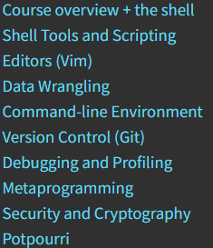
More background on CS tools
We don’t have a good class on this
CS150 and CS211 try to give you some basics
One good source of material: MIT course
“The Missing Semester of Your CS Education”
https://missing.csail.mit.edu/
Another approach: use terminal
The more you use it, the more you google how to do things, and the better you’ll get at it

Slide 53
Recommendation: don’t forget about Unix
Keep playing around with Unix shell
Incredibly useful tool for software development and productivity
Several options
Native MacOS
Windows Subsystem for Linux (WSL)
Linux installed in a virtual machine (Virtualbox is a good choice)
Installing Linux on a virtual machine yourself is a good experience
Free and only takes an hour
And then you can wreck it, with no consequences

Slide 54
Outline
Course Goals
When should you use C and C++?
Rust for C/C++ Programmers
Review of Class Topics
What’s next?

Slide 55
More CS classes!
CS211 is a pre-requisite for CS213
Obvious next step while you’re still fresh with C programming
CS111, CS150, and CS211 are the “programming classes”
Teach you how to program
Teach you programming languages
Future classes in CS are “computer science classes”
Teach you how to understand computation and computers
How do we use computers to understand and effect our world
You’ll write programs along the way

Slide 56
New languages
“Wait, but I only know like four programming languages?!!”
Learning others will be up to you
The same ideas you’ve already learned will apply
Types and Imperative Programming
Functional Programming
Debugging and Testing
Lots of great guides online for popular languages

Slide 57
Full-Stack Programming
A benefit to being a “computer scientist” versus “knowing a programming language”
Our curriculum teaches you multiple different parts of the software stack
You can understand front-end (user-facing) software
Probably something like Python or Javascript
You can understand back-end (software-facing) software
Probably something like C++

Slide 58
Plenty More Testing and Debugging
If you’re going to do a lot of programming, debugging is the most useful skill
You get better with lots of practice
Learning to test your code will help you be more successful
Especially on big projects

Slide 59
Outline
Course Goals
When should you use C and C++?
Rust for C/C++ Programmers
Review of Class Topics
What’s next?

