Slide 1
Lecture 18 Git Version Control
CS211 – Fundamentals of Computer Programming II
Branden Ghena – Spring 2023
Slides adapted from: Pat Pannuto & Marcus Darden (Michigan), Max Goldman & Rober Miller (MIT), Michael Ernst (Washington)

Slide 2
Administrivia
Projects are due on Friday!
Submissions to Gradescope are available now
It will check that your submitted code compiles properly
Submit as many times as you want to
Make sure to submit Resources/ files!!
Evaluation guide will be due over the weekend
For each spec item, tell us how to confirm you did it
Also identify your “non-trivial” model tests
Quiz today at 3pm (warn your absentee friends)

Slide 3
Today’s Goals
Understand concepts behind Version Control Systems
Why are they important?
How do we use them?
Describe one specific Version Control System: Git
How does Git work conceptually?
How do we use Git?
Where does Github fit into this?

Slide 4
Guides for learning Git
Understanding Git commits and branches
https://learngitbranching.js.org/
Remember git commands
https://education.github.com/git-cheat-sheet-education.pdf
Learning more about Git
https://www.atlassian.com/git/tutorials/learn-git-with-bitbucket-cloud
https://git-scm.com/book/en/v2

Slide 5
Outline
Version Control Overview
Systems for Version Control
Git Commit Structure
Using Git
Using Github
Best Practices

Slide 6
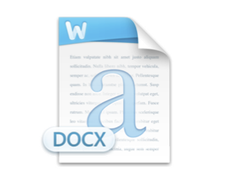
Simplest ideas of version control
Undo/Redo in programs
Keeps track of prior actions and lets you go back to them
Manual file renaming
What if I told you there was a better way?
Project Report
Project Report v2
Project Report v3
Project Report final
Project Report final v2

Slide 7

You mean there’s a better way?

Slide 8
Building a better system: backup naming
Start with a system capable of doing the file rename for you
When you choose to “commit” the file, the system makes a backup copy
Backup copies are kept with metadata
Examples:
What time was this version saved
Who made the changes to the file
Message from the user about what changed

Slide 9
Need some way to “revert” to an old version
Oh no! This most recent version broke something
Change back to a previous version of the file
Or maybe several versions ago
Might also ask to see what changed since previous version
One of those lines must be what broke it
How we do this depends on the file
Code: line-by-line comparison
Word documents: more complicated…

Slide 10
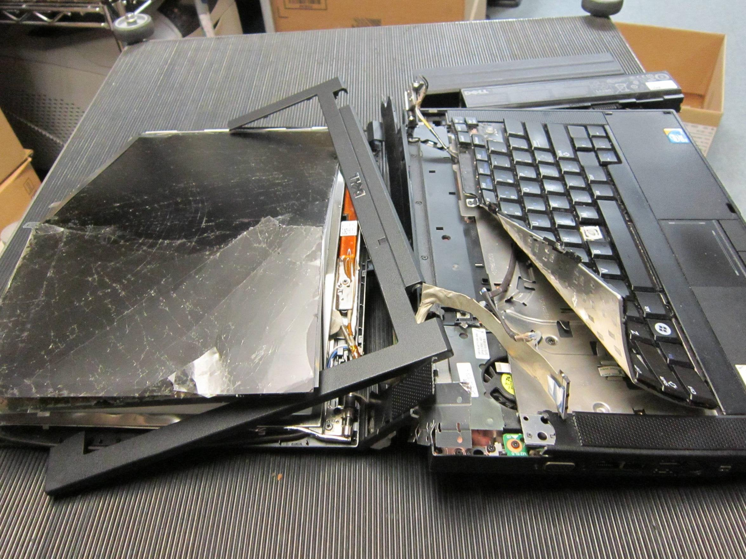
How do we survive tragic computer accidents?
Need backups on another computer

Slide 11
Improve reliability with cloud backups
Sync files up to the cloud
Includes all versions of all files
Probably does some stuff to optimize space
Only keep the changes, not the whole file
Download files from the cloud
Provides the most recent file (“Head”)
Enables sharing files across multiple computers!
Across one or multiple people

Slide 12
Version control on a grocery list
Cloud Server
Version 1
Version 2
Version 3
Eggs
Apples
Eggs
Apples
Spindrift
Eggs
Apples
Bread
Spindrift

Slide 13
Working on local copies of files
Cloud Server
Version 1
Version 2
Version 3
Eggs
Apples
Eggs
Apples
Spindrift
Eggs
Apples
Bread
Spindrift
Version 3
Version 3
Eggs
Apples
Bread
Spindrift
Eggs
Apples
Bread
Spindrift
Branden’s Computer
Joe’s Computer

Slide 14
Making a new version of a file
Cloud Server
Version 1
Version 2
Version 3
Eggs
Apples
Eggs
Apples
Spindrift
Eggs
Apples
Bread
Spindrift
Version 4
Version 3
Eggs
Oranges
Bread
Spindrift
Eggs
Apples
Bread
Spindrift
Branden’s Computer
Joe’s Computer

Slide 15
Conflicts when editing files!
Cloud Server
Version 1
Version 2
Version 3
Eggs
Apples
Eggs
Apples
Spindrift
Eggs
Apples
Bread
Spindrift
Version 4
Version 4
Eggs
Oranges
Bread
Spindrift
Eggs
Apples
Spindrift
Branden’s Computer
Joe’s Computer

Slide 16
Problem: simultaneous edits
Multiple editors can lead to file conflicts!
Whoever commits first wins, loser has to handle the problem
How does the system handle “merging” the files?
Sometimes just ask the human to figure it out
Sometimes realize that changes are to different parts of the file and just apply both

Slide 17
Fundamental version control operations
Commit file(s)
Save a new version of them
Revert file(s)
Return to a previous version of them
Compare file(s) across version
Push file(s) to a server
Pull file(s) from a server
Merge changes to a file and handle conflicts

Slide 18
Version Control Systems are essential
Not just for software, any files!
Code
Documents
Data files
Lecture slides
Often designed with source code in mind
Work particularly well on human-readable text files
Comparisons can happen line-by-line (diff)
Text is easily compressed for transfer and storage

Slide 19
Outline
Version Control Overview
Systems for Version Control
Git Commit Structure
Using Git
Using Github
Best Practices

Slide 20
Version control terminology
Repository (a.k.a. repo)
Holds all of the versions of all of the files for a project
You commit files to a repo
And push to it, if it’s on a different computer
Local versions of files are known as the “Working Copy”
You can edit these files and then commit them to the repo
The most recent version of a file is known as the “Head”

Slide 21
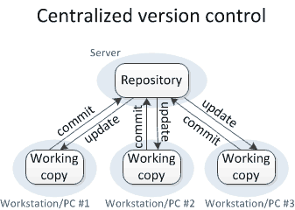
Older systems: Centralized version control
Local computers only ever have a working copy
Must request version information from repo on a server

Slide 22
Centralized version control systems
Revision Control System (RCS), 1982
Basic idea of versioning for single files
Concurrent Versions System (CVS), 1990
Expands version to an entire project of files
Subversion (SVN), 2000
A “Commit” includes changes across multiple files
Often multiple source/header files might be changed together!
Ensures atomic changes to the repo
1st
Generation
2nd
Generation

Slide 23
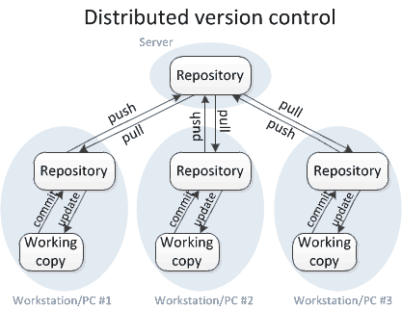
Modern systems: Distributed version control
Local computers have their own copy of the repository
Along with the working copy that users directly edit

Slide 24
Distributed version control systems
Bazaar (bzr), 2005
No longer developed
Mercurial (hg), 2005
Still developed, not widely used
Git (git), 2005
Most popular version control system
All provide methods for enabling distributed version control
Changes can be made and tracked locally
Sets of changes can be sent to others as needed
Often to a central shared server
3rd Generation

Slide 25
Sidebar: what happened in 2005?
Bazaar (bzr), 2005
Mercurial (hg), 2005
Git (git), 2005
Bitkeeper, a proprietary distributed version control system decided to end free access for open-source projects
Including Linux!
Led to simultaneous development of new systems
And the death of Bitkeeper

Slide 26
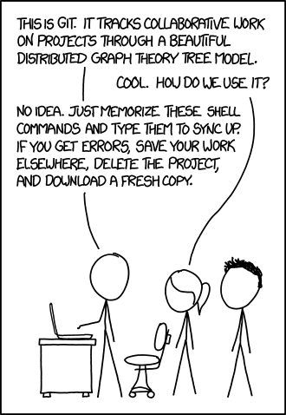
Break + xkcd
https://xkcd.com/1597/

Slide 27
Outline
Version Control Overview
Systems for Version Control
Git Commit Structure
Using Git
Using Github
Best Practices

Slide 28
Commits are the units of change in Git
A Commit contains
File modifications
Timestamps
Author of commit
Commit message
Parent of Commit
Git commits each have a name
Example: 42e2e5af9d49de268cd1fda3587788da4ace418a
160-bit SHA1 hash of the commit data (guaranteed unique)
Usually referred to by first 7 digits (268 million choices, likely unique)
Example: 42e2e5a

Slide 29
Every commit has a parent
Simplest structure of commits can form a sort of linked list
Head

Slide 30
The commit history can branch
Multiple commits can have the same parent
Branching intentionally forms a new path for commits
Starts at a parent from the main “branch”
Continues on separately from there
Often used for development of new features
Original code path is known as Main
Occasionally referred to as “master” in legacy projects

Slide 31
Some parents have multiple children
Simplest structure of commits can form a sort of linked-list
With branches, commits can form a tree structure
Head of Main
Head of Feature1
Head of test-branch

Slide 32
Branches may later merge back into Main
Combining two branches requires a “merge” operation
Might include conflicts if both branches modify the same file!
Git is pretty good at automatically resolving conflicts
Unless the two branches both modify the same line of code
Merge commit gets added to list the multiple parent commits
There is an alternative: a “rebase” operation
Change branch’s parent to the current head of Main
Probably works as long as nothing major has changed

Slide 33
Git’s true nature is a graph structure
Simplest structure of commits can form a sort of linked-list
With branches, commits can form a tree structure
Reality of Git: Directed, acyclical graph
Each commit has one or more parents
There are no cycles (parents that are children of themselves)
Head of Main
test-branch

Slide 34
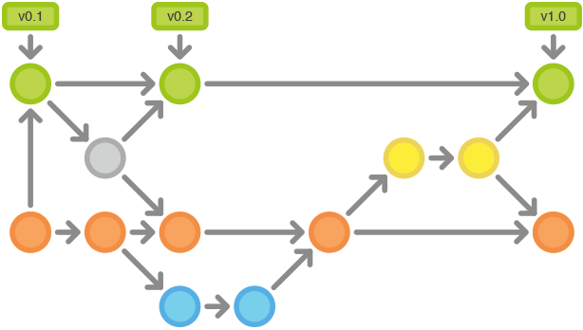
Tags let you refer to specific commits from repo’s history
Git history can start to get rather complicated
What if you want to point to something other than the Head of Main?
Tags are alternative names given to specified commits
Can be reverted to
Can be compared against
Usually for major versions of your project

Slide 35
Example commit networks
https://github.com/tov/ge211/network
https://github.com/tock/tock/network

Slide 36
Outline
Version Control Overview
Systems for Version Control
Git Commit Structure
Using Git
Using Github
Best Practices

Slide 37
Git is a distributed version control system
There will be one (or more!) server repositories
Each user will also have their own local repository clone

Slide 38
Git splits the local computer into several parts
Local computer repo
A copy of the repo from the cloud
Might have various local commits/branches that aren’t on the cloud
Working Directory
Staging Area
Local Computer Repo
Cloud Server Repo

Slide 39
Git splits the local computer into several parts
Staging Area
Where files are held that are ready to be committed
User selects files that are ready to commit and first adds them to staging area
Working Directory
Staging Area
Local Computer Repo
Cloud Server Repo

Slide 40
Git splits the local computer into several parts
Working Directory
Files actually in use on the local computer
Initially matches a commit in the repo
Might include local edits that haven’t been staged
Working Directory
Staging Area
Local Computer Repo
Cloud Server Repo

Slide 41
Git commands modify files in different areas
Working Directory
Staging Area
Local Computer Repo
Cloud Server Repo
git add
git commit

Slide 42
Git commands modify files in different areas
Working Directory
Staging Area
Local Computer Repo
Cloud Server Repo
git add
git commit
git restore
git restore --staged

Slide 43
Git commands modify files in different areas
Working Directory
Staging Area
Local Computer Repo
Cloud Server Repo
git add
git commit
git restore
git restore --staged
git checkout

Slide 44
Git commands modify files in different areas
Working Directory
Staging Area
Local Computer Repo
Cloud Server Repo
git push
git pull

Slide 45
Overview of moving files
Working Directory
Staging Area
Local Computer Repo
Cloud Server Repo
git add
git commit
git push
git restore
git restore --staged
git checkout
git pull

Slide 46
Break + Question: how would I share a new file with everyone?
Working Directory
Staging Area
Local Computer Repo
Cloud Server Repo
git add
git commit
git push
git restore
git restore --staged
git checkout
git pull

Slide 47
Break + Question: how would I share a new file with everyone?
Working Directory
Staging Area
Local Computer Repo
Cloud Server Repo
git add
git commit
git push
git restore
git restore --staged
git checkout
git pull

Slide 48
Keeping your file revisions safe
Many of these commands will fail rather than overwrite changes in your working directory or staging area
Exception: git restore will overwrite whatever is in your Working Directory with the version from the Staging Area

Slide 49
Other important commands
git clone
Makes a local repo that’s a copy of some remote server repo
git status
Lists all modified Working Directory files
Lists all files currently in the Staging Area
git diff
Lists all modifications from the Staging Area for all files
git diff FILE lists differences for a single file

Slide 50
Other important commands
git branch
Creates a new branch with a parent of the current commit
git checkout
Changes which commit or branch is the current one
git log
Lists commit history previous to the current commit
git log -N lists details from the last N commits

Slide 51
Outline
Version Control Overview
Systems for Version Control
Git Commit Structure
Using Git
Using Github
Best Practices

Slide 52
What is Github?
A website that hosts remote repos
Can be the one shared cloud repo that everyone pulls from and pushes to
Could just be a copy of that repo for public access
There are many websites that provide this
Github
Bitbucket
Gitlab
Often provide additional features as well
Viewing history of the repo in a GUI
Managing community input about a project

Slide 53
Public and Private Repos
A repo hosted by Github can be Public or Private
Public repos are accessible by anyone
Private repos are accessible by only specified users
Generally, want to make repos Public if possible
That’s how you share neat work with others and build off their work
Specifically, make sure any class files are in Private repos
Otherwise, you could be accused of academic dishonesty

Slide 54
Pull Requests
Pull Requests are a feature of hosting websites
Literally: a request for the remote repo to pull from your copy
Repo maintainers can review pull requests, comment on them, make changes, and eventually pull them to add the commits to their project
These are how you contribute to open source projects
Copy their repo
Make changes to it
Pull request so they can get your changes

Slide 55
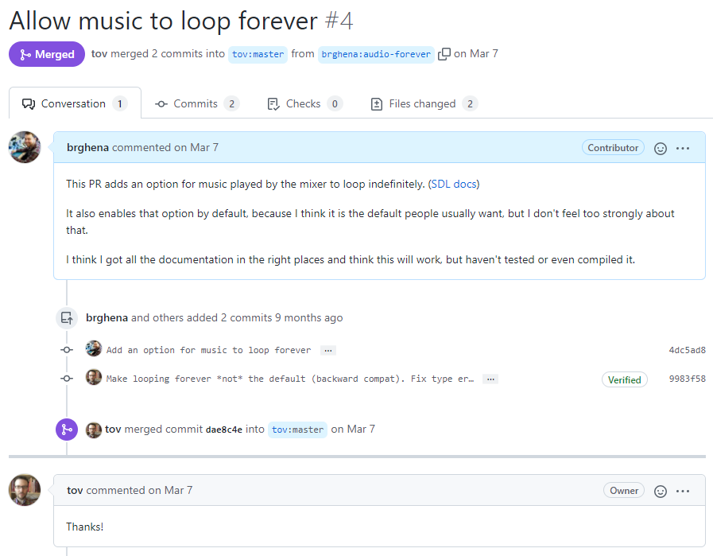
Example Pull Request
Adds a commit and explains why it is useful
Maintainer adds their own commit and then merges
https://github.com/tov/ge211/pull/4

Slide 56
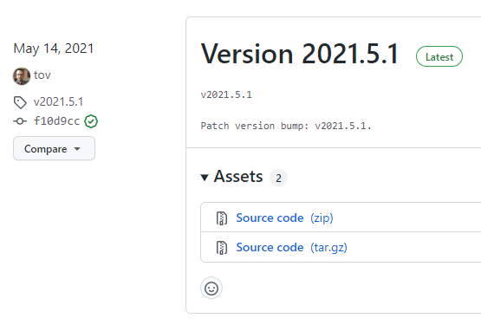
Github also hosts releases
A release is
A tagged commit
Plus the built files that you want to distribute
Users can clone the repo and checkout the code for that particular release
Or, they can just download the pre-compiled files
https://github.com/tov/ge211/releases

Slide 57
Outline
Version Control Overview
Systems for Version Control
Git Commit Structure
Using Git
Using Github
Best Practices

Slide 58
Pull often
Especially when working on group projects
Don’t want to be working with old versions of the files
Might end up fixing the same bug someone else already did
Helps to avoid conflicts
If you’re working on the most up-to-date version of a file, you’ll only conflict if someone else modifies it while you do

Slide 59
Commits should be a sensible unit
Commits should include every file related to a change
And should NOT included files with unrelated changes
The goal is that any commit is valid and compiles
Otherwise collaborators will get upset when they pull…
Advanced users can re-write commits to combine or split them allowing them to fix this later
Git has all kinds of crazy features for rewriting local history before sending up to the remote repo

Slide 60
Don’t commit generated files
Source code and build system should be committed
Built artifacts should not be committed
.o files
Executables
Any user can regenerate them whenever they are needed
Non-text files don’t play well with version control
Can only detect if anything changed, not what
Often hard to compress

Slide 61
Use .gitignore files
Enable you to list which files should NEVER be committed
Example from one of my repos:
build/
*.pdf
*.tgz
.DS_Store
*~
.idea/
Definitely use these to keep accidents from happening

Slide 62
Don’t force anything
If the version control system doesn’t let you do something, there’s usually a good reason
Example: you cannot push commits that don’t align with the history of the branch in the remote repo
Because that would mess things up for anyone else using it
If you know that no one else is using it, then you can force push to overwrite the old commits with the new ones

Slide 63
Git demo
https://github.com/brghena/git-example
Clone the repo
Check the log of commits
Diff what changed in those commits
Make some modifications
Demonstrate adding and restoring
Commit files
Push changes

Slide 64
Outline
Version Control Overview
Systems for Version Control
Git Commit Structure
Using Git
Using Github
Best Practices

