Slide 1
Lecture 04 Input and Output
CE346 – Microprocessor System Design
Branden Ghena – Fall 2021
Some slides borrowed from: Josiah Hester (Northwestern), Prabal Dutta (UC Berkeley)

Slide 2
Administrivia
Office Hours
My office hours are: Fridays 1-2pm on Zoom (see Canvas homepage)
Also available by request (make a post to Campuswire)
General lab office hours will hopefully be posted this weekend?
Lab tomorrow!
Tech CG50
https://www.mccormick.northwestern.edu/contact/tech-room-finder-map.php?id=CG50&room-floor=0&room-id=259&room-ingress=

Slide 3
General Lab access
We’ll double-check on Friday, but your ID cards should get you into CG50 at any time
You are welcome to go in there to work on stuff 24/7
However, Tech is doing contact tracing and needs your help
If you are going to lab (apart from class/office hours) please send an email to ece-labs@northwestern.edu 24 hours in advance
You’re not scheduling anything, and they likely won’t respond, but they’ll keep the info for Tech for contact-tracing purposes
If you don’t remember 24 hours in advance:
2 hours, 15 minutes, 0 hours, or -1 hours are all still helpful

Slide 4
Today’s Goals
How does a microcontroller interact with peripherals to perform input and output operations?
Memory-Mapped I/O
Interrupts
DMA
Explore reliable use of MMIO
Discuss interaction patterns for Interrupts and DMA
Understand General Purpose I/O (GPIO) peripherals
And what kind of configurations they have

Slide 5
Outline
I/O Motivation
Memory-Mapped I/O
Interrupts
Controlling digital signals
GPIO
GPIOTE
DMA

Slide 6
Devices are the point of computers
Traditional systems need to receive input from users and output responses
Keyboard/mouse
Disk
Network
Graphics
Audio
Various USB devices
Embedded systems have the same requirement, just more types of IO
Computer
Processor
Memory
Devices
Control
Input
Datapath
Output

Slide 7
Devices are core to useful general-purpose computing
Input
Output
Mouse
Monitor
Computer
Keyboard
Headphones
Ethernet
Ethernet
Bluetooth
Bluetooth

Slide 8
Devices are essential to cyber-physical systems too
Input
Output
Lidar
Throttle Control
Computer
Inertial Measurement Unit
Brake Control
Camera
Wheel Rotation
CAN
CAN

Slide 9
Device access rates vary by many orders of magnitude
Rates in bit/sec
System must be able to handle each of these
Sometimes needs low overhead
Sometimes needs to not wait around
Device | Behavior | Partner | Data Rate (Kb/s)
Keyboard | Input | Human | 0.2
Mouse | Input | Human | 0.4
Microphone | Output | Human | 700.0
Bluetooth | Input or Output | Machine | 20,000.0
Hard disk drive | Storage | Machine | 100,000.0
Wireless network | Input or Output | Machine | 300,000.0
Solid state drive | Storage | Machine | 500,000.0
Wired LAN network | Input or Output | Machine | 1,000,000.0
Graphics display | Output | Human | 3,000,000.0

Slide 10
Outline
I/O Motivation
Memory-Mapped I/O
Interrupts
Controlling digital signals
GPIO
GPIOTE
DMA

Slide 11
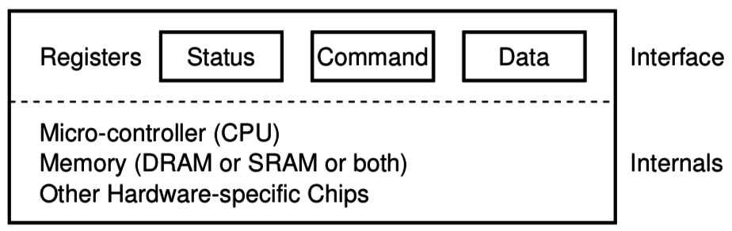
How does a computer talk with peripherals?
A peripheral is a hardware unit within a microcontroller
Sort of a “computer-within-the-computer”
Performs some kind of action given input, generates output
We interact with a peripheral’s interface
Called registers (actually are from EE perspective, but you can’t use them)
Read/Write like they’re data
How do we read/write them?
Options:
Special assembly instructions
Treat like normal memory

Slide 12

Memory-mapped I/O (MMIO): treat devices like normal memory
Certain physical addresses do not actually go to memory
Instead they correspond to peripherals
And any instruction that accesses memory can access them too!
Every microcontroller I’ve ever seen uses MMIO
Address
0xFFFFFFFF
0xFFFF0000
control reg.
data reg.
0x00000000

Slide 13
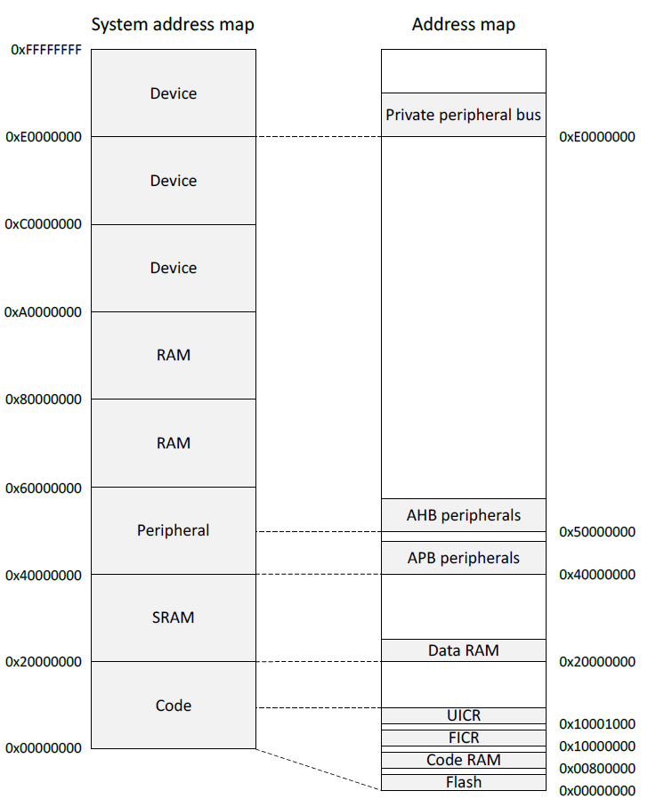
Memory map on nRF52833
Flash 0x00000000
SRAM 0x20000000
APB peripherals 0x40000000
Everything but GPIO
AHB peripherals 0x50000000
Just GPIO
UICR – User Information Config
FICR – Factory Information Config

Slide 14
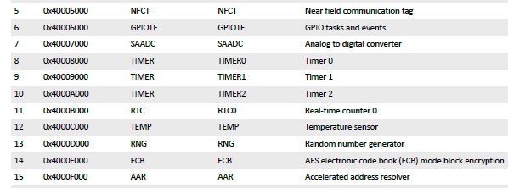
Example nRF52 peripheral placement
0x1000 is plenty of space for each peripheral
1024 registers, each 32 bits
No reason to pack them tighter than that

Slide 15
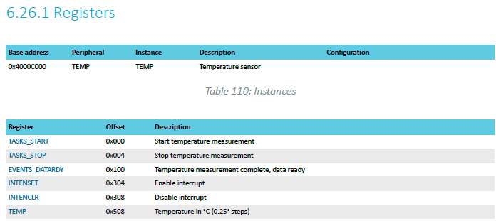
TEMP on nRF52833 example
Internal temperature sensor
0.25° C resolution
Range equivalent to microcontroller IC (-40° to 105° C)
Various configurations for the temperature conversion (ignoring)

Slide 16
MMIO addresses for TEMP
What addresses do we need? (ignore interrupts for now)
0x4000C000 – TASKS_START
0x4000C100 – EVENTS_DATARDY
0x4000C508 - TEMP

Slide 17
Accessing addresses in C
What does this C code do?
*(uint32_t*)(0x4000C000) = 1;

Slide 18
Accessing addresses in C
What does this C code do?
*(uint32_t*)(0x4000C000) = 1;
0x4000C000 is cast to a uint32_t*
Then dereferenced
And we write 1 to it
“There are 32-bits of memory at 0x4000C000. Write a 1 there.”

Slide 19
Example code
To the terminal!

Slide 20
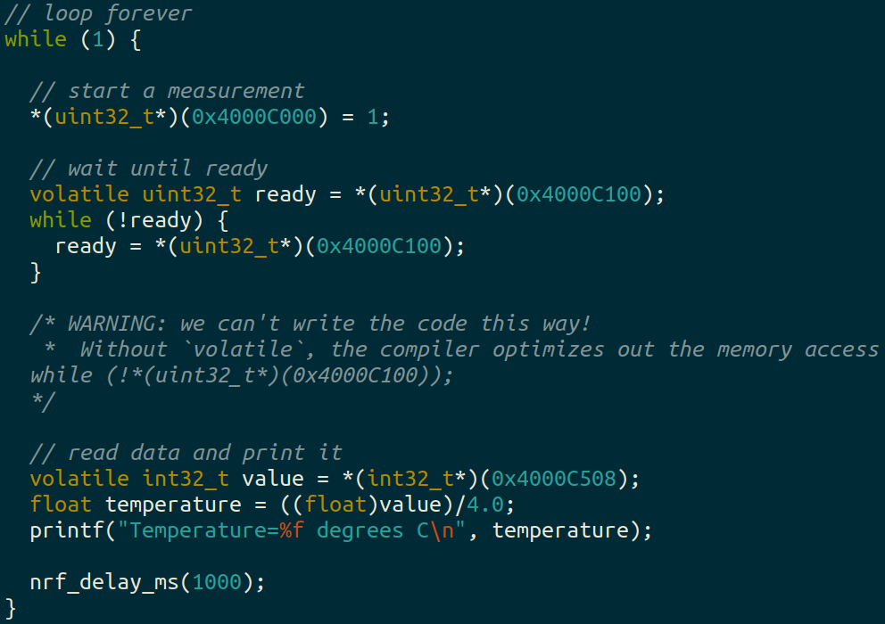
Example code

Slide 21
Using structs to manage MMIO access
Writing simple C code and access peripherals is great!
Problems:
Need to remember all these long addresses
Need to make sure compiler doesn’t stop us!
Solution:
Wrap entire access in a struct!
Compilers turn it into the same thing in the end anyways

Slide 22
C structs
Collection of variables placed together in memory
typedef struct {
uint32_t variable_one;
uint32_t variable_two;
uint32_t array[2];
} example_struct_t;
Placement rules - Variables are placed adjacent to each other in memory except:
Variables are always placed at a multiple of their size
Padding added to the end to make the total size a multiple of the biggest member
Microcontrollers can usually ignore these: all registers are the same size!

Slide 23
Temperature peripheral MMIO struct
typedef struct {
} temp_regs_t;

Slide 24
Temperature peripheral MMIO struct
typedef struct {
uint32_t TASKS_START;
uint32_t TASKS_STOP;
uint32_t _unused_A[62];
uint32_t EVENTS_DATARDY;
uint32_t _unused_B[64+64+1];
uint32_t INTENSET;
uint32_t INTENCLR;
uint32_t _unused_C[64+64];
uint32_t TEMP;
} temp_regs_t;
volatile temp_regs_t* TEMP_REGS = (temp_regs_t*)(0x4000C000);

Slide 25
Temperature peripheral MMIO struct
typedef struct {
uint32_t TASKS_START;
uint32_t TASKS_STOP;
uint32_t _unused_A[62];
uint32_t EVENTS_DATARDY;
uint32_t _unused_B[64+64+1];
uint32_t INTENSET;
uint32_t INTENCLR;
uint32_t _unused_C[64+64];
uint32_t TEMP;
} temp_regs_t;
volatile temp_regs_t* TEMP_REGS = (temp_regs_t*)(0x4000C000);
// code to access
TEMP_REGS->TASKS_START = 1;
while (TEMP_REGS->EVENTS_DATARDY == 0);
float temperature = ((float)TEMP_REGS->TEMP)/4.0;

Slide 26
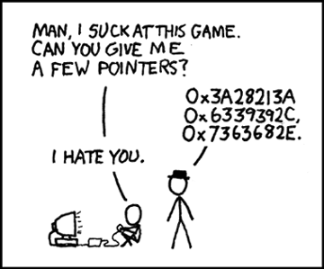
Break + relevant xkcd
https://xkcd.com/138/

Slide 27
Outline
I/O Motivation
Memory-Mapped I/O
Interrupts
Controlling digital signals
GPIO
GPIOTE
DMA

Slide 28
What do interactions with devices look like?
while STATUS==BUSY; Wait
(Need to make sure device is ready for a command)
Write value(s) to DATA
Write command(s) to COMMAND
while STATUS==BUSY; Wait
(Need to make sure device has completed the request)
Read value(s) from Data
This is the “polling” model of I/O.
“Poll” the peripheral in software repeatedly to see if it’s ready yet.

Slide 29
Waiting can be a waste of CPU time
while STATUS==BUSY; Wait
(Need to make sure device is ready for a command)
Write value(s) to DATA
Write command(s) to COMMAND
while STATUS==BUSY; Wait
(Need to make sure device has completed the request)
Read value(s) from Data
Imagine a keyboard device
CPU could be waiting for minutes before data arrives
Need a way to notify CPU when an event occurs
Interrupts!

Slide 30
Interrupts
What is an interrupt?
Some event which causes the processor to stop normal execution
The processor instead jumps to a handler for that event
What causes interrupts?
Hardware exceptions
Divide by zero, Undefined Instruction, Memory bus error
Software
Syscall, Software Interrupt (SWI)
External hardware
Input pin, Timer, various “Data Ready”

Slide 31
Interrupts, visually
Some code that’s executing

Slide 32
Interrupts, visually
Some code that’s executing
Interrupt triggers!
Interrupt handler code

Slide 33
Interrupts, visually
Some code that’s executing
Interrupt triggers!
Interrupt handler code
Continue original code

Slide 34
ARM Nested Vectored Interrupt Controller (NVIC)
Handles interrupt entry and exit
Stacking
Unstacking
Priorities
Interrupts can preempt other interrupts!
Jump directly to the interrupt handler
Manages interrupt requests (IRQ)
Stores all callee saved registers on the stack
So the handler code doesn’t overwrite them
Moves the PC to the proper handler, a.k.a. Interrupt Service Routine (ISR)
Restores registers after handler returns and moves PC back

Slide 35
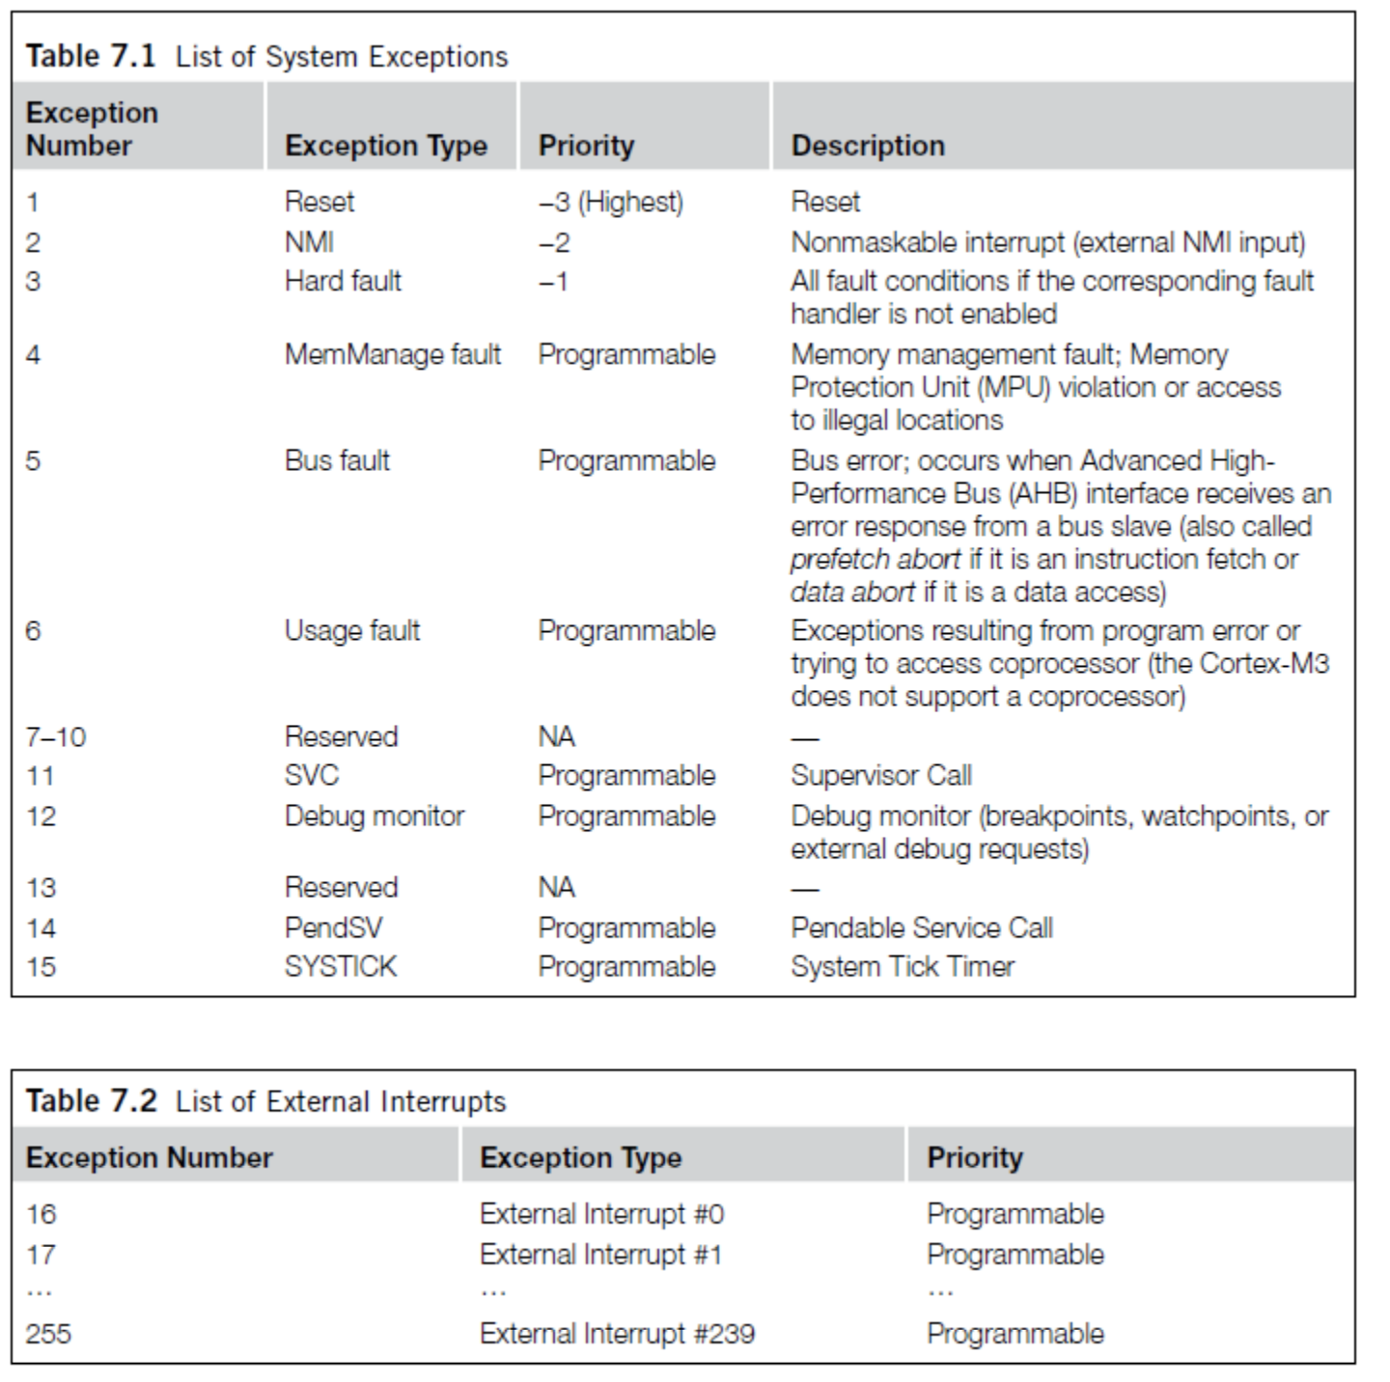
ARM Vector table
List of function pointers to handler for each interrupt/exception
First 15 are architecture-specific exceptions
After that are microcontroller interrupt signals

Slide 36
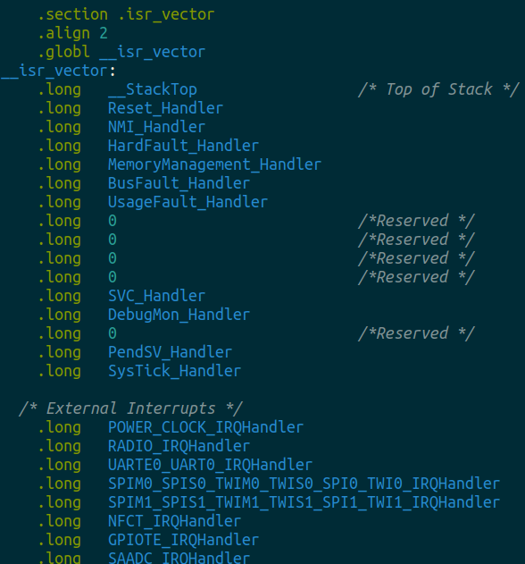
Vector table in software
Placed in its own section
LD file puts it first in Flash
Reset_Handler determines where software starts executing
After that are all exception and interrupt handlers
All function pointers to some C code somewhere

Slide 37
NVIC functionality
NVIC functions
NVIC_EnableIRQ(number)
NVIC_DisableIRQ(number)
NVIC_SetPriority(number, priority)
Technically 256 priorities
Only 8 are implemented
Must enable interrupts in two places!
Enabling interrupt in the peripheral will generate the signal
Enabling interrupt in the NVIC will cause signal to jump to handler
Priority determines which interrupt goes first
And determines how interrupts are nested

Slide 38
Nested interrupts, visually
Some code that’s executing
Interrupt triggers!
Interrupt handler
Higher priority Interrupt triggers!
Interrupt handler
continues
Continue original code

Slide 39
Break + Open Question
When should a system use interrupts versus polling?

Slide 40
Outline
I/O Motivation
Memory-Mapped I/O
Interrupts
Controlling digital signals
GPIO
GPIOTE
DMA

Slide 41
Digital signals
Simplest form of I/O
Exist in two states:
High (a.k.a. Set, a.k.a. 1)
Low (a.k.a. Clear, a.k.a. 0)
Simpler to interact with
Constrained to two voltages
With quick transitions between the two
No math for voltage level
Either high or low

Slide 42
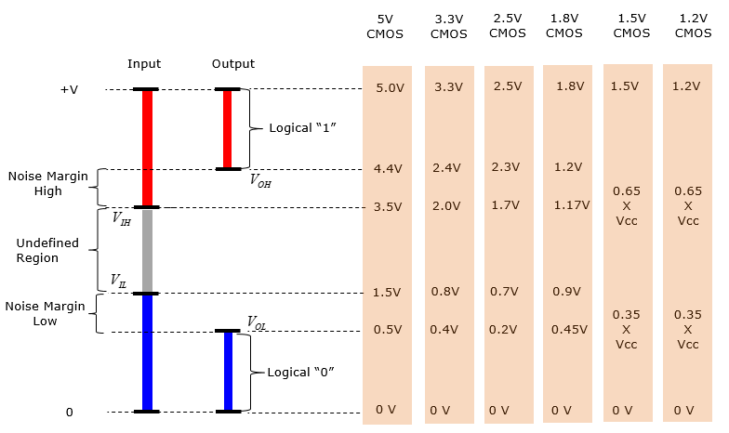
Digital signals map to voltage ranges
Upper range is high signal
~0.7*VDD
Bottom range is low signal
~0.3*VDD
Middle is undefined
Only exists during transitions
http://www.sharetechnote.com/html/Electronics_CMOS.html

Slide 43
General Purpose Input/Output (GPIO)
Read/write from/to external pins on the microcontroller
Two possible values: high (1) or low (0)
Basic unit of operation for microcontrollers
Allows them to interact with buttons and LEDs
Every microcontroller has GPIO

Slide 44
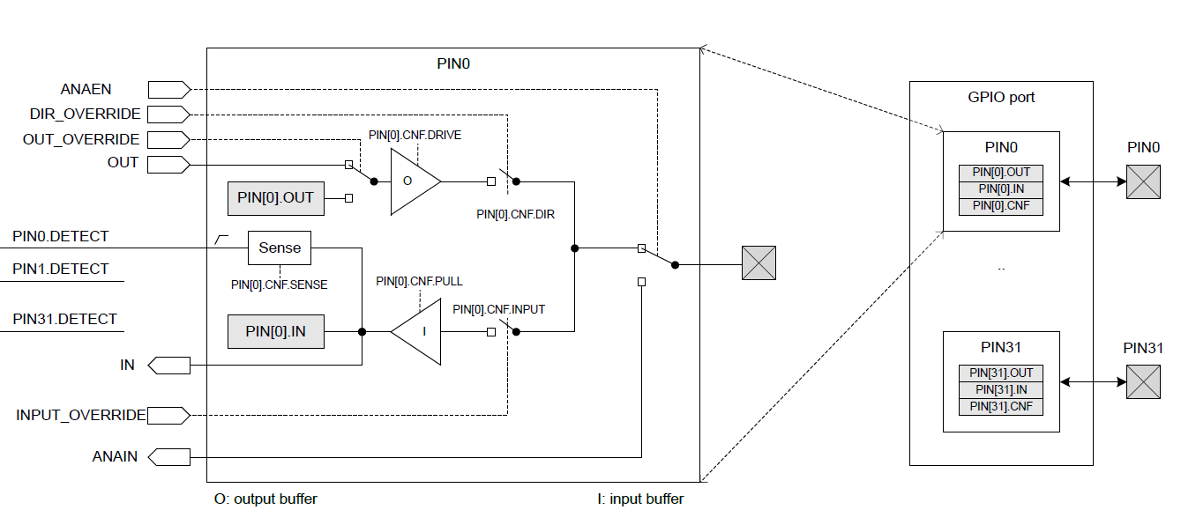
GPIO on nRF52833

Slide 45
GPIO on nRF52833
Abstract model of the pin.
This isn’t really how the hardware is implemented. But it’s a reasonable model for users.

Slide 46
GPIO on nRF52833
Inputs and outputs to/from the peripheral.
GPIO could be controlled by other peripherals. Controlling a pin in use by other peripherals is bad.

Slide 47
GPIO on nRF52833
Registers within the GPIO peripheral. Configure various things about setup.

Slide 48
GPIO on nRF52833
Peripheral contents are duplicated for each output pin.
Each pin has its own registers (or portions thereof).

Slide 49
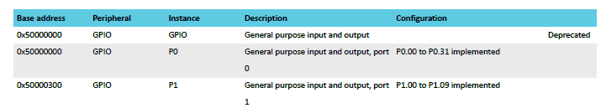
Multiple ports
nRF52833 has up to 42 I/O pins
But only 32 can fit in a single word
Splits them into two “ports”
Pins are named based on port
P0.14 – Button A, P0.23 – Button B
P1.04 – LED column 4

Slide 50
GPIO on nRF52833
External pin on the microcontroller

Slide 51
GPIO on nRF52833
Output chain. Signal comes from OUT register, through output buffer, to external pin.

Slide 52
GPIO Output
Outputs a high or low signal
Output configurations
High drive output (either for high, low, or both)
Sources or sinks additional current
For powering external devices
Normal drive: ~2 mA
High drive: ~10 mA
Disconnect (a.k.a. High Impedance or High-Z)
Wired-OR or Wired-AND scenarios

Slide 53
GPIO on nRF52833
Input chain. Signal goes from pin, through input buffer, to IN register.

Slide 54
GPIO Input
Reads in a signal as either high or low
Input Configurations
Input buffer connect/disconnect
Allows the pin to be disabled if not being read from
Pull
Disabled, Pulldown, Pullup
Connects an internal pull up/down resistor (~13 kΩ)
Sets default value of input

Slide 55
Electrical specifications
High voltage range: 0.7*VDD to VDD (~2.3 volts)
Low voltage range: Ground to 0.3*VDD (~1 volt)
GPIO are extremely fast
Transition time is <25 ns
Connected directly to memory bus for faster interactions
This allows complicated signal patterns to be replicated in software
If they aren’t implemented as a hardware peripheral
Known as “bit-banging”

Slide 56
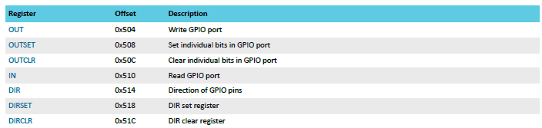
Set/Clear registers
OUT works traditionally: write a 1 for high, 0 for low
OUTSET write a 1 to set that pin (high) zero has no effect
OUTCLR write a 1 to clear that pin (low) zero has no effect
Lets you modify a pin without modifying the others (or reading first)

Slide 57
Outline
I/O Motivation
Memory-Mapped I/O
Interrupts
Controlling digital signals
GPIO
GPIOTE
DMA

Slide 58
Handling interrupts from GPIO
Separate peripheral, GPIOTE (GPIO Task/Event)
Manages up to 8 individual pins
Can read inputs and trigger interrupts
Can also connect outputs from events on other peripherals (PPI)
Can trigger interrupts for a “Port event” as well
Software checks which pin(s) caused the event to occur
Very low power operation (works with system clocks off)
Unclear why this is a separate peripheral
Presumably too complicated/expensive to have 42 of them

Slide 59
Configuring individual input interrupts
Pick an available GPIOTE channel (0-7)
Configure it
Port and Pin number
Task (output), Event (input), or Disabled
Polarity for input events
Low-to-high
High-to-low
Toggle (both directions)
Enable interrupts for channel in GPIOTE (and in NVIC!)
Clear event in interrupt handler
Doesn’t happen automatically

Slide 60
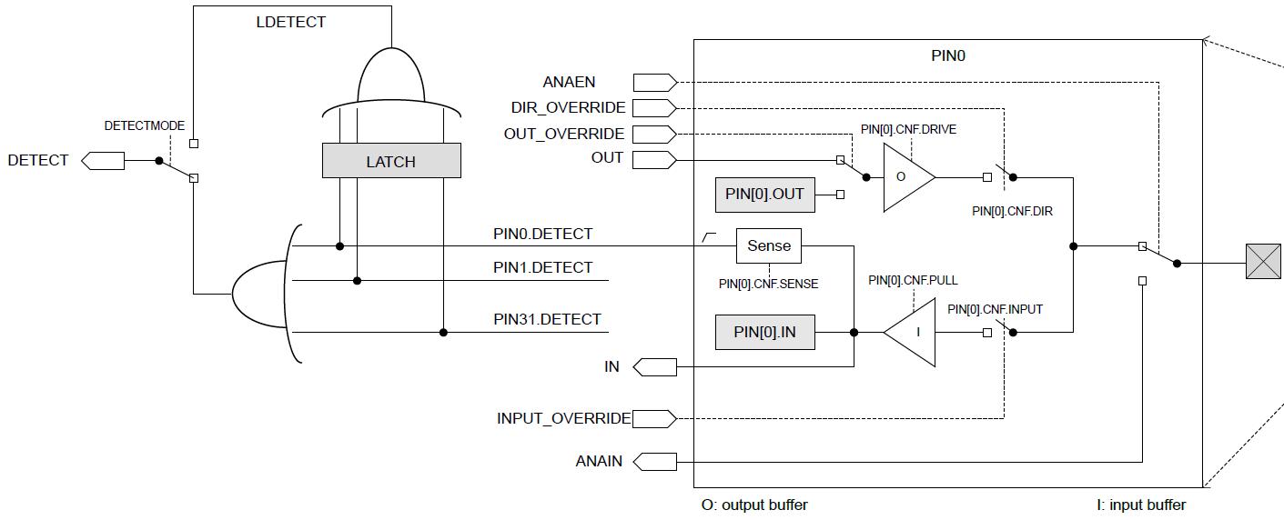
Sensing port events
Uses the “Detect” signal. Generated from pin Sense configuration

Slide 61
Configuring port input interrupts
Configure the Sense for each pin
High or Low
Allows different pins to have different “active” states
Select detect mode
Direct connection to pins
Latched version (saved even if pin later changes back)
Enable interrupts for port in GPIOTE (and in NVIC!)
Clear event in interrupt handler and value in Latch register
Doesn’t happen automatically

Slide 62
Break

Slide 63
Outline
I/O Motivation
Memory-Mapped I/O
Interrupts
Controlling digital signals
GPIO
GPIOTE
DMA

Slide 64
Direct Memory Access (DMA)
Even with interrupts, providing data to the peripheral is time consuming
Need to be interrupted every byte, to copy the next byte over
DMA is an alternative method that uses hardware to do the memory transfers for the processor
Software writes address of the data and the size to the peripheral
Peripheral reads data directly from memory
Processor can go do other things while read/write is occurring

Slide 65
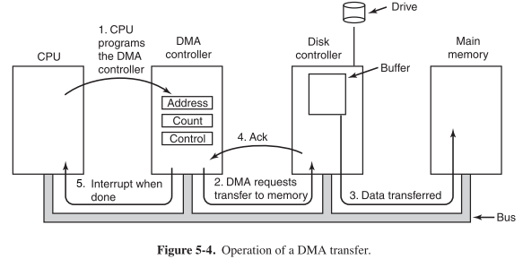
General-purpose DMA

Slide 66
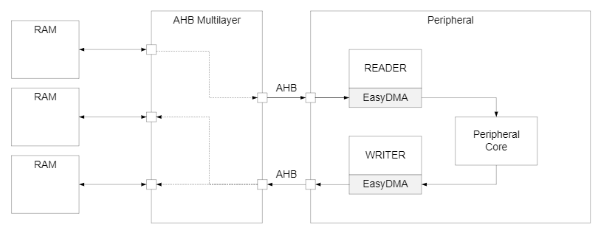
Special-purpose DMA
nRF52 uses “EasyDMA”, which is built into individual peripherals
Only capable of transferring data in/out of that peripheral
Easier to set up and use in practice
Only available on some peripherals though (no DMA for TEMP)
Warning: addresses for DMA MUST be in RAM!

Slide 67
Full peripheral interaction pattern
Configure the peripheral
Enable peripheral interrupts
Set up peripheral DMA transfer
Start peripheral
Continue on to other code
Interrupt occurs, signaling DMA transfer complete
Set up next DMA transfer
Continue on to other code, and repeat

Slide 68
Outline
I/O Motivation
Memory-Mapped I/O
Interrupts
Controlling digital signals
GPIO
GPIOTE
DMA

