Slide 1
Lecture 05 Digital Circuits
CE346 – Microprocessor System Design
Branden Ghena – Fall 2021
Some slides borrowed from: Josiah Hester (Northwestern), Prabal Dutta (UC Berkeley)

Slide 2
Administrivia
Labs
Debrief: How did that go?
Can use personal computers if preferred
See schedule of Lab hours available on Canvas
Quiz
Today at end of class

Slide 3
Project Proposals
It is time to start forming teams and working on Proposals
Due next week Tuesday!
Project details are posted to Campuswire
Specific proposal details are on the Canvas assignment

Slide 4
Today’s Goals
Explore a final interaction pattern: DMA
Understand the basics of digital circuitry
Enough to be able to interact with the Microbit
Finish our exploration of the GPIO peripherals on the Microbit
One step deeper in to EE-land: energy use

Slide 5
Outline
DMA
Digital Circuits
GPIOTE
Energy

Slide 6
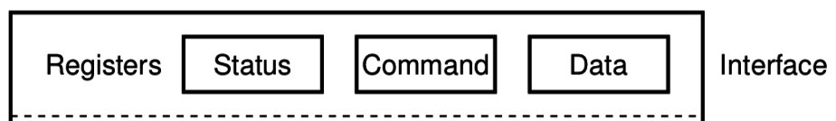
Reminder: Polling I/O
while STATUS==BUSY; Wait
(Need to make sure device is ready for a command)
Write value(s) to DATA
Write command(s) to COMMAND
while STATUS==BUSY; Wait
(Need to make sure device has completed the request)
Read value(s) from Data
This is the “polling” model of I/O.
“Poll” the peripheral in software repeatedly to see if it’s ready yet.

Slide 7
Reminder: Interrupts, visually
Some code that’s executing
Interrupt triggers!
Interrupt handler code
Continue original code

Slide 8
Direct Memory Access (DMA)
Even with interrupts, providing data to the peripheral is time consuming
Need to be interrupted every byte, to copy the next byte over
DMA is an alternative method that uses hardware to do the memory transfers for the processor
Software writes address of the data and the size to the peripheral
Peripheral reads data directly from memory
Processor can go do other things while read/write is occurring

Slide 9
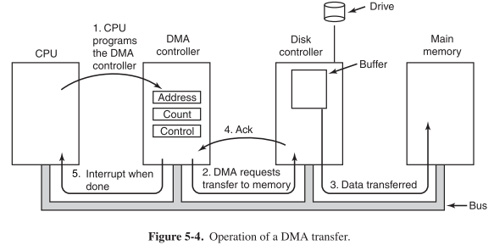
General-purpose DMA

Slide 10
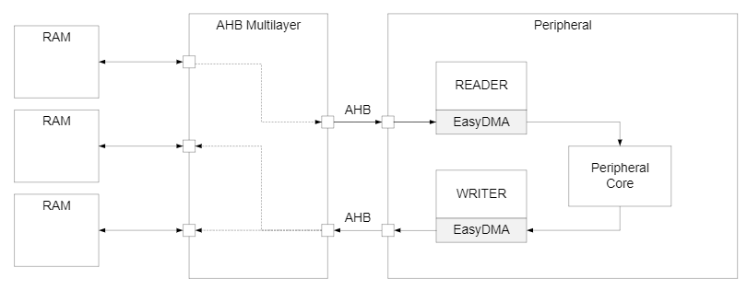
Special-purpose DMA
nRF52 uses “EasyDMA”, which is built into individual peripherals
Only capable of transferring data in/out of that peripheral
Easier to set up and use in practice
Only available on some peripherals though (no DMA for TEMP)
Warning: addresses for DMA MUST be in RAM!

Slide 11
Full peripheral interaction pattern
Configure the peripheral
Enable peripheral interrupts
Set up peripheral DMA transfer
Start peripheral
Continue on to other code
Interrupt occurs, signaling DMA transfer complete
Set up next DMA transfer
Continue on to other code, and repeat

Slide 12
Outline
DMA
Digital Circuits
GPIOTE
Energy

Slide 13
Digital signals
Exist in two states:
High (a.k.a. Set, a.k.a. 1)
Low (a.k.a. Clear, a.k.a. 0)
Simpler to interact with
Constrained to two voltages
With quick transitions between the two
No math for voltage level
Either high or low

Slide 14
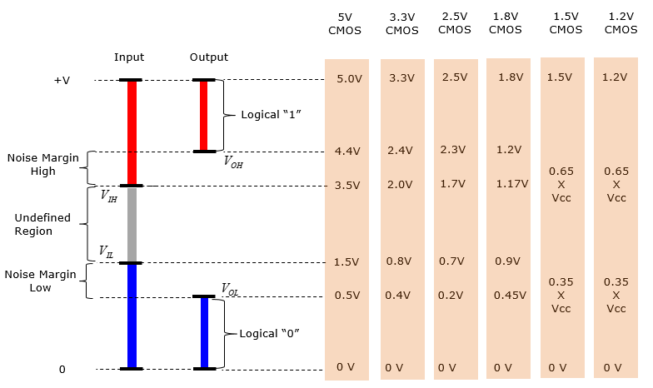
Digital signals map to voltage ranges
Upper range is high signal
~0.7*VDD
Bottom range is low signal
~0.3*VDD
Middle is undefined
Only exists during transitions
http://www.sharetechnote.com/html/Electronics_CMOS.html

Slide 15
Digital circuits
Connecting components together with digital signals
Mostly ICs
Also buttons/switches and LEDs
Way simpler than analog circuits
Mostly connecting boxes with wires
Plus a few resistors here and there
An abstraction
Not sufficient for fully understanding electronics behavior, but close

Slide 16
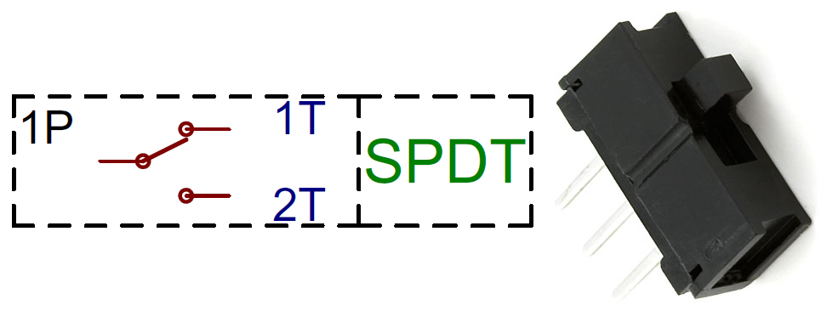
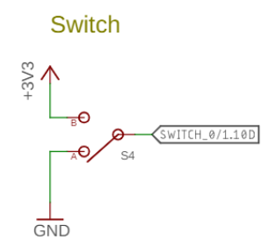
Switches
Single Pole, Double Throw switch
Middle pin (Pole) connects to one of two outer pins (Throws)
For controlling microcontrollers
Often connect outer pins to VCC and Ground respectively
Input then goes High or Low depending on switch state
https://learn.sparkfun.com/tutorials/button-and-switch-basics/

Slide 17
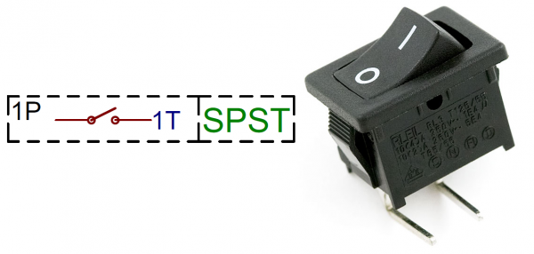
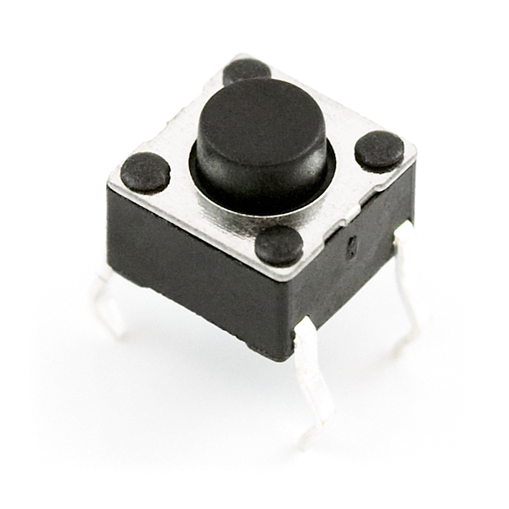
Buttons
Single Pole, Single Throw switch
Pole pin either connects to Throw pin or is disconnected
Come in normally-closed (connected) and normally-open (disconnected)

Slide 18
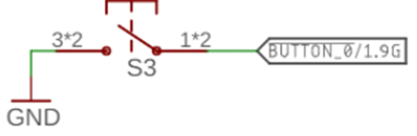
Disconnected circuits
When button is pushed, input signal is low
What is the value of the input when the button is unpressed?

Slide 19
Disconnected circuits
When button is pushed, input signal is low
What is the value of the input when the button is unpressed?
Floating! Could be any voltage
Solution: connect weakly to either high or low voltage

Slide 20
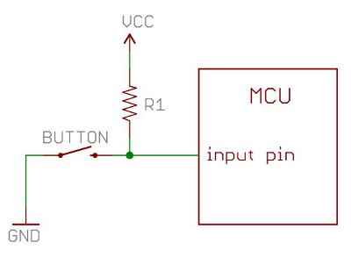
Current flows through the “path of least resistance”
Simplification
Works well for the types of circuits we use
Pull-up resistor
When button is open (disconnected), the only path is through the resistor
When button is closed (connected) the least resistance path is through the button to Ground

Slide 21
Pull-up resistors and pull-down resistors
Resistor sets the “default” value of a wire
Pull-up connects to VCC
Pull-down connects to Ground
Usually 10-100 kΩ
When button is open (disconnected)
Connection through the resistor sets signal
When button is closed (connected)
Signal is directly connected to a voltage source
Much lower resistance means that signal dominates

Slide 22
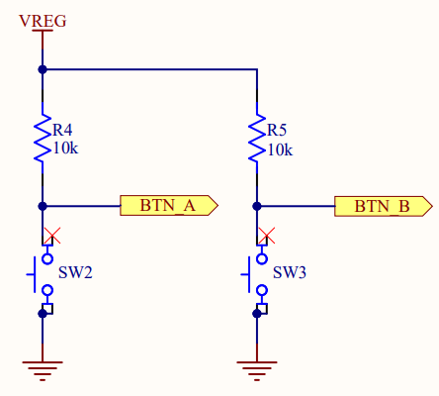
Buttons on the Microbit
Normally open buttons
Disconnected by default
Active low signal
Activating (pushing) button creates a low signal
Pull-up resistors
Set button signal high by default

Slide 23
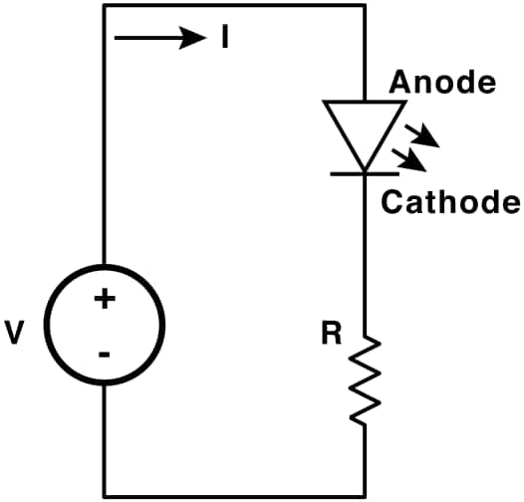
LEDs
Light Emitting Diodes
Generate light as current passes through them
Various colors available
Diodes
Only allow current to go through one way
Not particularly relevant for LEDs
Treat as a digital component
Connect anode to high voltage and cathode to ground
Plus a resistor to limit the total amount of current
https://learn.sparkfun.com/tutorials/light-emitting-diodes-leds

Slide 24
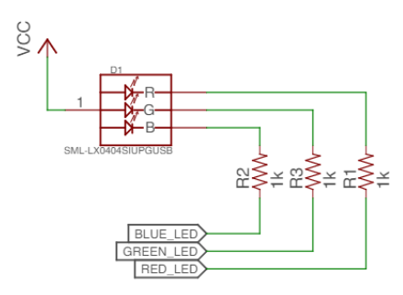
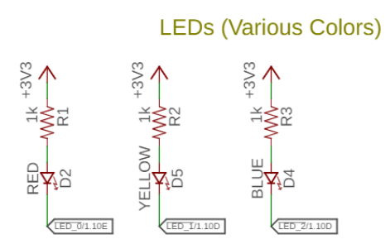
Active state for LEDs
LEDs can be active high or active low depending on configuration
Active high is how people assume they work
Active low is often used instead
GPIO pins can usually sink more current than they can source

Slide 25
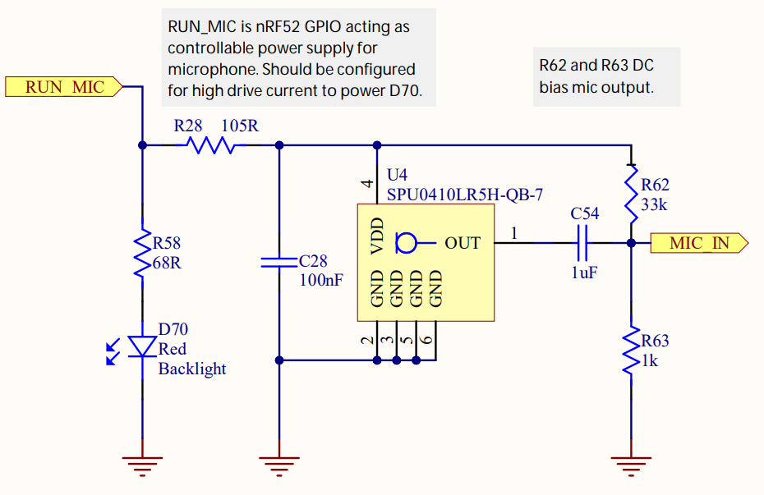
LEDs on the Microbit
Microphone LED
Active high
Simple to use
Ignore this other part for now

Slide 26
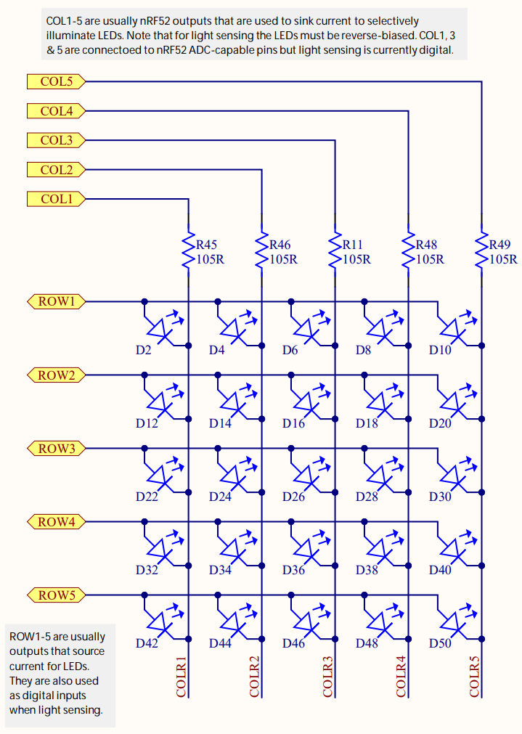
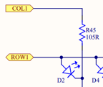
LEDs on the Microbit
Use two GPIO pins to control each LED
Row high as VDD
Column low as Ground
Remember, connections only exist where there are dots

Slide 27
Controlling the LED matrix
Cannot individually control all LEDs simultaneously
Need to light one row at a time
Iterate rows quickly to make them appear on all the time
We’ll have a lab on these later
Combine GPIO and timers

Slide 28
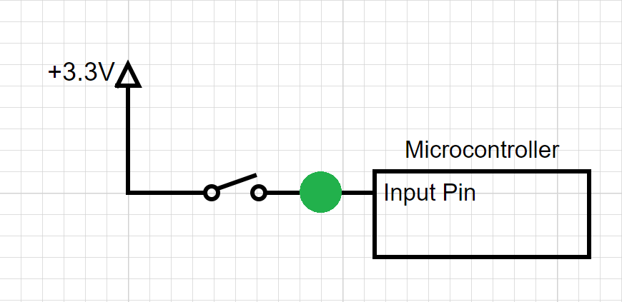
Break + Question
Should the spot in green have?
Pull-up Resistor
Pull-down Resistor
Either
Neither

Slide 29
Break + Question
Should the spot in green have?
Pull-up Resistor
Pull-down Resistor (needs to pull input low by default)
Either
Neither

Slide 30
Outline
DMA
Digital Circuits
GPIOTE
Energy

Slide 31
Handling interrupts from GPIO
Separate peripheral, GPIOTE (GPIO Task/Event)
Manages up to 8 individual pins
Can read inputs and trigger interrupts
Can also connect outputs from events on other peripherals (PPI)
Can trigger interrupts for a “Port event” as well
Software checks which pin(s) caused the event to occur
Very low power operation (works with system clocks off)
Unclear why this is a separate peripheral
Presumably too complicated/expensive to have 42 of them

Slide 32
Configuring individual input interrupts
Pick an available GPIOTE channel (0-7)
Configure it
Port and Pin number
Task (output), Event (input), or Disabled
Polarity for input events
Low-to-high
High-to-low
Toggle (both directions)
Enable interrupts for channel in GPIOTE (and in NVIC!)
Clear event in interrupt handler
Doesn’t happen automatically

Slide 33
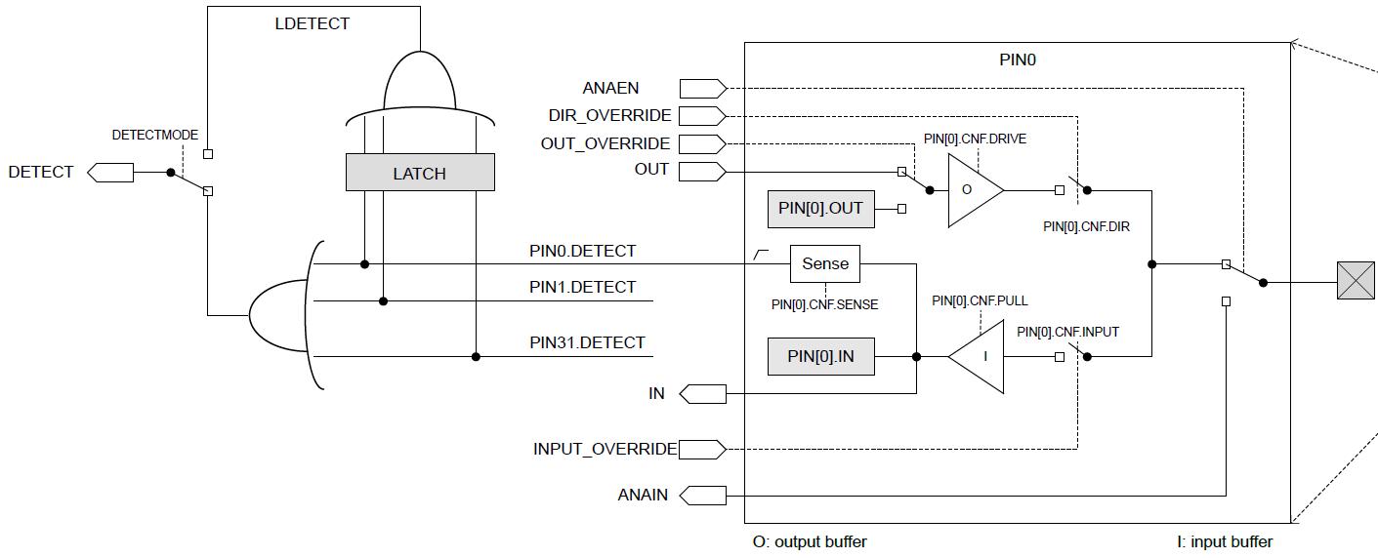
Sensing port events
Uses the “Detect” signal. Generated from pin Sense configuration

Slide 34
Configuring port input interrupts
Configure the Sense for each pin
High or Low
Allows different pins to have different “active” states
Select detect mode
Direct connection to pins
Latched version (saved even if pin later changes back)
Enable interrupts for port in GPIOTE (and in NVIC!)
Clear event in interrupt handler and value in Latch register
Doesn’t happen automatically

Slide 35
Outline
DMA
Digital Circuits
GPIOTE
Energy

Slide 36
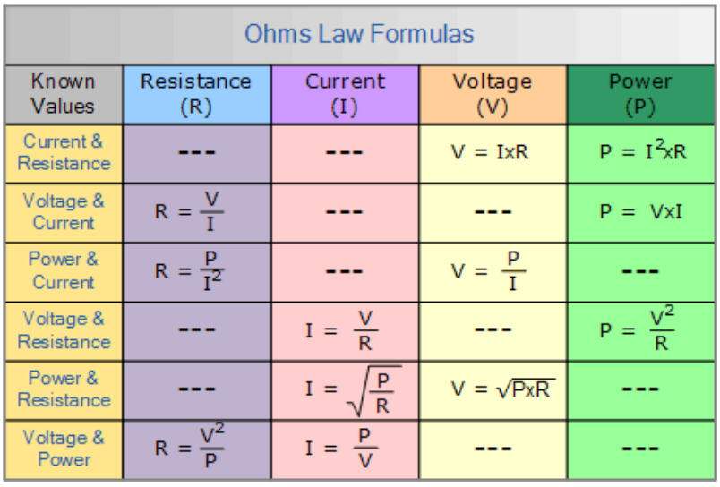
Ohm’s Law
V = I x R
Volts = Current times Resistance
P = I x V
Power = Current times Voltage
These two equations govern most of the circuit math we’ll need in this course
Work with resistive circuits

Slide 37
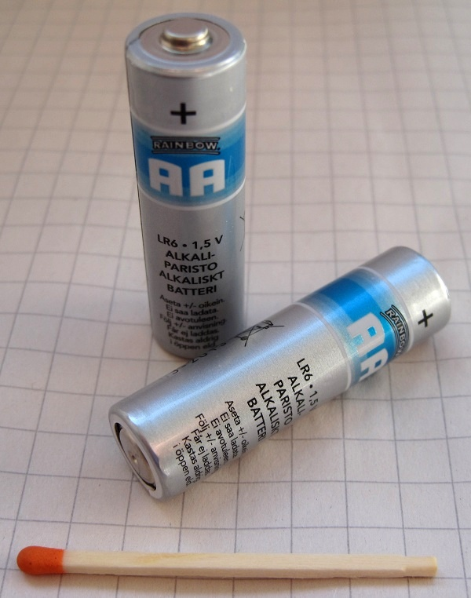
Thinking about energy
Batteries often list energy in mA*h (milliamp – hours)
Coin cell battery: 3v at 220 mAh
2x AA battery: 3v at 2000 mAh
iPhone 11 battery: 3.7v at 3000 mAh
nRF52833 active current: 5.6 mA (at 3v)
Coin cell: 40 hours -> ~2 days
2x AA: 360 hours -> ~15 days
iPhone 11: 535 hours -> ~22 days
So how does any of this work???

Slide 38
Microcontroller sleep modes
Sleep mode
Processor stops running
Most peripherals are disabled
Continues until an interrupt occurs and wakes the microcontroller
Usually a timer or GPIO input
nRF52833 sleep mode current: 1.8 μA (GPIO port event only)
Coin cell: 122222 hours -> ~5000 days -> ~14 years
Low-power systems shoot for less than 1% duty cycle
Average current of ~100 μA or less
Warning: other stuff on the board counts!!
LEDs are 1-10 mA each… Power is not a concern of the Microbit

Slide 39
Outline
DMA
Digital Circuits
GPIOTE
Energy

