Slide 1
Lecture 07 Driver Design
CE346 – Microprocessor System Design
Branden Ghena – Fall 2021
Some slides borrowed from: Josiah Hester (Northwestern), Prabal Dutta (UC Berkeley)

Slide 2
Administriva
Project Proposals due today!
A few are in so far and they look great and I’m super excited!!!!!

Slide 3
Today’s Goals
Finish up Timer-like peripherals
Explore another aspect of device driver design
Non-blocking vs Blocking interfaces
Discuss how interrupts interact with these
Event-loop as a partial alternative

Slide 4
Outline
Real-time Counter
Watchdog Timer
Driver Interfaces (Blocking and Non-Blocking)
Event Loop

Slide 5
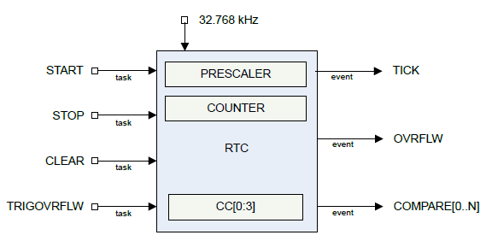
Real-time Counter
Low-power (32 kHz) version of Timer
Only a 24-bit internal Counter
Note: abbreviated RTC, but that already means something else (Real-Time Clock)

Slide 6
Differences between Real-Time Counter and Timer
Runs off of LFCLK instead of HFCLK
With smaller prescaler value (4096 vs 32768)
24-bit counter vs 32-bit counter for Timer
Can read the Counter value directly
No need for Capture task
Otherwise extremely similar. Just a low-power version of Timer

Slide 7
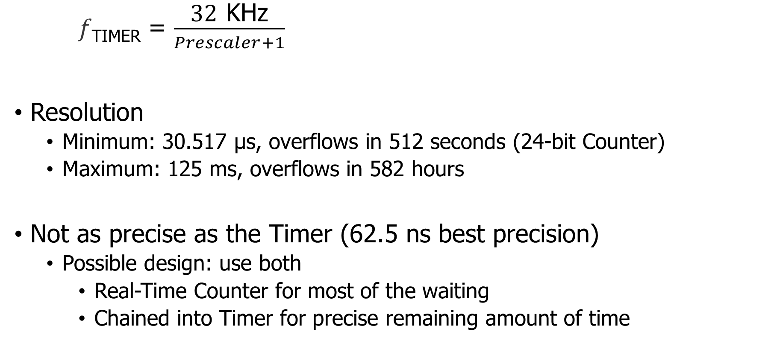
Time resolution for Real-Time Counter
𝑓_{TIMER} = $\frac{\text{32} \text{K}\text{Hz}}{Prescaler+1}$
Resolution
Minimum: 30.517 μs, overflows in 512 seconds (24-bit Counter)
Maximum: 125 ms, overflows in 582 hours
Not as precise as the Timer (62.5 ns best precision)
Possible design: use both
Real-Time Counter for most of the waiting
Chained into Timer for precise remaining amount of time

Slide 8
Outline
Real-time Counter
Watchdog Timer
Driver Interfaces (Blocking and Non-Blocking)
Event Loop

Slide 9
Reliable systems
What’s the most common way to solve computer problems?
Turn it off and turn it on again.
Why?

Slide 10
Reliable systems
What’s the most common way to solve computer problems?
Turn it off and turn it on again.
Why?
Resets “state” to original values, which are likely good
Startup is often well-tested
It’s long-running code interacting in unexpected ways that leaves systems in a broken state

Slide 11
Watchdog timer (WDT)
Focused on failures where the system “hangs” forever
Maybe software, maybe hardware!
Can’t know for certain the system is hung, but can know practically
Select a timeout that is the maximum amount of time you expect the system to ever go without looping in main()
Multiply it by 2-10
Set a watchdog timer to that value
If watchdog timer ever expires, it resets the system (in hardware)

Slide 12
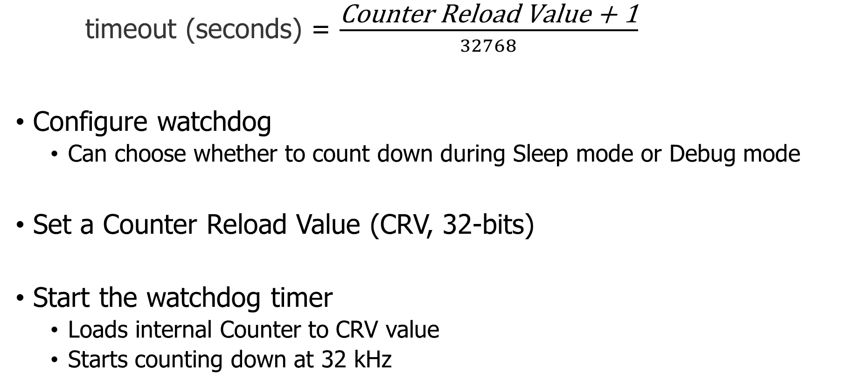
Watchdog configuration
timeout (seconds) = $\frac{\text{Counter} \text{Reload} \text{Value}\text{ + 1}}{32768}$
Configure watchdog
Can choose whether to count down during Sleep mode or Debug mode
Set a Counter Reload Value (CRV, 32-bits)
Start the watchdog timer
Loads internal Counter to CRV value
Starts counting down at 32 kHz

Slide 13
Running applications with a watchdog timer
Need to periodically reset the watchdog to keep it from expiring
Known as “feeding” the watchdog or “kicking” the watchdog
Reload Request register
Must write sequence 0x6E524635 to reload watchdog
Incredibly unlikely to happen by accident
While running, watchdog is protected from modification
Configure once, run forever (at least until a reboot)
Only option is to make periodic Reload Requests
Default off on the nRF52833

Slide 14
Break + Open Question
MSP430 microcontrollers start with the watchdog on by default
What are the pros and cons of this choice?

Slide 15
Outline
Real-time Counter
Watchdog Timer
Driver Interfaces (Blocking and Non-Blocking)
Event Loop

Slide 16
Callback functions
timer_start(duration, my_timer_handler, context);
Driver interfaces often provide a callback mechanism
Caller provides a function which should be executed when complete
“Context” is often provided as well (void*)
Ability for caller to pass an argument for the callback function
Often a pointer to a position in a structure or a shared variable to modify

Slide 17
Function pointers in C
Harder than in Javascript or C++. Can’t define anonymous function inline
Instead create a pointer to an existing function in your code
void myfun (int a) {
// do something here
}
void main() {
void (*fun_ptr)(int) = &myfun;
fun_ptr(10); // dereference happens automatically
}

Slide 18
Callbacks usually run in an interrupt mode
If the interrupt handler calls the callback, the callback will be within that same interrupt mode
Be careful which variables you modify!!
Same concurrency problems mentioned before
Starts to get pretty annoying
Embedded systems deal with concurrency issues just like OS

Slide 19
Blocking function calls
Alternative option: blocking calls
Do not return until request is complete
void myfun (void* context) {
*(boolean*)context = true; // context is the flag pointer
}
void timer_start_blocking(duration) {
boolean flag = false;
// duration, pointer, context
timer_start(duration, &myfun, &flag);
while (!flag) { }
}

Slide 20
Temp driver example
nu-microbit-base/software/apps/temp_driver/

Slide 21
Outline
Real-time Counter
Watchdog Timer
Driver Interfaces (Blocking and Non-Blocking)
Event Loop

Slide 22
Interrupts are frustrating
We do not want to block on every call
We also do not want to deal with concurrency issues
Alternative: one main event loop
Polls necessary sensors
Iterates through state machine and determine actions
Runs at a certain frequency

Slide 23
Event loop
Rather than polling a single driver, poll all of them
Each time through the loop check all relevant inputs
Respond to events that are necessary
Sleep until ready to start again
while (1) {
time start = get_time();
boolean result = check_timer();
if (result) { check_gps(); }
adjust_throttle();
sleep(1ms – (get_time() – start));
}

Slide 24
Top-half / Bottom-half handler design
Top half
Implements interface that higher layers require
Performs logic to start device requests
Wait for I/O to be completed
Synchronously (blocking) or asynchronously (return to event loop)
Handle responses from the device when complete
Bottom half
Interrupt handler
Continues next transaction
Or signals for top half to continue (often with shared variable)

Slide 25
Temperature event-loop example
nu-microbit-base/software/apps/temp_event_loop/

Slide 26
Outline
Real-time Counter
Watchdog Timer
Driver Interfaces (Blocking and Non-Blocking)
Event Loop

