Slide 1
Lecture 10 Prototyping
CE346 – Microprocessor System Design
Branden Ghena – Fall 2021
Some slides borrowed from: Josiah Hester (Northwestern), Prabal Dutta (UC Berkeley), Project Lead The Way

Slide 2
Administrivia
Project Design Presentations
Next week Thursday in class
See Campuswire post for details

Slide 3
Today’s Goals
Discuss issues to consider when prototyping systems
Understand how to use breadboards for prototyping
Explore various components and how you might use them with a breadboard
Also, understand process of capacitive touch sensing

Slide 4
Outline
Overview of Prototyping
Breadboarding Components
Capacitive Touch Sensing

Slide 5
Prototyping goals
Does this thing work at all?
Particular IC
Circuit layout
Software design
etc.
Sometimes before doing something more serious with it
Design a PCB, Make a product, etc.
Not uncommon that the prototype is as far as you’ll get

Slide 6
Isolating tests
The goal when prototyping is to isolate the question at hand
Do consider
New sensor/IC/component/whatever
Do not consider
Power
Interference
Enclosure
Stable microcontroller
Soldering skills

Slide 7
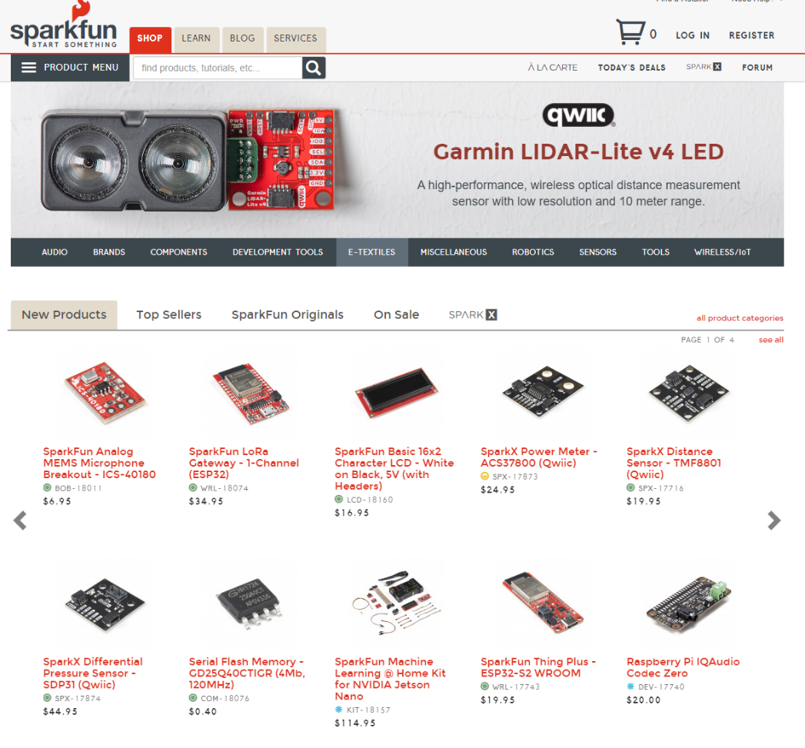
Buying Parts
Prototyping vendors
Where you look for cool stuff to buy
Sparkfun
Adafruit
Electronics vendors
Where you buy parts when you know what you need
Digikey
Mouser

Slide 8
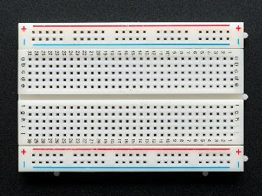
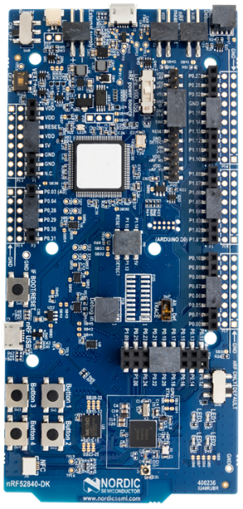
Prototyping methods
Breadboarding
Plug and connect components as needed
Build up arbitrarily complex designs from nothing
Development kits
Pre-fabricated systems design for testing components
Small-scale test PCBs
Design a PCB that demonstrates the thing you’re interested in
Making a PCB is less hard than some might think (Eagle, Fritzing, etc.)
$20-30 for small, low-speed PCBs from batch services like OSHPark

Slide 9
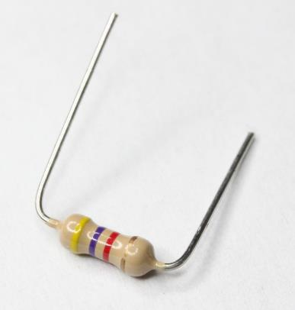
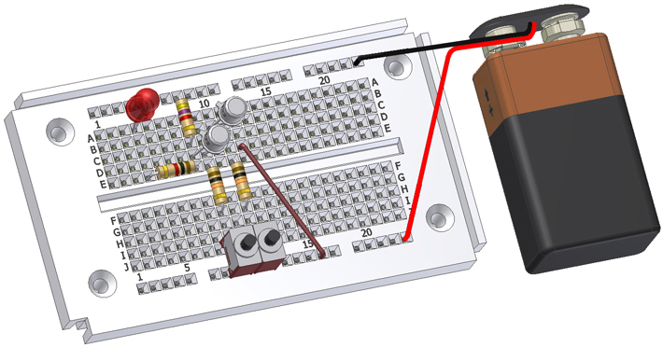
Breadboards for prototyping
Reusable platform for temporary circuits
Plug in jumper wires and through-hold components

Slide 10
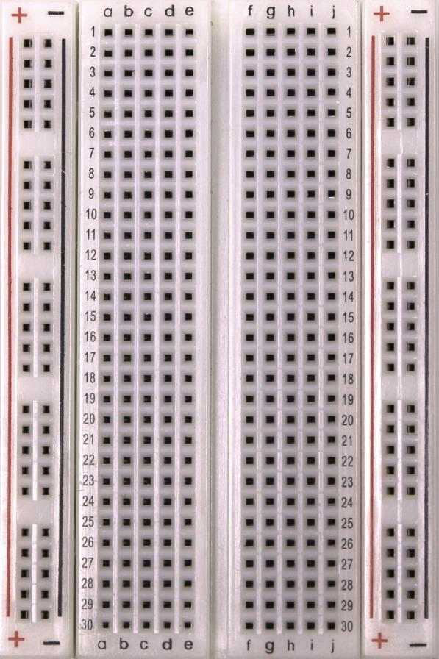
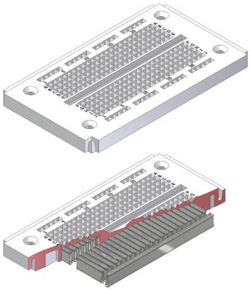
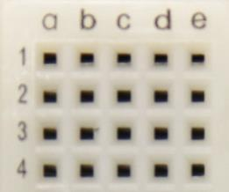
How a breadboard works
Component leads and wires are inserted into holes in the breadboard
Half-rows of five holes are connected
Vertical columns are connected for power/ground
Holes to
insert wires

Slide 11
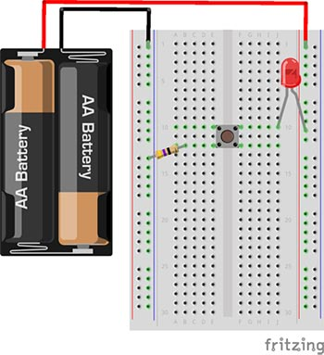
Breadboard LED example
Uses button to control LED

Slide 12
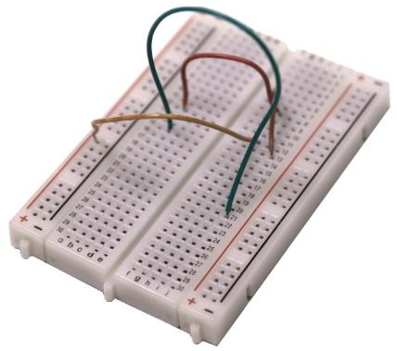
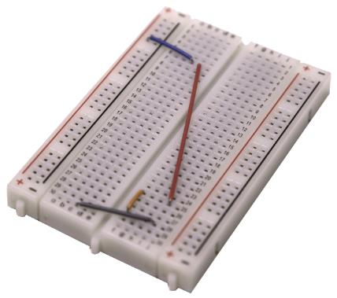
Breadboard guidelines
Long wires in large bird nests makes debugging very difficult
Shorter, constrained wires are easier to understand
In this class, we’ll only have large jumper wires though…
Use the minimum jumpers necessary, mostly use breadboard for connections
Bad
Better

Slide 13
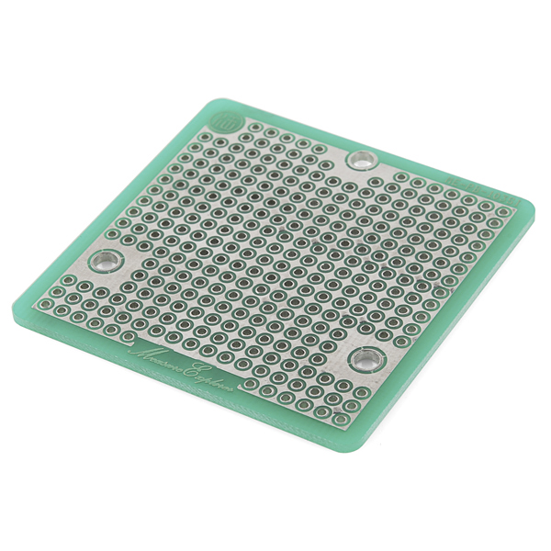
More permanent breadboards
Breadboards are also known as “Solderless Breadboards”
Protoboard allows configurable circuits
Solder jumper wires between locations
Solder adjacent pads to form connection
Usually not worth it (just make a PCB)
Does solve core problem of breadboards: things getting unintentionally unplugged
Might be useful for some projects!

Slide 14
When to not use breadboards
Breadboards work great for digital circuits and simple analog!
High voltage/current are bad for breadboards
Honestly, anything above 12 volts DC shouldn’t be in a breadboard
Also avoid high-power applications above a few Watts
Never put AC in a breadboard
Sensitive analog circuits
Particularly anything sensitive to capacitance may not work right
Sets of metal holes with strips connecting them function as capacitors
Anything in long term use

Slide 15
Outline
Overview of Prototyping
Breadboarding Components
Capacitive Touch Sensing

Slide 16
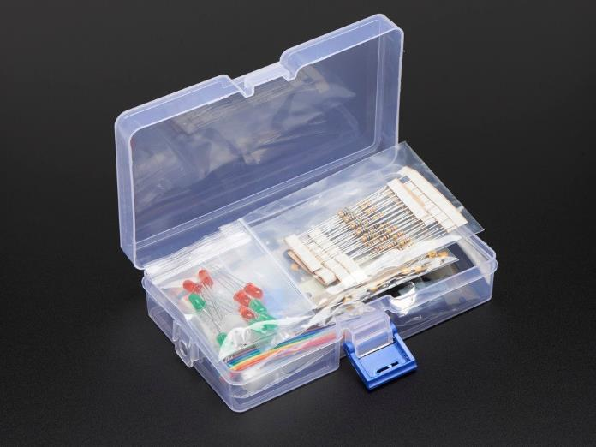
Prototyping with a breadboard
What kinds of things might you use with a breadboard?
Jumper wire
Microbit!
Resistors/Capacitors
LEDs
Buttons/Switches
Analog Sensors
Various other through-hole components
Transistors, Op-Amps, other ICs
https://www.adafruit.com/product/2975

Slide 17
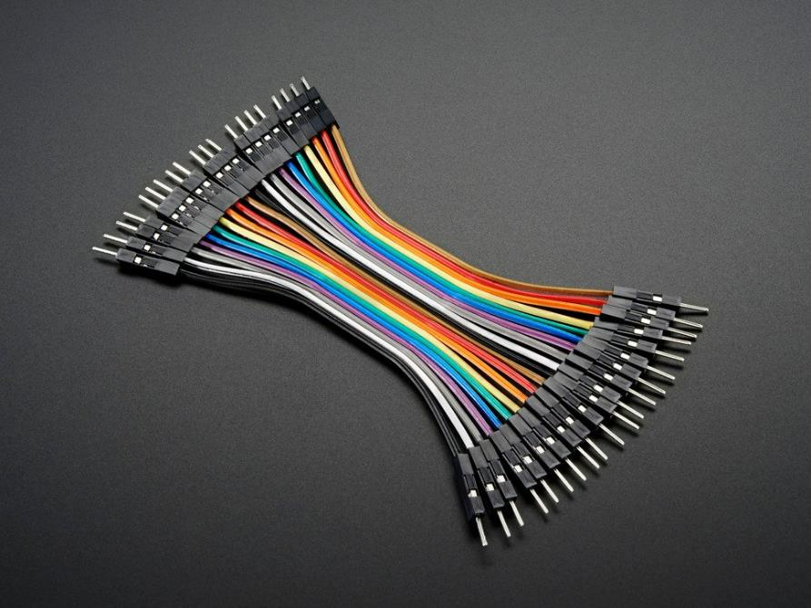
Jumper wires
Connect two rows in the breadboard together
Recommendation:
Peel off sets of 2-4 wires and keep them stuck together
Often want to run multiple at once

Slide 18
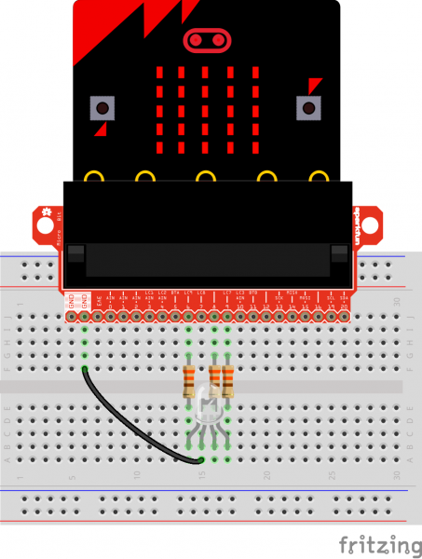

Microbit
Always connect LED matrix side up
Breaks out various pins from board
Need to consult table to know which pins
https://tech.microbit.org/hardware/schematic/
https://www.sparkfun.com/products/13989
https://learn.sparkfun.com/tutorials/microbit-breakout-board-hookup-guide

Slide 19
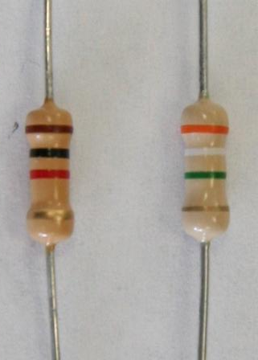
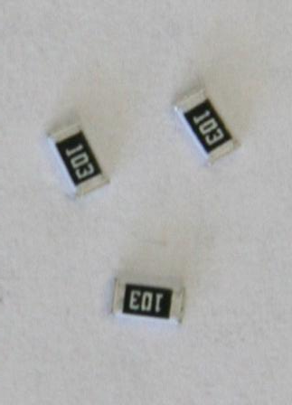
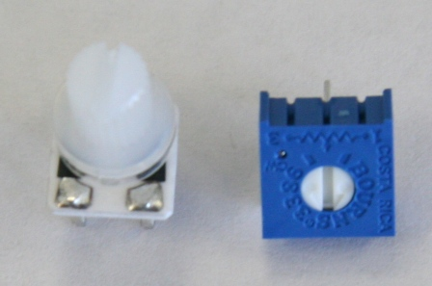

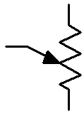
Resistors
Carbon Film Resistors
Surface Mount Resistors
Variable Resistors
(potentiometer)
4 Bands

Slide 20
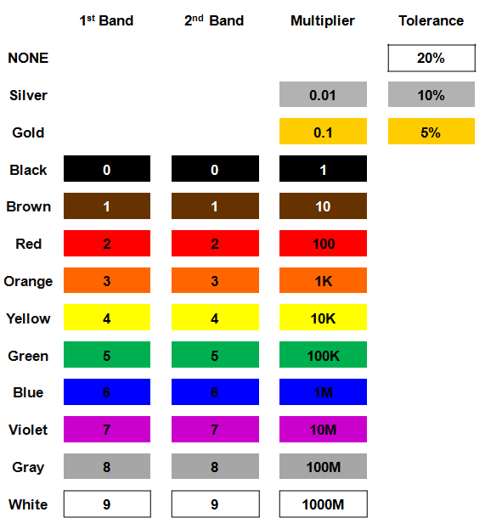
Resistor color codes
Colored bands on resistors label the resistance value of the part
First and second bands are the digits
Third band is multiplier
Fourth band is tolerance
Usually gold: +/- 5%

Slide 21
Example: determine the resistor

Slide 22
Example: determine the resistor
56 x 10 Ω = 560 Ω (±5%)

Slide 23
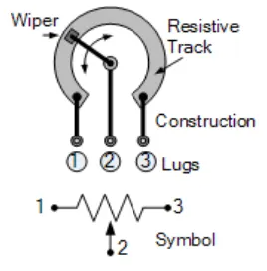
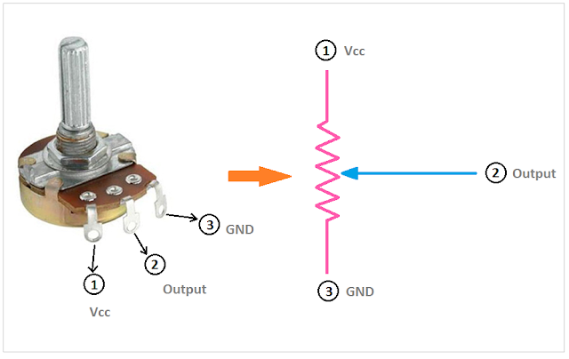
Potentiometers
Vary resistance between zero and some maximum
1 kΩ, 10 kΩ, 100 kΩ common
Connect middle and an edge for just a changeable resistor
Middle terminal is a movable resistor divider
Knob changes middle output if outer pins are VCC and Ground

Slide 24
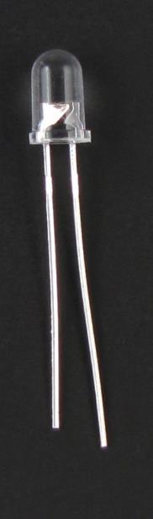
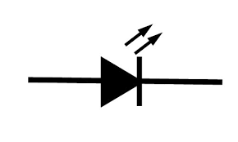
LEDs
Directional component: only allows current to flow one way
Shorter side is the negative one
i.e. where current flows to
Larger metal component
inside of case or case flat spot is cathode or
negative (-) lead
Shorter wire is cathode or
negative (-) lead
Negative ( - ) lead
Schematic Symbol

Slide 25
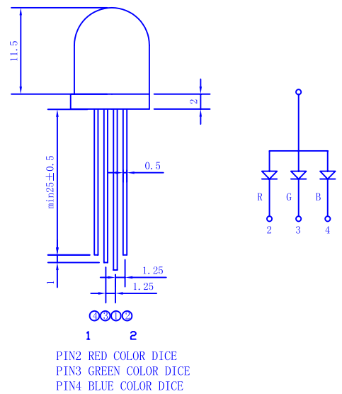
RGB LED
Three different colors of LED in a single large diffuser
Short leads are negative ends
One for each color
Long lead is common power
Common anode
Combinations of LEDs give other colors
Cyan, Yellow, Violet, White
https://cdn-shop.adafruit.com/datasheets/FLR-100WAS-RGB.pdf

Slide 26
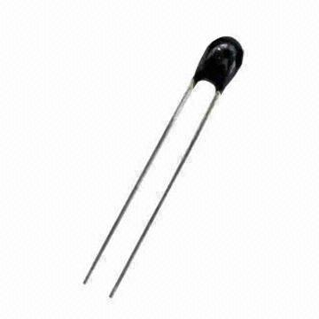
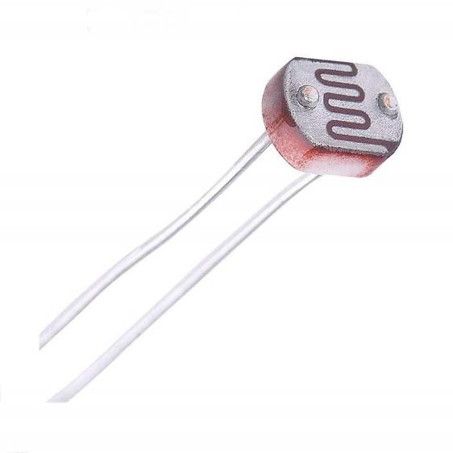
Sensors
Thermistor
Photoresistor

Slide 27
Breadboard demo!
RGB LED
Plus resistors
Control LED with
Switch
Potentiometer
Photoresistor

Slide 28
Outline
Overview of Prototyping
Breadboarding Components
Capacitive Touch Sensing

Slide 29
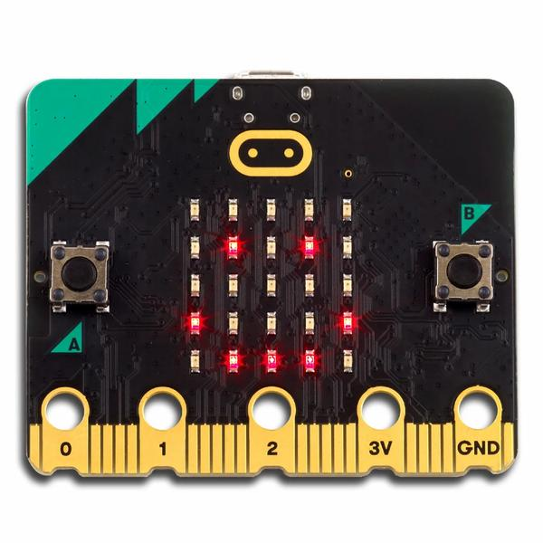
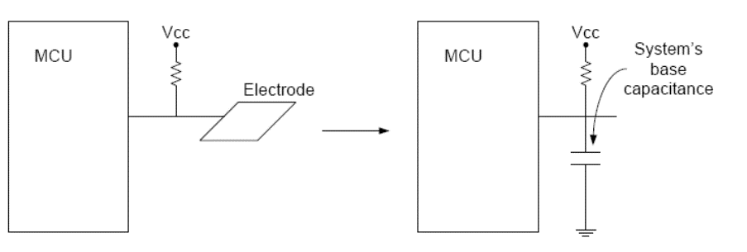
Capacitive Touch Sensor
Pull-up resistors connected to metal pads
Also connected to GPIO pin
Acts as a capacitor connected to ground

Slide 30
Capacitive touch sensing method
Drive GPIO pin low
Connects the pad to ground
Set GPIO pin as input and enable low-to-high interrupt
Pad is pulled high. This takes time based on capacitance
Use a timer to determine time until interrupt
~70 μs with no finger, milliseconds with finger
Needs to timeout after a few milliseconds
Repeat periodically
Sudden large increase in rise time ⇨ someone is touching!
Finger acts as a large capacitor

Slide 31
Capacitive touch works on any metal surface
Idea: Microbit door handle sensor
Connect a wire and a pull-up resistor to a metal door handle to sense when someone is touching it!
Timing will be very different from capacitive pad, but should be repeatable and distinguishable from human touch

Slide 32
Outline
Overview of Prototyping
Breadboarding Components
Capacitive Touch Sensing

