Slide 1
Lecture 11 Analog Output
CE346 – Microprocessor System Design
Branden Ghena – Fall 2021
Some slides borrowed from: Josiah Hester (Northwestern), Prabal Dutta (UC Berkeley)

Slide 2
Administrivia
Design presentations on Thursday
Happy to discuss things before then either after class or on Campuswire
Drop deadline is end-of-week
I’m not worried about anyone in CE346

Slide 3
Today’s Goals
Explore common methods for generating analog signals
Understand the role of Digital-to-Analog converters
Discuss the concepts of Pulse-Width Modulation
And the nRF52 implementation of it

Slide 4
Outline
Digital-to-Analog Converters
Pulse-Width Modulation
nRF52 PWM

Slide 5
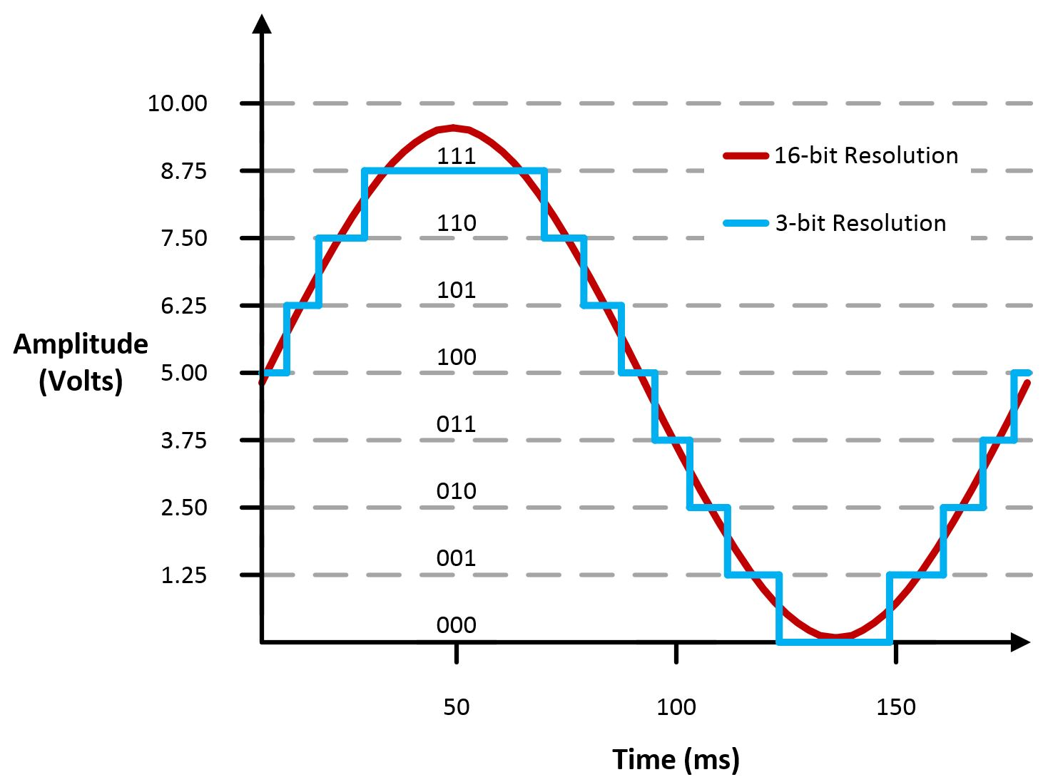
Digital-to-Analog Converters
Generates an analog voltage
DACs are conceptually the inverse of ADCs
Number of bits of resolution choose analog step size
Frequency determines step duration

Slide 6
High resolution versus high frequency
What role does each play in a DAC? Which is more important?
High resolution can accurately represent a voltage
High frequency can accurately represent a changing voltage
In practice:
Need high enough resolution, then as high of frequency as possible

Slide 7
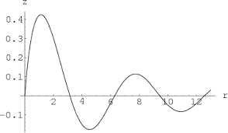
Infinite resolution is not sufficient
DAC frequency corresponds to representable signal changes
Rise and fall times
Even an infinite resolution DAC cannot represent a signal if it is not fast enough

Slide 8
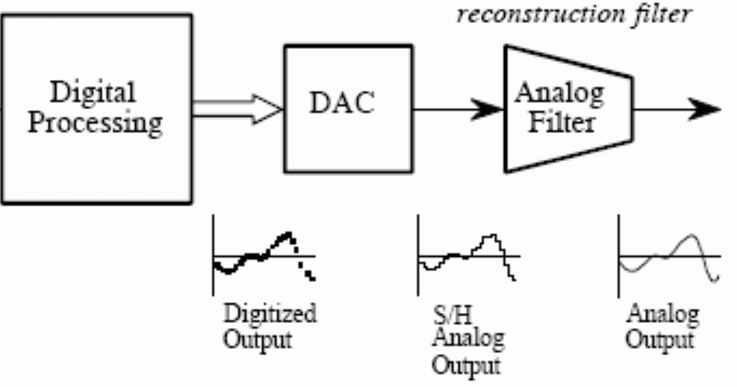
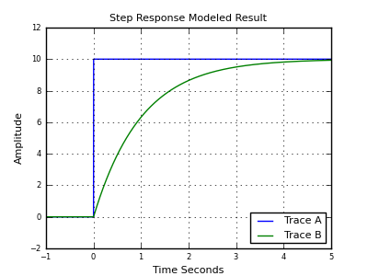
Low-pass filter smooths output
Low-pass filter delays changes in voltage and smoothly transitions between them
Low-frequency signals stay
High-frequency are smoothed
Greatly improves quality of output but must be tuned to the desired signal frequency
Usually not included in microcontroller

Slide 9
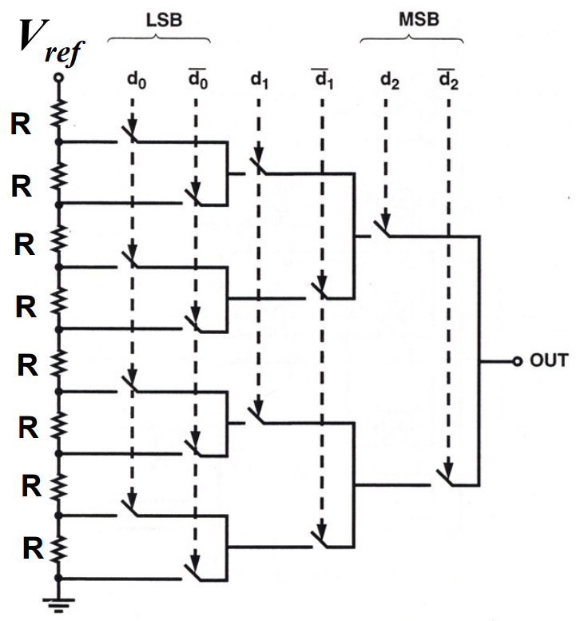
Resistor string DAC
Use series of voltage dividers and switches to set output voltage
Generates equally spaced voltages that can be selected between
Needs output buffer to provide stable current
Takes a lot of resistors
And resistors take a lot of silicon

Slide 10
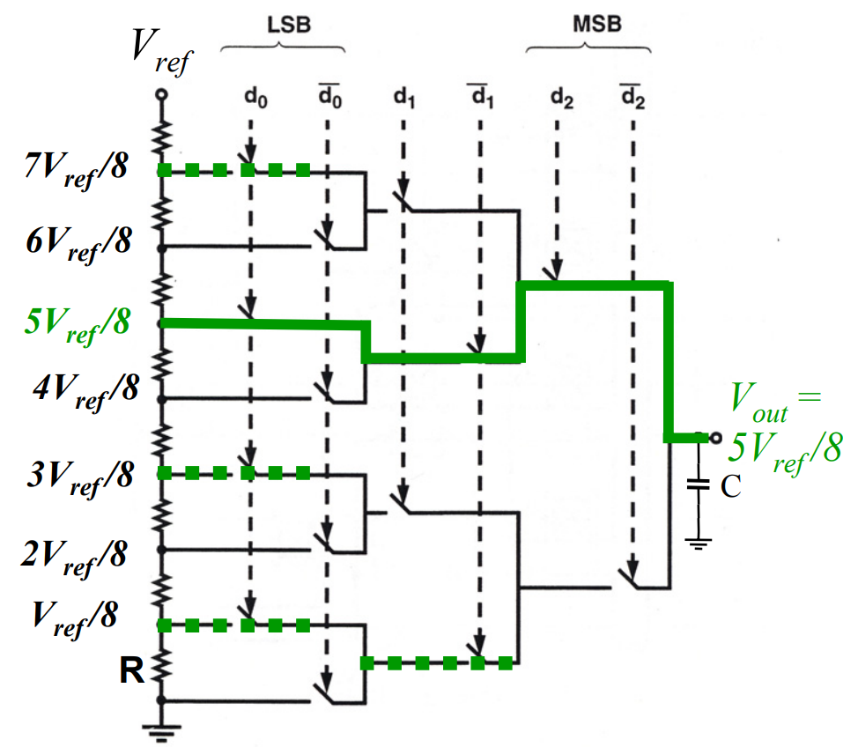
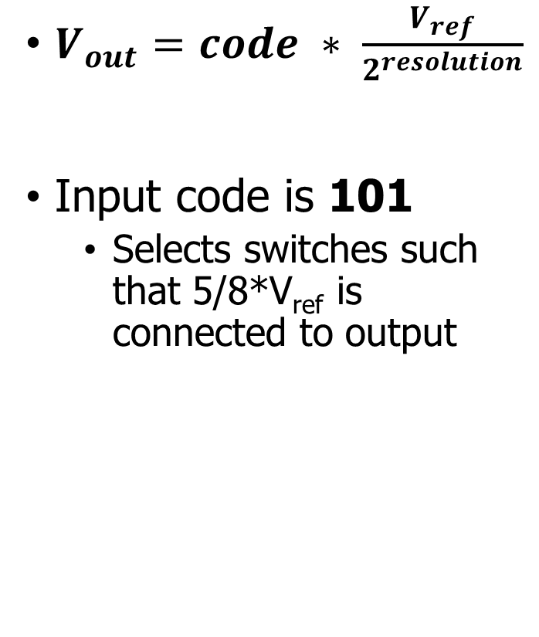
Resistor string example
$V_{out}=code ∗ \frac{V_{ref}}{2^{resolution}}$
Input code is 101
Selects switches such that 5/8*V_{ref} is connected to output

Slide 11
DAC applications
What do you use an analog output for?
Audio output
But it needs to be high quality (resolution and speed)
Motors
But only with a controller that actually drives them with enough current
LED brightness
Not Much
And these last two can be done more easily with PWM

Slide 12
DACs are not in all microcontrollers
Not rare, but not ubiquitous either
Every microcontroller has GPIO
Just about every microcontroller has an ADC
Some microcontrollers have DACs
Reasons
Hardware is complicated (but we could fit it if we wanted)
Use cases are uncommon (and might need very high quality)
Many devices can be controller digitally
Pulse-Width Modulation (PWM) can emulate usably analog signals

Slide 13
Outline
Digital-to-Analog Converters
Pulse-Width Modulation
nRF52 PWM

Slide 14
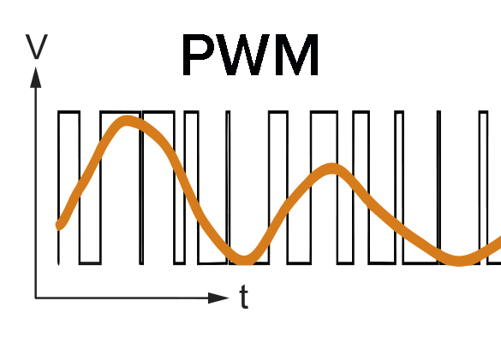
Pulse-Width Modulation
Much easier to control high or low than an analog output
Idea: modify how long a signal is high within some switching frequency, a.k.a duty cycle
On 50% of the time for half voltage
On 10% of the time for tenth voltage
Duty cycle, not frequency!

Slide 15
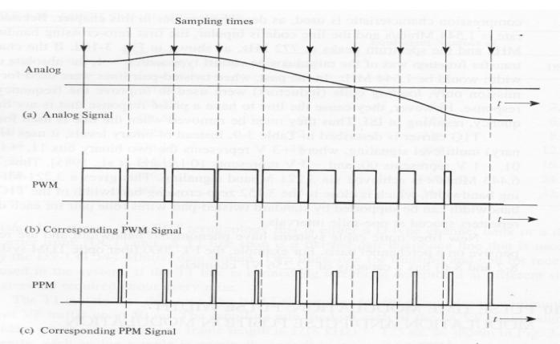
Analog to PWM example

Slide 16
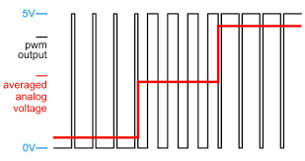
PWM to Analog Signal example

Slide 17
Low-pass approach works here too
Importantly, many devices are inherent low-pass filters
Heaters, Motors
LEDs are not
But our eyes are!

Slide 18
Controlling PWM
Vary duty cycle by selecting transition points
Time when set
Time when unset
Repeat every cycle
Period much faster than signal if possible
Makes analog approximation more accurate
The faster you run it, the less likely it matters that it is not actually analog
Example: LED switching frequency
Duty cycle could vary cycle-by-cycle if it must

Slide 19
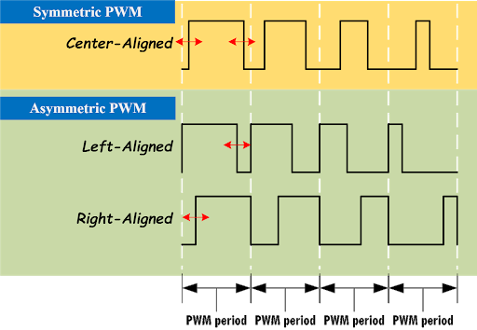
PWM alignment
Can select alignment as well
Equivalent to a phase delay
Centering produces cleaner analog output
Less harmonics
Not relevant for most devices

Slide 20
Every microcontroller can do PWM
Not every microcontroller has a PWM peripheral
But every microcontroller has timers and digital outputs
But all that is need is a GPIO and a Timer (or two)
Timer determines when to turn GPIO on and off
Often can be automated in hardware rather than use interrupt handler

Slide 21
PWM is a method of encoding data
PWM is a pulse-width modulated signal
There are many other ways to “modulate” a signal to transmit data
Amplitude, Frequency, and Phase are common
Layers data on top of an existing “carrier signal”
Used especially for high-speed communication
Wired (cable lines) or Wireless (basically everything)

Slide 22
PWM applications
Servos
Duty cycle chooses angle
Motor controllers
Duty cycle chooses current and therefore speed
LED brightness
And “breathing” effect
Audio
Can sound okay if frequency is high enough

Slide 23
Break + Open Question
How much faster should the PWM frequency be than the signal frequency?
What happens if the PWM frequency is too low?

Slide 24
Outline
Digital-to-Analog Converters
Pulse-Width Modulation
nRF52 PWM

Slide 25
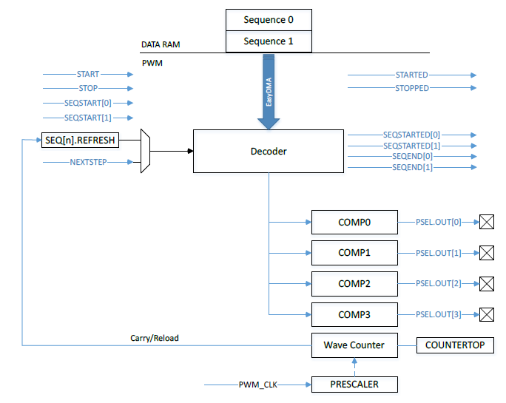
nRF52 PWM peripheral
Uses internal timer to create PWM output on up to 4 pins
4 peripherals, so up to 16 pins total
Loads compare values via DMA to rapidly vary “analog” signal

Slide 26
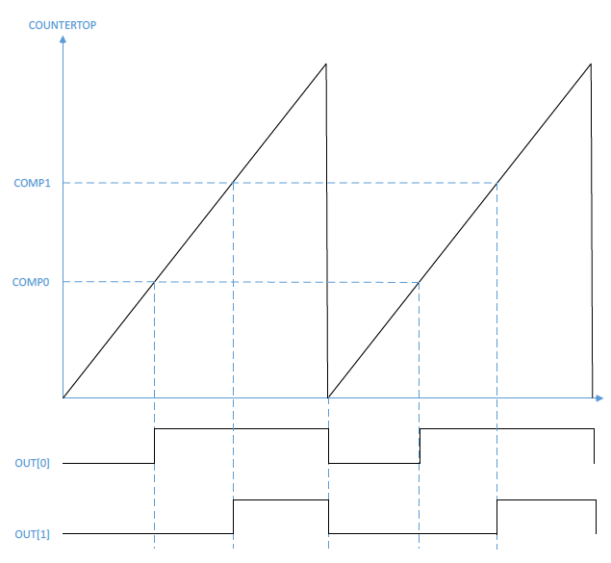
PWM example
One PWM period
Counter increments up to COUNTERTOP, resets and continues
Frequency
Chosen by COUNTEROP and timer PRESCALER
Counter Value
Time

Slide 27

PWM example
One PWM period
Counter increments up to COUNTERTOP, resets and continues
Duty Cycle
COMP0 chooses first toggle point for OUT[0]
Second toggle point is when the timer resets
Counter Value
(right-aligned) $COMP=$
$$COUNTERTOP−(COUNTERTOP∗DutyCycle)$$
(left-aligned) $COMP=$
$$COUNTERTOP∗DutyCycle$$
Time

Slide 28
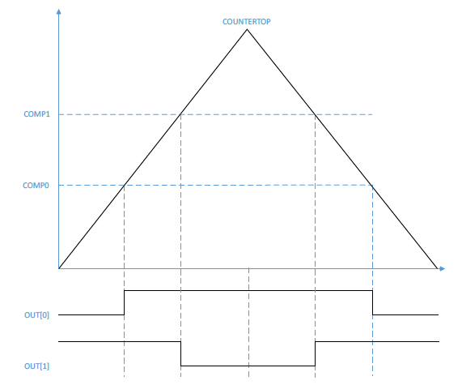
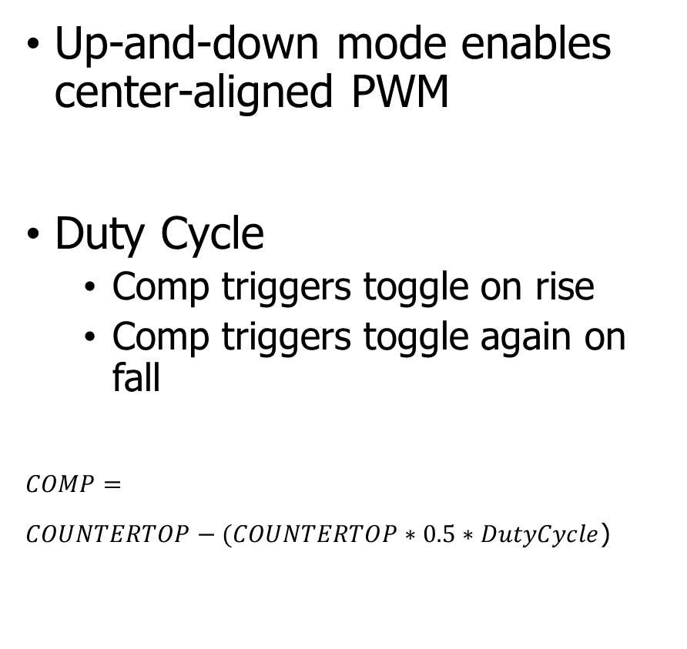
Center-aligned PWM
Up-and-down mode enables center-aligned PWM
Duty Cycle
Comp triggers toggle on rise
Comp triggers toggle again on fall
$$COMP=$$
$COUNTERTOP−(COUNTERTOP∗0.5∗DutyCycle$)

Slide 29
Trading speed and accuracy
How do you get the most accurate PWM values?
Select the largest COUNTERTOP possible
Most possible COMP values
Up to 15-bit resolution (32767 max)
How do you get the fastest PWM frequency?
Select the smallest COUNTERTOP possible
PRESCALER also affects this
16 MHz – 128 kHz (8 possible values)
Fastest PRESCALER + largest COUNTERTOP equals 488 Hz
Likely need to sacrifice resolution for speed

Slide 30
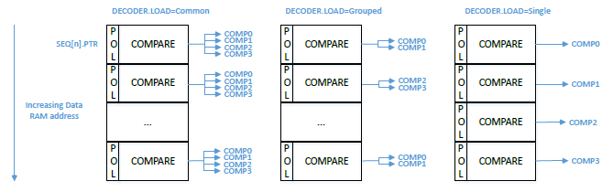
DMA with PWM
Every N periods it loads a new configuration from RAM
N combined with PRESCALER and COUNTERTOP chooses “analog signal” period
Configuration sets COMP values for each output channel
Also sets polarity (starting value: low or high)
Application of memory loads to channels is configurable

Slide 31
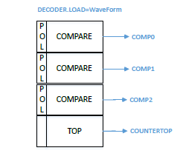
Waveform mode
Also has the option to change COUNTERTOP every N PWM periods
Allows arbitrary waveforms to be created
Frequency changes every period
Duty cycle can also change each period

Slide 32
Other configurations
How many times the entire DMA sequence repeats
0 to large number, infinite with a configuration in SHORTS
How long to delay between repeating sequence cycles
Repeats last PWM configuration
Two DMA sequence configurations (0 and 1)
Can modify one while the other is playing
Allows continuous signal (for example, music)

Slide 33
nRF SDK PWM driver
https://infocenter.nordicsemi.com/index.jsp?topic=%2Fsdk_nrf5_v16.0.0%2Fgroup__nrfx__pwm.html
Initialize PWM with base configuration
Output pins, Clock frequency, COUNTERTOP, DMA grouping mode
Handler for events from peripheral
nrfx_pwm_simple_playback(instance, sequence, count, flags)
Instance: pointer to global variable with registers
Sequence: struct containing sequence to be played (see next slide)
Count: number of times (1 or more) to repeat sequence
Flags: stop peripheral when done, loop forever, various events

Slide 34
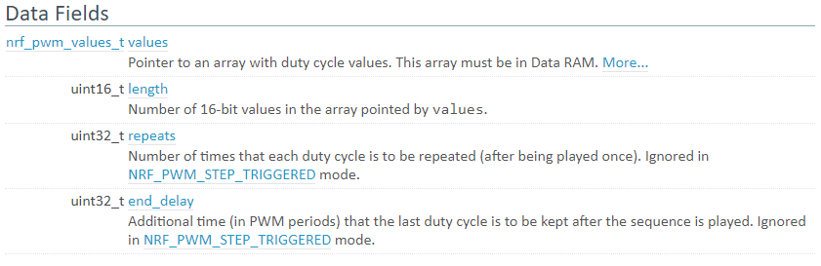
Sequence struct
values: pointer to array of uint16_t values (union of types)
length: length of array
repeats: number of times to repeat each individual value
Sets period for “analog value” changing

Slide 35
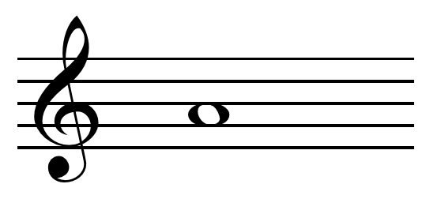
Example, playing a note
Pick PWM frequency to match note frequency
Combination of PRESCALER, COUNTERTOP, and repeats
440 Hz for the note A
PRESCALER 1 MHz, COUNTERTOP 227 -> 4.40 kHz
repeats = 10 -> 440 Hz (in case we’re changing notes)
Set duty cycle of PWM to control volume
50% duty cycle -> COMP value of 113
Set sequence with an array of length 1, content is {113} (polarity 0)
Repeats 10, end_delay 0
Set playback_count to 1 and flags to NRFX_PWM_FLAG_LOOP

Slide 36
Controlling LED Matrix brightness
Option 1: PWM peripheral
Need to use multiple PWM peripherals to get 5 pins
Could only allow brightness to be controlled for the entire matrix
Then use a single PWM output to control the row
When timer fires, change which row pin is used for PWM
Option 2: do it manually (for individual control)
Can’t determine duty cycle when the row is turned on
Each row already at 100 Hz, duty cycling would be slower and visible
Instead add 5 new one-shot app timers, one for each column
Fire at some time while the row is active (within that 2 ms)
Use to toggle column LED back to off

Slide 37
Outline
Digital-to-Analog Converters
Pulse-Width Modulation
nRF52 PWM

