Slide 1
Lecture 18 Wrapup
CE346 – Microprocessor System Design
Branden Ghena – Fall 2021
Some slides borrowed from: Josiah Hester (Northwestern), Prabal Dutta (UC Berkeley)

Slide 2
Administrivia
This is the last lecture!! 😭
No class on Thursday
I can schedule meetings with groups if needed
Project Demos - Next week Tuesday
Tuesday 12/7
Mudd 3514
2:00-5:00 pm

Slide 3
Today’s Goals
Discuss remaining parts of the Microbit and nRF52833
Realize that we’ve covered almost everything on the system!!
Explore sensing systems research

Slide 4
Outline
What haven’t we talked about?
Microbit
nRF52833
Sensing Systems Research

Slide 5
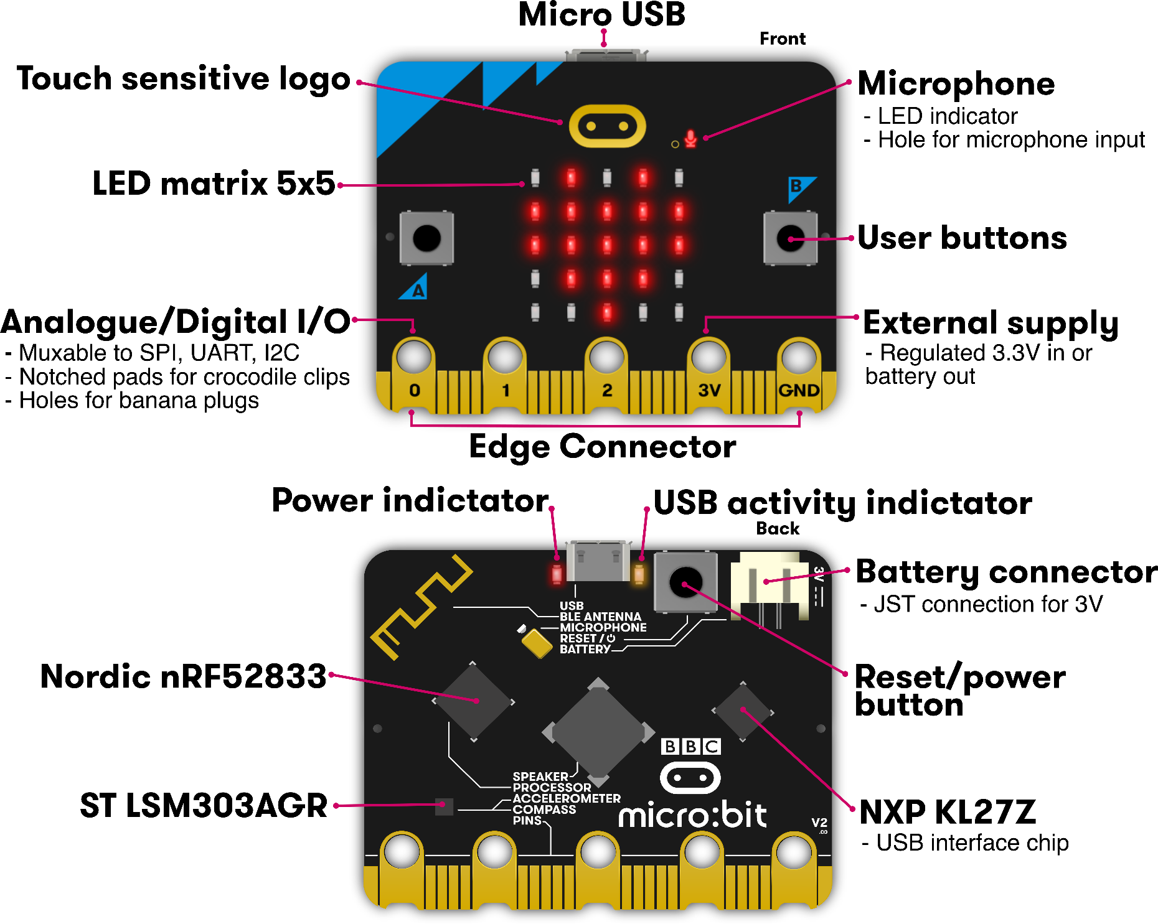
Microbit
Used almost all of this!
Remaining:
Batteries
Wireless
KL27Z I2C

Slide 6
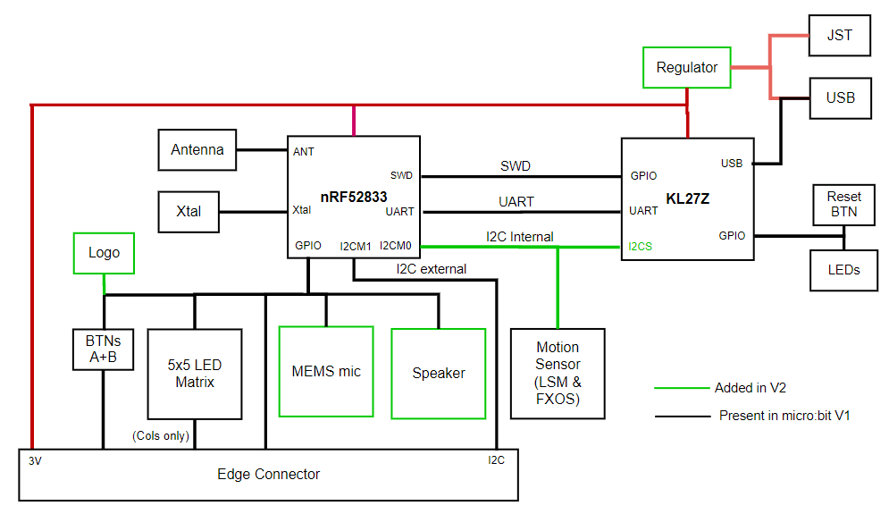
Internal Microbit connections

Slide 7
KL27 I2C Interface
Device information
Version of board and JTAG firmware
Power state of board
USB, Battery, both
Voltage values for battery and VIN
USB connection state
Disable the power LED!!
Flash Storage
128 kB of the KL27’s Flash is readable/writable over I2C

Slide 8
Outline
What haven’t we talked about?
Microbit
nRF52833
Task/Event Chaining with PPI
Sensing Systems Research

Slide 9
Software stops when the processor does, but peripherals continue
Solution to low power: keep the processor off
Problem: when the processor is off, no code is running
Solutions
Peripherals can wake it up again
Can probably go for milliseconds to minutes without any actions
Timer interrupt can wake processor to do things
Have hardware handle some parts in the background without the processor’s involvement
DMA
PPI

Slide 10
Controlling peripherals while processor sleeps
DMA (Direct Memory Access)
Set up a pointer to memory and a length
Peripheral can load/store memory without processor’s involvement
Usually use completion interrupt to wake processor
PPI (Programmable Peripheral Interconnect)
Any Event can be tied to any Task within the nRF52
Allows for complicated actions to be chained together

Slide 11
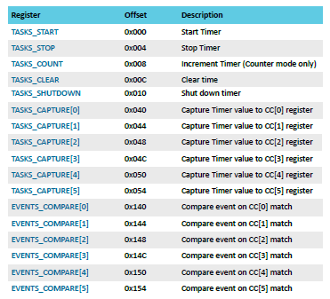
nRF52 Tasks and Events
Example: Timer peripheral
Tasks are used to perform some operation
Often written to by software
Events change value when some change in status occurs
Often used to trigger interrupts
PPI peripheral can connect any TASK to any EVENT

Slide 12
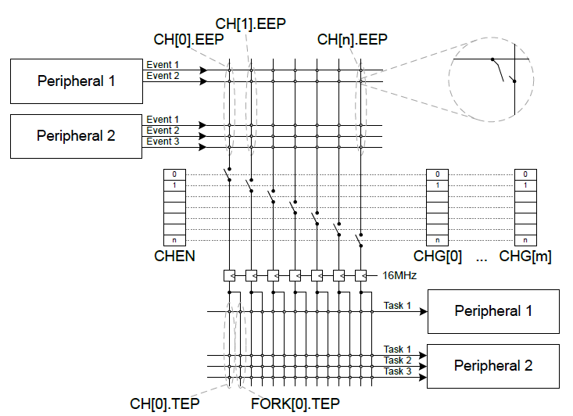
nRF52 PPI peripheral
Connects Events to Tasks via hardware
Each channel gets one Event pointer and up to two Task pointers
Must point to Event/Task registers

Slide 13
Example PPI use case
Automatic high-speed ADC sampling
Software configures and sleeps
ADC (buffer and enable)
Timer (prescaler, compare value, short from compare to clear, and start)
PPI: When Timer fires (EVENTS_COMPARE[0]),
Sample ADC (TASKS_SAMPLE)
PPI: When ADC buffer full (EVENTS_END),
Stop Timer (TASKS_STOP)
Fork: wake processor (via software interrupt from EGU)

Slide 14
Outline
What haven’t we talked about?
Microbit
nRF52833
Peripheral overview
Sensing Systems Research

Slide 15
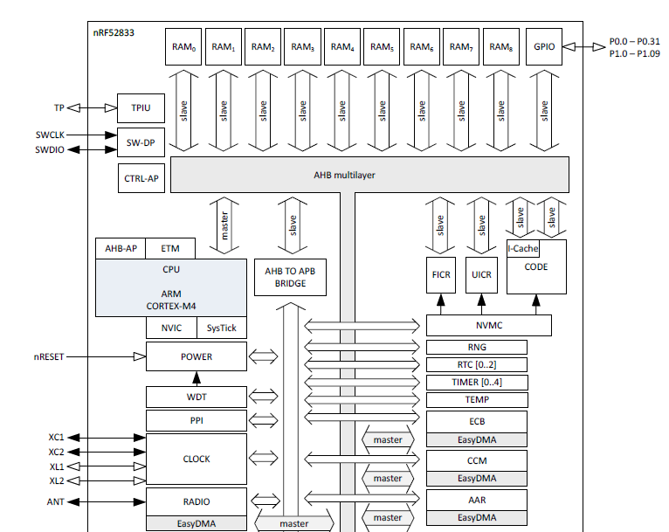
nRF52833 Peripherals
Tour of the nRF52833 peripherals
With some details on the ones we haven’t talked about
Wireless
Crypto
Audio

Slide 16
nRF52833 Peripherals
Cortex-M4F processor
32-bit ARM core
Floating point
Includes Interrupt control and SysTick (an extra timer)

Slide 17
nRF52833 Peripherals
Memory buses

Slide 18
nRF52833 Peripherals
JTAG and Debugging
Allows code updates
Allows GDB to step through code

Slide 19
nRF52833 Peripherals
Volatile memory
SRAM, 128 kB

Slide 20
nRF52833 Peripherals
Nonvolatile memory
Flash, 512 kB
Non-Volatile Memory Controller

Slide 21
nRF52833 Peripherals
Power and Clock management

Slide 22
nRF52833 Peripherals
GPIO pins

Slide 23
nRF52833 Peripherals
Various timers
Watchdog Timer
Real-Time Counter
Timer peripheral

Slide 24
nRF52833 Peripherals
Programmable Peripheral Interconnect
Random Number Generator
Temperature sensor

Slide 25
nRF52833 Peripherals
Wireless radio
Bluetooth Low Energy
802.15.4 (Zigbee or Thread)
Cryptography
ECB (AES mode)
CCM (AES mode)
AAR (Accelerated Address Resolver)
For BLE random addresses

Slide 26
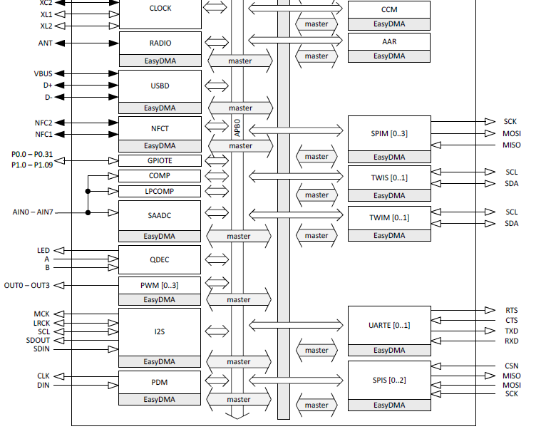
nRF52833 Peripherals
Wired communication protocols
USB Device
SPI
Controller/Peripheral
TWI (I2C)
Controller/Peripheral
UART

Slide 27
nRF52833 Peripherals
Inter-IC Sound (I2S)
Wired communication bus explicitly for audio data
Unrelated to I2C
Like a synchronous UART
Clock, data in, data out
Additional signals
MCK – synchronization
LRCK – left/right channel select

Slide 28
nRF52833 Peripherals
NFC
Near-Field Communication
Close-range wireless communication protocol
“Tap-to-pay” systems

Slide 29
nRF52833 Peripherals
GPIOTE
GPIO interrupts

Slide 30
nRF52833 Peripherals
Analog inputs
Comparator
Low-Power Comparator
Successive Approximation Analog-to-Digital Converter

Slide 31
nRF52833 Peripherals
Quadrature Decoder peripheral
Detects rotation speeds and direction
Usually for motors

Slide 32
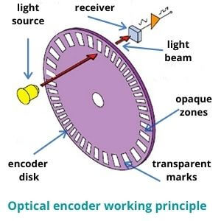
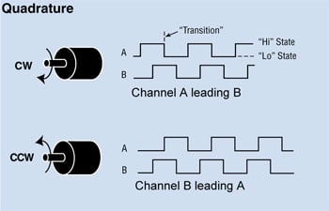
Quadrature Encoding

Slide 33
nRF52833 Peripherals
Pulse Width Modulation
Pulse Density Modulation
Similar idea to PWM
Input-only peripheral
Targets microphones

Slide 34
nRF52833 is complete
That’s just about everything!
First 550 out of 600 pages of nRF52833 datasheet
Remaining 50 are hardware details
Pinout for different packages
Recommended circuit layout
Soldering details

Slide 35
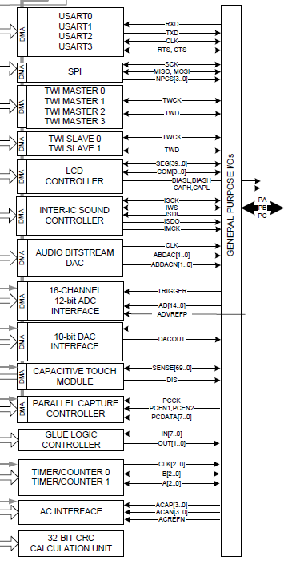
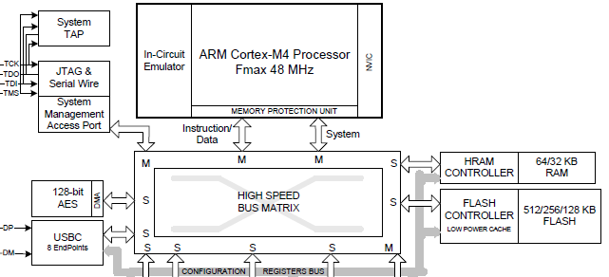
This knowledge is transferrable!
Example: SAM4L datasheet
Atmel Cortex M4F
Various peripherals
USART, SPI, TWI, I2S, DAC, ADC, Timer, …

Slide 36
Outline
What haven’t we talked about?
Microbit
nRF52833
Sensing Systems Research

Slide 37
Conferences for sensing systems research
SenSys
Conference on Embedded Networked Sensor Systems
IPSN
Conference on Information Processing in Sensor Networks
MobiCom
Conference on Mobile Computing and Networking
UbiComp
Conference on Pervasive and Ubiquitous Computing
Various other systems or HCI venues
Occasionally Electrical or Civil Engineering venues too

Slide 38
Sensing systems research
Combination of engineering and exploration
Generally divides into two different focuses
Often projects will mix some of each domain
Platforms
How to improve the capabilities of sensing systems
Examples: lower power, better wireless, new sensors
Applications
How to use sensing systems to meet some desired goal
Examples: track human interactions, measure household energy use

Slide 39
Sensing systems research
Platforms
How to improve the capabilities of sensing systems
Examples: lower power, better wireless, new sensors
Applications
How to use sensing systems to meet some desired goal
Examples: track human interactions, measure household energy use

Slide 40
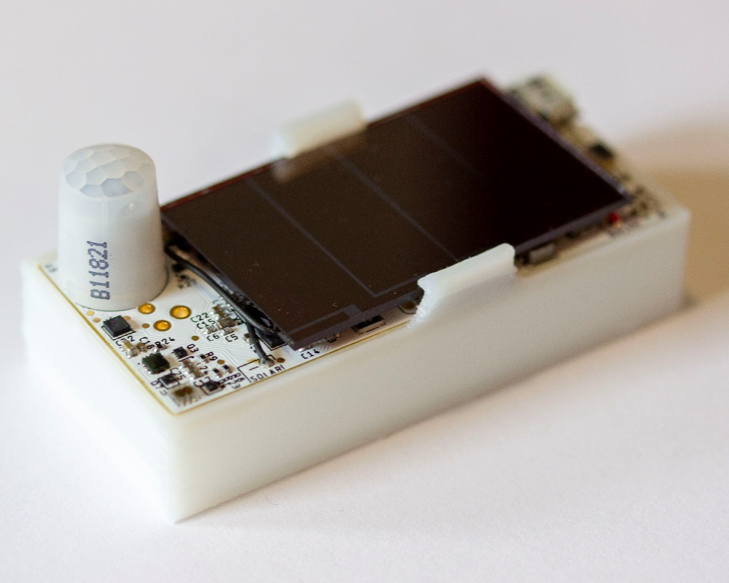
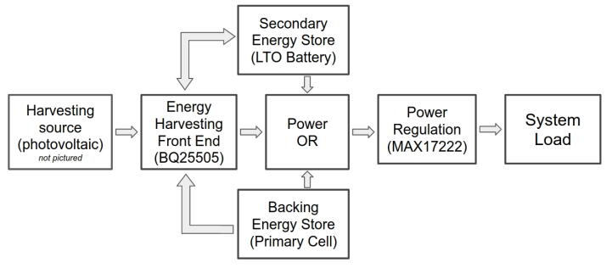
Permamote (Jackson, Adkins, Dutta)
Goal: create a 10-year wireless sensor
Solutions
Modern sensors and microcontroller
Energy harvesting combined with rechargeable battery
Non-rechargeable battery as backup power
https://lab11.eecs.berkeley.edu/content/pubs/jackson19capacity.pdf

Slide 41
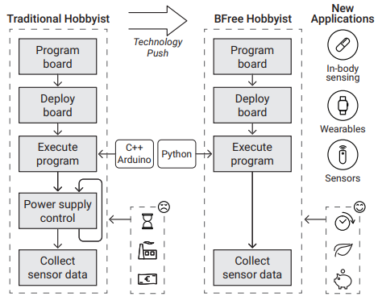
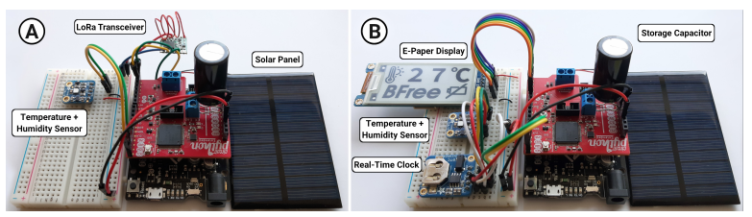
Bfree (Kortbeek, Bakar, Cruz, Yildririm, Pawelczak, Hester)
Goal: hobbyist intermittent systems
Solutions
Automatic checkpointing in python runtime
Hardware module for easy prototyping
User studies to demonstrate improvements
https://dl.acm.org/doi/abs/10.1145/3432191

Slide 42
Tock (Levy, Campbell, Ghena, Giffin, Pannuto, Dutta, Levis)
Goal: safe and reliable embedded OS
Demonstrate this is possible on small embedded platforms
Solutions
Dedicated OS kernel with separate applications
Protect applications with hardware features
Memory Protection Unit
Protect kernel with language features
Rust programming language
https://lab11.eecs.berkeley.edu/content/pubs/levy17multiprogramming.pdf

Slide 43

Tock software organization
C App Ported to Tock
App written in Rust
[Service] BLE Environmental Sensing Profile
while(1)
😈
Untrusted
(isolated by the MPU and preemptively scheduled)
Syscall Interface
libtock
libtock-rs
libtock
libnrf
Kernel (Rust)
System Calls
Thread
Virt. Timer
BLE
Temp. Sensor
Untrusted
(unsafe forbidden)
Capsules
6LoWPAN
SD Card
Console
SI7021
Core Kernel
Scheduler, Process management, etc.
Standardized Hardware Interface Layer (HIL)
Trusted
(unsafe allowed for MMIO, PIC, etc.)
Microcontroller-specific Peripheral Drivers
SPI
RNG
Timer
ADC
GPIO
I2C
UART
AES
DAC
USB
Hardware
CPU
SPI
RNG
Timer
ADC
GPIO
I2C
UART
AES
DAC
USB

Slide 44
Sensing systems research
Platforms
How to improve the capabilities of sensing systems
Examples: lower power, better wireless, new sensors
Applications
How to use sensing systems to meet some desired goal
Examples: track human interactions, measure household energy use

Slide 45
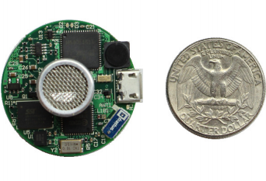
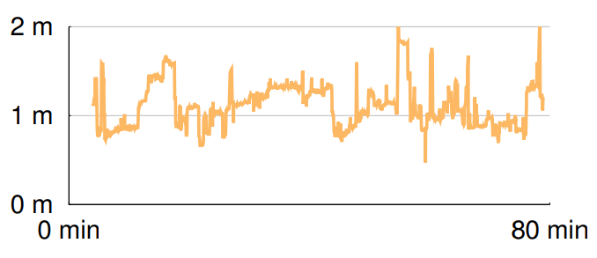
Opo (Huang, Kuo, Pannuto, Dutta)
Goal: sense distance of human interactions
Real-time, high accuracy, deployable
Solutions
Ultrasonic allows for low-power detection of nearby devices
Also provides directionality
Measure difference in arrival time of RF and Ultrasonic to determine distance
https://lab11.eecs.berkeley.edu/content/pubs/huang14opo.pdf

Slide 46
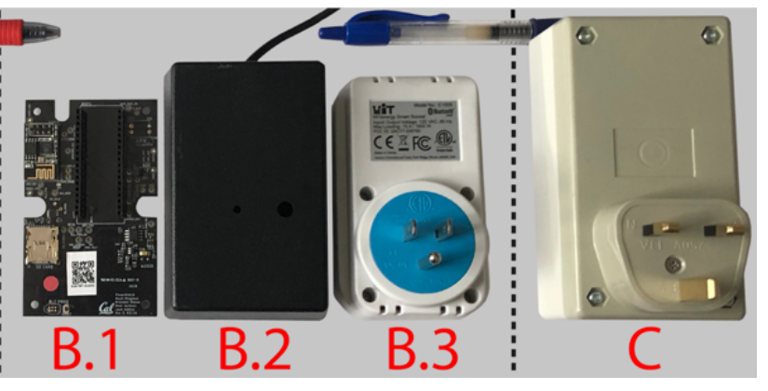
Powerwatch (Klugman, Adkins, et al.)
Goal: measure electric grid reliability in developing regions
“Access alone is insufficient. Reliability matters too.”
Solutions:
Wall-powered sensor with battery-backup to detect outages and report over cellular
Infrastructure to collect measurements and cross-correlate
Create a team to manage the deployment
https://lab11.eecs.berkeley.edu/content/pubs/klugman19scale.pdf

Slide 47
Outline
What haven’t we talked about?
Microbit
nRF52833
Sensing Systems Research

