Slide 1
Lecture 03 Embedded Software
CE346 – Microprocessor System Design
Branden Ghena – Spring 2021
Some slides borrowed from: Josiah Hester (Northwestern), Prabal Dutta (UC Berkeley)

Slide 2
Updates
Hardware for anyone who filled out the form by class Wednesday
Should be here today? Maybe Monday.
All orders have been placed
Except for a few new students

Slide 3
Today’s Goals
Discuss challenges of embedded software
Describe compilation and linking of embedded code
Explore the microcontroller boot process

Slide 4
Outline
Microbit microcontroller
Embedded Software
Embedded Toolchain
Lab Software Environment
Boot Process

Slide 5
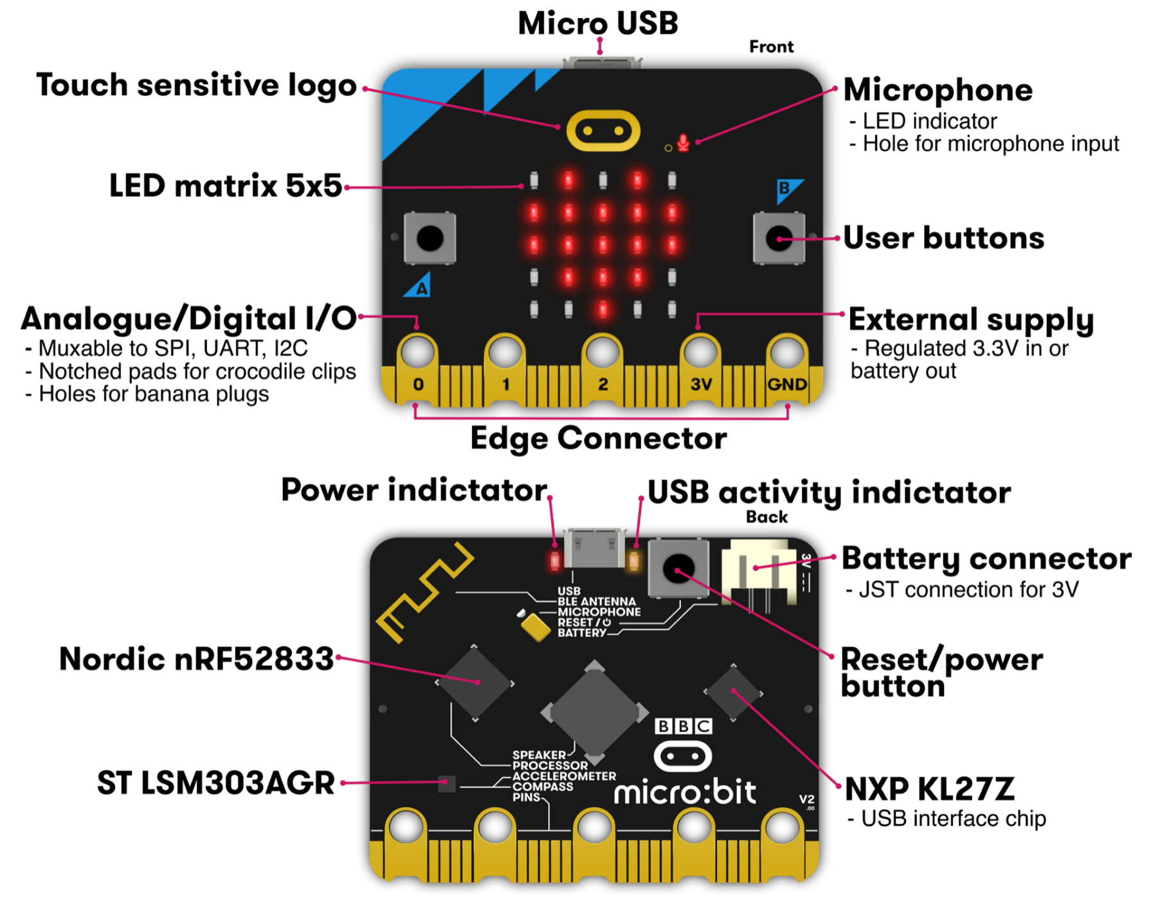
Micro:bit v2
Circuit board
Entire thing
a.k.a “Dev Board”
a.k.a PCB (Printed Circuit Board)
Microcontroller
The computer on it
Microbit has two
One as a programmer
One for applications
Microcontrollers

Slide 6
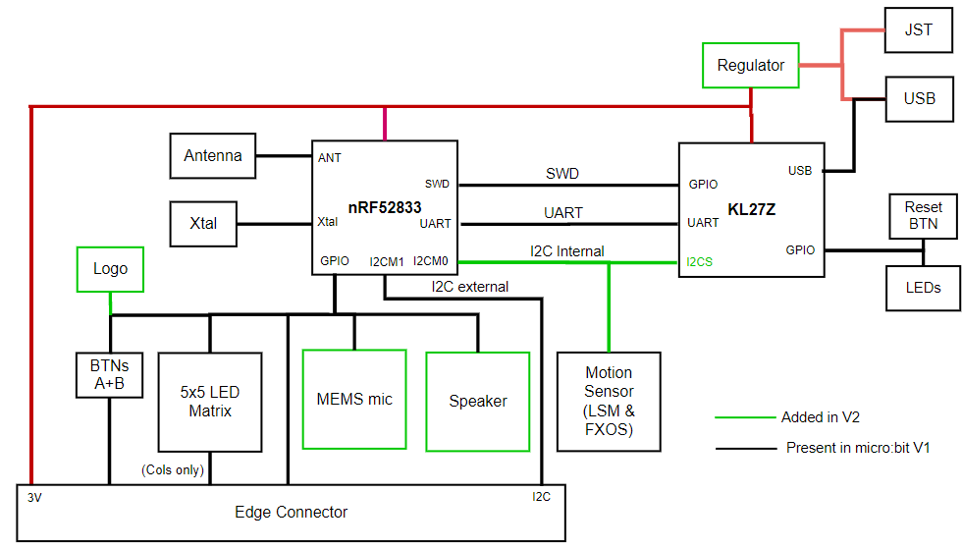
KL27Z – Programmer on the Micro:bit v2
32-bit ARM Cortex-M0+ microcontroller
48 MHz core, 16 KB RAM, 256 KB Flash
Acts as a programming interface to nRF52833
Connects to USB and to JTAG (SWD)

Slide 7
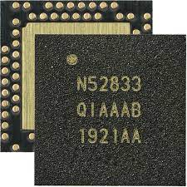
nRF52833 – Microcontroller on the Micro:bit v2
32-bit ARM Cortex-M4F microcontroller
64 MHz core, 128 KB RAM, 512 KB Flash
Floating point support
2.4 GHz Radio: Bluetooth Low energy / 802.15.4
Various peripherals
ADC, PWM
I2C, UART, SPI, USB
RNG, 32-bit Timers, Watchdog, Temperature
Up to 42 I/O pins

Slide 8
To the datasheet!
nRF52833 Product Specification
Online: https://infocenter.nordicsemi.com/index.jsp?topic=%2Fps_nrf52833%2Fkeyfeatures_html5.html
PDF: https://infocenter.nordicsemi.com/pdf/nRF52833_PS_v1.3.pdf

Slide 9
Outline
Microbit microcontroller
Embedded Software
Embedded Toolchain
Lab Software Environment
Boot Process

Slide 10
Assumptions of embedded programs
Expect limitations
Very little memory
Very little computational power
Very little energy
Don’t expect a lot of support
Likely no operating system
Might not even have error reporting capabilities
Moral: think differently about your programs

Slide 11
Ramifications of limited memory
Stack and Data sections are limited
Be careful about too much recursion
Be careful about large local variables
Large data structures defined globally are preferred
Fail at compile time
Heap section is likely non-existent
Why?

Slide 12
Ramifications of limited memory
Stack and Data sections are limited
Be careful about too much recursion
Be careful about large local variables
Large data structures defined globally are preferred
Fail at compile time
Heap section is likely non-existent
Why?
Malloc could run out of memory at runtime

Slide 13
Avoiding dynamic memory
Malloc is scary in an embedded context
What if there’s no more memory available?
Traditional computer
Swap memory to disk
Worst case: wait for a process to end (or kill one)
Embedded computer
There’s likely only a single application
And it’s the one asking for more memory
So it’s not giving anything back anytime soon
This is unlikely to happen at boot
Instead it’ll happen hours or days into running as memory is slowly exhausted…

Slide 14
Limitations on processing power
Typically not all that important
Code still runs pretty fast
10 MHz -> 100 ns per cycle
Controlling hardware usually doesn’t have a lot of code complexity
Quickly gets to the “waiting on hardware” part
Problems
Machine learning
Learning on the device is neigh impossible
Memory limitations make it hard to fit weights anyways
Cryptography
Public key encryption takes seconds to minutes

Slide 15
Common programming languages for embedded
C
For all the reasons that you assume
Easy to map variables to memory usage and code to instructions
Assembly
Not entirely uncommon, but rarer than you might guess
C code optimized by a modern compiler is likely faster
Notable uses:
Cryptography to create deterministic algorithms
Operating Systems to handle process swaps

Slide 16
Rarer programming languages for embedded
C++
Similar to C but with better library support
Libraries take up a lot of code space though ~100 KB
Rust
Modern language with safety and reliability guarantees
Relatively new to the embedded space
And a high learning curve
Python, Javascript, etc.
Mostly toy languages
Fine for simple things but incapable of complex operations

Slide 17
What’s missing from programming languages?
The embedded domain has several requirements that other domains do not
What is missing from programming languages that it wants?
Sense of time
Sense of energy

Slide 18
Programming languages have no sense of time
Imagine a system that needs to send messages to a motor every 10 milliseconds
Write a function that definitely completes within 10 milliseconds
Accounting for timing when programming is very challenging
We can profile code and determine timing at runtime
If we know many details of hardware, instructions can give timing
Unless the code interacts with external devices

Slide 19
Determining energy use is rather complicated
Software might
Start executing a loop
Turn on/off an LED
Send messages over a wired bus to another device
Determining energy these operations take is really difficult
Even with many details of the hardware
Different choices of clocks can have a large impact
Often profiled at runtime after writing the code
Iterative write-test-modify cycle

Slide 20
Outline
Microbit microcontroller
Embedded Software
Embedded Toolchain
Lab Software Environment
Boot Process

Slide 21
Embedded compilation steps
Same first steps as any system
Compiler
Turn C code into assembly
Optimize code (often for size instead of speed)

Slide 22
Cross compilers compile for different architectures
The compiler we’ll be using is a cross compiler
Run on one architecture but compile code for another
Example: runs on x86-64 but compiles armv7e-m
GCC is named: ARCH-VENDOR-(OS-)-ABI-gcc
arm-none-eabi-gcc
ARM architecture
No vendor
No OS
Embedded Application Binary Interface
Others: arm-none-linux-gnueabi, i686-unknown-linux-gnu

Slide 23
Embedded compilation steps
Same first steps as any system
Compiler
Turn C code into assembly
Optimize code (often for size instead of speed)
Linker
Combine multiple C files together
Resolve dependencies
Point function calls at correct place
Connect creation and uses of global variables

Slide 24
Informing linker of system memory
Linker actually places code and variables in memory
It needs to know where to place things
How do traditional computers handle this?

Slide 25
Informing linker of system memory
Linker actually places code and variables in memory
It needs to know where to place things
How do traditional computers handle this?
Virtual memory allows all applications to use the same memory addresses
Embedded solution
Only run a single application
Provide an LD file
Specifies memory layout for a certain system
Places sections of code in different places in memory

Slide 26
Anatomy of an LD file
nRF52833: 512 KB Flash, 128 KB SRAM
First, LD file defines memory regions
MEMORY {
FLASH (rx) : ORIGIN = 0x00000000, LENGTH = 0x80000
RAM (rwx) : ORIGIN = 0x20000000, LENGTH = 0x20000
}
A neat thing about microcontrollers: pointers have meaning
Just printing the value of a pointer can tell you if it’s in Flash or RAM

Slide 27
Anatomy of an LD file
It then places sections of code into those memory regions
.text : {
KEEP(*(.Vectors))
*(.text*)
*(.rodata*)
. = ALIGN(4);
} > FLASH __etext = .;
.data : AT (__etext) {
__data_start__ = .;
*(.data*)
__data_end__ = .;
} > RAM
.bss : {
. = ALIGN(4);
__bss_start__ = .;
*(.bss*)
. = ALIGN(4);
__bss_end__ = .;
} > RAM

Slide 28
Sections of code
Where do these sections come from?
Most are generated by the compiler
.text, .rodata, .data, .bss
You need to be deep in the docs to figure out how the esoteric ones work
Some are generated by the programmer
Allows you to place certain data items in a specific way
__attribute__((section(".foo")))
int test[10] = {0,0,0,0,0,0,0,0,0,0};

Slide 29
Embedded compilation steps
Same first steps as any system
Compiler
Turn C code into assembly
Optimize code (often for size instead of speed)
Linker
Combine multiple C files together
Resolve dependencies
Point function calls at correct place
Connect creation and uses of global variables
Output: a binary (or hex) file

Slide 30
Example
Demonstrated in the blink application in lab repo
https://github.com/nu-ce346/nu-microbit-base/tree/main/software/apps/blink

Slide 31
Outline
Microbit microcontroller
Embedded Software
Embedded Toolchain
Lab Software Environment
Boot Process

Slide 32
Embedded environments
There are a multitude of embedded software systems
Every microcontroller vendor has their own
Popular platforms like Arduino
We’re using the Nordic software plus some extensions made by my research group
It’ll be a few weeks until that matters for the most part
We’ll start off by writing low-level drivers ourselves

Slide 33
Software Development Kit (SDK)
Libraries provided by Nordic for using their microcontrollers
Actually incredibly well documented! (relatively)
Various peripherals and library tools
SDK documentation
https://infocenter.nordicsemi.com/topic/sdk_nrf5_v16.0.0/index.html
Warning: search doesn’t really work
Most useful link is probably to the list of data structures
https://infocenter.nordicsemi.com/topic/sdk_nrf5_v16.0.0/annotated.html

Slide 34

nRF52x-base
Wrapper built around the SDK by Lab11
Branden Ghena, Brad Campbell (UVA), Neal Jackson, a few others
Allows everything to be used with Makefiles and command line
https://github.com/lab11/nrf52x-base
We include it as a submodule
It has a copy of the SDK code and softdevice binaries
It has a whole Makefile system to include to proper C and H files
We include a Board file that specifies our specific board’s needs and capabilities
Go to repo to explain

Slide 35
Outline
Microbit microcontroller
Embedded Software
Embedded Toolchain
Lab Software Environment
Boot Process

Slide 36
How does a microcontroller start running code?
Power comes on
Microcontroller needs to start executing assembly code
You expect your main() function to run
But a few things need to happen first

Slide 37
Step 0: set a stack pointer
Assembly code might need to write data to the stack
Might call functions that need to stack registers
ARM: Valid address for the stack pointer is at address 0 in Flash
Needs to point to somewhere in RAM
Hardware loads it into the Stack Pointer when it powers on

Slide 38
Step 1: set the program counter (PC)
a.k.a. the Instruction Pointer (IP) in x86 land
ARM: valid instruction pointer is at address 4 in Flash
Could point to RAM, usually to Flash though
Automatically loaded into the PC after the SP is loaded
Again, hardware does this

Slide 39
Step 2: “reset handler” prepares memory
Code that handles system resets
Either reset button or power-on reset
Address was loaded into PC in Step 1
Reset handler code:
Loads initial values of .data section from Flash into RAM
Loads zeros as values of .bss section in RAM
Calls SystemInit
Handles various hardware configurations/errata
Calls _start
nu-microbit-base/software/nrf52x-base/sdk/nrf5_sdk_16.0.0/modules/nrfx/mdk/gcc_startup_nrf52833.S nu-microbit-base/software/nrf52x-base/sdk/nrf5_sdk_16.0.0/modules/nrfx/mdk/system_nrf52.c

Slide 40
Step 3: set up C runtime
_start is provided by newlib
An implementation of libc – the C standard library
Startup is a file usually named crt0
Does more setup, almost none of which is relevant for our system
Probably is this code that actually zeros out .bss
Sets argc and argv to 0
Calls main() !!!
https://sourceware.org/git/gitweb.cgi?p=newlib-cygwin.git;a=blob_plain;f=libgloss/arm/crt0.S;hb=HEAD

Slide 41
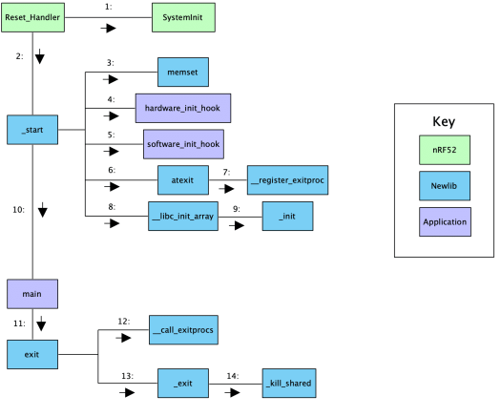
Online writeup with way more details and a diagram
Relevant guide!!
https://embeddedartistry.com/blog/2019/04/17/exploring-startup-implementations-newlib-arm/
Covers the nRF52!

Slide 42
Outline
Microbit microcontroller
Embedded Software
Embedded Toolchain
Lab Software Environment
Boot Process

