Slide 1
Lecture 04 Input and Output
CE346 – Microprocessor System Design
Branden Ghena – Spring 2021
Some slides borrowed from: Josiah Hester (Northwestern), Prabal Dutta (UC Berkeley)

Slide 2
Today’s Goals
How does a microcontroller interact with peripherals to perform input and output operations?
Memory-Mapped I/O
Interrupts
DMA
Explore reliable use of MMIO
Discuss interaction patterns for Interrupts and DMA

Slide 3
Outline
I/O Motivation
Memory-Mapped I/O
Interrupts
DMA

Slide 4
Devices are the point of computers
Traditional systems need to receive input from users and output responses
Keyboard/mouse
Disk
Network
Graphics
Audio
Various USB devices
Embedded systems have the same requirement, just more types of IO
Computer
Processor
Memory
Devices
Control
Input
Datapath
Output

Slide 5
Devices are core to useful general-purpose computing
Input
Output
Mouse
Monitor
Computer
Keyboard
Headphones
Ethernet
Ethernet
Bluetooth
Bluetooth

Slide 6
Devices are essential to cyber-physical systems too
Input
Output
Lidar
Throttle Control
Computer
Inertial Measurement Unit
Brake Control
Camera
Wheel Rotation
CAN
CAN

Slide 7
Device access rates vary by many orders of magnitude
Rates in bit/sec
System must be able to handle each of these
Sometimes needs low overhead
Sometimes needs to not wait around
Device | Behavior | Partner | Data Rate (Kb/s)
Keyboard | Input | Human | 0.2
Mouse | Input | Human | 0.4
Microphone | Output | Human | 700.0
Bluetooth | Input or Output | Machine | 20,000.0
Hard disk drive | Storage | Machine | 100,000.0
Wireless network | Input or Output | Machine | 300,000.0
Solid state drive | Storage | Machine | 500,000.0
Wired LAN network | Input or Output | Machine | 1,000,000.0
Graphics display | Output | Human | 3,000,000.0

Slide 8
Outline
I/O Motivation
Memory-Mapped I/O
Interrupts
DMA

Slide 9
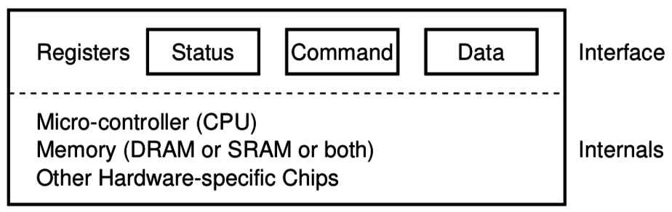
How does a computer talk with peripherals?
A peripheral is a hardware unit within a microcontroller
Sort of a “computer-within-the-computer”
Performs some kind of action given input, generates output
We interact with a peripheral’s interface
Called registers (actually are from EE perspective, but you can’t use them)
Read/Write like they’re data
How do we read/write them?
Options:
Special assembly instructions
Treat like normal memory

Slide 10

Memory-mapped I/O (MMIO): treat devices like normal memory
Certain physical addresses do not actually go to memory
Instead they correspond to peripherals
And any instruction that accesses memory can access them too!
Every microcontroller I’ve ever seen uses MMIO
Address
0xFFFFFFFF
0xFFFF0000
control reg.
data reg.
0x00000000

Slide 11
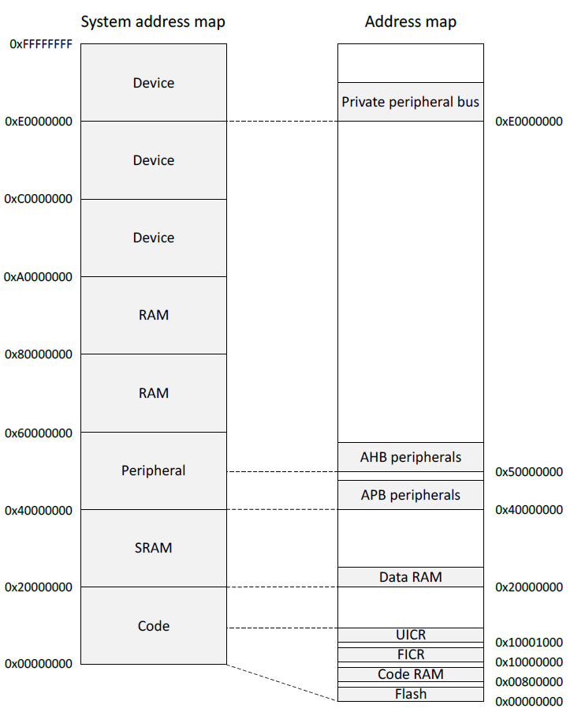
Memory map on nRF52833
Flash 0x00000000
SRAM 0x20000000
APB peripherals 0x40000000
Everything but GPIO
AHB peripherals 0x50000000
Just GPIO
UICR – User Information Config
FICR – Factory Information Config

Slide 12
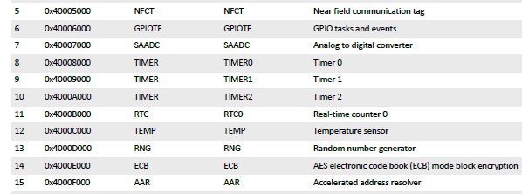
Example nRF52 peripheral placement
0x1000 is plenty of space for each peripheral
1024 registers, each 32 bits
No reason to pack them tighter than that

Slide 13
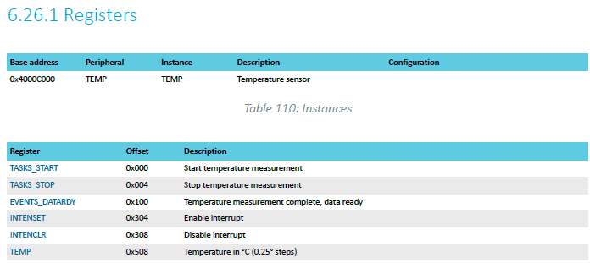
TEMP on nRF52833 example
Internal temperature sensor
0.25° C resolution
Range equivalent to microcontroller IC (-40° to 105° C)
Various configurations for the temperature conversion (ignoring)

Slide 14
MMIO addresses for TEMP
What addresses do we need? (ignore interrupts for now)
0x4000C000 – TASKS_START
0x4000C100 – EVENTS_DATARDY
0x4000C508 - TEMP

Slide 15
Example code
To the terminal!

Slide 16
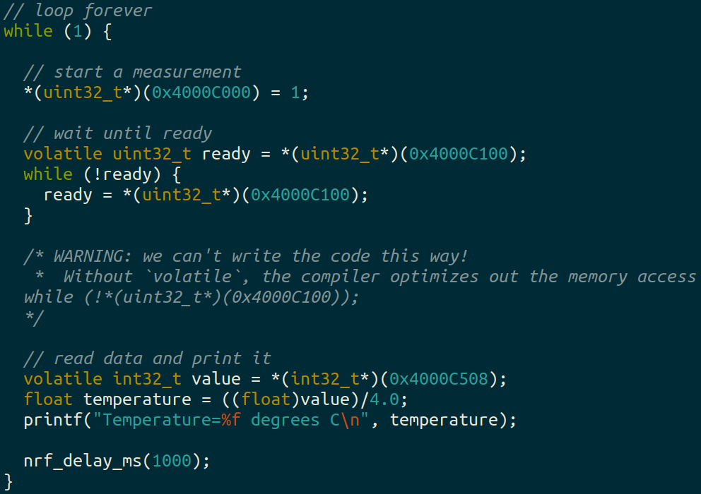
Example code

Slide 17
Using structs to manage MMIO access
Writing simple C code and access peripherals is great!
Problems:
Need to remember all these long addresses
Need to make sure compiler doesn’t stop us!
Solution:
Wrap entire access in a struct!
Compilers turn it into the same thing in the end anyways

Slide 18
C structs
Collection of variables placed together in memory
typedef struct {
uint32_t variable_one;
uint32_t variable_two;
uint32_t array[2];
} example_struct_t;
Placement rules - Variables are placed adjacent to each other in memory except:
Variables are always placed at a multiple of their size
Padding added to the end to make the total size a multiple of the biggest member
Microcontrollers can usually ignore these: all registers are the same size!

Slide 19
Temperature peripheral MMIO struct
typedef struct {
} temp_regs_t;

Slide 20
Temperature peripheral MMIO struct
typedef struct {
uint32_t TASKS_START;
uint32_t TASKS_STOP;
uint32_t _unused_A[62];
uint32_t EVENTS_DATARDY;
uint32_t _unused_B[64+64+1];
uint32_t INTENSET;
uint32_t INTENCLR;
uint32_t _unused_C[64+64];
uint32_t TEMP;
} temp_regs_t;
volatile temp_regs_t* TEMP_REGS = (temp_regs_t*)(0x4000C000);

Slide 21
Temperature peripheral MMIO struct
typedef struct {
uint32_t TASKS_START;
uint32_t TASKS_STOP;
uint32_t _unused_A[62];
uint32_t EVENTS_DATARDY;
uint32_t _unused_B[64+64+1];
uint32_t INTENSET;
uint32_t INTENCLR;
uint32_t _unused_C[64+64];
uint32_t TEMP;
} temp_regs_t;
volatile temp_regs_t* TEMP_REGS = (temp_regs_t*)(0x4000C000);
// code to access
TEMP_REGS->TASKS_START = 1;
while (TEMP_REGS->EVENTS_DATARDY == 0);
float temperature = ((float)TEMP_REGS->TEMP)/4.0;

Slide 22
Outline
I/O Motivation
Memory-Mapped I/O
Interrupts
DMA

Slide 23
What do interactions with devices look like?
while STATUS==BUSY; Wait
(Need to make sure device is ready for a command)
Write value(s) to DATA
Write command(s) to COMMAND
while STATUS==BUSY; Wait
(Need to make sure device has completed the request)
Read value(s) from Data
This is the “polling” model of I/O.
“Poll” the peripheral in software repeatedly to see if it’s ready yet.

Slide 24
Waiting can be a waste of CPU time
while STATUS==BUSY; Wait
(Need to make sure device is ready for a command)
Write value(s) to DATA
Write command(s) to COMMAND
while STATUS==BUSY; Wait
(Need to make sure device has completed the request)
Read value(s) from Data
Imagine a keyboard device
CPU could be waiting for minutes before data arrives
Need a way to notify CPU when an event occurs
Interrupts!

Slide 25
Interrupts
What is an interrupt?
Some event which causes the processor to stop normal execution
The processor instead jumps to a handler for that event
What causes interrupts?
Hardware exceptions
Divide by zero, Undefined Instruction, Memory bus error
Software
Syscall, Software Interrupt (SWI)
External hardware
Input pin, Timer, various “Data Ready”

Slide 26
Interrupts, visually
Some code that’s executing

Slide 27
Interrupts, visually
Some code that’s executing
Interrupt triggers!
Interrupt handler code

Slide 28
Interrupts, visually
Some code that’s executing
Interrupt triggers!
Interrupt handler code
Continue original code

Slide 29
ARM Nested Vectored Interrupt Controller (NVIC)
Handles interrupt entry and exit
Stacking
Unstacking
Priorities
Interrupts can preempt other interrupts!
Jump directly to the interrupt handler
Manages interrupt requests (IRQ)
Stores all callee saved registers on the stack
So the handler code doesn’t overwrite them
Moves the PC to the proper handler, a.k.a. Interrupt Service Routine (ISR)
Restores registers after handler returns and moves PC back

Slide 30
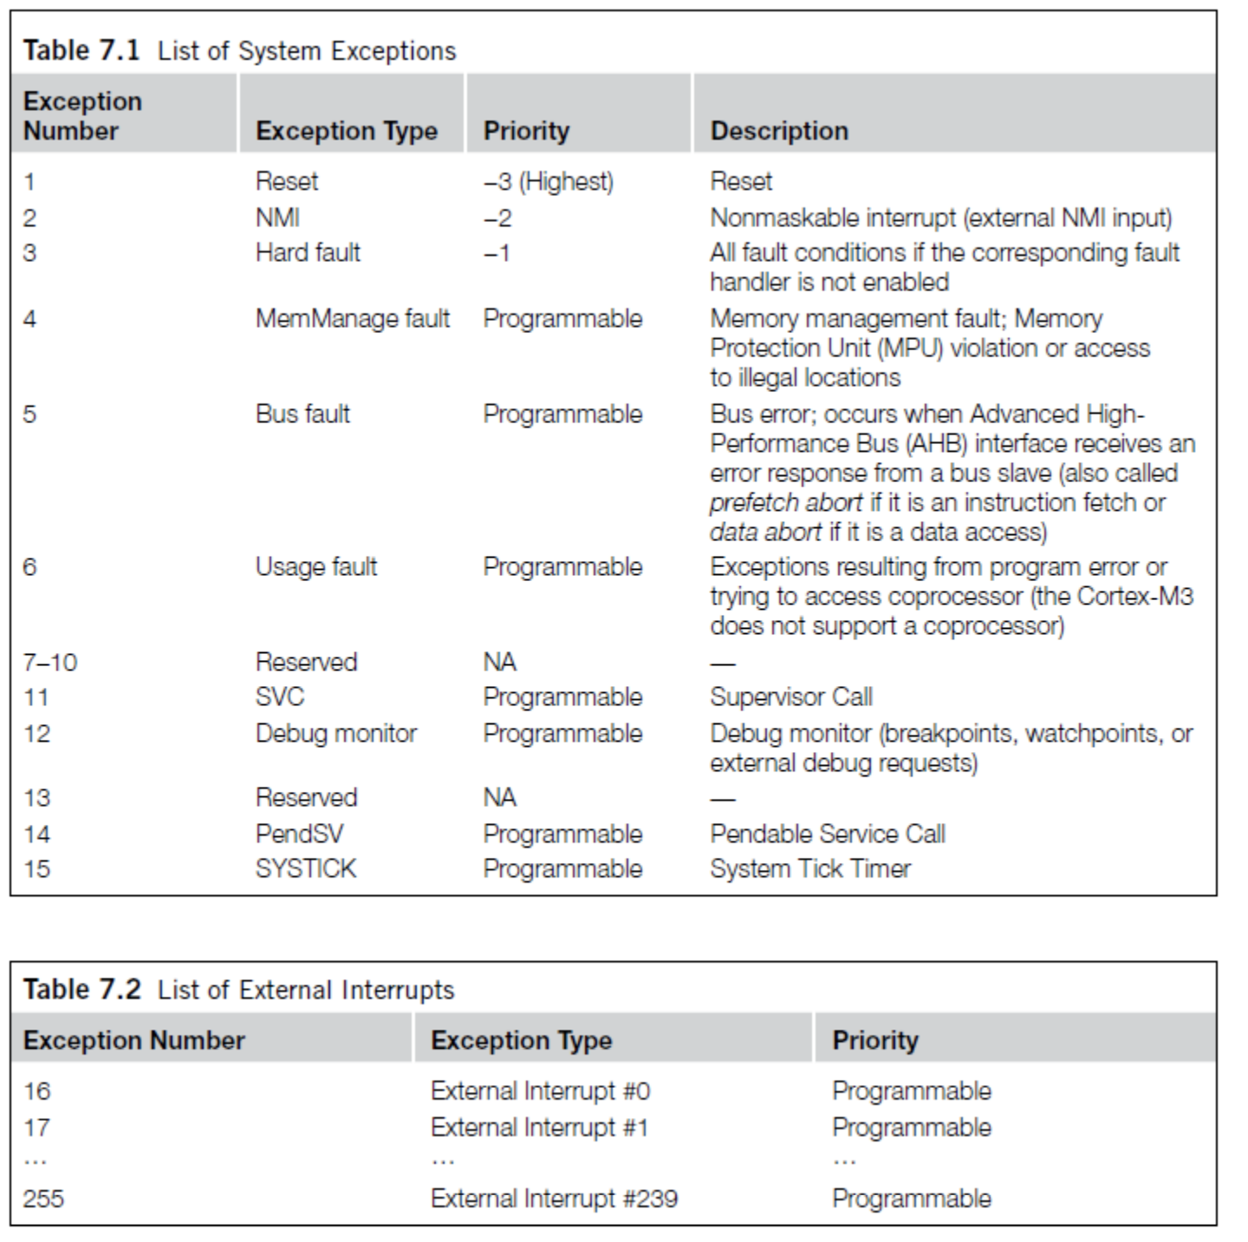
ARM Vector table
List of function pointers to handler for each interrupt/exception
First 15 are architecture-specific exceptions
After that are microcontroller interrupt signals

Slide 31
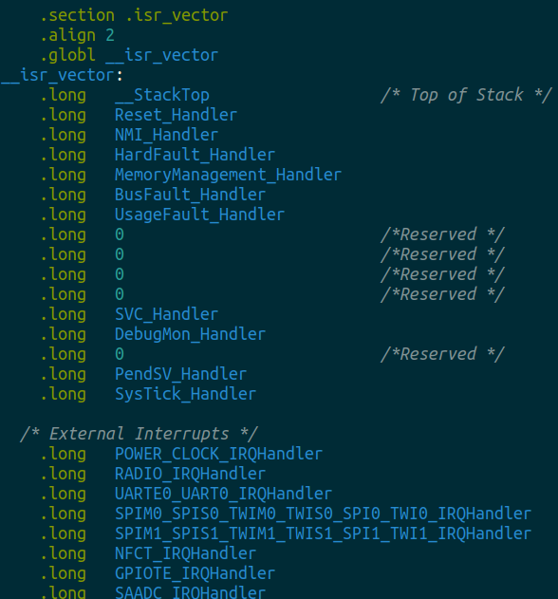
Vector table in software
Placed in its own section
LD file puts it first in Flash
Reset_Handler determines where software starts executing
After that are all exception and interrupt handlers
All function pointers to some C code somewhere

Slide 32
NVIC functionality
NVIC functions
NVIC_EnableIRQ(number)
NVIC_DisableIRQ(number)
NVIC_SetPriority(number, priority)
Technically 256 priorities
Only 8 are implemented
Must enable interrupts in two places!
Enabling interrupt in the peripheral will generate the signal
Enabling interrupt in the NVIC will cause signal to jump to handler
Priority determines which interrupt goes first
And determines how interrupts are nested

Slide 33
Nested interrupts, visually
Some code that’s executing
Interrupt triggers!
Interrupt handler
Higher priority Interrupt triggers!
Interrupt handler
continues
Continue original code

Slide 34
Outline
I/O Motivation
Memory-Mapped I/O
Interrupts
DMA

Slide 35
Direct Memory Access (DMA)
Even with interrupts, providing data to the peripheral is time consuming
Need to be interrupted every byte, to copy the next byte over
DMA is an alternative method that uses hardware to do the memory transfers for the processor
Software writes address of the data and the size to the peripheral
Peripheral reads data directly from memory
Processor can go do other things while read/write is occurring

Slide 36
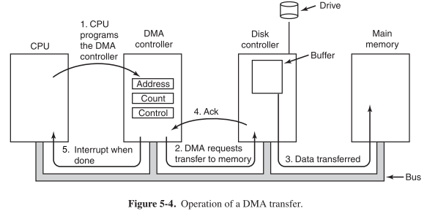
General-purpose DMA

Slide 37
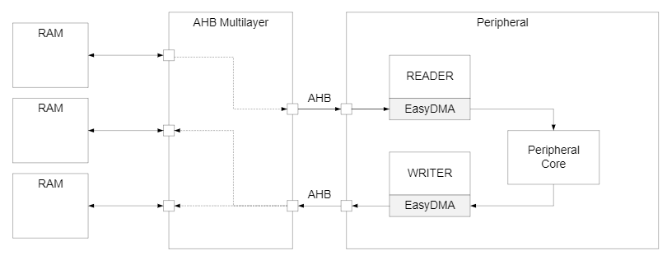
Special-purpose DMA
nRF52 uses “EasyDMA”, which is built into individual peripherals
Only capable of transferring data in/out of that peripheral
Easier to set up and use in practice
Only available on some peripherals though (no DMA for TEMP)
Warning: addresses for DMA MUST be in RAM!

Slide 38
Full peripheral interaction pattern
Configure the peripheral
Enable peripheral interrupts
Set up peripheral DMA transfer
Start peripheral
Continue on to other code
Interrupt occurs, signaling DMA transfer complete
Set up next DMA transfer
Continue on to other code, and repeat

Slide 39
Outline
I/O Motivation
Memory-Mapped I/O
Interrupts
DMA

