Slide 1
Lecture 05 Digital Circuits
CE346 – Microprocessor System Design
Branden Ghena – Spring 2021
Some slides borrowed from: Josiah Hester (Northwestern), Prabal Dutta (UC Berkeley)

Slide 2
Today’s Goals
Understand the basics of digital circuitry
Enough to be able to interact with the Microbit
Explore how the Microbit controls digital inputs and outputs

Slide 3
Outline
Digital circuits
Controlling digital signals
GPIO
GPIOTE

Slide 4
Digital signals
Exist in two states:
High (a.k.a. Set, a.k.a. 1)
Low (a.k.a. Clear, a.k.a. 0)
Simpler to interact with
Constrained to two voltages
With quick transitions between the two
No math for voltage level
Either high or low

Slide 5
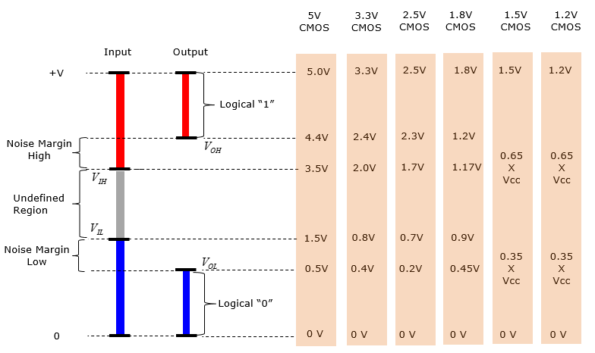
Digital signals map to voltage ranges
Upper range is high signal
~0.7*VDD
Bottom range is low signal
~0.3*VDD
Middle is undefined
Only exists during transitions
http://www.sharetechnote.com/html/Electronics_CMOS.html

Slide 6
Digital circuits
Connecting components together with digital signals
Mostly ICs
Also buttons/switches and LEDs
Way simpler than analog circuits
Mostly connecting boxes with wires
Plus a few resistors here and there
An abstraction
Not sufficient for fully understanding electronics behavior, but close

Slide 7
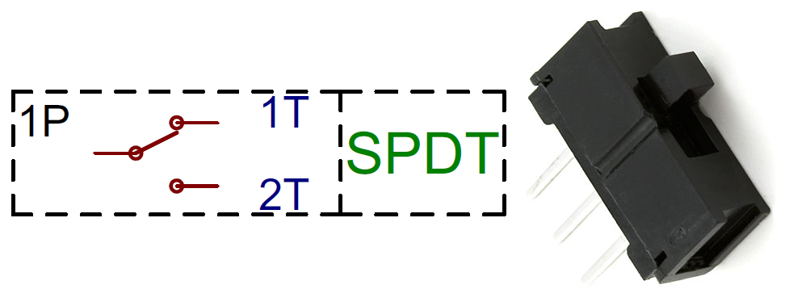
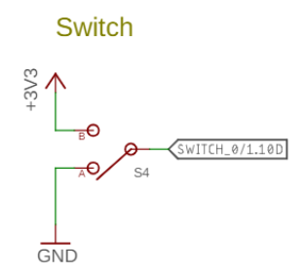
Switches
Single Pole, Double Throw switch
Middle pin (Pole) connects to one of two outer pins (Throws)
For controlling microcontrollers
Often connect outer pins to VCC and Ground respectively
Input then goes High or Low depending on switch state
https://learn.sparkfun.com/tutorials/button-and-switch-basics/

Slide 8
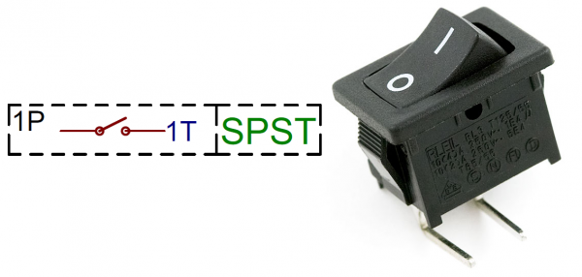
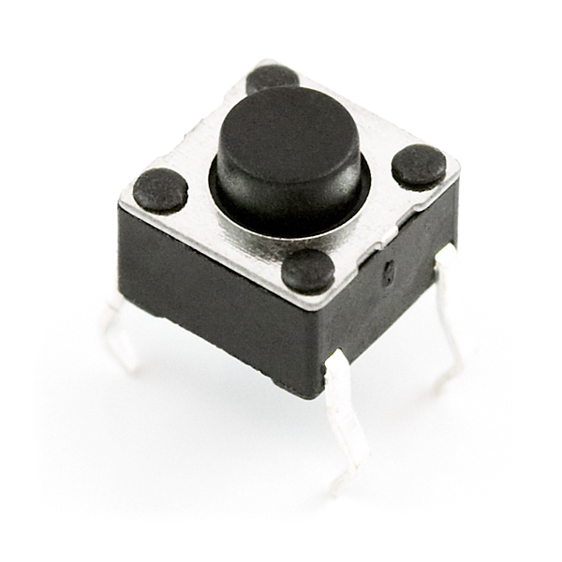
Buttons
Single Pole, Single Throw switch
Pole pin either connects to Throw pin or is disconnected
Come in normally-closed (connected) and normally-open (disconnected)

Slide 9
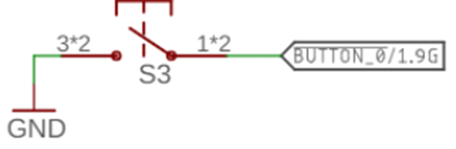
Disconnected circuits
When button is pushed, input signal is low
What is the value of the input when the button is unpressed?

Slide 10
Disconnected circuits
When button is pushed, input signal is low
What is the value of the input when the button is unpressed?
Floating! Could be any voltage
Solution: connect weakly to either high or low voltage

Slide 11
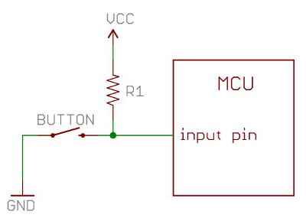
Current flows through the “path of least resistance”
Simplification
Works well for the types of circuits we use
Pull-up resistor
When button is open (disconnected), the only path is through the resistor
When button is closed (connected) the least resistance path is through the button to Ground

Slide 12
Pull-up resistors and pull-down resistors
Resistor sets the “default” value of a wire
Pull-up connects to VCC
Pull-down connects to Ground
Usually 10-100 kΩ
When button is open (disconnected)
Connection through the resistor sets signal
When button is closed (connected)
Signal is directly connected to a voltage source
Much lower resistance means that signal dominates

Slide 13
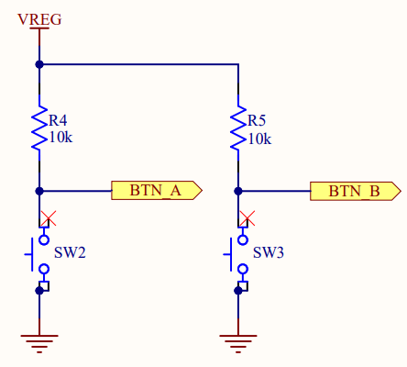
Buttons on the Microbit
Normally open buttons
Disconnected by default
Active low signal
Activating (pushing) button creates a low signal
Pull-up resistors
Set button signal high by default

Slide 14
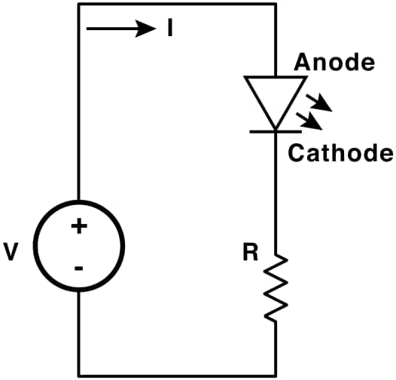
LEDs
Light Emitting Diodes
Generate light as current passes through them
Various colors available
Diodes
Only allow current to go through one way
Not particularly relevant for LEDs
Treat as a digital component
Connect anode to high voltage and cathode to ground
Plus a resistor to limit the total amount of current
https://learn.sparkfun.com/tutorials/light-emitting-diodes-leds

Slide 15
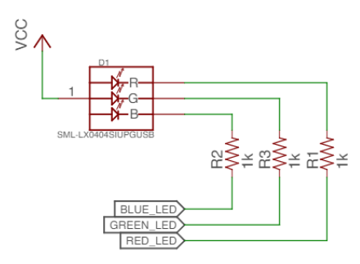
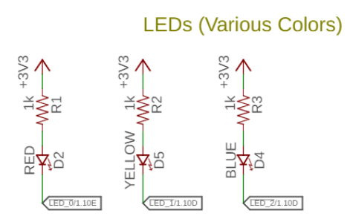
Active state for LEDs
LEDs can be active high or active low depending on configuration
Active high is how people assume they work
Active low is often used instead
GPIO pins can usually sink more current than they can source

Slide 16
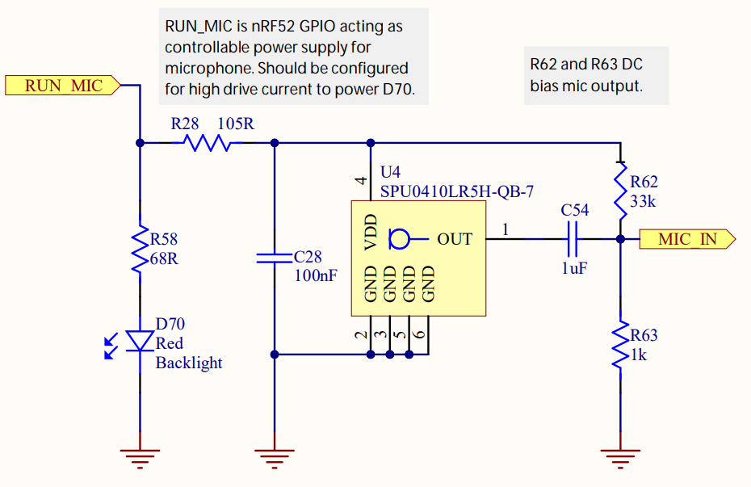
LEDs on the Microbit
Microphone LED
Active high
Simple to use
Ignore this other part for now

Slide 17
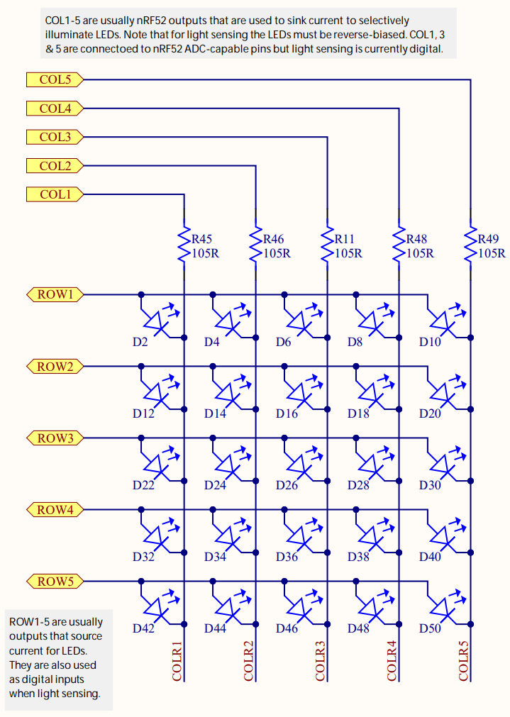
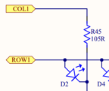
LEDs on the Microbit
Use two GPIO pins to control each LED
Row high as VDD
Column low as Ground
Remember, connections only exist where there are dots

Slide 18
Controlling the LED matrix
Cannot individually control all LEDs simultaneously
Need to light one row at a time
Iterate rows quickly to make them appear on all the time
We’ll have a lab on these later
Combine GPIO and timers

Slide 19
Outline
Digital circuits
Controlling digital signals
GPIO
GPIOTE

Slide 20
General Purpose Input/Output (GPIO)
Read/write from/to external pins on the microcontroller
Two possible values: high (1) or low (0)
Basic unit of operation for microcontrollers
Allows them to interact with buttons and LEDs
Every microcontroller has GPIO

Slide 21
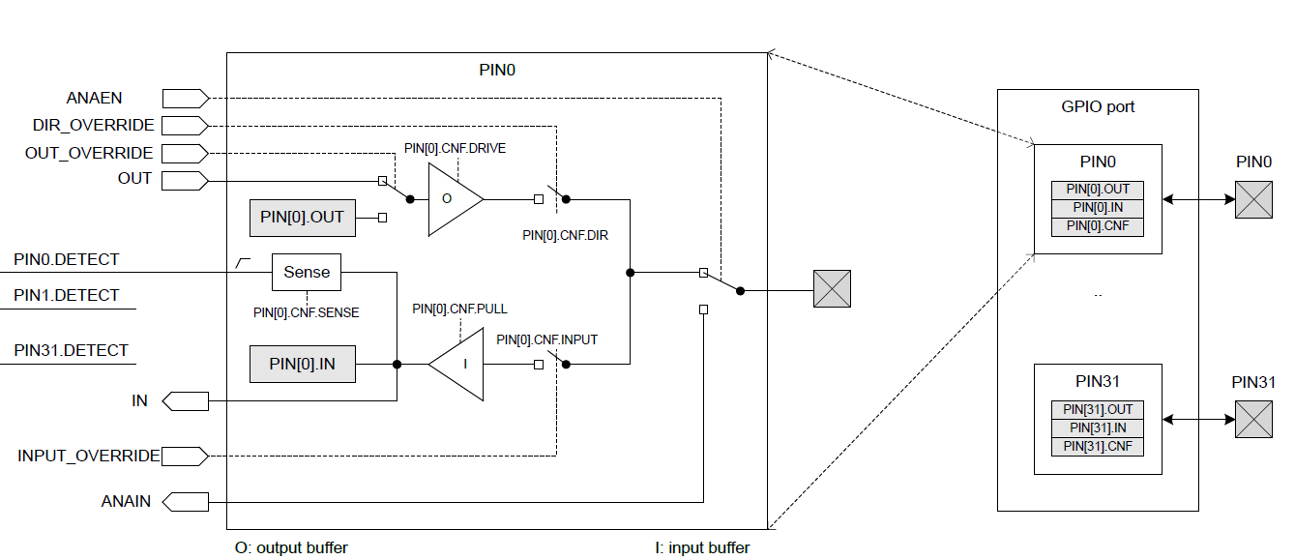
GPIO on nRF52833

Slide 22
GPIO on nRF52833
Abstract model of the pin.
This isn’t really how the hardware is implemented. But it’s a reasonable model for users.

Slide 23
GPIO on nRF52833
Inputs and outputs to/from the peripheral.
GPIO could be controlled by other peripherals. Controlling a pin in use by other peripherals is bad.

Slide 24
GPIO on nRF52833
Registers within the GPIO peripheral. Configure various things about setup.

Slide 25
GPIO on nRF52833
Peripheral contents are duplicated for each output pin.
Each pin has its own registers (or portions thereof).

Slide 26
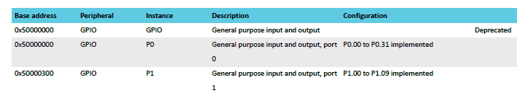
Multiple ports
nRF52833 has up to 42 I/O pins
But only 32 can fit in a single word
Splits them into two “ports”
Pins are named based on port
P0.14 – Button A, P0.23 – Button B
P1.04 – LED column 4

Slide 27
GPIO on nRF52833
External pin on the microcontroller

Slide 28
GPIO on nRF52833
Output chain. Signal comes from OUT register, through output buffer, to external pin.

Slide 29
GPIO Output
Outputs a high or low signal
Output configurations
High drive output (either for high, low, or both)
Sources or sinks additional current
For powering external devices
Normal drive: ~2 mA
High drive: ~10 mA
Disconnect (a.k.a. High Impedance or High-Z)
Wired-OR or Wired-AND scenarios

Slide 30
GPIO on nRF52833
Input chain. Signal goes from pin, through input buffer, to IN register.

Slide 31
GPIO Input
Reads in a signal as either high or low
Input Configurations
Input buffer connect/disconnect
Allows the pin to be disabled if not being read from
Pull
Disabled, Pulldown, Pullup
Connects an internal pull up/down resistor (~13 kΩ)
Sets default value of input

Slide 32
Electrical specifications
High voltage range: 0.7*VDD to VDD (~2.3 volts)
Low voltage range: Ground to 0.3*VDD (~1 volt)
GPIO are extremely fast
Transition time is <25 ns
Connected directly to memory bus for faster interactions
This allows complicated signal patterns to be replicated in software
If they aren’t implemented as a hardware peripheral
Known as bit-banging

Slide 33
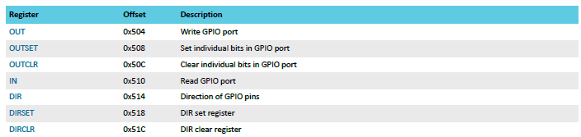
Set/Clear registers
OUT works traditionally: write a 1 for high, 0 for low
OUTSET write a 1 to set that pin (high) zero has no effect
OUTCLR write a 1 to clear that pin (low) zero has no effect
Lets you modify a pin without modifying the others (or reading first)

Slide 34
Outline
Digital circuits
Controlling digital signals
GPIO
GPIOTE

Slide 35
Handling interrupts from GPIO
Separate peripheral, GPIOTE (GPIO Task/Event)
Manages up to 8 individual pins
Can read inputs and trigger interrupts
Can also connect outputs from events on other peripherals (PPI)
Can trigger interrupts for a “Port event” as well
Software checks which pin(s) caused the event to occur
Very low power operation (works with system clocks off)
Unclear why this is a separate peripheral
Presumably too complicated/expensive to have 42 of them

Slide 36
Configuring individual input interrupts
Pick an available GPIOTE channel (0-7)
Configure it
Port and Pin number
Task (output), Event (input), or Disabled
Polarity for input events
Low-to-high
High-to-low
Toggle (both directions)
Enable interrupts for channel in GPIOTE (and in NVIC!)
Clear event in interrupt handler
Doesn’t happen automatically

Slide 37
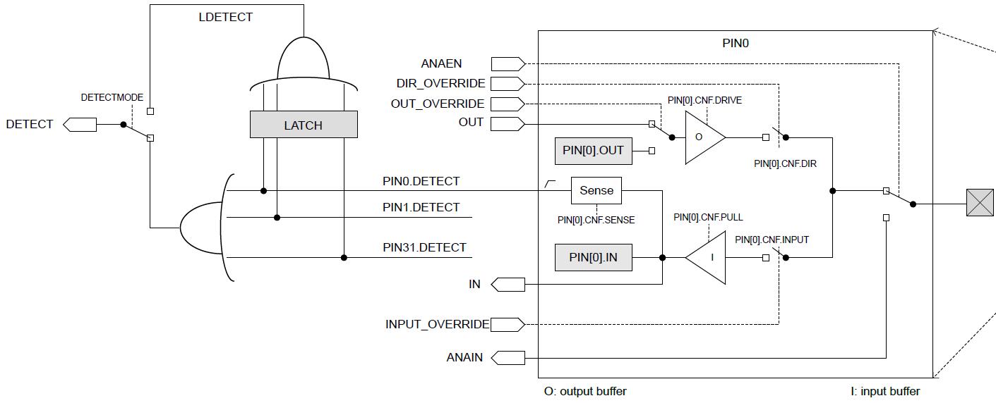
Sensing port events
Uses the “Detect” signal. Generated from pin Sense configuration

Slide 38
Configuring port input interrupts
Configure the Sense for each pin
High or Low
Allows different pins to have different “active” states
Select detect mode
Direct connection to pins
Latched version (saved even if pin later changes back)
Enable interrupts for port in GPIOTE (and in NVIC!)
Clear event in interrupt handler and value in Latch register
Doesn’t happen automatically

Slide 39
Outline
Digital circuits
Controlling digital signals
GPIO
GPIOTE

Slide 40
Outline
Bonus: thoughts on energy use

Slide 41
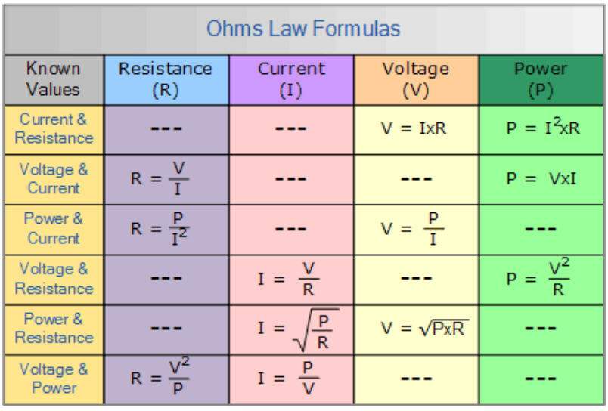
Ohm’s Law
V = I x R
Volts = Current times Resistance
P = I x V
Power = Current times Voltage
These two equations govern most of the circuit math we’ll need in this course
Work with resistive circuits

Slide 42
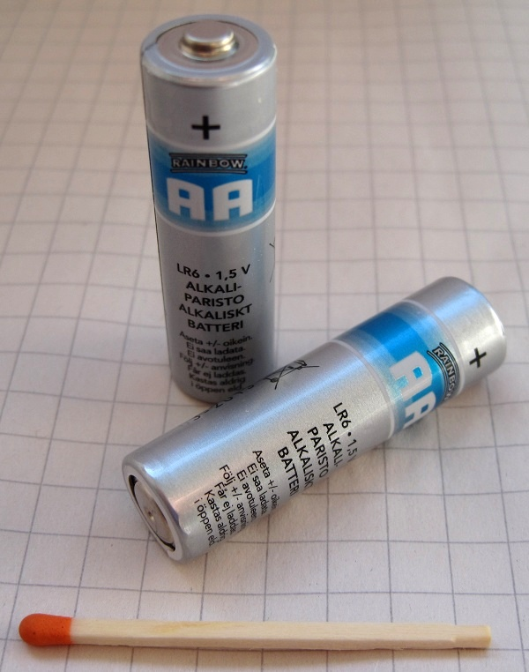
Thinking about energy
Batteries often list energy in mA*h (milliamp – hours)
Coin cell battery: 3v at 220 mAh
2x AA battery: 3v at 2000 mAh
iPhone 11 battery: 3.7v at 3000 mAh
nRF52833 active current: 5.6 mA (at 3v)
Coin cell: 40 hours -> ~2 days
2x AA: 360 hours -> ~15 days
iPhone 11: 535 hours -> ~22 days
So how does any of this work???

Slide 43
Microcontroller sleep modes
Sleep mode
Processor stops running
Most peripherals are disabled
Continues until an interrupt occurs and wakes the microcontroller
Usually a timer or GPIO input
nRF52833 sleep mode current: 1.8 μA (GPIO port event only)
Coin cell: 122222 hours -> ~5000 days -> ~14 years
Low-power systems shoot for less than 1% duty cycle
Average current of ~100 μA or less
Warning: other stuff on the board counts!!
LEDs are 1-10 mA each… Power is not a concern of the Microbit

