Slide 1
Lecture 06 Timers
CE346 – Microprocessor System Design
Branden Ghena – Spring 2021
Some slides borrowed from: Josiah Hester (Northwestern), Prabal Dutta (UC Berkeley)

Slide 2
Today’s Goals
Understand the role of clocks in a microcontroller
Explore functionality of various timer peripherals on the Microbit

Slide 3
Outline
Clocks
Timers
Real-Time Counter
Watchdog

Slide 4
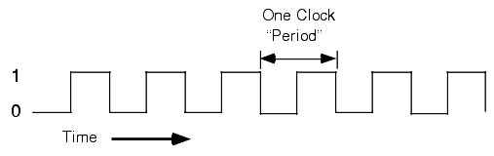
What are clocks?
Clock signals, in the microcontroller context, are oscillating square wave signals used to latch inputs
A clock MUST be running for (almost) anything on a microcontroller to function (processor and peripherals)
Exceptions:
Low-power input interrupts
GPIOTE port interrupt, Analog LPCOMP interrupt, NFC sense interrupt, USB power interrupt
Reset signal

Slide 5
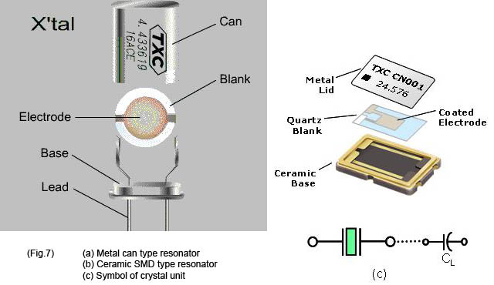
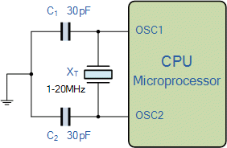
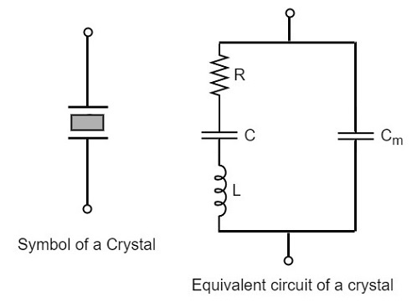
Generating clocks
External crystal oscillator
Creates clock signal
Chunk of quartz
Behaves like RLC circuit but uses less energy
Internal mechanisms
RC oscillator
Creates clock signal
Less accurate and higher energy than crystal
Phase-Locked Loop (PLL)
Multiply input to create new higher frequency clocks

Slide 6
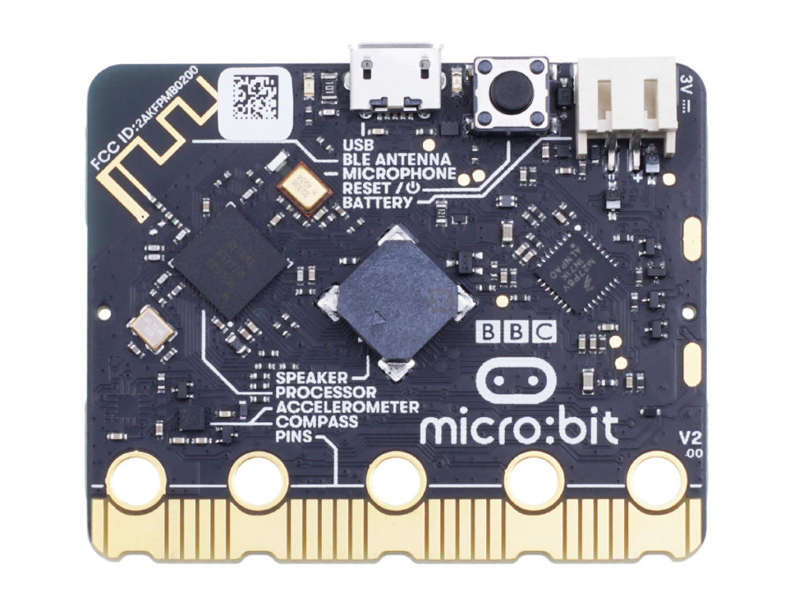
Microbit crystal for nRF52833

Slide 7
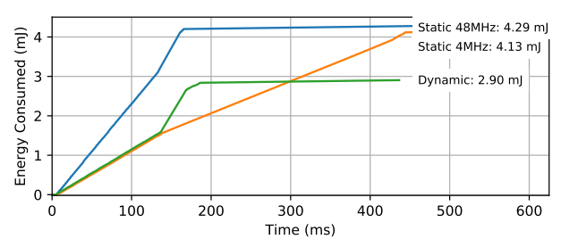
Clocks and energy
Fundamental tradeoff
Faster clock gets things done faster but uses more energy
Slower clock uses less energy but gets things done slower
Which to use depends on the situation
CPU bound: faster clock, IO bound: slower clock
Example of clock selection for a mixed load (part IO, part CPU)
Energy consumed becomes a horizontal line when the task is completed
Chiang et al. “Power Clocks: Dynamic Multi-Clock Management for Embedded Systems” EWSN 2021

Slide 8
Controlling clocks
Some microcontrollers provide extremely fine-grained control over clocks
Really complicated section of code to get working
Many combinations are invalid
Manually enable/disable clocks as needed
nRF52 instead gives almost no control but is easier to use
One 64-MHz clock for processor
Multiple peripheral clocks, but (most) peripherals are hardwired to one
16 MHz for almost all peripherals (PDM and I2S are 32 MHz)
Low-frequency 32 kHz clock for low-power peripherals
Automatically enables/disables clocks

Slide 9
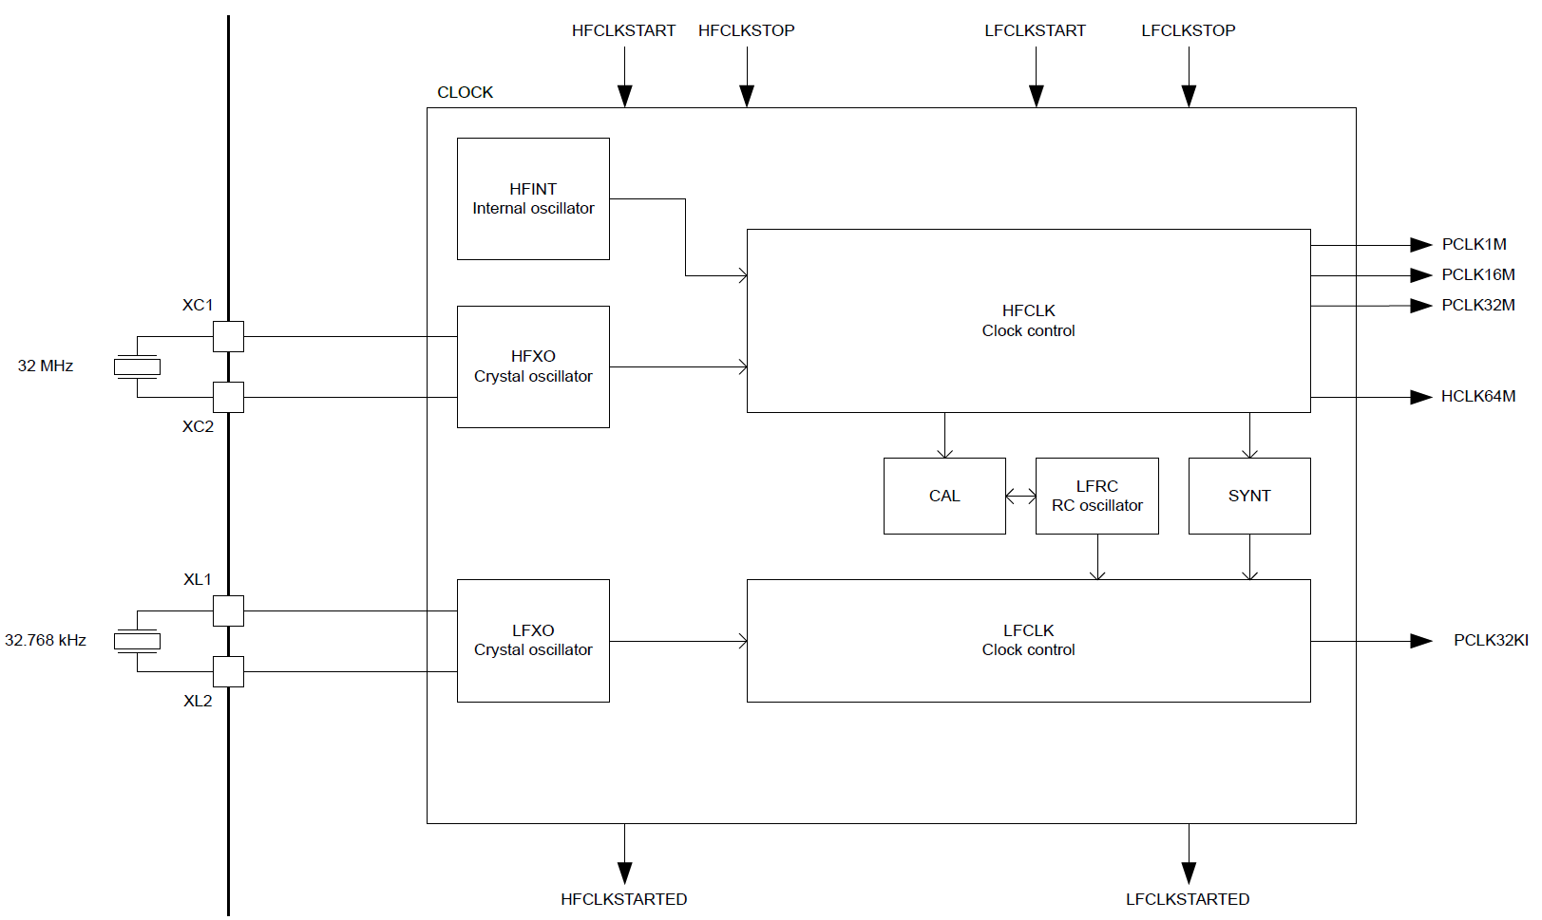
nRF52833 clocks
Optional: for lower energy and higher accuracy

Slide 10
Electrical characteristics
Active power of clocks
32 kHz crystal run current: 0.23 μA
32 kHz RC oscillator run current: 0.70 μA
32 MHz crystal average run current: 300-700.00 μA
32 MHz standby current: 110.00 μA
Startup time for external crystals
32 kHz crystal: 250-500 ms (milliseconds!!!)
32 MHz crystal: 60-200 μs
Beware: switching can lead to delays and instability
nRF52 uses RC oscillator while crystal is not yet ready

Slide 11
Outline
Clocks
Timers
Real-Time Counter
Watchdog

Slide 12
Timer peripherals
Common need for embedded systems: sense of time
Start this behavior after a certain amount of time
Stop this behavior after a certain amount of time
Measure how much time passed between two events
Timer peripherals
Input is one of the system clocks
Counts up a register at each clock tick
Looking at register at start and end can give real-world duration
Compare to saved value and trigger interrupt on match
Allows interrupts to be scheduled in the future

Slide 13
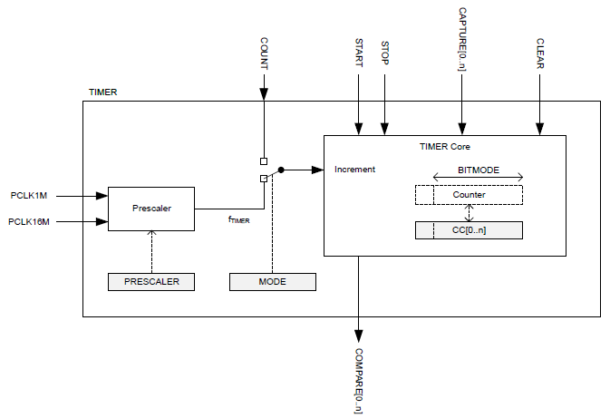
Timer peripheral on nRF52833

Slide 14
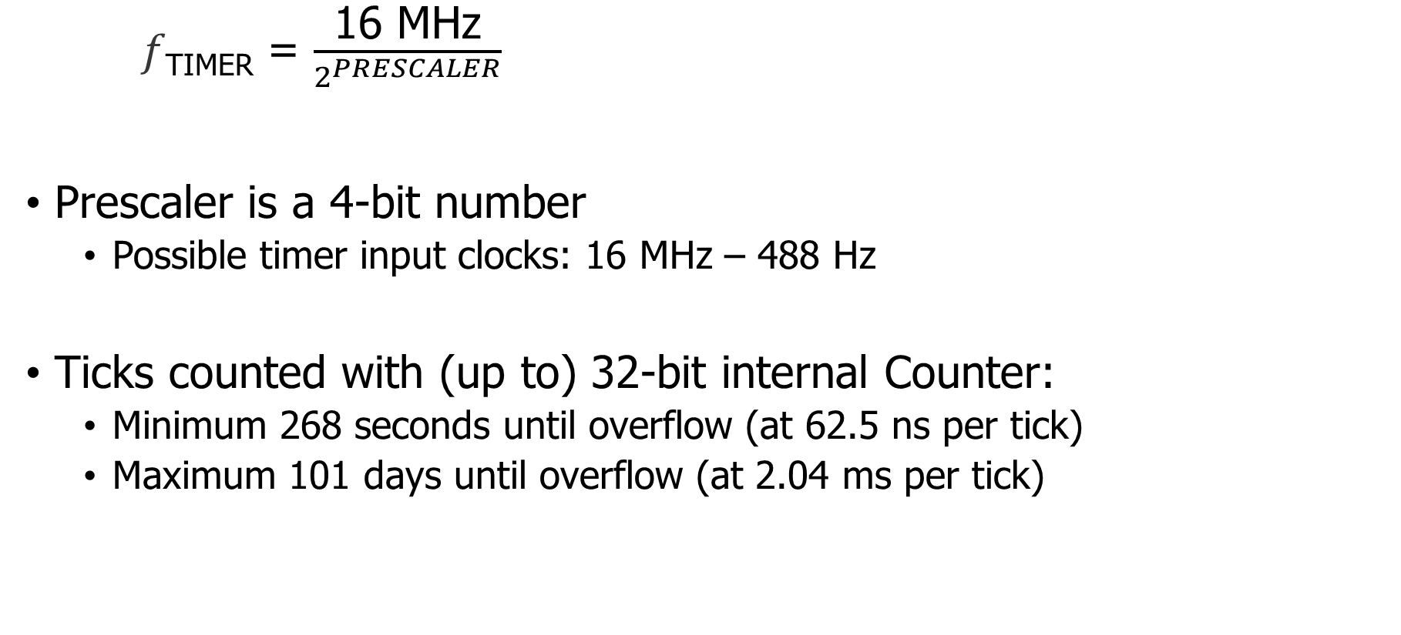
Input and Prescaler
𝑓_{TIMER} = $\frac{\text{16 }\text{MHz}}{2^{PRESCALER}}$
Prescaler is a 4-bit number
Possible timer input clocks: 16 MHz – 488 Hz
Ticks counted with (up to) 32-bit internal Counter:
Minimum 268 seconds until overflow (at 62.5 ns per tick)
Maximum 101 days until overflow (at 2.04 ms per tick)

Slide 15
Alternate input source for counter mode
Counter mode works with non-timer inputs
E.g. GPIO input event
Count anything!

Slide 16
Capture/Compare registers (CC)
32-bit storage registers (each timer has multiple)
Uses: capturing or comparing
On Capture[n] event
Internal Counter value copied to CC[n]
Capture used to measure durations of events
Capture can be triggered by software or by Events from other peripherals
Multiple registers to measure multi-part events

Slide 17
Comparing with CC registers
When internal Counter value equals a CC register
Corresponding Compare[n] event is triggered
Can trigger interrupts
Usually written to in advance to start/stop behavior
Toggle LED every second
Sample sensor every five minutes
Refresh LED matrix every 1/60 seconds

Slide 18
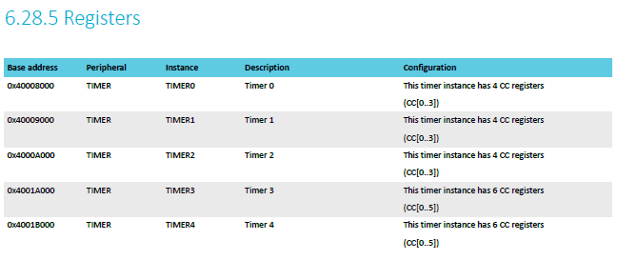
The nRF52833 has multiple Timer instances

Slide 19
Bonus concept: shorts
Reminder: Tasks are inputs and Events are outputs
Shorts connect an Event to a Task within a peripheral
Tasks and Events are fairly nRF specific
Timer shorts
Connect Compare[n] to Clear
Connect Compare[n] to Stop

Slide 20
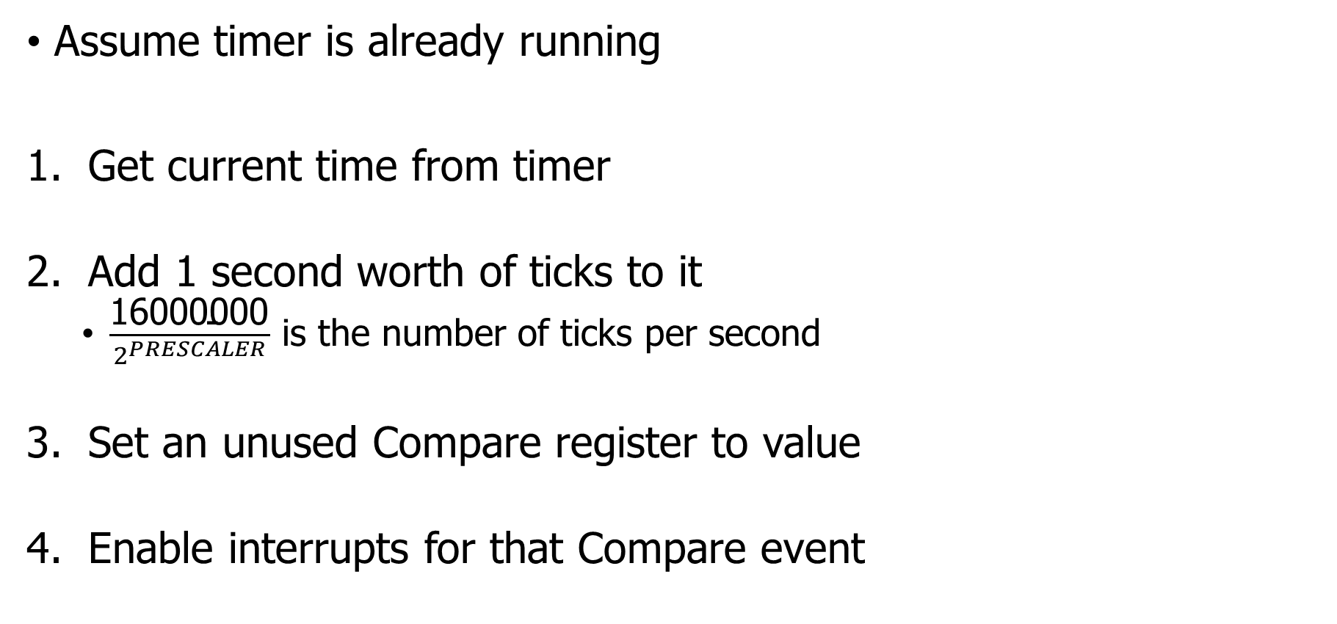
Usage: how do we set a one second timer?
Assume timer is already running
Get current time from timer
Add 1 second worth of ticks to it
$\frac{\text{16}\text{000000}}{2^{PRESCALER}}$ is the number of ticks per second
Set an unused Compare register to value
Enable interrupts for that Compare event
Warning: what if you’re setting a 1 us timer instead? Or a 100 ns timer?
Timer could expire before software writes it to the peripheral.

Slide 21
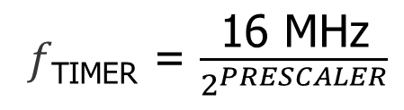
Check your understanding
𝑓_{TIMER} = $\frac{\text{16 }\text{MHz}}{2^{PRESCALER}}$
Prescaler value is 4
Current internal Counter value is 0x1000
Want a 0.5 second timer
What do you set the CC[0] register to? (32-bits)

Slide 22
Check your understanding
𝑓_{TIMER} = $\frac{\text{16 }\text{MHz}}{2^{PRESCALER}}$
Prescaler value is 4
Current internal Counter value is 0x1000
Want a 0.5 second timer
What do you set the CC[0] register to? (32-bits)
1 MHz Timer frequency -> 500,000 ticks in 0.5 seconds
500000 -> 0x7A120
Plus initial value of counter = 0x7B120

Slide 23
Outline
Clocks
Timers
Real-Time Counter
Watchdog

Slide 24
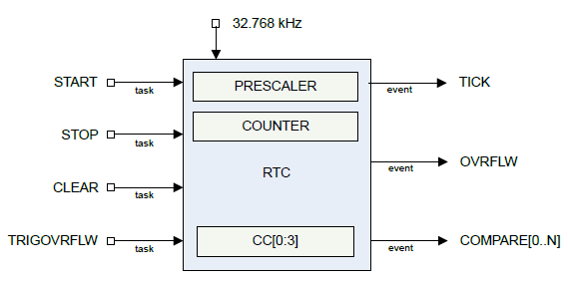
Real-time Counter
Low-power (32 kHz) version of Timer
Only a 24-bit internal Counter
Note: abbreviated RTC, but that already means something else (Real-Time Clock)

Slide 25
Differences between Real-Time Counter and Timer
Runs off of LFCLK instead of HFCLK
With smaller prescaler value (4096 vs 32768)
24-bit counter vs 32-bit counter for Timer
Can read the Counter value directly
No need for Capture task
Otherwise extremely similar. Just a low-power version of Timer

Slide 26
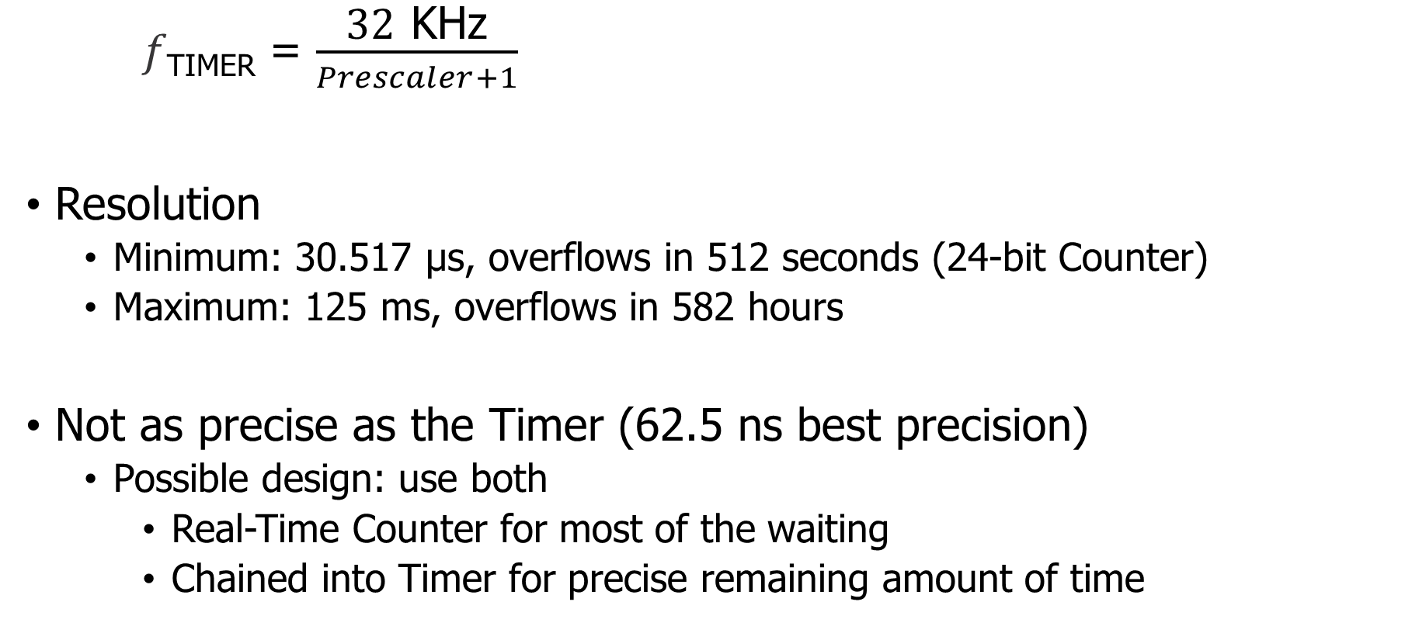
Time resolution for Real-Time Counter
𝑓_{TIMER} = $\frac{\text{32} \text{K}\text{Hz}}{Prescaler+1}$
Resolution
Minimum: 30.517 μs, overflows in 512 seconds (24-bit Counter)
Maximum: 125 ms, overflows in 582 hours
Not as precise as the Timer (62.5 ns best precision)
Possible design: use both
Real-Time Counter for most of the waiting
Chained into Timer for precise remaining amount of time

Slide 27
Outline
Clocks
Timers
Real-Time Counter
Watchdog

Slide 28
Reliable systems
What’s the most common way to solve computer problems?
Turn it off and turn it on again.
Why?

Slide 29
Reliable systems
What’s the most common way to solve computer problems?
Turn it off and turn it on again.
Why?
Resets “state” to original values, which are likely good
Startup is often well-tested
It’s long-running code interacting in unexpected ways that leaves systems in a broken state

Slide 30
Watchdog timer (WDT)
Focused on failures where the system “hangs” forever
Maybe software, maybe hardware!
Can’t know for certain the system is hung, but can know practically
Select a timeout that is the maximum amount of time you expect the system to ever go without looping in main()
Multiply it by 2-10
Set a watchdog timer to that value
If watchdog timer ever expires, it resets the system (in hardware)

Slide 31
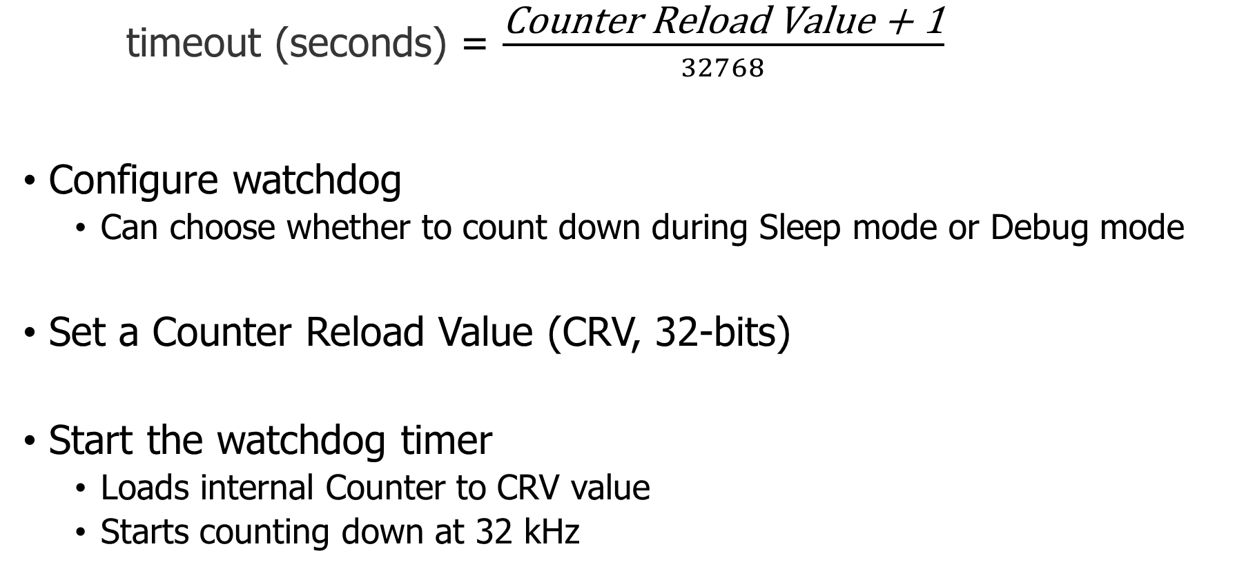
Watchdog configuration
timeout (seconds) = $\frac{\text{Counter} \text{Reload} \text{Value}\text{ + 1}}{32768}$
Configure watchdog
Can choose whether to count down during Sleep mode or Debug mode
Set a Counter Reload Value (CRV, 32-bits)
Start the watchdog timer
Loads internal Counter to CRV value
Starts counting down at 32 kHz

Slide 32
Running applications with a watchdog timer
Need to periodically reset the watchdog to keep it from expiring
Known as “feeding” the watchdog or “kicking” the watchdog
Reload Request register
Must write sequence 0x6E524635 to reload watchdog
Incredibly unlikely to happen by accident
While running, watchdog is protected from modification
Configure once, run forever (at least until a reboot)
Only option is to make periodic Reload Requests
Default off on the nRF52833 (default on for the MSP430!)

Slide 33
Outline
Clocks
Timers
Real-Time Counter
Watchdog

