Slide 1
Lecture 14 USB
CE346 – Microprocessor System Design
Branden Ghena – Spring 2021
Some slides borrowed from: Josiah Hester (Northwestern), Prabal Dutta (UC Berkeley)

Slide 2
Today’s Goals
Discuss more advanced wired communication protocols
With a little less detail
Think about higher-layer concerns like data routing, interpretation, and reliability

Slide 3
Outline
I2C (wrapup)
USB
CAN

Slide 4
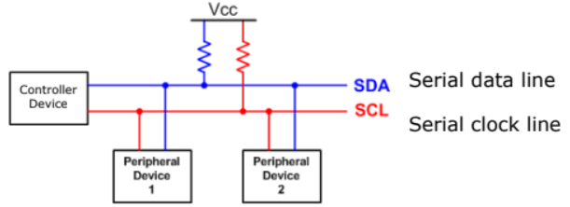
I2C overview
SDA – Serial Data
SCL – Serial Clock
Usually 100 kHz or 400 kHz
Communication is a shared bus between all controller(s) and peripheral(s)
Pull-up resistors for open-drain communication

Slide 5
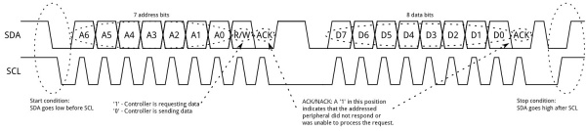
I2C transactions
Start and Stop Conditions: change SDA while SCL is low
Address + R/W bit, then data byte(s)
Common pattern:
Write to device to choose an internal data (known as registers)
Repeated-start, followed by read to get data value

Slide 6
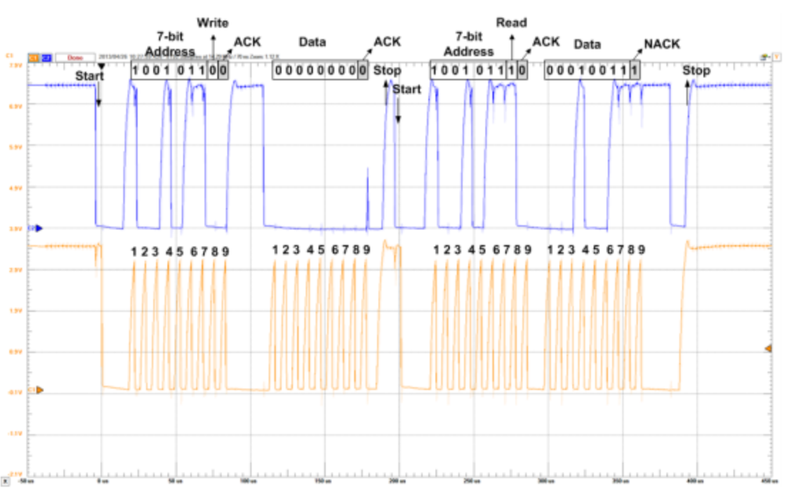
Real-world I2C transactions

Slide 7
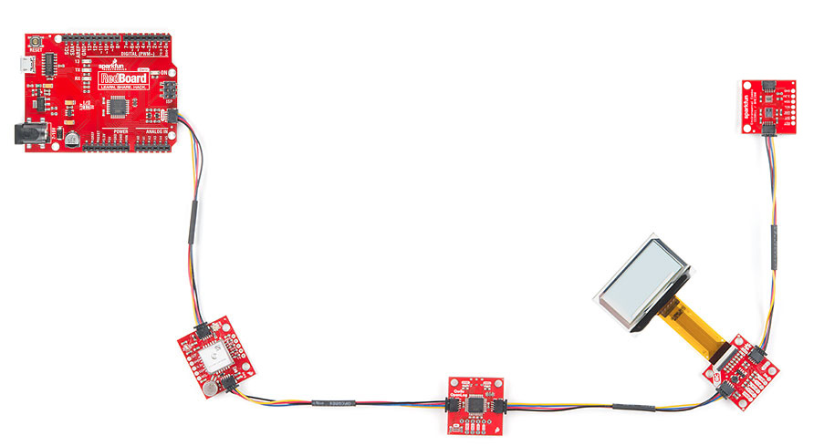
Sparkfun Qwiic connect system
System for wiring multiple prototyping boards together
Four-pin connector
VCC (3.3 volts)
Ground
SDA
SCL
Daisy-chains through boards
Actually connects to chips in parallel as a bus
https://www.sparkfun.com/qwiic

Slide 8
I2C use cases
Various sensors
Usually low to medium speed
Even relatively high speed stuff often has I2C for convenience
Accelerometers and microphones
Often with intelligent filtering built in
Communication between microcontrollers
Either can act as the Controller when necessary
Commonly exists internally within smartphones and laptops too
Light sensors, Temperature sensors, etc.

Slide 9
System Management Bus (SMBus)
Related communication specification
A little more strict in places, but generally interoperable
Adds ability to broadcast or unicast messages
Generic addresses for Controller and various peripherals (Battery)
Adds an open-drain shared interrupt signal
High-impedance or pull low, just like SDA and SCL
Allows any device to alert a controller
Controller has to probe bus to determine which device wants attention

Slide 10
nRF TWI peripherals
TWIM – for I2C Controller
This is the common case
Provide buffer to write from and/or read into for DMA
Configure registers, perform interaction, repeat
TWIS – for I2C peripheral
Less common for microcontroller to be a peripheral
Supports dual-mode where you are switching between states
Provide up to two addresses that will be matched against
When interrupted with write data
Change buffer connected to read DMA (as appropriate)
Possibly stretching clock to make it all work

Slide 11
I2C Pros and Cons
Pros
Wiring is simple
Only uses two pins
Very widely supported
Cons
Relatively slow communication rate
Speed versus power use tradeoff (due to pull-down resistor)
Open collector makes debugging difficult

Slide 12
Outline
I2C
USB
CAN

Slide 13
USB references
USB in a NutShell
https://www.beyondlogic.org/usbnutshell
Other stuff I found useful
https://www.usbmadesimple.co.uk/
http://kofa.mmto.arizona.edu/stm32all/blue_pill/usb/an57294.pdf
https://en.wikipedia.org/wiki/USB

Slide 14
Universal Serial Bus (USB)
Pervasive wired communication protocol
Universal accurately applies!
Targets predominantly external devices over a plug/cable
Good combination of simple and capable
Base version for simple devices does not require too much in terms of pins or resources
More complex versions can transfer a significant amount of data
These grew organically over time though
Great support for interoperability
Generic device profiles that allowed for plug-and-play
Supported by OS initiatives to include driver software

Slide 15
USB is a layered protocol
USB protocol describes how to:
Electrically send bits
Send frames of multiple bytes
Communicate data between two devices
Communicate specific application data (through device classes)
Much larger compared to others
SPI: only how to electrically send bits
UART and I2C: how to send frames of bytes

Slide 16
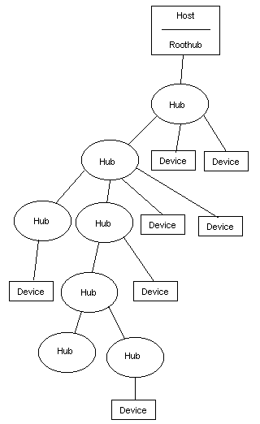
Roles and topology
Hosts and Devices
USB On-The-Go allows host negotiation
Added later. Support devices like smartphones
Host is in charge of communication (“Upstream”)
Devices provide various capabilities Host can interact with (“Downstream”)
Tiered star topology
Host connects to hubs, which connect to devices
Up to 127 devices per hub. Up to 5 layers of hubs

Slide 17
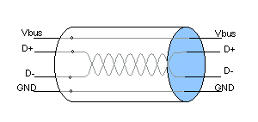
USB signals
Four signals
Vbus (5 volts, can power devices)
D+
D-
Ground
D+/D- are a differential pair
Signals are inverses of each other
Usually, occasionally act separately to signal special conditions
Increases voltage difference between states (5 - -5 = 10 volts)
Wires are twisted to avoid interference

Slide 18
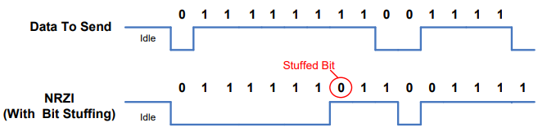
Synchronizing data
No clock signal!! How is USB so fast?
Partially EE magics: better receivers, matched wire impedance
Partially easier to distinguish signal states
Also guaranteed transitions, which allow resynchronization
Transitions are used to denote data (non-return-to-zero inverted)
With guaranteed transition in within every 8 bits (bit stuffing)
Allows clocks on the two devices to synchronize

Slide 19
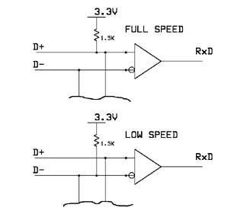
USB speeds
USB 1.0
Low Speed: 1.5 Mbps
Not clear if this is used anymore
Full Speed: 12 Mbps
Microcontrollers tend to support Full Speed
We’re focusing on details from it
USB 2.0
High Speed: 480 Mbps
USB 3.0+
Super Speed: 5-20 Gbps
Adds multiple parallel data connections
Pull-up resistors allow for detection of a plugged device
Also identify speed

Slide 20
USB data frames
General packet format
Sync field, allows transmitter and receiver clocks to synchronize
Packet ID, determines what type of packet is being sent
Token, setup Device or read/write data from/to Device
Data, application data
Handshake, acknowledgement (or explicit NAK)
Address+Endpoint, for Token packets to identify Device
Data, up to 1023 bytes (full speed, often capped at 64 for microcontrollers)
CRC, (Cyclical Redundancy Check) to detect bit errors
End-of-packet

Slide 21
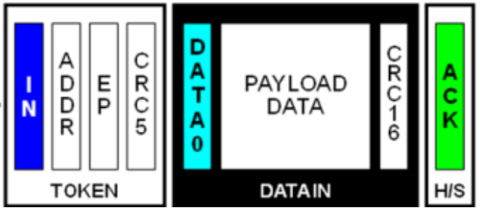
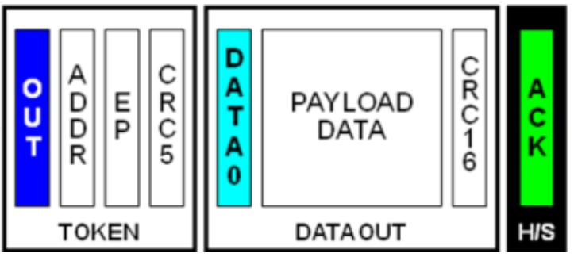
USB transactions
All transmissions are initiated by the Host, which can periodically request reading from a Device if desired
Reading data from Device
Writing data to Device

Slide 22
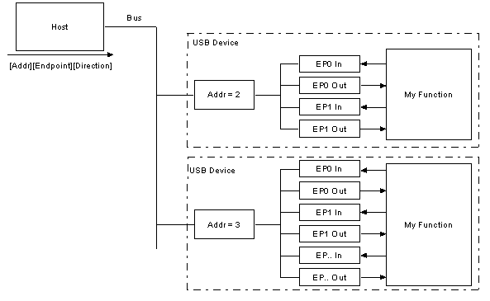
Interacting with USB devices
Each Device is given a separate address on the bus
Each Device also has a number of Endpoints
Logical communication channels
Direct data and guide communication patterns

Slide 23
USB endpoint types
Interrupt transfers
Guaranteed latency, small amounts of data
Important sensor data (mice and keyboards)
Polled frequently by Host
Bulk transfers
Sporadic large transfers, reliable communication
General reading/writing of data (flash drives and USB serial)
Polled by Host whenever there is available bandwidth
Isochronous transfers
Guaranteed data rate, unreliable communication
Continuous data streaming (audio and webcams)
Polled frequently by host

Slide 24
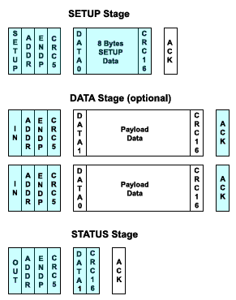
USB control endpoint
Every USB Device has a special Control endpoint as well
Used for setting up the USB Device driver on the Host
Initializing a Device
Host sends SETUP transaction requesting device descriptor
Host performs IN transaction to read device descriptor
Host performs OUT transaction to write device status

Slide 25
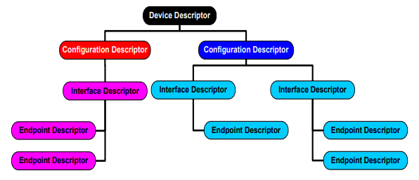
USB device descriptors
Packed version of tree structure describing the device
Interfaces it provides
Endpoints associated with each interface

Slide 26
Example Microbit
Interface: Communications, Abstract (modem), CDC
Endpoint: 3, IN, Interrupt
Interface: CDC Data, CDC DATA interface
Endpoint: 1, IN, Bulk
Endpoint: 2, OUT, Bulk
Interface: Vendor Specific Class, Subclass, Protocol
Endpoint: 5, IN, Bulk
Endpoint: 4, OUT, Bulk
Interface: Mass Storage, SCSI, MSD interface
Endpoint: 7, IN, Bulk
Endpoint: 6, OUT, Bulk
Virtual serial device
SEGGER JTAG interface
USB external filesystem

Slide 27
Minimal virtual serial USB Device
Virtual Serial Device
Endpoint 0: Control, IN/OUT
Respond to IN requests by setting up OUT with a buffer of descriptor data of the correct size
Endpoint 1: Interrupt, IN
Needed for serial modem controls, just ignore it
Endpoint 2: Bulk, OUT
Connect to buffer from _write() (just takes raw characters)
Endpoint 3: Bulk, IN
Connect buffer to _read() (just provides raw characters)

Slide 28

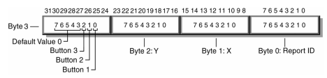
HID USB Device (Human Interface Device)
Used for human interaction devices, like keyboard/mouse
“Report” structure is provided over Interrupt IN endpoint
Or on demand via Control IN endpoint
Example mouse with x,y and three buttons

Slide 29
USB summary
Specification for fast data communication
Specification for interacting with abstract device types
Connects correct driver to interpret and send data
Pros
Very fast
Very interoperable
Cons
Hardware and software are way more complex than simple protocols like UART, SPI, and I2C
Not very energy efficient

Slide 30
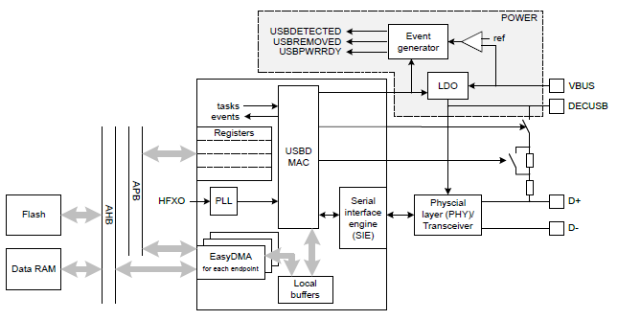
nRF52 USBD
Implements USB Device (not Host)
Control endpoint
14 bulk/interrupt (7 IN, 7 OUT)
64-byte transfers
2 isochronous (1 IN, 1 OUT)
1023-byte transfers
Full-speed USB
With 5 volt signals

Slide 31
Outline
I2C
USB
CAN

Slide 32
Controller Area Network (CAN bus)
Designed for highly reliable interactions within a vehicle
Multi-master with arbitration
Similar to I2C
Mechanism for sending messages with “identifiers”
Identifies that data in the message, not the device
Lower value identifiers have high priority
All messages are received by all CAN nodes
Which can decide at higher levels which identifiers they care about

Slide 33
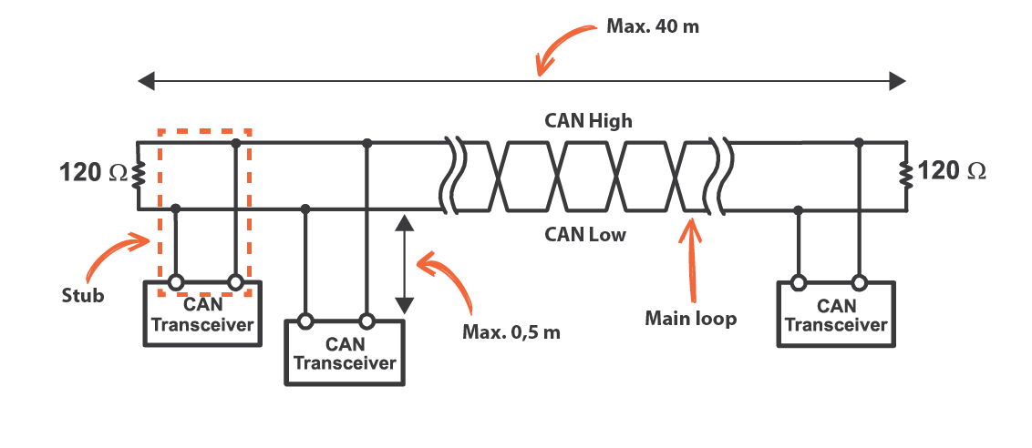
CAN physical connections
Two differential, wired-AND signal lines
Transitions are used to transmit bits (non-return-to-zero) with bit-stuffing
Combines aspects of USB and I2C
125 kHz – 5 Mbps speeds

Slide 34

CAN packet format
11-bit identifier
Check bits as they are sent to see if you win arbitration
Up to 8 bytes (64 bits) of data
CRC for checking
Acknowledgement
Like I2C, let the line float and see if another device responds
If not, explicitly retransmit!

Slide 35
CAN message types
Data frame
Transmission of data for a certain identifier
Remote frame
Requests data transmission of a certain identifier
Error frame
Transmitted when an error is detected with the previous message
Overload frame
Transmitted by a node that is too busy to respond right now

Slide 36
CAN reliability design – detecting errors
Check for errors everywhere and appropriately handle
Bit error
If the value found on the bus differs from the one sent
Stuff error
If 6 consecutive bits of the same type are found
CRC error
If CRC does not match
Form error
Format field has unexpected values
Acknowledgement error
No ACK received
Devices detecting an error broadcast a message signifying it!
Multiple devices sending the same message works without arbitration loss
Previous message is then retransmitted

Slide 37
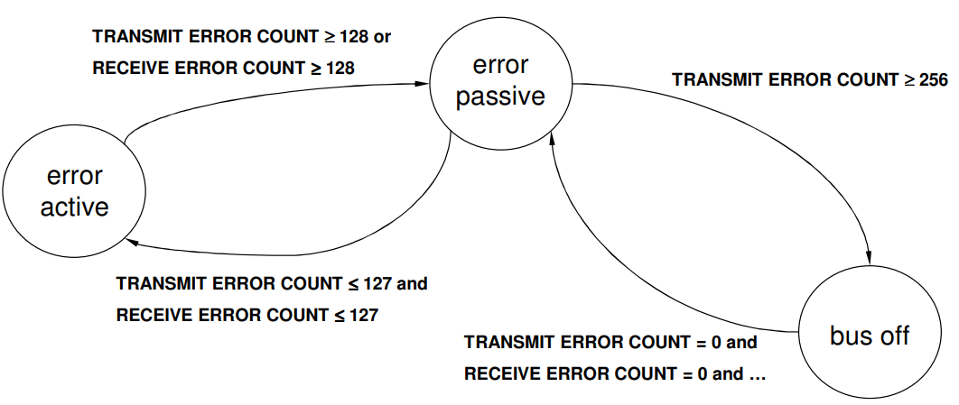
CAN reliability design – handling errors
Each node accepts the possibility that maybe it is the faulty one
Track errors and successes and change device state
Passive: limited error signaling and transmissions
Bus off: does not transmit in any way
Idea is that the CAN controller hardware can be faulty but still detect it in some cases

Slide 38
CAN summary
Designed for reliable vehicular communication
Multi-master bus with serial communication
Pros
Highly reliable
Extensible to many devices
Cons
Special-purpose design. Whole system has to agree on identifiers
Relatively slower throughput

Slide 39
Outline
I2C
USB
CAN

