Slide 1
Lecture 16 Nonvolatile Memory
CE346 – Microprocessor System Design
Branden Ghena – Spring 2021
Some slides borrowed from: Josiah Hester (Northwestern), Prabal Dutta (UC Berkeley)

Slide 2
Administrivia
Friday
Will do last checkoffs for people who need them on Lab 6
Also available to discuss projects
Will put a sign-up form online
Moving forward
Only two lectures left!!
Time to put some serious effort into projects (two weeks remaining)
Week after next is project demos
Details to come

Slide 3
Today’s Goals
Discuss uses of memory, especially nonvolatile memory, in embedded systems
Introduce protocols for interacting with non-volatile memory
Internal Flash
External SD Card

Slide 4
Outline
Embedded Memories
nRF52 NVMC
SD Cards

Slide 5
Memory in computing
Various different memories serve different purposes in computing
Needs
Fast, infinite-lifetime memory to keep things like stack memory
Nonvolatile memory that can be read from
Desires
Fast, infinite-lifetime nonvolatile memory

Slide 6
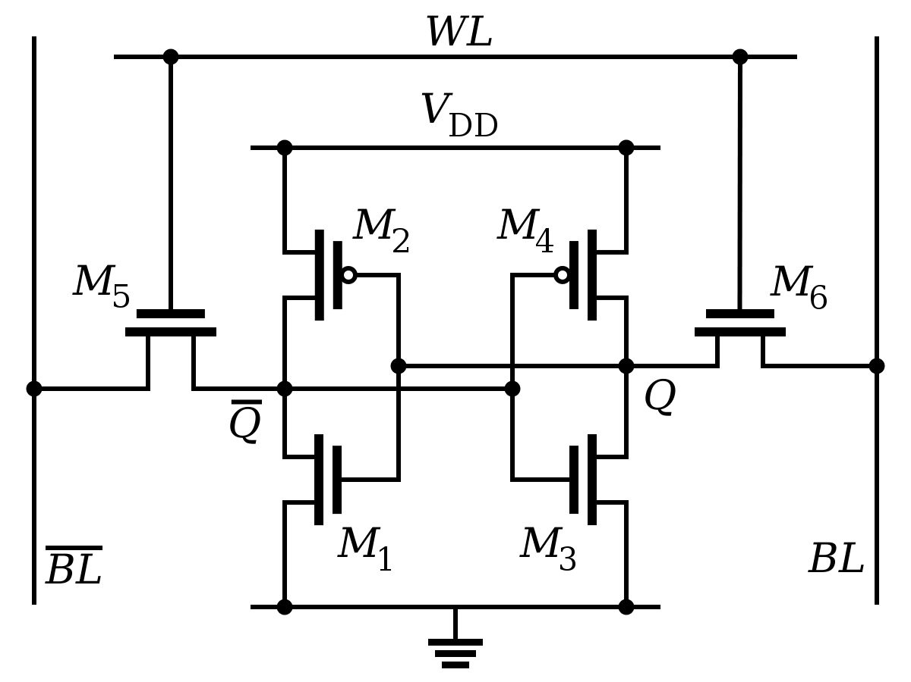
Register technology: SRAM
Static RAM (SRAM)
Each cell stores a bit in a bi-stable circuit, typically a six-transistor circuit
Static – no need for periodic refreshing; keeps data while powered
Relatively insensitive to disturbances such as electrical noise
Energetic particles (alpha particles, cosmic rays) can flip stored bits
Fastest memory on computer
Also most expensive and takes up most space per bit
Typically used for registers and cache memories

Slide 7
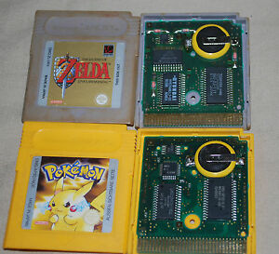
SRAM can be used a permanent memory in a pinch
Gameboy and Gameboy Color used batteries to save state
Gameboy Advanced games used batteries for an internal clock
PSA: your old Gameboy games have likely lost their save files

Slide 8
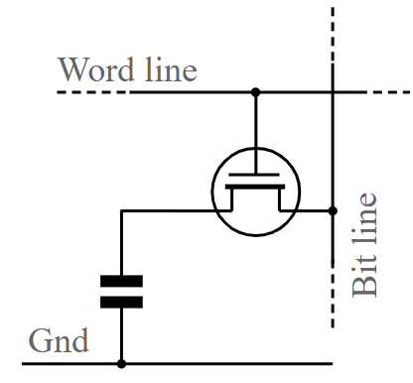
Main memory technology: DRAM
Dynamic RAM (DRAM)
Each cell stores a bit as a charge in a capacitor
Capacitors lose charge; each cell must be refreshed every 10-100 ms
More sensitive to disturbances (EMI, radiation, …) than SRAM
Slower than SRAM, but cheaper and denser
~100x slower than registers

Slide 9
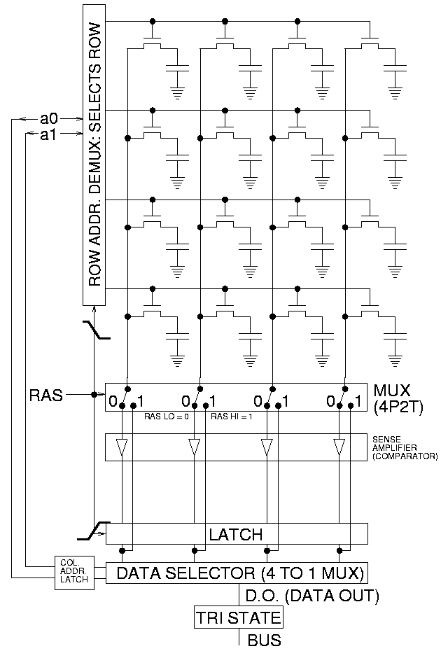
Accessing DRAM
Read entire row of data at a time
Large in practice, kilobytes
Select actual bytes that are wanted
Possibly modifying those bits
Write row back to memory
Must always happen!
Reading is destructive
Typically used for main memory in traditional computing systems
Constant refresh makes it untenable for low-power embedded systems

Slide 10
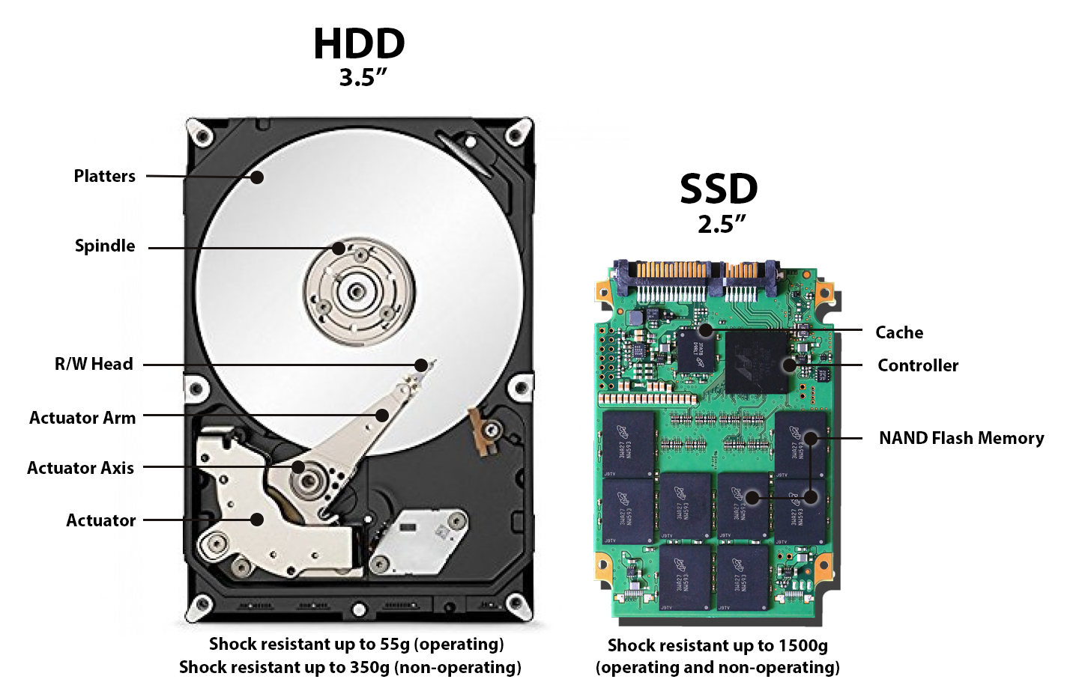
Disk drive storage

Slide 11
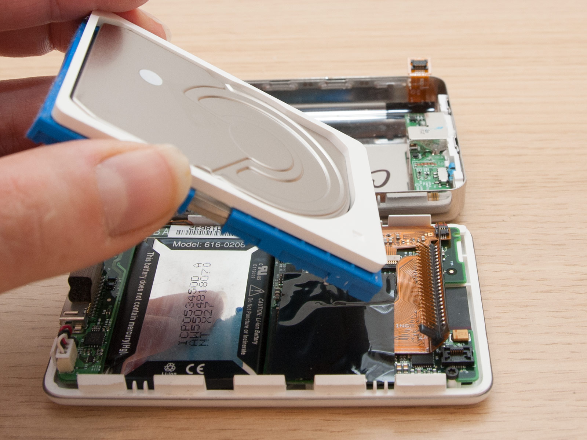
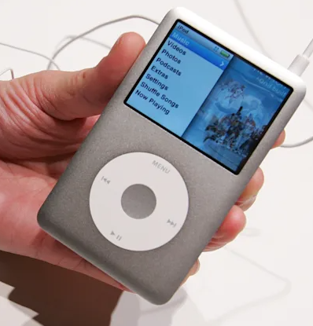
Need breeds creativity
Original iPod used a small disk drive

Slide 12
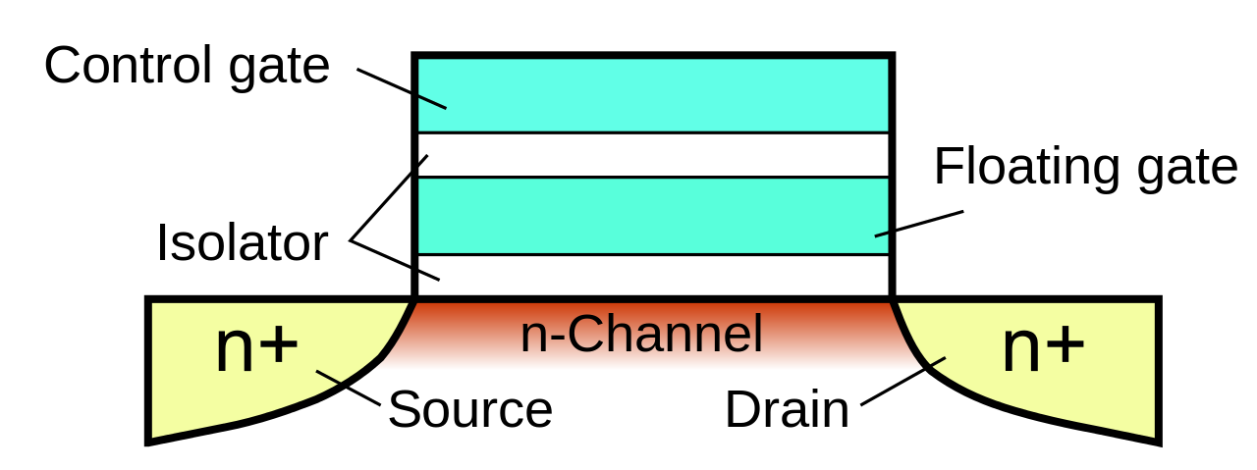
Floating-gate transistors
Concept behind transistor-based non-volatile memory
EPROM, EEPROM, and Flash
High voltage on control gate creates charge on floating gate
Charge on floating gate activates/deactivates transistor
High voltage degrades structure, leading it to eventually fail after enough writes

Slide 13
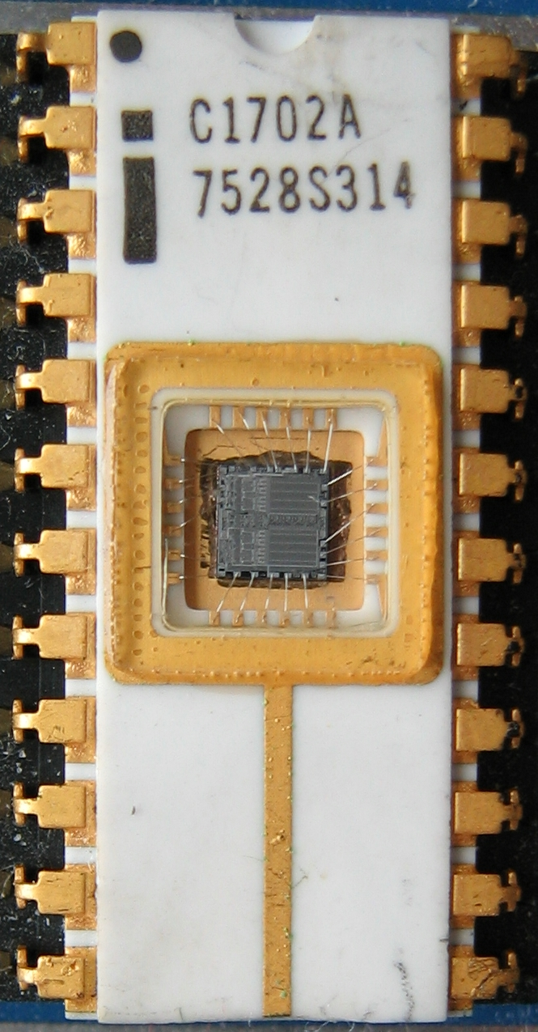
EPROM
Erasable programmable read-only memory
Erasable
If you shine UV light directly on the IC
Needed a window to expose the IC
Programmable
With high voltage (25-50 volts)
Typically acted as read-only memory in circuits

Slide 14
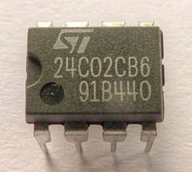
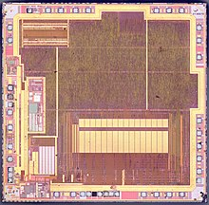
EEPROM
Electrically-erasable programable read-only memory
Same concept as EPROM, but includes internal circuitry to allow rewriting under normal conditions
Slow and high-power to write
Has a longer lifetime compared to flash, ~100k writes
Can be built into other ICs
Example: AT90USB162 microcontroller (512 bytes)

Slide 15
Flash
Similarly based on floating-gate transistors
But with a different design that allows for faster erase of entire blocks
More limited lifetime, ~1k-100k writes (10k common for embedded)
Cannot erase individual bytes, must erase in units of blocks
Read can happen in units of bytes though
Heavily used in commercial devices
Flash drives
SSDs
Smartphone storage
Microcontroller non-volatile storage!

Slide 16
More exotic memories
FRAM and MRAM are both rising protentional Flash replacements
Non-volatile
Writable at the byte level
Very high to infinite write/erase cycles
Lower energy costs for writing and reading
The two use unrelated magnetic techniques for data storage
Starting to appear in microcontrollers
TI MSP430s have used 16 kB FRAM
Apollo4 (ARM Cortex-M4F) has 2 MB of MRAM

Slide 17
Outline
Embedded Memories
nRF52 NVMC
SD Cards

Slide 18
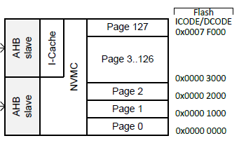
Flash memory on the nRF52833
512 kB total Flash memory
128 pages each 4 kB in size
Non-Volatile Memory Controller (NVMC) controls access
Enables writing to flash
Enables erasing flash
Manages status of flash

Slide 19
Writing to Flash
Configurable, disabled by default
Enable with configuration register
Rules for writing to Flash
Must write word-aligned 32-bit values
Can only write 0 values, not ones
Can only write 2 times before erasing (even if there are still 1 bits)
Takes 42.5 μs to write a 32-bit word
64 MHz clock ⇨ 2720 cycles per 32-bit write

Slide 20
Erasing Flash
Lifetime: 10000 erase cycles per page
Options
Erase a single page (4 kB): 87.5 ms
Erase all of flash (512 kB): 173 ms
CPU is halted if executing code from Flash during the erase
That’s 5.6 million cycles…
Code can execute from SRAM instead
Can also be split into a series of partial erases
Which must add up to a complete erase time before writing

Slide 21
Factory Information Configuration Registers
Read-only memory
Chip-specific information and configuration
Code size
Unique device ID
Production IDs
Temperature conversion functions

Slide 22
User Information Configuration Registers
Additional Flash memory for non-volatile user configurations
Writable and erasable through NVMC processes described earlier
32 words of customer information (128 bytes total)
Special configurations
Reset pin
NFC pin enable/disable
Debug configuration

Slide 23
Outline
Embedded Memories
nRF52 NVMC
SD Cards

Slide 24
SD card references
ChaN
Embedded systems engineer in Japan (and is amazing)
http://elm-chan.org/docs/mmc/mmc_e.html
http://elm-chan.org/fsw/ff/00index_e.html
Various others
http://users.ece.utexas.edu/~gerstl/ee445m_s15/lectures/Lec08.pdf
http://alumni.cs.ucr.edu/~amitra/sdcard/Additional/sdcard_appnote_foust.pdf
https://luckyresistor.me/cat-protector/software/sdcard-2/
http://users.ece.utexas.edu/~valvano/EE345M/SD_Physical_Layer_Spec.pdf
https://github.com/tock/tock/blob/master/capsules/src/sdcard.rs

Slide 25
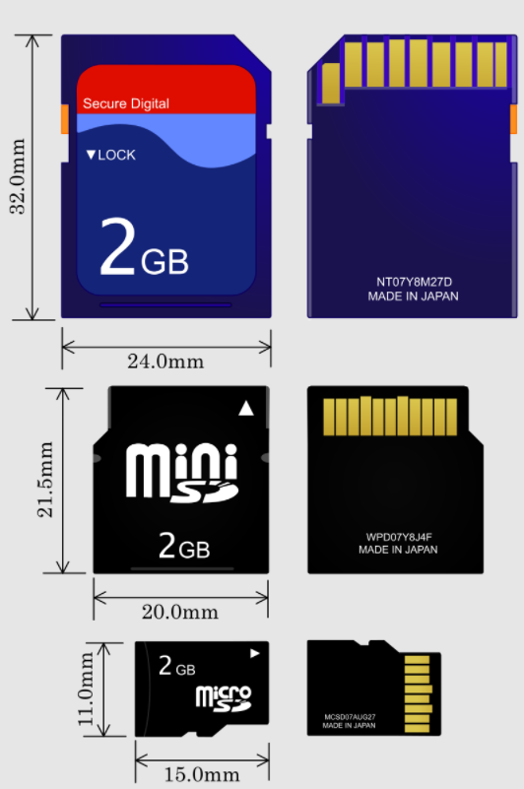
SD cards
“Secure Digital” Card
Includes various formfactors
Flash memory
Capacities from 8 MB to 128 TB
512 byte blocks
Supports 1-bit SPI interface
As well as 4-bit SD bus protocol
Easy to support in embedded systems
Cheap but high power

Slide 26
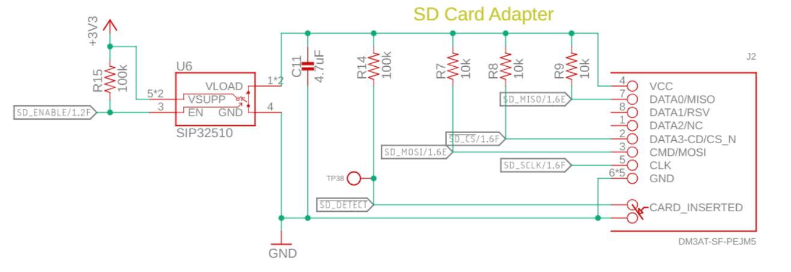
Electrical connections for an SD card
SD Card connections
SPI CIPO, COPI, CS, SCLK
Plus a switch to enable/disable the SD card and a detect signal

Slide 27
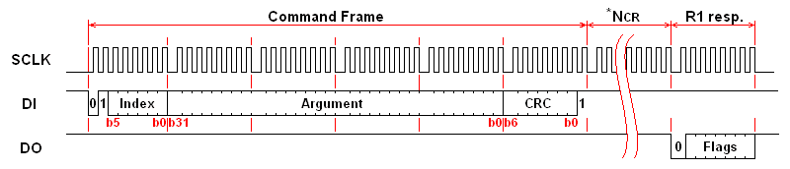
Controlling the SD card
Index: 6-bit value of command being sent
Argument: 32-bit value that may be arguments to commands
CRC: checks for bit errors
Response (after delay)

Slide 28
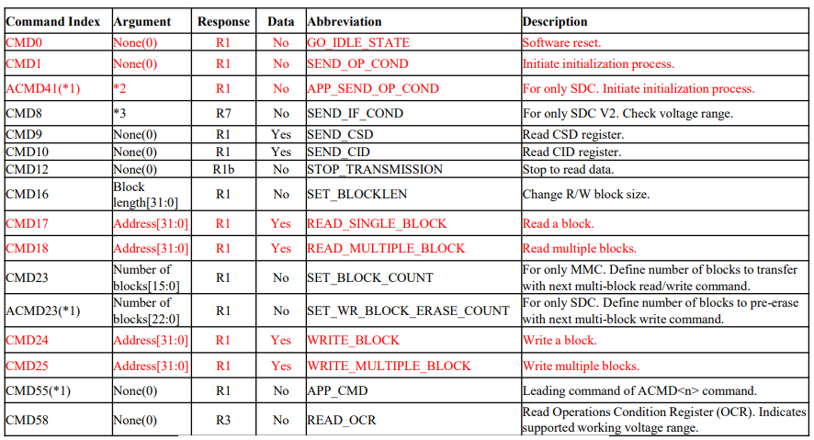
SD card SPI commands

Slide 29
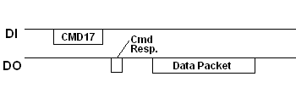
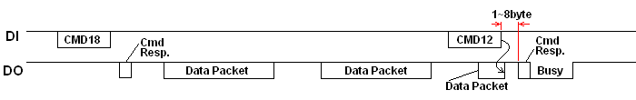
Reading from the SD card
Single block read
Multiple block read (CMD12 – Stop Transmission)

Slide 30
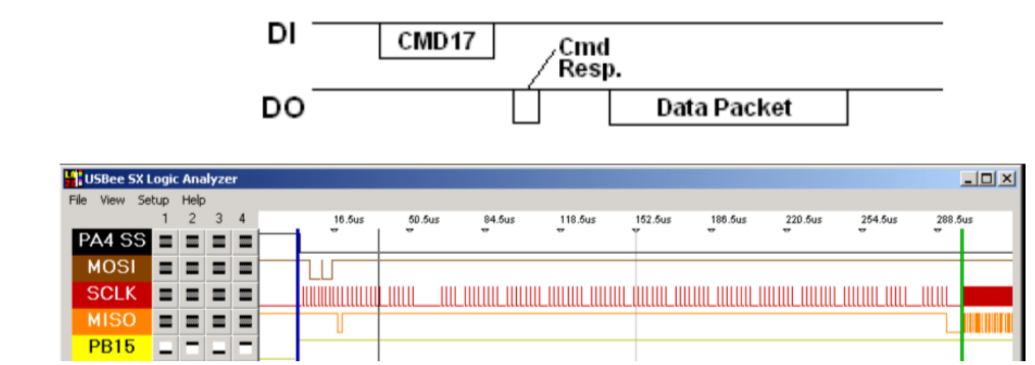
SD card delays can be significant
Performing a single byte read
Almost 300 μs before the SD card starts sending data
~200 μs additional time to send the 512 bytes (20 Mbps data, 8 Mbps total)

Slide 31
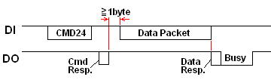
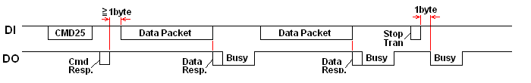
Writing to the SD card
Single block write
Multiple block write

Slide 32
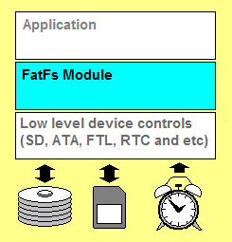
Layering a filesystem on top of an SD card
FatFs library implements the filesystem agnostic of application and storage medium
Enables the use of file system calls:
Open, Close, Read, Seek
Connects to generic interface for low-level implementation
disk_status, disk_init, disk_read, disk_write

Slide 33
Outline
Embedded Memories
nRF52 NVMC
SD Cards

