Slide 1
Lecture 05: Condvars and Semaphores
CS343 – Operating Systems
Branden Ghena – Fall 2024
Some slides borrowed from: Stephen Tarzia (Northwestern), and Shivaram Venkataraman (Wisconsin)

Slide 2
Administrivia
PCLab is out and ready to work on
Some of this week’s material is relevant
But you can totally get started right now
About 25% of the class has already made commits to Github

Slide 3
Today’s Goals
Understand how we can apply locks to gain correctness and maintain performance
Counter
Signaling between threads to enforce ordering
Condition Variables
Semaphores

Slide 4
Review: Locks/Mutexes
Simple mutual exclusion primitive
Init(), Acquire()/Lock(), Release()/Unlock()
Implementations trade complexity, fairness, and performance
Spinlocks
Ticket locks
Yielding locks
Queueing locks

Slide 5
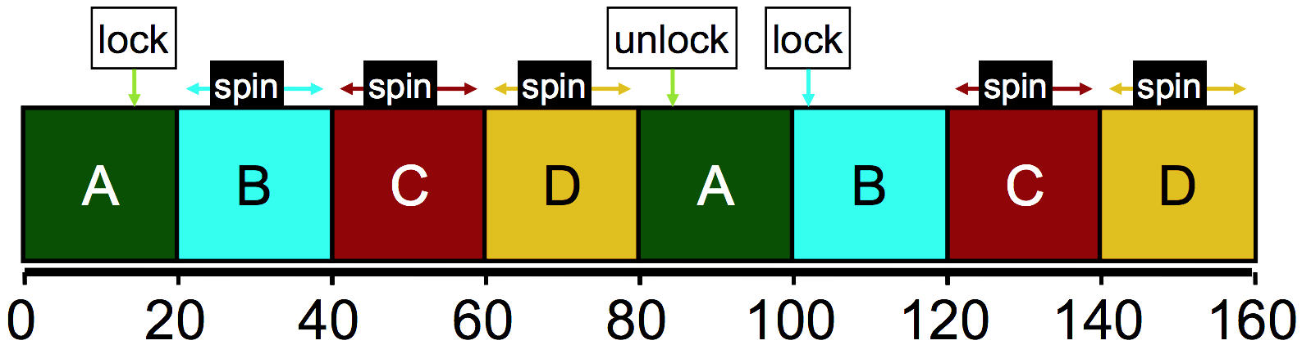
Ticket lock still wastes time spinning
B, C, and D are “busy waiting”
Might be occupying an entire core in multicore
Scheduler is fairly scheduling all threads, but ignorant of locks
Idea: can we skip threads that are waiting on a lock?

Slide 6
Yield timeslice when not yet ready
Yield syscall unschedules the current thread
sched_yield() in POSIX API
Gives the user process just a little control over the scheduler
In acquire(), yield after checking condition
Might delay thread response time in multicore scenario
void mutex_lock(lock_t* mutex) {
int myturn = atomic_fetch_and_add(&(mutex->ticket), 1); // take a ticket
while (mutex->turn != myturn) {
sched_yield(); // not ready yet
}
}

Slide 7
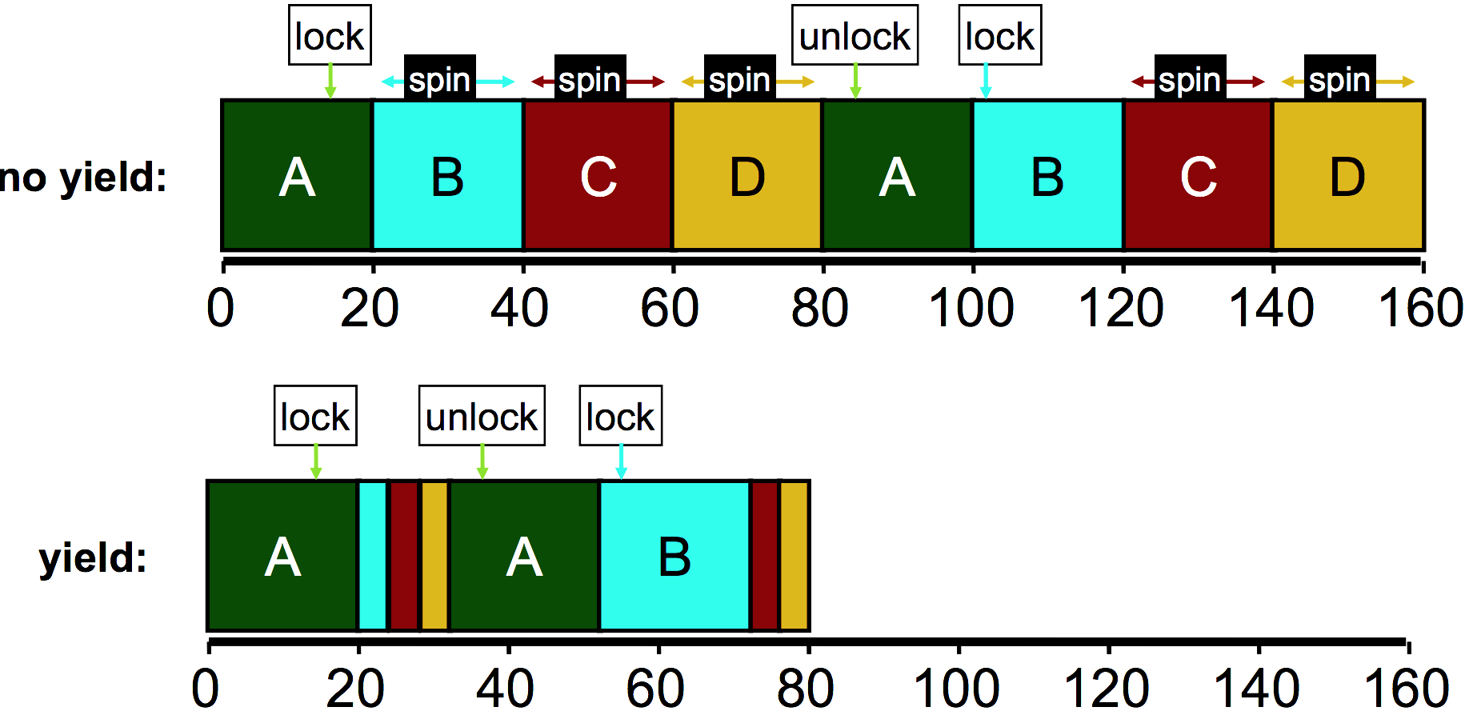
Yielding reduces busy-waiting

Slide 8
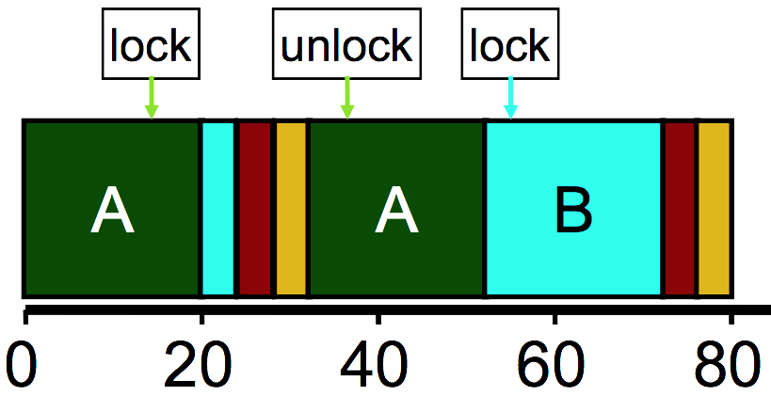
How much does yielding improve things?
Performance better with yield(), but still doing a lot of unnecessary context switches
Wasted CPU cycles
Without yield(): O(threads*timeslice)
With yield(): O(threads*context_switch)
Timeslice ~1 ms, Context switch: ~1 µs
Still expensive if we expect many threads to be contending over the lock

Slide 9
Building a blocking lock
A more performant solution requires cooperation between thread’s locks and the OS scheduler to block threads
If a thread cannot acquire the lock, it instead makes a system call informing the OS that it is blocked on the lock resource
When a thread releases the lock, it makes a system call to notify the OS that it can wake one thread waiting on that resource
Operation needs OS support
Solaris: Park/Unpark
Linux: implemented as part of Futex -> used for Pthread Mutex implementation!

Slide 10
Linux Futex (fast userspace mutex) syscalls
Similar to park/unpark, but the queue is in the kernel
Key idea: only makes the kernel calls when you actually need to wait or wake a sleeping thread
futex_wait(int* pointer, int expected)
Put thread to sleep if the value at address equals “expected”
Used to build acquire()
futex_wake(int* pointer)
Unblock one thread waiting on “pointer”
Used to build release()
See https://eli.thegreenplace.net/2018/basics-of-futexes/

Slide 11
Spinning versus Blocking
Each approach is better under different circumstances
Single core systems
If waiting process is scheduled, then process holding lock is not
Waiting process should always yield its time
Multicore systems
If waiting process is scheduled, then process holding lock could also be
Spin or block depends how long until the lock is released
If the lock is released quickly, spin wait
If the lock is released slowly, block
Where quick and slow are relative to context-switch cost

Slide 12
Two-phase waiting
Problem: we can’t always know how long the wait will be
Programmer might know…
Library definitely can’t know
One common compromise:
Spin lock for a little while, and then give up and block
Example: Linux Native POSIX Thread Library (NPTL)
Check the lock at least three times before blocking with Futex

Slide 13
Summary on lock implementations
Spinlocks
Ticket locks
Yielding locks
Queueing locks
Pthread Mutex on Linux (implemented via Futex, see hidden slide)
Sophisticated locks are more fair and do not waste processor time “busy waiting”
But also have unnecessary context-switch overhead if the lock is only briefly and rarely held

Slide 14
Outline
Applying Locks
Ordering with Condition Variables
Semaphores

Slide 15
Review: Need to enforce mutual exclusion on critical sections
#include <stdio.h>
#include <pthread.h>
static volatile int counter = 0;
static const int LOOPS = 1e9;
void* mythread(void* arg) {
printf("%s: begin\n", (char*)arg);
for (int i=0; i<LOOPS; i++) {
counter++;
}
printf("%s: done\n", (char*)arg);
return NULL;
}
int main(int argc, char* argv[]) {
pthread_t p1, p2;
printf("main: begin (counter = %d)\n", counter);
pthread_create(&p1, NULL, mythread, "A");
pthread_create(&p2, NULL, mythread, "B");
// wait for threads to finish
pthread_join(p1, NULL);
pthread_join(p2, NULL);
printf("main: done with both (counter = %d, goal was %d)\n", counter, 2*LOOPS);
return 0;
}

Slide 16
Broken concurrency can actually performance too!
Single-threaded counter: | 3.850 seconds
Multithreaded no-lock counter: | 4.700 seconds (Broken!)
When iterating one billion times:
Why is the no-lock multithreaded version so slow?
Not 100% certain
Likely something to do with hardware memory/cache consistency

Slide 17
Naively locked counter example
static volatile int counter = 0;
static const int LOOPS = 1e9;
static pthread_mutex_t lock;
void* mythread(void* arg) {
printf("%s: begin\n", (char*)arg);
for (int i=0; i<LOOPS; i++) { pthread_mutex_lock(&lock);
counter++;
pthread_mutex_unlock(&lock);
}
printf("%s: done\n", (char*)arg);
return NULL;
}
int main(int argc, char* argv[]) {
pthread_t p1, p2;
pthread_mutex_init(&lock, 0);
printf("main: begin (counter = %d)\n", counter);
pthread_create(&p1, NULL, mythread, "A");
pthread_create(&p2, NULL, mythread, "B");
// wait for threads to finish
pthread_join(p1, NULL);
pthread_join(p2, NULL);
printf("main: done with both (counter = %d, goal was %d)\n", counter, 2*LOOPS);
return 0;
}

Slide 18
Problem: locking overhead decreases performance
Single-threaded counter: | 3.850 seconds
Multithreaded no-lock counter: | 4.700 seconds (Broken!)
Naïve-locked counter: | 80.000 seconds (Correct…)
When iterating one billion times:
Formerly loop contained 3 instructions (mov, add, mov)
Now it has
Two function calls
Multiple instructions inside of those
Possibly even interaction with the OS…
3 instructions -> 60 instructions

Slide 19
Simple mutual exclusion: one big lock
Simple solution “one big lock”
Find all the function calls that interact with shared memory
Lock at the start of each function call and unlock at the end
Essentially, no concurrent access
Correct but poor performance
If you’ve forgotten all of this years from now, “one big lock” will still work

Slide 20
Counter example with big lock technique
code posted with last lecture on canvas
static volatile int counter = 0;
static const int LOOPS = 1e9;
static pthread_mutex_t lock;
void* mythread(void* arg) {
pthread_mutex_lock(&lock);
printf("%s: begin\n", (char*)arg);
for (int i=0; i<LOOPS; i++) {
counter++;
}
printf("%s: done\n", (char*)arg);
pthread_mutex_unlock(&lock);
return NULL;
}
int main(int argc, char* argv[]) {
pthread_t p1, p2;
pthread_mutex_init(&lock, 0);
printf("main: begin (counter = %d)\n", counter);
pthread_create(&p1, NULL, mythread, "A");
pthread_create(&p2, NULL, mythread, "B");
// wait for threads to finish
pthread_join(p1, NULL);
pthread_join(p2, NULL);
printf("main: done with both (counter = %d, goal was %d)\n", counter, 2*LOOPS);
return 0;
}

Slide 21
Problem: locking decreases performance
Single-threaded counter: | 3.850 seconds
Multithreaded no-lock counter: | 4.700 seconds (Broken!)
Naïve-locked counter: | 80.000 seconds
Big lock counter: | 3.895 seconds
Big lock technique basically returned us to single-threaded execution time (and single-threaded implementation)
But non-critical section code could still run in parallel

Slide 22
Reducing lock overhead
We want to enable parallelism, but deal with less lock overhead
Need to increase the amount of work done when not locked
Goal: lots of parallel work per lock/unlock event
“Sloppy” updates to global state
Keep local state that is operated on
Occasionally synchronize global state with current local state
Counter example
Keep a local counter for each thread (not shared memory)
Add local counter to global counter periodically

Slide 23
Sloppy counter example
code posted with last lecture on canvas
static volatile int counter = 0;
static const int LOOPS = 1e9;
static pthread_mutex_t lock;
void* mythread(void* arg) {
int sloppy_count = 0;
printf("%s: begin\n", (char*)arg);
for (int i=0; i<LOOPS; i++) {
sloppy_count++;
if (i%1000 == 0) {
pthread_mutex_lock(&lock);
counter += sloppy_count;
pthread_mutex_unlock(&lock);
sloppy_count = 0;
}
}
int main(int argc, char* argv[]) {
pthread_t p1, p2;
pthread_mutex_init(&lock, 0);
printf("main: begin (counter = %d)\n", counter);
pthread_create(&p1, NULL, mythread, "A");
pthread_create(&p2, NULL, mythread, "B");
// wait for threads to finish
pthread_join(p1, NULL);
pthread_join(p2, NULL);
printf("main: done with both (counter = %d, goal was %d)\n", counter, 2*LOOPS);
return 0;
}
Offscreen Tail condition: don’t forget to update “counter” again when the for loop is complete!

Slide 24
Problem: locking decreases performance
Single-threaded counter: | 3.850 seconds
Multi-threaded no-lock counter: | 4.700 seconds (Broken!)
Naïve-locked counter: | 80.000 seconds
Big lock counter: | 3.895 seconds
Sloppy lock (synchronize every 100): | 2.150 seconds
Sloppy lock (synchronize every 10000): | 1.472 seconds
Sloppy lock (synchronize every 1000000): Sloppy lock (synchronize every 1000000000): | 1.478 seconds 1.500 seconds
Optimal for this counter example will be synchronizing once, when entirely finished with the local sum

Slide 25
Break + Open Question
Avoiding data races is challenging
Synchronization means we’re running some code in parallel anyways
Is concurrency worth it? What kinds of problems work best?

Slide 26
Break + Open Question
Avoiding data races is challenging
Synchronization means we’re running some code in parallel anyways
Is concurrency worth it? What kinds of problems work best?
Problems that do not share data will still be HUGE wins!
No (or few) data races. Big concurrency performance gains.
Such problems are termed: embarrassingly parallel
https://en.wikipedia.org/wiki/Embarrassingly_parallel#Examples

Slide 27
Outline
Applying Locks
Ordering with Condition Variables
Semaphores

Slide 28
Requirements for sensible concurrency
Mutual exclusion
Prevents corruption of data manipulated in critical sections
Atomic instructions → Locks → Concurrent data structures
Ordering (B runs after A)
By default, concurrency leads to a lack of control over ordering
We can use mutex’d variables to control ordering, but it’s inefficient:
while(!myTurn) sleep(1);
We would like cooperating threads to be able to signal each other.
Park/unpark and futex could be used solve this problem
But we want a higher-level abstraction

Slide 29
Barriers for all-or-nothing synchronization
Barriers create synchronization points in the program
All threads must reach barrier before any thread continues
pthread_barrier_init(barrier_t)
pthread_barrier_wait(barrier_t)
Use case: neural network processing
Spawn a pool of threads
Each thread handles a portion of the input data
Collect results from all threads at the end of the layer
Distribute results to appropriate threads for next layer

Slide 30
Basic Signaling with Condition Variable (condvar)
Queue of waiting threads
Combine with a flag and a mutex to synchronize threads
wait(condvar_t, lock_t)
Lock must be held when wait() is called
Puts the caller to sleep AND releases lock (atomically)
When awoken, reacquires lock before returning
signal(condvar_t)
Wake a single waiting thread (if any are waiting)
Do nothing if there are no waiting threads
Called while holding the lock
(but the newly woken thread won’t leave their wait() until they get the lock)

Slide 31
Waiting for a thread to finish
pthread_t p1, p2; // create child threads pthread_create(&p1, NULL, mythread, "A"); pthread_create(&p2, NULL, mythread, "B");
...
// join waits for the child threads to finish thr_join(p1, NULL); thr_join(p2, NULL); return 0;
How to implement join?

Slide 32
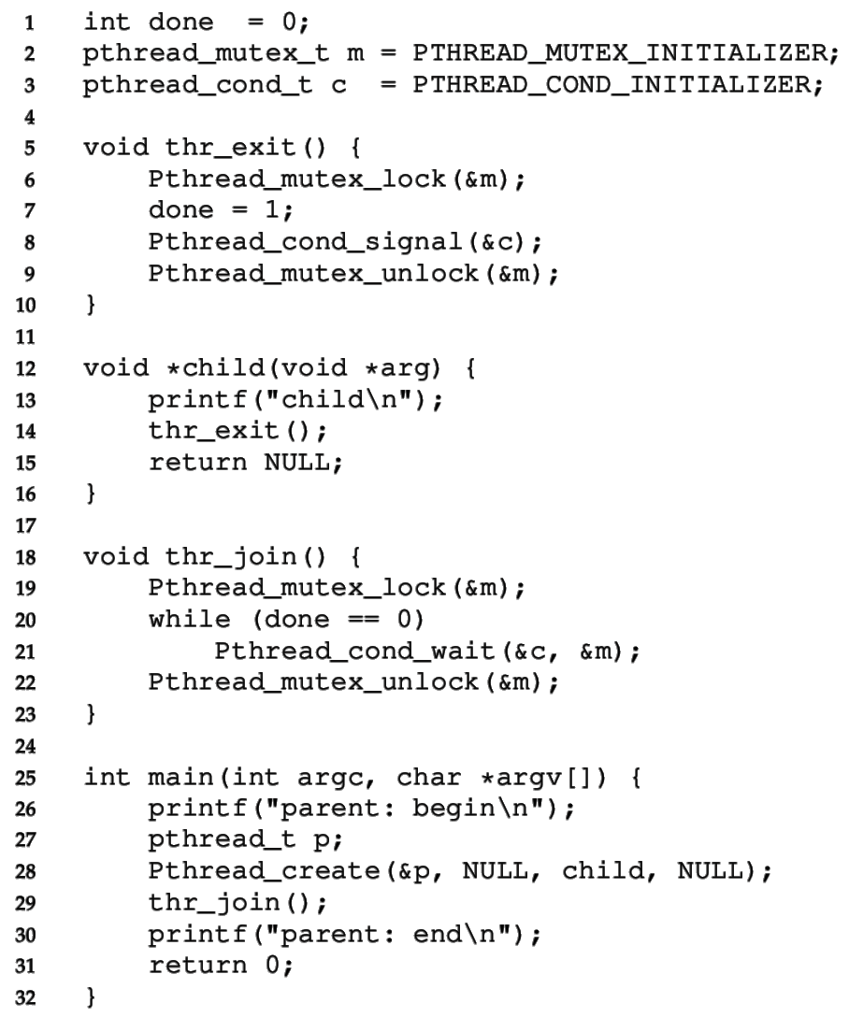
CV for child wait
Must use mutex to protect “done” flag and condvar
Done flag tracks the event
Condvar is used for ordering
Mutex protects both!

Slide 33
CV for child wait
Must use mutex to protect “done” flag and condvar
Parent calls thr_join()
wait()’s until done==1

Slide 34
CV for child wait
Must use mutex to protect “done” flag and condvar
Parent calls thr_join()
wait()’s until done==1
Child calls thr_exit()
sets done to 1
calls signal()
unlocks mutex

Slide 35
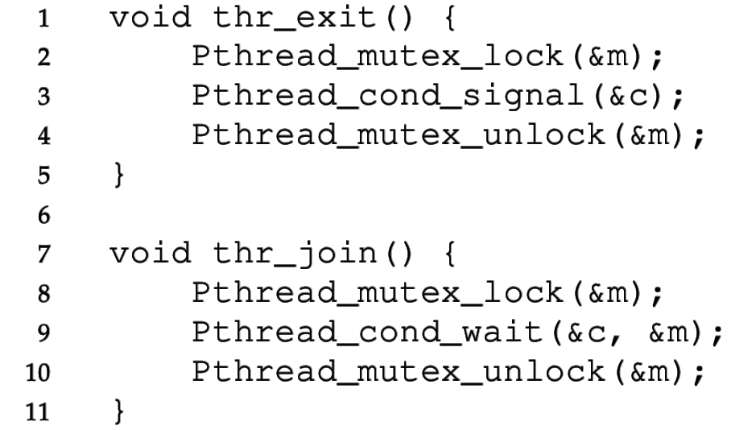
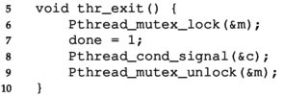
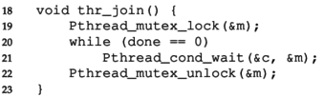
Check your understanding: why doesn’t this work?
Incorrect Code
Correct Code
Parent Child
Consider if an ordering exists that would lead to incorrect behavior
Lock means that only one critical section will run at a time

Slide 36
Buggy attempts to wait for a child, no flag
Incorrect Code
Correct Code
Parent Child
Without done variable:
The child could run first and signal
Before the parent starts waiting for the child
Parent waits forever…

Slide 37
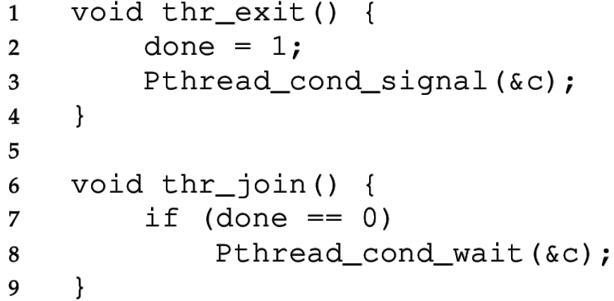
Check your understanding: is a lock necessary?
Incorrect Code
Correct Code
Parent Child
What could go wrong?
Without the lock, these lines could be interleaved in any way

Slide 38
Buggy attempts to wait for a child, no mutex
Incorrect Code
Correct Code
Parent Child
Without the lock:
Parent could see done == 0 and enter the if statement
Child could then exit, setting done to 1 and signaling
Parent then calls wait (missed the signal) and waits forever

Slide 39
Always use a loop to check the flag variable
It’s possible for the thread to wake up from a wait, but the resource is not available!
Maybe another thread took the resource first
Another thread could run and claim it before the woken thread is scheduled
Maybe a spurious wakeup occurred
Often other sources can cause wakeups to occur
Signals or Interrupts usually
Makes the implementation of condvar simpler, and we need to double-check the flag anyways, so it doesn’t matter

Slide 40
Must check condition within a loop
Thread 1 is working on the resource (claimed the lock already)
Thread 2 calls condvar_wait()
Thread 1 does some work, calls condvar_signal()
Before Thread 2 is scheduled, Thread 3 executes and skips the wait because the resource is ready!
Now Thread 2 will run, but the resource will not be ready
There is no guarantee that the condition you’ve been waiting for is true when you are awoken
So, we must also use a “predicate loop.” (while, not if)

Slide 41
Spurious (fake) wakeups
Pthreads allows wakeup to return not just when a signaled, but also when a timer expires or for no reason at all!
Spurious wakeups were included in the specification because they may allow some implementations be more efficient.
Should be safe since we have to wait with a while loop anyways

Slide 42
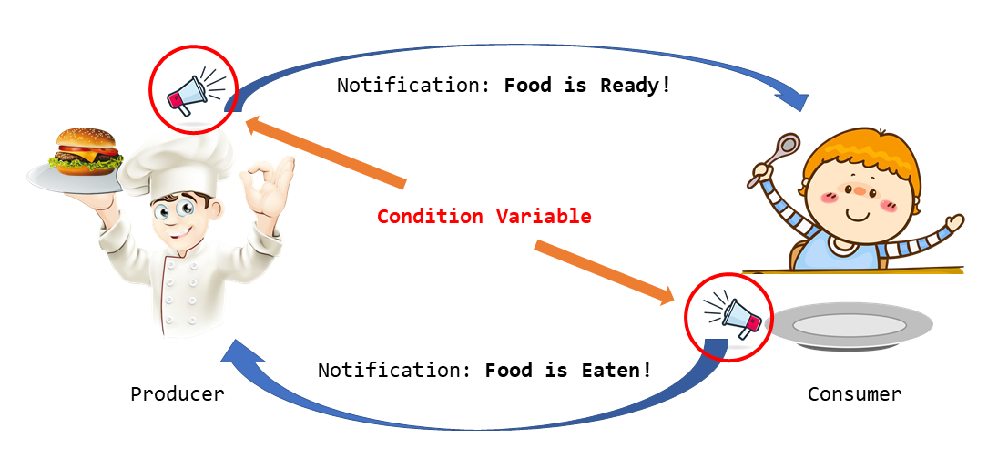
Classical concurrency problem: Producer-Consumer

Slide 43
Produce/Consumer Example Details
We have multiple producers and multiple consumers that communicate with a shared queue (FIFO buffer).
Concurrent queue allows work to happen asynchronously.
Buffer has finite size (does not dynamically expand)
Two operations:
Put, which should block (wait) if the buffer is full.
Get, which should block (wait) if the buffer is empty.
This is more complex than a (linked-list-based) concurrent queue because of the finite size and waiting.
Example scenario: request queue in a multi-threaded web server.

Slide 44
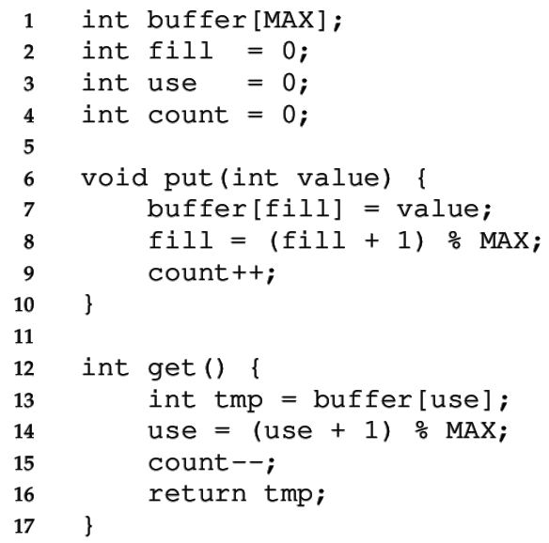
Managing the buffer
A simple implementation of a circular buffer that stores data in a fixed-size array.
fill is the index of the tail
use is the index of the head
count is the number of items
This simple implementation assumes:
Concurrency is managed elsewhere
It will overwrite data if we try to put more than MAX elements.
44

Slide 45
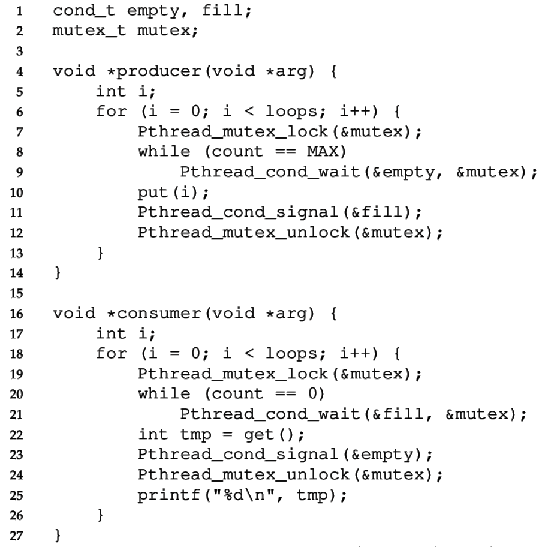
Managing the concurrency
Always acquire mutex
Must use same mutex in both functions
Use two condvars
45

Slide 46
Managing the concurrency
Always acquire mutex
Must use same mutex in both functions
Use two condvars
Producer waits on empty while the buffer is full
Producer signals fill after put
46

Slide 47
Managing the concurrency
Always acquire mutex
Must use same mutex in both functions
Use two condvars
Producer waits on empty while the buffer is full
Producer signals fill after put
Consumer waits on fill while the buffer is empty
Consumer signals empty after get
47

Slide 48
Managing the concurrency
Always acquire mutex
Must use same mutex in both functions
Use two condvars
Producer waits on empty while the buffer is full
Producer signals fill after put
Consumer waits on fill while the buffer is empty
Consumer signals empty after get
Loops re-check count condition after breaking out of wait, to check that there really is a resource
48

Slide 49
Broadcast makes more complex conditions possible
Recall that signal wakes one waiting thread (FIFO)
But there are times when threads are not all equivalent
The signal may not be serviceable by any of the threads
For example, consider memory allocation/free requests
An allocation can only be serviced by free of >= size
pthread_cond_broadcast wakes all threads
This approach may be inefficient, but it may be necessary to ensure progress

Slide 50
Condition Variable: rules of thumb
Shared state determines if condition is true or not
Check the state in a while loop before waiting on condvar
Use a mutex to protect:
The shared state on which condition is based, and
Operations on the condvar itself
Use different condvars for different conditions
Sometimes, cond_broadcast() helps if you can’t find an elegant solution using cond_signal()

Slide 51
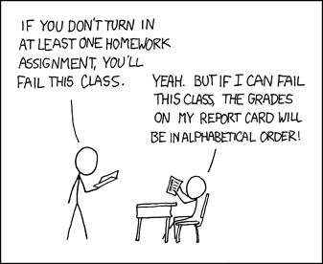
Break + xkcd (not relevant, just funny)
https://xkcd.com/336/

Slide 52
Outline
Applying Locks
Ordering with Condition Variables
Semaphores

Slide 53
Generalizing Synchronization
Condvars have no state or lock, just a waiting queue
The rest is handled by the programmer
Semaphores are a generalization of condvars and locks
Includes internal (locked) state
Sometimes this makes them more complicated, sometimes simpler

Slide 54

Semaphores (by Edsger Dijkstra, 1965)
Keeps an internal integer value that determines what happens to a calling thread
Init(val)
Set the initial internal value
Value cannot otherwise be directly modified
Up/Signal/Post/V() (from Dutch verhogen “increase”)
Increase the value. If there is a waiting thread, wake one.
Down/Wait/Test/P() (from Dutch proberen “to try”)
Decrease the value. Wait if the value is negative.
Dijkstra invented Dijkstra’s Algorithm! Also Semaphores and the entire field of Concurrent Programming
https://en.wikipedia.org/wiki/Edsger_W._Dijkstra

Slide 55
Semaphores vs Condition Variables
Semaphores
Condition Variables
Up/Post: increase value and wake one waiting thread
Down/Wait: decrease value and wait if it’s negative
Signal: wake one waiting thread
Wait: wait
Compared to CVs, Semaphores add an integer value that controls when waiting is necessary
Value counts the quantity of a shared resource currently available
Up makes a resource available, down reserves a resource
Negative value -X means that X threads are waiting for the resource

Slide 56
Check your understanding: build a mutex
How would we build a mutex out of a semaphore?
typdef struct {
sem_t sem;
} lock_t;
init(lock_t* lock){ }
acquire(lock_t* lock) {
}
release(lock_t* lock) {
}
sem_init(sem_t*, int initial)
sem_wait(sem_t*): Decrement, wait until value >= 0
sem_post(sem_t*): Increment value then wake a single waiter

Slide 57
Check your understanding: build a mutex
How would we build a mutex out of a semaphore?
typdef struct {
sem_t sem;
} lock_t;
init(lock_t* lock){
sem_init(&(lock->sem), 1); }
acquire(lock_t* lock) {
sem_wait(&(lock->sem));
}
release(lock_t* lock) {
sem_post(&(lock->sem));
}
sem_init(sem_t*, int initial)
sem_wait(sem_t*): Decrement, wait until value >= 0
sem_post(sem_t*): Increment value then wake a single waiter

Slide 58
Explanation of semaphore mutex implementation
typdef struct {
sem_t sem;
} lock_t;
init(lock_t* lock){
sem_init(&(lock->sem), 1); }
acquire(lock_t* lock) {
sem_wait(&(lock->sem));
}
release(lock_t* lock) {
sem_post(&(lock->sem));
}
The semaphore value represents the number of resources available
For a lock, there is 1 available initially
Acquiring the lock might give it to you immediately
Or it might wait
Multiple threads could be waiting
Releasing the lock only occurs after acquiring and resets it to 1

Slide 59
Semaphores reduce effort for numerical conditions
Condition Variable
Semaphore
void thr_exit() {
sem_post(&s);
}
void thr_join() {
sem_wait(&s);
}
// somewhere before all of this
sem_init(&s, 0);
Parent Child
Want parent to wait immediately so initialize to 0
If child thread finishes first, semaphore increments to 1
Resource: number of threads completed

Slide 60
Readers-Writers Problem
Some resources don’t need strict mutual exclusion, especially if they have many read-only accesses. (eg., a linked list)
Any number of readers can be active simultaneously, but
Writes must be mutually exclusive AND cannot happen during read
API:
acquire_read_lock(), release_read_lock()
acquire_write_lock(), release_write_lock()

Slide 61
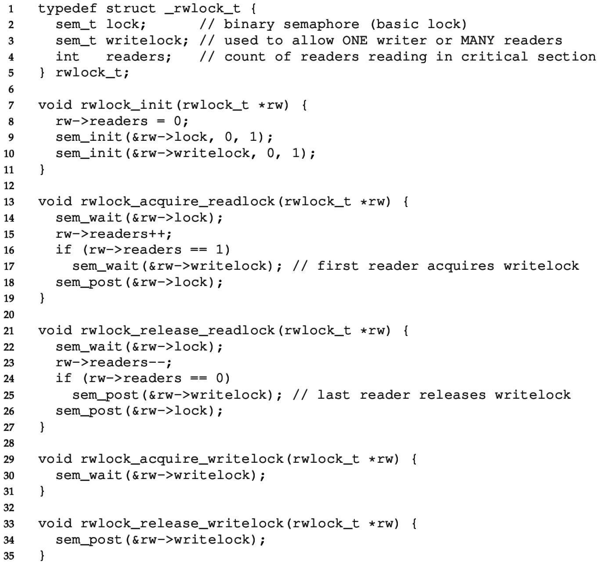
Reader-writer Lock
“lock” semaphore used as a mutex

Slide 62
Reader-writer Lock
“writelock” must be held during read to block writes or during write to block reads.
During reads
Number of active readers is counted.
First/last reader handles acquiring/releasing writelock.

Slide 63
Classical concurrency problems
Note that this particular solution could starve writers
There might always be readers in the critical section
Full solution to readers-writers problem with progress guarantee
https://en.wikipedia.org/wiki/Readers%E2%80%93writers_problem
Generally: try to map your problem to one of these solved problems
Producers/Consumers or Readers/Writers
There are MANY solutions to these problems available online

Slide 64
Outline
Applying Locks
Ordering with Condition Variables
Semaphores

