Slide 1
Lecture 07: Classical Scheduling
CS343 – Operating Systems
Branden Ghena – Fall 2024
Some slides borrowed from: Stephen Tarzia (Northwestern), Shivaram Venkataraman (Wisconsin), and UC Berkeley CS162

Slide 2
Administriva
PC Lab due Thursday
Scheduling Lab should be out on Tuesday
Put it out early so you could get started before the exam

Slide 3
Midterm Exam 1
Exam Details
In class, Tuesday October 22. Starts at 12:30 sharp. 80-minute exam
Covers all lectures through this week Thursday
(1. Introduction through 8. Scheduling: Real-Time & Modern)
You may bring ONE 8.5”x11” sheet of paper with notes on front and back
Handwritten, typeset, whatever you want
No calculators or other notes
Review materials
Posted to Canvas homepage: practice problems + prior exams

Slide 4
Today’s Goals
Introduce the concept and challenges of scheduling
Explore scheduling for batch and interactive systems
Identify important metrics for measuring scheduler performance
Examine several scheduling policies that target these metrics

Slide 5
Outline
Scheduling Overview
Scheduler Metrics
Batch Systems
First In First Out scheduling
Shortest Job First scheduling
Shortest Remaining Processing Time scheduling
Interactive Systems
Round Robin scheduling
Multi-Level Feedback Queue scheduling

Slide 6
Lies your operating system always told you
“Every process on your computer gets to run at the same time!”
This is an illusion
My desktop at home (running Windows)
Current load: 250 processes with 2987 threads
So how does the magic work?

Slide 7
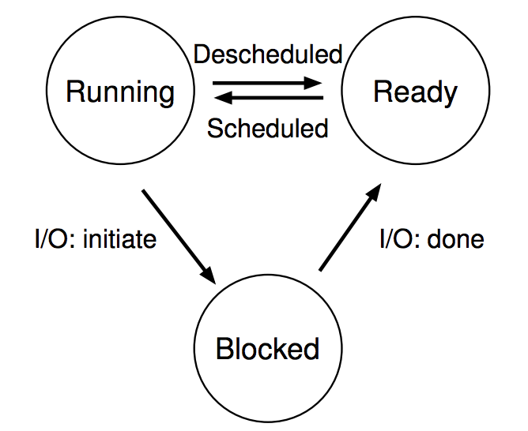
Processes don’t run all the time
The three basic process states:
OS schedules processes
Decides which of many competing processes to run.
A blocked process is not ready to run and is waiting on I/O
I/O means input/output – anything other than computing.
For example, reading/writing disk, sending network packet, waiting for keystroke, condvar/semaphore!
While waiting for results, the OS blocks the process, waiting to do more computation until the result is ready

Slide 8
Multiprogramming processes
The three basic process states:
Even with a single processor, the OS can provide the illusion of many processes running simultaneously
And also use this opportunity to get more useful work done
When one process is Blocked, OS can schedule a different process that is Ready
OS can also swap between various Ready processes so they all make progress

Slide 9
Scheduling
We know that multiple processes will be sharing the CPU
Possibly multiple threads in each process
Possibly multiple cores in the CPU
Scheduling is creating a policy for sharing the CPU
Which process/thread is chosen to run, and when?
When (if ever) does the OS change which process is running?

Slide 10
Scheduling terminology
Job - an execution unit handled by the scheduler (a.k.a. “task”)
Thread or process (doesn’t matter in this context)
Moves between Ready and Blocked queues
Workload – set of jobs
Arrival time of each job
Run time of each job

Slide 11
When can the OS make scheduling decisions?
Whenever the OS is actually running
i.e. after a context switch
Possible triggers
System calls
Process/Thread creation/termination
I/O requests
Synchronization primitives (futex/condvar/semaphore)
Hardware events (interrupts)
I/O complete
Timer triggers

Slide 12
Goal of most schedulers: always have a job running
The schedulers we look at in class are “work-conserving”
Always keeps scheduled resource busy if possible
When in doubt, make sure some job is running on the processor
Remember this for the lab and for exams!
Counter-examples of “non-work-conserving” schedulers
Network I/O scheduling may rate-limit to avoid overloading network
Energy-limited systems may choose to run nothing to preserve energy

Slide 13
Scheduling assumptions
Jobs all arrive at the same time
Each job runs for the same amount of time
Jobs cannot be stopped while executing
No new jobs are created while running existing jobs
Job runtime is known in advance
All jobs only use CPU (no I/O)
All jobs have equal priority
There is only one core (we’ll discuss this one next lecture)

Slide 14
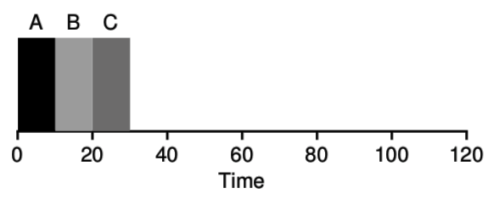
First scheduler: FIFO Scheduling
First In, First Out (FIFO)
also known as First Come First Served (FCFS)
Policy
First job to arrive gets scheduled first
Let a job continue until it is complete
Then schedule next remaining job with earliest arrival

Slide 15
Outline
Scheduling Overview
Scheduler Metrics
Batch Systems
First In First Out scheduling
Shortest Job First scheduling
Shortest Remaining Processing Time scheduling
Interactive Systems
Round Robin scheduling
Multi-Level Feedback Queue scheduling

Slide 16
Metrics for systems
Metric – standard for measuring something
Mathematical optimization: objective function
Economics: utility function
For different computing scenarios, different metrics will be most important
Computing systems have different goals and uses
Performance metrics are often in conflict with each other
Operating Systems are full of tradeoffs

Slide 17
A global scheduling metric
Fairness
Each job should get a “fair” share of the processor
Fair means different things of course
Could be “each job gets equal time”
Could be “each job starts in order it arrives”
Could be “each job is handled based on its priority”
Scheduler should be fair with regards to the goals of the system it runs on

Slide 18
Other scheduling metrics
Performance
How many jobs does the system complete?
How quickly are jobs completed?
Responsiveness
How responsive does the system feel to users
Energy use, types of jobs run, processor cores used, etc.

Slide 19
Different systems have different important metrics
Example: network server
Request for home page
Request for contact page
Example: personal computer
Text editor that the user is actively interacting with
Compilation running in the background
Example: autonomous vehicle
Image recognition algorithms
Radio

Slide 20
Different systems have different important metrics
Example: network server – Batch System
Request for home page
Request for contact page
Example: personal computer – Interactive System
Text editor that the user is actively interacting with
Compilation running in the background
Example: autonomous vehicle – Real-time System
Image recognition algorithms
Radio

Slide 21
Break + Say hi to your neighbors
Things to share
Name
Major
One of the following
Favorite Candy
Favorite Pokemon
Favorite Emoji

Slide 22
Break + Say hi to your neighbors
Things to share
Name -Branden
Major -Electrical and Computer Engineering, and Computer Science
One of the following
Favorite Candy - Twix
Favorite Pokemon - Eevee
Favorite Emoji - 🍢

Slide 23
Outline
Scheduling Overview
Scheduler Metrics
Batch Systems
First In First Out scheduling
Shortest Job First scheduling
Shortest Remaining Processing Time scheduling
Interactive Systems
Round Robin scheduling
Multi-Level Feedback Queue scheduling

Slide 24

What are batch systems?
Systems designed to run a set of provided tasks
No direct interaction with users
Predominantly run-to-completion jobs
Example: banking systems or payroll management
Modern example: network servers
Tasks are serving requests
Multiple types of requests, each with known runtimes

Slide 25
Metrics for batch systems
Throughput
Jobs completed per unit time
Throughput = jobs_completed / total_duration
Higher is better
Turnaround time
Duration from job arrival until job completion
T_{turnaround} = T_{completion} – T_{arrival}
Lower is better
Average turnaround time is computed across all jobs

Slide 26
Example: throughput and turnaround
Jobs A and B arrive
Running Job A
Running Job B
time
0
10
40
60
Job A
Arrival: 10
Completion: 40
Duration: 30
Job B
Arrival: 10
Completion: 60
Duration: 20

Slide 27
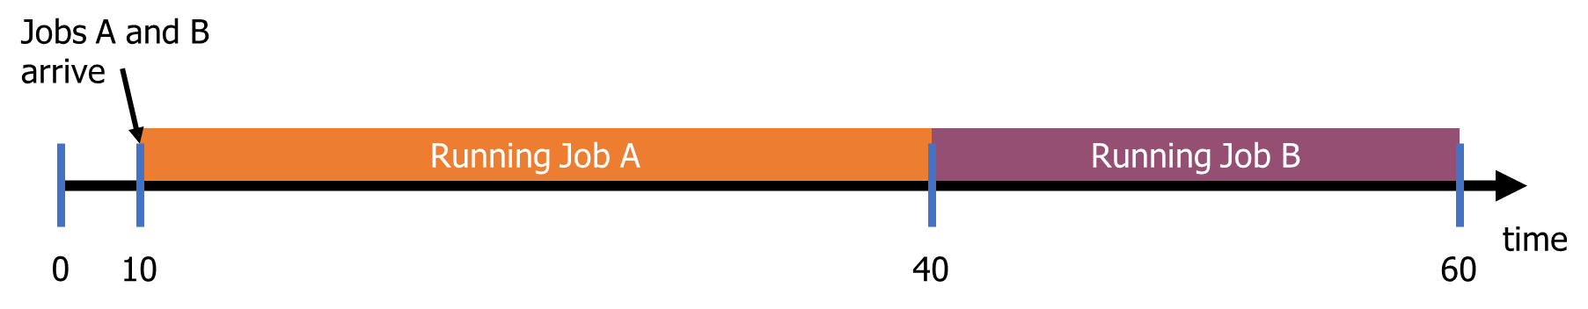
Example: throughput and turnaround
Throughput = jobs_completed / total_duration
T_{turnaround} = T_{completion} – T_{arrival}
Throughput
Turnaround for A
Turnaround for B
Average Turnaround

Slide 28
Example: throughput and turnaround
Throughput = jobs_completed / total_duration
T_{turnaround} = T_{completion} – T_{arrival}
Throughput
2 jobs / 50 time = 0.04
Turnaround for A
40-10 = 30
Turnaround for B
60-10 = 50
Average Turnaround
(30+50)/2 = 40

Slide 29
Batch scheduler metric
Which metric is most relevant to a batch system scheduler with a finite list of processes?
Throughput or Turnaround
Throughput only cares about sum of durations of jobs
Throughput is the same no matter whether A or B goes first
Turnaround accounts for delays in scheduling a job
Swapping A and B would result in better average turnaround
Turnaround for A
60-10 = 50
Turnaround for B
30-10 = 20
Average Turnaround
(50+20)/2 = 35

Slide 30
Schedulers for batch systems
First In First Out
Shortest Job First
Preemptive Shortest Remaining Processing Time

Slide 31
Revisiting scheduling assumptions
Jobs all arrive at the same time Jobs have arrival times
Each job runs for the same amount of time
Jobs cannot be stopped while executing
No new jobs are created while running existing jobs
Job runtime is known in advance
All jobs only use CPU (no I/O)
All jobs have equal priority

Slide 32
1. FIFO Scheduling
First In, First Out (FIFO)
assumption for now: all jobs arrive at time zero
What is the average turnaround for this workload?
(10 + 20 + 30)/3 = 20

Slide 33
Revisiting scheduling assumptions
Jobs all arrive at the same time Jobs have arrival times
Each job runs for the same amount of time Jobs can have different run durations
Jobs cannot be stopped while executing
No new jobs are created while running existing jobs
Job runtime is known in advance
All jobs only use CPU (no I/O)
All jobs have equal priority

Slide 34
Check your understanding – FIFOs with different durations
What is a problematic scenario for FIFO scheduling?
(consider job durations)

Slide 35
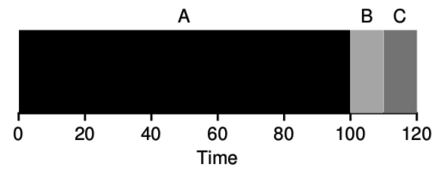
Check your understanding – FIFOs with different durations
What is a problematic scenario for FIFO scheduling?
One big job can cause lots of jobs behind it to wait
Convoy effect – lots of small jobs stuck behind one big job
Average turnaround time = (100+110+120)/3 = 110
Minimum average turnaround time = (10+20+120)/3 = 50

Slide 36
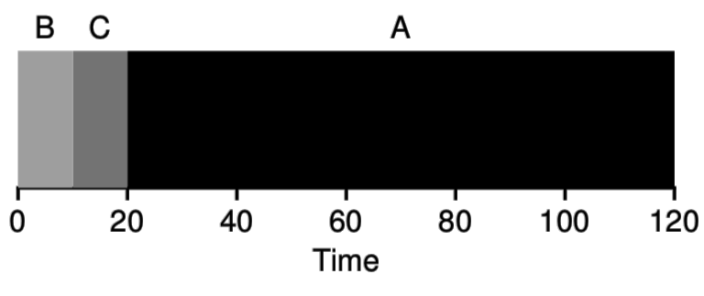
2. Shortest Job First
Policy
Schedule the job with the smallest duration first
Let a job continue until it is complete
Then schedule next remaining job with smallest duration
Essentially: complete a job as soon as possible
Minimizes the number of waiting jobs, minimizing average turnaround
Average Turnaround
(10+20+120)/3 = 50

Slide 37
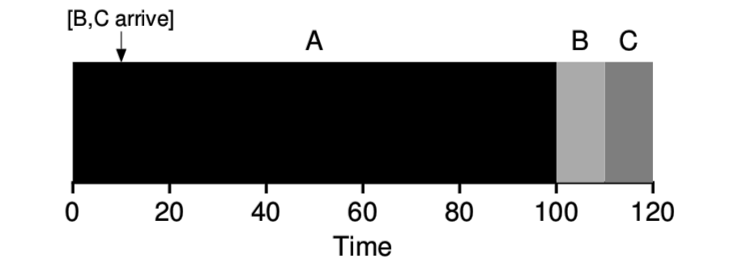
Shortest Job First can fail with late arrivals
Scheduler’s previously optimal decision could be invalidated by new job arrivals
If B and C arrive late, they will have to wait because A is already running

Slide 38
Check your understanding
What is the average turnaround time for this example?
B and C arrive at time 10

Slide 39
Check your understanding
What is the average turnaround time for this example?
B and C arrive at time 10
Average turnaround = ((100-0) + (110-10) + (120-10))/3
= 103.33333333

Slide 40
Revisiting scheduling assumptions
Jobs all arrive at the same time Jobs have arrival times
Each job runs for the same amount of time Jobs can have different run durations
Jobs cannot be stopped while executing Jobs can be preempted during execution
No new jobs are created while running existing jobs
Job runtime is known in advance
All jobs only use CPU (no I/O)
All jobs have equal priority

Slide 41
Preemption
Let’s add a new scheduler capability: preemption
OS can “deschedule” jobs that are running
This means it can make scheduling decisions more frequently
System calls
Interrupts
Timers

Slide 42
Context switching overhead
Switching processes is expensive
Context switch to OS is on the order of 1 μs (1 millionth of a second)
Switching registers and CPU mode
Memory is often the larger expense though
New process has different physical memory pages
Which means that caches have to be cleared
Caches will “warm up” as the process runs
Less of a penalty to threads (only stack changes)
Alternative option: cooperative scheduling through yield()

Slide 43
Revisiting scheduling assumptions
Jobs all arrive at the same time Jobs have arrival times
Each job runs for the same amount of time Jobs can have different run durations
Jobs cannot be stopped while executing Jobs can be preempted during execution
No new jobs are created while running existing jobs Jobs can be created at any time
Job runtime is known in advance
All jobs only use CPU (no I/O)
All jobs have equal priority

Slide 44
3. Preemptive Shortest Remaining Processing Time
Also known as Shortest Time-to-Completion First
Policy
Schedule job with smallest duration first
Preempt a running job when new jobs arrive
Then schedule job with smallest remaining duration
Essentially, reevaluate schedule when new information is gained

Slide 45
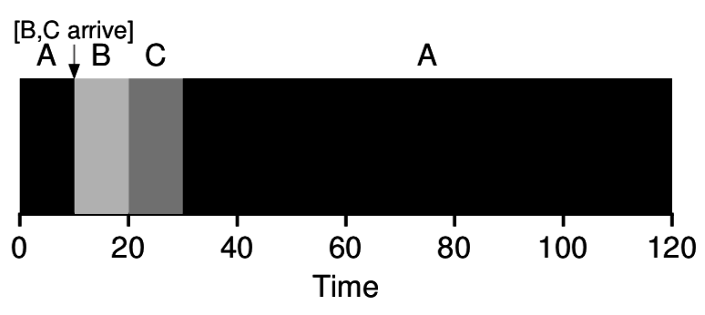
Shortest Remaining Processing Time example
A is preempted when B and C arrive at time 10
Scheduler chooses B as new shortest remaining time
B=10, C=10, A=100
Average Turnaround
(120+10+20)/3 = 50

Slide 46
Break + Starvation and scheduling
Starvation can occur in schedulers
When one job will never actually get a chance to run
We’ve discussed:
FIFO, Shortest Job First, and Shortest Remaining Processing Time
Which of these can exhibit starvation?
Notes:
Need probably ~25 more minutes to finish interactive

Slide 47
Break + Starvation and scheduling
Starvation can occur in schedulers
When one job will never actually get a chance to run
We’ve discussed:
FIFO, Shortest Job First, and Shortest Remaining Processing Time
Which of these can exhibit starvation?
Shortest Remaining Processing Time
Shortest Job First too if we allow new job arrivals (without preemption)
Arriving short tasks could lead a long task to never be scheduled

Slide 48
Outline
Scheduling Overview
Scheduler Metrics
Batch Systems
First In First Out scheduling
Shortest Job First scheduling
Shortest Remaining Processing Time scheduling
Interactive Systems
Round Robin scheduling
Multi-Level Feedback Queue scheduling

Slide 49
What are interactive systems?
Every computer you directly interact with
Desktops, laptops, smartphones
Differences from batch systems
Humans are “in-the-loop”
Computer needs to feel responsive for programs they are using
Many jobs have no predefined duration
How long does Chrome run for?
Still have some batch jobs though (background services)

Slide 50
Metric for interactive systems
Response time
Time from arrival until the job begins execution
Doesn’t matter how long the job takes to run since it runs indefinitely
T_{response} = T_{start} – T_{arrival}
Particularly useful for interactive processes
Need to quickly show that they are reacting to user inputs
Exact total run duration isn’t so important though

Slide 51
Schedulers for interactive systems
Round Robin
Multi-Level Feedback Queue

Slide 52
Revisiting scheduling assumptions
Jobs all arrive at the same time Jobs have arrival times
Each job runs for the same amount of time Jobs can have different run durations
Jobs cannot be stopped while executing Jobs can be preempted during execution
No new jobs are created while running existing jobs Jobs can be created at any time
Job runtime is known in advance Job runtime is unknown
All jobs only use CPU (no I/O)
All jobs have equal priority

Slide 53
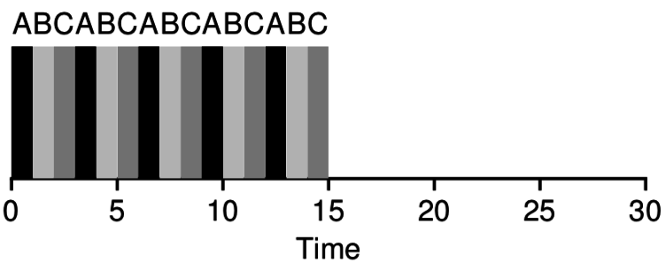
1. Round Robin
Round Robin scheduling runs a job for a small timeslice (quanta), then schedules the next job
If all jobs arrive at time 0
Average response time = (0 + 1 + 2)/3 = 1
Smaller timeslice means smaller response time

Slide 54
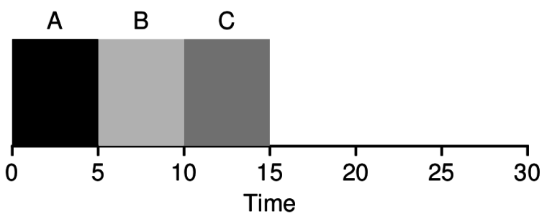
Check your understanding
Round Robin scheduling:
Avg turnaround time =
Avg response time =
Shortest Job first or SRPT:
Avg turnaround time =
Avg response time =

Slide 55
Different policies favor different metrics
Round Robin scheduling:
Avg turnaround time = 14
Avg response time = 1
Shortest Job first or SRPT:
Avg turnaround time = 10
Avg response time = 5
Better response time versus Better turnaround time

Slide 56
Remember, context switches are not free
Round Robin scheduling:
Context switches = 14
Shortest Job first or SRPT:
Context switches = 2
In a real OS, Round Robin would take an extra ~12 μs
Plus more time lost with cold caches…
Timeslice must be much greater than context switch time
Usually timeslice is ~1 ms and context switch is ~1 μs

Slide 57
Handling a round-robin edge case
Assume quantum (timeslice duration) is 5
What should the scheduler do?
Schedule nothing for the rest of the timeslice
Schedule a new job for the rest of the timeslice
Schedule a new job with a new, full timeslice
C
C completes at time 12

Slide 58
Handling a round-robin edge case
Assume quantum (timeslice duration) is 5
What should the scheduler do?
Schedule nothing for the rest of the timeslice Not work-conserving
Schedule a new job for the rest of the timeslice
Schedule a new job with a new, full timeslice
C
C completes at time 12

Slide 59
Handling a round-robin edge case
Assume quantum (timeslice duration) is 5
What should the scheduler do?
Schedule nothing for the rest of the timeslice Not work-conserving
Schedule a new job for the rest of the timeslice Not fair
Schedule a new job with a new, full timeslice Correct!
C
C completes at time 12

Slide 60
Timeslices are attached to jobs
Each job gets its own timeslice duration
Jobs may use less than their entire timeslice voluntarily
They could complete
They could become blocked
They could decide to yield
The scheduler, however, should always provide a full timeslice
In previous example: runtime of one job shouldn’t affect another job

Slide 61
Revisiting scheduling assumptions
Jobs all arrive at the same time Jobs have arrival times
Each job runs for the same amount of time Jobs can have different run durations
Jobs cannot be stopped while executing Jobs can be preempted during execution
No new jobs are created while running existing jobs Jobs can be created at any time
Job runtime is known in advance Job runtime is unknown
All jobs only use CPU (no I/O) Jobs can make I/O requests that block
All jobs have equal priority

Slide 62
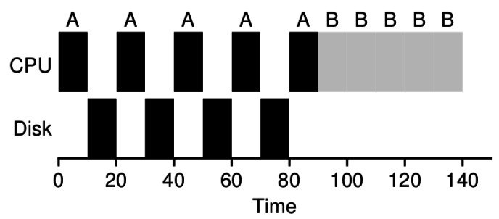
I/O creates scheduling overlap opportunities
Job A does I/O every ten milliseconds and each I/O takes 10 ms:
A is blocked during its I/O.
It’s just waiting for data from the disk
But it does not need the CPU

Slide 63
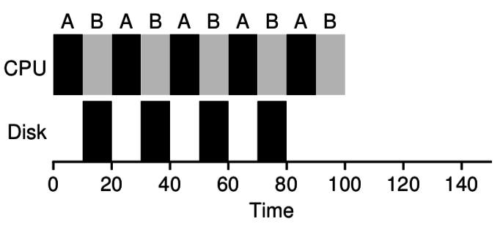
I/O creates scheduling overlap opportunities
Job A does I/O every ten milliseconds and each I/O takes 10 ms:
A is blocked during its I/O.
It’s just waiting for data from the disk
But it does not need the CPU
We can schedule another job during process A’s I/O
Once a job is blocked, the scheduler can immediately move to the next job!

Slide 64
Jobs can be I/O-bound or CPU-bound
CPU-bound process
Lots of computation between each I/O request
Actually needs to do computation on a processor
Example: doing matrix math
I/O-bound process
Very little computation between each I/O request
Just needs a processor to figure out its next I/O request
Example: searching a file system for a file name

Slide 65
Scheduling goal: I/O-bound before CPU-bound
First maximize I/O
Run the I/O-bound jobs as quickly as possible,
So they can send next I/O request,
And our disks, network cards, etc. are maximally used
Then fill up the processor(s)
Lots of room for multiprogramming between the I/O requests
Blocked jobs are still “progressing” as their I/O is fetched

Slide 66
Scheduling goal: I/O-bound before CPU-bound
First maximize I/O
Run the I/O-bound jobs as quickly as possible,
So they can send next I/O request,
And our disks, network cards, etc. are maximally used
Then fill up the processor(s)
Lots of room for multiprogramming between the I/O requests
Blocked jobs are still “progressing” as their I/O is fetched
But how do you know when a job is going to use I/O?
Can’t know the future
Can track past behavior of the job

Slide 67
Revisiting scheduling assumptions
Jobs all arrive at the same time Jobs have arrival times
Each job runs for the same amount of time Jobs can have different run durations
Jobs cannot be stopped while executing Jobs can be preempted during execution
No new jobs are created while running existing jobs Jobs can be created at any time
Job runtime is known in advance Job runtime is unknown
All jobs only use CPU (no I/O) Jobs can make I/O requests that block
All jobs have equal priority Jobs have individual priority

Slide 68
2. Multi-Level Feedback Queue (MLFQ)
General purpose scheduler to support multiple goals
Good response time for interactive jobs
Good turnaround time for batch jobs
Achieves this by prioritizing I/O bound jobs over CPU bound jobs
Policy
Automatically attach priority to jobs:
Interactive, I/O bound jobs should be highest priority
CPU bound, batch jobs should be lowest priority
Apply different round robin timeslices to each priority level

Slide 69
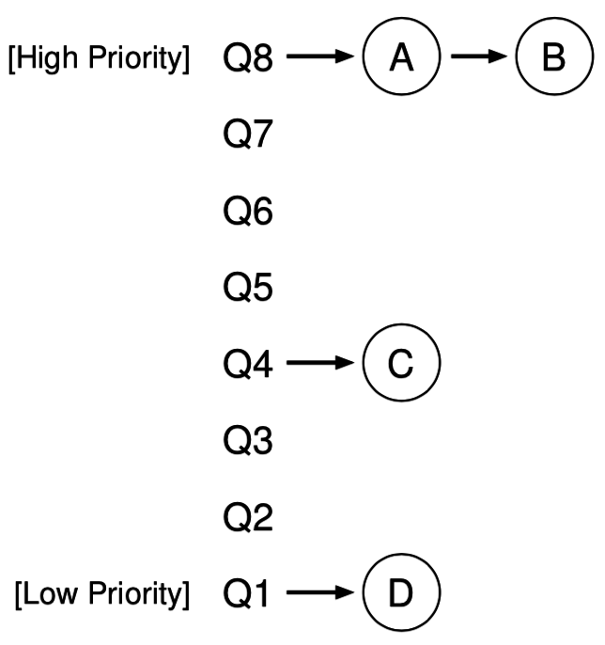
Multi-Level Feedback Queue Details
Run highest priority level available
Round robin among jobs there
When all jobs at a level are blocked on I/O
Move down to next lower level
Long running jobs lose priority
Set a processor usage limit at a given level
When used up, demote job one level

Slide 70
MLFQ Rules
If Priority(J₁) > Priority(J₂), J₁ runs
If Priority(J₁) = Priority(J₂), J₁ and J₂ run in Round Robin
Jobs start at top priority
When a job uses its time quota for a level, demote it one level
Every S seconds, reset priority of all jobs to top

Slide 71
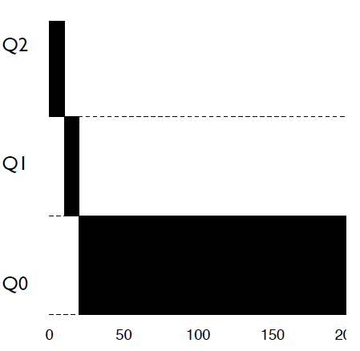
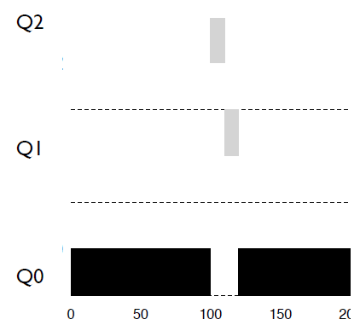
MLFQ Example
Higher priority jobs run first
Job’s priority drops as it runs
Priority
Time
Time

Slide 72
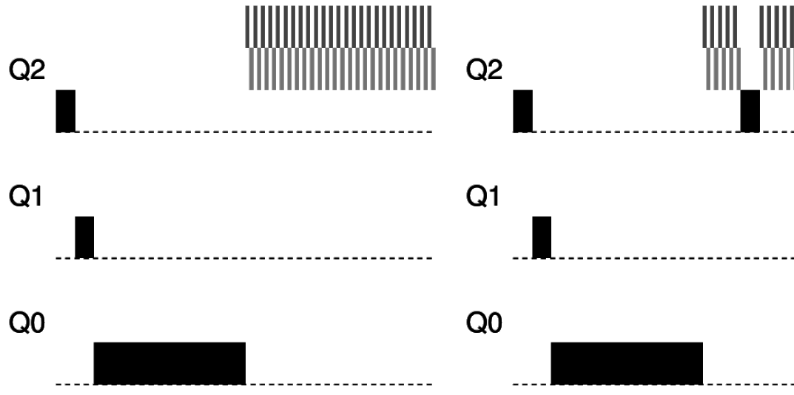
MLFQ avoids starvation with periodic priority reset
Low priority jobs could starve if there are enough interactive jobs
MLFQ avoids starvation by periodically resetting priorities
Many new interactive jobs
Priority reset
Time
Time

Slide 73
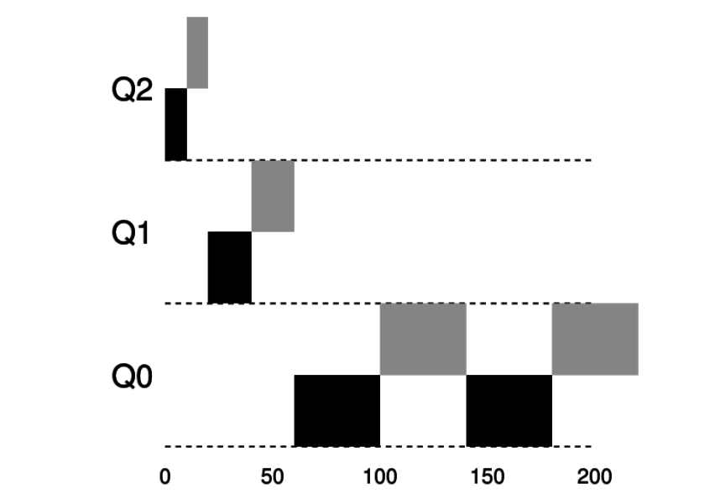
Change timeslices to optimize response and turnaround
Lower priority jobs are CPU bound, not interactive
So we can use longer timeslices to minimize context switches
Priority
Time

Slide 74
MLFQ parameters
Every MLFQ implementation needs to choose a bunch of parameters
How many queues/priority levels?
When does a job get demoted in priority?
How often to reset priority for everything?
How large is the timeslice at each priority level?

Slide 75
MLFQ in the wild
The embedded OS I work on has an MLFQ scheduler!
https://github.com/tock/tock/blob/master/kernel/src/scheduler/mlfq.rs
How many queues/priority levels?
Three
When does a job get demoted in priority?
If it ever uses its whole timeslice without blocking
How often to reset priority for everything?
Every five seconds
How large is the timeslice at each priority level?
10 ms, 20 ms, 50 ms

Slide 76
Outline
Scheduling Overview
Scheduler Metrics
Batch Systems
First In First Out scheduling
Shortest Job First scheduling
Shortest Remaining Processing Time scheduling
Interactive Systems
Round Robin scheduling
Multi-Level Feedback Queue scheduling

