Slide 1
Lecture 10: Device Drivers
CS343 – Operating Systems
Branden Ghena – Fall 2024
Some slides borrowed from: Stephen Tarzia (Northwestern), Jaswinder Pal Singh (Princeton), and UC Berkeley CS162

Slide 2
Administrivia
Scheduling Lab due tonight! 😱
Be sure to test on your own workloads in addition to ours
Your code should never crash and should always finish
Do the math on paper and compare response/turnaround times
Driver Lab will be up tonight or maybe tomorrow

Slide 3
Today’s Goals
Explore how software for device I/O is architected.
Discuss OS considerations at multiple software layers.
Investigate example device drivers
One in Nautilus
One in Linux and Tock

Slide 4
Outline
Abstractions
Device I/O layers
Application Layer
Kernel I/O Subsystem
Device Driver
Interrupt Handler
Example Driver: Nautilus Character Device
Example Driver: Temperature Sensor

Slide 5
Writing software to manage devices
Kernel software for managing a device is a device driver
70% of Linux code is device drivers
15.3 Million lines of source code
Big challenge for device drivers
How do we enable interactions with so many varied devices?
Need abstractions to allow software to interact with them easily
Need mechanisms to reuse a lot of code for commonalities

Slide 6
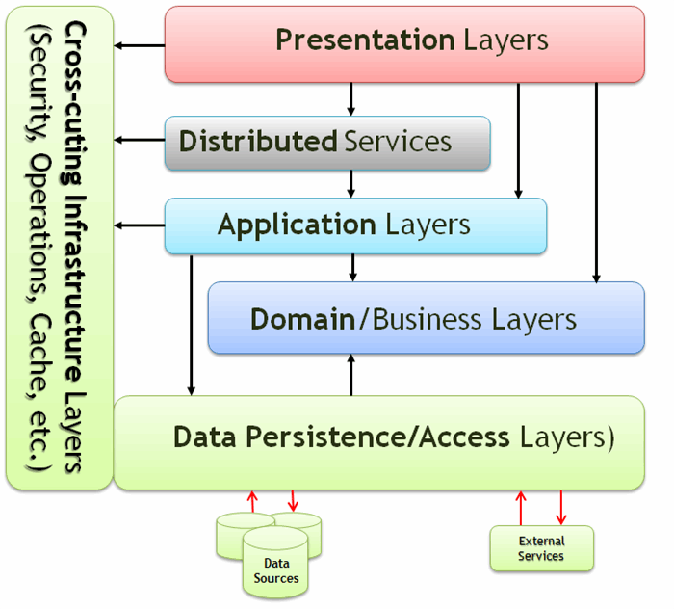
General software abstractions
When building large software projects, we like to define layers of code
Makes it clear what is handled where
Enables swapping out implementations when desired

Slide 7
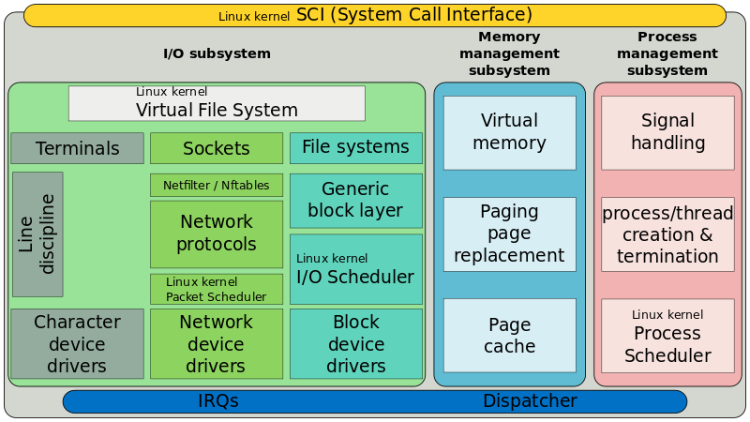
Linux Kernel Layering

Slide 8
Linux Kernel Layering

Slide 9
Linux Kernel Layering

Slide 10
Linux Kernel Layering

Slide 11
Linux Kernel Layering

Slide 12
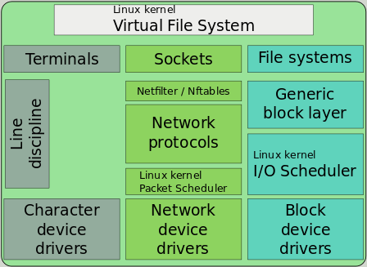
Abstraction: everything is a file!
Hardware: treat devices like memory
They can be read and written at addresses
Software: treat devices like files
They can be read and written
They may be created or destroyed (plugged/unplugged)
They can be created in hierarchies. Example:
SATA devices
SSD
USB devices
Webcam
Microphone

Slide 13
Linux device classes
Character devices
Accessed as a stream of bytes (like a file)
Example: Webcam, Keyboard, Headphones
We will focus on these
Block devices
Accessed in blocks of data (like a disk)
Can hold entire filesystems
Example: Disks, Flash drives
Network interfaces
See CS340 (Computer Networking)
Accessed through transfer of data packets
dev
char
block
net
Serial
Parallel
SATA
SCSI
Ethernet
WiFi
video
2D
3D

Slide 14
System layers when interacting with devices
User applications
Do useful things
I/O subsystem
Receive syscalls, route to device drivers
Device drivers
Translate application requests into device interactions
Interrupt Handler
Receive events from hardware
Hardware
Do useful things
User Applications
I/O Subsystem
Device Drivers
Interrupt Handler
Hardware

Slide 15
Outline
Abstractions
Device I/O layers
Application Layer
Kernel I/O Subsystem
Device Driver
Interrupt Handler
Example Driver: Nautilus Character Device
Example Driver: Temperature Sensor

Slide 16
Where we are at in the system
Processes
User Applications
I/O Subsystem
Device Drivers
Interrupt Handler
Hardware

Slide 17
Communication with devices
Interactions occur through system calls
Open/Close
Read/Write
Seek, Flush
Ioctl
And various others

Slide 18
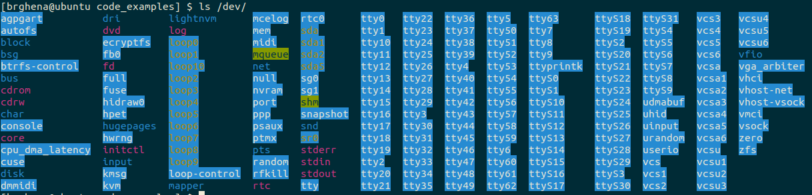
Accessing devices
Open/Close
Inform device that something is using it (or not)
Argument is path to device (like path to file)
Get a file descriptor that the other operations act on
“/dev” directory is populated with devices

Slide 19
Interacting with devices
Same read/write commands you’ve likely seen before
These are actually syscalls!
Read
ssize_t read(int fd, void *buf, size_t count);
Write
ssize_t write(int fd, const void *buf, size_t count);

Slide 20
Arbitrary device interactions
ioctl – I/O Control
int ioctl(int fd, unsigned long request, ...);
Request number followed by an arbitrary list of arguments
“request” may be broken in fields: command, size, direction, etc.
Catch-all for device operations that don’t fit into file I/O model
Combine with “magic numbers” to form some special action
Reset device, Start action, Change setting, etc.
Read the device documentation to find these

Slide 21
ioctl example – webcam capabilities
Magic number to request webcam capabilities: 0x80685600
Returns a struct with various data fields
Driver name, Device name, Bus location
Capabilities flags (various video modes, async operation support)
Documentation: https://www.kernel.org/doc/html/v4.9/media/uapi/v4l/vidioc-querycap.html
./ioctl /dev/video0 0x80685600 | hexdump -C
Decoded values: ioctl=0x80685600, direction=R, arg size=104 bytes, device number=0x56 ('V')
Used values: ioctl=0x80685600, direction=R, arg size=104 bytes, device number=0x56 ('V')
Returned 0
00000000 75 76 63 76 69 64 65 6f 00 00 00 00 00 00 00 00 |uvcvideo........|
00000010 48 44 20 50 72 6f 20 57 65 62 63 61 6d 20 43 39 |HD Pro Webcam C9|
00000020 32 30 00 00 00 00 00 00 00 00 00 00 00 00 00 00 |20..............|
00000030 75 73 62 2d 30 30 30 30 3a 30 33 3a 30 30 2e 30 |usb-0000:03:00.0|
00000040 2d 32 00 00 00 00 00 00 00 00 00 00 00 00 00 00 |-2..............|
00000050 0c 08 06 00 01 00 a0 84 01 00 20 04 00 00 00 00 |.......... .....|
00000060 00 00 00 00 00 00 00 00 |........|
00000068
Command line tool for sending ioctl commands: https://github.com/jerome-pouiller/ioctl

Slide 22
Asynchronous I/O operations
Previous examples were all synchronous I/O calls
Read/Write will block process until complete
Easy to use, but not always most efficient method
Asynchronous I/O calls also exist
POSIX AIO library
aio_read/aio_write – enqueue read/write request
aio_error – check status of an I/O request
aio_return – get result of a completed I/O request

Slide 23
Synchronous blocking read example
Process
Kernel
Device
Read
Context Switch
Driver sets up request
DMA Request
Block Process
DMA Read
Driver handles response
Interrupt
Unblock Process
Continue Process
Context Switch

Slide 24
Asynchronous read example
Process
Kernel
Device
aio_read
Context Switch
Driver sets up request
DMA Request
Do other work
DMA Read
Driver handles response
aio_error aio_return
Interrupt
Ready
Continue Process
Context Switch

Slide 25
Asynchronous read example with early request
Process
Kernel
Device
aio_read
Context Switch
Driver sets up request
DMA Request
Do other work
aio_error
DMA Read
Not Ready
Do other work
Driver handles response
aio_error aio_return
Interrupt
Ready
Continue Process
Context Switch

Slide 26
Break + Open Question
Could you re-create the asynchronous I/O interface using threads?

Slide 27
Break + Open Question
Could you re-create the asynchronous I/O interface using threads?
aio_read creates a new thread, which does the actual blocking read
Thread will essentially block immediately
aio_error / aio_return get data from that worker thread
Synchronized with locks
Thread exits after aio_return occurs
This is basically the underlying implementation for glibc POSIX AIO

Slide 28
Outline
Abstractions
Device I/O layers
Application Layer
Kernel I/O Subsystem
Device Driver
Interrupt Handler
Example Driver: Nautilus Character Device
Example Driver: Temperature Sensor

Slide 29
Where we are at in the system
Processes
User Applications
I/O Subsystem
Device Drivers
Interrupt Handler
Hardware

Slide 30
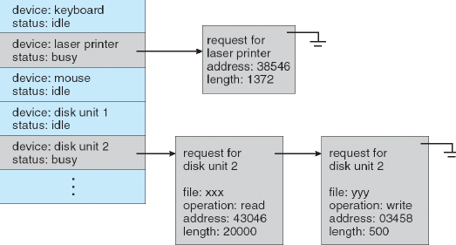
Kernel I/O subsystem
The OS kernel does various things for devices that are not specific to the individual device
Manages permissions
Routes call to appropriate driver
Schedules requests to drivers

Slide 31
Kernel needs to handle process memory
Address translation
All the data user processes give to the kernel comes with virtual addresses
Pointers are either going to have to be translated
Or memory is going to need to be copied
Buffering
Kernel may need to hold on to a copy of data
Especially in asynchronous case
When copies are done and how many times is a big kernel efficiency question

Slide 32
Outline
Abstractions
Device I/O layers
Application Layer
Kernel I/O Subsystem
Device Driver
Interrupt Handler
Example Driver: Nautilus Character Device
Example Driver: Temperature Sensor

Slide 33
Where we are at in the system
Processes
User Applications
I/O Subsystem
Device Drivers
Interrupt Handler
Hardware

Slide 34
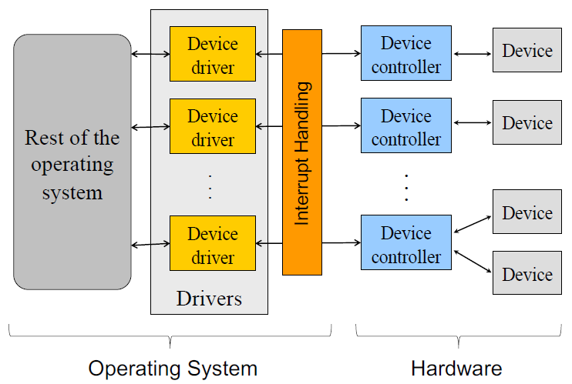
Device drivers
Device-specific code for communicating with device
Supports some interfaces above and below
Possibly file syscalls above and memory-mapped I/O below
Possibly internal API above and below..
Examples
Specific disk drivers are layered on top of SATA driver
Keyboard driver is layered on top of USB driver
Ethernet driver has various network interfaces layered above it

Slide 35
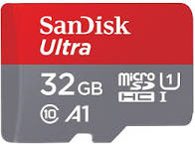
Example: possible driver layers for an SD card
Block device interface
Various filesystems
Generic SD Card Driver
microSDHC UHS-I Driver
Generic SPI Interface Driver
Intel SPI Controller Driver
Memory-Mapped I/O

Slide 36
Device I/O is handled by device drivers
Communication is up to the hardware
Port-mapped I/O or memory-mapped I/O
Or function calls to a lower-level driver
Interaction design is up to the driver (and OS)
Programed I/O
Synchronous or with interrupts
Direct Memory Access
Needs hardware support
With interrupts

Slide 37
Device drivers are often designed with two “halves”
Top half
Interrupt handler
Continues next transaction
Or signals for bottom half to continue (often with shared variable)
Bottom half
Implements interface that higher layers require
Performs logic to start device requests
Wait for I/O to be completed
Synchronously (blocking) or asynchronously (return to kernel)
Handle responses from the device when complete

Slide 38
Virtualizing one device for many users
Some devices need to be virtualized
Software that emulates unique devices for each higher level user even though only a single hardware resource actually exists
Process 1
Process 2
Kernel
Virtualized Disk
Disk Driver

Slide 39
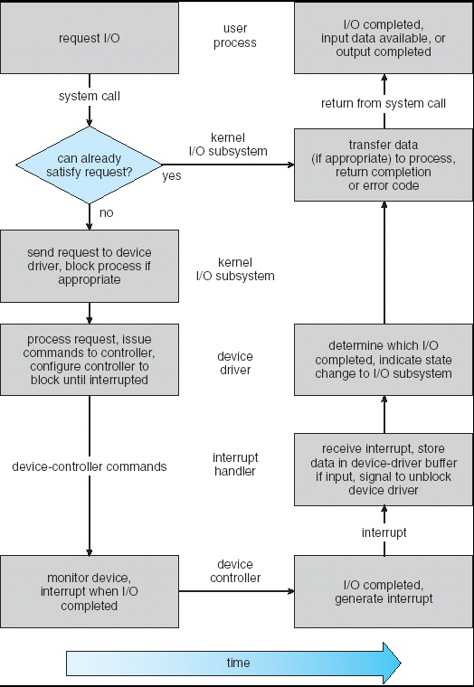
Life cycle of an I/O request
User
Program
Kernel I/O
Subsystem
Device Driver
Bottom Half
Device Driver
Top Half
Device
Hardware

Slide 40
How are devices found anyways?
At boot, the OS kernel searches for devices attached to it
Action is usually called “probe”
Starts up drivers for each device it finds
A significant amount of time is spent in device discovery
Run “dmesg” on linux to see printouts from this process
Live demo!

Slide 41
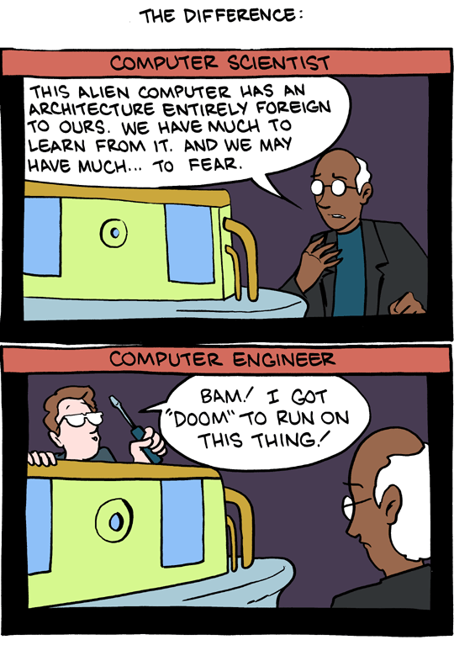
Break + SMBC webcomic
Not really relevant to class, just amuses me
Take a break and reset your brains for a minute
https://www.smbc-comics.com/comic/2011-02-18

Slide 42
Outline
Abstractions
Device I/O layers
Application Layer
Kernel I/O Subsystem
Device Driver
Interrupt Handler
Example Driver: Nautilus Character Device
Example Driver: Temperature Sensor

Slide 43
Nautilus kernel
http://cs.iit.edu/~khale/nautilus/
Small, light-weight kernel for research use
All the basic features for getting an x86-64 computer to boot
And just about nothing else
Created by Kyle Hale (Illinois Institute of Technology) and Peter Dinda (Northwestern)
Example use case: experiment with virtual memory strategies

Slide 44
Nautilus character device abstraction
Character device: a device that can read/write arbitrary characters
(as compared to Block devices that must read/write in chunks)
Nautilus says every character device must have the following:
get_characteristics() – every device has this, none particularly for chardev
read() – single byte
write() – single byte
status() – determine if device is readable or writeable or both

Slide 45
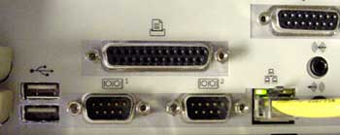
Layering in Nautilus
Virtual Console Driver
Character Device Driver
Serial Port
Parallel Port

Slide 46
Layering in Nautilus
Virtual Console Driver
Character Device Driver
Serial Port
Parallel Port

Slide 47
Virtual console
Allows keyboard input and text output for a user
Generally, the basic terminal that you have open
Could be implemented in all kinds of ways though
Example: keyboard input plus printer output
Any device that can read/write individual characters could act as a console
So the virtual console just contains a nk_char_dev
Passed into the virtual console at initialization
Could be implemented with any hardware

Slide 48
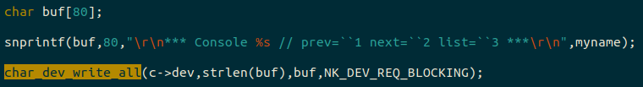
Virtual console reads and writes to generic char_dev
Tries to write an entire string in blocking mode
Should not return until the entire string is displayed

Slide 49
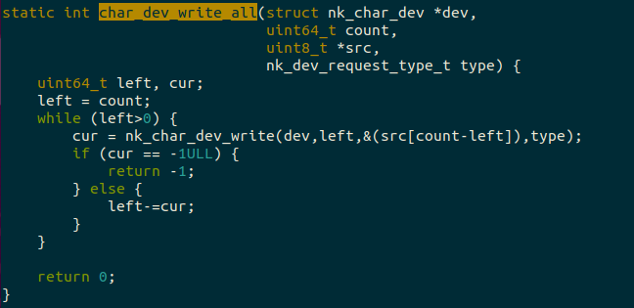
Virtual Console implements by calling into nk_char_dev

Slide 50
Layering in Nautilus
Virtual Console Driver
Character Device Driver
Serial Port
Parallel Port

Slide 51
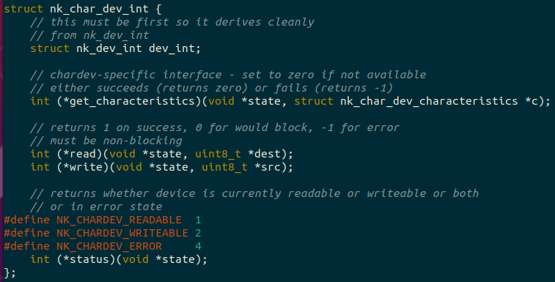
Each nk_char_dev holds an interface of function pointers

Slide 52
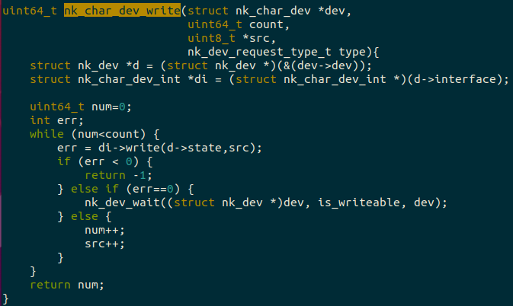
Simplified nk_char_dev_write: calls write() operation

Slide 53
Layering in Nautilus
Virtual Console Driver
Character Device Driver
Serial Port
Parallel Port

Slide 54
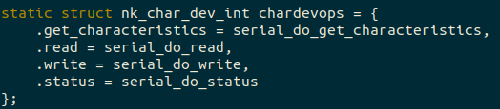
A serial device implements the nk_char_dev operations
Serial device implements all of those operations
When you create a serial device, you actually make an nk_char_dev and initialize it with a chardevops
All of the generic device operations call into the actual serial device

Slide 55
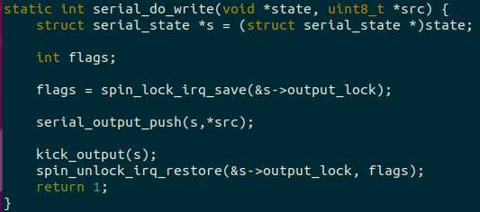
Simplified Serial device: pushes data into a queue

Slide 56
Serial queue operation
Whenever a write comes in, we push data byte into a queue
Serial output goes slowly, so many bytes could be queued up
Then we enable interrupts and write the first byte to the MMIO register
Then when an interrupt comes in, we pop the next byte from the queue and write it to the MMIO register
Repeats until the queue is empty

Slide 57
Layering in Nautilus
Virtual Console Driver
Character Device Driver
Serial Port
Parallel Port

Slide 58
Parallel port will be implemented by you!
A little simpler than the serial port version
Never queues bytes and instead only writes one at a time
Reject additional bytes while the system is in operation
Whenever an interrupt comes in, that byte is complete so you’re ready for the next one
Same idea though, parallel port supports all the basic operations of an nk_char_dev
When initialized, creates an nk_char_dev connected to its operations

Slide 59
Outline
Abstractions
Device I/O layers
Application Layer
Kernel I/O Subsystem
Device Driver
Interrupt Handler
Example Driver: Nautilus Character Device
Example Driver: Temperature Sensor

Slide 60
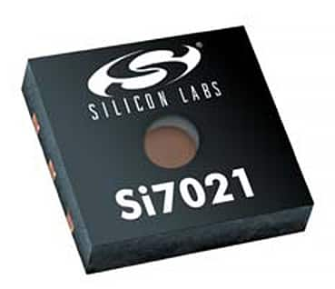
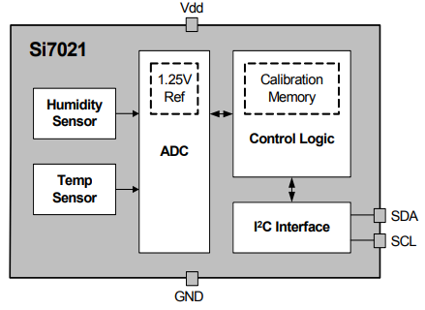
Si7021 temperature and humidity sensor
Popular on embedded devices
Also has a Linux driver!
Connects to computer over I²C bus
Two-wire, 100 Kbps low-power bus
Like any other bus
Takes an address
Whether it’s a read or write transaction
And an amount of data
https://www.silabs.com/documents/public/data-sheets/Si7021-A20.pdf

Slide 61
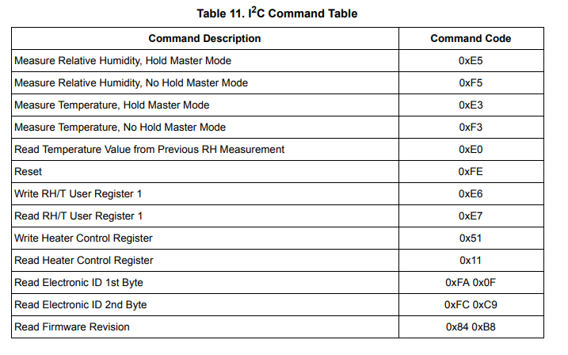
How do we make it do anything?
Typically with I²C devices, you write a 1-2 byte command
Then you read the data in the next transaction
Commands are found in the datasheet

Slide 62

What will the driver look like?
Layer below it will be I²C controller (function calls)
In the Temperature driver we need to
See what the request from the layer above is
Perform an I²C write transaction with a command byte (0xE3)
Wait until data is ready
Perform an I²C read transaction to get the data
Translate the data into meaningful units

Slide 63
What are the driver layers going to be?
In Linux, some sensors are connected through the Industrial I/O subsystem (IIO)
Handles sensor data generically
Get raw sample
Get scaling value
Get offset value
Lower layers could change and everything would still work
USB->I2C converter for example
Or a totally different sensor
Character Device
IIO Core
Si7021
Generic I2C Interface
Computer-Specific I2C Driver
Memory-Mapped I/O

Slide 64
Demo: Linux device driver code for Si7021
https://github.com/torvalds/linux/blob/master/drivers/iio/humidity/si7020.c
Linux source code is all on Github!
But if you want to explore Linux code, a better link is: https://elixir.bootlin.com/linux/latest/source/drivers/iio/humidity/si7020.c
Creates linked databases for function calls and variable types
Lists where it is defined
Lists where it is used
Makes it easy to hop up and down layers

Slide 65
OSes can make design choices about drivers
Interface does not have to be like a file
For example: could have a set of unique syscalls for device interactions
Asynchronous model could be enforced
Must register callback handlers with lower layer to get response
Tock embedded operating system does both of these
https://www.tockos.org/

Slide 66
Demo: Tock device driver code for Si7021
https://github.com/tock/tock/blob/master/capsules/extra/src/si7021.rs

Slide 67
Outline
Abstractions
Device I/O layers
Application Layer
Kernel I/O Subsystem
Device Driver
Interrupt Handler
Example Driver: Nautilus Character Device
Example Driver: Temperature Sensor

