Slide 1
Lecture 12: Virtual Memory Optimizations and Implementation
CS343 – Operating Systems
Branden Ghena – Fall 2024
Some slides borrowed from: Stephen Tarzia (Northwestern), Shivaram Venkataraman (Wisconsin), and UC Berkeley CS162

Slide 2
Administrivia
Driver Lab is due next week Thursday!
There’s quite a lot of work for this one
You need to write your own tests for the GPU
There are lots of edge cases where students commonly lose points
Get started ASAP
Reminder: get help in office hours when you need it
19 hours across Monday-Friday
Come ask questions about the class, labs, debugging, etc.
Chronically underutilized this quarter

Slide 3
Today’s Goals
Explore optimizations to memory paging.
Insight into how virtual memory is used and what it looks like in today’s systems.
Review of the memory hierarchy and how the OS interacts with each level.

Slide 4
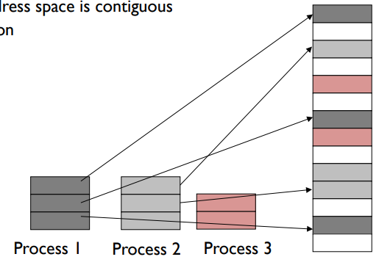
Memory paging
Divide memory into small, fixed-sized pages
Pages of virtual memory map to pages of physical memory
Like segments were mapped, but many more pages than segments
Processes and their sections can be mapped to any place in memory

Slide 5
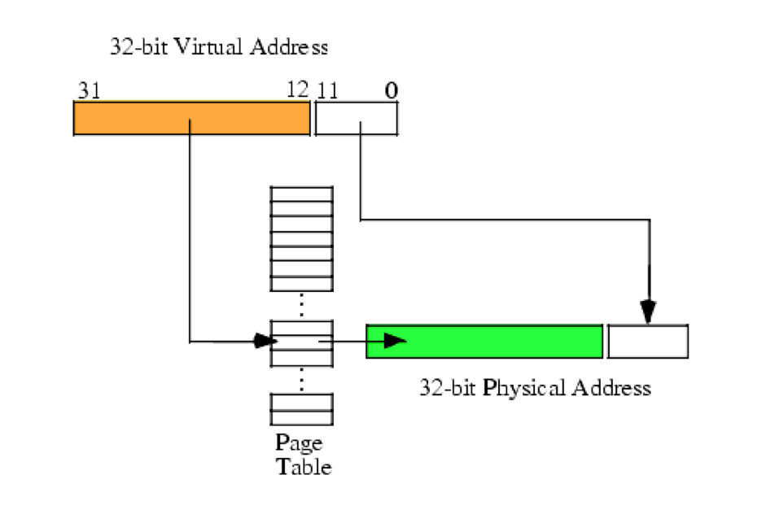
Page table translates virtual addresses to physical addresses
Use topmost bits of virtual address to select page table entry
One page table entry per each virtual page
Add address at page table entry to bottommost bits
Actually just concatenate the two
Just like segment tables, there will be a different page table for each process

Slide 6
Virtual Memory
(Process B Only!)
Process A
Physical Memory (RAM)
Shared
Process B
0
1
2
3
4
5
6
7
8
Process A
0
1
2
3
4
5
6
Process B
Process A
Process B Page Table
Process B
VPN | PPN | Valid?
0 | 2 | 1
1 | X | 0
2 | X | 0
3 | 6 | 1
4 | X | 0
5 | X | 0
6 | X | 0
7 | 4 | 1
8 | X | 0
Process B
CPU
Process A
Process B
Process A
Process B
Process B

Slide 7
Paging challenges
Page tables are slow to access
Page tables need to be stored in memory due to size
MMU only holds the base address of the page table and reads from it
Two memory loads per load!!!
Going to have to fix this…
Page tables require a lot of storage space
Mapping must exist for each virtual page, even if unused
Becomes a serious issue on 64-bit systems

Slide 8
Outline
Paging improvements
Improving translation speed
Improving table storage size
OS Paging Implementation
Memory Hierarchy

Slide 9
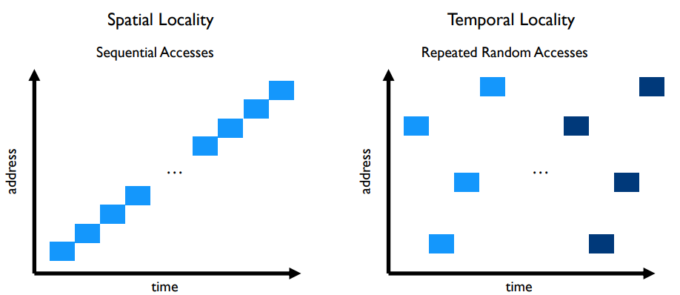
Caching can speed up page table access
How do we make page table access faster?
How do we make memory access faster?
Cache it!
Code and Stack have very high spatial locality

Slide 10
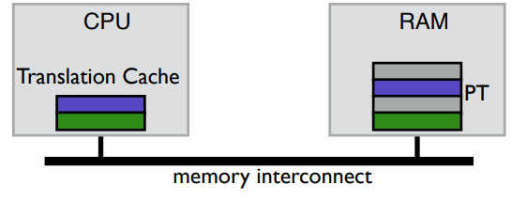
TLB caches page table entries
Translation Lookaside Buffer
Fully-associative cache (only compulsory misses)
Holds a subset of the page table (VPN->PPN mapping and permissions)
On a TLB miss, go check the real page table (done in hardware)

Slide 11
Address translation with TLB
Virtual Address
hardware
hardware or software
software
TLB
Lookup
TLB Miss
TLB Hit
Page Table
“Walk”
Protection
Check
Page not
in Mem
Page
in Mem
Access
Denied
Access
Permitted
Page Fault
(OS loads page)
Update
TLB
Protection
Fault
Physical
Address
Find in Disk
Find in Mem
SEGFAULT
Check cache

Slide 12
Address translation with TLB
Virtual Address
hardware
hardware or software
software
TLB
Lookup
TLB Miss
TLB Hit
Page Table
“Walk”
Protection
Check
Page not
in Mem
Page
in Mem
Access
Denied
Access
Permitted
Page Fault
(OS loads page)
Update
TLB
Protection
Fault
Physical
Address
Find in Disk
Find in Mem
SEGFAULT
Check cache

Slide 13
Context switches with a TLB
A process must only access its own page table entries in the TLB!
Otherwise, the mapping is wrong, and it accesses another process…
OS needs to manage the TLB
Option 1: Flush TLB on each context switch
Costly to lose recently cached translations
Option 2: Track with process each entry corresponds to
x86-64 Process Context Identifiers (12-bit -> 4096 different processes)
Extra state for the OS to manage if it has more processes than that

Slide 14
Software controlled TLBs
Some RISC CPUs have a software-managed TLB
TLB still used for translation, but a miss causes a fault for OS to handle
OS looks in page table for proper entry
OS evicts an existing entry from TLB
OS inserts correct entry into TLB
Special instruction allows OS to write to TLB
Hardware is simpler and OS has control over the TLB functionality
Can prefetch page table entries it thinks might be important
Can flush entries relevant to other processes
TLB misses take longer to complete, however

Slide 15
Break + Question
How many TLB entries do you need? (i.e., how many page table entries do you need to cache)

Slide 16
Break + Question
How many TLB entries do you need? (i.e., how many page table entries do you need to cache)
Remember: each page is 4096 bytes of memory, which is a quite a bit
Want at least
One page in the code section (maybe a couple here for libraries)
One page in the stack section
One page in the data section
Could get away with a pretty small TLB: 4-16 entries
BUT, we really want to avoid misses, so more would be great

Slide 17
Outline
Paging improvements
Improving translation speed
Improving table storage size
OS Paging Implementation
Memory Hierarchy

Slide 18
Paging disadvantages
Page tables are slow to access
Memory access for page table before any other memory access
TLB can speed this up considerably for common execution
Page tables require a lot of storage space
Mapping must exist for each virtual page, even if unused
Becomes a serious issue on 64-bit systems

Slide 19
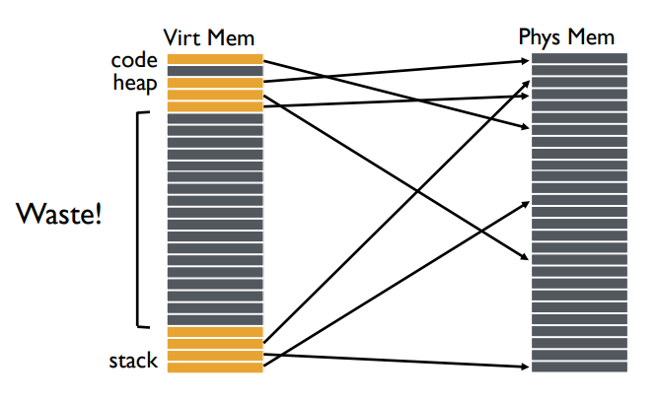
Why do page tables take so much storage space?
For every virtual page, there must exist an entry in the page table
Even though most virtual addresses aren’t used!
64-bit address space with 4 kB pages
2^64/2^12 = 4,503,599,627,370,496 pages
At 8 bytes per page table entry: 36 Petabytes of storage space

Slide 20
Create multiple page tables, each with useful mappings only
How do we eliminate extraneous entries from the page tables?
Virtual Page Number | Valid? | Physical Page Number
0 | 1 | 2
1 | 1 | 3
2 | 0
3 | 0
4 | 0
5 | 1 | 7
6 | 0
7 | 0

Slide 21
Create multiple page tables, each with useful mappings only
Collect groups of page table entries (call them “page table entry pages”?)
Virtual Page Number | Valid? | Physical Page Number
0 | 1 | 2
1 | 1 | 3
2 | 0
3 | 0
4 | 0
5 | 1 | 7
6 | 0
7 | 0

Slide 22
Create multiple page tables, each with useful mappings only
Collect groups of page table entries
Only keep groups that have valid mappings in them
Virtual Page Number | Valid? | Physical Page Number
0 | 1 | 2
1 | 1 | 3
4 | 0
5 | 1 | 7

Slide 23
Create multiple page tables, each with useful mappings only
Collect groups of page table entries
Only keep groups that have valid mappings in them
Remaining groups are now separate tables
Virtual Page Number | Valid? | Physical Page Number
0 | 1 | 2
1 | 1 | 3
Virtual Page Number | Valid? | Physical Page Number
4 | 0
5 | 1 | 7

Slide 24
Create multiple page tables, each with useful mappings only
Collect groups of page table entries
Only keep groups that have valid mappings in them
Remaining groups are now separate tables
Create a directory of page tables to collect existing page tables
Virtual Page Number | Valid? | Physical Page Number
0 | 1 | 2
1 | 1 | 3
Virtual Page Number | Valid? | Physical Page Number
4 | 0
5 | 1 | 7
Virtual Page Number Range | Valid? | Page Table Address
0-1 | 1
2-3 | 0
4-5 | 1
6-7 | 0

Slide 25
Multilevel page tables
Virtual Address
31
22
21
12
11
0
p1 p2 offset
10-bit
L1 index
10-bit
L2 index
Root of the Current
L1 Page Table (Hardware register)
offset
Physical Memory
p2
p1
Valid page table
Level 1
Page Table
(Directory)
Invalid page table
Valid page
Level 2
Page Tables
Invalid page
Unused RAM
Valid data in RAM
Data Pages

Slide 26
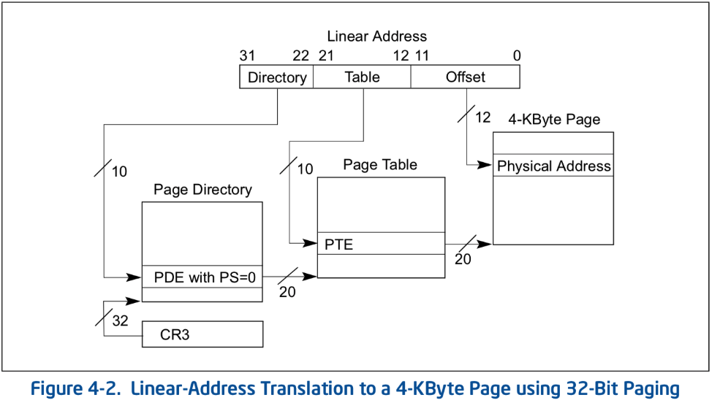
Multilevel page table logistics
Virtual address is broken down into three or more parts
Highest bits index into highest-level page table
A missing entry at any level triggers a page fault
Size of tables in memory proportional to number of pages of virtual memory used
Small processes can have proportionally small page tables

Slide 27
Multilevel page tables can keep nesting
Even page table directory is often sparse, so break it up too
x86-64
Four levels of page table
48-bit addresses (256 TB RAM ought to be enough for everyone right?)
9 bits
9 bits
9 bits
9 bits
12 bits
48-bit Virtual
Address:
Virtual
P1 index
Virtual
P2 index
Virtual
P3 index
Virtual
P4 index
Offset
PageTablePtr
8 bytes
4096-byte pages (12 bit offset) Page tables also 4k bytes (pageable)
Physical
Address:
(40-50 bits)
Physical Page #
12bit Offset

Slide 28
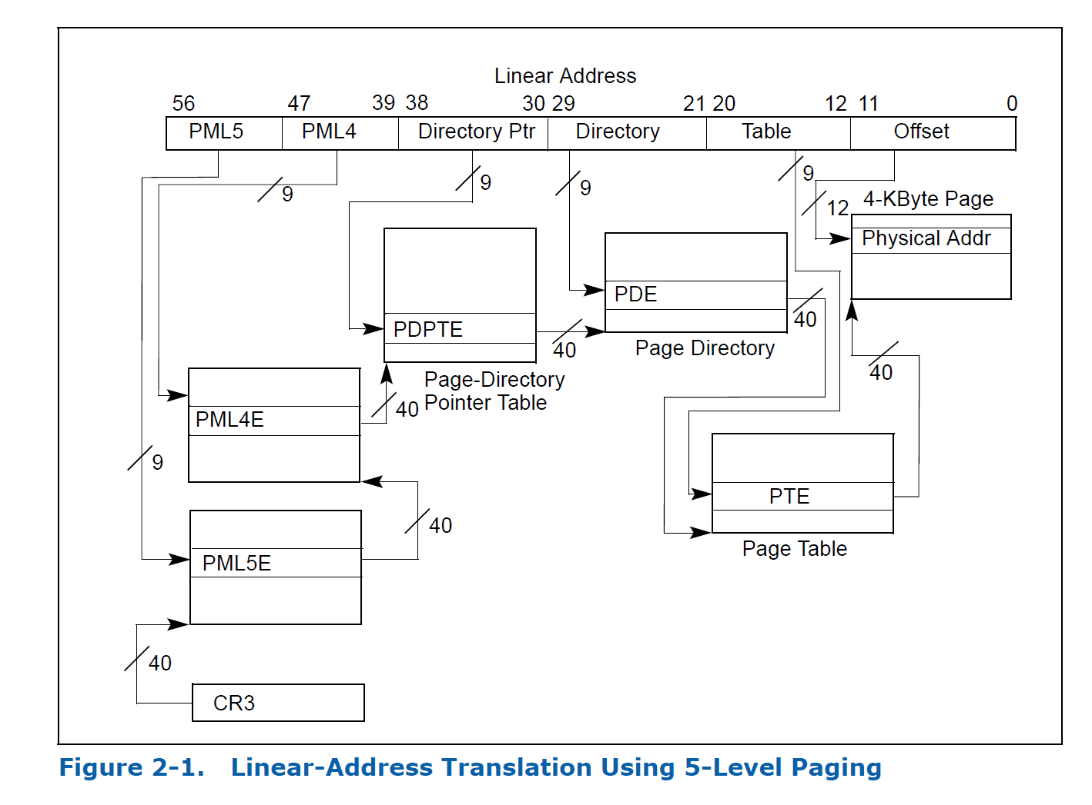
Intel Ice Lake (2019): 5 layers!!
Allows for 57-bit virtual memory space
128 PB of virtual address space

Slide 29
Check your understanding – multilevel page table
How many memory loads per read are there now?

Slide 30
Check your understanding – multilevel page table
How many memory loads per read are there now?
6
As in each memory access takes six times as long
TLB is extremely important

Slide 31
Additional optimization: large pages
Always using large pages results in wasted memory
Example: 1 MB page where only 1 KB is used
Always using small pages results in unnecessary page table entries
Example: 250 entries in a row to represent 1 MB of memory
Can we mix in larger pages opportunistically?
Small pages normally
Large pages occasionally
Huge pages rarely

Slide 32
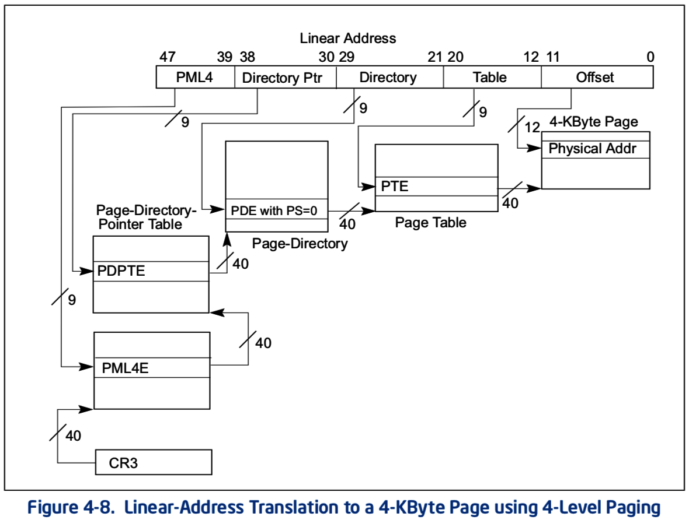
x86-64 allows multiple-sized pages: 4 KB
Normal x86-64 paging

Slide 33
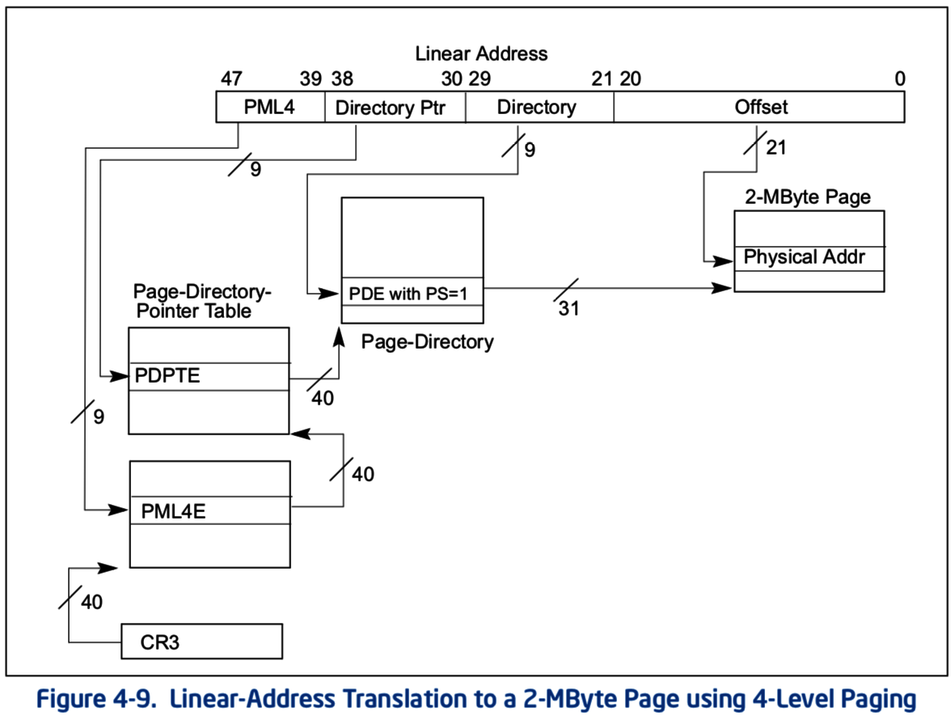
x86-64 allows multiple-sized pages: 2 MB
Page Size bit skips next table and goes straight to 2 MB page in memory
Remaining address bits are used as offset into larger page

Slide 34
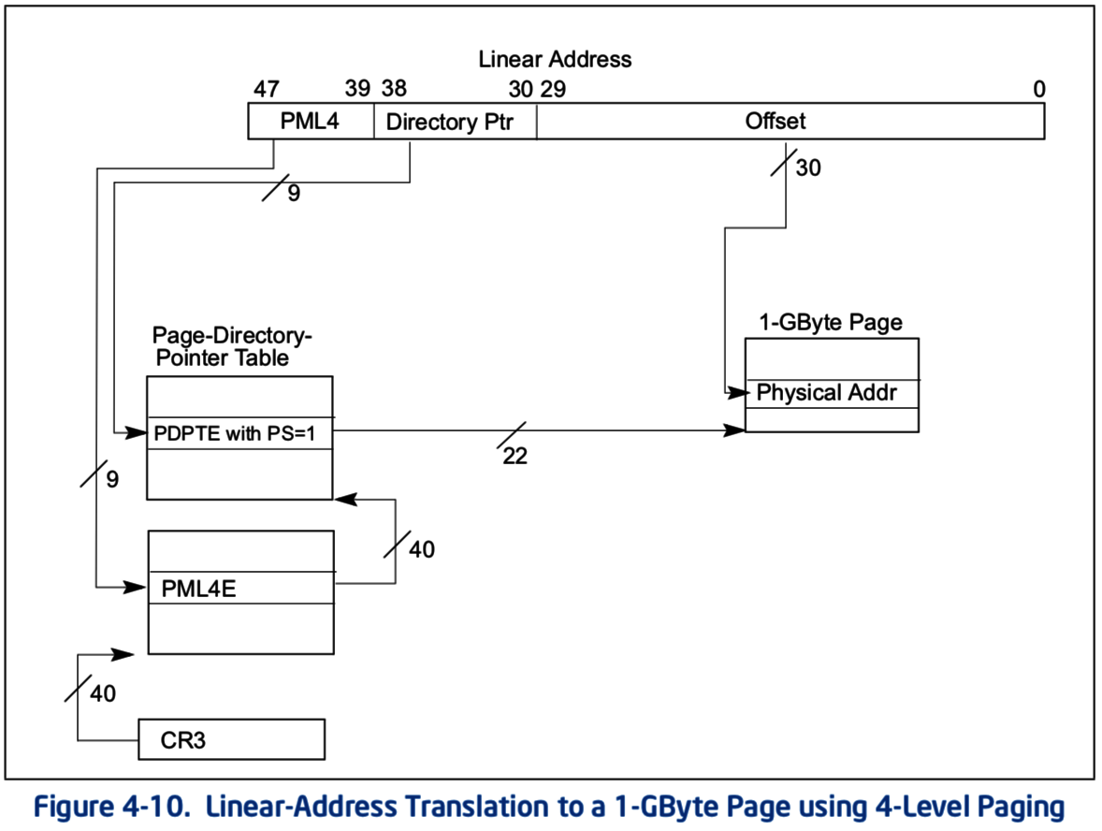
x86-64 allows multiple-sized pages: 1 GB
Can also skip straight to 1 GB pages
With a bit of extra hardware, TLB can hold large page entries
Occupies a single TLB entry for 1 GB of data (250000 normal entries)

Slide 35
Page Table data structure
If hardware handles TLB misses
Need a regular structure it can “walk” to find page table entry
x86-64 requires the use of multilevel page tables with a specific layout
If software handles TLB misses
OS can use whatever data structure it pleases
Example: inverted page tables
Only store entries for virtual pages with valid physical mappings
Use hash of VPN+PCID to find the entry you need

Slide 36
Real-world example TLB size
My office processor: i5-8260U (8th generation: Coffee Lake)
Separate Data and Instruction TLBs. Two levels of TLB
Data LTB
4 – 1 GB pages
32 – 2 MB pages
64 – 4 kB pages
Instruction TLB
8 – 2 MB pages
64 – 4 kB pages
L2 unified TLB
1536 – 4 kB / 2 MB pages

Slide 37
Break + Question
If every page of virtual memory was used, would a multi-level page table take more or less space than a “flat” page table?
How often is every page of virtual memory used?

Slide 38
Break + Question
If every page of virtual memory was used, would a multi-level page table take more or less space than a “flat” page table?
More! Still need an entry for every “used” page
Now would have to add tree structure as well
How often is every page of virtual memory used?
Never! That would be 18 exabytes of storage in one process
For reference: ~150,000 Exabytes is all of human digital storage (2024)
https://www.statista.com/statistics/871513/worldwide-data-created/

Slide 39
Multi-level Virtual Memory Example
Virtual Address breakdown (48 bits)
9 bits | 9 bits | 9 bits | 9 bits | 12 bits
L4 Index | L3 Index | L2 Index | L1 Index | Offset
Given an address: 0xBC00CD00DE00 (48-bit)
Determine the index for each level of the cache

Slide 40
Multi-level Virtual Memory Example
Virtual Address breakdown (48 bits)
9 bits | 9 bits | 9 bits | 9 bits | 12 bits
L4 Index | L3 Index | L2 Index | L1 Index | Offset
Given an address: 0xBC00CD00DE00 (48-bit)
Determine the index for each level of the cache
Step 1: convert to binary, so we can pull out each part
0b101111000000000011001101000000001101111000000000
0b101111000000000011001101000000001101111000000000

Slide 41
Multi-level Virtual Memory Example
Virtual Address breakdown (48 bits)
9 bits | 9 bits | 9 bits | 9 bits | 12 bits
L4 Index | L3 Index | L2 Index | L1 Index | Offset
Given an address: 0xBC00CD00DE00 (48-bit)
Step 1: convert to binary, so we can pull out each part
0b101111000000000011001101000000001101111000000000
Step 2: convert sections back to hex or decimal (we’ll do hex)
L4: 0x178 L3: 0x003 L2: 0x068 L1: 0x00D Offset: 0xE00

Slide 42
Outline
Paging improvements
Improving translation speed
Improving table storage size
OS Paging Implementation
Memory Hierarchy

Slide 43
OS tracks regions rather than pages
A Region is a collection of one or more pages for a process
An Address Space is a collection of regions for a process
A region is a contiguous chunk of virtual memory
The OS will keep a data structure of regions for each process
Includes starting page/address and size
Protection fields
Additional bookkeeping information
Is it a kernel region or an application?
Is it a “pinned” region, i.e. a region we should never remove?
Is the region in RAM or on disk?
Has the region been modified?

Slide 44
Operations on regions
Add
Create a new region for an address space
Accesses to virtual addresses in that range should now succeed
Remove
Remove the region entirely from an address space
Accesses to virtual addresses in that range should now fault
Move
Change physical addresses associated with the region
Protect
Change protection status of region
Could change from read-only to read-and-write

Slide 45
Considerations when adding new regions
The new region goes in the OS data structure immediately
However, we don’t necessarily need to allocate space in RAM immediately or update the Page Table
Those actions are a lot of work
But maybe the process is never going to actually use most pages

Slide 46
Page faults enable lazy allocation and lazy loading
Paging is not just translation and error checking
Paging provides an opportunity to be lazy about loading requested data
Trick: don’t load data upfront, do it later when it’s first needed!
This is an important performance optimization, reducing program start time

Slide 47
Lazy loading in practice
If a process requests a huge chunk of memory, maybe it will not use all that memory immediately (or ever!).
Programmers and compilers are sometimes greedy in their requests
We can virtually allocate memory, but mark most of the pages “not present”
Let the CPU raise an exception when the memory is really used
Then really allocate the demanded page
Lazy allocation minimizes latency of fulfilling the request and it prevents OS from allocating memory that will not be used.

Slide 48
Lazy allocation makes Fork faster
Recall that fork + exec is the only way to create a child process in unix
Fork clones the entire process, including all virtual memory
This can be very slow and inefficient, especially if the memory will just be overwritten by a call to exec.

Slide 49
Lazy allocation via copy-on-write with Fork
Copy on write is a performance optimization:
Don’t copy the parent’s pages, share them
Make the child process’ page table point to the parent’s physical pages
Mark all the pages as “read only” in the PTEs (temporarily)
If parent or child writes to a shared page, a page fault exception will occur
OS handles the page fault by:
Copying parent’s page to the child & marking both copies as writeable
When the faulting process is resumed, it retries the memory write.

Slide 50
Back to adding regions
Adding a Lazy Region
Just add the region to the process data structure
Later, when an exception occurs you can load data update the Page Table as necessary
Adding an Eager Region (a.k.a. a non-lazy region)
Do everything right away
Add to data structure, load into RAM, update Page Table
Example: a process’s code might be eagerly loaded along with the first couple pages of the stack

Slide 51
Region “mappings”
Another choice when creating a new region
Where does the memory come from??
Three possibilities
It’s a duplicate of somewhere else in RAM
For sharing memory, or for kernel memory at boot
It’s fresh, zeroed-out memory (Anonymous Mapping)
Stack and heap memory
Should start as all zeroes for security
It’s a copy of a file from disk (File-backed Mapping)
Program code and initial variable values
Likely read-only, and can be reloaded from disk whenever necessary

Slide 52
Lazy loading can apply to both of these
Lazy loading works for large, file-backed code binaries
Delay loading a page of instructions from disk until it’s needed
Maybe won’t need some library files at all
New anonymous pages must be all zeroes
Program does not necessarily expect the new memory to contain zeros,
But we clear the memory for security, so that other process’ data is not leaked.
OS can keep one read-only physical page filled with zeros and just give a reference to this at first.
After the first page fault (due to writing a read-only page), allocate a real page.

Slide 53
Removing, moving, and protecting pages
Modify the region in the data structure
Also update the Page Table immediately
Can’t do this lazily, as future accesses to pages MUST change
But what if page table data is already in the TLB?!! Two options:
Flush the entire TLB (remove all entries in it)
Invalidate particular pages (removes individual entry from TLB if it exists)
For performance, which to do depends on how many pages you’re updating. Answer depends on the processor hardware, threshold is: 2-1000

Slide 54
OS management of processes with paging
When loading a process
Add regions to data structure
For eager regions, also allocate RAM pages and update Page Table
For lazy regions (most), don’t do anything now
Some regions might connect to shared libraries already in RAM
When a context switch occurs
OS changes which page table is in use (%CR3 register in x86)
When a fault occurs
OS handles it by checking the region data structure and the page table
Might be an invalid access (based on address or permissions)
Might be a page that’s on disk or was lazily allocated

Slide 55
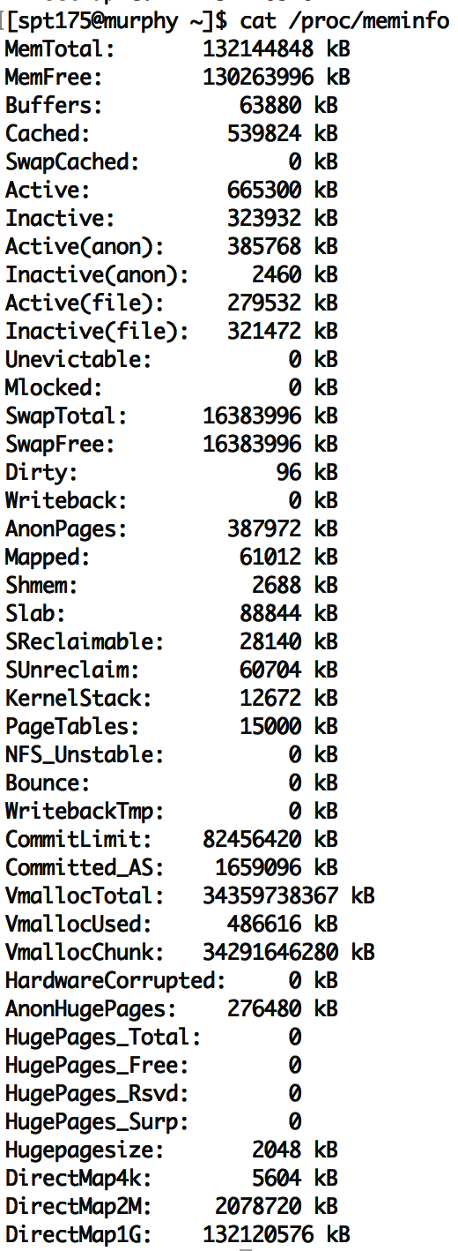
To see virtual memory info on Linux
cat /proc/meminfo
vmstat
pmap
top
Try these commands yourself sometime!

Slide 56
Virtual memory in practice
On Linux, the pmap command shows a process’ VM mapping.
We see:
OS tracks which file code is loaded from, so it can be lazily loaded
The main process binary and libraries are lazy loaded, not fully in memory
Libraries have read-only sections that can be shared with other processes
cat /proc/<pid>/smaps shows even more detail
References:
https://unix.stackexchange.com/a/116332
https://www.akkadia.org/drepper/dsohowto.pdf

Slide 57
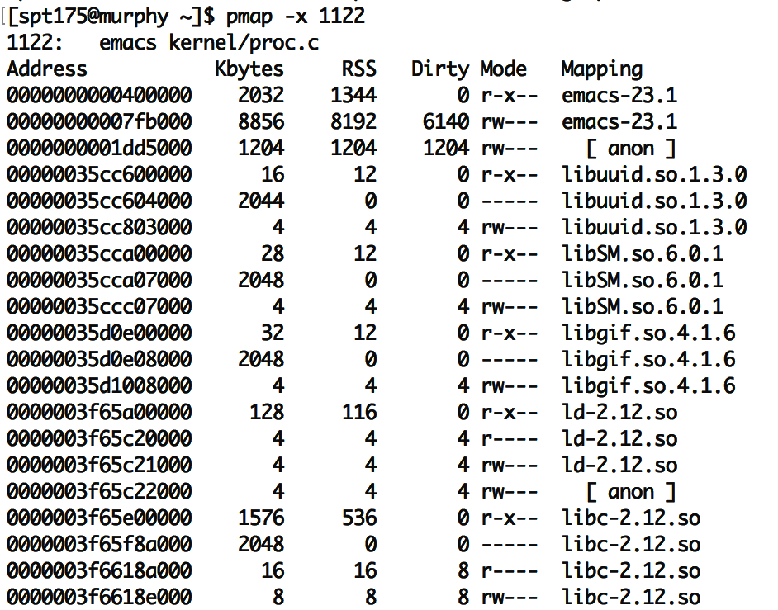
pmap on emacs
“Mapping” shows source of the section
“anon” are regular program data, requested by sbrk or mmap. (usually heap or stack)
Each library has several sections:
“r-x--” for code can be shared
“r----” for constants
“rw---” for global data
“-----” for guard pages:
(not mapped to anything, just reserved to generate page faults)
RSS means resident in physical mem.
Dirty pages have been written and therefore cannot be shared with others

Slide 58
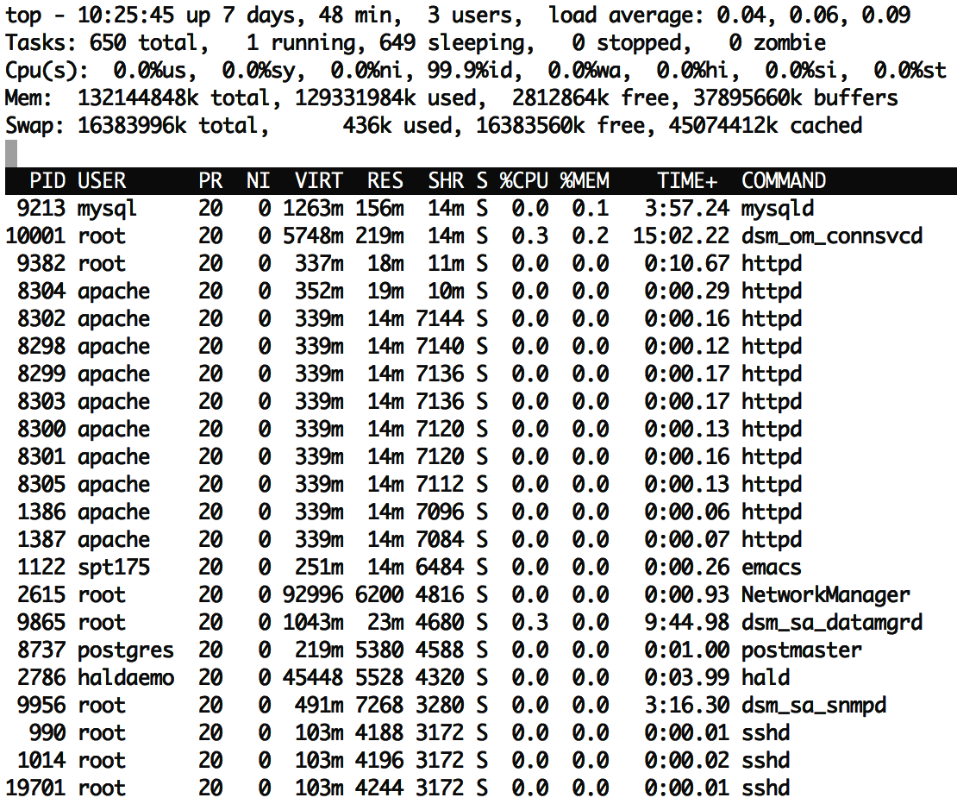
top has a column showing shared memory
The duplicate processes are using a lot of shared memory:
~50% of resident memory for httpd is shared ~75% of resident memory for sshd is shared
Even if there is just one instance of emacs running, it may share many libraries with other running programs.
Total virtual memory is ~10x larger than resident memory
Processes only use a small fraction of their VM!
Due to sharing and lazy loading.

Slide 59
Process side: requesting memory from the OS – brk()
System call to change data segment size (the program “break”)
Either set a new virtual address pointer for top of data segment
Or increment the size of the data segment by N bytes
These are the old system calls to dynamically change program memory
How malloc creates space
“sbrk() and brk() are considered legacy even by 1997 standards”
Removed from POSIX in 2001
Still exists in some form in lots of OSes (including Nautilus and Tock)

Slide 60
Process side: modern requesting memory from the OS – mmap()
Map (or unmap) files or devices into memory
Given a file, places the file in the process’s virtual address space
Process can request an address to place it at, which OS might follow
Given flag MAP_ANONYMOUS, creates empty memory
Initialized to zero and accessible from process
Malloc implementation uses this
Many other options
Create huge page, create memory for a stack, shared memory

Slide 61
Break + Consideration
Why use mmap() to put a file in your address space, when you could just read()/write() it instead?

Slide 62
Break + Consideration
Why use mmap() to put a file in your address space, when you could just read()/write() it instead?
Speed! No longer need to make system calls for each file access
A downside: now you need to handle file interactions yourself
Track offset for reading and writing
Make sure you don’t go past the end of the file

Slide 63
Outline
Paging improvements
Improving translation speed
Improving table storage size
OS Paging Implementation
Memory Hierarchy

Slide 64
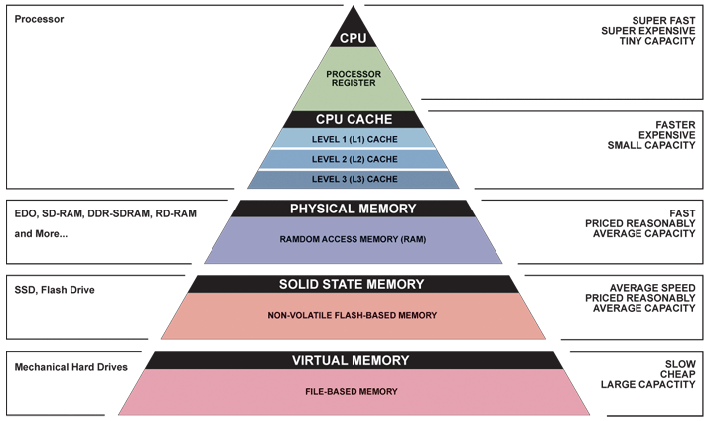
Memory Hierarchy

Slide 65
The OS view on registers
Illusion: separate set for each process
Reality: separate set for each core (or each thread in a core)
OS needs to save and update registers whenever the currently running process changes
Process and hardware handle moving memory into registers

Slide 66
The OS view on caches
Mostly ignore them, handled by the hardware automatically
Occasionally might need to clear them for security purposes
Or maybe there’s a way to tag cache entries with a process ID
Addresses in the caches are either entirely physical addresses
Or are virtually indexed, physically tagged
Cache lookup and TLB lookup happen in parallel
TLB result is used as Tag for cache to determine if there was a hit

Slide 67
The OS view on memory
Managed through virtual memory translation
Paging (or Segmentation) that we talked about last time
OS chooses which portions of processes go in RAM
Other portions of memory get “swapped” to disk
Writeable memory regions (stack, heap, global data) must be preserved
Read-only memory regions (code) can be reloaded from original location

Slide 68
The OS view on disk
Non-volatile memory store
Everything else on the system disappears when power is removed (and cannot be trusted across reboots)
Backing store for lots of information
Boot information: via “Master Boot Record” on disk
Filesystem, which the OS manages access to through system calls
Swap space, which the OS moves extra pages in and out of
Disk is significantly bigger than RAM, so this will work
Disk is a device that the OS manages and reads in “blocks”
Compare to memory, which is directly addressed by processes

Slide 69
Outline
Paging improvements
Improving translation speed
Improving table storage size
OS Paging Implementation
Memory Hierarchy

