Slide 1
Lecture 14: Security
CS343 – Operating Systems
Branden Ghena – Fall 2024
Some slides borrowed from: Tyler Bletsch (NC State), Berkeley CS61C

Slide 2
Administrivia
Driver Lab due today
Paging Lab out sometime this evening or tomorrow
I’m fixing up a few things

Slide 3
Today’s Goals
Introduce OS security considerations.
Describe memory-based attacks and defenses.
Explore speculative execution attacks and ramifications.

Slide 4


Why is computer security so important?
Most public security happens at least in some portion on the honor system
Pretty easy to break a window
Keyed locks are easy to pick
Master keys can be determined and manufactured (Matt Blaze attack)
Laws apply after you’ve done it

Slide 5
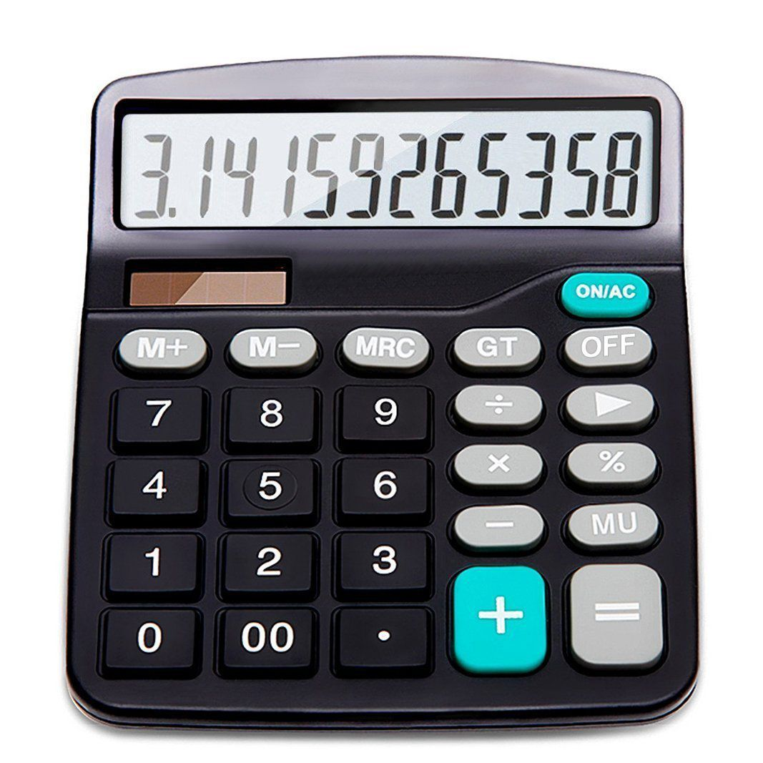
Early computers didn’t have any security either
Simple machines for doing computation do not have private files or contention
Timesharing machines meant there were multiple users, but all were employees of the same company
Permissions needed to be as secure as a file in a locked drawer on a desk
“The act of breaking into a computer system has to have the same social stigma as breaking into a neighbor's house. It should not matter that the neighbor's door is unlocked.” - Ken Thompson, Turing Award Lecture, 1984

Slide 6
Connectivity of computers makes security a top concern
Importantly, physical item security is dependent on the fact that one person can only steal one thing at a time
And it’s usually obvious when theft occurs
The internet changed all of this for computers
Usually not people breaking into computers manually, one at a time
Instead it is computers breaking into computers by means of scripting
And you can access a computer from anywhere on Earth
Breaking into or controlling one car is a crime
Controlling 100,000 cars remotely is a problem for the manufacturer

Slide 7
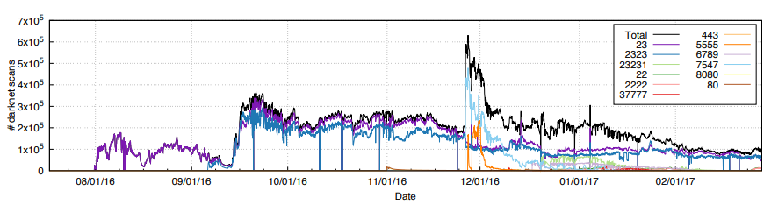
Mirai botnet (2016)
Takes control of up to 600,000 insecure connected devices
IP-attached cameras, DVRs, routers, printers

Slide 8
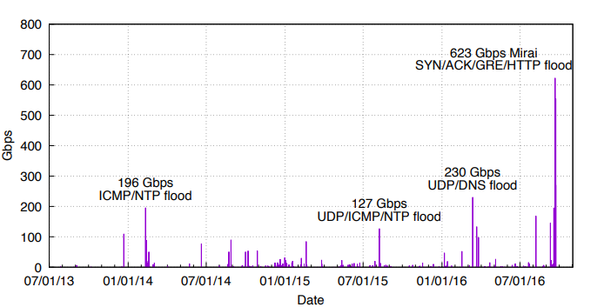
Botnets can be directed towards denial-of-service attacks
Mirai is used for DDOS attacks on various websites
Krebs on Security blog gets 623 Gbps of traffic during one attack
DDOS attacks targeting Krebs on Security

Slide 9
Outline
Design for security
Memory attacks and defenses
Buffer Overflows
Return-Oriented Programming
Speculative execution attacks
Meltdown
Spectre

Slide 10
Trusted Computing Base (TCB)
Trusted Computing Base is everything the OS relies on to enforce security
If everything outside of the TCB is “evil”, the TCB can still be trusted
Important to be a clear, minimum set of components
TCB includes
Scheduler, Memory Management, Parts of file system, Parts of device drivers
Anything else must be assumed malicious
Processes memory accesses, System call arguments, Received packets

Slide 11
Modern code bases are enormous
Program/Use Case | Millions of Lines of Code
Unix v1.0 | 0.01
Average iPhone app | 0.04
Space Shuttle | 0.4
Windows 3.1 | 2.5
Mars Curiosity Rover | 5
Firefox (2015) | 9.7
F-35 Fighter jet | 24
Microsoft Office 2001 | 25
Windows 7 | 40
Facebook (2015) | 62
Debian 5.0 codebase | 68
For many projects, no one person has read and understood all of it
TCB needs to be agreed upon by everyone working on the project
And needs to enforced by everyone in the project
https://www.informationisbeautiful.net/visualizations/million-lines-of-code/

Slide 12
Can we even trust the Trusted Computing Base?
Can you trust the OS with your password? (or anything, really)
How do you know that the OS you’re running hasn’t already been taken over or modified in some way?
Particularly large concern for server operators
Thousands of computers
All operated remotely without explicit users
Need to ensure that they aren’t taken over
Really malicious code might modify the OS if it has access
That way even if the computer reboots, the malicious part remains
Or modify the boot software (UEFI) to compromise everything

Slide 13
Hardware Root-of-Trust
Idea: software can be tampered with, but hardware is MUCH more difficult
Requires physical access, at which point all bets are off anyways…
When a server starts:
Root-of-Trust chip boots first and hardware automatically checks the authentication of its code before starting it
Root-of-Trust code checks authentication of OS code before booting the OS on the actual CPU
OS actually starts running on the CPU
Now the code running on the server can be trusted to be authentic

Slide 14
Writing auditable code
Code style and semantics really do matter!!
If you want code to be secure, it needs to be read AND understood by many people
This is why I focus so much on semantics in Intro to C/C++
Bad code style/semantics builds up cognitive load of the reader making them less likely to notice when something is wrong
0 versus NULL
&buf[0] versus &(buf[0])
int x, y, z; versus int x; int y; int z;

Slide 15
Apple “goto fail” SSL bug
Spacing intentional. This code mixes tabs and spaces and has random extra line breaks.
It is actually decently commented overall, just not in this particular section.
...
if ((err = SSLFreeBuffer(&hashCtx)) != 0)
goto fail;
if ((err = ReadyHash(&SSLHashSHA1, &hashCtx)) != 0)
goto fail;
if ((err = SSLHashSHA1.update(&hashCtx, &clientRandom)) != 0)
goto fail;
if ((err = SSLHashSHA1.update(&hashCtx, &serverRandom)) != 0)
goto fail;
if ((err = SSLHashSHA1.update(&hashCtx, &signedParams)) != 0)
goto fail;
goto fail;
if ((err = SSLHashSHA1.final(&hashCtx, &hashOut)) != 0)
goto fail;
...

Slide 16
Apple “goto fail” SSL bug
Spacing intentional. This code mixes tabs and spaces and has random extra line breaks.
It is actually decently commented overall, just not in this particular section.
...
if ((err = SSLFreeBuffer(&hashCtx)) != 0)
goto fail;
if ((err = ReadyHash(&SSLHashSHA1, &hashCtx)) != 0)
goto fail;
if ((err = SSLHashSHA1.update(&hashCtx, &clientRandom)) != 0)
goto fail;
if ((err = SSLHashSHA1.update(&hashCtx, &serverRandom)) != 0)
goto fail;
if ((err = SSLHashSHA1.update(&hashCtx, &signedParams)) != 0)
goto fail;
goto fail;
if ((err = SSLHashSHA1.final(&hashCtx, &hashOut)) != 0)
goto fail;
...

Slide 17
Apple “goto fail” SSL bug
Spacing intentional. This code mixes tabs and spaces and has random extra line breaks.
It is actually decently commented overall, just not in this particular section.
...
if ((err = SSLFreeBuffer(&hashCtx)) != 0)
goto fail;
if ((err = ReadyHash(&SSLHashSHA1, &hashCtx)) != 0)
goto fail;
if ((err = SSLHashSHA1.update(&hashCtx, &clientRandom)) != 0)
goto fail;
if ((err = SSLHashSHA1.update(&hashCtx, &serverRandom)) != 0)
goto fail;
if ((err = SSLHashSHA1.update(&hashCtx, &signedParams)) != 0)
goto fail;
goto fail;
if ((err = SSLHashSHA1.final(&hashCtx, &hashOut)) != 0)
goto fail;
...
Outside of IF statement!! Always runs.

Slide 18
Sandboxing approach to untrusted code
What if you don’t know if you can trust some running code?
Or you know you actively don’t trust it, but still want to run it
Example, PDF interpretation is actually a Turing-complete language
Lots of possibly buggy or abusable things going on in there
But we do still want to interpret PDFs!
Sandboxing: running code with restricted access to other parts of the system
Reduces the possible attacks the code might make on your system

Slide 19
iOS “BlastDoor” Sandbox
iOS uses BlastDoor to sandbox arriving iMessage data
Anyone can send anything over iMessage
Data needs to be decompressed and interpreted with various image file types supported
LOTS of attack surface: various targeted “zero-click attacks”
BlastDoor limits possible interactions
No file system access
No network access
No interaction with other processes
On a crash, restarts with exponential delay

Slide 20
Principle of Least Privilege
Only provide access to resources that are necessary for a legitimate purpose
That way malicious behavior, that you aren’t even aware of yet, has a limited amount of damage it can inflict

Slide 21
Security properties OS should enforce
Confidentiality
Private information should remain private
Example: processes can’t read memory in another process
Integrity
Mechanisms should not be modified without permission
Example: OS data structures can’t be modified by processes
Availability
Resources on the computer should be able to be fairly accessed
Example: network access is shared among processes

Slide 22
OS security concerns
Processor access
Integrity: User versus kernel mode
Availability: Timeslicing
Memory access
Confidentiality and Integrity: Virtual memory (and permissions)
Availability: Swapping
File access
Confidentiality: Permissions (user and group)
Integrity: only accessible through system calls

Slide 23
What about devices?
Device access
Confidentiality: User permissions… sort of?
This gets complicated
Should any app I run be able to activate my webcam or microphone?
When should Uber be able to access my location?
Still figuring this one out
Smartphones are at the forefront

Slide 24
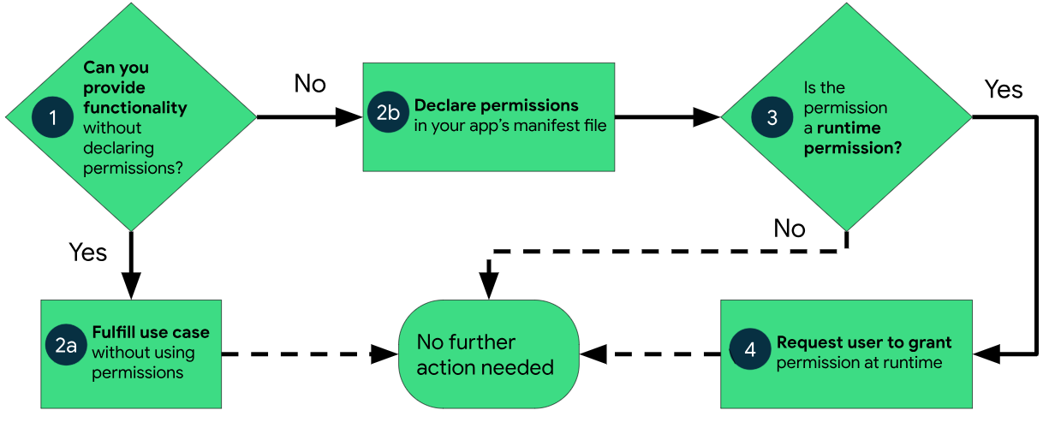
Android access control model
Ask the user to approve
Either at install time or at runtime

Slide 25
Authentication
Act of proving some information, such as the identity of a computer system user
Often the responsibility of the kernel as a trusted entity
Many actions are limited based on identity
File access privileges
Ability to install new programs
Access to certain hardware devices or mechanisms
Kernel versus user process is one identity separation
Servers might have many different users

Slide 26

Identifying users
Three overarching methods:
Authentication based on “what you know”
Passwords, Security questions
Authentication based on “what you have”
Security key, Cell phone
Authentication based on “what you are”
Biometrics: fingerprint, face ID, retinal scan
Multi-Factor Authentication (MFA) requires multiple different categories from the above

Slide 27
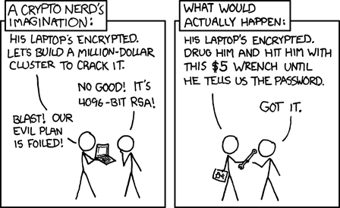
Break + xkcd
https://xkcd.com/538/

Slide 28
Outline
Design for security
Memory attacks and defenses
Buffer Overflows
Return-Oriented Programming
Speculative execution attacks
Meltdown
Spectre

Slide 29
What’s wrong with this code?
#include <stdlib.h>
#include <stdio.h>
int main() {
char name[1024];
printf("What is your name? ");
scanf("%s", name);
printf("%s is cool.\n", name);
return 0;
}

Slide 30
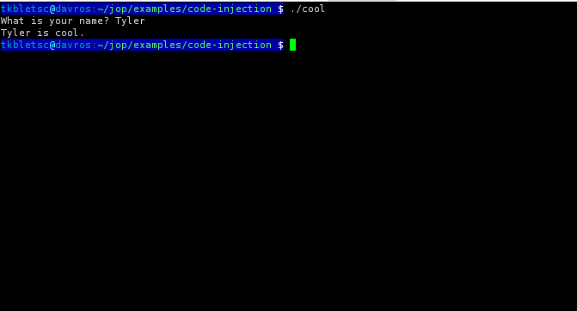
Buffer overflow potential with “nice” input

Slide 31
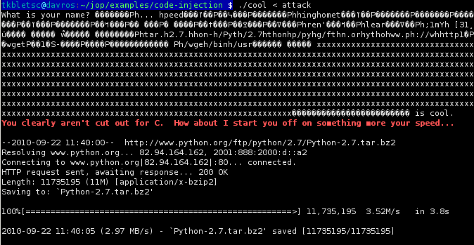
Buffer overflow potential with “evil” input

Slide 32
Buffer Overflow
Arrays (buffers) in C are not bounds checked
Can keep writing past the end of the array
Overwrites either data section or stack section
Still an incredibly common problem in C
Key problem
Trusting input from an untrustworthy source
Users are not part of the trusted computing base
Certainly not arbitrary inputs they can make

Slide 33
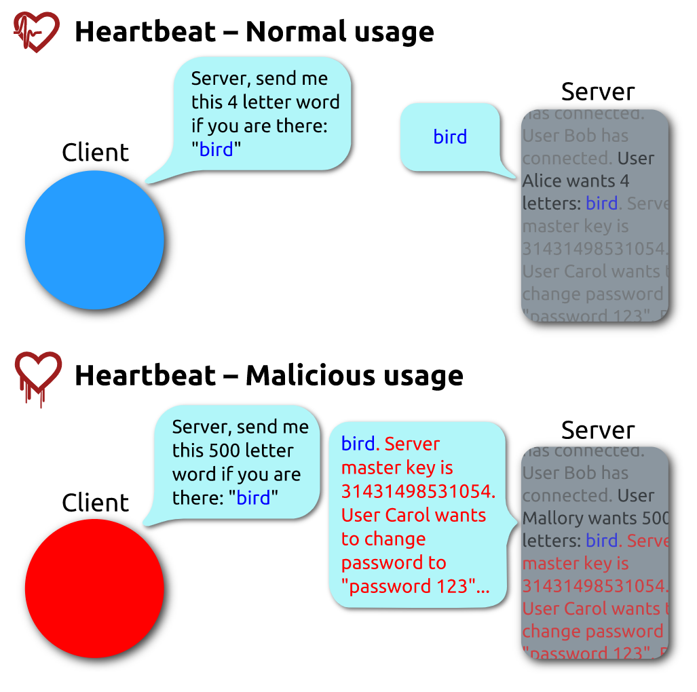

Heartbleed attack
Vulnerability in OpenSSL
2014
Started the trend of vulnerabilities with cool names and logos

Slide 34
Heartbleed attack
Vulnerability in OpenSSL
2014
Started the trend of vulnerabilities with cool names and logos

Slide 35
Unsafe C library functions (and replacements)
Better choices:
char *fgets(char *s, int size, FILE *stream)
snprintf(char *str, size_t size, const char *format, ...);
strncat(char *dest, const char *src, size_t n)
strncpy(char *dest, const char *src, size_t n)
vsnprintf(char *str, size_t size, const char *format, va_list ap)

Slide 36
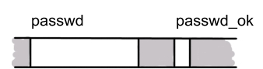
Buffer overflows can overwrite important variables
Long input string can overwrite variables on the stack
Such as the password check
int main(int argc, char *argv[]) {
char passwd_ok = 0;
char passwd[8];
strcpy(passwd, argv[1]);
if (strcmp(passwd, "niklas")==0)
passwd_ok = 1;
if (passwd_ok) { ... }
}
longpassword1

Slide 37
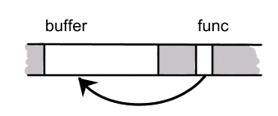
Buffer overflows can overwrite function pointers
Overwriting a function pointer can allow you to redirect code anywhere
First writing machine code in the stack then overwriting function pointer to execute it allows for arbitrary code execution
char buffer[100];
void (*func)(char*) = thisfunc; strcpy(buffer, argv[1]);
func(buffer);
arbitrarycodeX

Slide 38

Return addresses constantly live on the stack
Recall: When a function is called…
parameters are pushed on stack
return address pushed on stack
called function puts local variables on the stack
Memory layout
C’s calling convention means arbitrary execution could happen anywhere!
arbitrarystuffX

Slide 39
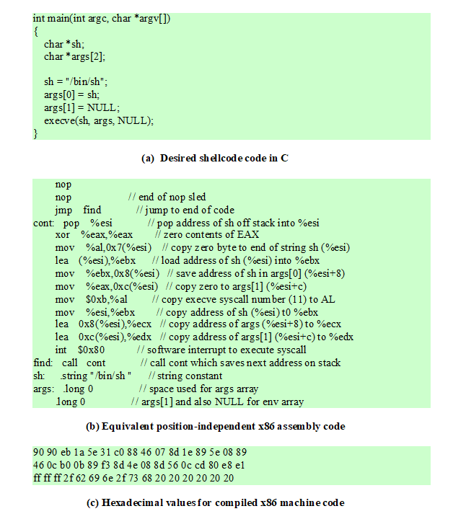
What do you do with arbitrary execution?
Open a shell that can run anything…
Top: C code
Middle: position-independent x86 assembly
Bottom: machine code hex

Slide 40
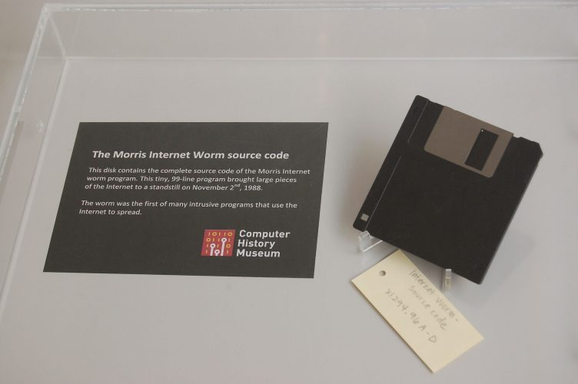
Morris Worm
November 02, 1988
Roughly 88,000 computers on internet at the time
Worm
Invading program that installs itself on additional computers
Infected several thousand computers, taking down internet for several days

Slide 41
How the worm entered computers: three methods
Debug vulnerability in sendmail – an email sending service
Connect, enter debug mode, send arbitrary code to execute
Buffer overflow in finger – a command to list user details
Send request with more than 512 bytes of arguments
Execute /bin/sh
Guess passwords
Get list of users for the machine worm is already running in
Guess username, reverse username, 400 “popular” words, entire dictionary

Slide 42
Effects of Morris Worm
Morris Worm created too many copies of itself
Checked if there was already a worm on the computer before running
1 out of 7 of the executables just ran anyways (too high a default)
Computers ended up with many processes running
Check your understanding: How are too many processes harmful?

Slide 43
Effects of Morris Worm
Morris Worm created too many copies of itself
Checked if there was already a worm on the computer before running
1 out of 7 of the executables just ran anyways (too high a default)
Computers ended up with many processes running
Long response time due to so many processes
Thrashing due to too much memory pressure
Slowed computers to a halt
Outcomes:
Invaded ~6000 computers in hours (10% of the Internet at the time)
CERT was created to manage software security
First Computer Fraud and Abuse Act (CFAA) prosecution

Slide 44
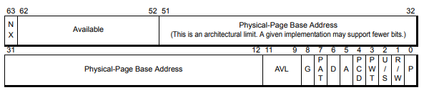
Stopping malicious code by disabling execution
The OS can allow a region to be written or executed
But not both!
NX bit in x86-64 (no-execute)

Slide 45
Overcoming no-execute
Do we need malicious code to have malicious behavior? No
argument 2
argument 2
argument 2
argument 1
argument 1
argument 1
"/bin/sh"
RA
RA
RA
Address of attack code
Address of system()
frame pointer
frame pointer
frame pointer
locals
locals
Padding
locals
Attack code
(launch a shell)
buffer
buffer
buffer
Default Stack
Code injection
Code reuse (!)
"Return-into-libc" attack

Slide 46
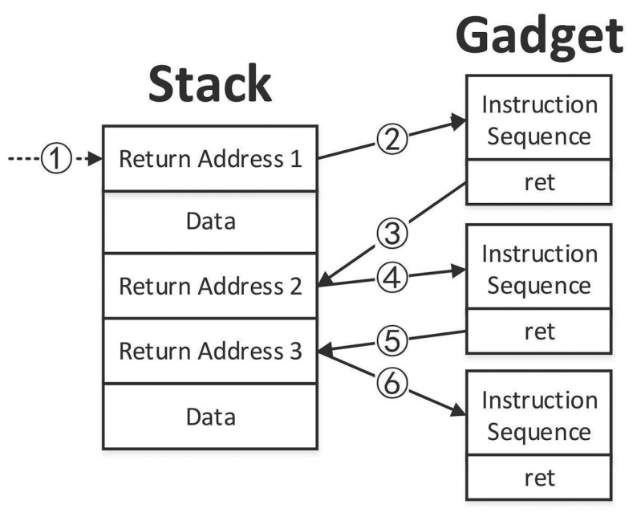
Return-oriented programming
More general process to enable arbitrary execution without code rewrite
Look through assembly instructions followed by a return
Known as “gadgets”
Chain these gadget together to make working code
By placing addresses on stack

Slide 47


Gadgets can create a Turing-complete programming environment
Loading constants
Arithmetic
Control flow
Memory
pop eax ; ret
pop esp ; ret
0x55555555
...
stack
pointer
stack
pointer
pop eax ; ret
add eax, ebx ; ret
mov ebx, [eax] ; ret
0x8070abcd (address)
stack
pointer
stack pointer

Slide 48
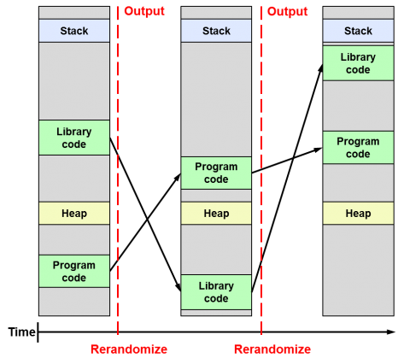
Address-space layout randomization (ASLR)
Randomize memory region locations in virtual memory
Already spread throughout physical memory
Move locations of libraries and code relative to each other
Arbitrary address for attacker to send code to gets harder to predict!
Implemented 2005-2007
Linux, MacOS, and Windows
2011 for Android and iOS
Running a process again re-randomizes its layout

Slide 49
Overcoming ASLR
ASLR is a probabilistic approach, merely increases attacker’s expected work
Each failed attempt results in crash; at restart, randomization is different
Counters:
Information leakage
Program reveals a pointer? Game over.
De-randomization attack
Just keep trying! (carefully)
32-bit ASLR defeated in 216 seconds
BlastDoor sandbox has delay after crash for exactly this scenario
Under certain scenarios is less effective
Poor source of randomness

Slide 50
Break + Question
The Common Vulnerabilities and Exposures (CVE) system documents publicly released software vulnerabilities.
How long has it been since the last CVE due to a buffer overflow?
https://www.cvedetails.com/vulnerability-list.php

Slide 51
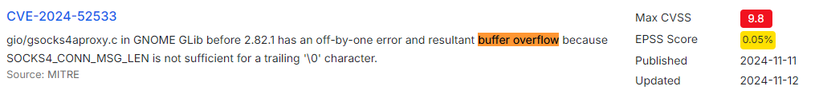
Break + Question
The Common Vulnerabilities and Exposures (CVE) system documents publicly released software vulnerabilities.
How long has it been since the last CVE due to a buffer overflow?
Today is Thursday (November 14th, 2024)
Discovered Monday, November 11th
https://www.cvedetails.com/vulnerability-list.php

Slide 52
Outline
Design for security
Memory attacks and defenses
Buffer Overflows
Return-Oriented Programming
Speculative execution attacks
Meltdown
Spectre

Slide 53
First, some background knowledge
To understand Speculative Execution Attacks you really need to understand low-level software and hardware
A few pieces of background knowledge will be useful:
Timing Side Channels
Speculative Execution
Keeping the kernel in Virtual Memory

Slide 54
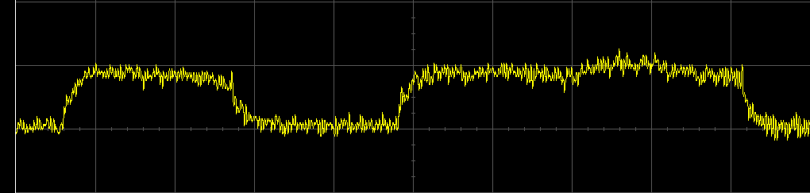
Background: Side channel attacks
Important for understanding speculative execution attacks
Many physical systems have properties that may leak information about internal state
Determine RSA key bits based on power use during a decrypt operation
Determine length of password by how long it takes to check it

Slide 55
Timing attacks are one side channel
Timing attacks can be overcome with constant-time algorithms which always take as long as the worst-case execution time
But this means reducing performance
Caches are essentially one big timing attack
Speeds up access to data if it is present in the cache
This was the goal!!
An attack can know which data was accessed recently
But that seems harmless, right?

Slide 56
Background: Speculative Execution
Modern processors want to always be doing something
What if we’re going to branch based on a memory load?
What if we just guess what the result will be and start executing early!!
So they are often “speculatively executing” instructions
Perform the operation and throw out the result if we shouldn’t actually do it
For example, branch prediction

Slide 57
Optimization: Kernel Mapped in Virtual Memory
Virtual Memory
Page tables map virtual memory to physical memory for a process
But actually, we often leave the OS memory in the page table too…
Each page is marked as no-read, no-write
Faster to switch back to the OS
No need to TLB flush or page table swap if the OS intends to go right back to process
Also allows the kernel to swap out parts of its own memory if necessary
Such as page tables themselves
0xFFFFFFFF
Process Memory
Empty
OS Memory
Empty
0x00000000

Slide 58

Meltdown
Security vulnerability in all modern processors that allows arbitrary reads from memory
Disclosed in January 2018 by: (told Intel in June 2017)
Jann Horn (Google Project Zero),
Werner Haas, Thomas Prescher (Cyberus Technology),
Daniel Gruss, Moritz Lipp, Stefan Mangard, Michael Schwarz (Graz University of Technology)
Details:
https://hackernoon.com/a-simplified-explanation-of-the-meltdown-cpu-vulnerability-ad316cd0f0de
https://meltdownattack.com/meltdown.pdf

Slide 59
Step 1: Read from a kernel address
mov $KERNEL_ADDRESS_OF_SECRET, %r12
mov (%r12), %eax
%eax now holds a byte of memory that we shouldn’t able to access
This will be an invalid page fault!
Once the instruction actually hits the end of the pipeline...
For now, it loads that value into %r12 right away and continues executing speculatively

Slide 60
Step 2: Read based on secret
mov $KERNEL_ADDRESS_OF_SECRET, %r12
mov (%r12), %eax
mov MY_ARRAY(%eax), %edx
%edx is a valid read from our own memory
This is never going to finish either because the process will have an exception from the prior instruction, but it will start executing...
MY_ARRAY here is a 256-byte array which is not in the cache

Slide 61
Step 3: Handle the Exception
mov $KERNEL_ADDRESS_OF_SECRET, %r12
mov (%r12), %eax
mov MY_ARRAY(%eax), %edx
The processor realizes you tried to read from memory you didn’t have access to and generates an exception
You can catch these and recover
The invalid instruction and ones after it are rolled back as if they never happened

Slide 62
Everything’s still safe right?
The processor never saved any results from the invalid accesses to memory in registers
So there’s no problem, right?
We forgot about the cache

Slide 63
The load affected the cache!!!
mov $KERNEL_ADDRESS_OF_SECRET, %r12
mov (%r12), %eax
mov MY_ARRAY(%eax), %edx
The value at address MY_ARRAY+%eax was saved in our cache

Slide 64
Step 4: Time loads from memory
for (int i=0; i<255; i++){
start_time = time();
int temp = MY_ARRAY[i*CACHE_BLOCKSIZE];
stop_time = time();
if ((stop_time-start_time) <= SHORT_TIME){
secret = i;
}
}
The cache speeds up the access to the one memory address that was cached due to speculative execution

Slide 65
Step 5: Repeat and Profit
Now we know the value of a single byte
But we can repeat this process over and over to read arbitrary memory
Read from memory at ~500 kbps
Incredible part is how relatively simple this attack is
Does require systems knowledge of multiple domains
Computer architecture, OS, and security

Slide 66
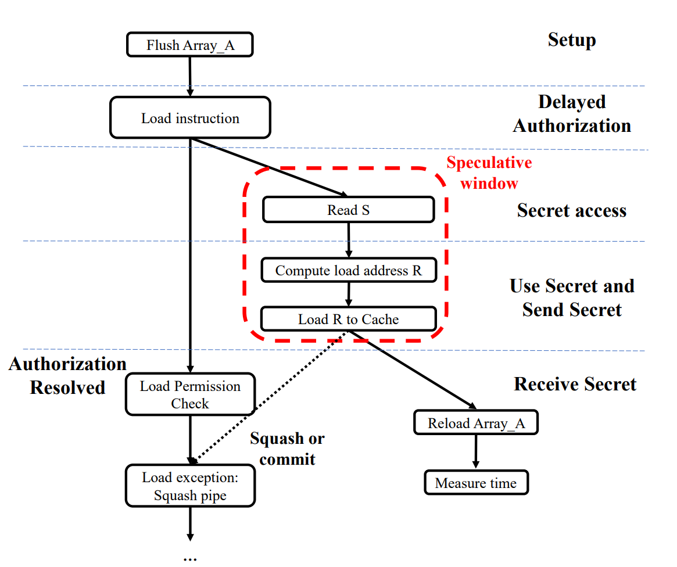
Meltdown overview
He, Zecheng, Guangyuan Hu, and Ruby Lee. "New models for understanding and reasoning about speculative execution attacks.“ 2021 IEEE International Symposium on High-Performance Computer Architecture (HPCA). IEEE, 2021.

Slide 67
How do we fix this?
Stop speculatively executing
Already in the hardware
Would slow all computers down a lot
Stop caching speculative loads
Already in the hardware
Would slow all computers down a lot
Stop leaving OS memory in the page table ✔
Would slow all computers down somewhat
Kernel Page Table Isolation
Estimated 5-30% performance loss
Improved by use of PCID bit in TLB

Slide 68
Sidebar: how long were we vulnerable to Meltdown
From the authors, every Intel processor implementing out-of-order execution is potentially affected
Which is roughly every processor from 1995-2018 (20+ years)
Some non-Intel processors are affected as well around the same time range
New processors can be designed to avoid the vulnerability

Slide 69

Spectre
Speculative execution targeting branch prediction
Disclosed in January 2018 by
Jann Horn (Google Project Zero) and
Paul Kocher in collaboration with, in alphabetical order, Daniel Genkin (University of Pennsylvania and University of Maryland), Mike Hamburg (Rambus), Moritz Lipp (Graz University of Technology), and Yuval Yarom (University of Adelaide and Data61)

Slide 70
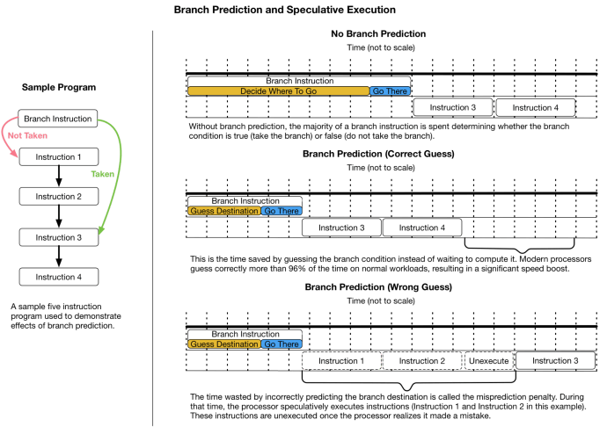
Background: Branch Prediction
Incredibly accurate in modern day computers
>95%

Slide 71
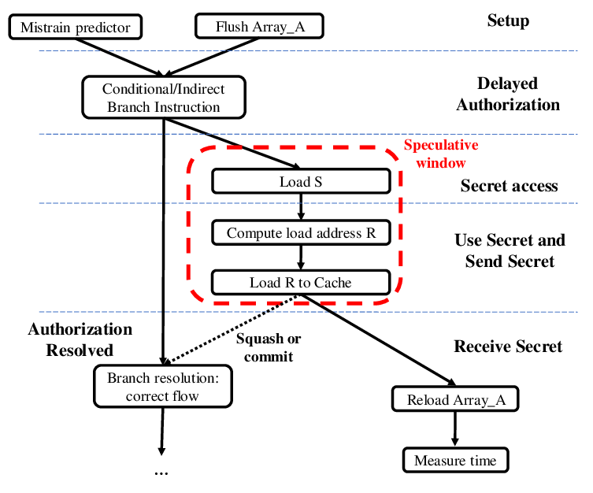
Spectre overview
He, Zecheng, Guangyuan Hu, and Ruby Lee. "New models for understanding and reasoning about speculative execution attacks.“ 2021 IEEE International Symposium on High-Performance Computer Architecture (HPCA). IEEE, 2021.

Slide 72
Spectre v1
Repeat meltdown-style attack using conditional branches
Conditional branches are especially prevalent for bounds checks in software virtual machines (like the Javascript runtime)
Train conditional branch predictor that bounds check branch always succeeds
Make an invalid bounds-checked read, affecting cache state
Use cache timing analysis to determine value of read byte

Slide 73
Spectre v2
Combine indirect branch prediction and in-kernel ROP gadgets
Indirect branch predictors try loading a guessed address
Train indirect branch predictor to go to a particular address
Make a system call requesting something
Within the system call, a branch mis-prediction then runs the targeted gadget, affecting cache state
Note: the gadget runs with kernel permission on physical memory
Use cache timing attack to determine result

Slide 74
Spectre fallout
Spectre allows code inside a process to access all memory of the process
Bypassing any security mechanisms or containerization
Example: Javascript running inside a web browser
Led to increased push for “one website per process”
Spectre is harder to fix too. Can’t just change page tables
No one simple thing can fix all of these problems
Stopping branch prediction helps, but we don’t want to stop it everywhere
Active research on targeted branch prediction disabling
Hardware fixes take years to propagate

Slide 75
Ramifications of speculative execution attacks
Particularly big deals in the era of cloud computing
Anyone can run a program on an AWS server
And now can maybe read data from the other running programs…
Speculative execution attacks are a new era for computer security
Hardware is still being actively developed to address attacks
Websites can be fixed in hours, Programs in days, OSes in weeks, and Hardware takes years
Attacks are still being developed
Role of the OS: mitigate hardware issues as best possible

Slide 76
Security is an arms race
There is no single fix for system security
New attacks are constantly being discovered
New solutions are constantly being applied
Find a vulnerability and how it can be exploited
Fix vulnerability
Go back to 1
But if the OS is designed with security in mind, it’s hopefully harder to find vulnerabilities in the first place

Slide 77
Outline
Design for security
Memory attacks and defenses
Buffer Overflows
Return-Oriented Programming
Speculative execution attacks
Meltdown
Spectre

