Slide 1
Lecture 17: Embedded OS
CS343 – Operating Systems
Branden Ghena – Fall 2024

Slide 2
Today’s Goals
Introduce embedded OS concerns and how they are different from general-purpose computing.
Provide insight into an alternative OS approach from Unix.
Tock embedded operating system
Explore what OS research looks like.
Sidebar: I promise not to test you on specific Tock details
Although I might ask you about embedded OS in general

Slide 3

General Tock resources
https://github.com/tock/tock
https://www.tockos.org/
“Multiprogramming a 64 kB Computer Safely and Efficiently” Levy et al. 2017. Symposium on Operating Systems Principles. https://brandenghena.com/projects/tock/levy17multiprogramming.pdf

Slide 4
Outline
Embedded Systems
Embedded Operating Systems
Tock
Overview
Designing a secure kernel
Designing secure applications

Slide 5
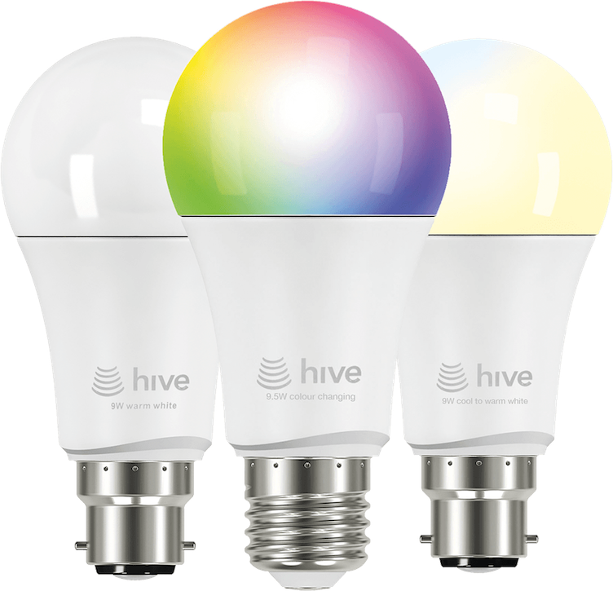
What are embedded systems?
An “embedded computer”, as in a computer within something else
Interacted with as a device, not as a computer
Smart lightbulbs, autonomous vehicles, wearable devices
Internet of Things, Robotics, Industry 4.0, Smart Home
Common desire of interaction with the real world
Variety of possible concerns
Cost
Power
Real-time
Fault-tolerance

Slide 6
Resource-constrained embedded systems
Class of embedded systems with onerous constraints
Limited memory, compute, and power
Often used in battery-operated or energy-harvesting scenarios
This is the domain of ubiquitous computing
Cheap systems that can be deployed anywhere
Wireless sensor networks
We’ll be exploring this area in this lecture
This is where my research has been focused
Takes problems that normal computing can mostly ignore
And amplifies them to an extreme point

Slide 7
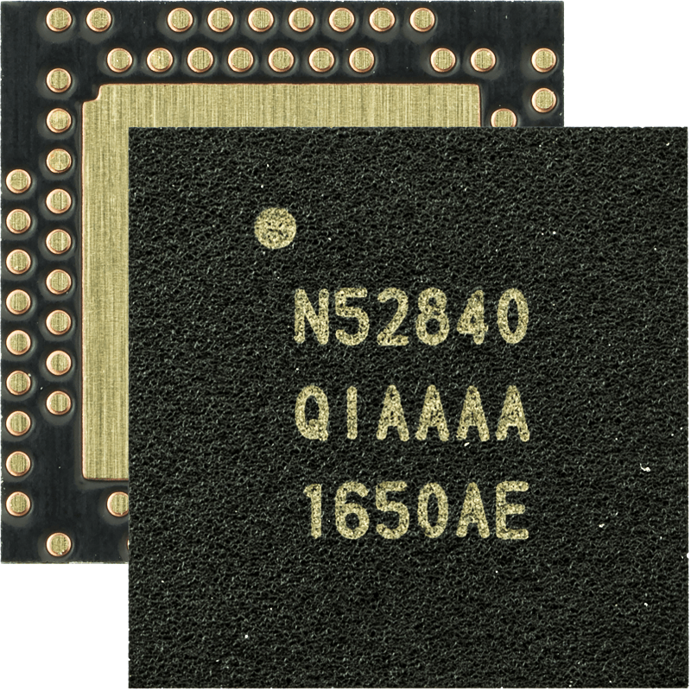
Microcontrollers drive embedded systems
Microcontroller is ~95% of a computer within a single chip
CPU
RAM
Flash storage
Hardware controllers for various signals and buses
Digital I/O, Analog I/O, PWM
UART, I2C, SPI, sometimes CAN or even Ethernet
Radio for wireless communication
Bluetooth Low Energy, 802.15.4 (Zigbee), WiFi
What’s missing?
Power, Sensors, Connectors, Antennas
7 mm x 7 mm

Slide 8
Microcontrollers are comparatively very constrained
CPU
Single core, very simple pipeline
32-bit or 16-bit (although 8-bit systems still exist)
100 MHz or less (e.g. 32 kHz)
RAM
1-256 KB
Systems often disable some RAM to save power…
Flash storage
32-2048 KB
Mapped directly into memory
Code usually executes from flash!

Slide 9
Drivers are incredibly important
Vast variety of sensors that might be used
Temperature, Humidity, Light Intensity, Light Color, Air Pressure, Air Quality, Acceleration, Rotation, Magnetic Field, Buttons
Variety of other systems to communicate with
SD cards, radios, GPS, other microcontrollers
Devices are the core purpose of embedded systems
Which makes correct drivers more important
But variety means you’re constantly writing new drivers

Slide 10
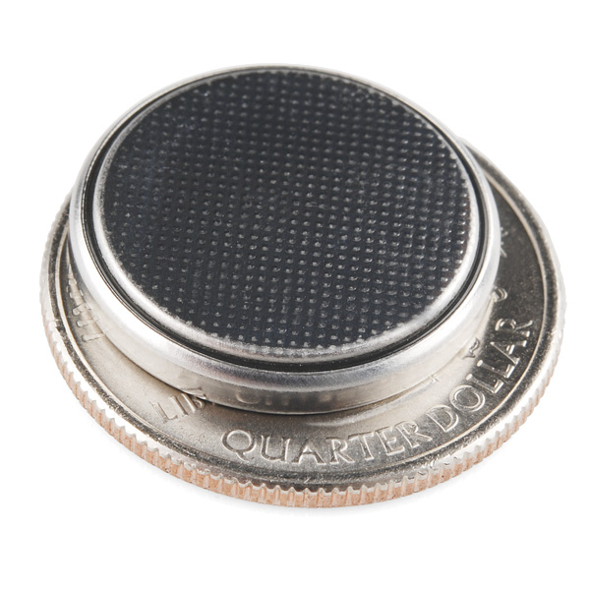
Energy is often the dominant concern
Normal computer power (varies a lot)
~10-500 W total
CPU uses ~60 Watts
Powered by plug into mains
Embedded systems often run on batteries
Four AA batteries: 15 Watt-hours
Average power to get 1 year of life: 1.7 mW
Coin cell battery: 0.36 Watt-hours
Average power to get 1 year of life: 41 μW
Embedded system power (also varies a lot)
~50 mW when active
~10 μW when in sleep mode
Goal of an embedded system: get back to sleep mode

Slide 11

Note: this is only one class of embedded
Robotics: ROS (Robot OS) on top of normal Linux
Industrial and smart home IoT
QNX (Unix-like RTOS)
Azure IoT (platform for secure, updatable devices)
Hardware/Software design with multiple microcontrollers
One just for security and managing resources
One just for managing over-the-air updates

Slide 12
Outline
Embedded Systems
Embedded Operating Systems
Tock
Overview
Designing a secure kernel
Designing secure applications

Slide 13
Embedded needs its own operating systems
Can’t use normal Linux!
Too little memory and processing in embedded hardware
Too much concern about power in embedded applications
Microcontrollers don’t have the necessary hardware features (virtual memory)
Important: Linux is never going to be the solution
Capabilities of general computers are orders of magnitude better
Embedded systems are gaining more capabilities
But new lower-power, lower-cost systems keep emerging too

Slide 14

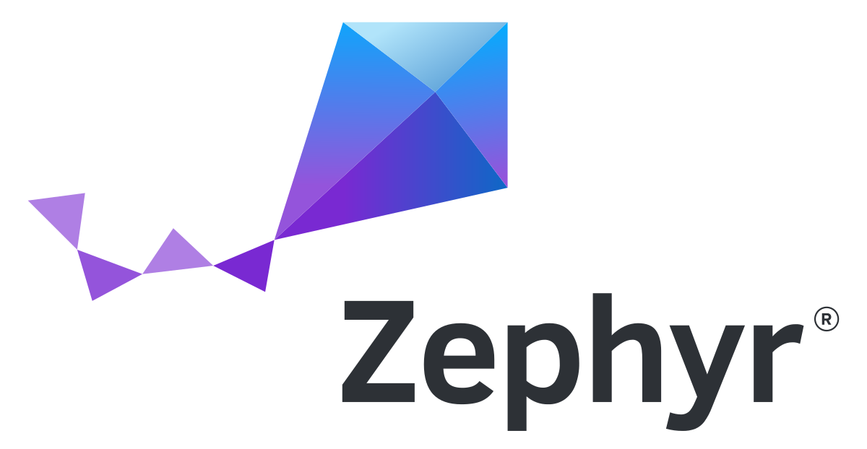



Typical embedded OS design
Assumption: embedded device has one single purpose
One application and one kernel combined into a single program
Application might be multiple cooperative tasks
Kernel is mostly drivers, with maybe a scheduler
No protection, and usually minimal resource management
Contiki-NG

Slide 15
Two needs not met by traditional embedded OSes
Security
Protect the core platform from applications
Multiprogramming
Run multiple, unrelated applications (securely)

Slide 16
Challenge for secure embedded: no virtual memory
No hardware support for virtual memory
So all addresses on the system are real physical addresses
Nothing prevents applications from
Manipulating kernel data structures
Directly accessing hardware
All applications on the system must be trusted
Devices do have one single purpose
But any weak link leaves the whole system broken

Slide 17
Embedded devices are a weak link
Custom, application-specific code written in C
Limited code-reuse
Low testing coverage
All code on the system is trusted
No isolation: any code can directly access hardware registers
Little distinction between “kernel” and “application”

Slide 18
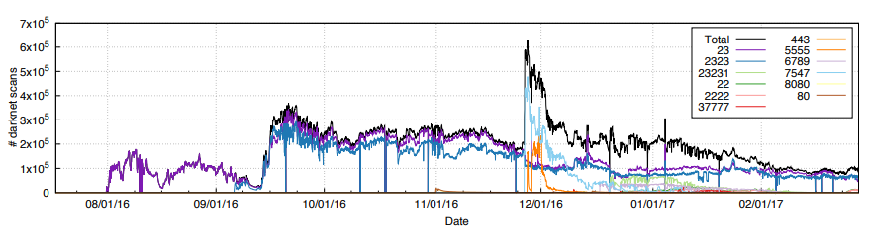
Reminder: Mirai botnet (2016)
Takes control of up to 600,000 insecure connected devices
IP-attached cameras, DVRs, routers, printers

Slide 19
Weak devices provide network entry points
IoT devices can be used as a network entry point
Step one: hack the device
Step two: use the device to access information on the private network
Example: casino high-rollers database obtained through an IoT fish tank thermostat
https://interestingengineering.com/a-casinos-database-was-hacked-through-a-smart-fish-tank-thermometer

Slide 20
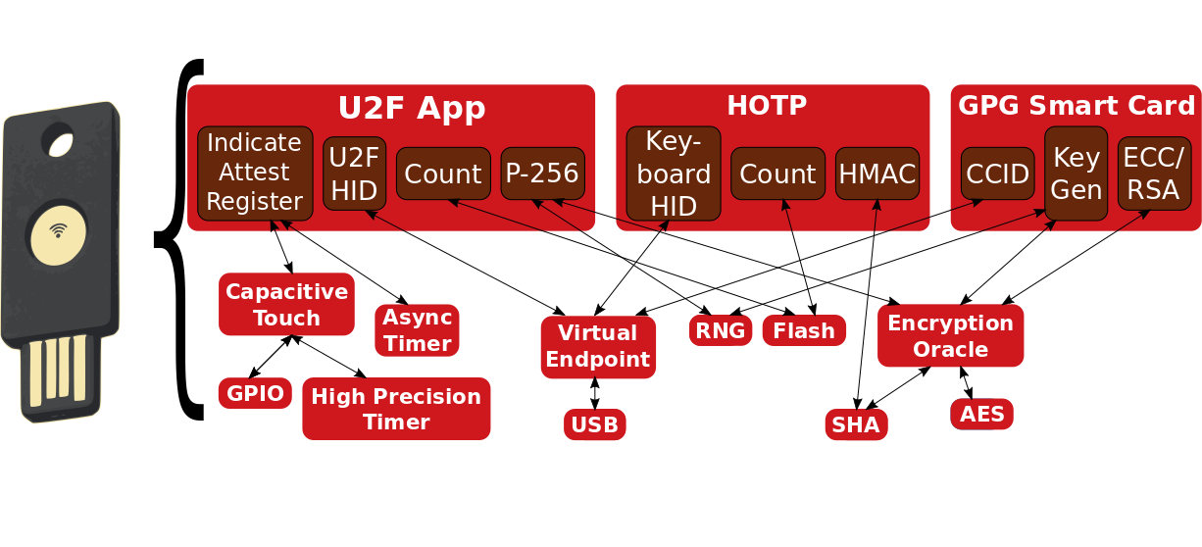
Modern systems increasingly need support for multiprogramming
Example: USB authentication key
Universal Second Factor (U2F)
HMAC One-time Password (HOTP)
GPG Key (GNU Privacy Guard)

Slide 21
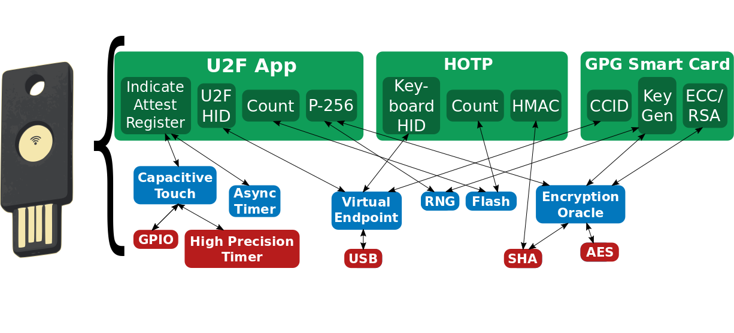
Security layering is desirable
Different domains with different expectations
Applications, services, and platform

Slide 22
Platform layer
Core kernel plus microcontroller-specific code
~10 developers
Trusted compute base
Goal: possible to correctly extend TCB

Slide 23
Services layer
Device drivers, networking, libraries
~100 developers
Auditable, but possibly still buggy
Goal: protect kernel from safety violations

Slide 24
Applications layer
End-user functionality
~1000 developers
Third-party applications, potentially malicious
Goal: end-users can install 3rd-party apps

Slide 25
Break + Question
What are challenges for updating IoT device firmware?

Slide 26
Break + Question
What are challenges for updating IoT device firmware?
Manufacturer needs to create update (still exist AND care)
Software is usually closed source, so others can’t update it
Update needs to get to the device
Either the device needs an internet connection to check
Or consumer needs to be aware of update and have a mechanism to upload it

Slide 27
Outline
Embedded Systems
Embedded Operating Systems
Tock
Overview
Designing a secure kernel
Designing secure applications

Slide 28
Tock
Embedded OS designed for secure multiprogramming
Kernel written in Rust programming language
Applications written in any language
Runs on multiple hardware platforms
Open-source research project
2015 collaboration between Stanford, UC Berkeley, and Michigan
Since expanded to 6-7 universities (Princeton, UCSD, Northwestern)
Plus several companies (Google, Western Digital)
https://github.com/tock/tock
https://tockos.org/

Slide 29
Tock Features
A preemptive embedded OS (runs on microcontrollers)
ARM Cortex-M and RISC-V supported now
Has separate kernel and user space
Most embedded OS have the one piece software philosophy
Runs untrusted apps in user space
Uses memory protection on applications (hardware support required)
Kernel (and drivers) written in Rust
Apps written in C/C++ or Rust (any language is possible)

Slide 30

Tock software organization
C App Ported to Tock
App written in Rust
[Service] BLE Environmental Sensing Profile
while(1)
😈
Untrusted
(isolated by the MPU and preemptively scheduled)
Syscall Interface
libtock
libtock-rs
libtock
libnrf
Kernel (Rust)
System Calls
Thread
Virt. Timer
BLE
Temp. Sensor
Untrusted
(unsafe forbidden)
Capsules
6LoWPAN
SD Card
Console
SI7021
Core Kernel
Scheduler, Process management, etc.
Standardized Hardware Interface Layer (HIL)
Trusted
(unsafe allowed for MMIO, PIC, etc.)
Microcontroller-specific Peripheral Drivers
SPI
RNG
Timer
ADC
GPIO
I2C
UART
AES
DAC
USB
Hardware
CPU
SPI
RNG
Timer
ADC
GPIO
I2C
UART
AES
DAC
USB

Slide 31
Tock’s isolation mechanisms
Totally untrusted
Trusted for liveness, not safety
Processes
Standalone executable in any language
C, C++, Rust, Lua
Isolation enforced at runtime
Higher overhead
Applications
Capsules
Rust code linked into kernel
Isolation enforced at compile-time
Lower overhead
Used for device drivers, protocols, timers...

Slide 32
How do applications access devices?
System calls are used to access devices
All device interactions are non-blocking (start now, finish later)
Three generic syscalls
Command – takes a 32-bit numerical argument
Allow – takes a pointer to a buffer to read/write
Subscribe – takes a pointer to a function to callback
First two arguments to all syscalls
Driver number (the driver it wants to interact with)
Minor number (driver-specific identifier)

Slide 33
Example: console capsule (driver number: 1)
Command syscall values
Transmit from buffer, argument is length
Receive into buffer, argument is length
Cancel request
Allow syscall values
Pointer to buffer for sending
Pointer to buffer for receiving
Subscribe syscall values
Send complete handler
Receive complete handler
Writing bytes to console:
uint8_t buffer[20] = {…data…}
Allow(1, 1, buffer)
Command(1, 1, 20)

Slide 34
Event-driven programming
Tock adopts an event-driven model to avoid concurrency issues
Single core system, so the source of concurrency is interrupts
Exposed to applications through “subscribe” callbacks
Callbacks never occur during normal operation
Even if application is descheduled due to timeslice
Additional syscall: yield – no arguments
Application pauses until a callback is ready for it
Once one or more events are ready
Call the callback handlers, one at a time
Return from yield statement

Slide 35
Yield example
void sensor_callback (int value) { printf("Got sensor reading %i\n", value); }
int main () { sensor_register(sensor_callback); // calls allow sensor_sample(); // calls command yield(); }

Slide 36
Synchronous interactions with event model
bool sensor_flag = false;
void sensor_callback (int value) {
printf("Got sensor reading %i\n", value);
sensor_flag = true;
}
void sample_sensor_blocking () {
sensor_flag = false;
sensor_register(sensor_callback); // calls allow
sensor_sample(); // calls command while (!flag) {
yield();
} }

Slide 37
Outline
Embedded Systems
Embedded Operating Systems
Tock
Overview
Designing a secure kernel
Designing secure applications

Slide 38
Tock threat models
Threat model – the universe of concerns for a system design
Systems can’t defend against every possible attack
So what attacks is the OS actually concerned about?
Tock splits threat model into application and kernel parts

Slide 39
Kernel threat model
What does security mean for the kernel?
Confidentiality
Secrets may not be accessed by applications or capsules.
Integrity
Applications and capsules may not modify kernel data except through exposed APIs.
Availability
Applications cannot starve the kernel of resources or deny service.
Capsules may deny service but should be designed to prevent starvation.

Slide 40
Guarantees of safety from parts of the kernel
How do we guarantee these without virtual memory?
Secrets may not be accessed by applications or capsules.
Applications and capsules may not modify kernel data except through exposed APIs.
In normal operating systems, drivers are run in kernel mode
Full access to memory and hardware on the system
Otherwise, they would be in userspace with limited access
Likely resulting in slower operation

Slide 41

Tock solution: use language features
Tock uses the Rust programming language for the kernel
Systems language
Represents how hardware actually interacts
Strong type system and memory safety
Runtime behavior similar to C
Result: capsules cannot access memory they do not own
Cannot access application secrets
Cannot modify other kernel structures (even by accident)

Slide 42
What problems is Rust trying to solve?
Memory lifetime
Use-after-free
Common example: pass a reference into a function, then free it
Data races
Multiple access to data and at least one modifies it
Problems we were solving with locks
Generally: have the compiler handle for you whatever it can

Slide 43
Rust has a strong notion of “ownership”
Ownership is a notion of managing memory and sharing.
Rust ownership rules
Each value has a variable that’s called its owner.
There can only be one owner at a time.
When the owner goes out of scope, the value is dropped.
Last one is straightforward:
Values on the stack go away at the end of the function (or any block { })
This lifetime works just like C or C++

Slide 44
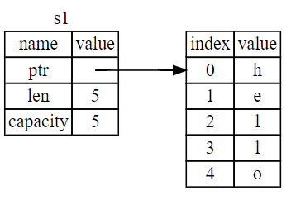
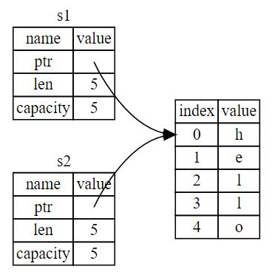
Example: ownership with strings
Rust ownership rules
Each value has a variable that’s called its owner.
There can only be one owner at a time.
let s1 = String::from("hello");
let s1 = String::from("hello"); let s2 = s1;

Slide 45
Ownership is transferred through function calls
fn main() { let s = String::from("hello"); // s comes into scope takes_ownership(s); // s's value moves into the function... // s is no longer valid here } // Here, s goes out of scope. But because s's value // was moved, nothing special happens.
fn takes_ownership(some_string: String) { // some_string comes into scope println!("{}", some_string); } // Here, some_string goes out of scope and `drop` is called. // The backing memory is freed.

Slide 46
Ownership model prevents data races
References allow multiple read-only access to a value
For example: passing a value into a function by reference
Any number of references may exist to a value
Requesting a writable (mutable) reference requires sole ownership
No other references may exist
Original owner cannot access value
This is enforced by the compiler!!!
So there is no runtime cost
And programmers cannot do bad things by accident

Slide 47
Tock downside: all drivers must be written in Rust
Why hasn’t every OS taken the “language support” path?
Primarily, it wasn’t really available. C or C++ were the only real options.
Also, the vast majority of developers know C but not Rust
And the vast majority of existing code is in C and not Rust
One of Tock’s major challenges is that things like networking stacks need to be re-written in Rust
BLE, 802.15.4, WiFi

Slide 48
My feelings about writing code in Rust
Three steps of Rust acceptance
You are confused about little weird syntax things.
You are frustrated by so many compilation errors.
You realize your code mostly works if it compiles.

Slide 49
Sidebar: the future of Rust
Rust is still growing in popularity but still young
Many people are excited to have a safe alternative to C
But there is a steep learning curve to using Rust
And a vast body of existing code already in C
How dominant would it have to be to switch our curriculum?
Unclear. We’ve taught C for decades.
Certainly considering it for CS211, but no immediate plan to change
Still can’t stop teaching C (too useful)
Rust in 5 weeks at the end of CS211 would be much harder than C++

Slide 50
Learning Rust
No class at Northwestern uses it right now 😢
So you’ll definitely need to learn it on your own
https://www.rust-lang.org/learn
https://doc.rust-lang.org/book/
https://serokell.io/blog/learn-rust
https://learnxinyminutes.com/docs/rust/ (5 minute overview)

Slide 51
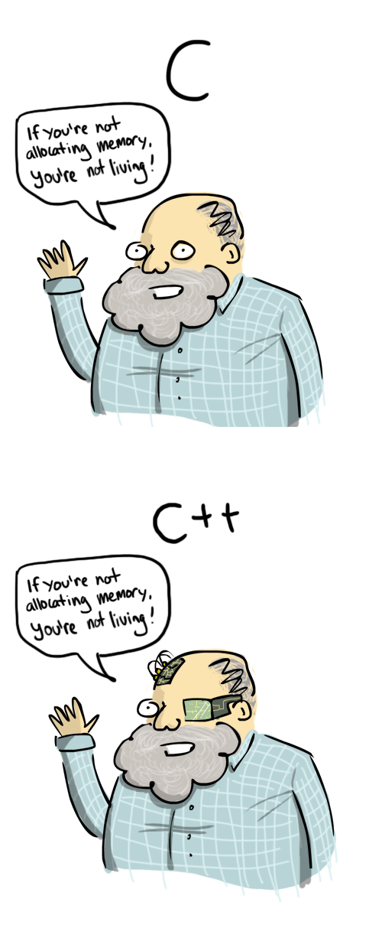
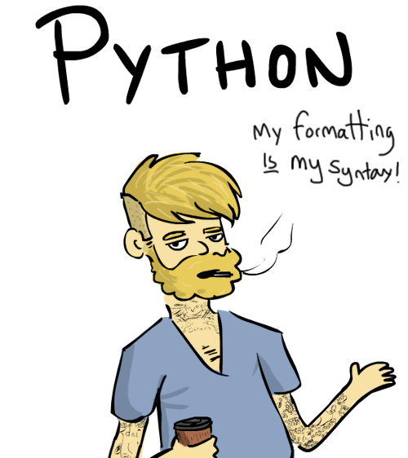

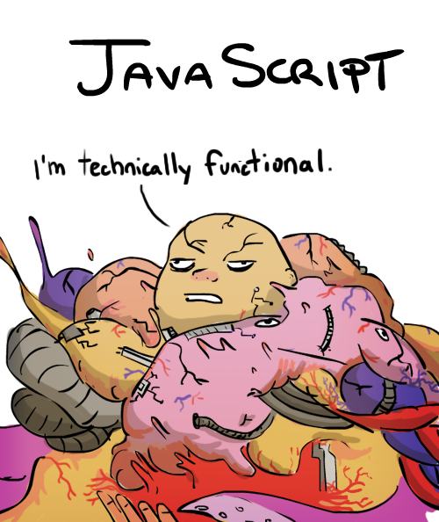
Break + Programming languages personified
https://leftoversalad.com/c/015_programmingpeople/

Slide 52
Outline
Embedded Systems
Embedded Operating Systems
Tock
Overview
Designing a secure kernel
Designing secure applications

Slide 53
Tock OS research question
How do you design a secure operating system that runs on constrained embedded systems hardware?
What are the primary challenges of doing so?
What are the solutions to those challenges?

Slide 54
Application threat model
How does Tock define security for applications?
Confidentiality
Secrets may not be accessed by other applications or capsules.
Integrity
Data may not be modified by other applications or capsules except when the applications allows access.
Availability
Applications may not deny service to one another, except that finite resources may be granted in a first-come, first-served order.

Slide 55
Problems to deal with in applications
How do we prevent malicious accesses without virtual memory?
Secrets may not be accessed by other applications
Data may not be modified by other applications

Slide 56
Memory access protection with hardware
Modern microcontrollers have a memory safety feature
Memory Protection Unit (MPU)
Base-and-bounds model of security
Bounds checking, but no translation
Memory Protection Unit
mode == user?
Physical Address
No
Physical Address
< lower bound?
> upper bound?
Yes
No
No
Fault
Yes

Slide 57
Problems to deal with in applications
How do we prevent malicious accesses without virtual memory?
With Memory Protection Unit hardware
How do we load multiple applications without virtual memory?
We do not want to compile programs for specific physical addresses

Slide 58
Application addresses managed by Position-Independent Code
Position Independent Code (PIC)
Compile program using only relative assembly instructions
Plus a register (base pointer) that is set to point to data section
Feature available in modern GCC for ARM
All accesses in program become relative
Stack accesses relative to stack pointer
Data accesses relative to base pointer
Heap accesses relative to base pointer (plus size of data)
Code accesses relative to current instruction pointer
OS kernel sets up stack, base, and instruction pointers for where program was really placed in memory

Slide 59
Problems to deal with in applications
How do we prevent malicious accesses without virtual memory?
With Memory Protection Unit hardware
How do we load multiple applications without virtual memory?
With Position Independent Code
How do we manage having so little memory?
Applications may not deny service to one another

Slide 60
Example of denial of service with timers
Timer Driver
Multiple applications like want their own individual timers

Slide 61
Example of denial of service with timers
Timer Driver
Static allocation of timers results in needs of some applications denying service to others

Slide 62
Example of denial of service with timers
Timer Driver
Dynamic allocation leads to needs of unrelated drivers denying service to applications

Slide 63
Example of denial of service with timers
Timer Driver
Dynamic allocation leads to needs of unrelated drivers denying service to applications

Slide 64
Example of denial of service with timers
Timer Driver
Dynamic allocation leads to needs of unrelated drivers denying service to applications

Slide 65
Example of denial of service with timers
Timer Driver
Dynamic allocation leads to needs of unrelated drivers denying service to applications

Slide 66
Example of denial of service with timers
AES Driver
Timer Driver
Bluetooth Driver
Dynamic allocation leads to needs of unrelated drivers denying service to applications

Slide 67
How does memory allocation work lead to limitations?
Kernel
RAM
Allocation
Process
RAM
Allocation
Heap
Heap
Process
Accessible
Memory
Data
Data
Stack
Stack
Flash
Code
Flash
Code

Slide 68
Per-process heaps limit failures to that one process
Kernel
RAM
Allocation
Heap
Heap
Heap
Data
Data
Data
Stack
Stack
Stack
Flash
Code
Code
Code

Slide 69
Per-process heaps limit failures to that one process
Heap
Kernel
RAM
Allocation
Heap
Heap
Data
Data
Data
Stack
Stack
Stack
Flash
Code
Code
Code

Slide 70
Per-process heaps limit failures to that one process
Heap
Heap
Kernel
RAM
Allocation
Heap
Data
Data
Data
Stack
Stack
Stack
Flash
Code
Code
Code

Slide 71
Traditional kernel heap allocation results in shared fate across all processes
Kernel
RAM
Allocation
Heap
Heap
Heap
Data
Data
Data
Stack
Stack
Stack
Flash
Code
Code
Code

Slide 72
Traditional kernel heap allocation results in shared fate across all processes
Kernel
RAM
Allocation
Heap
P1 allocation
Heap
Heap
Data
Data
Data
Stack
Stack
Stack
Flash
Code
Code
Code

Slide 73
Traditional kernel heap allocation results in shared fate across all processes
Heap
P1 allocation
P2 allocation
Kernel
RAM
Allocation
Heap
Heap
Data
Data
Data
Stack
Stack
Stack
Flash
Code
Code
Code

Slide 74
Traditional kernel heap allocation results in shared fate across all processes
Heap
P1 allocation
P2 allocation
P2 allocation
P2 allocation
P2 allocation
P2 allocation
Kernel
RAM
Allocation
Heap
Heap
Data
Data
Data
Stack
Stack
Stack
Flash
Code
Code
Code

Slide 75
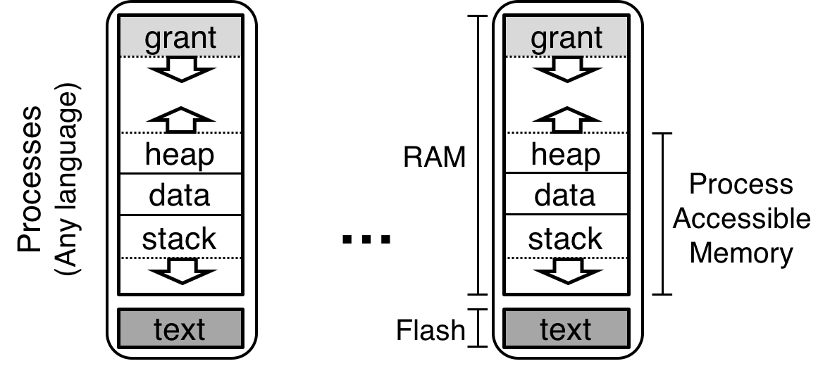
Solution: per-process kernel heaps
Grant section is only accessible to the kernel
Used to store application-specific kernel structures

Slide 76
Grants balance reliability and flexibility
Timer Driver
Using too much memory only affects processes that do so
No application can deny kernel services to another application

Slide 77
Problems to deal with in applications
How do we prevent malicious accesses without virtual memory?
With Memory Protection Unit hardware
How do we load multiple applications without virtual memory?
With Position Independent Code
How do we manage having so little memory?
With Grant regions

Slide 78
Tock research contributions
Design of an OS kernel using language safety features
What parts of this were particularly challenging?
Design of a multiprogramming OS under severe memory restrictions
No virtual memory
~64 KB of RAM for the entire system (kernel and applications)
Grants as a solution for reliable flexibility
“Multiprogramming a 64 kB Computer Safely and Efficiently” Levy et al. 2017. Symposium on Operating Systems Principles. https://brandenghena.com/projects/tock/levy17multiprogramming.pdf

Slide 79
Outline
Embedded Systems
Embedded Operating Systems
Tock
Overview
Designing a secure kernel
Designing secure applications

